Slide 1
Game Presentation -The Hospital-YR YSbyty
cm1101
Credit: Kai Barker, Jack le bon, marton zeisler, conor kemp, leo gardner, Njabulo nyakaza, Panayiotis kkolis, sohaib saify

Slide 2

The Game
Type : Text based puzzle game
Setting : Abandoned hospital
How to win: Find the vials escape the building
Difficulty levels : 4
Notes:
We decided that we all liked escape rooms and puzzle games. Therefore it made sense to us all that we would model our game after one. We decided on a abandoned hospital via a group vote. We wanted our player to win by completing a certain amount of the puzzles present in the game and collecting the vials to escape, and a difficulty system to allow for newer players to play the game without feeling like they were under too much stress.

Slide 3
The setting
The world has been infected with the CM1101 virus a.k.a Krillian.
Protagonist has been sent to the hospital in the hope of finding a cure
You have a gas mask that has been supressing the effects of the virus but it has now become defective. Meaning that your time is limited.
Notes:
The lore behind the game was decided by group consensus, we needed it to make sense with what we we’re planning on doing.

Slide 4
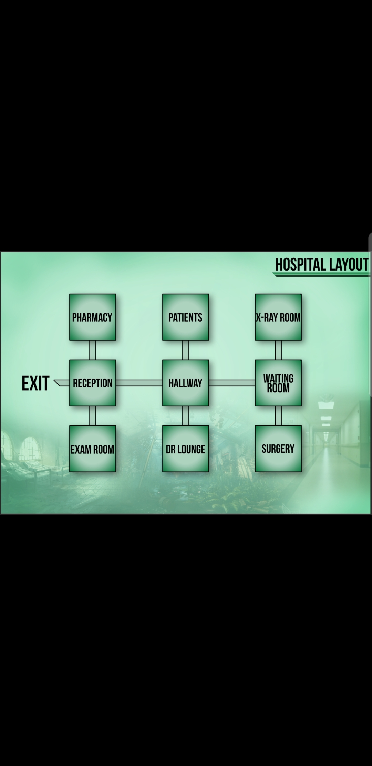
Notes:
A map of the hospital.

Slide 5
The rooms
Similar environment as real hospital.
Ability to interact with items that you would find in a real hospital.
Each group member assigned a room to develop creativity.
Ability to move within a room.
Main commands : inspect take drop move use
Turn counter, dynamically linked to the difficulty
Notes:
We wanted the game to be a dynamic game and not linear.

Slide 6
The puzzles
Each room has a puzzle which need to be solved.
This was thought of by the member who created the room.
We tried to make the puzzles vary to enhance user experience.
User is given the puzzle In the room’s description.
Notes:
We decided that each room should be given to a different person in our group to help promote diversity in our game, so that not every puzzle was the same.

Slide 7
The Items
Each room has items that could be used.
Again, we tried to keep these as realistic as possible.
Some of these included surgical instruments and computers.
Some items can also be combined with other items.
Notes:
Unique items in every room, also wanted to keep them realistic to ensure that the game is immersive. Items can only be used in the puzzle of that room, this was to prevent several things. One being that the rooms would be their own puzzle, they would be separate to every other room. This was a major design idea that we all liked and wanted to implement into the game.

Slide 8
COMANDS
HELP - Displays a list of all commands and functions
INVENTORY - Lists all items currently in your inventory
VIALS - Displays how many vials you have and how many you need
TURNS - Allows you to see how many actions you have left before the mask breaks
ROOM - Prints the description of the room and the items within it
GO <EXIT> - Moves the player to a valid location
INPUT <TEXT> - Inputs text for those times when hitting items together isn't enough
COMBINE <ITEMX> <ITEMY> - Attempts to combine two items together
TAKE <ITEMX> - Attempts to take the item and put it in your inventory
DROP <ITEMX> - Drops the item on the room's floor
USE <ITEMX> <ITEMY> - Uses one item on another or the room (Leave ITEMY empty)
INSPECT <ITEMX> - Gives you a description of the selected item
MOVE <ITEMX> - Moves items you can't pick up. Only works on items in room
Notes:
A list of our commands. We decided on these because they would allow for the puzzles to have varying degrees of complexity. Also helps promote user friendliness.

Slide 9


Why should you buy our game?

Slide 10
Bilingual game/Gêm ddwyieithog
One of the unique features of our game is that it can be played in more than one language.
Since we study in Wales it makes sense to make the game welsh compatible.
Croeso i ein gêm!
Notes:
Bi lingual- to allow for both English and welsh speakers to play the game to help prevent anyone from being unable to play.

Slide 11
User friendly
The code is designed to be very beginner friendly.
The user is reminded the commands they can use by entering the help command.
Some commands include “go” “take” “combine”.
Dynamic difficulty system
Notes:
Dynamic difficulty system means that players can decide on how they want to play.

Slide 12
Easy to develop/extend
Nothing is done with fixed commands.
Easy to add new languages, due to a dynamically developed coding system.
Rooms and puzzles can also be appended at ease.
Notes:
Easy to improve upon and add new stuff to it. Because of the way that the game was designed.

