Slide 1


Code +

Slide 2
Today
What did we do?
What we plan to do
Some practice
Code +

Slide 3

What did we do
Code +

Slide 4
What we plan to do
Stage 1 – Basic
Stage 2 – Core
Stage 3 - Advanced
Code +

Slide 5
Stage 1
Syntax ; Variable ; Language
Expressions
If else conditions
For while do while loops
Guess Number Game
Code +

Slide 6
Stage 2
Lists Sets Dictionaries
For each loop
Functions
Parameters
Tic Tac Toe
Code +

Slide 7

Stage 3
OO programing?
Libraries?
Quest?
Code +

Slide 8
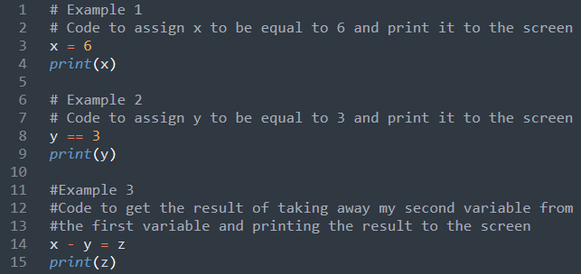
Some Practice
Code +

