Slide 1
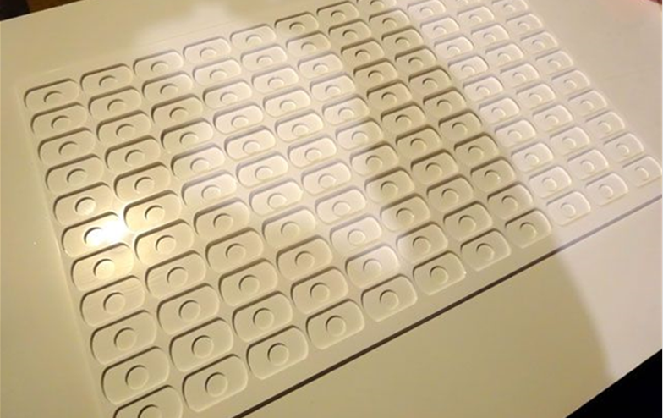

Laser Cutter Advanced Techniques
Learn how to improve the quality of your products and save time with these tips and tricks for the laser cutter

Slide 2

Laser Cutter Advanced Techniques

