Slide 1

Car Plate Recognition and Reconstruction with Deep Learning
Computer Vision – A.A. 2024-2025
Flavio Corsetti – 1997818
Federica Sardo - 1760539

Slide 2
● Title: Report the project name, your names, and course information
● Outline: Briefly describe the presentation workflow
● Problem Statement: The challenge you are addressing
● State of the Art: How current research approaches this challenge
● Proposed Method: How you approached this challenge
● Dataset: The data you used for the project
● Experimental Setup: How you configured the elements of the project
● Model Evaluation: How you assessed the performance of your model
● Conclusions: Final considerations and future work
● References: Where you drew inspiration from

Slide 3
Outline

Slide 4
Introduction
Automatic license plate recognition (ALPR) is a critical task in intelligent transportation systems, traffic monitoring, and security.
Detecting license plates accurately in real-world conditions is challenging due to:
Varying lighting and weather conditions
Different plate sizes, colors, fonts, and formats across regions
Occlusions, motion blur, and low image quality
Precise plate detection is the first crucial step before character recognition can be performed.
Traditional computer vision methods struggle with real-time accuracy and robustness.
Deep learning techniques, especially object detectors like YOLO, have significantly improved detection accuracy and speed.

Slide 5
Related works

Slide 6
Proposed Method: Unified ResNet18
Key points:
Unified Model Architecture: A single ResNet18-based backbone with two possible heads:
Bounding Box Head: predicts plate location as 4 normalized coordinates.
OCR Head: predicts characters on the plate via multi-head classification (7 characters, 68 possible classes).
Design Highlights:
Shared feature extractor (ResNet18) reduces computation and training time.
Separate heads specialized for their tasks improve accuracy and flexibility.
Dropout and batch normalization used to improve generalization.
Advantages:
Simplifies pipeline by combining plate detection and recognition into one architecture.
Easily saved and loaded in parts for modular training and inference.
Works effectively on diverse plates by learning both spatial and character features.

Slide 7
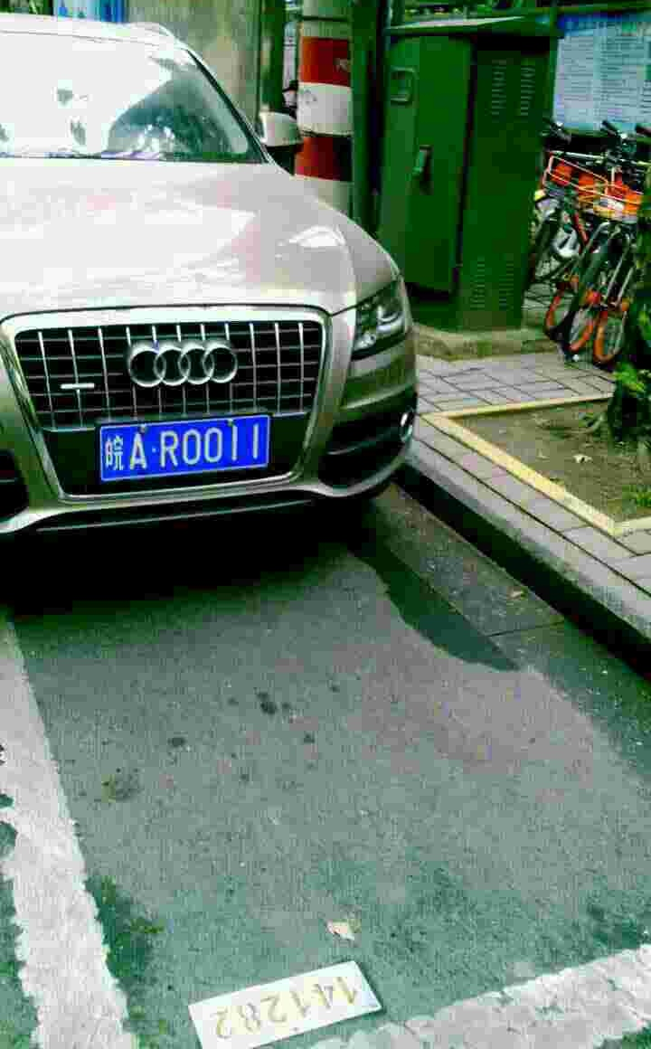

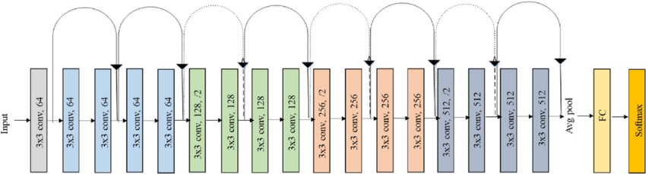
Unified ResNet18
1
Bounding Box linear part
Shared Convolutional Architecture:
ResNet18
OCR linear part
2
皖AR0011

Slide 8
Paper Proposed Method: Yolov5-PLDPR
Key points:
Two-Stage Pipeline:
Stage 1: YOLOv5 detects and localizes license plates in the image.
Stage 2: Custom OCR model reads characters from cropped plates.
OCR Model Architecture:
IGFE (Improved Global Feature Extractor):
Extracts rich spatial features with a combination of CNN blocks and residual connections.
Uses a custom FocusStructure for efficient feature downsampling.
Transformer Encoder-Decoder:
Encoder applies positional 2D encoding + multi-head self-attention layers to model spatial dependencies.
Decoder uses self-attention and cross-attention with encoder output to predict character sequences.
Adaptive pooling and linear classifier decode features into character probabilities over 68 classes.
Advantages:
Transformer architecture captures global context, improving character recognition accuracy.
Modular design separates detection and recognition for flexibility.
State-of-the-art performance reported in the paper.

Slide 9
Yolov5 + PDLPR
IGFE
512 x 6 x 18
Encoder
48 x 144 x 3
Object detection:
Yolov5
512 x 6 x 18
Parallel Decoder
皖AR0011
PDLPR

Slide 10

CCPD (Chinese City Parking Dataset)
A large-scale, publicly available dataset for license plate detection and recognition.
Contains over 250,000 images of vehicles with annotated license plates.
Dataset Characteristics:
Diverse conditions: various lighting, weather, and viewpoints.
Plates captured in real-world scenarios including occlusion, blur, and distortion.
Annotations include bounding boxes for plates and character-level labels.
test
train
tilt
db
rotate
weather
base
blur
fn
challenge

Slide 11
Evaluation metrics (?)

Slide 12
Baseline results

Slide 13
Immaginette sui risultati della baseline

Slide 14
Pldpdlpld results

Slide 15
Results

Slide 16
Comparison
Chi fa meglio?

Slide 17
Conclusions

