Slide 1
Car Plate Recognition and Reconstruction with Deep Learning
Computer Vision – A.Y. 2024-2025
Flavio Corsetti – 1997818
Federica Sardo - 1760539

Slide 2
Outline
Introduction
Proposed methods
Datasets and metrics
Experimental results
Comparison
Conclusions
References
2/21

Slide 3
Introduction
Our goal was to develop a computer vision system to detect license plates in images using bounding box localization and extract text through optical character recognition, handling varied lighting and viewing angles for real-world accuracy.
1
2
3
4
Model Implementation
Testing & Evaluation
Performance Comparison
Baseline Development
Create proprietary baseline model
Develop Yolov5 and PDLPR models
Benchmark all models
Compare results and document findings
3/21

Slide 4
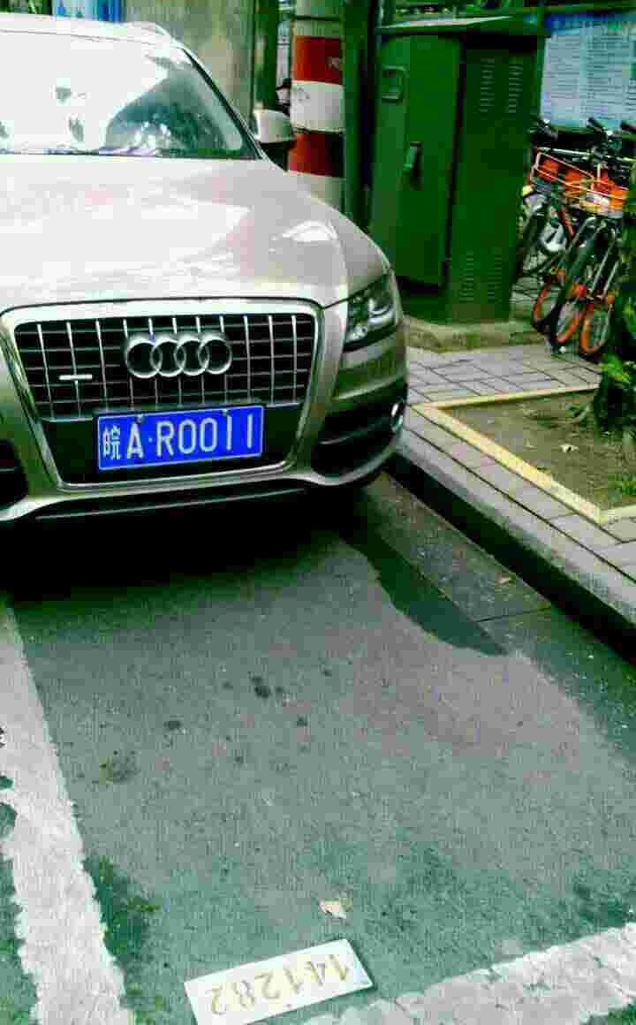

Yolov5-PDLPR Architecture Overview
IGFE
Encoder
Object Detection: Yolov5
Parallel
Decoder
PDLPR
皖AR0011
4/21

Slide 5
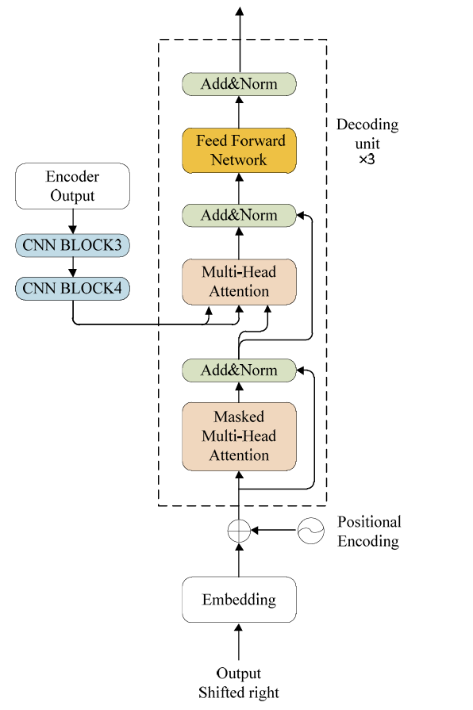
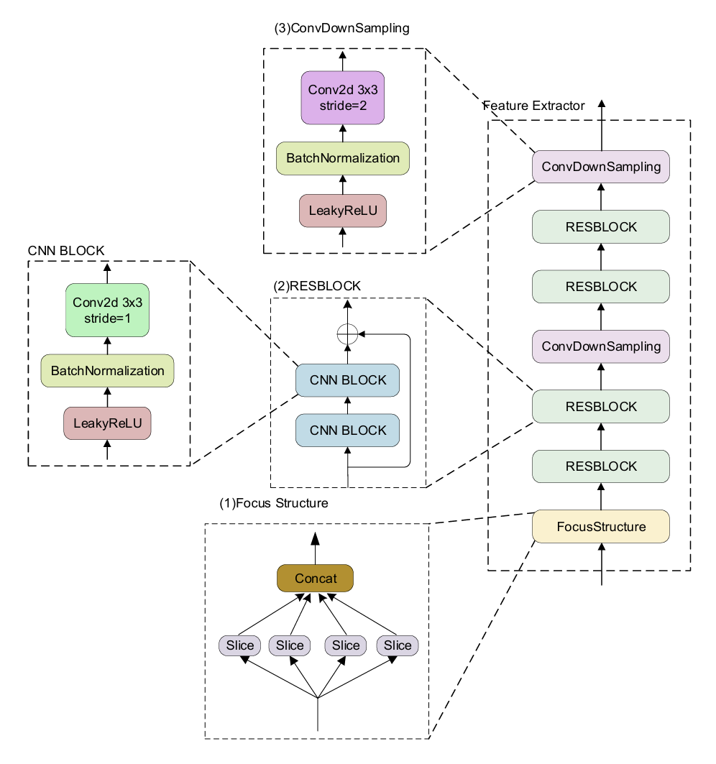
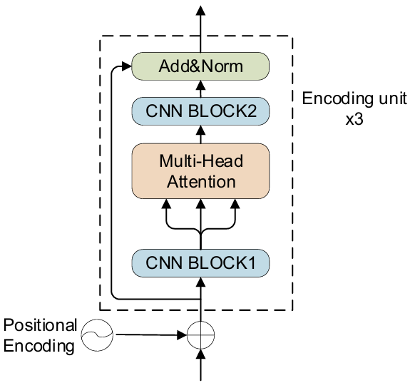
How PDLPR works
Encoder
IGFE
Decoder
5/21

Slide 6
ResNet18 Architecture Overview
Bounding Box
linear part
1
Same Convolutional Architecture: ResNet18
2
OCR linear part
皖AR0011
6/21

Slide 7
Linear layer OCR/BB
512
Linear +
Relu
Batch norm
1024
Dropout 0.4
Linear +
Relu
Linear +
Relu
Dropout 0.2
‘A’
1024
Linear +
Relu
256
.
.
.
.
.
.
.
.
.
.
.
.
.
.
.
512
7 heads
Dropout 0.3
512
256
Linear +
Relu
Linear +
Relu
Linear +
Relu
Dropout 0.2
‘A’

Slide 8

CCPD (Chinese City Parking Dataset)
A large-scale, publicly available dataset for license plate detection and recognition.
Contains over 250,000 images of vehicles with annotated license plates.
Dataset Characteristics:
Diverse conditions: various lighting, weather, and viewpoints.
Plates captured in real-world scenarios including occlusion, blur, and distortion.
Annotations include bounding boxes for plates and character-level labels.
tilt
challenge
db
rotate
base
blur
fn
weather
Train: 160.000
Val: 40.000
Test
8/21

Slide 9
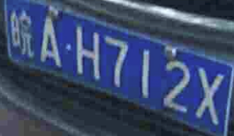

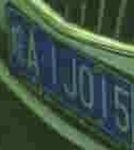
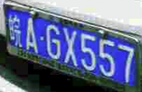


Examples of possible car plates
fn
db
tilt
rotate
blur
weather
9/21

Slide 10

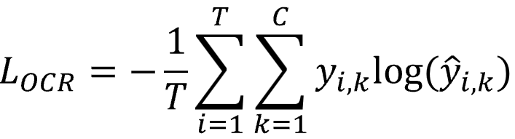
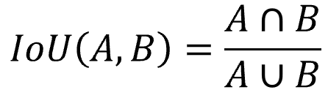
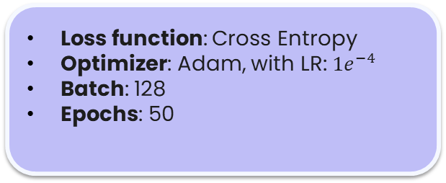
The Experimental setup (1)
Yolov5
PDLPR
Loss function: GIoU loss
Optimizer: Adam, with LR: 0.001
Batch: 50
Epochs: 15
Loss function: Cross Entropy
Optimizer: Adam, with LR: $1e^{−4}$
Batch: 128
Epochs: 50
10/21

Slide 11
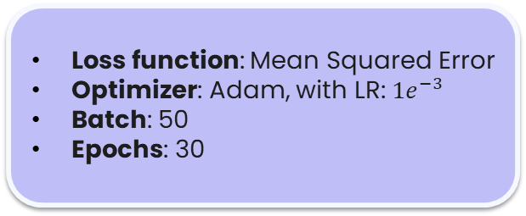

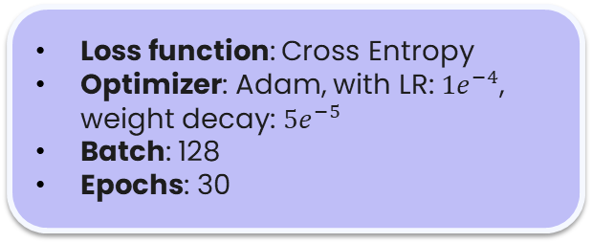
The Experimental setup (2)
RN18 Bounding Box
RN18 OCR
Loss function: Mean Squared Error
Optimizer: Adam, with LR: $1e^{−3}$
Batch: 50
Epochs: 30
Loss function: Cross Entropy
Optimizer: Adam, with LR: $1e^{−4}$, weight decay: $5e^{−5}$
Batch: 128
Epochs: 30
$$MSE= \frac{1}{n}\sum_{i=1}^{n}{{{(y}_{i}−{\hat{y}}_{i})}^{2}}$$
11/21

Slide 12
Yolov5 and RN18 BB results
IoU > 0.70
dataset | Yolov5 | RN18 OCR
base | 96,8% | 88.7%
blur | 89,4% | 80.1%
challenge | 87,7% | 82.1%
db | 78,3% | 76.2%
fn | 78,4% | 75.8%
rotate | 89,2% | 84.3%
tilt | 87,2% | 82.4%
weather | 92,5% | 86.2%
12/21

Slide 13
RN18 OCR results
 | base | tilt | blur | rotate | challenge | fn | db | weather | total
samples | 40000 | 30216 | 20611 | 10053 | 50003 | 20967 | 10132 | 9999 | 150K
avg loss | 0.3216 | 0.1204 | 0.1077 | 0.0700 | 0.0734 | 0.0859 | 0.1089 | 0.0040 | 0.1115
acc/char | 99.07% | 88.65% | 95.44% | 96.14% | 94.64% | 93.94% | 93.28% | 98.60% | 95.14%
acc/plate | 98.86% | 75.39% | 79.45% | 84.12% | 78.49% | 77.51% | 76.41% | 97.40% | 83.03%
13/21

Slide 14
PDLPR results
 | base | tilt | blur | rotate | challenge | fn | db | weather | total
samples | 40000 | 30216 | 20611 | 10053 | 50003 | 20967 | 10132 | 9999 | 150K
avg loss | 0.1096 | 0.0922 | 0.0552 | 0.1178 | 0.1206 | 0.1511 | 0.0080 | 0.1096 | 0.1115
acc/char | 99.45% | 96.74% | 97.44% | 98.74% | 97.11% | 96.82% | 96.02% | 99.78% | 97.76%
acc/plate | 99.07% | 82.22% | 85.83% | 92.86% | 85.94% | 84.27% | 80.04% | 98.46% | 89.59%
14/21

Slide 15
Accuracy for character position (ccpd-weather)
15/21

Slide 16
Most common letter and number confusions (1)
16/21

Slide 17
Most common letter and number confusions (2)
17/21

Slide 18
Pipeline evaluation
Model | Speed | Character Accuracy | Sequence Accuracy
Yolov5+PDLPR | 70.23 FPS | 99.45% | 99.07%
ResNet18 | 59.06 FPS | 99.07% | 98.86%
18/21

Slide 19
Conclusions
The specialized YOLOv5 + PDLPR pipeline delivers superior results, while ResNet18, a general-purpose model, achieves comparable performance with significantly faster training and easier management.
ResNet18 OCR and PDLPR show comparable performance, as ResNet18 demonstrates superior character recognition capabilities. However, ResNet18 falls slightly behind in bounding box detection, though it still delivers absolutely acceptable results that meet project requirements.
Both approaches effectively deliver the desired outcomes while offering distinct advantages in specialization versus versatility.
19/21

Slide 20
Future works
It would be interesting to evaluate the model proposed in the paper using YOLOv11, the latest version of the YOLO architecture, to potentially improve detection performance.
Testing the model on additional datasets would help assess its flexibility and generalization capabilities, especially for different types of license plates across various regions or formats.
20/21

Slide 21
Reference
1. Tao, L., A Real-Time License Plate Detection and Recognition Model in Unconstrained Scenarios. Sensors, Hong, S., Lin, Y., Chen, Y., He, P. and Tie, Z. (2024). 24(9), 2791
2. Xu, Z.; Yang, W.; Meng, A.; Lu, N.; Huang, H.; Ying, C.; Huang, L. Towards end-to-end license plate detection and recognition: A large dataset and baseline. In Proceedings of the European Conference on Computer Vision (ECCV), Munich, Germany, 8–14 September 2018.
3. R. K. Prajapati, Y. Bhardwaj, R. K. Jain and D. Kamal Kant Hiran, ”A Review Paper on Automatic Number Plate Recognition using Machine Learning : An In-Depth Analysis of Machine Learning Techniques in Automatic Number Plate Recognition: Opportunities and Limitations,” 2023 International Conference on Computational Intelligence, Communication Technology and Networking (CICTN), Ghaziabad, India, 2023, pp. 527-532
21/21

Slide 22
Thanks for your attention

