Slide 1


Multimodal RAG Chatbot
- presented by: Blesson Samuel L

Slide 2
Introduction
This project is an AI-powered conversational assistant that intelligently handles both voice and text inputs. It combines document understanding, natural language processing, and speech recognition to create a smart, interactive experience.
Users can upload PDF documents, ask questions about them through text or voice, and receive accurate, context-aware answers. Powered by FastAPI, Langchain, Google Gemini Flash, and AssemblyAI, the system classifies each user query and dynamically routes it to either a document-based RAG model or a friendly chatbot agent.
This model serves as a foundation for building intelligent applications that can read documents, understand voice, and talk back naturally making AI interaction seamless, informative, and human-like.

Slide 3





Key Features
PDF Document Upload & Storage
Voice Input & Transcription
Smart Query Classification
Upload PDFs, extract text, chunk content, and save as vector embeddings for semantic search.
Accepts audio input via API and transcribes to text using AssemblyAI for hands-free interaction.
Gemini-powered prompt classifies questions as "pdf" or "friendly" for accurate routing.
RAG-Based PDF Answering
Friendly Chatbot Agent
Uses vector search for relevant document chunks and Gemini Flash 2.0 for context-aware answers.
Responds naturally to general questions, maintains chat history, and engages like a virtual companion.

Slide 4
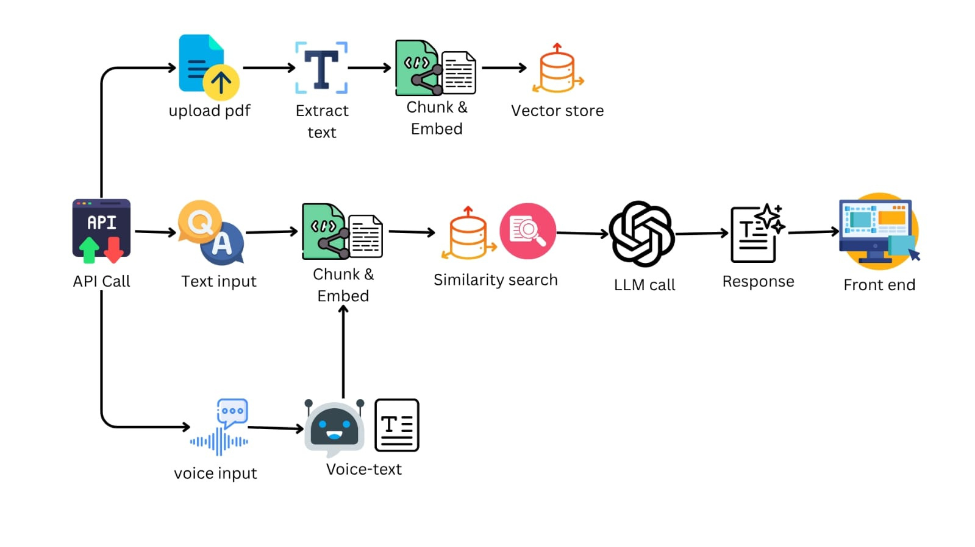
Architecture Diagram

Slide 5
Let’s go for a quick demo

Slide 6





Future Enhancements
Multiple Documents & Filters
Live Voice Chat
User Login & History
Real-time voice conversation with the chatbot via audio streaming.
User accounts to save files and chat history for personalization.
Upload and query multiple PDFs, filter by name, tags, or date.
Document Summarization
Offline Use
Functionality without internet using local AI models.
Quickly summarize PDFs and highlight key points.

Slide 7

Conclusion
This AI assistant integrates voice recognition, document understanding, and natural conversation. By combining FastAPI, Langchain, Gemini Flash, and AssemblyAI, it enables users to interact with PDFs and receive accurate, context-aware answers via text and voice. Its ability to classify questions and provide tailored responses makes it versatile and user-friendly, serving as a strong foundation for advanced, multi-modal AI applications.

Slide 8
Thank You!

