Slide 1
Week 10~11 Progress Report
Liu Weihao
28/10/2021

Slide 2
Progress Report
Task offloading and file transmitte
SUMO simulate and vehicle ID bonded
Some problem

Slide 3
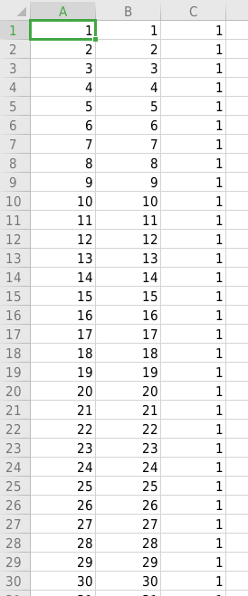
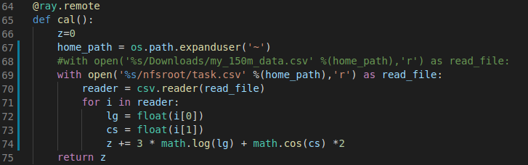
Processing tasks in ‘.csv’ file
Caculate ‘log’ and ‘cos’ 25000000 times
The file size is about 135.8 MB
Average transmit rate: 1.5 MB/S * 2
Total process time(transmit+caculate): 85.409180 s
Caculate time: 46.707061 s

Slide 4

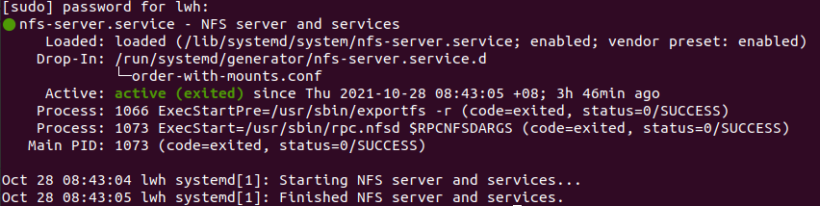
File transmit - via NFS
If the file size is larger than 500 KB, a connection error occurs during transmission
Use NFS and IPV6 address to share the file
sudo mount -t nfs [2406:3003:206b:1265:1d32:ed48:5799:5d17]:/home/lwh/nfsroot /home/pi/nfsroot -o nolock

Slide 5
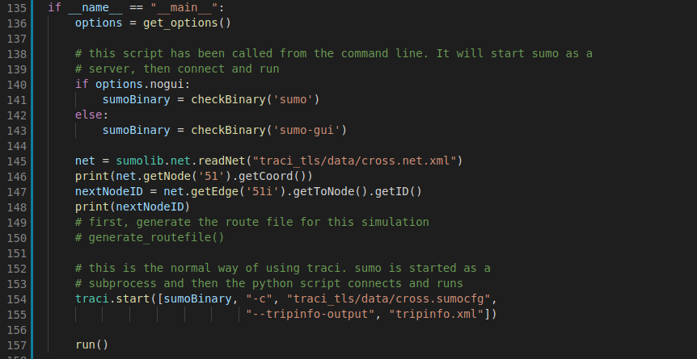
SUMO simulate
Use ‘sumolib’ and ‘traci’ in python to control SUMO-gui

Slide 6
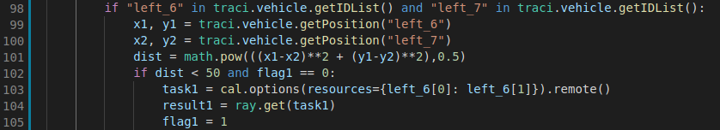

SUMO simulate
Use ‘sumolib’ and ‘traci’ in python to control SUMO-gui
traci.vehicle.getPosition(Vehicle ID) get vehicle’s positon
Bonded vehicle ID and RPi ID

Slide 7
Some problem
The transfer rate of NFS only 3~5 MB/s
When ray function is running, SUMO simulate will stop.
-- maybe I can use ray multiple thread.

