Slide 1
Week 8~9 Progress Report
Task offloading
Liu Weihao
14/10/2021

Slide 2

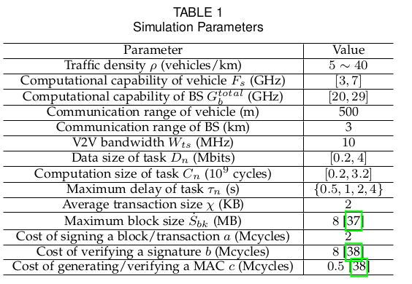
Vehicle environment
Task offloading state space
Utility, reliability, service price, etc.

Slide 3
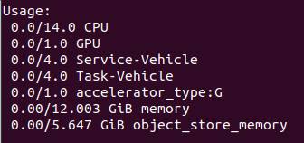
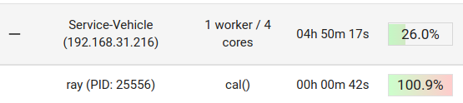
Use ray to allocate task
Start a local cluster
Assign resources to different task
task1=cal.options(num_cpus=4,resources={"Task-Vehicle": 1}).remote()

Slide 4

Wireless communicate
Transmission rate
Positation
SNR
power spectrum density

