Slide 1



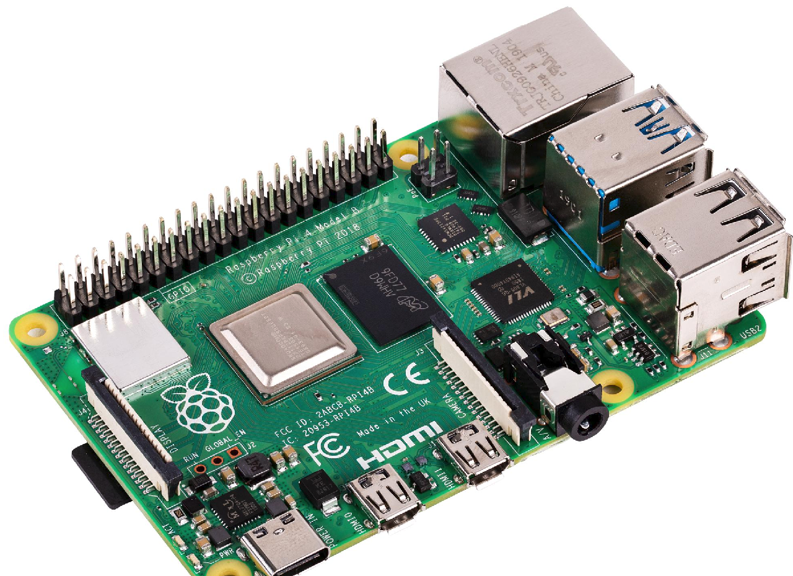
Base station 1
Base station 2
AP
wireless
wired
Base station 0
Raspberry Pi

Slide 2
Vehicle
BS
Vehicle
BS
Vehicle
BS
Request
Request
Request
Time out
Time out
Time out
ACK
ACK
Request
Request
Request
Time out
Time out
Time out
ACK
ACK
ACK
Packet lost
ACK lost
Early timeout

Slide 3


Start
Task vehicle
BS
Generate task
Offloading request
Waiting for request packet
Phase 1
Waiting for the
$V_{s}$ ID
Service vehicle ID
Apply policy, select service vehicle
Phase 2
Allocate task to $V_{s}$
Verify the results
Execution results
Waiting for the offloading results
Phase 4
Phase 3
Get reward & penalty, update the policy

Slide 4
4 bits integer
10 bytes strings
10 bytes strings
10 bytes strings
10 bytes strings
Packet length | Head | Data 1 | Data 2 | Data 3 | ……
UDP Packet

Slide 5
Data 1
Data 1
Data 2
Integrate
String
Encode
Sort byte
Byte stream
Decode
String
Split
Data 2
Transmission
……
Data 3
Data 3
……
UDP sender
UDP receiver
……

Slide 6
Base station
Waiting for offloading request
Request packet ?
No
Drop the packet
Yes
Processing the request and return back the service vehicle ID
Waiting for the task execution results
Verification packet ?
No
Drop the packet
Yes
Get reward/penalty
Update the policy

Slide 7
Task vehicle
Sending request to base station
Base station receive the request properly ?
No
Sleep one seconds
Yes
Waiting for service vehicle ID
Transmitting task to service vehicle
Sending the results to base station

Slide 8
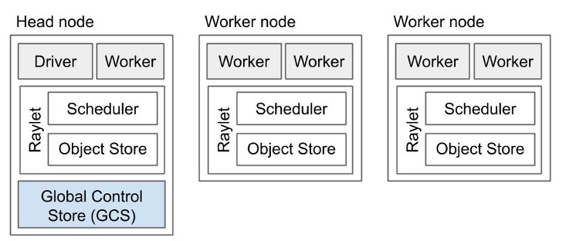

Slide 9
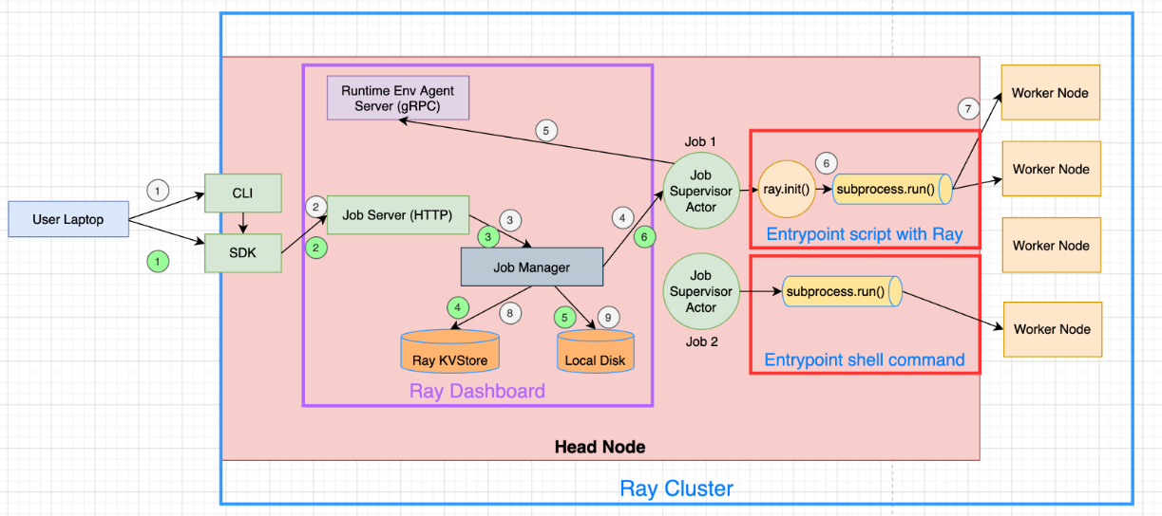

Slide 10
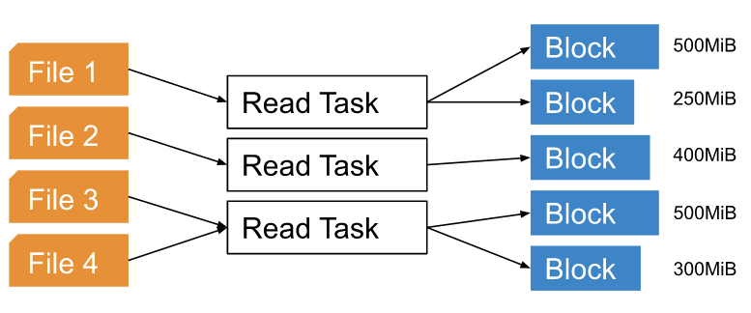

Slide 11
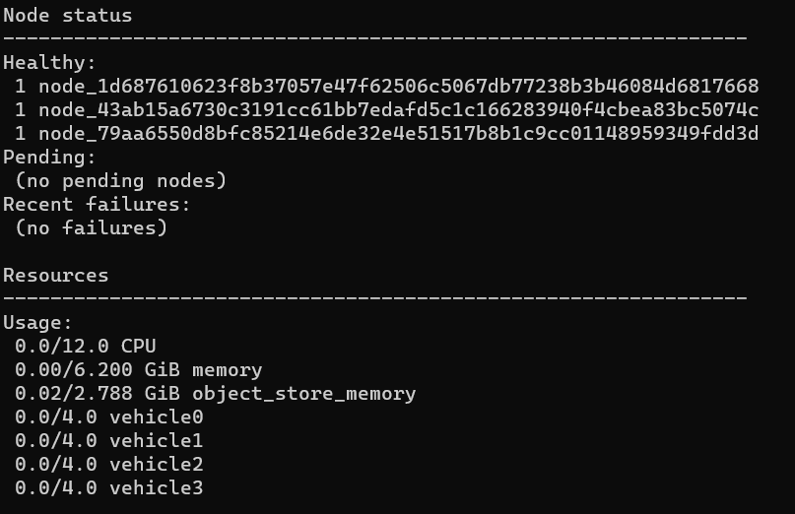
general resources
custom resources

Slide 12

Resources name
Quantity required

Slide 13



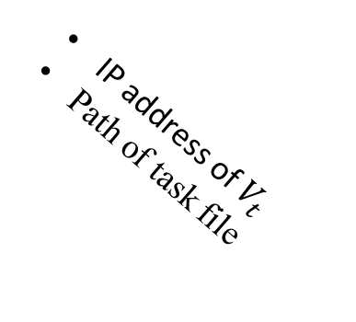
Base station
2
Select service vehicle
3
4
IP address of $V_{t}$
Path of task file
1
Offloading request
HTTP
Request Message
HTTP
Response Message
Service vehicle
Task vehicle
HTTP client
HTTP server
Task complete notification
5

Slide 14
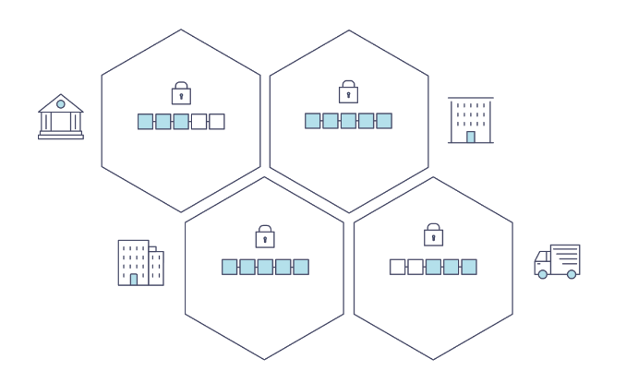
Peer 0
Peer 0
Peer 1
Peer 1
Peer ...
Org 1
Org 3
Peer ...
Peer 0
Peer 0
Peer 1
Peer 1
Peer ...
Org 2
Org 4
Peer ...

Slide 15
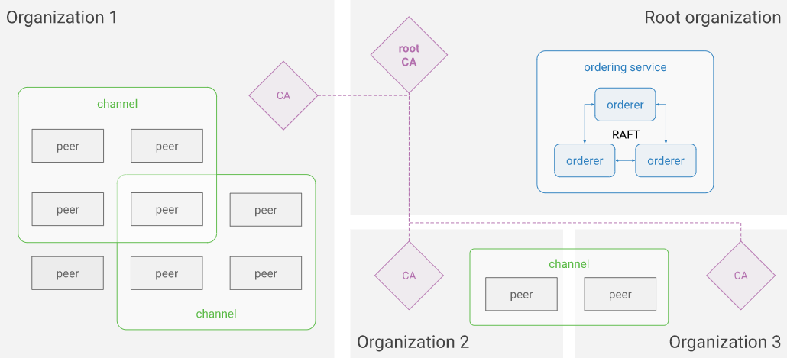

Slide 16
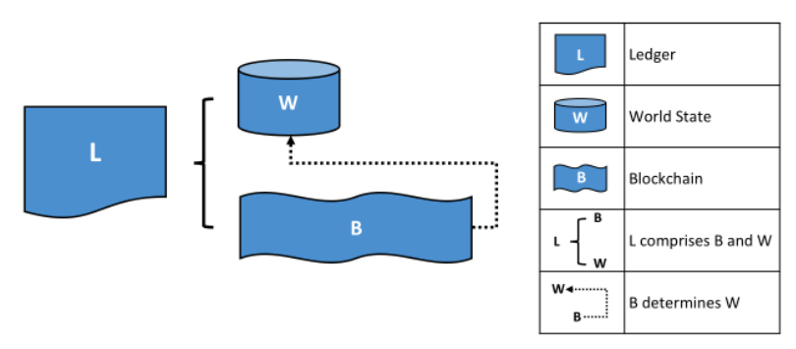

Slide 17
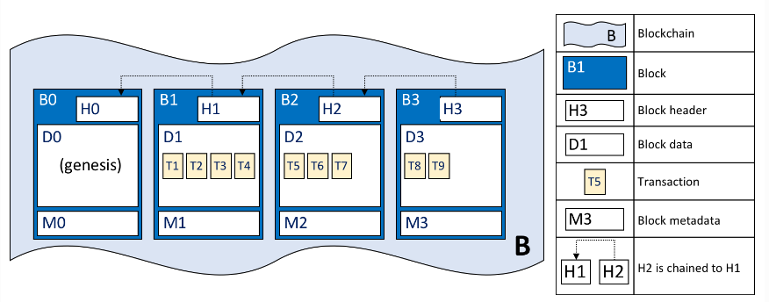

Slide 18
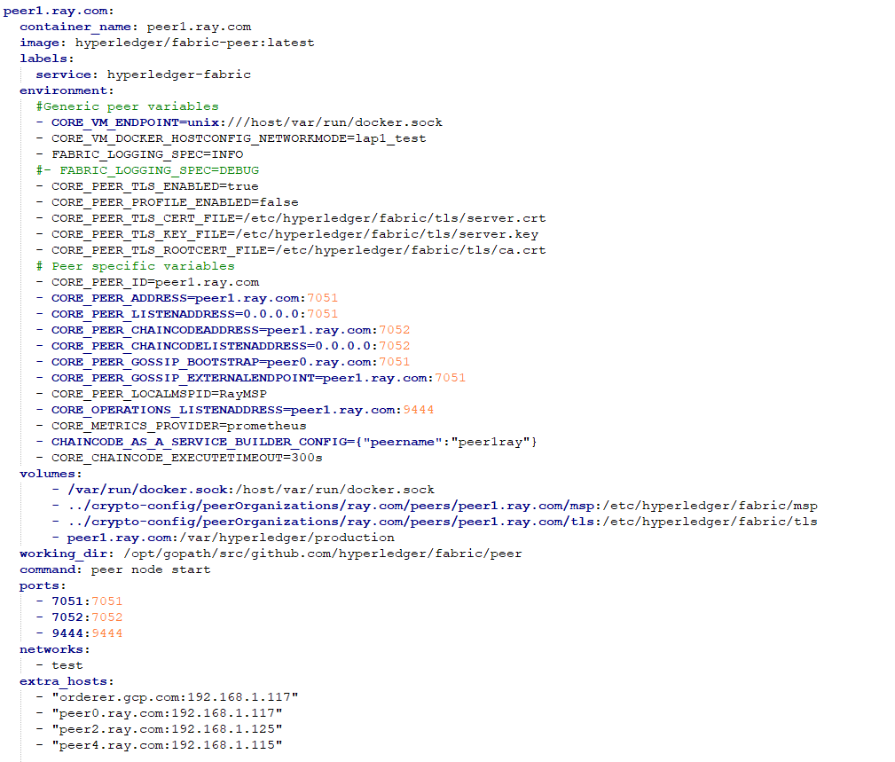
Node ID
Identifier
Gossip
External Node address

Slide 19
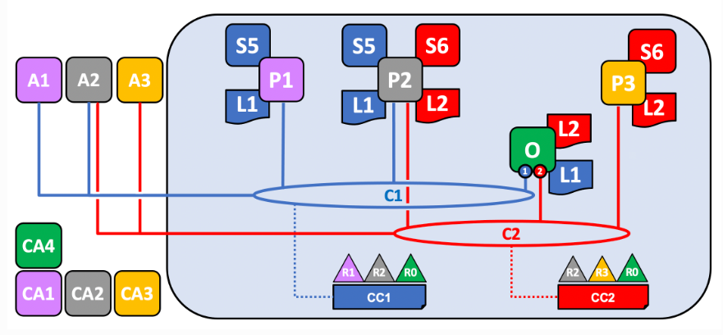
R1
R2
Organization
P1
P2
Peer / Node
L1
Ledger / data
S5
Contract / Chain code
A1
A2
user
O4
Order / Consensus
Node

Slide 20
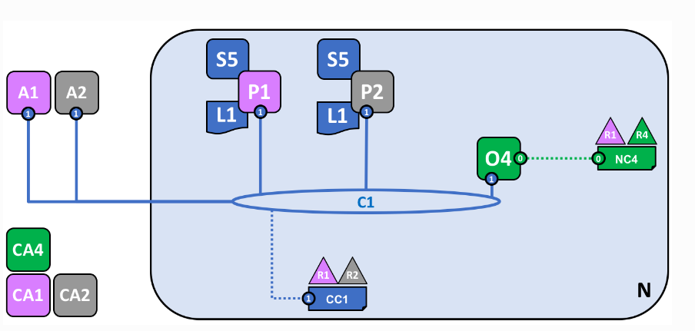
R1
R2
Organization
P1
P2
Peer / Node
L1
Ledger / data
S5
Contract / Chain code
A1
A2
user
O4
Order / Consensus
Node

Slide 21
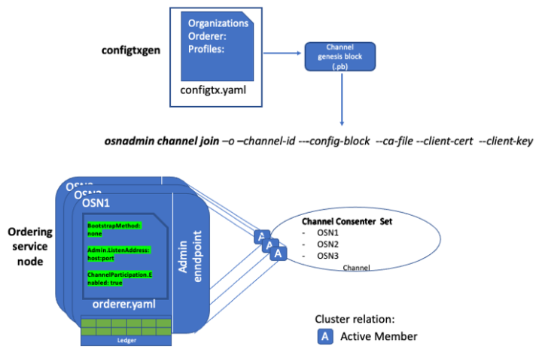

Slide 22
Blockchain Network
Chaincode
Vehicle
Task
SACC
Vehicle information
History task
Base station
information
Data

Slide 23
GCP - NFS server
GCP - MySQL server
Cloud storage - Google / Amazon
Block chain:
Node 1: GCP
Node 2: my laptop
database | Read/Write | Connect | Multiple user
NFS | 0.5s / 2s | command line | ×
Google storage | 8s / 12s | Python code | ×
Amazon S3 | 16s / 20s | Python code | ×
MySQL | 0.5s / 2s | Python code / command line | √
Block chain | 0.1s / 0.3s | Python code | √

