Slide 1
Week 6~7 Progress Report
Liu Weihao
30/09/2021

Slide 2
Progress Report
Compiler Ray source code on ARM platform
  Ray version: 1.6.0, 2.0.0
  Python version: 3.8.10
Set up Ray cluster in local area network
Connect to the cloud server

Slide 3

Compiler source code
Download source code from github: Ray project
Set up the complier environment: bazel, some library
Comliler the sorce code:
    $BUILD_DIR=$(pwd)
    $RAY_VERSION=1.1.0
    git clone https://github.com/ray-project/ray.git && \
    cd ray && \
    git checkout releases/$RAY_VERSION
    # Build dashboard
    cd $BUILD_DIR/ray/dashboard/client
    npm ci
    npm run build
    # Python WHL
    cd $BUILD_DIR/ray/python && \
    python setup.py bdist_wheel

Slide 4
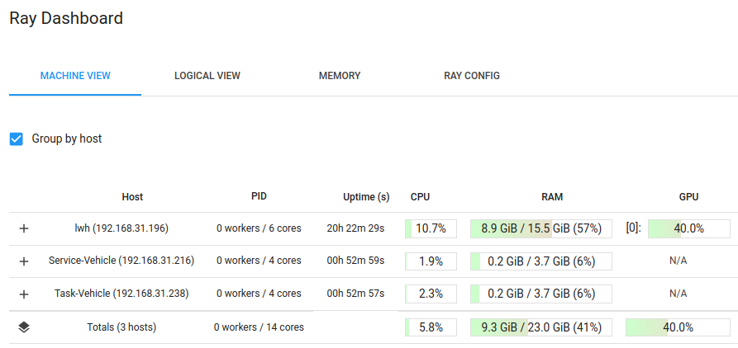
Set up cluster in LAN
ray start --head --port=’port number’

Slide 5
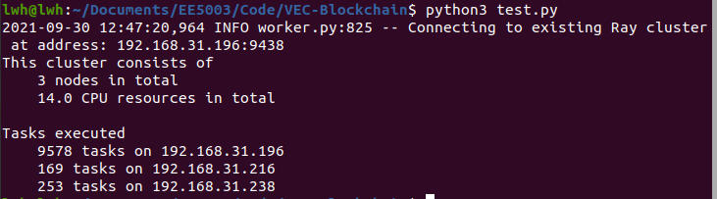
Set up cluster in LAN
ray.init(address='auto', _redis_password='5241590000000000')
If we want to allocate tasks to different machine, we need to use ray client or ray server (ray>1.5.0 !)
ray.init("ray://<head_node_host>:10001")

Slide 6
Connect to cloud server
Use “yaml” file to set up a server
Same as LAN, use “ray start” comand, and connect to the cloud server via “ray client”

