Slide 1
Week 4~5 Progress Report
Liu Weihao
16/09/2021

Slide 2
Progress Report
Program-Vehicle computation Environment
  Task vehicle
  Service vehicle
Wireless comunicate
Some question

Slide 3
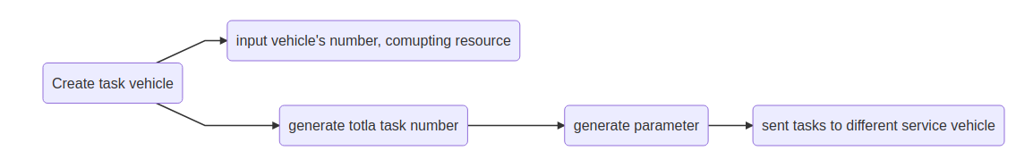
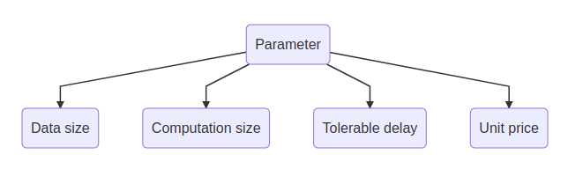
Task vehicle

Slide 4
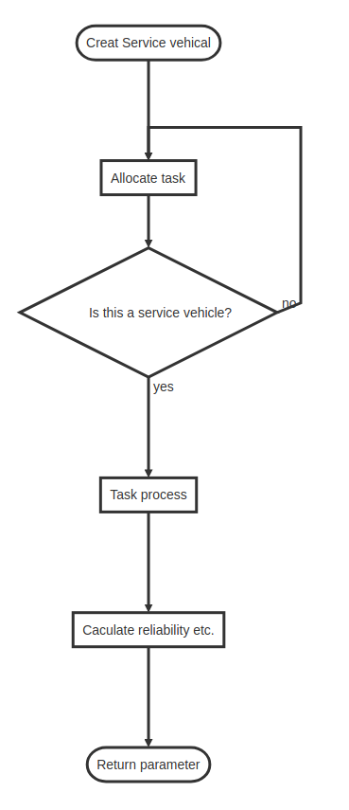
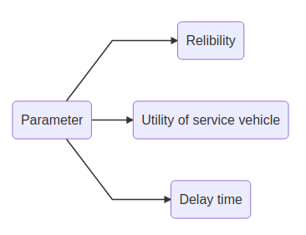
Service vehicle

Slide 5
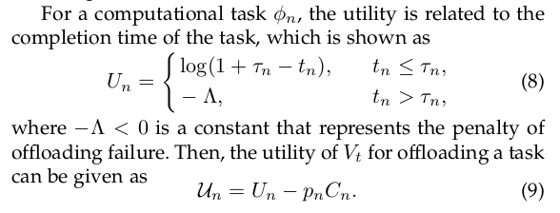
Task comfirm
After task processing is complete, task vehicle will confirm that whether τ< t, and pay the service price.

Slide 6

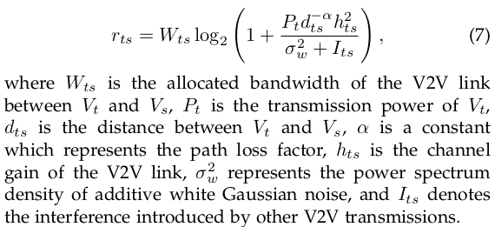
Wireless comunicate
In first paper, it use a simplify model to caculate the transmission rate, without any transmission protoco.

Slide 7

Some question
Service vehicle need to allocate computing resource for the task. But how to distribute resource is not mention in the paper.
Do we need to give a constant to every service vehicle, or just generat a random number each time?
The parameter of task are independent, some task may have small data size but need many computing resource.
Some parameter are not showen in the paper

