Slide 1
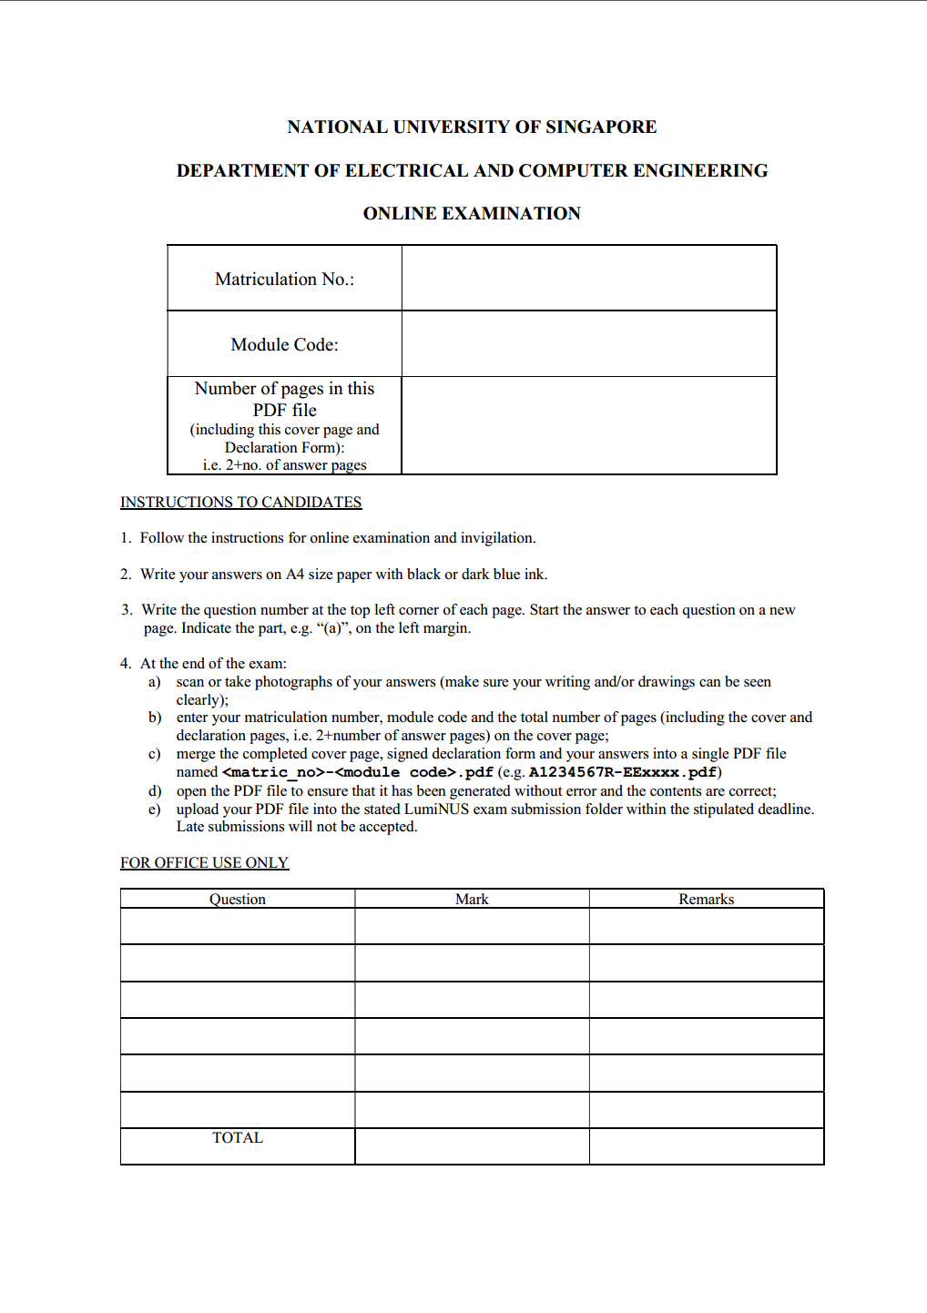

Slide 2
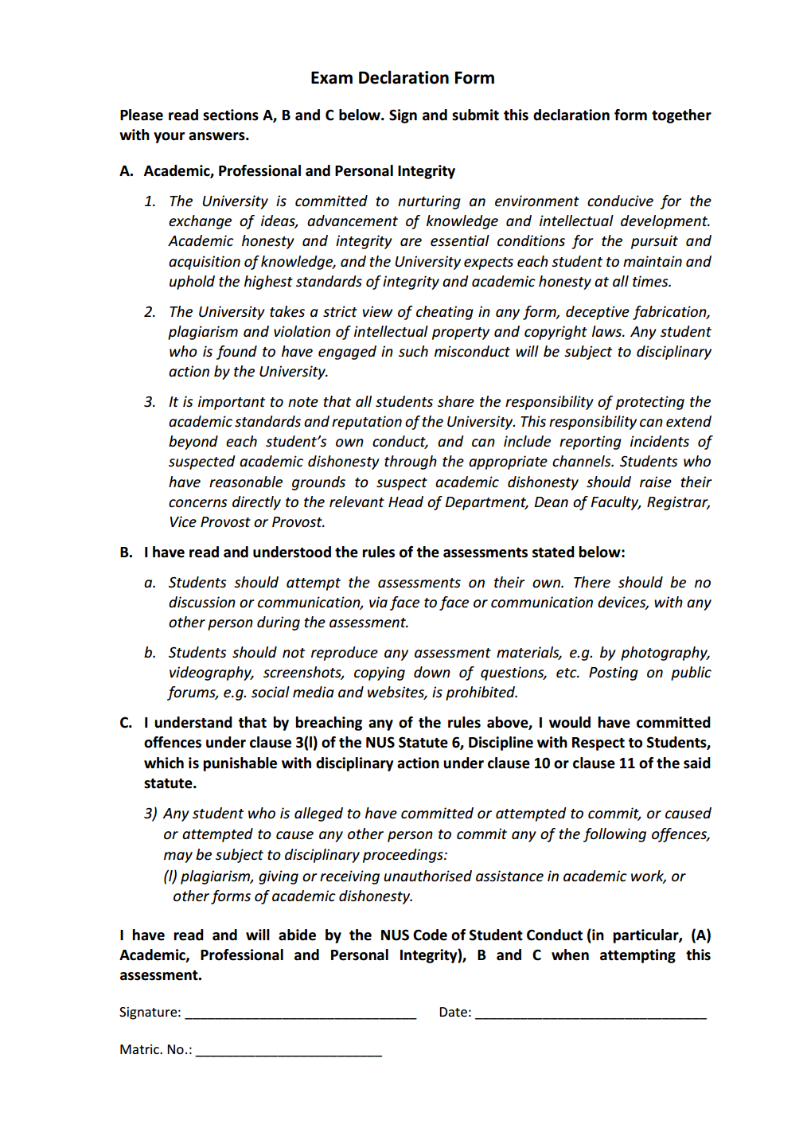
Note: After converting this Power-Point file into a PDF file, open the PDF file to ensure that it has been generated without error and the contents are correct before uploading the PDF file into LimiNUS.

