Slide 1
Progress Report
Liu Weihao
26 Jan, 2022

Slide 2
Block chain database
  Key-value pairs
  Python API
Integrate SAC, SUMO and Taskoffloading
  SUMO data
  SAC training

Slide 3
Block chain database
Base station - 1
Base station - 2
SAC
local database
vehicle information
DDQN
Block chain
BS information
SAC
local database
vehicle information
DDQN
Block chain
BS information

Slide 4
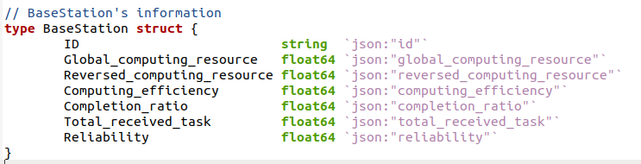
Block chain database
key-value pairs
Key: Base station ID (unique,index)
Value: Base station Information

Slide 5
Block chain database
Compare with mySQL
GCP - MySQL server
Block chain:
Node 1: GCP
Node 2: my laptop
database | Read/Write | Connect
MySQL | 0.5 s / 2s | Python code
Google storage | 0.1 s / 0.3 s | Python code

Slide 6
SAC & SUMO & Taskoffloading
Local database
Update
Get/
training
②
Task vehicle
Rpi #1
①
request
③
SUMO
simulation
SAC
Training-action
Service vehicle
Rpi #2
④
offloading

Slide 7
THE END

