Slide 1
EDTER: Edge Detection with Transformer
EE6934 CA-3
Liu Weihao
A0232935A
2023 Apr 14th

Slide 2
Table of Content
Summary
Experiment and Analysis
Strengths
Weaknesses

Slide 3
Summary
Target
In this research paper, the author's primary objective is to enhance the efficacy of edge detection techniques by incorporating transformer-based models into the process. Despite the potential advantages of utilizing transformers in edge detection,
The main problem this paper tries to solve:
Owing to computational constraints, transformers are frequently employed on relatively large-sized patches. However, these coarse-grained patches are not conducive to learning accurate features for edges. Therefore, it is imperative to implement self-attention mechanisms on fine-grained patches without exacerbating the computational demands of the system.
The task of accurately extracting edges from intersected and thin objects poses a considerable challenge in the field of edge detection. To address this issue, the authors investigate novel methodologies for the identification and extraction of precise edges, even in the presence of complex, intersected, and thin objects, thus significantly improving the performance of edge detection algorithms.

Slide 4
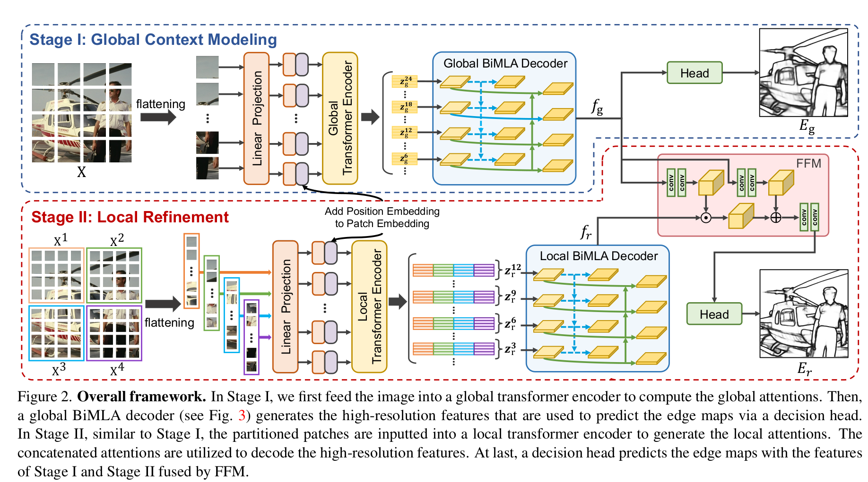
Key Ideas
this research paper is the first that incorporates transformer-based models into the edge detection process.
Two-stage approach is designed, with the aim of exploring long-range global context (Stage I) and capturing fine-grained local cues (Stage II). Additionally, a Feature Fusion Module (FFM) is employed to effectively combine the cues extracted from both Stage I and Stage II, resulting in a more comprehensive and accurate representation of the visual features within the edge detection framework.

Slide 5
Contributions
The authors propose a novel transformer-based edge detector, Edge Detection TransformER (EDTER), to detect object contours and meaningful edges in natural images. It is the first transformer-based edge detection model.
EDTER is designed to effectively explore long-range global context (Stage I) and capture fine-grained local cues (Stage II). Moreover, the authors propose a novel Bi-directional Multi-Level Aggregation (BiMLA) decoder to boost the information flow in the transformer.
To effectively integrate the global and local information, the authors use a Feature Fusion Module (FFM) to fuse the cues extracted from Stage I and Stage II.
Extensive experiments demonstrate the superiority of EDTER over the state-of-the-art methods on three well-known edge detection benchmarks.

Slide 6
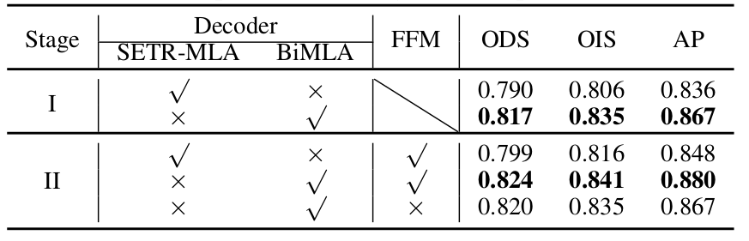
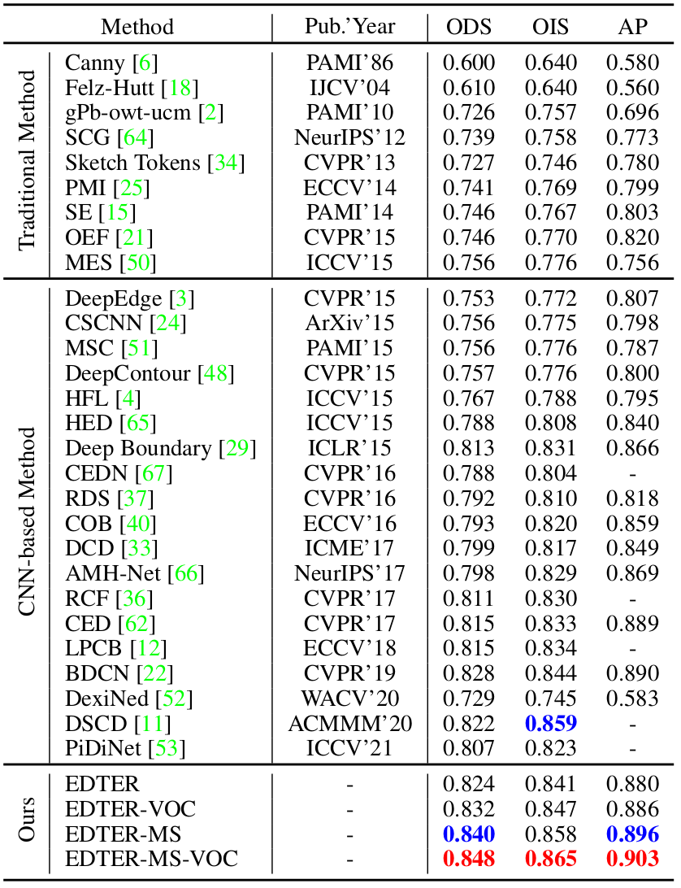
Performance
With regard to the BiMLA decoder and the Feature Fusion Module (FFM), experimental results demonstrate that the proposed method significantly outperforms SOTA approaches in edge detection. These findings indicate the effectiveness of the BiMLA decoder and FFM in enhancing the accuracy and precision of edge detection algorithms
The proposed method achieves superior results across all evaluated datasets, showcasing its robustness and adaptability. The EDTER model marginally surpasses the performance of state-of-the-art methods, exhibiting improvements in the range of 0.02-0.03 in performance metrics for the three types of datasets analyzed. This consistent enhancement of edge detection performance demonstrates the potential of the proposed method to be successfully employed in diverse scenarios, further solidifying its value as a significant contribution to the domain of computer vision.

Slide 7
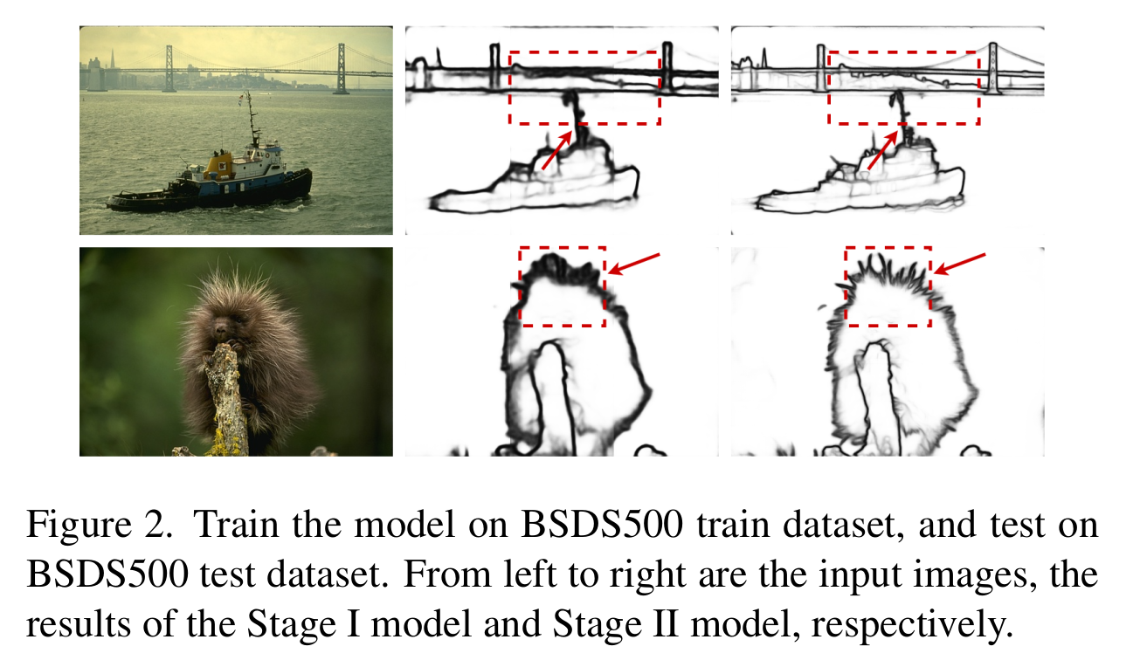
Experiment

Slide 8
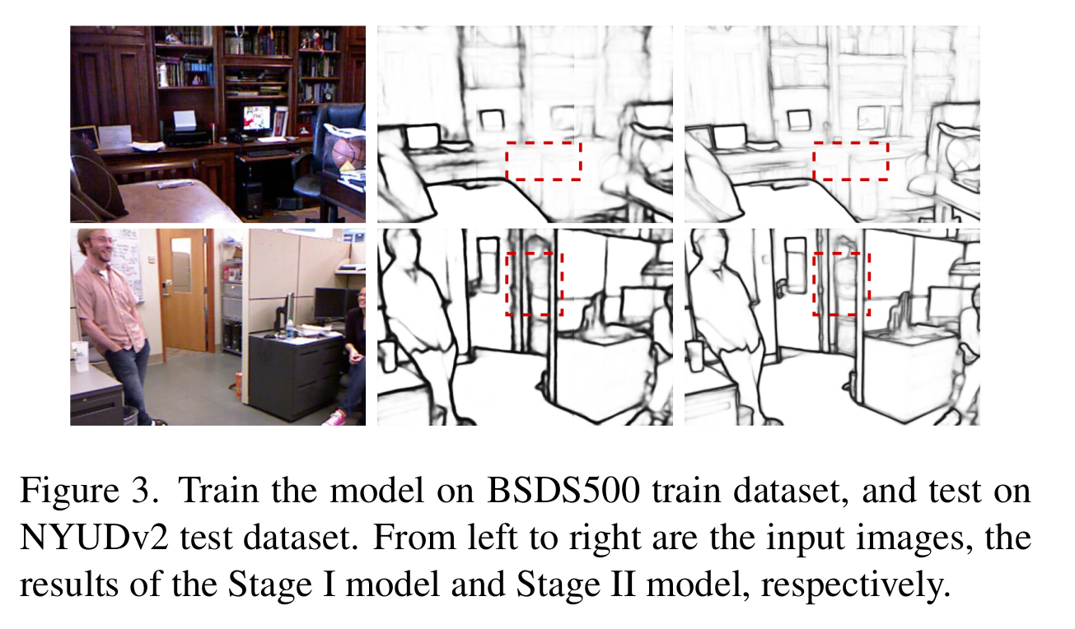
Experiment

Slide 9
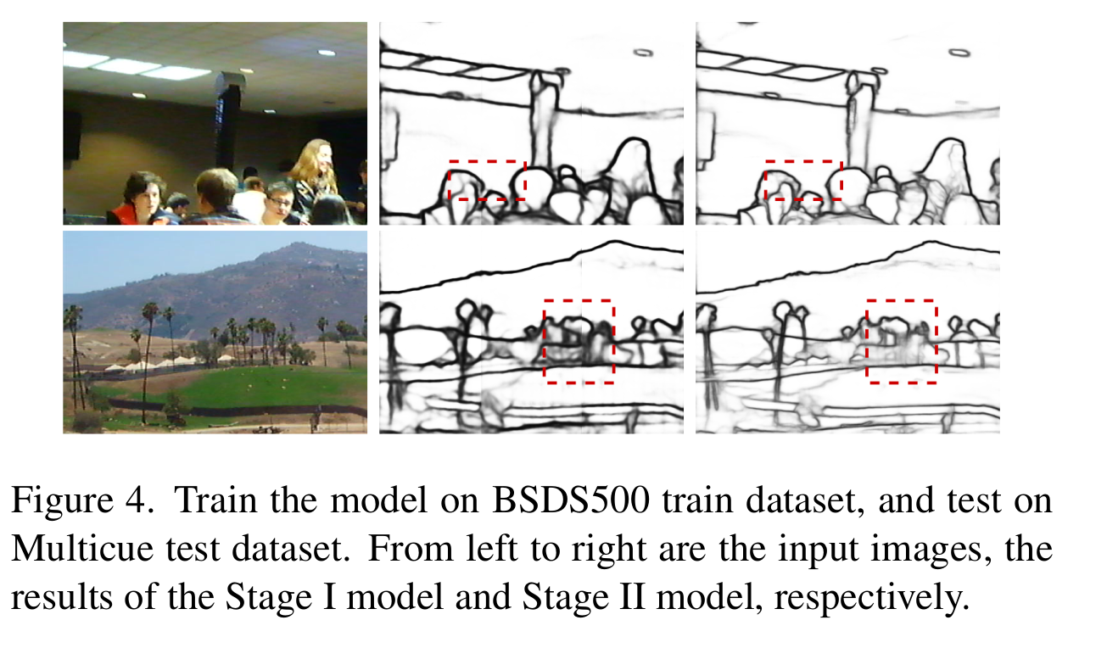
Experiment

Slide 10
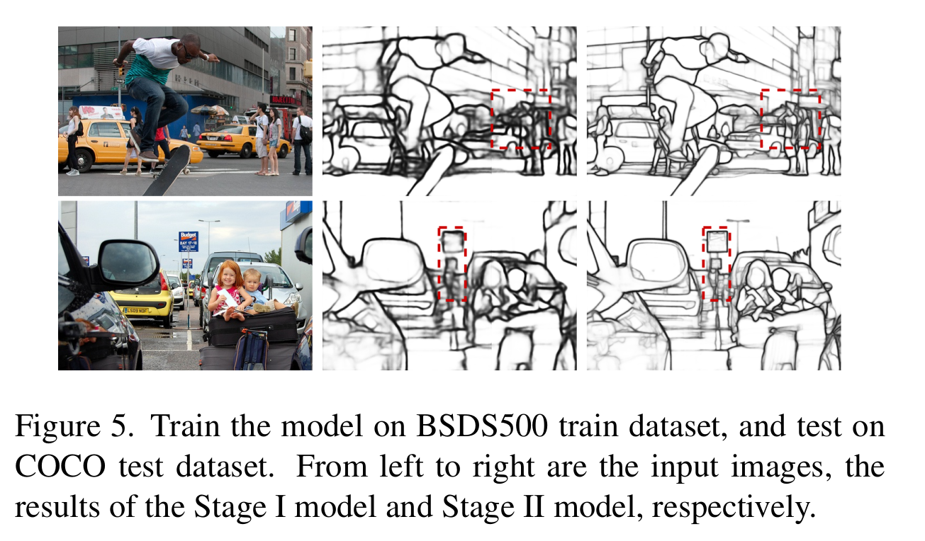
Experiment

Slide 11
Strengths
The two-stage training method is capable of capturing both long-range global context and short-range local cues, resulting in a more comprehensive and accurate representation of object boundaries. This approach enables the model to overcome limitations associated with traditional transformer-based edge detection methods.
The incorporation of the FFM further enhances the EDTER model's effectiveness by facilitating the seamless integration of information extracted from both stages, leading to more accurate and detailed edge detection results. Moreover, the model leverages the Bi-Directional Multi-Level Aggregation (BiMLA) decoder to accelerate information flow, further contributing to the model's efficiency and adaptability across various datasets.

Slide 12
Weaknesses
According to the paper, the model obtained from Stage I is capable of being applied to images of any size, a finding that was corroborated during my experiments. However, the Stage II model initially divides the image based on size. Consequently, if we wish to apply the model to different images, it is necessary to first crop the image to ensure compatibility with the trained model, allowing for proper data handling and processing.

Slide 13
THANK YOU

