Slide 1
Week Progress Report
Liu Weihao
13 Dec

Slide 2
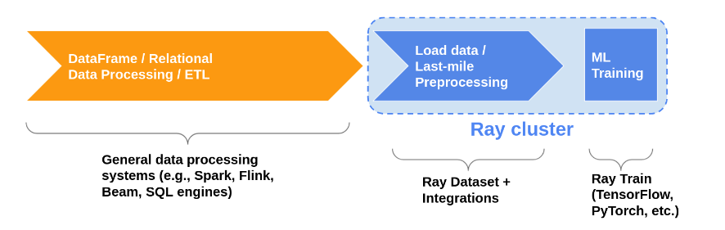
Ray Dataset

Slide 3
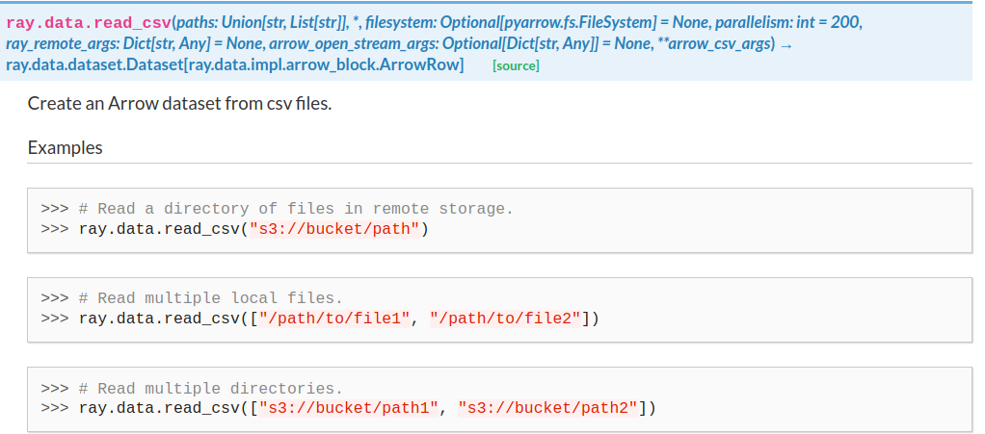
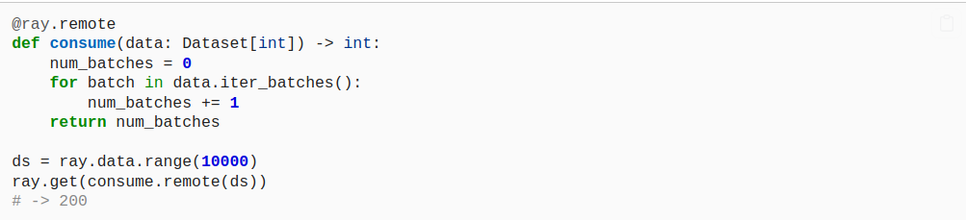
Data Transfer
Read local CSV file
Exchange dataset

Slide 4
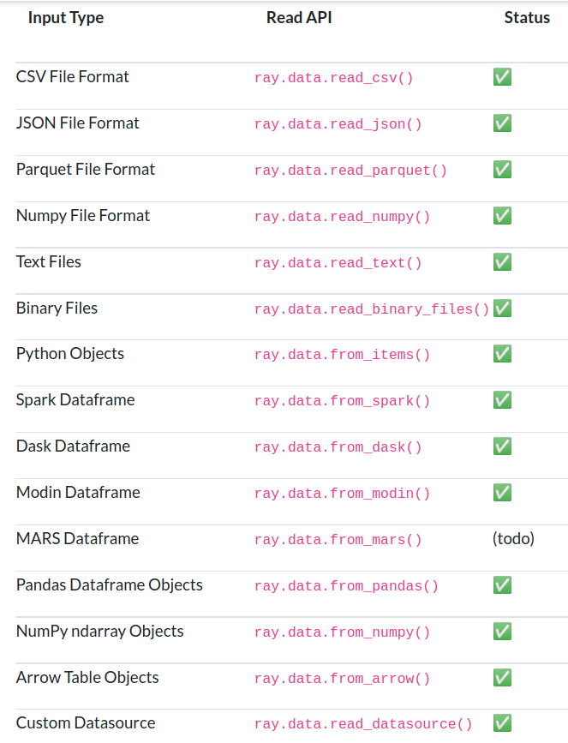
Data Transfer

