Slide 1
Week Progress Report
Liu Weihao
3 Jan 2022

Slide 2
Progress Report
Task offloading
  Base on ray
  UDP + HTTP
Data exchange (base station)
  GCP database and cloud storage
  Block chain
SUMO and database

Slide 3
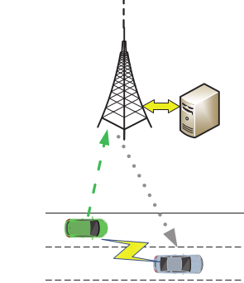
Task offloading - Ray
TV and SV join in same Ray cluster (2-5s)
TV make a request to BS, and BS will send it to the SV(<0.1s, TCP or UDP)
TV transfer task data to SV and get the result (2.5-5s)
SV send the result to BS (<0.1s, TCP or UDP)
Total time>5s >> tau_time
Request
Offloading
Task
Ray cluster

Slide 4
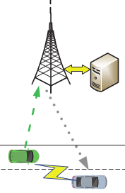
Task offloading - UDP+HTTP
TV make a request to BS, and BS send it to SV. (<0.1s, UDP)
TV transfer data to SV via HTTP, and get the result. (<0.2s, HTTP)
SV send the complete flag to BS and TV. (<0.1s, UDP)
Total time is about 0.3-0.5s
Request
offloading
HTTP transfer

Slide 5
Data exchange - Cloud storage
GCP - NFS server
GCP - MySQL server
Cloud storage - Google / Amazon
database | Read/Write | Connect
NFS | 0.5s / 2s | command line
MySQL | 0.5s / 2s | Python code / command line
Google storage | 8s / 12s | Python code
Amazon S3 | 16s / 20s | Python code

Slide 6
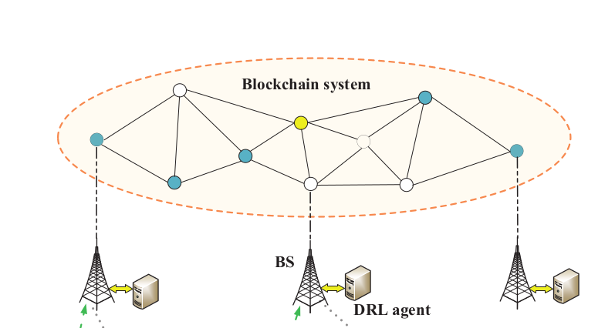
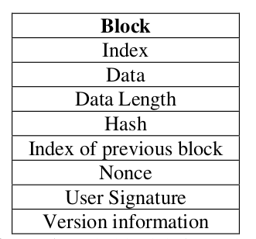
Data exchange - Block chain
Basic Block information

Slide 7
Data exchange - Block chain
Broadcast
Change confirm
Data change
New block
Node
Block chain network
Update database

Slide 8

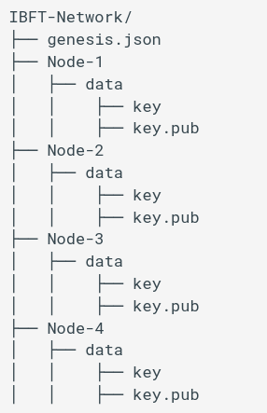
Block chain clients
GCP
Laptop
RPi-A
RPi-B

Slide 9
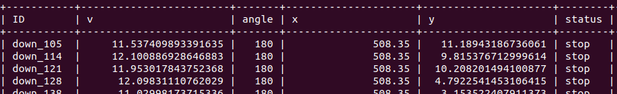
SUMO and database
SUMO - (1 step)
vehicle information
(traci)
update to database
(Mysql)

