Slide 1
Progress Report
Liu Weihao
12 Jan, 2022

Slide 2
Task Offloading
  Based on ray
  UDP + TCP
Blockchain - based on Hyperledger Fabric
  Key concepts
  Ledger and Block chain

Slide 3
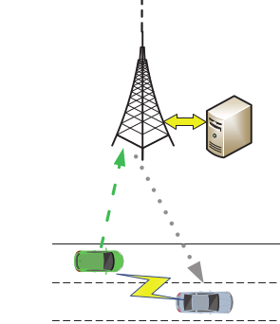
Task offloading
Based on Ray
TV and SV join in same Ray cluster (2-5s)
TV make a request to BS, and BS will send it to the SV(<0.1s, TCP or UDP)
TV transfer task data to SV and get the result (2.5-5s)
SV send the result to BS (<0.1s, TCP or UDP)
Total time>5s >> tau_time
Request
Offloading
Task
Ray cluster

Slide 4
Task Offloading
UDP + HTTP
TV make a request to BS, and BS send it to SV. (<0.1s, UDP)
TV transfer data to SV via HTTP, and get the result. (<0.2s, HTTP)
SV send the complete flag to BS and TV. (<0.1s, UDP)
Total time is about 0.3-0.5s
Request
Offloading
Task
HTTP trans

Slide 5
Task offloading
Data transfer
GCP - NFS server
GCP - MySQL server
Cloud storage - Google / Amazon
database | Read/Write | Connect
NFS | 0.5s / 2s | command line
MySQL | 0.5s / 2s | Python code / command line
Google storage | 8s / 12s | Python code
Amazon S3 | 16s / 20s | Python code

Slide 6
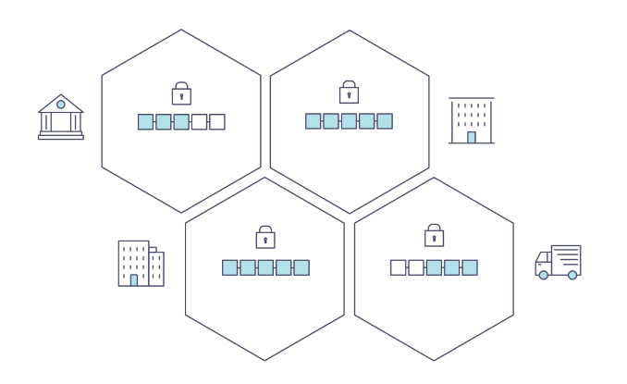
Blockchain
Key concept - Structure
Peer 0
Peer 0
Peer 1
Peer 1
Peer ...
Org 1
Org 3
Peer ...
Peer 0
Peer 0
Peer 1
Peer 1
Peer ...
Org 2
Org 4
Peer ...

Slide 7
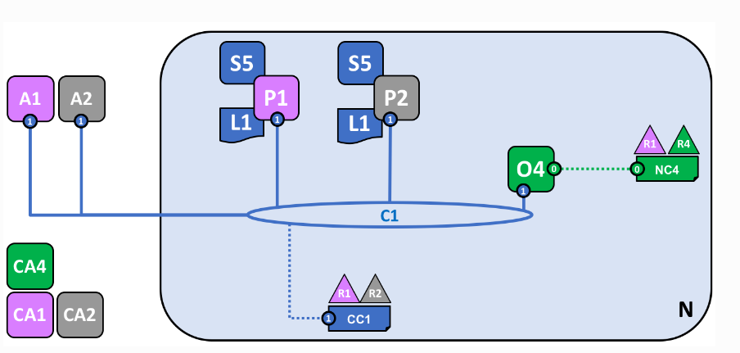
Blockchain
Key concept - Structure
R1
R2
Organization
P1
P2
Peer / Node
L1
Ledger / data
S5
Contract / Chain code
A1
A2
user
O4
Order / Consensus
Node

Slide 8
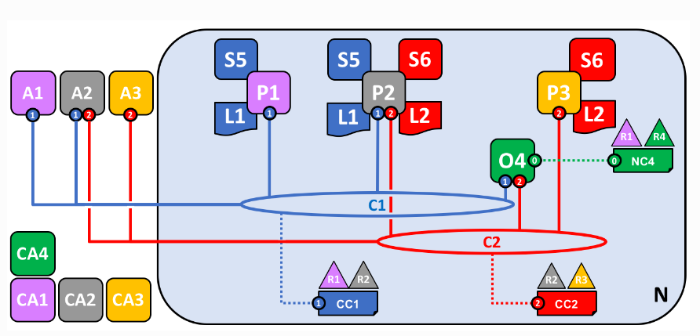
Blockchain
Key concept - Channel

Slide 9
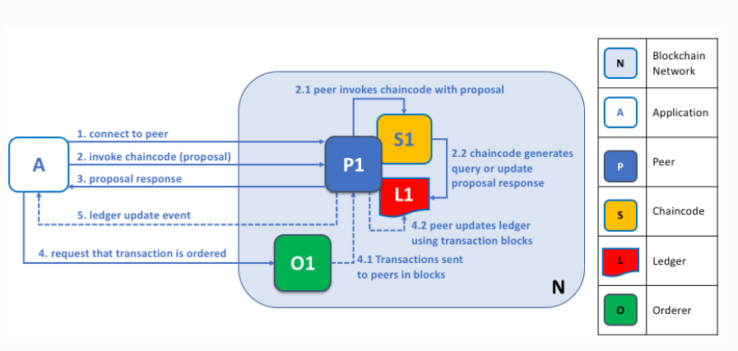
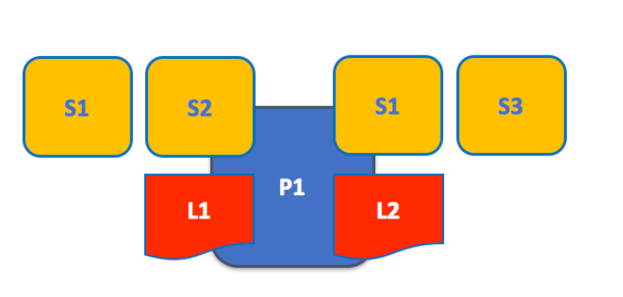
Blockchain
Key concept - Ledger and Contract(Chaincode)
P1 join 2 channel, and has 2 ledgers
Each ledger has two chaincode

Slide 10
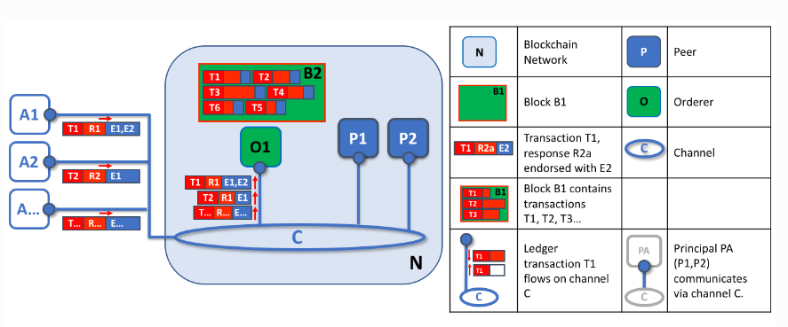
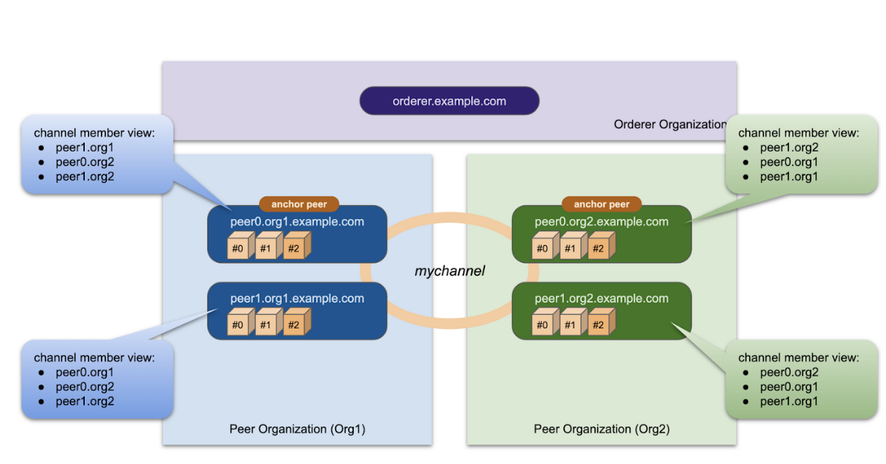
Blockchain
Key concept - Order node and Anchor node

Slide 11
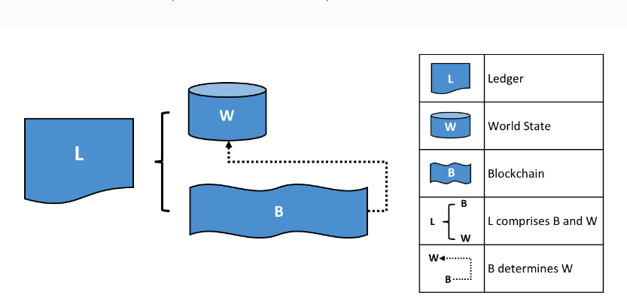
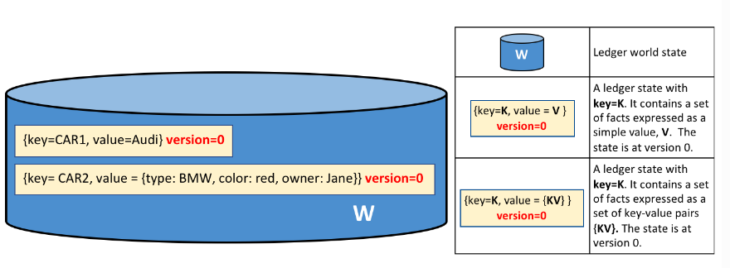
Blockchain
Ledger and Blockchain

Slide 12
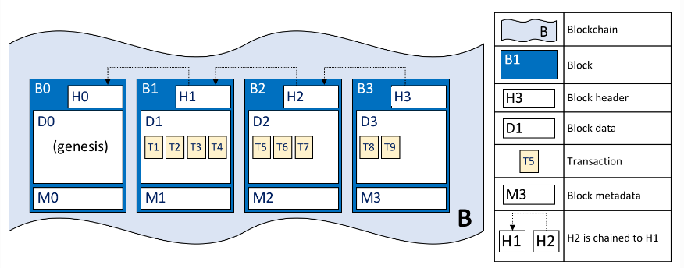
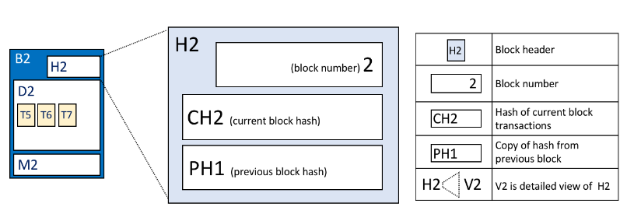
Blockchain
Ledger and Block chain

Slide 13
THE END

