Slide 1
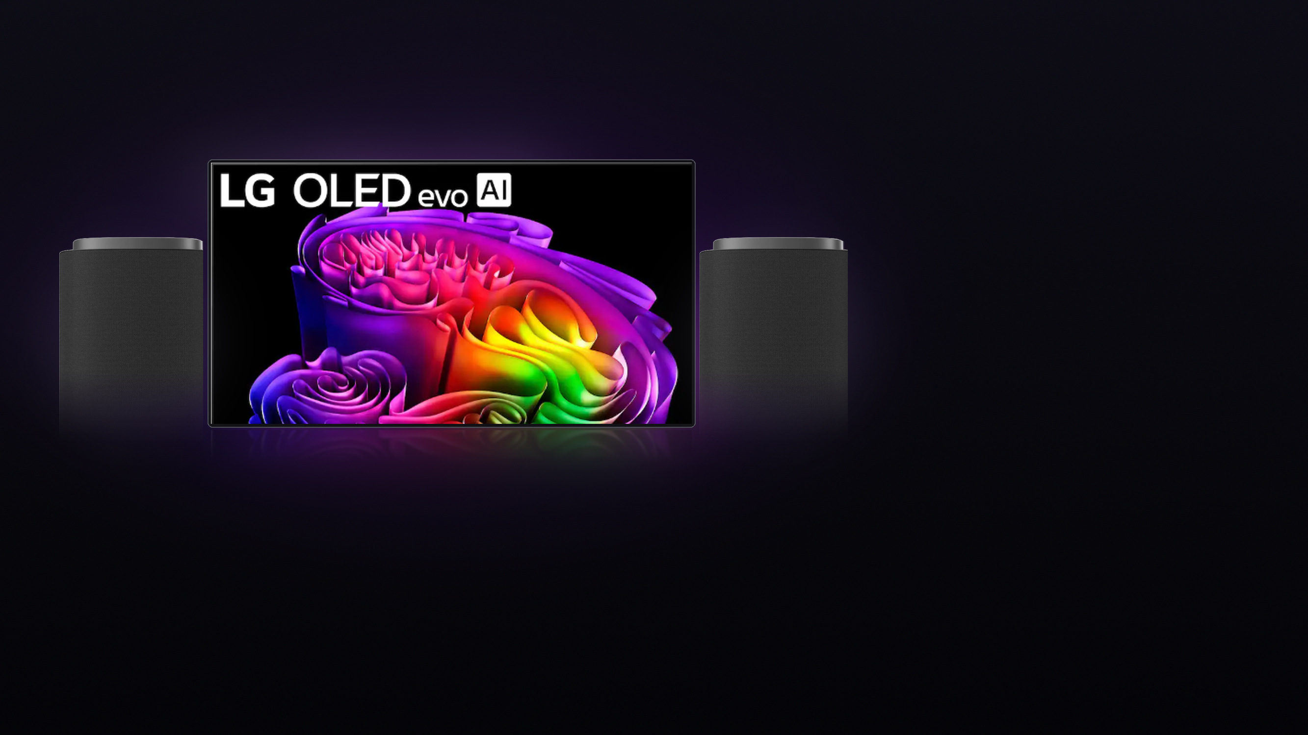


THIS WEEK'S FEATURED BUNDLE
LG HOME THEATER BUNDLE
BUNDLE WITH TOTAL
83-inch G6 OLED + two M7 wireless speakers
$6,099.97
1 M7 is FREE
with 83" G6 purchase
Before tax. Includes first year.
TV + 2 M7 speakers
$5,899.98
Total membership
$199.99
$199.99/year. Auto-renews until canceled.
$1,399.99 combined savings
$1,000 TV + free M7 value
OLED TV
M7 SPEAKER DEAL
24-MONTH FINANCING ESTIMATE*
83" LG G6 OLED evo AI
2x LG M7 speakers
$254.17 /mo.*
4K Smart TV with Gallery Design + Flush Wall Mount (2026)
+
Wi-Fi + Dolby Atmos wireless spatial speakers
=
$5,499.99
SAVE $1,000
$399.99
PAY FOR 1
If the full $6,099.97 purchase qualifies.
With My Best Buy® Credit Card.
Comp. value $6,499.99
2 speakers total
Prices and offers subject to change. Confirm current cart pricing, free M7 promotional eligibility, membership, financing eligibility and installation eligibility before presenting.
*Illustration: $6,099.97 ÷ 24 ≈ $254.17. Full-purchase eligibility and credit approval required. No interest if paid in full within 24 months.
Otherwise, interest is charged from the purchase date. Minimum monthly payments required. †Confirm 83" G6 eligibility, installation scope and current offer dates.
Notes:
LG / Best Buy featured bundle: 83" LG G6 OLED evo AI + 2x LG M7 wireless speakers.
MATH CHECK
- TV $5,499.99 + M7 pair $399.99 (pay for 1) = $5,899.98
- + first-year My Best Buy Total $199.99 = $6,099.97 before tax
- $6,099.97 / 24 = $254.17/mo. financing illustration
- Savings: $1,000 off TV + $399.99 free M7 = $1,399.99
Confirm current cart pricing, free M7 eligibility, membership, financing eligibility and installation scope before presenting.

