Slide 1

FREE DEFENSIVE SECURITY GUIDE
Blue Team &
SOC Analyst
Roadmap 2026
From logs to detection, investigation, response, and Purple Team validation.
A practical, tool-aware roadmap for people starting defensive cybersecurity — without requiring an expensive lab or a university program.
Community Learning Project • Updated October 2026

Slide 2
What Blue Team work actually is
Defensive security is not “watching alerts.” It is building reliable evidence, judgment, and response.
THE MISSION
SEE
DECIDE
ACT
IMPROVE
Collect the right telemetry from endpoints, identity, network, cloud, applications, and security controls.
Turn signals into hypotheses. Validate what happened, who was affected, and how confident you are.
Escalate, contain, preserve evidence, eradicate, recover, and communicate without making the incident worse.
Write detections, tune noisy rules, close visibility gaps, update playbooks, and retest against realistic behavior.
Core mindset
Logs are evidence. Alerts are hypotheses. Your job is to investigate until the story makes sense.

Slide 3
How to use this roadmap
Do not memorize a tool list. Build one investigation skill at a time, then prove it with evidence.
LEARNING LOOP
1
LEARN
2
INSTRUMENT
3
INVESTIGATE
Understand the protocol, operating system, identity flow, or attack behavior.
Generate or collect telemetry that would reveal the behavior.
Search, pivot, correlate, build a timeline, and test competing explanations.
4
EXPLAIN
5
IMPROVE
6
RETEST
Write what happened in plain language with evidence and confidence.
Create or tune a detection, playbook, query, or hardening action.
Reproduce the behavior and verify that the defense now works.
Rule of thumb: every study session should answer one question better than you could yesterday.

Slide 4
The 12–18 month progression
Move in layers. Foundations first; specialization after you can reliably investigate evidence.
ROADMAP
01
02
03
04
05
06
07
08
FOUNDATIONS
LOGS
SIEM
NETWORK
DETECTION
IR / DFIR
HUNTING
PURPLE
Networking • Linux • Windows • DNS • HTTP/TLS
Windows events • Sysmon • auth • app logs
Search • fields • pivots • dashboards • alert triage
Wireshark • Zeek • Suricata • PCAP reasoning
Sigma • ATT&CK • baselining • tuning
scoping • timelines • artifacts • containment
hypothesis-driven hunts • intel • anomalies
simulate → observe → detect → improve → retest
0–2 mo
2–4 mo
3–6 mo
5–8 mo
7–11 mo
9–13 mo
11–15 mo
12–18 mo

Slide 5
Stage 1 — Foundations defenders actually use
A SOC analyst who understands normal systems behavior can recognize abnormal behavior much faster.
FOUNDATIONS
NETWORKING
OPERATING SYSTEMS
IDENTITY
SCRIPTING
TCP/UDP • subnetting • routing • NAT • DNS • DHCP • ARP • HTTP/HTTPS • TLS • SMB • common ports
Practice: packet captures, DNS lookups, connection states, client/server flows.
Windows Event Viewer • services • registry • scheduled tasks • PowerShell • Linux processes • systemd • journald • permissions
Practice: explain what “normal” looks like before hunting malicious behavior.
Active Directory • local vs domain accounts • Kerberos basics • NTLM • MFA • SSO • tokens • service accounts
Practice: trace an authentication from user to resource.
Python basics • PowerShell • Bash • regex • JSON • CSV • APIs
Goal: automate repetitive analysis, not become a software engineer first.

Slide 6
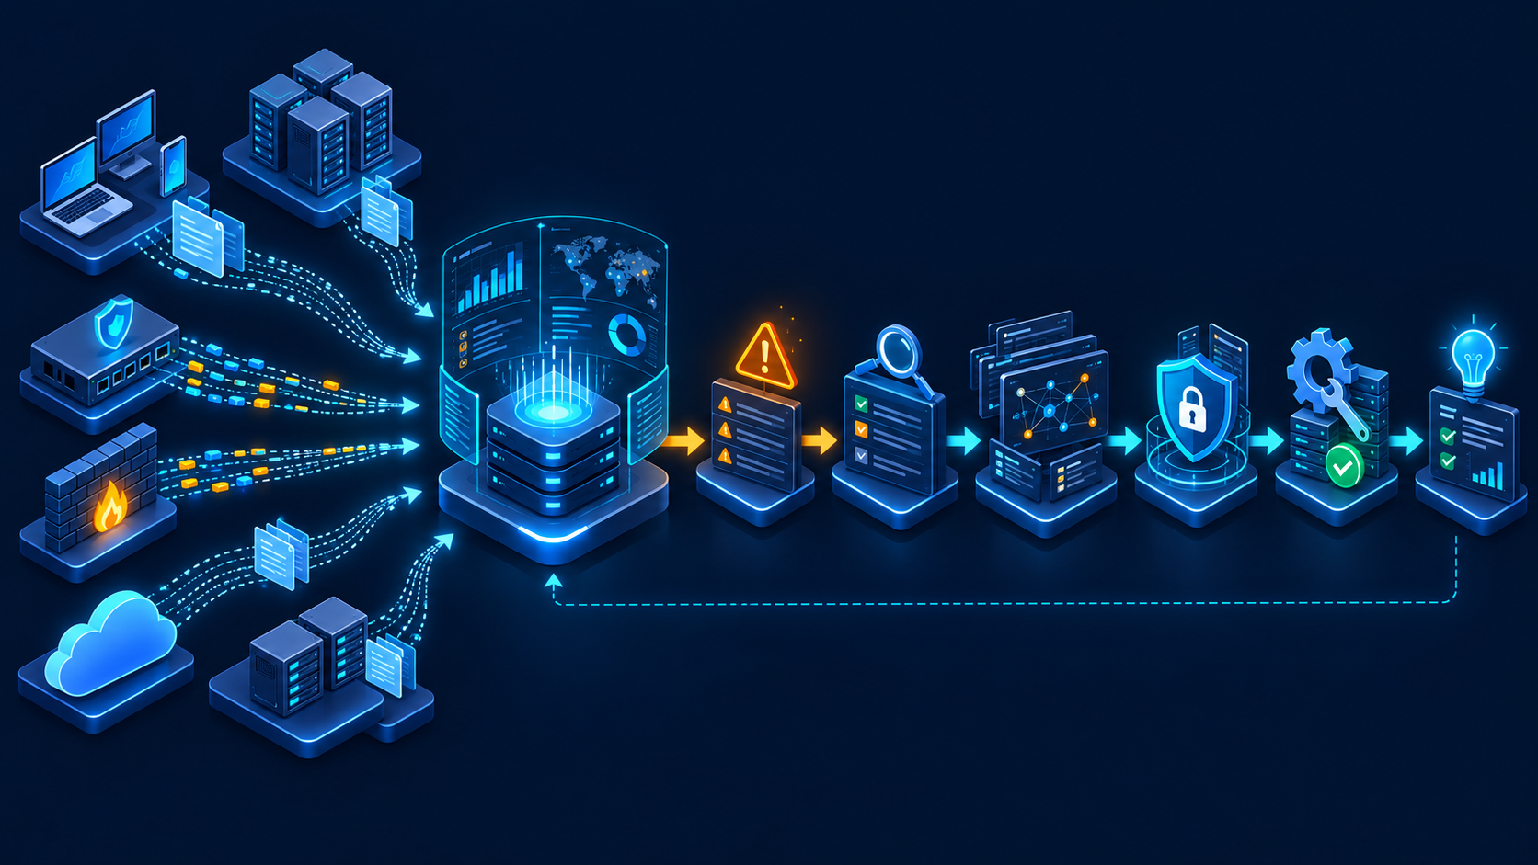
Telemetry before tooling
You cannot detect what you never collected. Learn what each data source can and cannot prove.
VISIBILITY
ENDPOINT
Windows Event Logs • Sysmon • EDR • process • file • registry • PowerShell
IDENTITY
AD/Entra sign-ins • Kerberos/NTLM • MFA • account changes • privilege use
NETWORK
DNS • flow • Zeek metadata • Suricata alerts • proxy • firewall • packet capture
CLOUD / APPS
Cloud audit logs • SaaS auth • web/app logs • database audit • API activity
2026 note: Sysmon is available as a built-in optional feature for Windows 11, in addition to the traditional Sysinternals package.

Slide 7
The SOC alert lifecycle
An alert is the beginning of an investigation—not the conclusion.
WORKFLOW
ALERT
VALIDATE
SCOPE
CORRELATE
DECIDE
IMPROVE
What fired?
What logic produced it?
Is the signal real, benign, expected, or unknown?
Which users, hosts, IPs, files, accounts, or sessions are involved?
Pivot across endpoint, identity, network, and cloud evidence.
Close • monitor • escalate • contain • preserve evidence
Document • tune • add detection • fix visibility • retest
A good Tier 1 analyst does not “solve every incident.” A good analyst gathers enough reliable evidence to make the next decision safe and efficient.

Slide 8
Modern defensive toolkit — organized by question
Tools are useful only when you know what evidence you are trying to obtain.
TOOL STACK
What happened on the endpoint?
What crossed the network?
Windows Event Logs • Sysmon • Velociraptor • osquery • Sysinternals
Wireshark • Zeek • Suricata • tcpdump
Where do I search at scale?
How do I express detections?
Wazuh • Security Onion • Elastic/OpenSearch-style SIEM workflows
Sigma • YARA • Suricata rules • native SIEM queries
How do I enrich evidence?
How do I validate defenses?
CyberChef • VirusTotal/public reputation • WHOIS/DNS • threat intel feeds
Atomic Red Team • safe lab simulations • known PCAP/log datasets
Do not install everything at once. Learn one tool deeply enough to answer one class of questions, then expand.

Slide 9
Investigation methodology — stay on one evidence thread
A repeatable method prevents “tool hopping” and makes your conclusions defensible.
DECISION FLOW
1
What triggered?
2
Can I validate the event?
3
Is it normal here?
Read the alert logic. Identify the entity, time window, and expected behavior.
Find the raw log / packet / process / authentication event behind the alert.
Compare with baseline, user role, parent process, destination, frequency, and business context.
4
What else is connected?
5
What is the impact?
6
What is the safest next action?
Pivot by user, host, IP, hash, process tree, session, time, and identity changes.
Decide whether evidence supports benign activity, suspicious behavior, or confirmed malicious activity.
Close, monitor, escalate, contain, preserve, or request additional telemetry.
Evidence hierarchy: raw telemetry > correlated context > tool verdict > intuition.

Slide 10
A lightweight lab that teaches real SOC skills
Start small. One SIEM, one Windows endpoint, one Linux endpoint, and reproducible test data are enough.
LAB BLUEPRINT
WINDOWS ENDPOINT
NETWORK SENSOR
Event Logs • Sysmon • Wazuh/Elastic agent • PowerShell
Zeek • Suricata • packet capture / imported PCAP
WAZUH OR
SECURITY ONION
Search • alerts • dashboards • cases
LINUX ENDPOINT
VALIDATION SOURCE
auth logs • journald • process/network telemetry • agent
Atomic Red Team • benign admin actions • curated PCAP/log datasets
Budget rule: if setup consumes the study session, simplify the lab.

Slide 11
Detection engineering — from behavior to reliable signal
A detection should explain what behavior matters, what telemetry is required, and why the signal deserves attention.
DETECTION
BEHAVIOR
TELEMETRY
LOGIC
TEST
TUNE
Choose a meaningful adversary or abuse behavior.
Identify the logs and fields that can observe it.
Write a query / Sigma rule / analytic that finds the pattern.
Generate known activity and confirm the signal appears.
Reduce false positives without hiding the behavior.
1
2
3
4
5
MITRE ATT&CK v18 moved toward Detection Strategies and Analytics: think in behaviors + evidence requirements, not just “one rule per technique.”
Sigma remains a portable, YAML-based format for expressing log detections across SIEM ecosystems.

Slide 12
Incident response + DFIR — investigate without destroying the story
Containment matters, but evidence, scope, communication, and recovery matter too.
IR / DFIR
DETECT
Evidence disciplines worth learning
Confirm the incident and establish confidence.
Timeline thinking: what happened before, during, and after the alert.
Volatile vs persistent evidence: know what disappears when a host changes state.
Chain of custody and documentation for cases that may become legal, HR, or compliance matters.
Endpoint triage: processes, autoruns, services, tasks, registry, browser/artifact history, network connections.
Network forensics: DNS, sessions, JA4/TLS metadata where available, HTTP, SMB, packet evidence.
Recovery validation: the incident is not over just because the process was killed.
RESPOND
Scope, prioritize, contain, coordinate, and preserve what matters.
RECOVER
Restore safely, monitor for recurrence, and validate normal operations.
NIST SP 800-61 Rev. 3 (2025) aligns incident response with CSF 2.0 and emphasizes Detect → Respond → Recover with continuous improvement.

Slide 13
Threat hunting + Purple Team validation
Hunting asks a question. Purple teaming tests whether your defenses can answer it.
HUNT → TEST → IMPROVE
THREAT HUNTING
PURPLE VALIDATION
IMPROVEMENT LOOP
Start with a hypothesis, not a dashboard.
Example pattern:
“Could a compromised user execute unusual remote admin activity without generating a useful signal?”
Hunt across authentication, process, network, and remote-management telemetry.
Reproduce a safe, authorized behavior in the lab.
Use Atomic Red Team or controlled manual actions. Observe what telemetry appears, which detections fire, and what the analyst can actually conclude.
Add missing telemetry. Write or tune detections. Update playbooks. Improve enrichment. Re-run the same test.
Success is not “we generated an alert.” Success is “an analyst can detect, investigate, and respond correctly.”

Slide 14
Free and genuinely useful places to learn
Prefer resources that make you inspect evidence, explain conclusions, or build detections.
HANDS-ON LEARNING
MITRE ATT&CK
Behavior mapping, Detection Strategies, Analytics, technique context
Sigma HQ
Portable detection rules, rule structure, log-source thinking
attack.mitre.org
sigmahq.io
Security Onion Docs
Free defender platform; Zeek, Suricata, endpoint visibility, hunt/cases
Wazuh Docs
Free/open SIEM + XDR platform; endpoint telemetry and threat hunting
docs.securityonion.net
documentation.wazuh.com
LetsDefend — free content
SOC Fundamentals, Windows Fundamentals, SIEM 101 + selected free practice
CyberDefenders
Blue-team CTF challenges covering network forensics, malware, cloud, logs
letsdefend.io
cyberdefenders.org
Malware-Traffic-Analysis.net
Current PCAP exercises with realistic malware/network traffic
CISA / NIST
Incident-response guidance, no-cost training resources, playbooks, standards
www.malware-traffic-analysis.net
www.cisa.gov/ | https://csrc.nist.gov

Slide 15
A practical 90-day starter sprint
Designed for people with limited time: learn, investigate, document, repeat.
90 DAYS
DAYS 1–30
DAYS 31–60
DAYS 61–90
FOUNDATIONS + LOGS
SIEM + INVESTIGATION
DETECTION + PORTFOLIO
Networking refresh
Windows Event Viewer
Sysmon / process trees
Linux auth + journald
Wireshark basics
Write 4 mini incident notes
Deploy Wazuh or use a hosted/free lab
Onboard Windows + Linux telemetry
Practice searches and pivots
Investigate 6 alerts / datasets
Start MITRE ATT&CK mapping
Build one timeline from evidence
Write 3 Sigma rules
Run safe validation tests
Analyze 2 PCAP exercises
Tune one noisy detection
Create one incident report
Publish sanitized findings to GitHub
After 90 days you should have evidence of skill: queries, notes, timelines, detections, PCAP analysis, and a small lab—not just completed videos.

Slide 16
Build proof, not just badges
A hiring manager cannot see what you learned in your head. Make the work visible.
PORTFOLIO
INVESTIGATION WRITE-UP
DETECTION PROJECT
PCAP CASE
Alert summary • evidence • timeline • pivots • conclusion • confidence
Hypothesis • required telemetry • Sigma/query • test data • false-positive notes
Traffic summary • DNS/HTTP/TLS observations • IOCs • timeline • ATT&CK mapping
SOC LAB
INCIDENT REPORT
PURPLE TEST
Architecture diagram • log sources • screenshots • sample searches • lessons learned
Executive summary • technical findings • scope • impact • actions • recommendations
Behavior simulated • expected telemetry • observed telemetry • detection gap • retest result
Use GitHub for the permanent technical record. Use LinkedIn to explain what you learned and invite professional feedback.
Honesty beats inflated titles: “Here is the evidence I analyzed, how I reasoned through it, what I got wrong, and what I improved.”

Slide 17
The defender’s operating principle
Understand normal. Collect evidence. Investigate deliberately. Improve the system.
See → Decide → Act → Improve → Retest
Primary references used for this 2026 edition
PROJECT ACKNOWLEDGMENT
• MITRE ATT&CK — Detection Strategies / Analytics
This educational roadmap was created by Sebastian Romero with the assistance of ChatGPT by OpenAI.
• Sigma HQ — detection format and rule docs
• Microsoft Sysmon documentation
• Security Onion documentation
• Wazuh documentation
Built to help beginners find a structured path into defensive cybersecurity and share practical knowledge freely with the community.
• NIST SP 800-61 Rev. 3 — Incident Response
• Zeek / Suricata / Velociraptor / osquery official docs
Use it. Question it. Improve it. Share what you learn.

