Slide 1

MORINGA DATA SCIENCE PREP W5 GROUP PROJECT TEAM_4 PRESENTATION

Slide 2


DATA REPORT ON CRIME STATISTICS IN SOUTH AFRICA
INTRODUCTION
The South African Police Service (SAPS) has accepted a new and challenging objective of ensuring that its crime statistics are in line with international best practice. This will be achieved through a Memorandum of Understanding with Statistics South Africa (Stats SA), aimed at further enhancing the quality and integrity of the South African crime statistics.

Slide 3
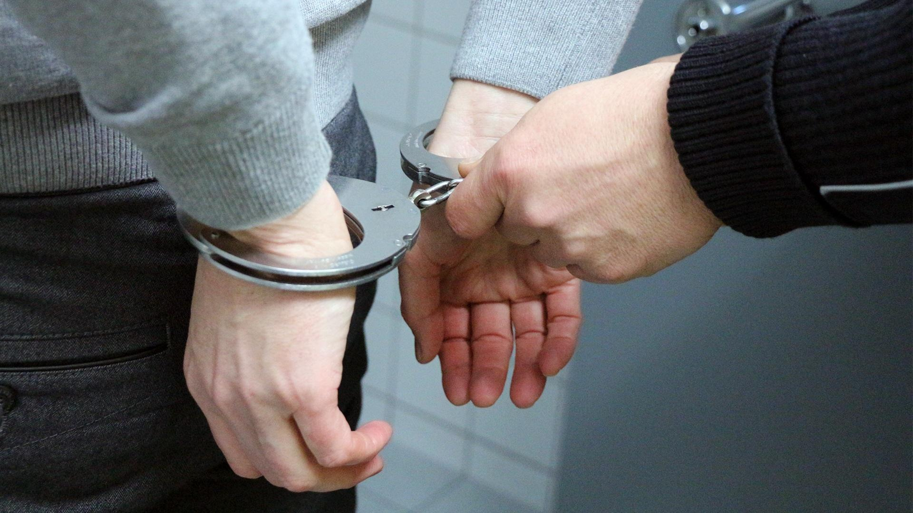
DATA REPORT ON CRIME STATISTICS IN SOUTH AFRICA
A brief history crime in South Africa
2005
2007
2009
2011
2013
2016

Slide 4


CRIMES RANKED WITH POPULARITY
1
2
3
4
5
6
All thefts not mentioned elsewhere
Burglary at residential places
Assault with the intent to inflict grievous bodily harm
Common assault
Malicious damage to property
Robbery at non-residential premises

Slide 5






TOP 5 YEARS RANKED ACCORDING TO CRIME CASES
1
2014-2015
2
2005-2006
4
3
2
2015-2016
2012-2013
2006-2007
5

Slide 6
TOP FIVE PROVINCES WITH HIGH CRIME RATES
1
2
3
4
5
2
GUATENG
WEST CAPE
KWAZULU
EASTERN CAPE
FREE STATE

Slide 7


Visual Charts

Slide 8
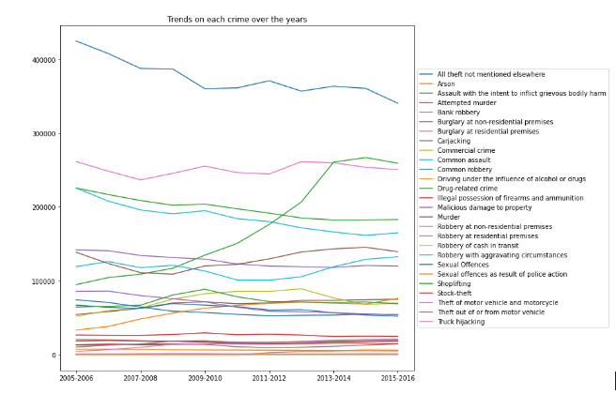
Trends on each crime over the years
Crime cases
Years

Slide 9
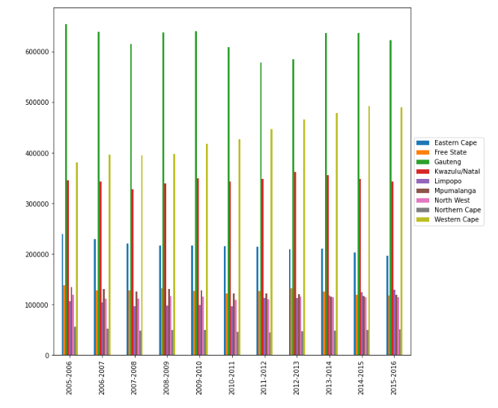
This graph represents the province with the number of crime
Crime cases
Years

Slide 10
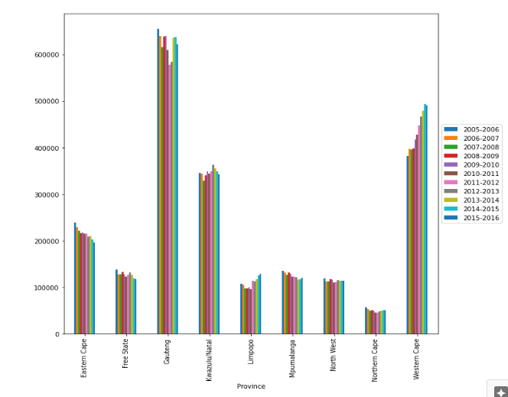
Crime-Infestation In Provinces
Crime cases

Slide 11
RECOMMENDATIONS
Following our analysis, the following conclusions were drawn from the provided data on the crime rate reported in South Africa
The year 2014-2015 registered the highest number of reported crimes with a total of 2,206,506
The most crime-infested province in the whole of South Africa is Gauteng with 2,784,982.
Mitchells Plain Police station in Gauteng recorded the highest number of reported crimes.

Slide 12
EVALUATION
From the data findings, it would be important to focus on any interventions in the province of Gauteng to ensure that the rate of crime is managed well.
It would also be important to capacity build Mitchell’s plain police station to enable it to be in a better position to handle and cope with the high rate of crimes being reported there.

