Slide 1

Land-secured financing of development impact fees for small residential subdivisions in California
Stakeholder overview | Pre-launch draft v1.0 | July 2026 | Prepared for Dennis Lanni, HGF Management Company
Not an offer of financing, legal advice, or investment advice. Subject to issuer approval and counsel review.
Notes:
Frame: proven 1982 mechanism, new operating model for the small end. Every number in this deck has a cited source in the Claims Register.

Slide 2
THE PROBLEM
The fees are due before the first home sells
Impact fees fund the roads, parks, and utility capacity new residents need. Proposition 13 pushed cities toward charging new construction directly, and the Mitigation Fee Act governs how. The amounts are large, and they land at the building permit, months or years before revenue.
$23,455
$150,000+
$19,806
Average California impact fee per single-family home (2015), nearly 3x the national average. Terner Center, UC Berkeley
Total development charges per unit in some California cities, before utility fees. Terner Center / HCD study
Average impact fee per unit on 2020-2023 affordable projects; 134 projects paid over $30,000 per unit. Terner Center, 2026
A ten-home project can owe several hundred thousand dollars at the permit counter.
INSITE (TM) Development Impact Fee Financing Program | Pre-launch | HGF Management Company | July 2026
2
Notes:
All three figures verified to Terner Center publications; URLs in the Claims Register.

Slide 3
WHO IT HITS
Small builders pay the most for money
Projects of 2 to 50 lots rarely carry institutional credit lines; the fee bill comes from working capital or private lenders
Published 2025-2026 guides price private real estate money at roughly 9.5 to 15 percent, with land at the expensive end
Cash paid at the counter is cash not building homes; expensive money shrinks what small builders can deliver
Large master-planned communities solved this decades ago with land-secured districts; small projects were priced out of the tool
The gap is not legal capability. It is transaction economics and calendar cadence, and that is an operating-model problem.
INSITE (TM) Development Impact Fee Financing Program | Pre-launch | HGF Management Company | July 2026
3
Notes:
Positioning: never claim no mechanism exists. The claim is that existing programs are built and priced for larger projects.

Slide 4
WHY NOW
The state is mass-producing exactly these projects
Senate Bill 684 (effective July 2024): subdivisions of 10 or fewer lots on multifamily-zoned sites must be approved ministerially, no hearings, no discretionary review, no environmental review, on a 60-day clock
Senate Bill 1123 (effective July 2025): the same fast lane extends to vacant single-family-zoned lots up to 1.5 acres
Cities including Los Angeles have published implementation checklists; the pipeline grows by statute
Every one of these projects meets the fee counter at the building permit
10
lots or fewer,
approved ministerially
INSITE (TM) Development Impact Fee Financing Program | Pre-launch | HGF Management Company | July 2026
4
Notes:
Sources: Allen Matkins analysis, ABAG technical assistance page, LA City Planning memo.

Slide 5
THE MECHANISM
A 44-year-old law, used as designed
The Mello-Roos Community Facilities Act of 1982 (Government Code 53311 and following) lets a public agency levy a voluntary special tax inside a Community Facilities District
On undeveloped land with fewer than 12 registered voters, the landowners are the electors: the developer approves the tax on their own property
The approved tax becomes a recorded lien, billed and collected with the ordinary property tax bill, with a foreclosure remedy behind it
Districts may finance development impact fees themselves, may cover scattered parcels, and may designate a future annexation area new projects join later
Statutory protections: an occupied home's tax cannot rise more than 10 percent because a neighbor went delinquent (53321(d)); the tax can never be based on property value; every owner holds a defined prepayment right
INSITE (TM) Development Impact Fee Financing Program | Pre-launch | HGF Management Company | July 2026
5
Notes:
Authority chain: CDIAC Debt Financing Guide plus statute sections; PACE is an operating analogy only, never authority.

Slide 6
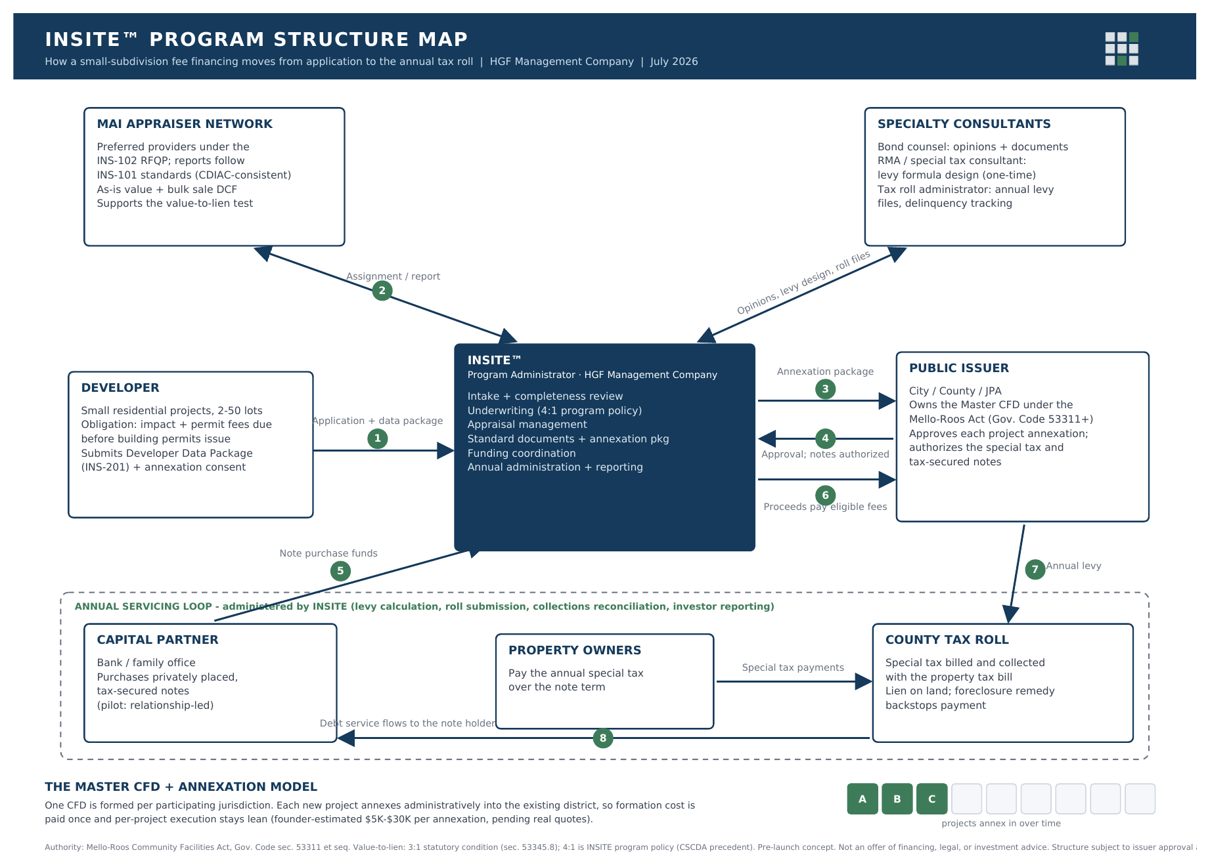
THE ARCHITECTURE
One district per city. One signature per project.
Numbered flows 1-8: application, appraisal, annexation package, approval, funding, fee payment, annual levy, debt service.
INSITE (TM) Development Impact Fee Financing Program | Pre-launch | HGF Management Company | July 2026
6
Notes:
Walk the 8 flows left to right; emphasize the annual servicing loop is INSITE's recurring role and revenue.

Slide 7
ANNEXATION MODEL
Form once. Annex forever. Zones stay separate.
Projects annex into the existing district over time; formation cost is paid once per jurisdiction.
A Master District is formed with a recorded Future Annexation Area on the boundary map
Each project joins by the landowner's one-page Unanimous Approval, acting as the election; no hearing, no ballot
Each project becomes its own tax zone with its own maximum tax table and its own note; a zone's taxes repay only that zone's debt (53339.3(d))
The pattern operates today in Escondido, Chula Vista, and Roseville; INSITE standardizes and administers it for the small end
INSITE (TM) Development Impact Fee Financing Program | Pre-launch | HGF Management Company | July 2026
7
Notes:
Zone isolation is the purchaser's key comfort: no cross-collateralization between projects.

Slide 8
ROLES
The issuer owns every approval. INSITE does the work.
Party | Role
Public issuer (city, county, or joint powers authority) | Owns the Master District, adopts policies, approves each annexation, authorizes the special tax and notes
INSITE (HGF Management Company) | Program administrator: intake, underwriting, appraisal management, documents and zone exhibits, funding coordination, annual administration and reporting
Independent MAI appraiser panel | Values every project to state (CDIAC) standards; supports the value finding; never an INSITE employee
Bond counsel, special tax consultant, tax roll administrator | Selection in progress; opinions, tax formula template, annual levy files. Contracted first per the sourcing plan
Capital partner | Purchases each privately placed, tax-secured note
County tax collector and property owners | Bills with the property tax; owners pay the disclosed, prepayable special tax over the note term
INSITE (TM) Development Impact Fee Financing Program | Pre-launch | HGF Management Company | July 2026
8
Notes:
Credibility answer lives here: every scrutinized seat is filled by a name the audience already knows.

Slide 9
UNDERWRITING
Stricter than the statute, by policy
Value-to-lien
Appraisals by independent MAI professionals under the State Treasurer (CDIAC) standards the statute requires
Total tax burden benchmarked at 2 percent of expected home value, per the adopted policy of the state's largest issuer; each city's own cap confirmed before sizing
Illustrative sizing: 10 lots financing $250,000 over 30 years near 6 percent works out to roughly $2,300 per home per year, including administration and a 10 percent coverage cushion (arithmetic, not a quote)
Inputs arrive on the standard data package (INS-201); appraisal scope per the program manual (INS-101)
3 : 1 statute (53345.8)
4 : 1 INSITE policy (CSCDA precedent)
INSITE (TM) Development Impact Fee Financing Program | Pre-launch | HGF Management Company | July 2026
9
Notes:
If asked why 4:1: it is CSCDA's own adopted standard; conservatism substitutes for tenure.

Slide 10
THE MARKET, ARITHMETIC SHOWN
62,372 units in the target segment last year
California permitted 103,856 housing units in 2025; 62,372 (60.1 percent) were in 1-to-4-unit structures. U.S. Census primary files, recomputed
At an assumed $25,000 of financeable public fees per unit, the measured segment is roughly $1.56 billion per year of fee obligations. The assumption is stated wherever the figure appears
Projects of 5 to 50 units are excluded because public data cannot separate them from large complexes: the estimate is deliberately conservative
INSITE (TM) Development Impact Fee Financing Program | Pre-launch | HGF Management Company | July 2026
10
Notes:
If challenged on the $1.56B: show the two factors and the exclusion; the conservatism is the argument.

Slide 11
COMPETITIVE LANDSCAPE
Not the first. Built for a different customer.
 | SCIP (CSCDA) | BOLD (CMFA) | INSITE (proposed)
Mechanism | 1913/1915 assessments, district option | Mello-Roos districts | Mello-Roos master district + annexation zones
Published scale | Typically from $500,000 in fees; pooled sales about 3x per year | About $550 million, 65+ projects, 12,000+ units since 2020 (about 185 units per project) | 2 to 50 lots; one small note per project, on the project's schedule
Cadence | Pool calendar | Project issuances | Administrative annexation per deal
Segment | Mid to large | Large | Small, purpose-built
Both programs prove the mechanism and the market. The gap is fixed cost per transaction and calendar, which is what the operating model attacks.
INSITE (TM) Development Impact Fee Financing Program | Pre-launch | HGF Management Company | July 2026
11
Notes:
Credit them by name, always. The honesty is the differentiator with sophisticated audiences.

Slide 12
BUSINESS MODEL
An administrator, never a lender
Revenue: transaction fees at each funding, plus annual administration fees for the life of every zone (levy, collections reconciliation, delinquency monitoring, investor reporting)
The Act contemplates it: district administrative expenses, including consultants, are recoverable through the special tax (53317(d))
Sourcing: independence functions (counsel, appraisal) stay outside permanently; the tax roll administrator is contracted first with shadow and transition rights, then brought in-house on defined triggers
The document library is the moat: standard checklist, appraisal manual, tax formula template, annexation package, workbook
Every closed deal pays administration for decades; the annual book compounds
INSITE (TM) Development Impact Fee Financing Program | Pre-launch | HGF Management Company | July 2026
12
Notes:
If asked fee levels: being modeled, not quoted; consultant costs pass through the levy by statute.

Slide 13
PILOT, ROLLOUT, AND WHAT COULD KILL IT
Small first, honest throughout
Pilot and rollout
Risk factors, stated plainly
Pilot: a small finished-lot subdivision in the Sacramento area, financing eligible permit and impact fees; specifics publish when documents are final
Phase by demand: first city direct, neighboring jurisdictions next, all documents issuer-neutral
A joint powers authority is the end state, not the start: formed or joined at roughly the third jurisdiction when defined triggers fire
Per-deal execution cost is a founder estimate ($5,000 to $30,000) until real quotes exist
No purchaser committed; small-note appetite is what the pilot must prove
City adoption pace; six-plus months to form each district before any JPA exists
Delinquency and foreclosure timelines; trademark clearance pending; school fees excluded at launch
Incumbents could move down-market
INSITE (TM) Development Impact Fee Financing Program | Pre-launch | HGF Management Company | July 2026
13
Notes:
The risk slide is the credibility slide: volunteer the failure modes before anyone hunts for them.

Slide 14
Status and asks
Proven today
Pending, and asked of this room
The legal mechanism and live annexation precedents
Market arithmetic from primary Census data
A verified document library: whitepaper, claims register with source URLs, appraisal manual and RFQP, data package checklist, structure map, strategy memos, brand system, website with calculator
Underwriting policy stricter than statute, with issuer precedent
Select bond counsel, the special tax consultant, and the tax roll administrator (criteria prepared)
A briefing with the pilot city's finance and community development staff
Capital diligence review of the package, toward a term sheet
Trademark clearance and the public-name decision before anything external
INSITE (TM) is a pre-launch program concept administered by HGF Management Company. Not an offer of financing, legal advice, or investment advice. Not an offer to sell, or a solicitation of an offer to buy, any security. Subject to issuer approval and counsel review.
Notes:
Close on the asks; the package hands over the evidence.

