Slide 1




















Slide 3














Device
Shop
Merchant Server
Merchant Frontend
SDK
Funds transfer
User
Password
PS-App
PS-Server

Slide 4


Merchant Application
Malicious Application
Payment Application
……amount=xxxx&description=xxxx&subject=xxxx
S1
Send payment request
S2
S3
Create order
S4
Order parameters
……amount=xxxx&description=xxxx&subject=xxxx
S5
Tampered request

Slide 5
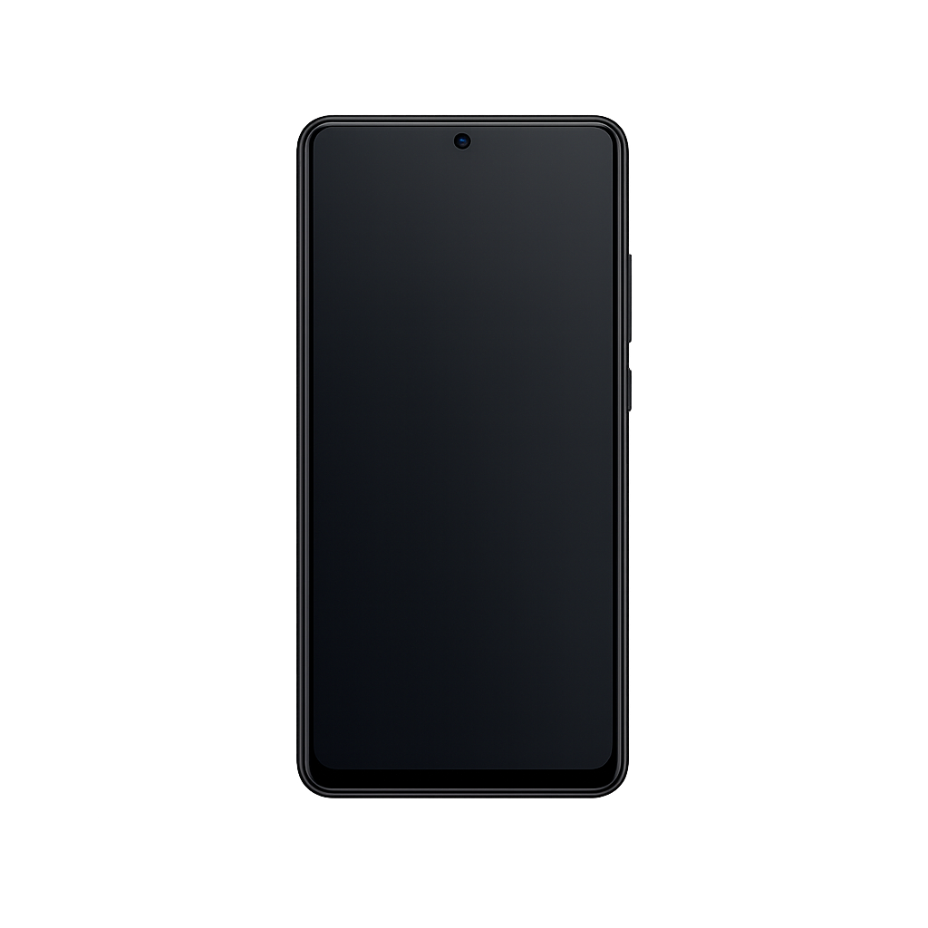
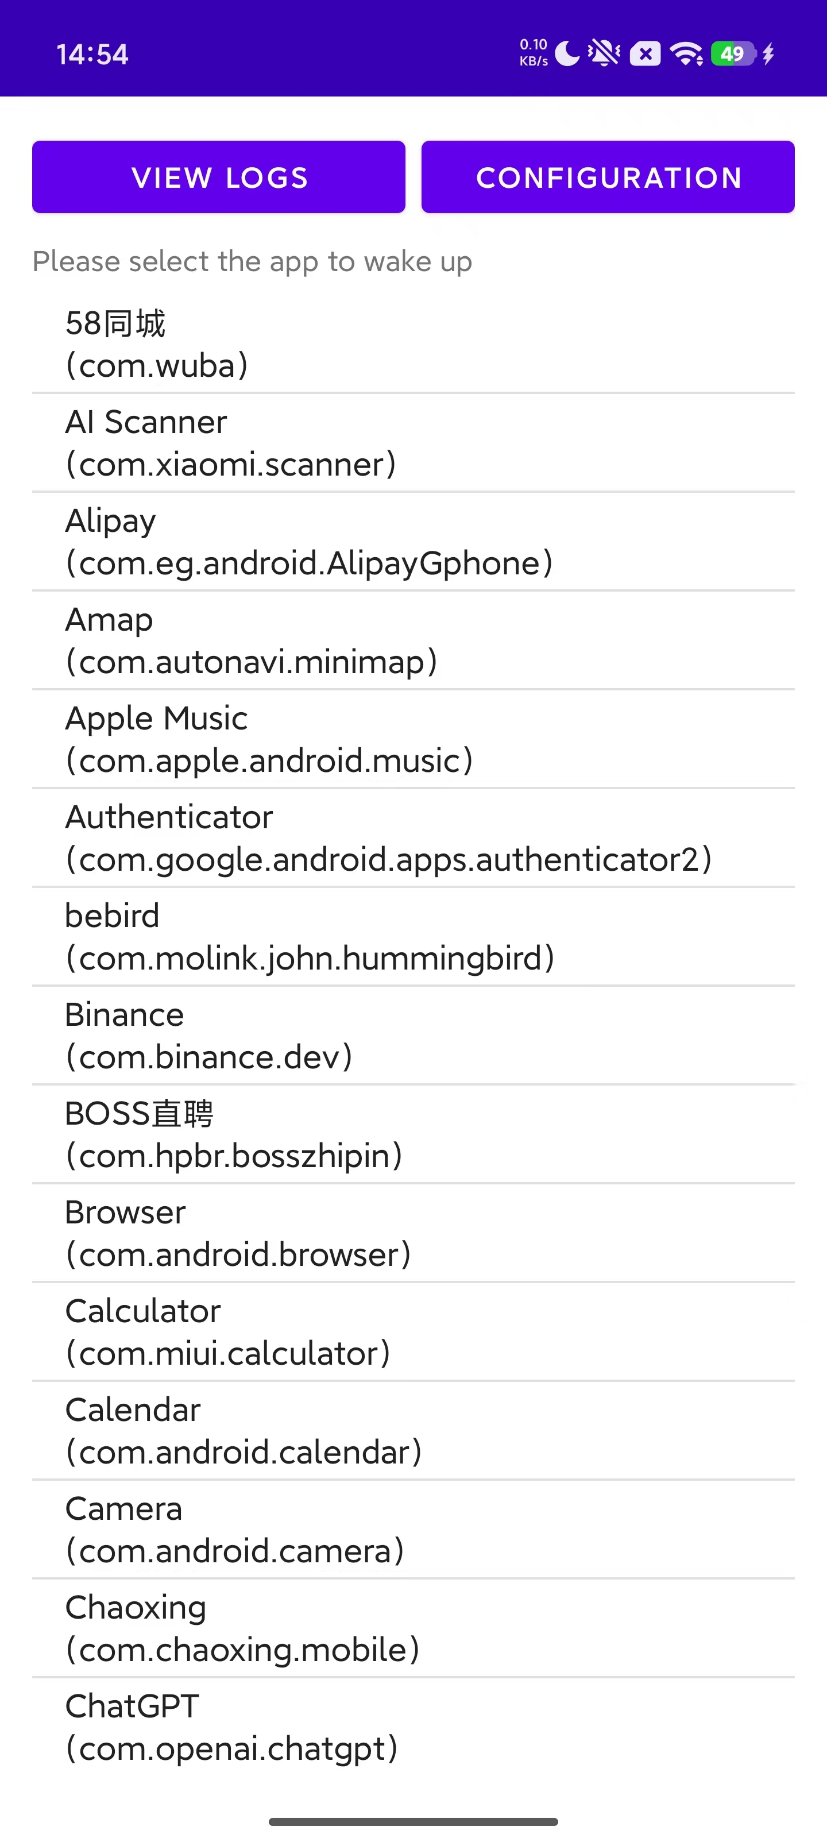
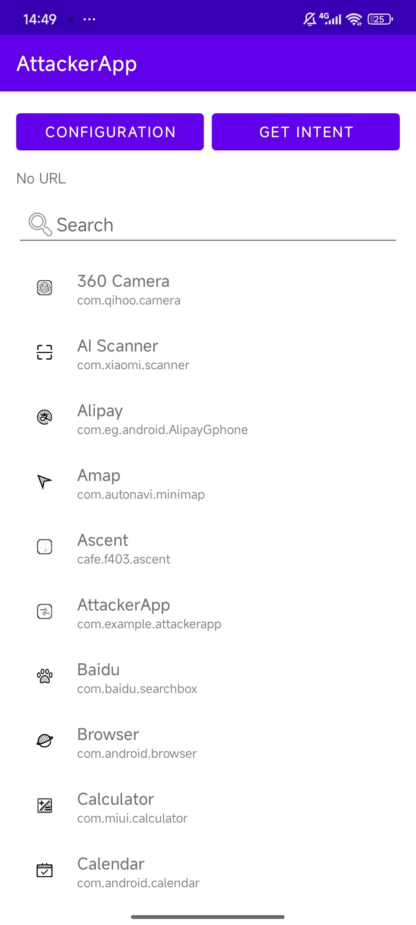

Slide 7


