Slide 1
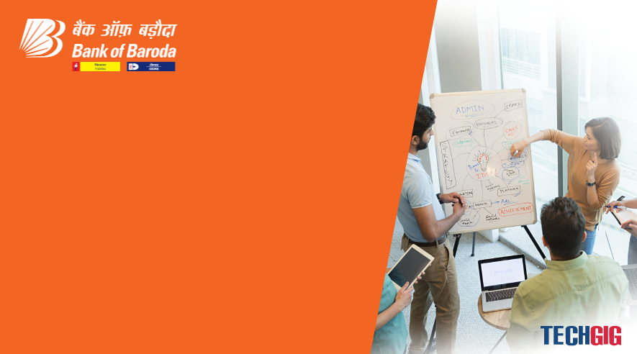
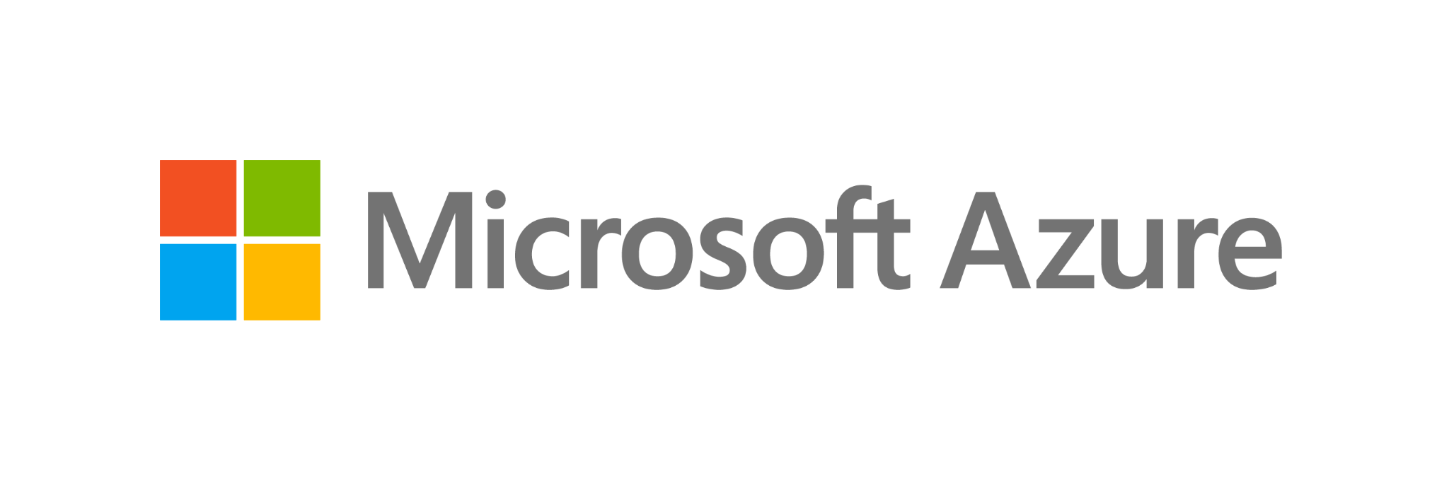
Technology Partner
Bank of Baroda Hackathon - 2022
Your Team Name :
cairo
Cairo team is azure solving team with a niche for programming
Your team bio :
Date :
23-august -2022

Slide 2
Problem Statement?
Why did you decide to solve this Problem statement?
In the complex customer authentication methods there is a need to balance effort for authenticating customer with impact on overall customers transaction experience . Electronic authentication methods include : passwords, KBA , Site keys, security tokens , online key , biometrics . Biometric authentication uses one or more of a person’s physical attributes to validate the
person’s identity. The controlled and validated enrollment of the individual and that individual’s biometrics is absolutely essential. Biometric identification systems can be divided into two types: positive identification and
negative identification. The positive identification system verifies that the biometrics are from an
individual known to the system, preventing multiple users of a single identity. An example of this
positive identification system would be a biometric fingerprint system
The fingerprint template captured at enrollment may be stored in a central database or may reside as a mathematical value on the card. In the central database configuration, the reader must have a connection to the database to match the “live” fingerprint template with the one in the database. But if the enrolled fingerprint template value is stored on the card, there is no need for online access. In this case, there would have to be data storage capability within the reader device to record the entry attempts. Financial institutions use positive identification systems for authenticating users conducting banking transactions.
A negative identification system is intended to prevent an individual from creating multiple identities by ensuring that the person’s biometrics don’t match an identity already enrolled in the system.
Biometric System Elements
Overt vs covert , public vs private , template vs image, open vs closed , supervised vs unsupervised etc . Biometric method characteristics : robust , distinctiveness , accessibility , availability, acceptibility, financial

Slide 3
User Segment & Pain Points
Which user /advertiser segment would be early adopter of your product & why?
I feel that Bank of Baroda or any competent industry or bank would be early adopter of my product in voice biometrics azure applications .
a voice recognition
system provides a way to overtly or covertly authenticate the
identity of an individual. While sometimes the terms are
incorrectly used interchangeably, a speech recognition system is
one that recognizes spoken words and converts them into digital
data for executing programmed instructions. Voice response
units (VRUs) were the most common form of speech recognition
hardware for consumers; the customer speaks a number or a
keyword instead of pressing the number on the phone’s keypad.
Apple’s Siri application is another form of speech recognition
software, and voice-to-text applications are now common on laptops and smartphones. The
technology for speech recognition systems has improved greatly over the last several years and
reached acceptable levels for information applications.
Voice recognition systems operate like other biometric systems. The individual’s identity is
enrolled and authenticated when the person speaks scripted phrases, numbers, or free text. The
resulting audio file is used to create a voice template, or “voiceprint.” The template is then
digitized and stored in a database. When the individual tries to access the system the next time,
the voiceprint of the current connection is compared to the template on file. There remain
concerns about the accuracy rate of this biometric outside of controlled audio environments
since there are a number of ways to disguise or alter one’s real voice with software or hardware
technology. The accuracy can also be affected by the quality of the connection—background
noise, a poor telephone carrier connection, or a low-quality microphone can alter the voice.

Slide 4
Pre-Requisite
What are the alternatives/competitive products for the problem you are solving?
Due to the accuracy limitations, voice recognition systems are often coupled with other
authentication methods. In the case of mobile phones, this could be the phone’s device
information as well as geolocation data. In the case of land lines, subscriber information can be
used to determine if the number being used could reasonably be tied to the legitimate account
holder. As mentioned earlier, USAA announced in January 2015 that it was supporting voice
recognition as a way for members to access their mobile banking application. Call centers at
banks and other financial services companies have used voice recognition systems, usually
covertly, to help authenticate customers.

Slide 5
Azure tools or resources
Azure tools or resources which are likely to be used by you for the prototype, if your idea gets selected
Biometric method | Availability | Distinctiveness | Accessibility | robustness | Acceptability | Financial
Voice recognition | High | Moderate | High | Moderate | Moderate | Moderate -high
Out-of-Band Authentication
A recent development tied to the widespread deployment of mobile phones in increasing the
confidence level that a company is dealing with the authentic customer is the use of out-of-band
authentication (OOBA). In such a scheme, the customer is required to have enrolled an e-mail
address or a telephone number with the company, information that the company has verified in
advance of the transaction. Before a transaction is finalized, the company receiving the
transaction request will send a message to the customer through a communications channel
different from the one used to initiate the transaction. For example, if the customer is conducting
business through an online banking site and wishes to initiate a wire transfer, the bank sends a
code through a text message or e-mail that the customer must enter before the transaction is
finalized.

Slide 6
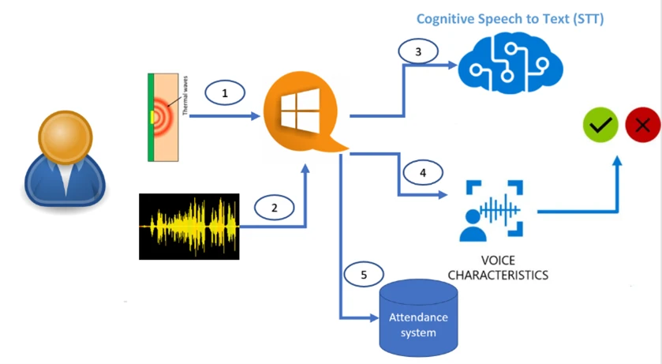
Any Supporting Functional Documents
Present your solution, talk about methodology, architecture & scalability
The company used Speech to Text (STT) service offered by Microsoft Azure Cognitive Services to come up with a speaker verification system instead of speaker identification, which transformed the registration process. The new solution used 140 voice features to match the registered profile and supported multiple voice diction and tones, including those not used during registration.
• The voice-based system made use of employee ID (short unique codes) to reduce validation time to 2 seconds, resulting in quick onboarding of users.
• Use of STT to identify users, voice profile to verify users, thus overcoming limit of 50 users
Step 1: Thermal sensor detects human presence
Step 2: User dictates the employee ID in front of a microphone
Step 3: Audio sample is sent to Speech to Text service to get employee ID
Step 4: App records user’s audio and buffers it
Step 5: Employee voice profile is loaded, and audio sample is sent to “Speech Recognition” service for verification
Step 6: Attendance system is updated upon successful verification

Slide 7
Key Differentiators & Adoption Plan
How is your solution better than alternatives and how do you plan to build adoption?
Benefits of the solution
Alleviated employee privacy concerns around facial recognition systems by giving companies complete control over data stored in a secure system.
Safe and secure employee return to workplace amid rising Covid-19 fears and strict safety protocols.
Accurately identification of speakers, effectively filtering ambient noise. Azure Voice biometric solution has proven to be a secure, robust alternative. Since the solution is scalable, we are focusing on integrating it with other product features and enhancing employee experience.active implementations are:
1. Enhanced interaction experience with mobile applications with functionality like login screen authentication and navigation through voice-based instructions within the Ramco Unify mobile app
2. Ease of interaction with systems, automated through voice with functions like reaching out to customer support, raising a support ticket, etc.
3. Multi-user device authentication, aiding in role-based access for shared systems
4. Improved employee experience through voice-based attendance, leave requests, etc. with a secure voice verification algorithm.

Slide 8
GitHub Repository Link & supporting diagrams, screenshots, if any
How far it can go?
Na

Slide 9
Thank You
Ratul banerjee

