Slide 1

Notes:
Hi everyone. Our project is about simulating random vectors that
follow a multivariate normal distribution with a covariance matrix
we choose. The tool that makes it work is the Cholesky decomposition,
and at the end we will play with different covariance structures.

Slide 2
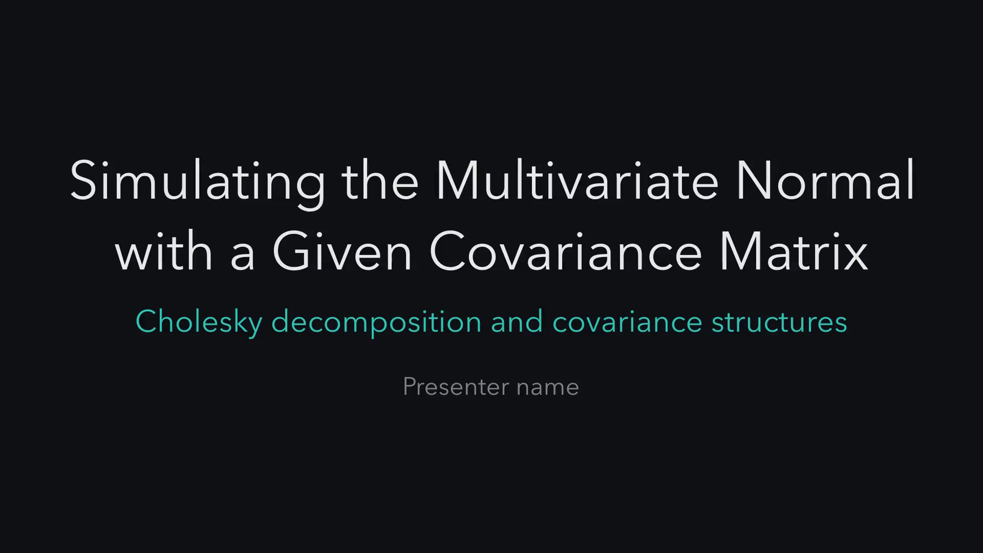
Notes:
Let's start with the problem. We will see where correlated
randomness matters, what a computer can give us, what we actually
want, and why the obvious fixes fail.

Slide 3
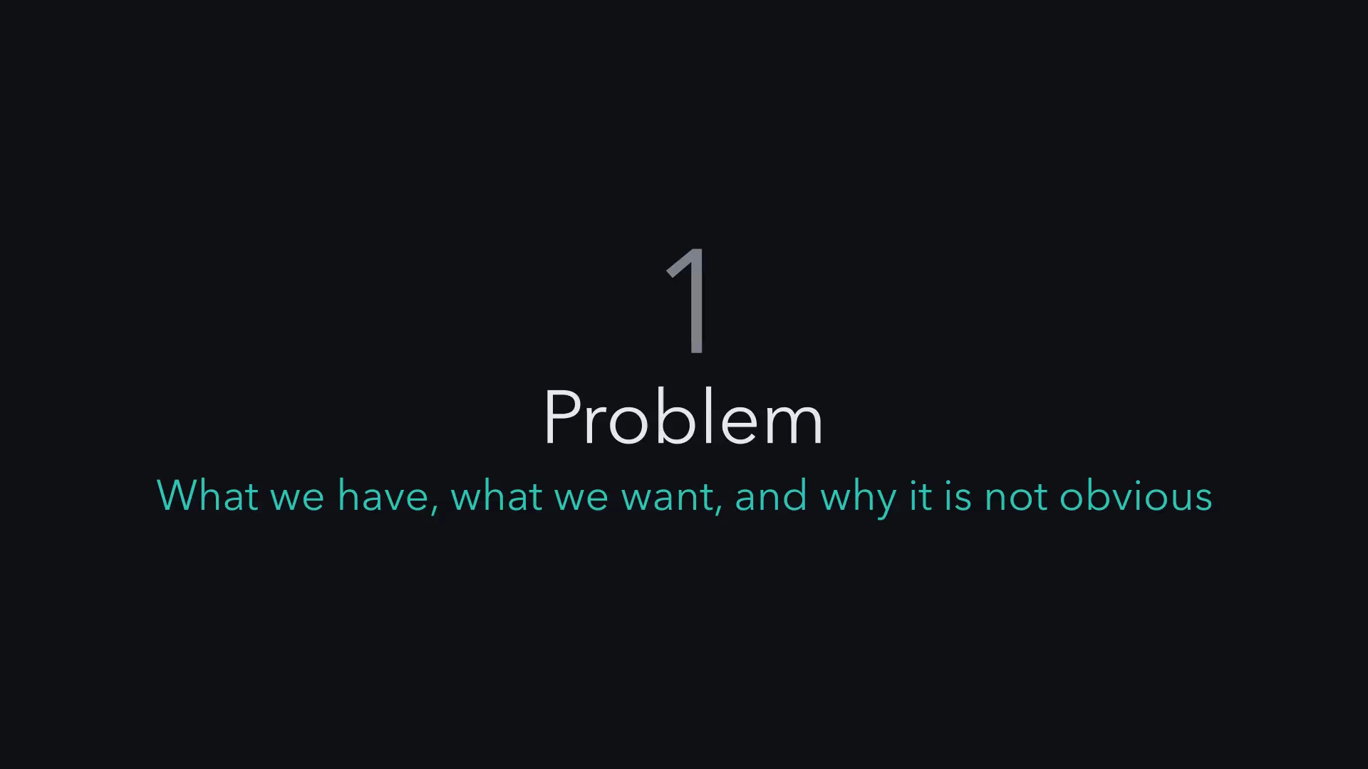
Notes:
Before any math, here are three places where correlated randomness
matters. A bank simulating a portfolio underestimates its risk if it
treats the stocks as independent. A random smooth curve is really one
draw from a 60 dimensional normal, and synthetic data is only useful
if it keeps the real correlations. All three need random numbers that
move together.

Slide 4
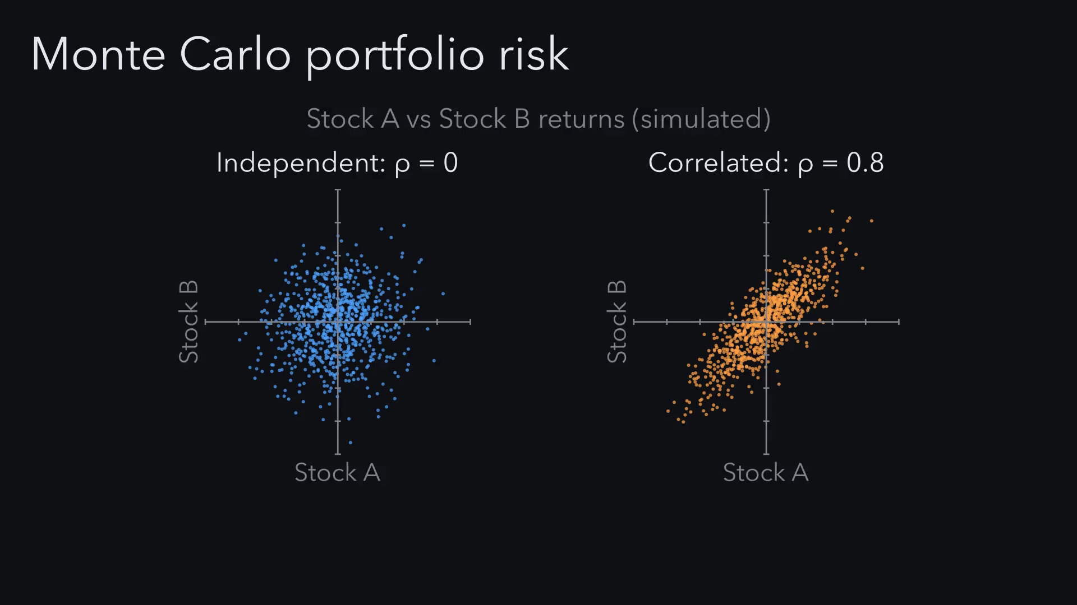
Notes:
Before any math, here are three places where correlated randomness
matters. A bank simulating a portfolio underestimates its risk if it
treats the stocks as independent. A random smooth curve is really one
draw from a 60 dimensional normal, and synthetic data is only useful
if it keeps the real correlations. All three need random numbers that
move together.

Slide 5
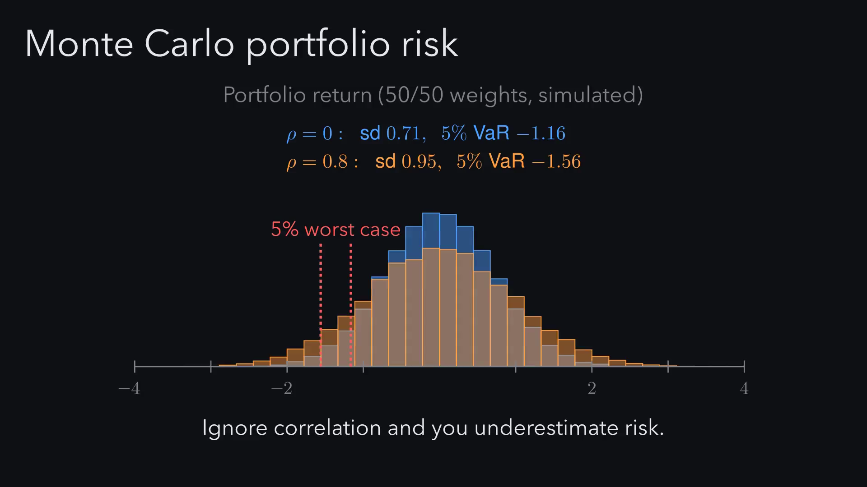
Notes:
Before any math, here are three places where correlated randomness
matters. A bank simulating a portfolio underestimates its risk if it
treats the stocks as independent. A random smooth curve is really one
draw from a 60 dimensional normal, and synthetic data is only useful
if it keeps the real correlations. All three need random numbers that
move together.

Slide 6
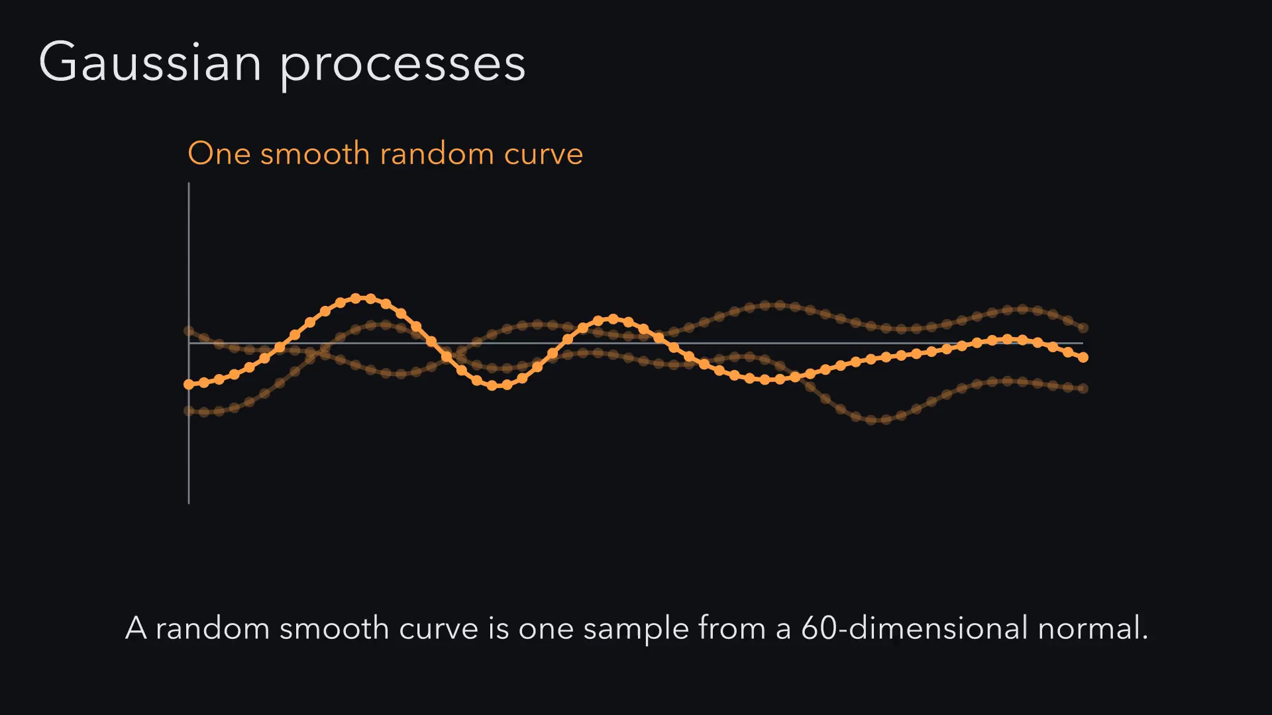
Notes:
Before any math, here are three places where correlated randomness
matters. A bank simulating a portfolio underestimates its risk if it
treats the stocks as independent. A random smooth curve is really one
draw from a 60 dimensional normal, and synthetic data is only useful
if it keeps the real correlations. All three need random numbers that
move together.

Slide 7
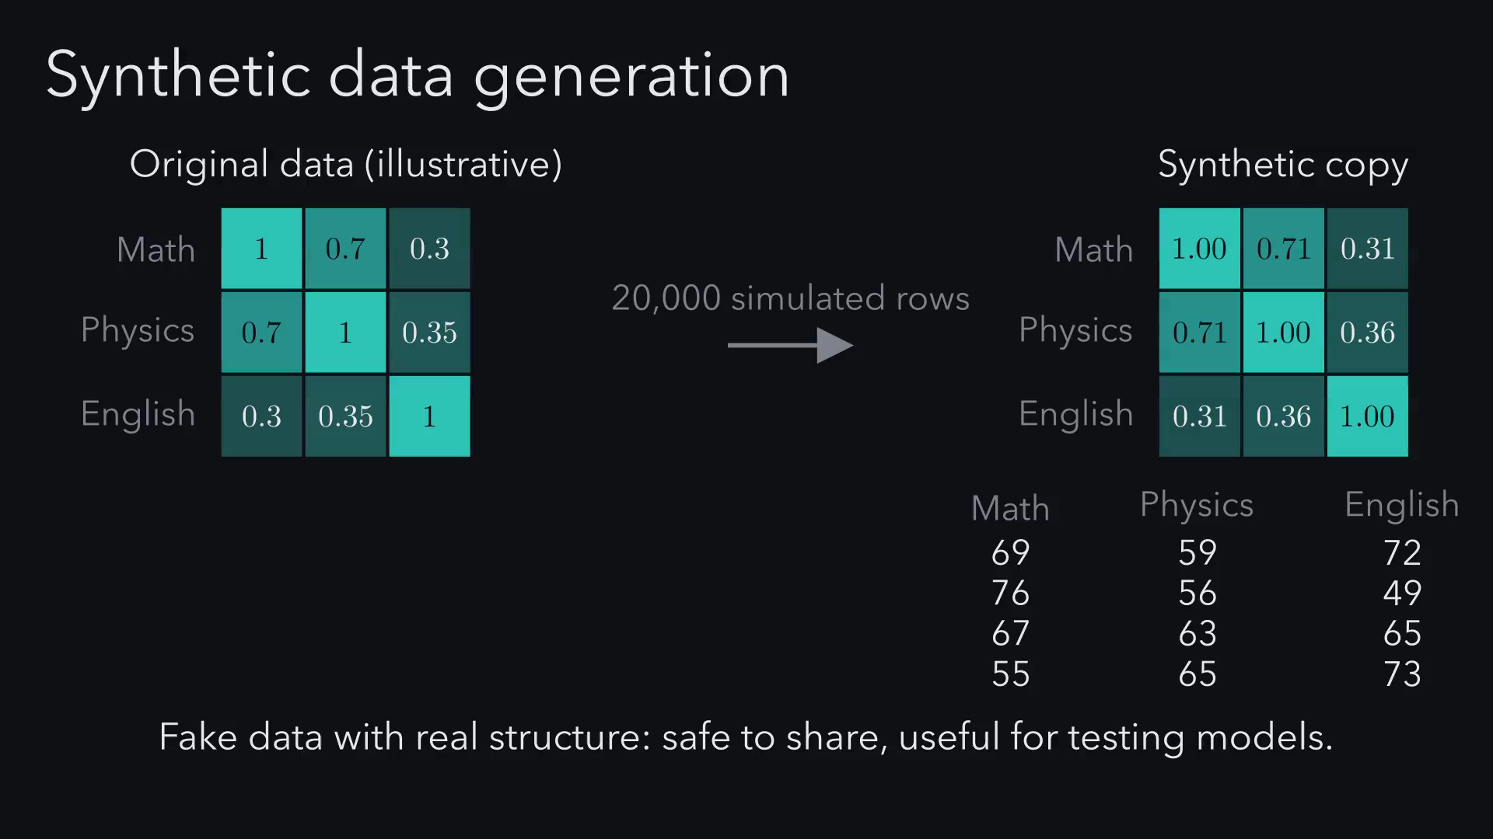
Notes:
Before any math, here are three places where correlated randomness
matters. A bank simulating a portfolio underestimates its risk if it
treats the stocks as independent. A random smooth curve is really one
draw from a 60 dimensional normal, and synthetic data is only useful
if it keeps the real correlations. All three need random numbers that
move together.

Slide 8
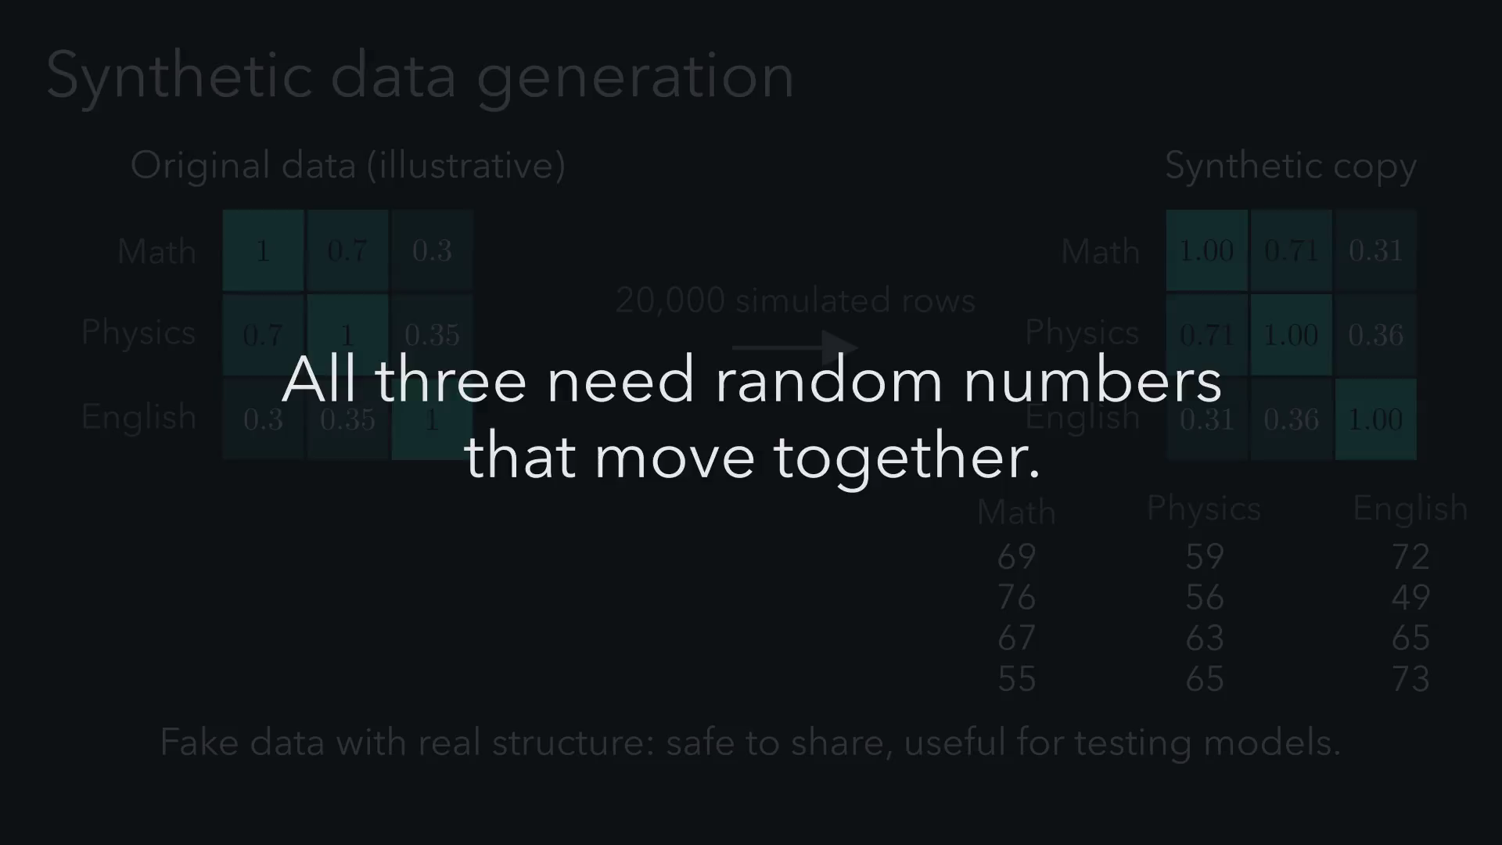
Notes:
Here's what a computer gives us for free. One line of numpy and we
get 800 rows, and each row is a point. Every draw is independent,
and the two columns have nothing to do with each other, so the
correlation is zero and the cloud is round. The rest of this talk is
about mixing those two columns together.

Slide 9
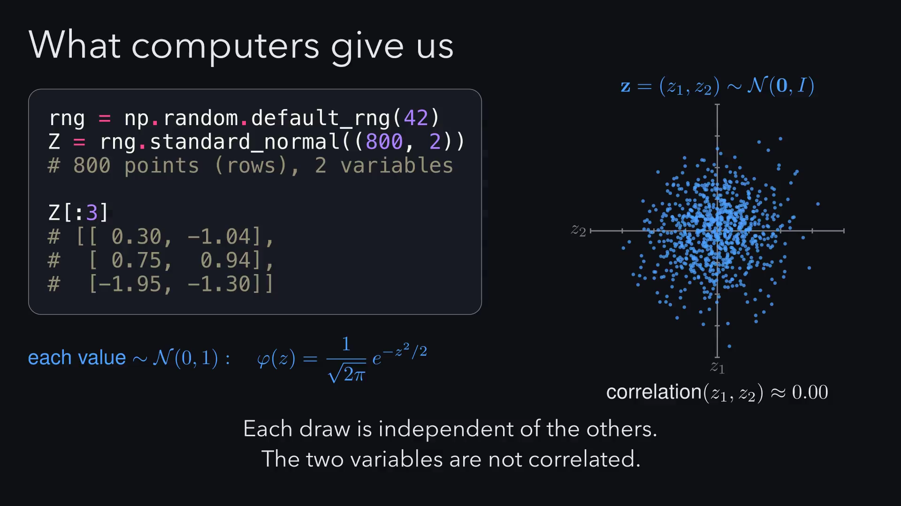
Notes:
What we actually want is a multivariate normal with a mean vector mu
and a covariance matrix Sigma. Mu is the center of the cloud. The
diagonal of Sigma holds the variances, how spread out each variable
is, and the off-diagonal entry is the covariance, how the two move
together. How we made this cloud is the rest of the talk.

Slide 10
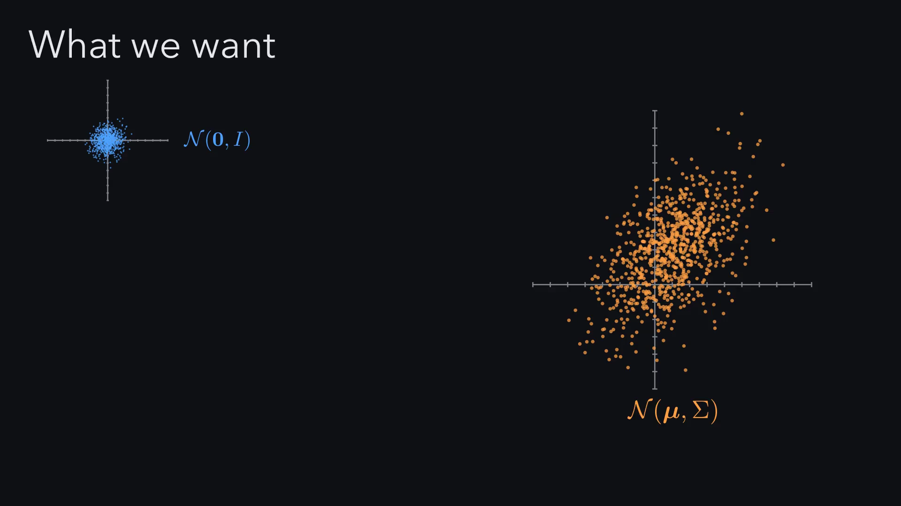
Notes:
What we actually want is a multivariate normal with a mean vector mu
and a covariance matrix Sigma. Mu is the center of the cloud. The
diagonal of Sigma holds the variances, how spread out each variable
is, and the off-diagonal entry is the covariance, how the two move
together. How we made this cloud is the rest of the talk.

Slide 11
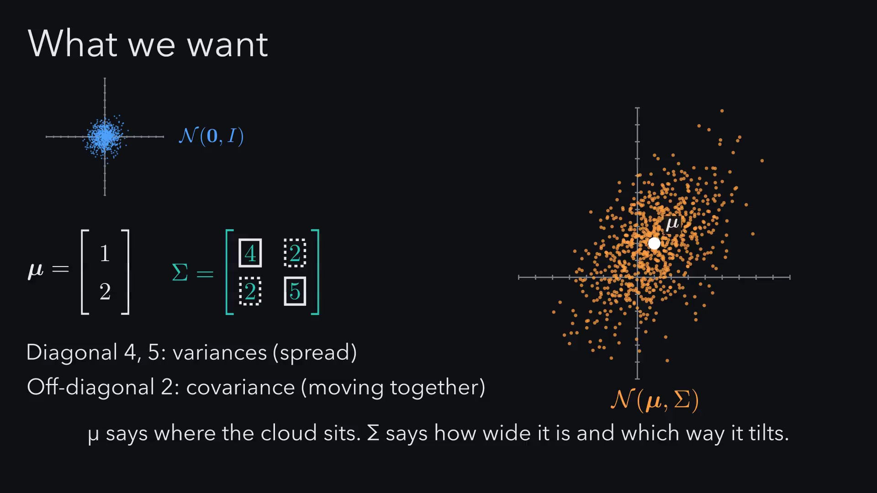
Notes:
This formula looks scary, but you already know it. Here's the 1D
bell curve, and if I rearrange it a little, it has exactly the same
shape as the multivariate one. Numbers become vectors, σ² becomes Σ,
and dividing becomes multiplying by an inverse. The only genuinely
new idea is the distance term: it measures distance in units of
spread, so a point along the long axis counts as closer than one the
same ruler distance along the short axis.

Slide 12
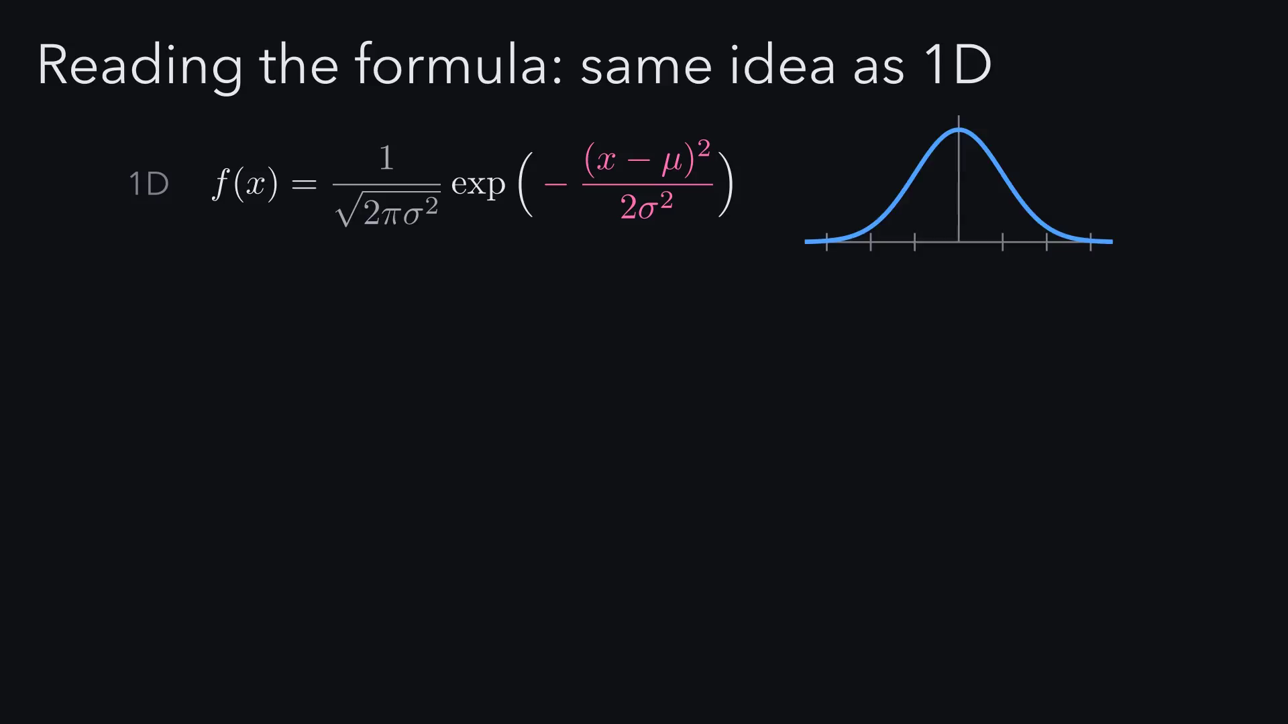
Notes:
This formula looks scary, but you already know it. Here's the 1D
bell curve, and if I rearrange it a little, it has exactly the same
shape as the multivariate one. Numbers become vectors, σ² becomes Σ,
and dividing becomes multiplying by an inverse. The only genuinely
new idea is the distance term: it measures distance in units of
spread, so a point along the long axis counts as closer than one the
same ruler distance along the short axis.

Slide 13
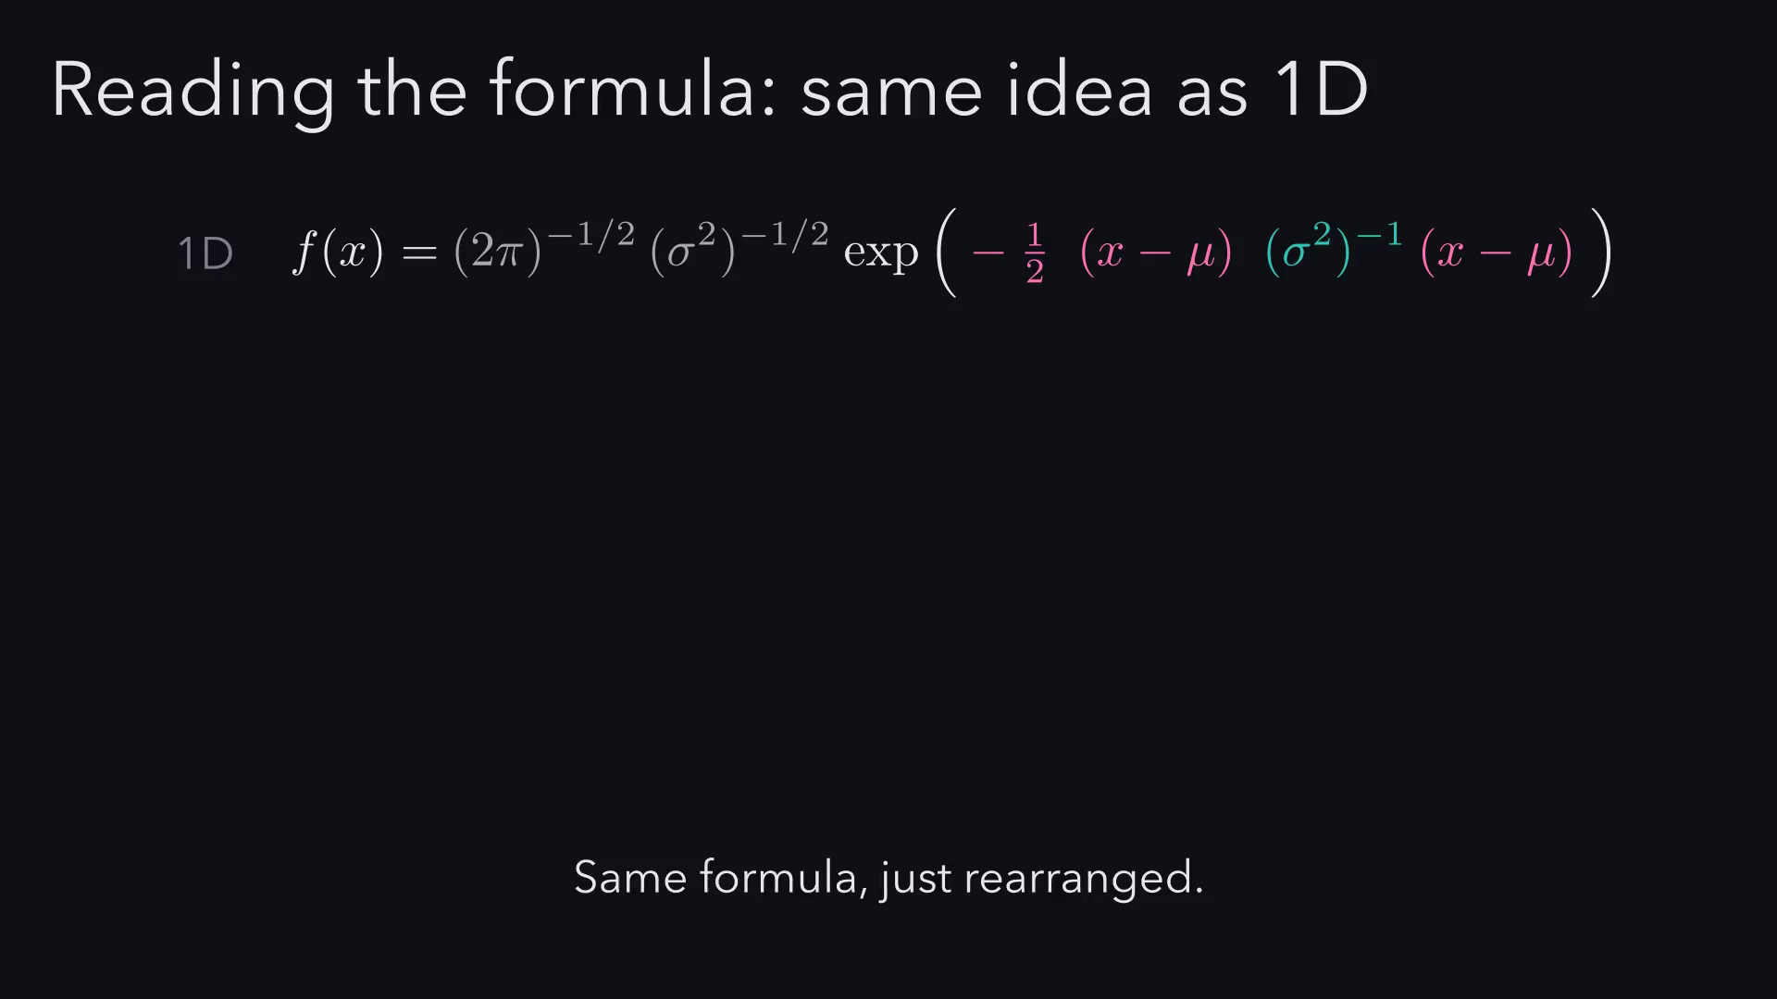
Notes:
This formula looks scary, but you already know it. Here's the 1D
bell curve, and if I rearrange it a little, it has exactly the same
shape as the multivariate one. Numbers become vectors, σ² becomes Σ,
and dividing becomes multiplying by an inverse. The only genuinely
new idea is the distance term: it measures distance in units of
spread, so a point along the long axis counts as closer than one the
same ruler distance along the short axis.

Slide 14
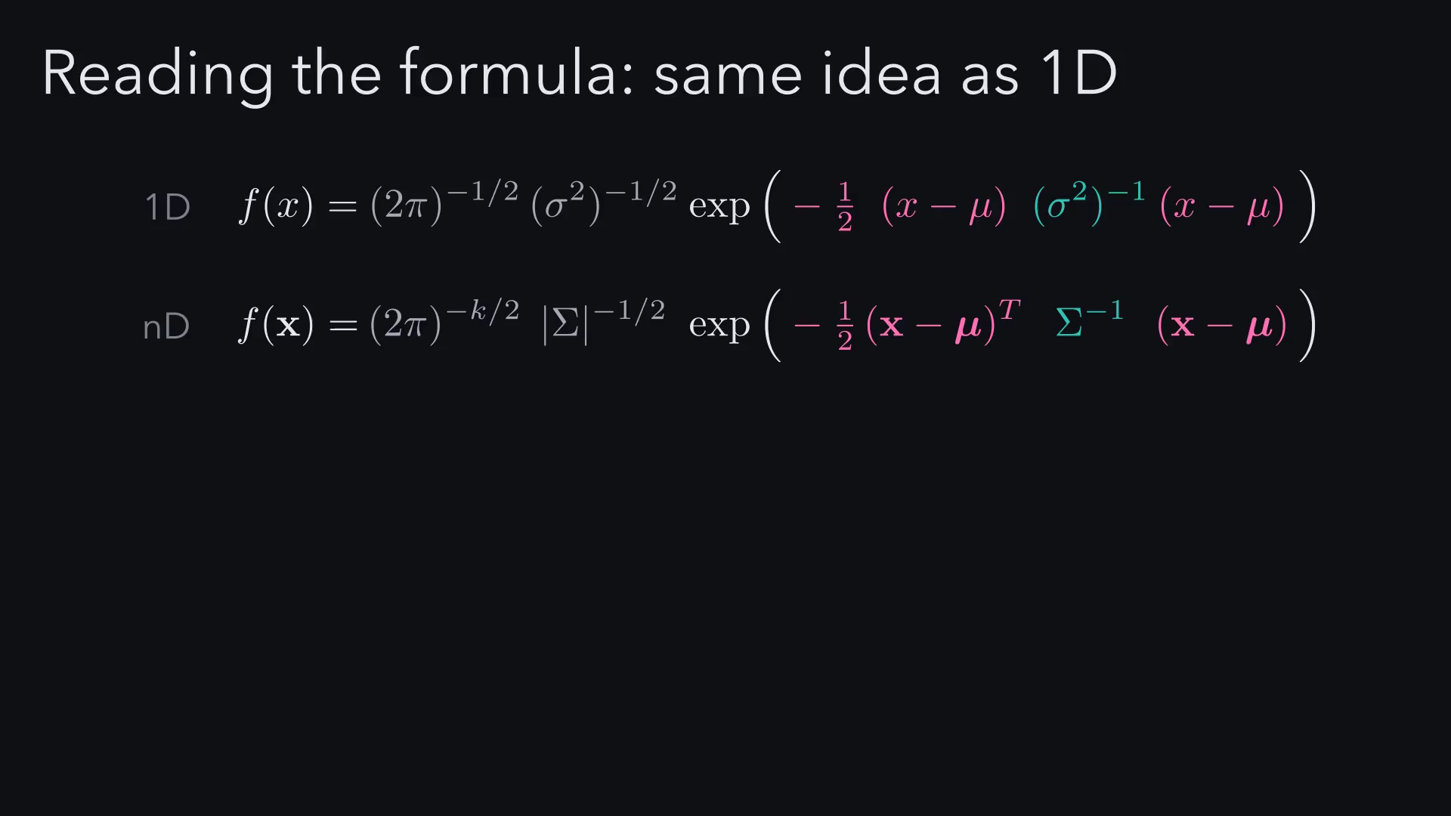
Notes:
This formula looks scary, but you already know it. Here's the 1D
bell curve, and if I rearrange it a little, it has exactly the same
shape as the multivariate one. Numbers become vectors, σ² becomes Σ,
and dividing becomes multiplying by an inverse. The only genuinely
new idea is the distance term: it measures distance in units of
spread, so a point along the long axis counts as closer than one the
same ruler distance along the short axis.

Slide 15
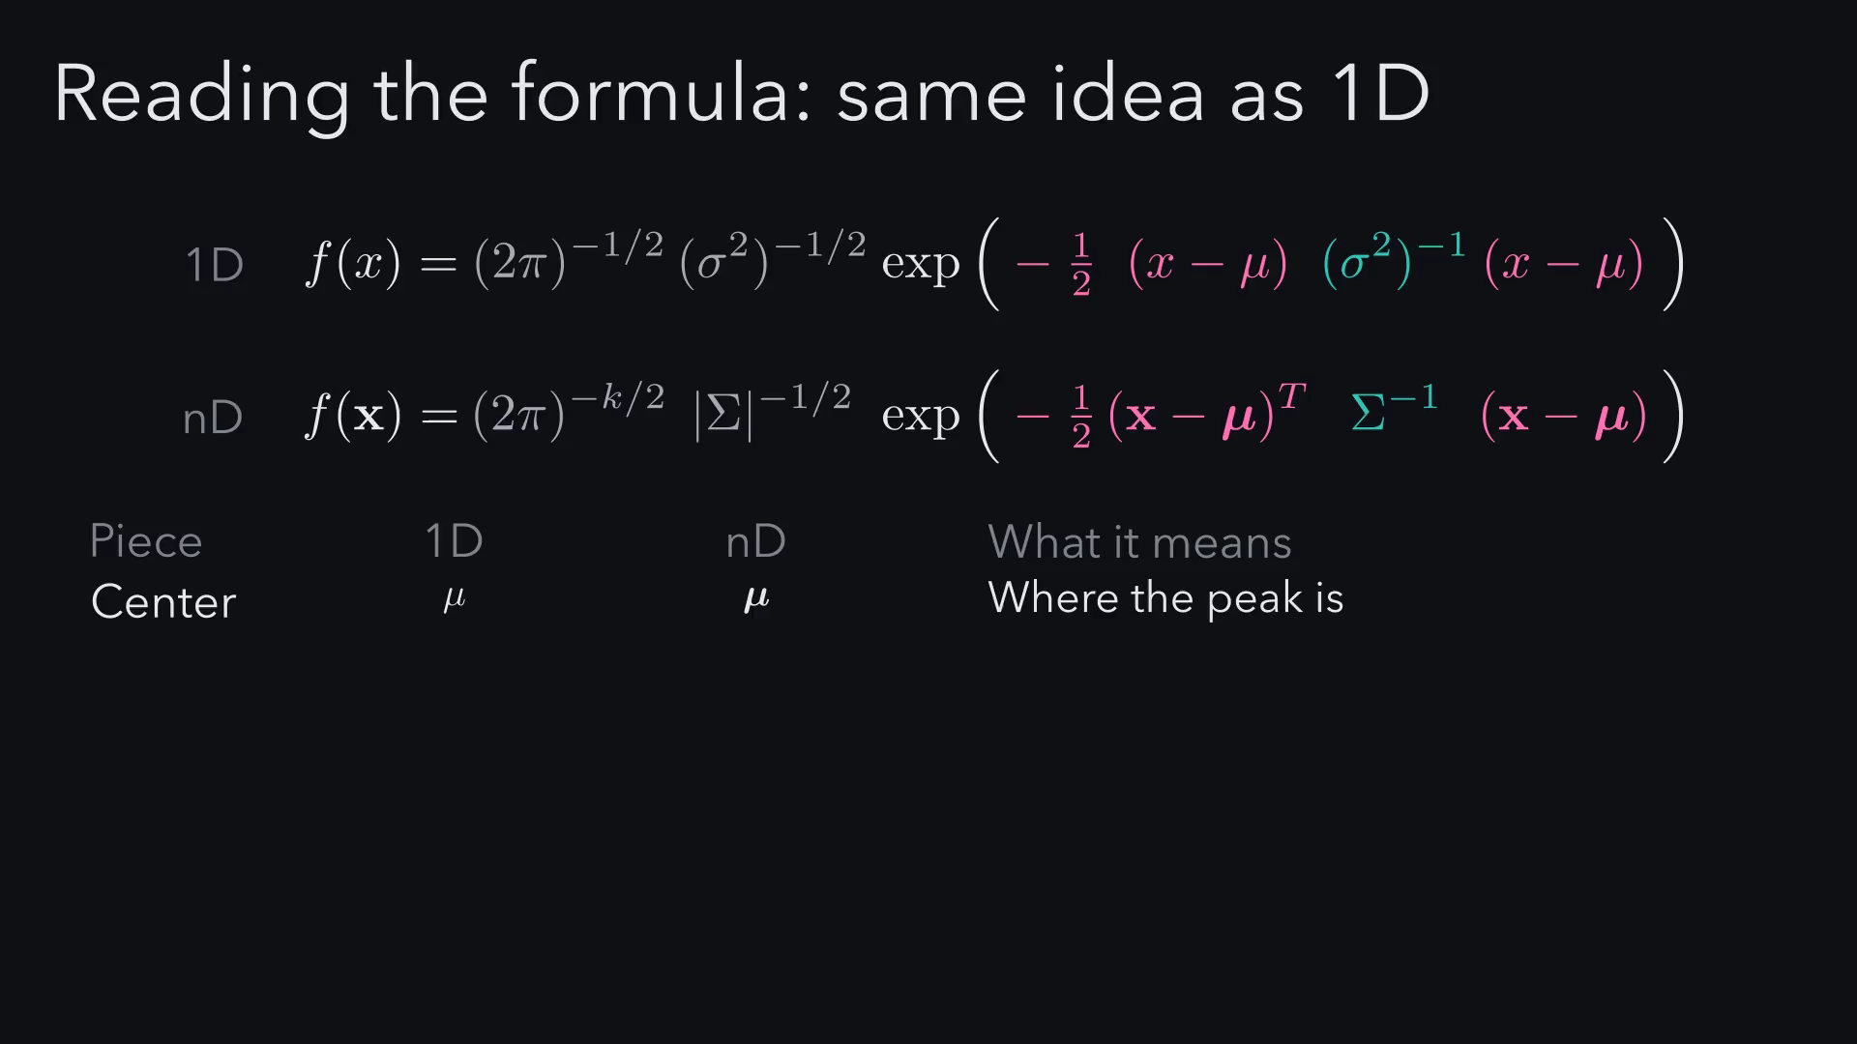
Notes:
This formula looks scary, but you already know it. Here's the 1D
bell curve, and if I rearrange it a little, it has exactly the same
shape as the multivariate one. Numbers become vectors, σ² becomes Σ,
and dividing becomes multiplying by an inverse. The only genuinely
new idea is the distance term: it measures distance in units of
spread, so a point along the long axis counts as closer than one the
same ruler distance along the short axis.

Slide 16
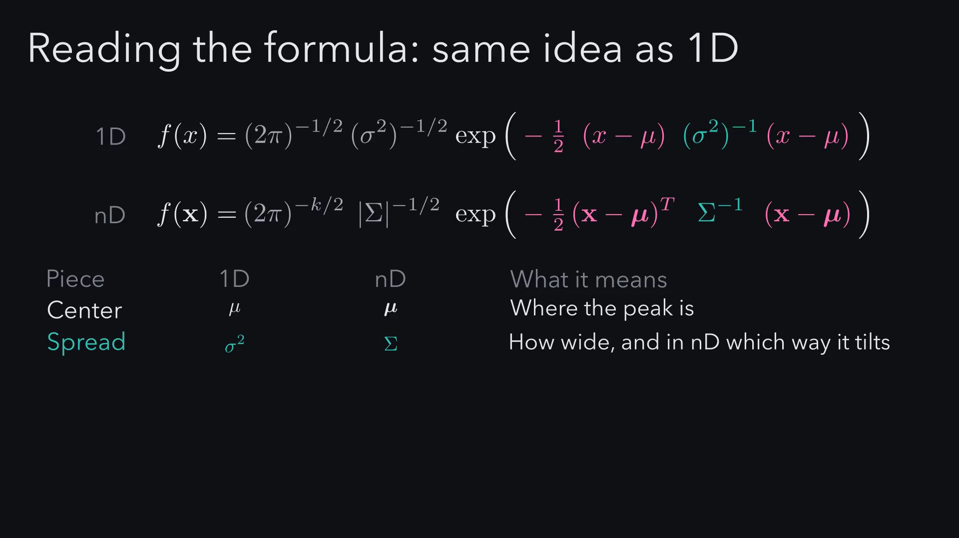
Notes:
This formula looks scary, but you already know it. Here's the 1D
bell curve, and if I rearrange it a little, it has exactly the same
shape as the multivariate one. Numbers become vectors, σ² becomes Σ,
and dividing becomes multiplying by an inverse. The only genuinely
new idea is the distance term: it measures distance in units of
spread, so a point along the long axis counts as closer than one the
same ruler distance along the short axis.

Slide 17
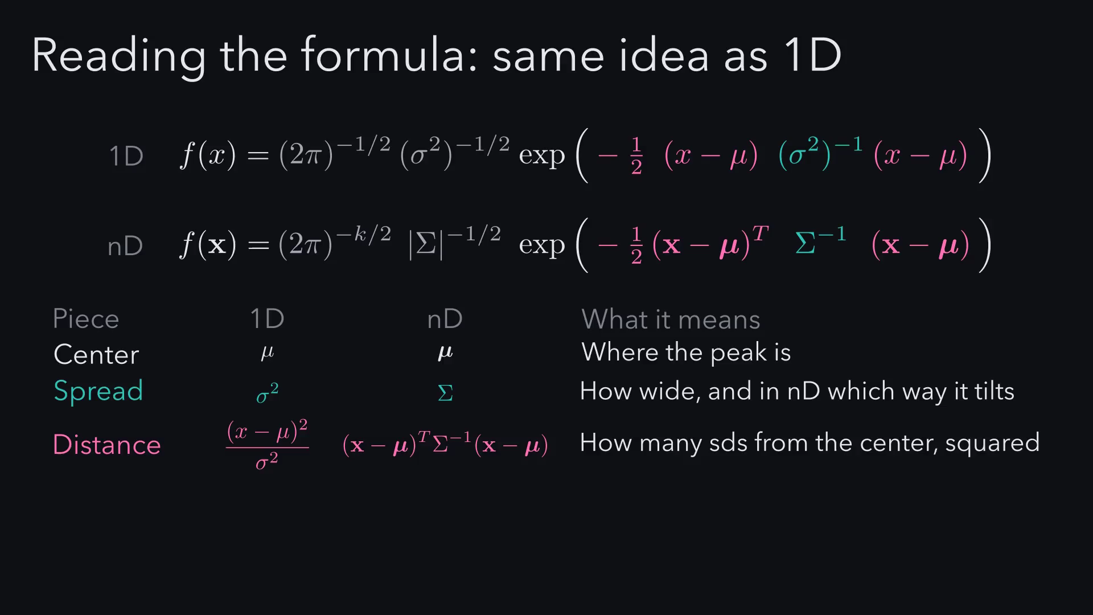
Notes:
This formula looks scary, but you already know it. Here's the 1D
bell curve, and if I rearrange it a little, it has exactly the same
shape as the multivariate one. Numbers become vectors, σ² becomes Σ,
and dividing becomes multiplying by an inverse. The only genuinely
new idea is the distance term: it measures distance in units of
spread, so a point along the long axis counts as closer than one the
same ruler distance along the short axis.

Slide 18
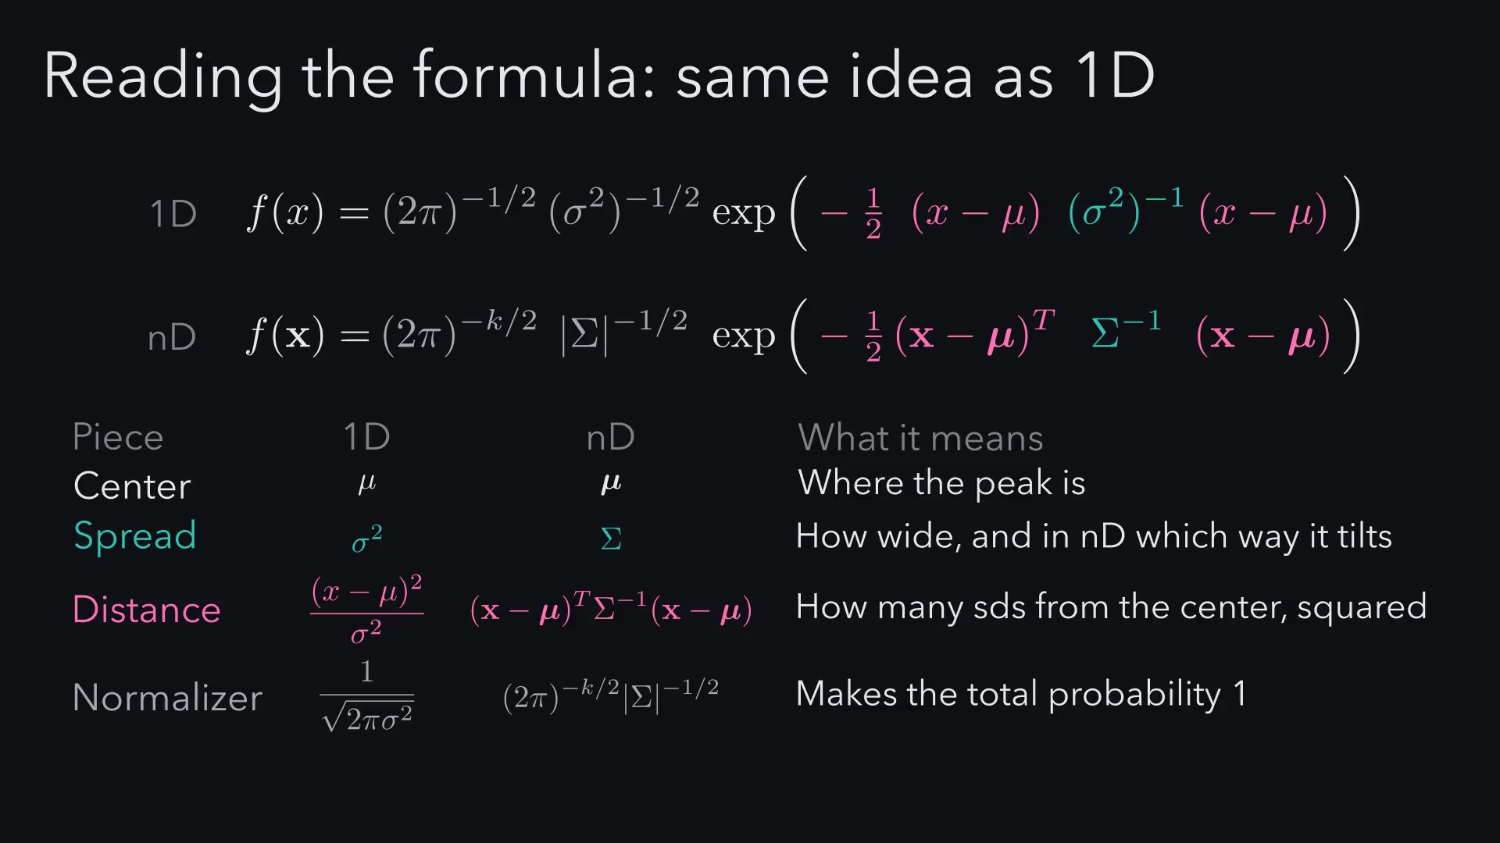
Notes:
This formula looks scary, but you already know it. Here's the 1D
bell curve, and if I rearrange it a little, it has exactly the same
shape as the multivariate one. Numbers become vectors, σ² becomes Σ,
and dividing becomes multiplying by an inverse. The only genuinely
new idea is the distance term: it measures distance in units of
spread, so a point along the long axis counts as closer than one the
same ruler distance along the short axis.

Slide 19
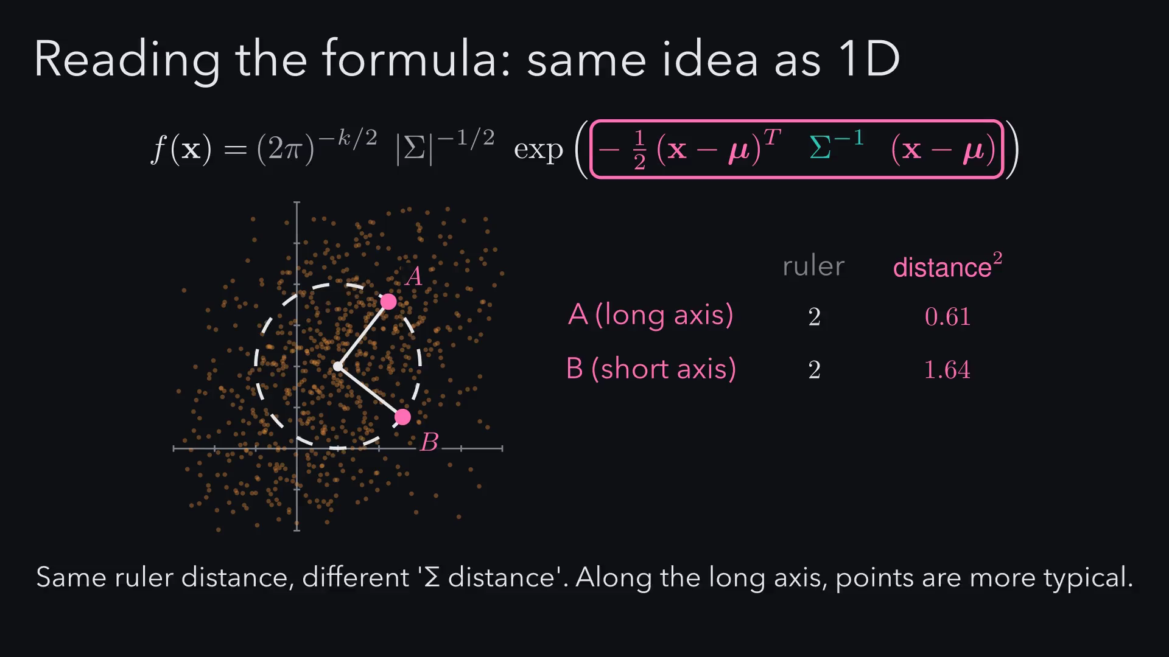
Notes:
This formula looks scary, but you already know it. Here's the 1D
bell curve, and if I rearrange it a little, it has exactly the same
shape as the multivariate one. Numbers become vectors, σ² becomes Σ,
and dividing becomes multiplying by an inverse. The only genuinely
new idea is the distance term: it measures distance in units of
spread, so a point along the long axis counts as closer than one the
same ruler distance along the short axis.

Slide 20
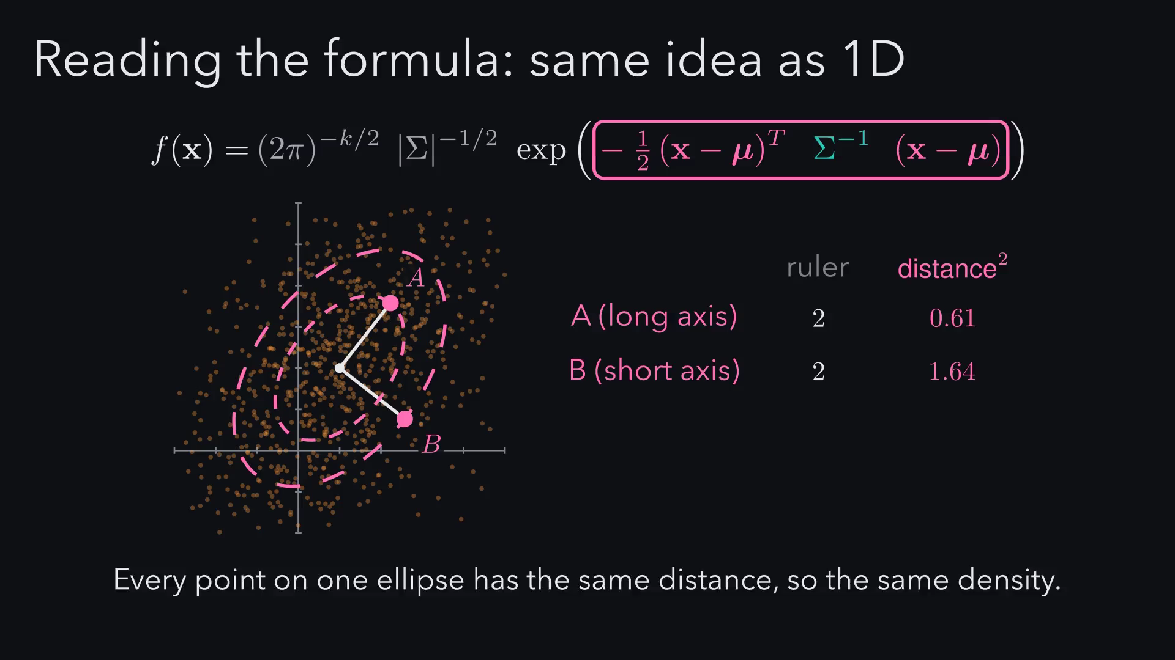
Notes:
This formula looks scary, but you already know it. Here's the 1D
bell curve, and if I rearrange it a little, it has exactly the same
shape as the multivariate one. Numbers become vectors, σ² becomes Σ,
and dividing becomes multiplying by an inverse. The only genuinely
new idea is the distance term: it measures distance in units of
spread, so a point along the long axis counts as closer than one the
same ruler distance along the short axis.

Slide 21
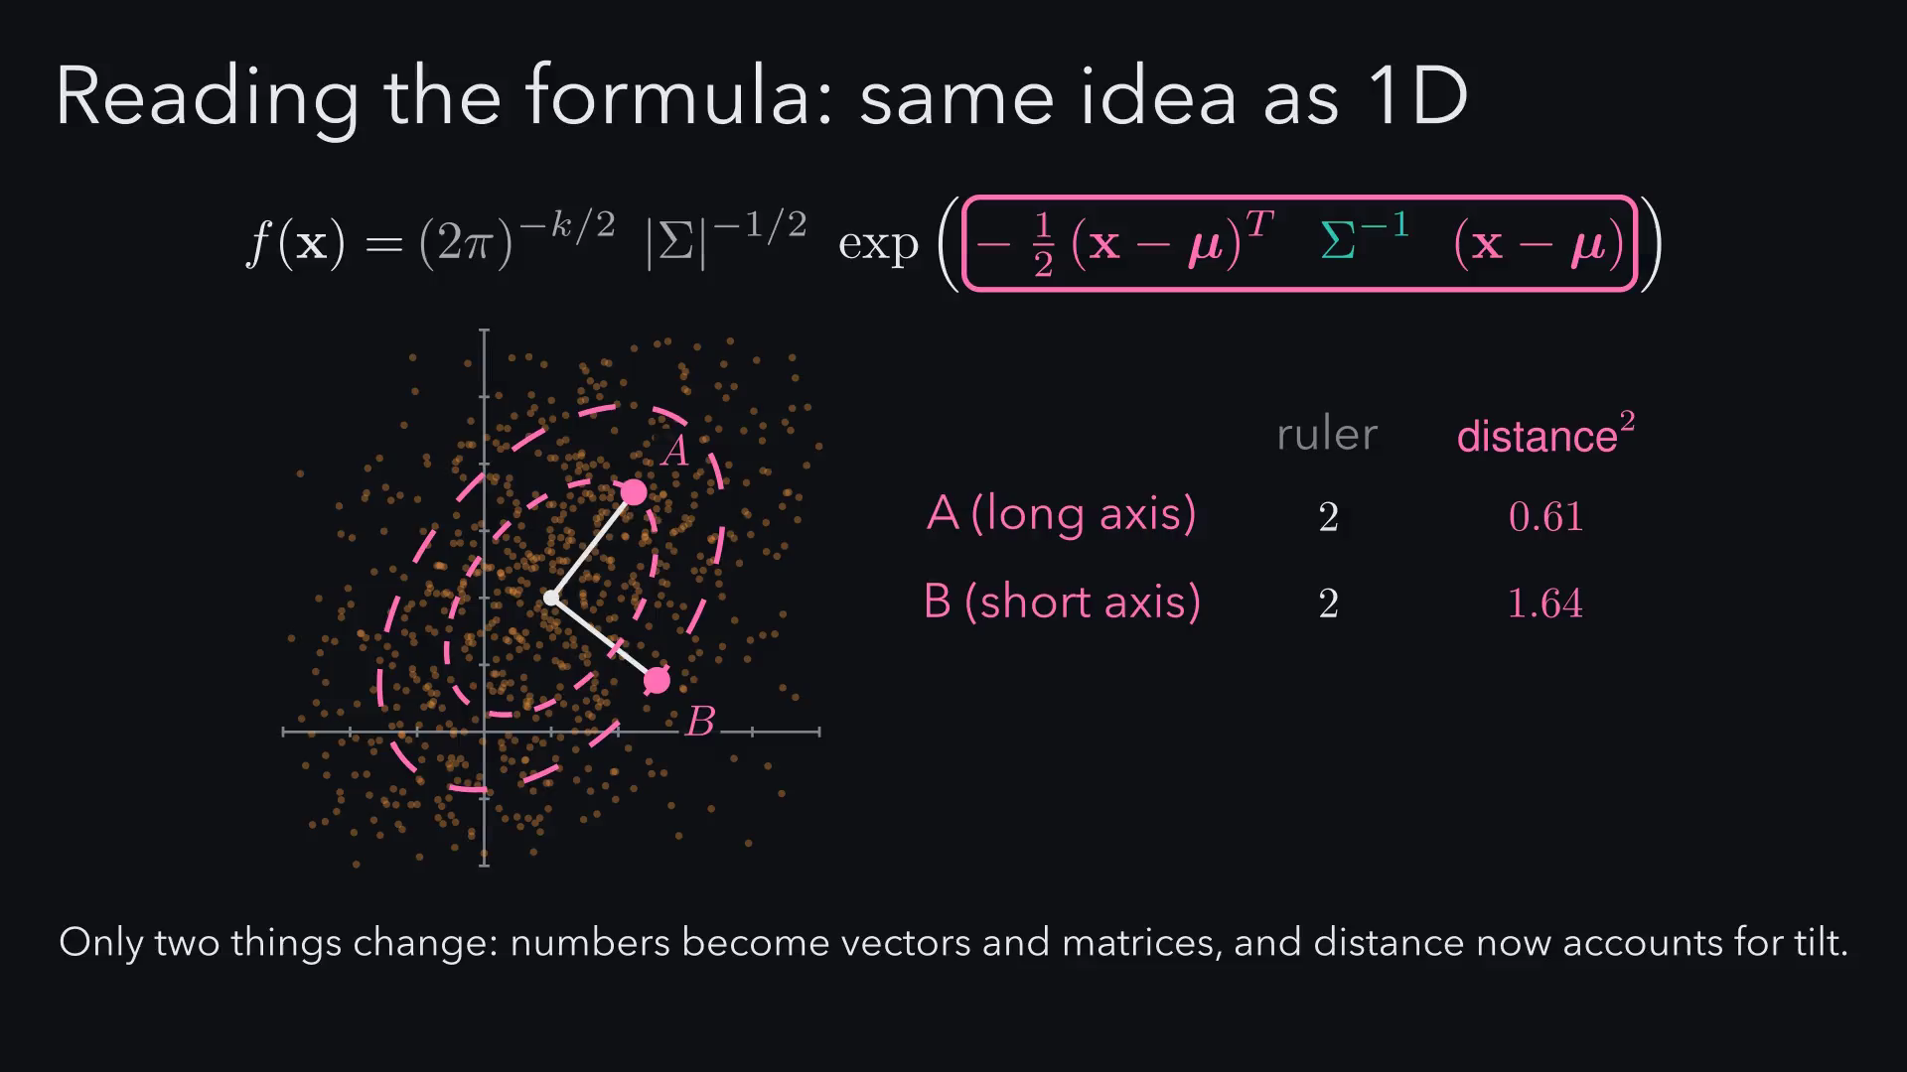
Notes:
So here is the whole problem in one picture. On the left is the
round cloud a computer gives us, and on the right is the tilted cloud
we want, drawn to the same scale. The question for the rest of the
talk is how to turn one into the other.

Slide 22
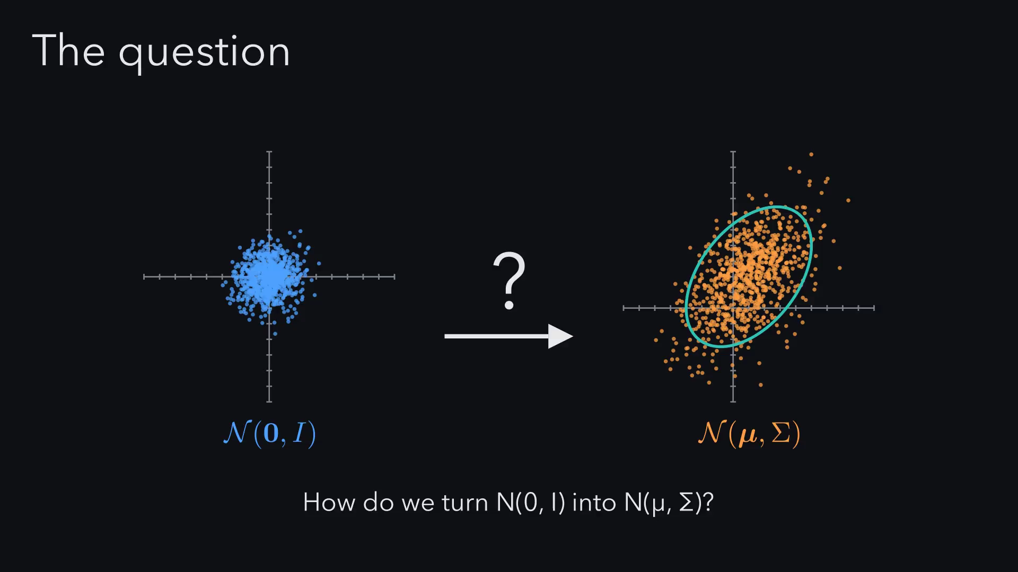
Notes:
Let's start with something we already know. We want a normal with
mean 3 and variance 4. The obvious
move is to multiply by 4, but the curve
overshoots and the variance jumps to 16,
because stretching by a multiplies the variance by a squared. So we
stretch by the square root of 4, which is
2, then shift by 3. To get
variance sigma squared, you scale by its square root.

Slide 23
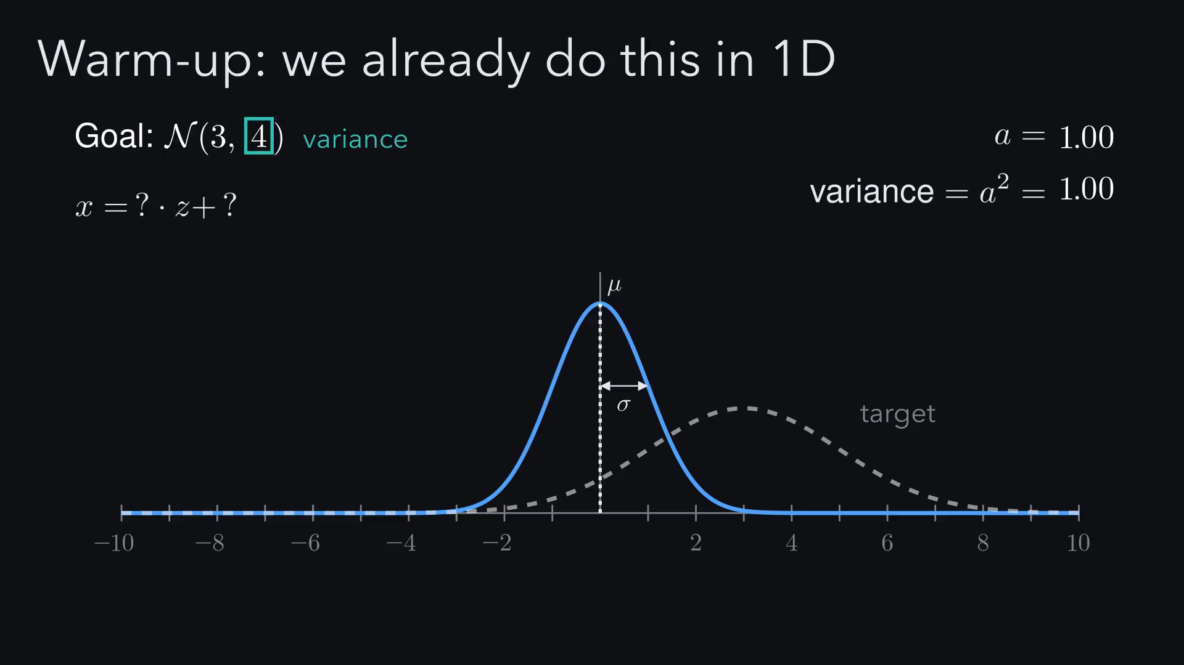
Notes:
Let's start with something we already know. We want a normal with
mean 3 and variance 4. The obvious
move is to multiply by 4, but the curve
overshoots and the variance jumps to 16,
because stretching by a multiplies the variance by a squared. So we
stretch by the square root of 4, which is
2, then shift by 3. To get
variance sigma squared, you scale by its square root.

Slide 24
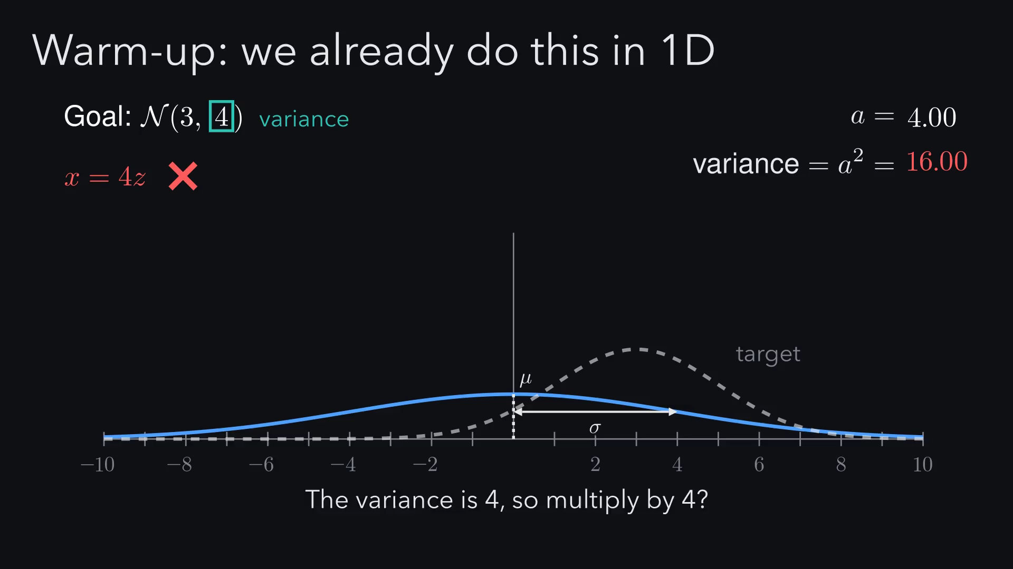
Notes:
Let's start with something we already know. We want a normal with
mean 3 and variance 4. The obvious
move is to multiply by 4, but the curve
overshoots and the variance jumps to 16,
because stretching by a multiplies the variance by a squared. So we
stretch by the square root of 4, which is
2, then shift by 3. To get
variance sigma squared, you scale by its square root.

Slide 25
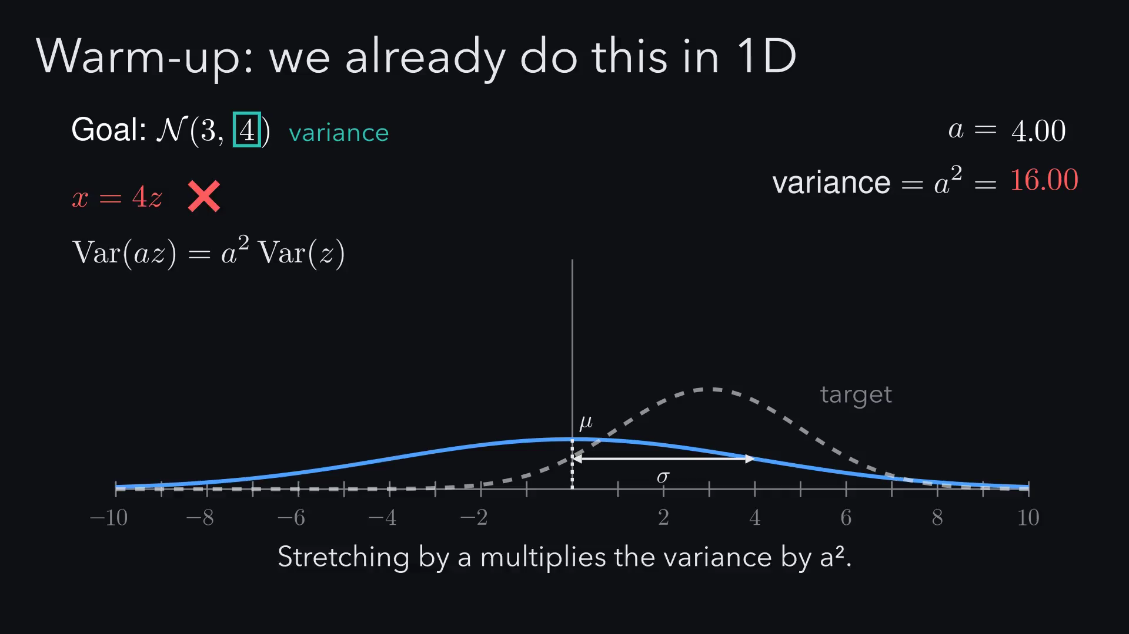
Notes:
Let's start with something we already know. We want a normal with
mean 3 and variance 4. The obvious
move is to multiply by 4, but the curve
overshoots and the variance jumps to 16,
because stretching by a multiplies the variance by a squared. So we
stretch by the square root of 4, which is
2, then shift by 3. To get
variance sigma squared, you scale by its square root.

Slide 26
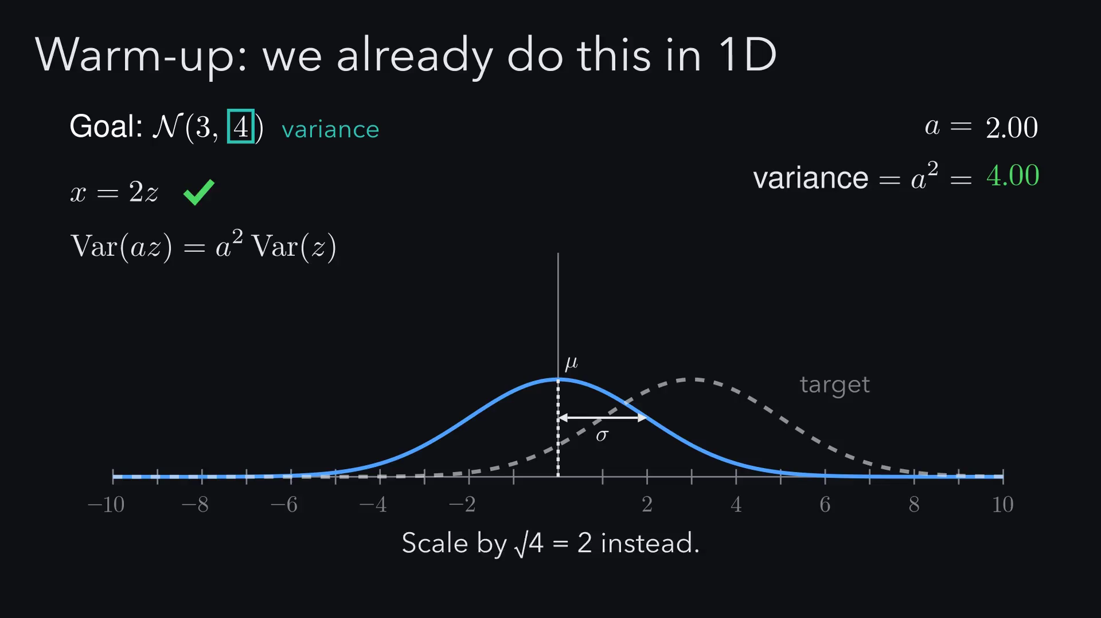
Notes:
Let's start with something we already know. We want a normal with
mean 3 and variance 4. The obvious
move is to multiply by 4, but the curve
overshoots and the variance jumps to 16,
because stretching by a multiplies the variance by a squared. So we
stretch by the square root of 4, which is
2, then shift by 3. To get
variance sigma squared, you scale by its square root.

Slide 27
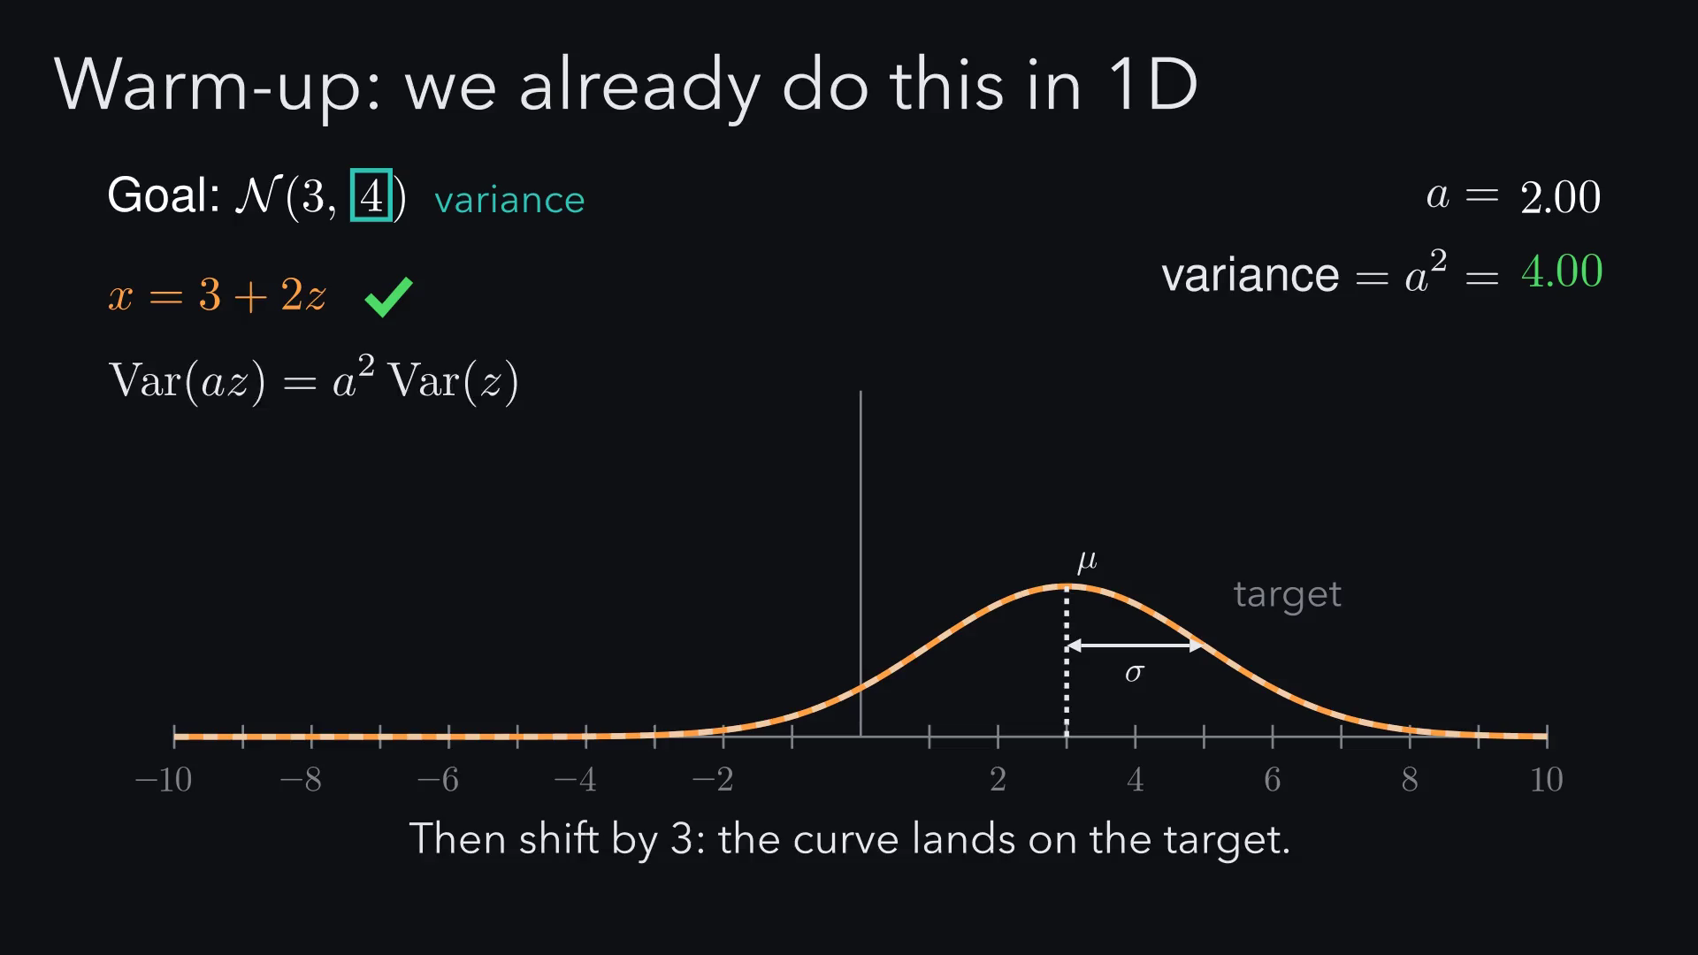
Notes:
Let's start with something we already know. We want a normal with
mean 3 and variance 4. The obvious
move is to multiply by 4, but the curve
overshoots and the variance jumps to 16,
because stretching by a multiplies the variance by a squared. So we
stretch by the square root of 4, which is
2, then shift by 3. To get
variance sigma squared, you scale by its square root.

Slide 28
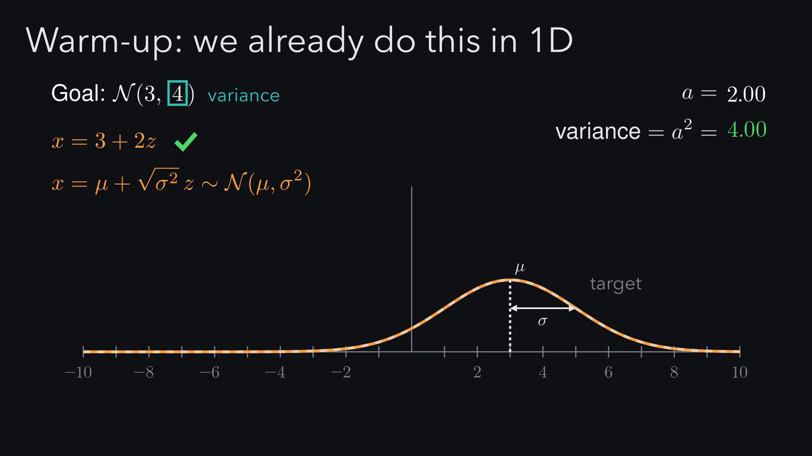
Notes:
Let's start with something we already know. We want a normal with
mean 3 and variance 4. The obvious
move is to multiply by 4, but the curve
overshoots and the variance jumps to 16,
because stretching by a multiplies the variance by a squared. So we
stretch by the square root of 4, which is
2, then shift by 3. To get
variance sigma squared, you scale by its square root.

Slide 29
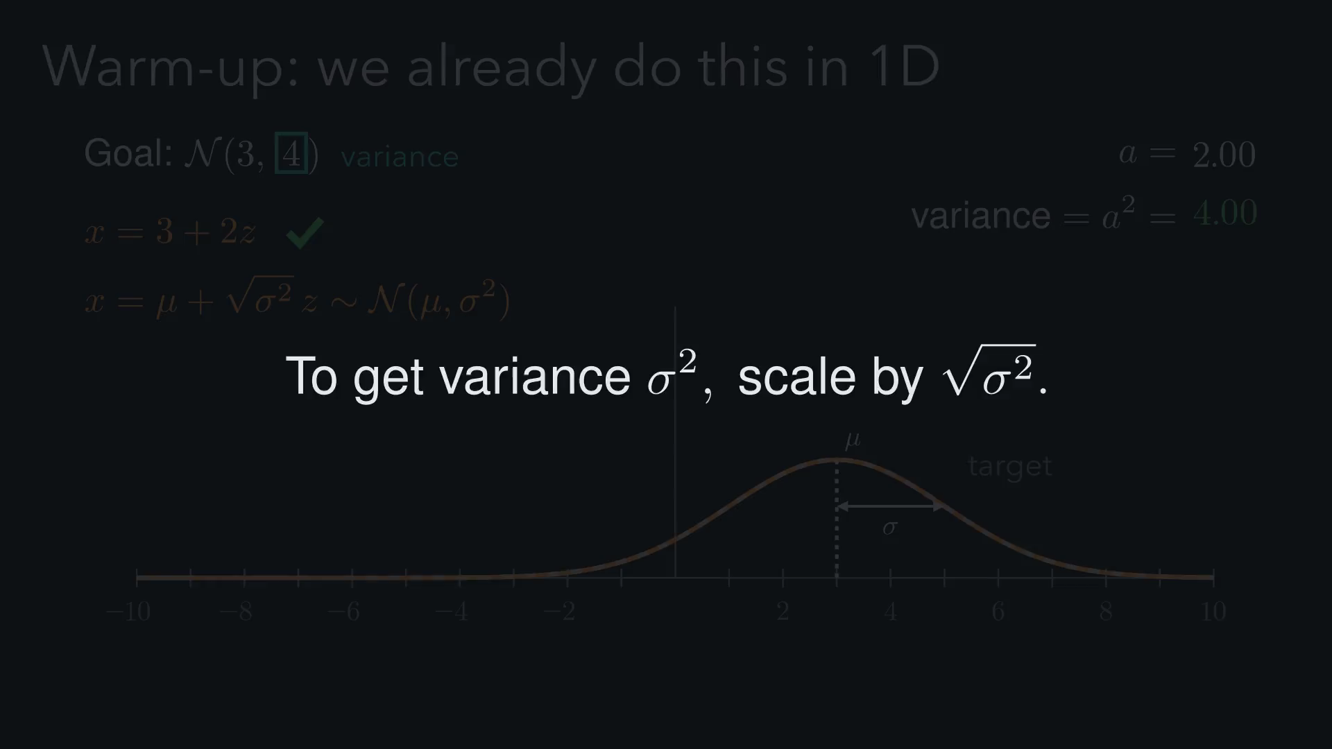
Notes:
Now go up a dimension. The variance is no longer one number, it's a
whole matrix. If we make the same mistake as before and multiply by
Σ, we get Σ squared. And taking the square root of each entry fails
too. So what does the square root of a matrix even mean?

Slide 30
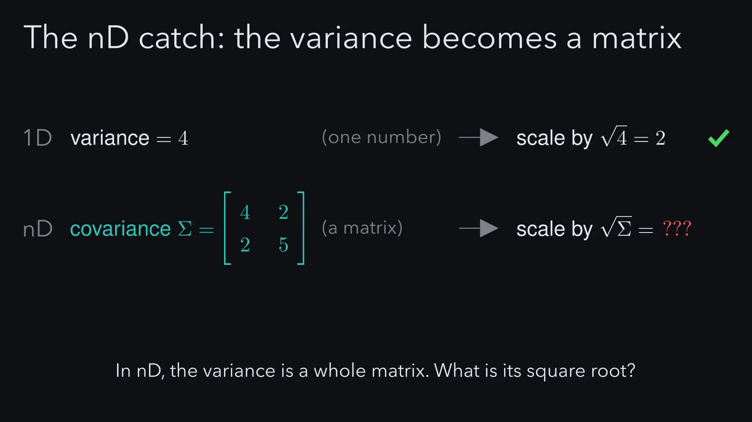
Notes:
Now go up a dimension. The variance is no longer one number, it's a
whole matrix. If we make the same mistake as before and multiply by
Σ, we get Σ squared. And taking the square root of each entry fails
too. So what does the square root of a matrix even mean?

Slide 31
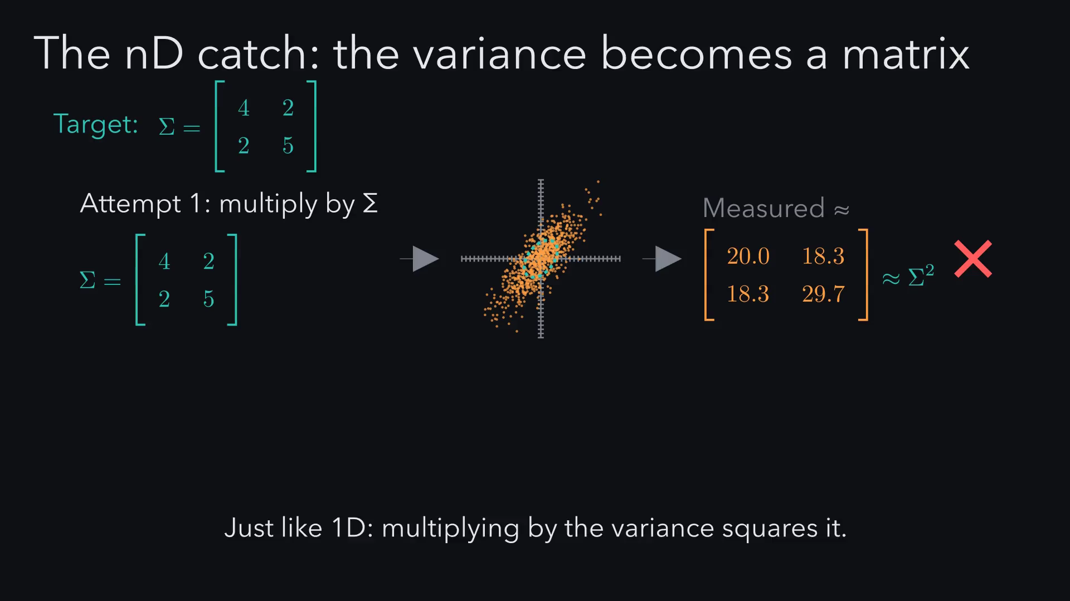
Notes:
Now go up a dimension. The variance is no longer one number, it's a
whole matrix. If we make the same mistake as before and multiply by
Σ, we get Σ squared. And taking the square root of each entry fails
too. So what does the square root of a matrix even mean?

Slide 32
Notes:
Now the solution. We will work out what a matrix does to the spread
of the data, use that to define the square root of a matrix, compute
it by hand, and turn it into a four line algorithm.

Slide 33
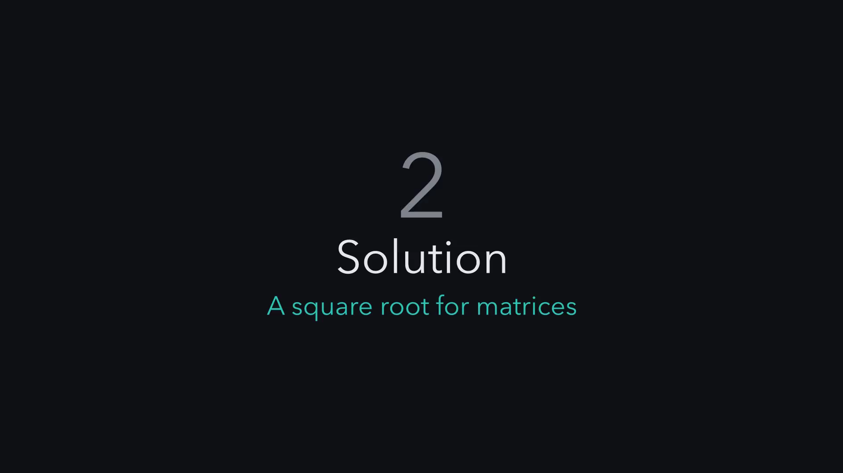
Notes:
Let's name our characters. z is the random point we start with, A is
the matrix we multiply by, and x is the point we get out. Each new
variable is a mix of z₁ and z₂, independent spreads add, and
covariance only comes from shared ingredients. Put those in a matrix
and it's exactly A times A transpose, the nD version of 'scaling by a
multiplies variance by a²'. So the real question is: what A gives
A Aᵀ = Σ?

Slide 34
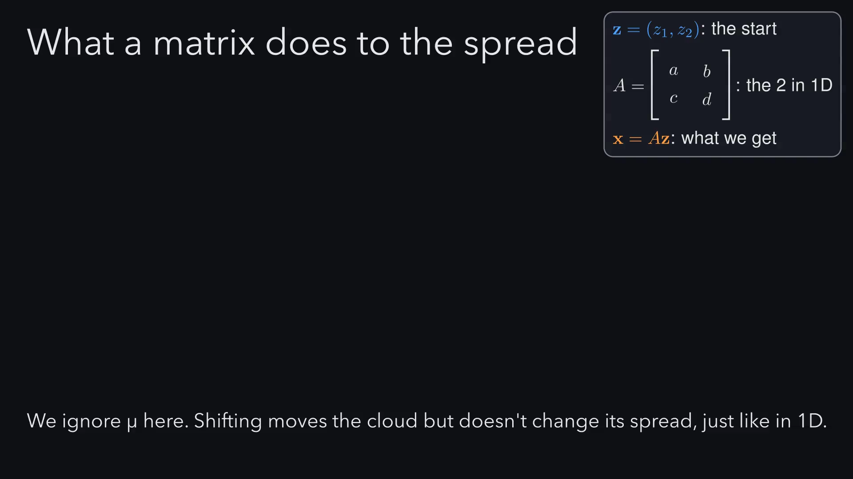
Notes:
Let's name our characters. z is the random point we start with, A is
the matrix we multiply by, and x is the point we get out. Each new
variable is a mix of z₁ and z₂, independent spreads add, and
covariance only comes from shared ingredients. Put those in a matrix
and it's exactly A times A transpose, the nD version of 'scaling by a
multiplies variance by a²'. So the real question is: what A gives
A Aᵀ = Σ?

Slide 35
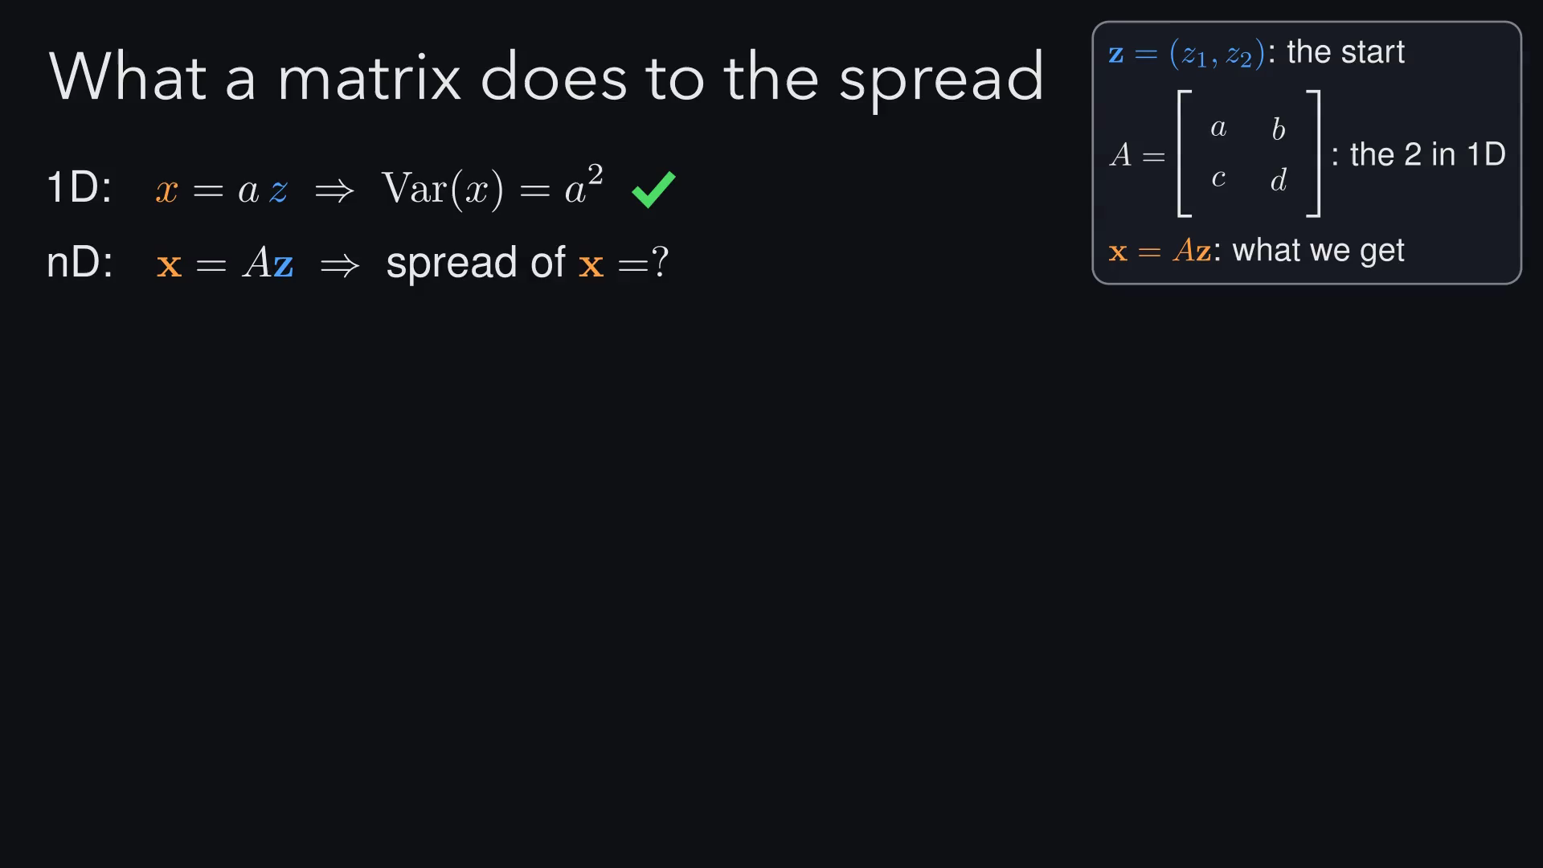
Notes:
Let's name our characters. z is the random point we start with, A is
the matrix we multiply by, and x is the point we get out. Each new
variable is a mix of z₁ and z₂, independent spreads add, and
covariance only comes from shared ingredients. Put those in a matrix
and it's exactly A times A transpose, the nD version of 'scaling by a
multiplies variance by a²'. So the real question is: what A gives
A Aᵀ = Σ?

Slide 36
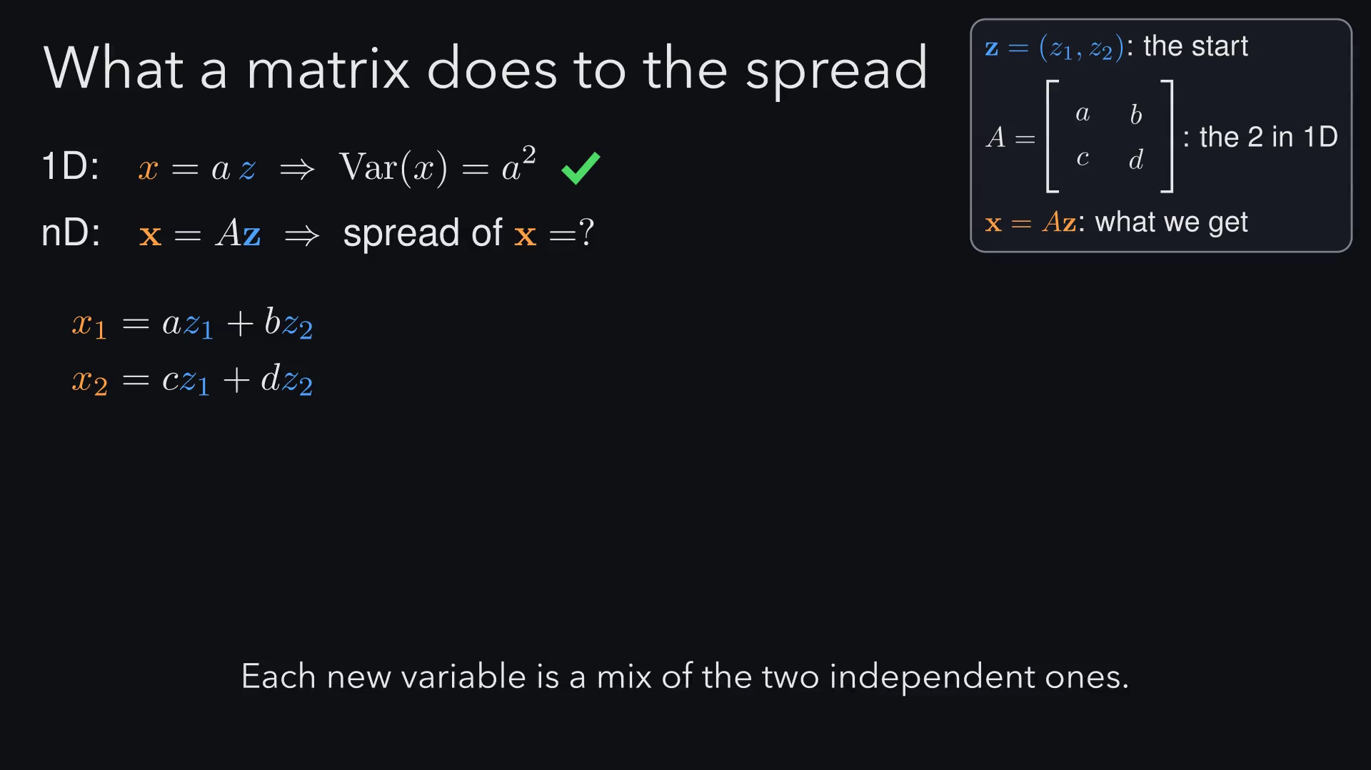
Notes:
Let's name our characters. z is the random point we start with, A is
the matrix we multiply by, and x is the point we get out. Each new
variable is a mix of z₁ and z₂, independent spreads add, and
covariance only comes from shared ingredients. Put those in a matrix
and it's exactly A times A transpose, the nD version of 'scaling by a
multiplies variance by a²'. So the real question is: what A gives
A Aᵀ = Σ?

Slide 37
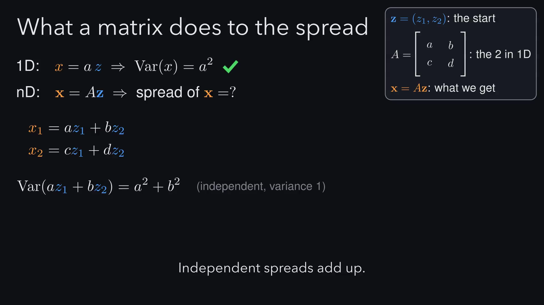
Notes:
Let's name our characters. z is the random point we start with, A is
the matrix we multiply by, and x is the point we get out. Each new
variable is a mix of z₁ and z₂, independent spreads add, and
covariance only comes from shared ingredients. Put those in a matrix
and it's exactly A times A transpose, the nD version of 'scaling by a
multiplies variance by a²'. So the real question is: what A gives
A Aᵀ = Σ?

Slide 38
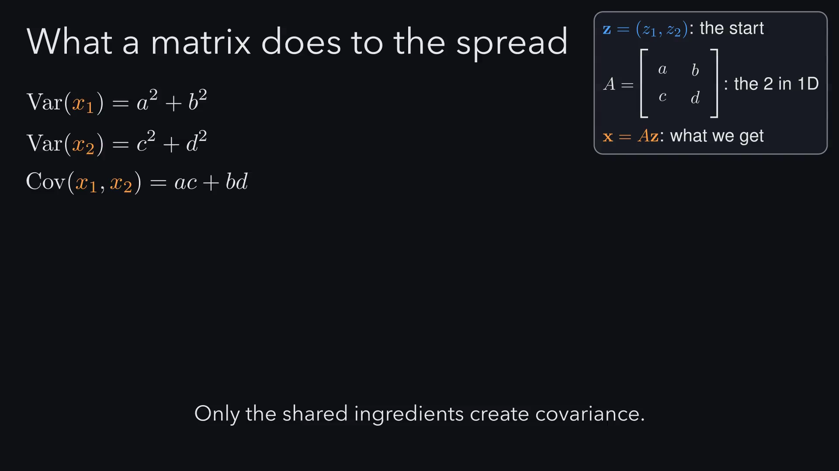
Notes:
Let's name our characters. z is the random point we start with, A is
the matrix we multiply by, and x is the point we get out. Each new
variable is a mix of z₁ and z₂, independent spreads add, and
covariance only comes from shared ingredients. Put those in a matrix
and it's exactly A times A transpose, the nD version of 'scaling by a
multiplies variance by a²'. So the real question is: what A gives
A Aᵀ = Σ?

Slide 39
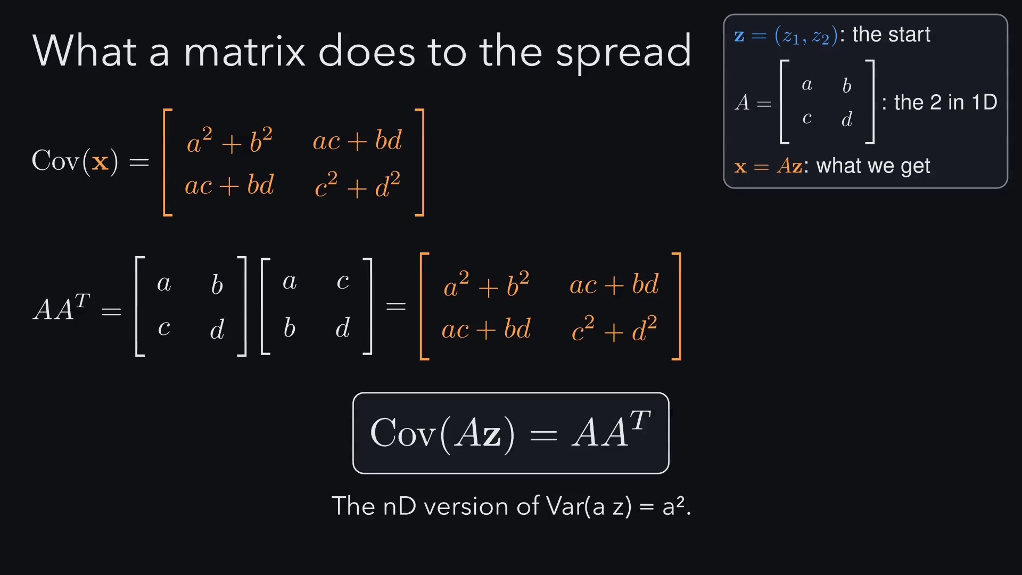
Notes:
Let's name our characters. z is the random point we start with, A is
the matrix we multiply by, and x is the point we get out. Each new
variable is a mix of z₁ and z₂, independent spreads add, and
covariance only comes from shared ingredients. Put those in a matrix
and it's exactly A times A transpose, the nD version of 'scaling by a
multiplies variance by a²'. So the real question is: what A gives
A Aᵀ = Σ?

Slide 40
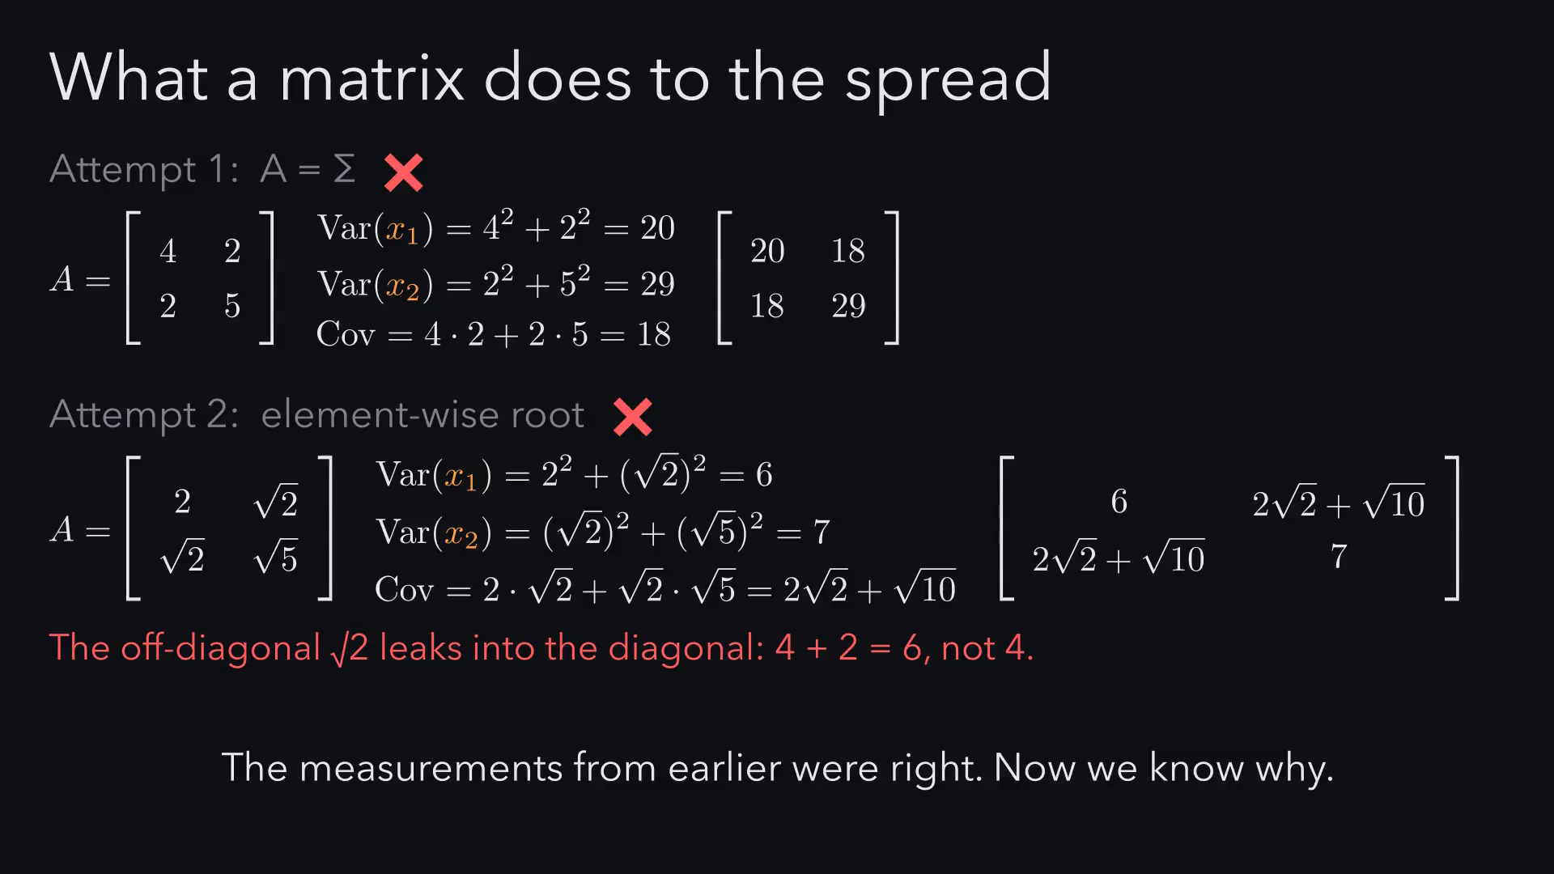
Notes:
Let's name our characters. z is the random point we start with, A is
the matrix we multiply by, and x is the point we get out. Each new
variable is a mix of z₁ and z₂, independent spreads add, and
covariance only comes from shared ingredients. Put those in a matrix
and it's exactly A times A transpose, the nD version of 'scaling by a
multiplies variance by a²'. So the real question is: what A gives
A Aᵀ = Σ?

Slide 41
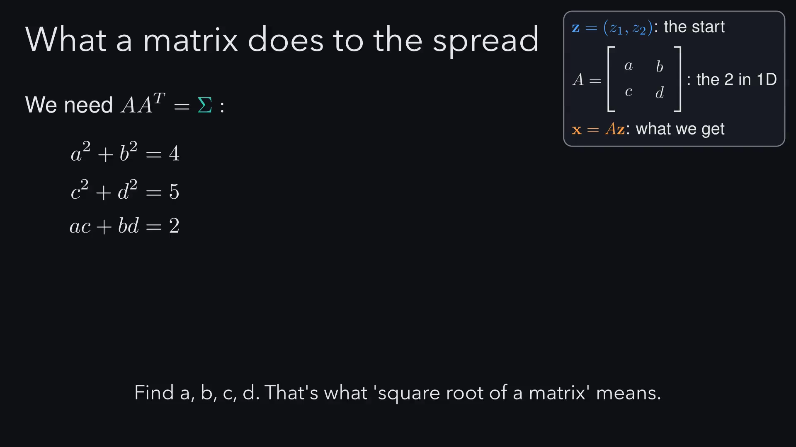
Notes:
So a square root of Σ means any matrix A with A A transpose equal to
Σ, just like σ times σ is σ² in one dimension. But it is not unique.
If we rotate the round cloud first, it still looks exactly the same,
so A times any rotation Q works too. We need a rule to pick one.

Slide 42
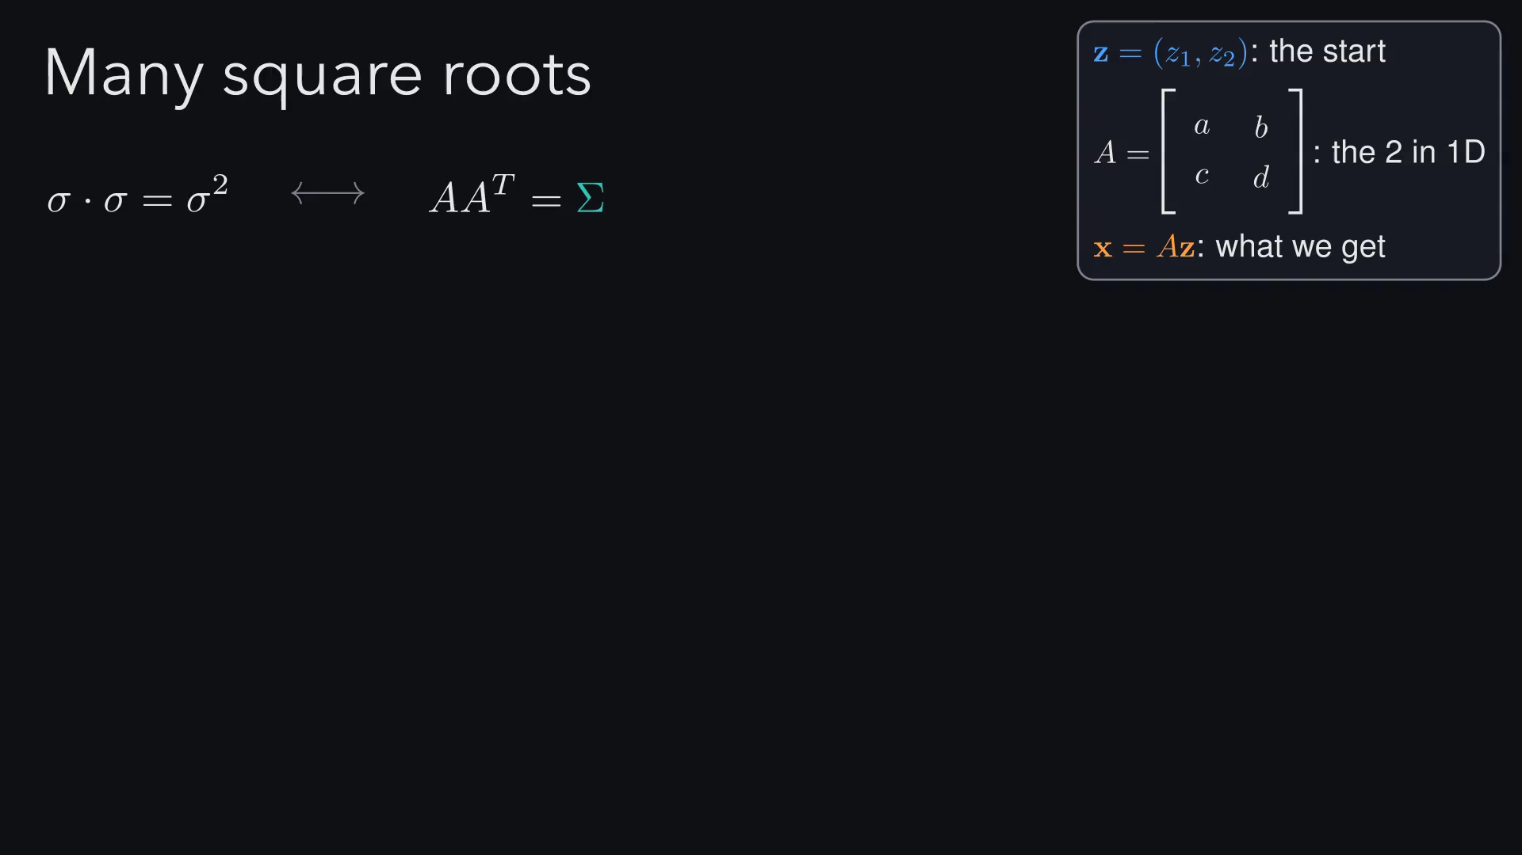
Notes:
So a square root of Σ means any matrix A with A A transpose equal to
Σ, just like σ times σ is σ² in one dimension. But it is not unique.
If we rotate the round cloud first, it still looks exactly the same,
so A times any rotation Q works too. We need a rule to pick one.

Slide 43
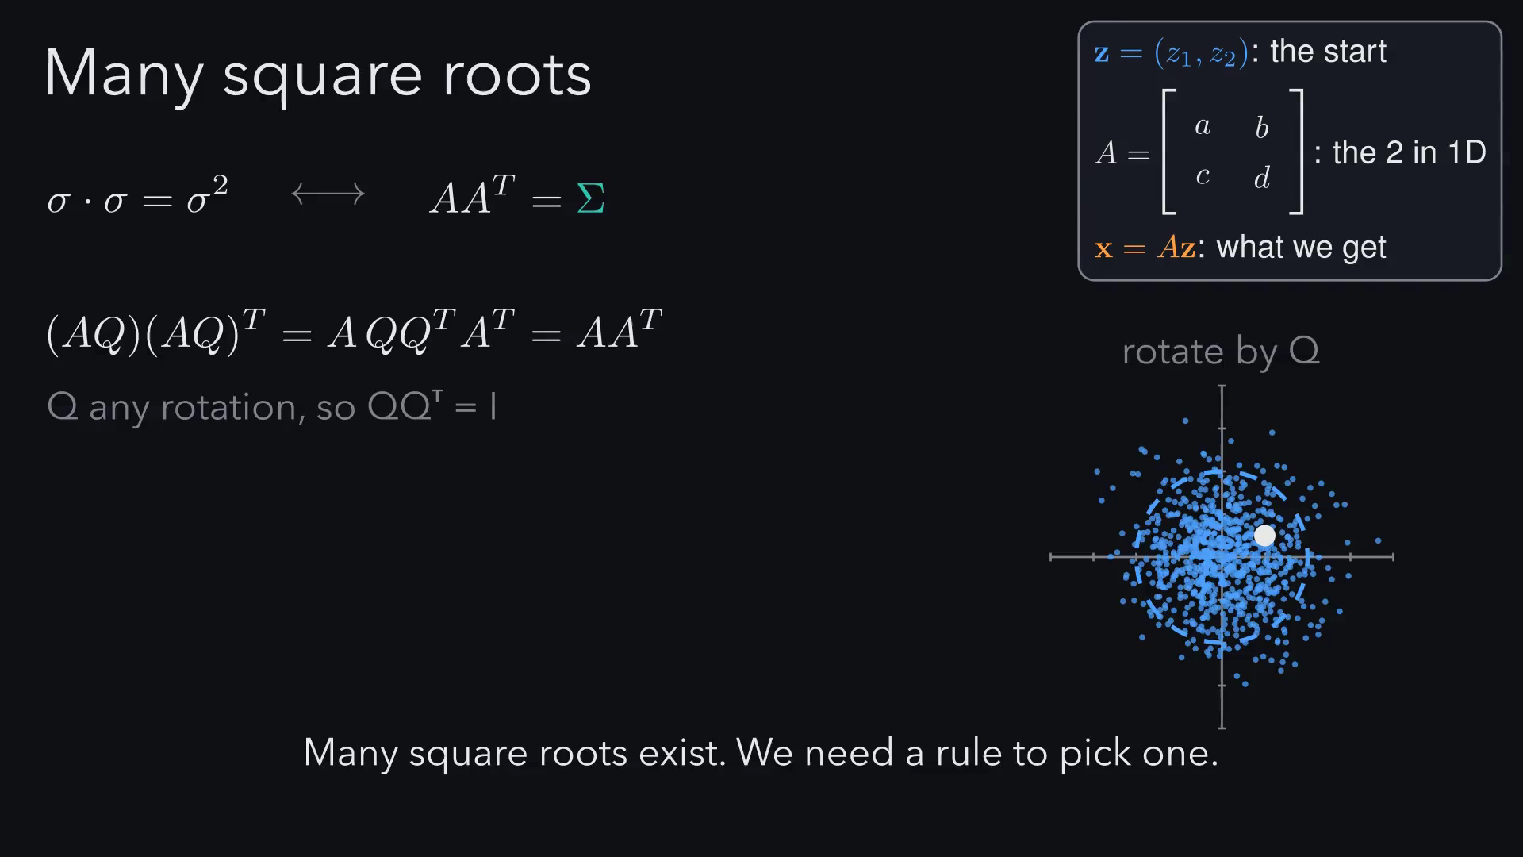
Notes:
Here is the rule. Force the top-right entry of A to zero, and the
three equations untangle: the first gives a, then the third gives c,
then the second gives d. That triangular A is the Cholesky factor,
and from now on we call it G. It is unique, it exists exactly when Σ
is positive definite, and it is fast. And note the test is G times G
transpose, not G times G.

Slide 44
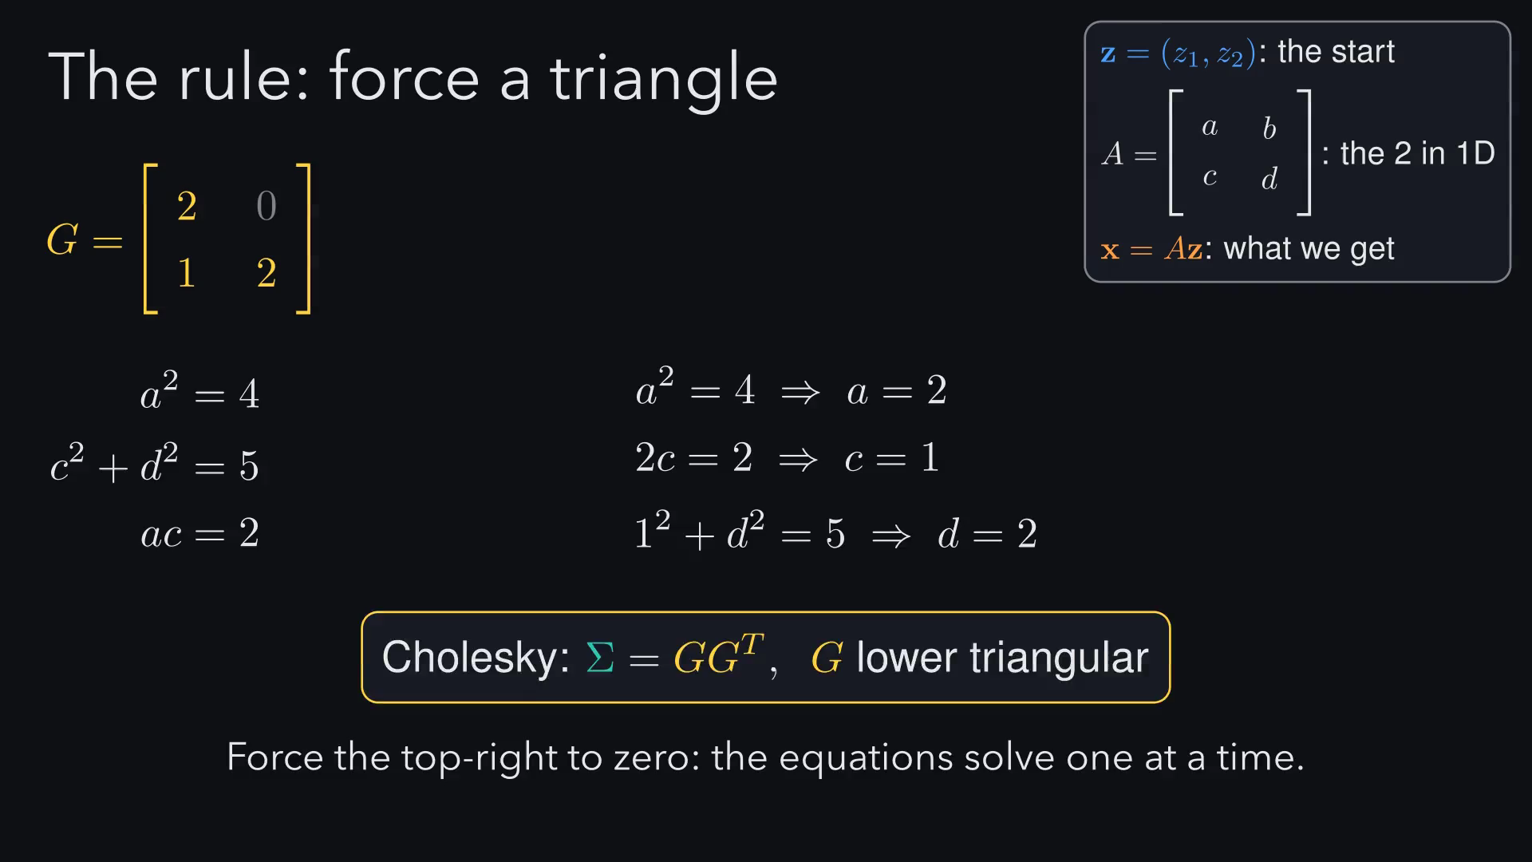
Notes:
Here is the rule. Force the top-right entry of A to zero, and the
three equations untangle: the first gives a, then the third gives c,
then the second gives d. That triangular A is the Cholesky factor,
and from now on we call it G. It is unique, it exists exactly when Σ
is positive definite, and it is fast. And note the test is G times G
transpose, not G times G.

Slide 45
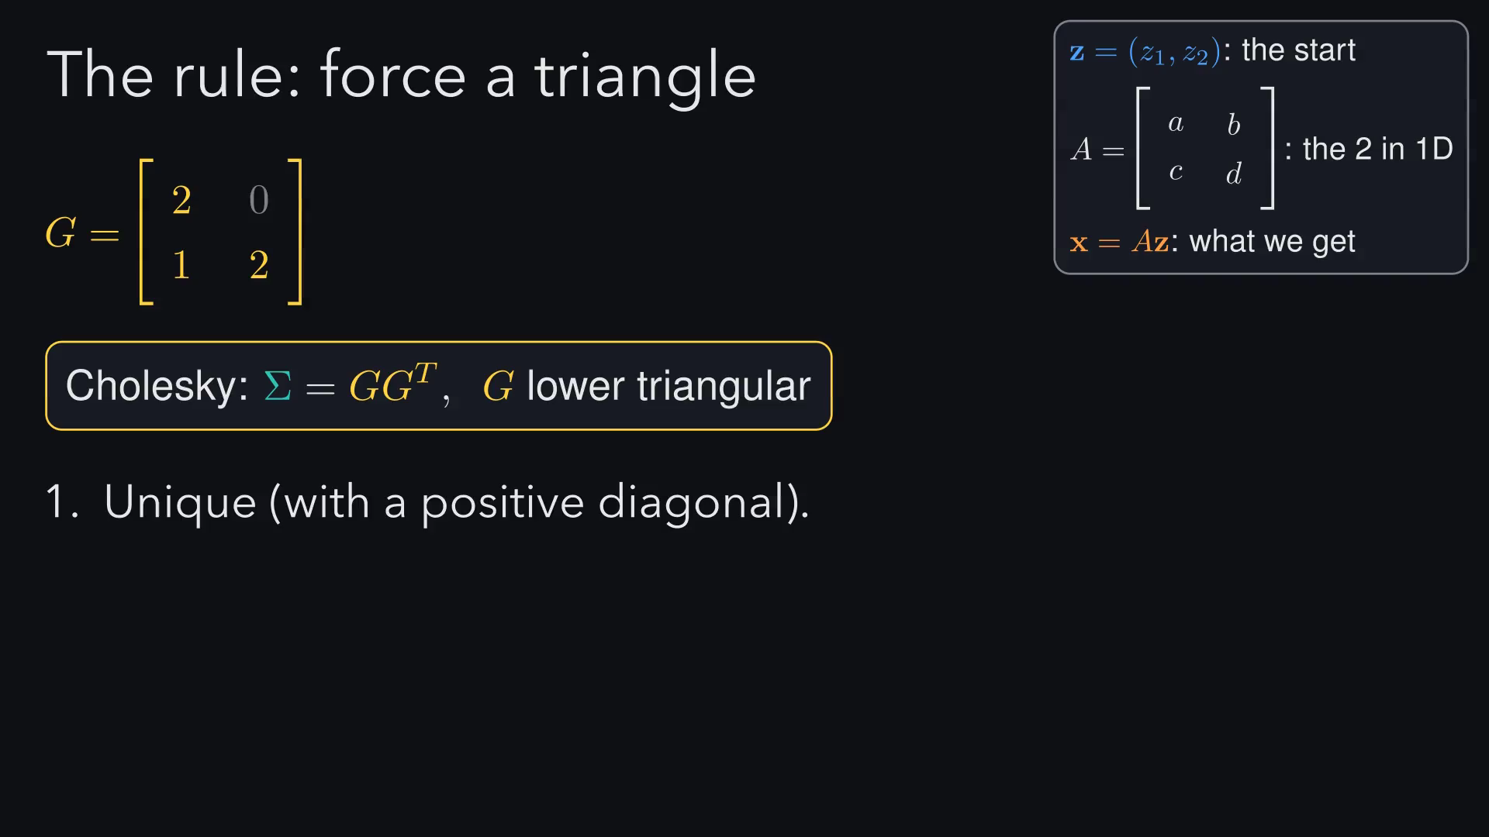
Notes:
Here is the rule. Force the top-right entry of A to zero, and the
three equations untangle: the first gives a, then the third gives c,
then the second gives d. That triangular A is the Cholesky factor,
and from now on we call it G. It is unique, it exists exactly when Σ
is positive definite, and it is fast. And note the test is G times G
transpose, not G times G.

Slide 46
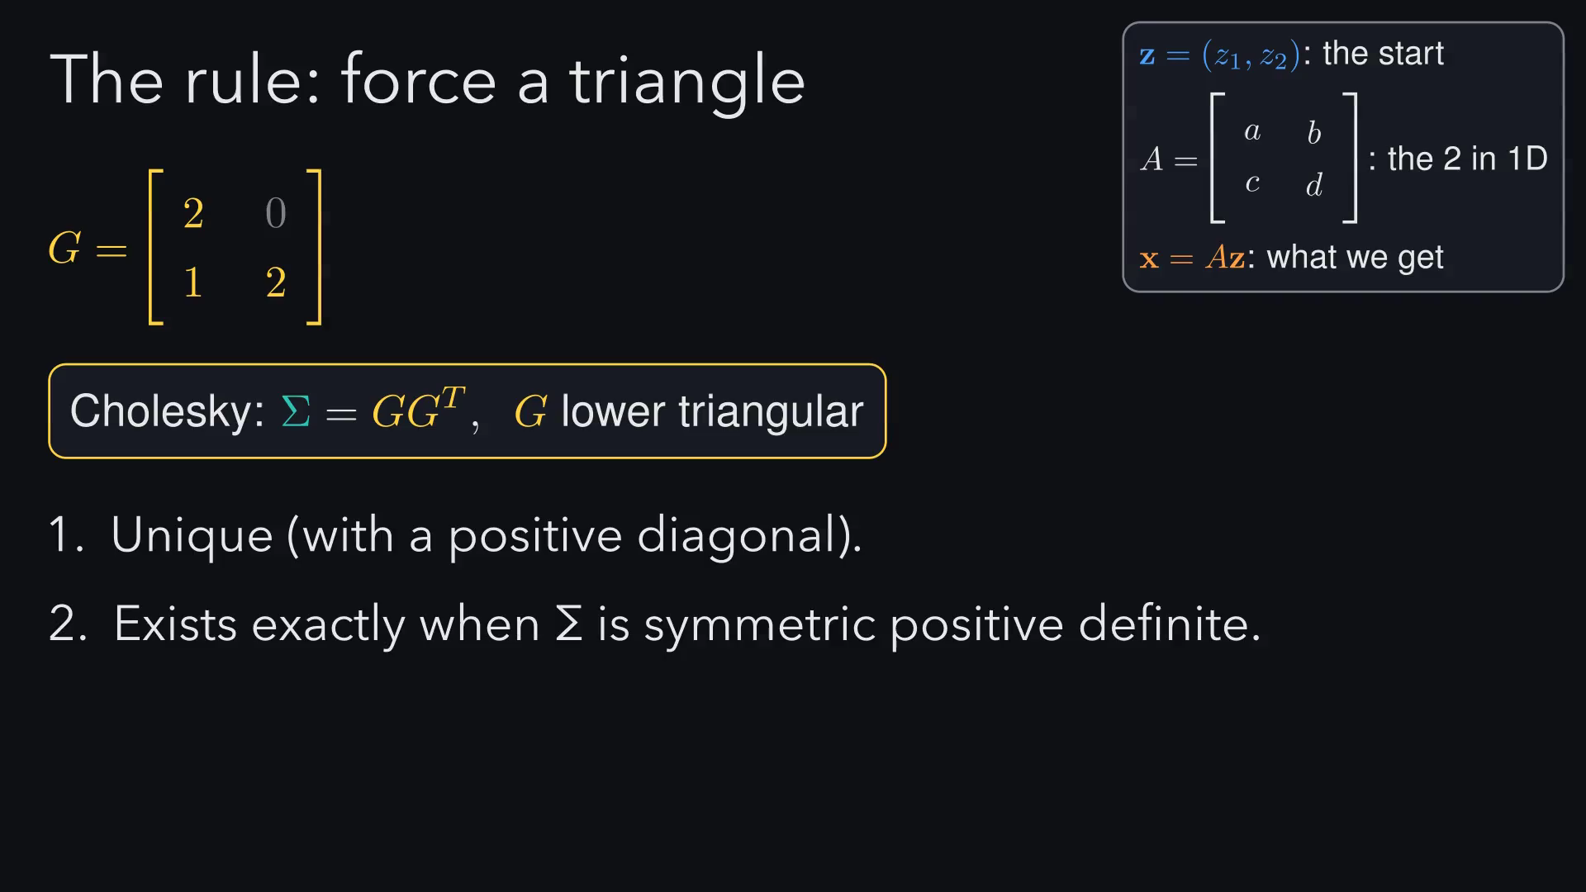
Notes:
Here is the rule. Force the top-right entry of A to zero, and the
three equations untangle: the first gives a, then the third gives c,
then the second gives d. That triangular A is the Cholesky factor,
and from now on we call it G. It is unique, it exists exactly when Σ
is positive definite, and it is fast. And note the test is G times G
transpose, not G times G.

Slide 47
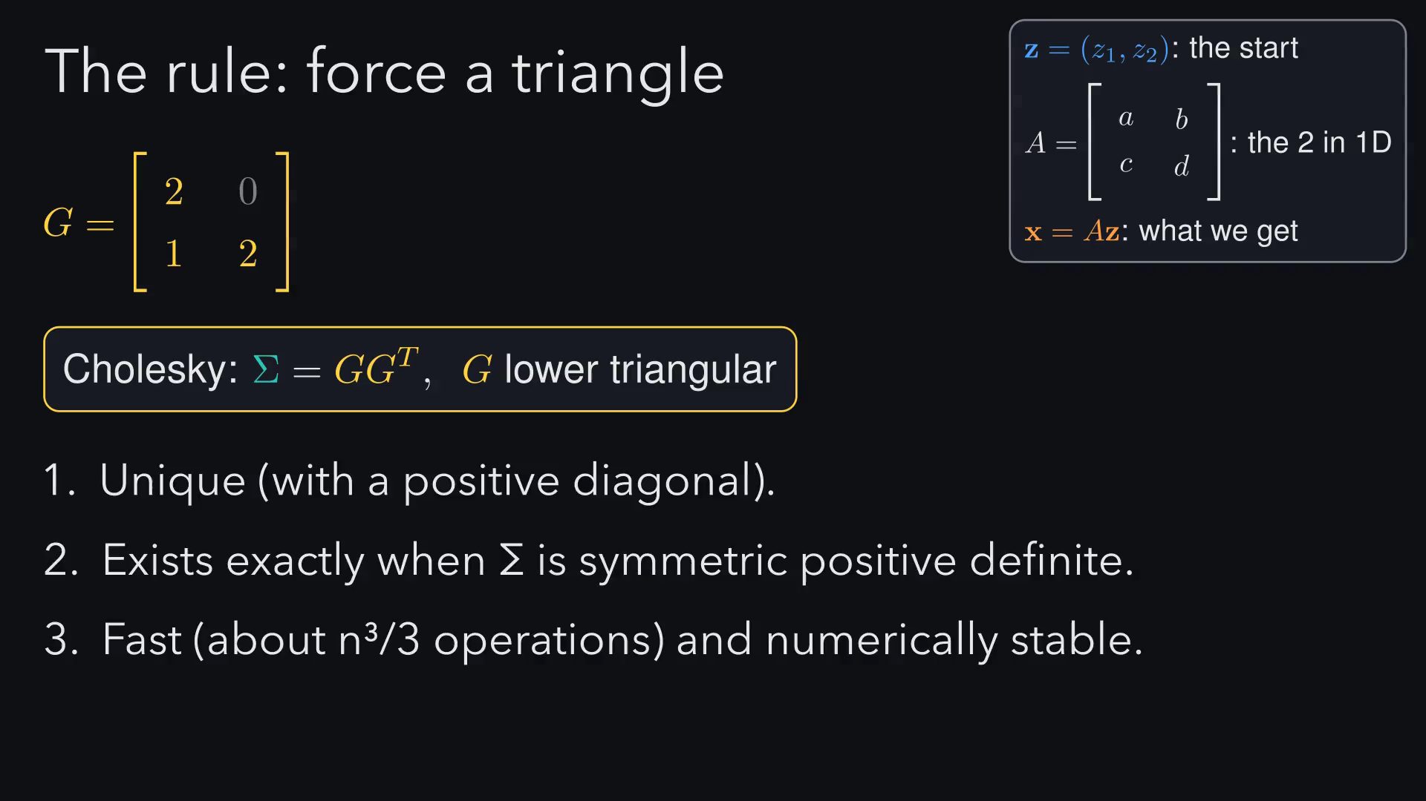
Notes:
Here is the rule. Force the top-right entry of A to zero, and the
three equations untangle: the first gives a, then the third gives c,
then the second gives d. That triangular A is the Cholesky factor,
and from now on we call it G. It is unique, it exists exactly when Σ
is positive definite, and it is fast. And note the test is G times G
transpose, not G times G.

Slide 48
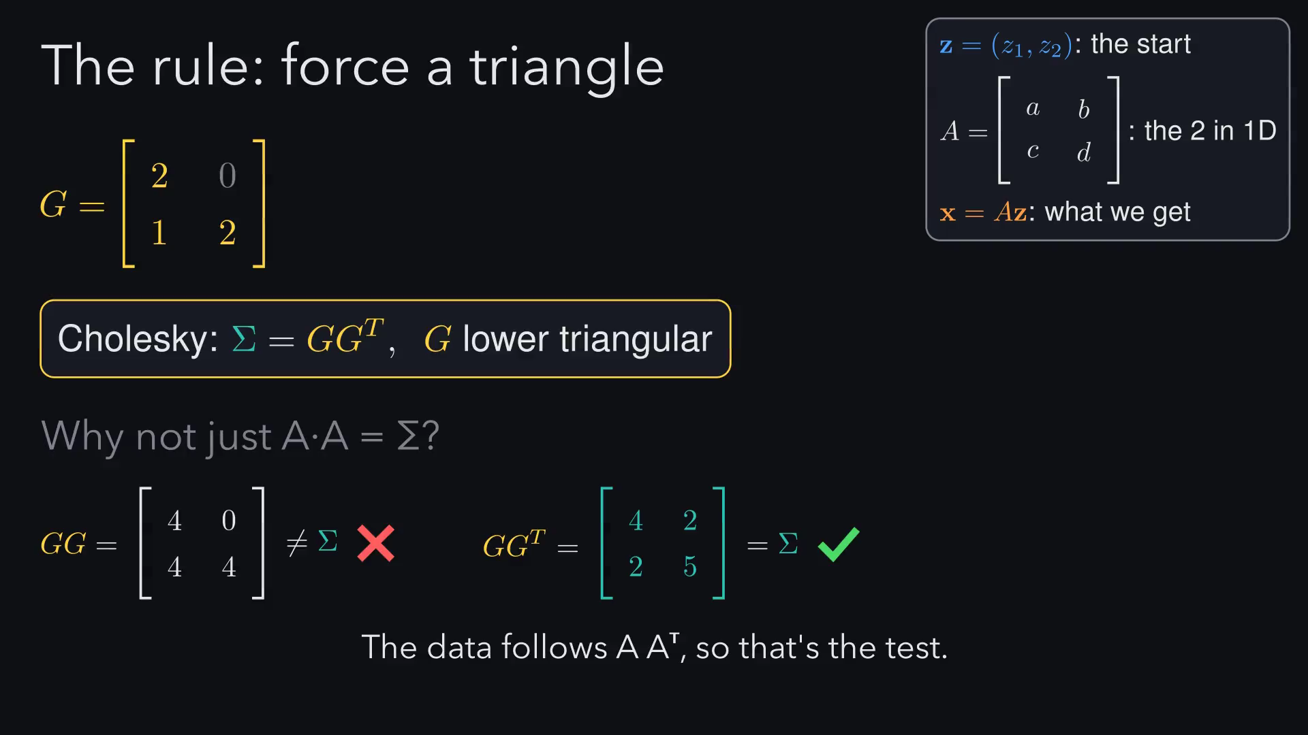
Notes:
We already know how to factor a matrix: Gaussian elimination. Each
step subtracts a multiple of one row from another. We record those
multipliers in L, and what's left is U.

Slide 49
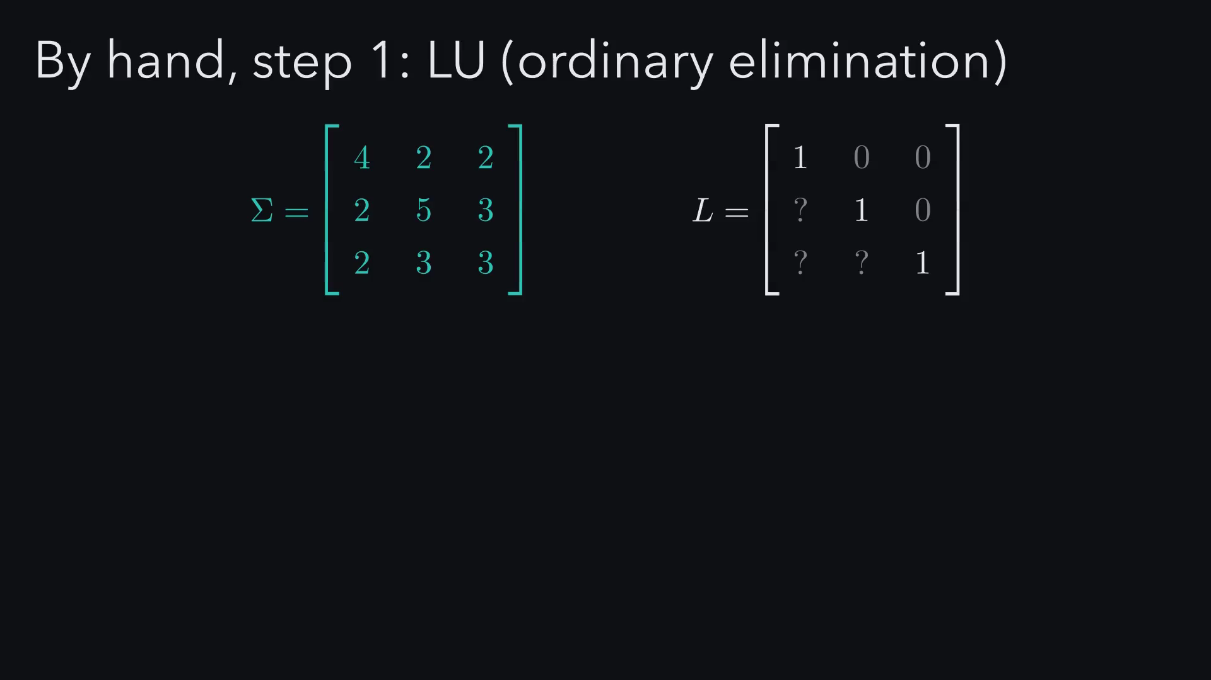
Notes:
We already know how to factor a matrix: Gaussian elimination. Each
step subtracts a multiple of one row from another. We record those
multipliers in L, and what's left is U.

Slide 50
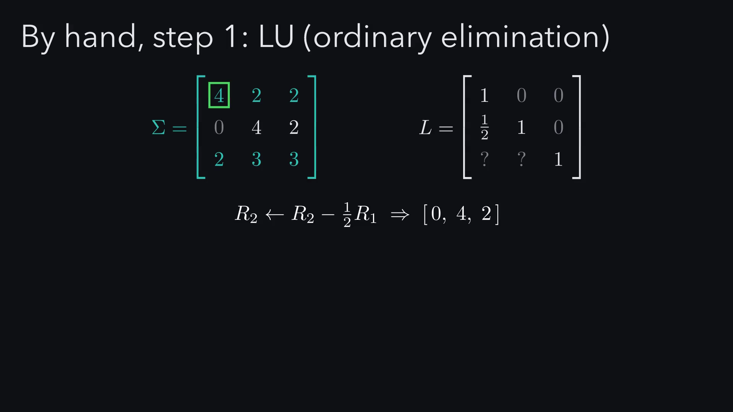
Notes:
We already know how to factor a matrix: Gaussian elimination. Each
step subtracts a multiple of one row from another. We record those
multipliers in L, and what's left is U.

Slide 51
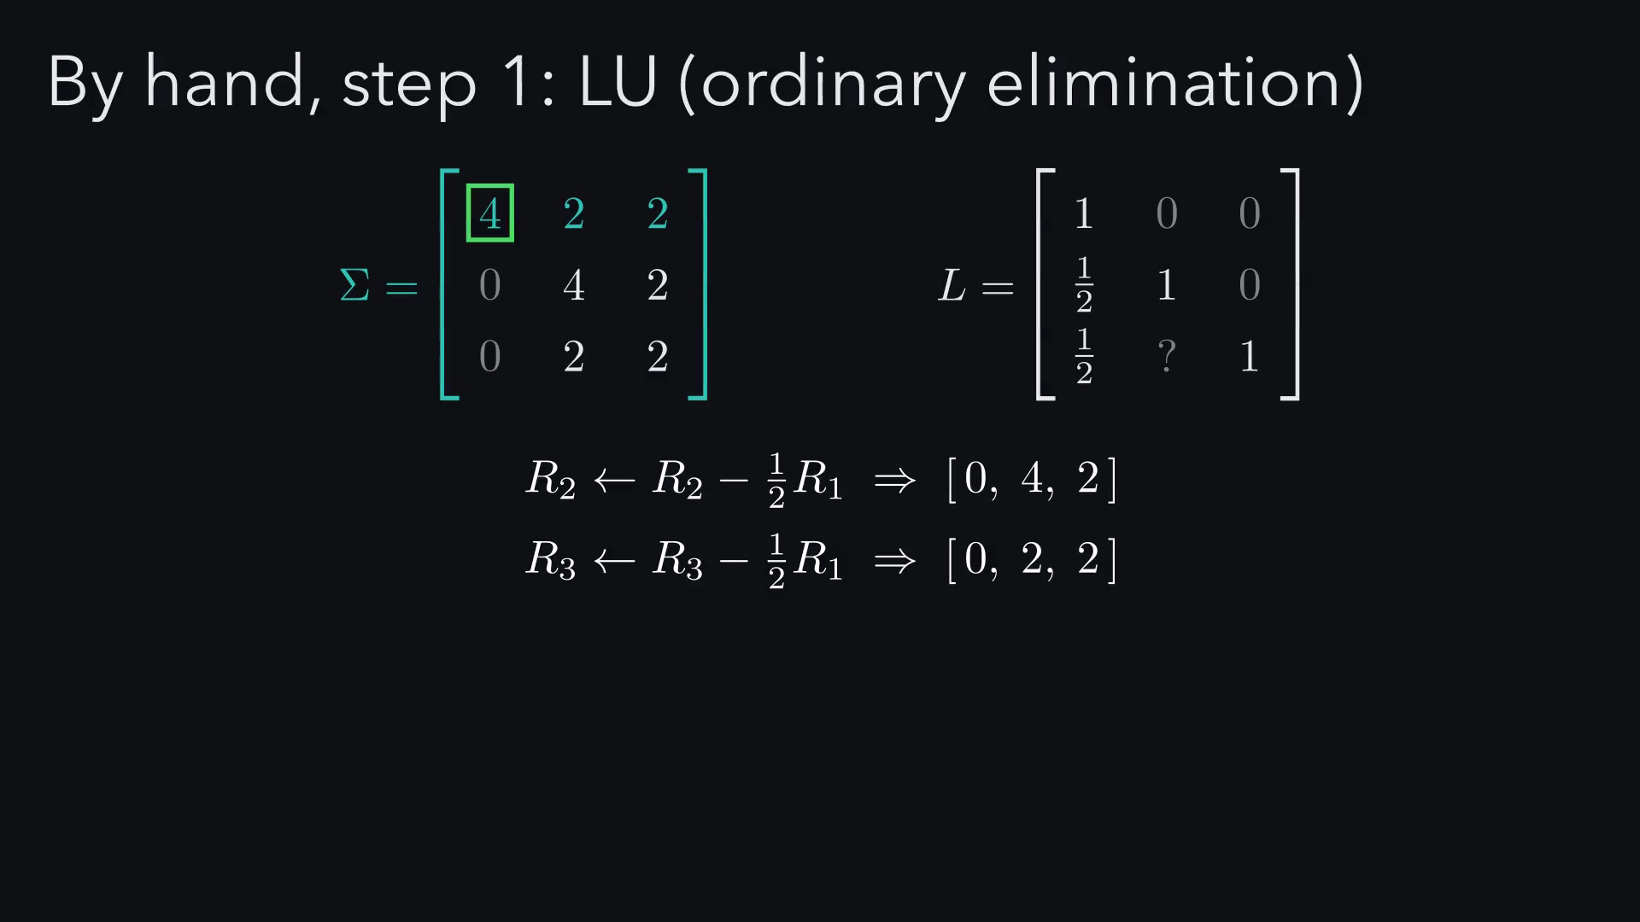
Notes:
We already know how to factor a matrix: Gaussian elimination. Each
step subtracts a multiple of one row from another. We record those
multipliers in L, and what's left is U.

Slide 52
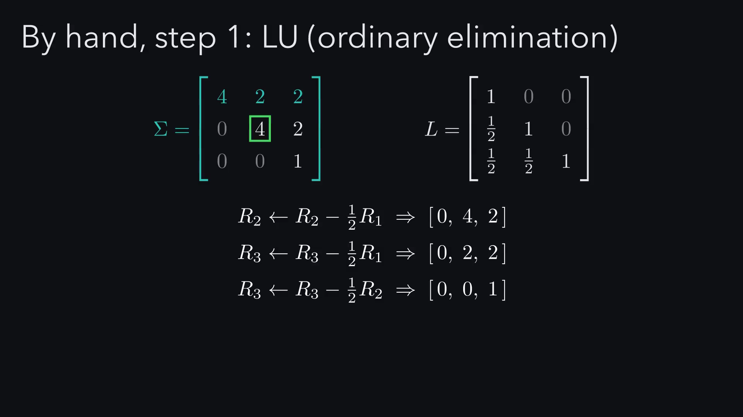
Notes:
We already know how to factor a matrix: Gaussian elimination. Each
step subtracts a multiple of one row from another. We record those
multipliers in L, and what's left is U.

Slide 53

Notes:
U's diagonal holds the pivots. If we pull them out into a diagonal
matrix D, we get L D V.

Slide 54

Notes:
U's diagonal holds the pivots. If we pull them out into a diagonal
matrix D, we get L D V.

Slide 55

Notes:
Because Σ is symmetric, V turns out to be exactly L transposed. So
Σ = L D Lᵀ.

Slide 56

Notes:
Because Σ is symmetric, V turns out to be exactly L transposed. So
Σ = L D Lᵀ.

Slide 57

Notes:
Because Σ is symmetric, V turns out to be exactly L transposed. So
Σ = L D Lᵀ.

Slide 58

Notes:
Now the trick: split D into two square roots and give one to each
side. L √D is our G, and Σ = G Gᵀ. That's Cholesky. It needs every
pivot to be strictly positive, which is exactly the positive definite
condition.

Slide 59

Notes:
Now the trick: split D into two square roots and give one to each
side. L √D is our G, and Σ = G Gᵀ. That's Cholesky. It needs every
pivot to be strictly positive, which is exactly the positive definite
condition.

Slide 60

Notes:
Now the trick: split D into two square roots and give one to each
side. L √D is our G, and Σ = G Gᵀ. That's Cholesky. It needs every
pivot to be strictly positive, which is exactly the positive definite
condition.

Slide 61

Notes:
Now the trick: split D into two square roots and give one to each
side. L √D is our G, and Σ = G Gᵀ. That's Cholesky. It needs every
pivot to be strictly positive, which is exactly the positive definite
condition.

Slide 62

Notes:
Now the trick: split D into two square roots and give one to each
side. L √D is our G, and Σ = G Gᵀ. That's Cholesky. It needs every
pivot to be strictly positive, which is exactly the positive definite
condition.

Slide 63

Notes:
In practice, you skip the detour and solve for G directly, column by
column. Same numbers, and the general formula is just that pattern
written down.

Slide 64

Notes:
In practice, you skip the detour and solve for G directly, column by
column. Same numbers, and the general formula is just that pattern
written down.

Slide 65

Notes:
In practice, you skip the detour and solve for G directly, column by
column. Same numbers, and the general formula is just that pattern
written down.

Slide 66

Notes:
Back to our 2 by 2, where G is 2, 0, 1, 2. The whole algorithm is
four lines: choose μ and Σ, factor Σ, draw independent normals, and
compute μ plus G z. Watch the grid: G shears the whole plane, the
circle becomes an ellipse, and then everything shifts by μ. Our
tracked point lands exactly at 2, 0.5, and in NumPy it is three lines.

Slide 67

Notes:
Back to our 2 by 2, where G is 2, 0, 1, 2. The whole algorithm is
four lines: choose μ and Σ, factor Σ, draw independent normals, and
compute μ plus G z. Watch the grid: G shears the whole plane, the
circle becomes an ellipse, and then everything shifts by μ. Our
tracked point lands exactly at 2, 0.5, and in NumPy it is three lines.

Slide 68

Notes:
Back to our 2 by 2, where G is 2, 0, 1, 2. The whole algorithm is
four lines: choose μ and Σ, factor Σ, draw independent normals, and
compute μ plus G z. Watch the grid: G shears the whole plane, the
circle becomes an ellipse, and then everything shifts by μ. Our
tracked point lands exactly at 2, 0.5, and in NumPy it is three lines.

Slide 69

Notes:
Back to our 2 by 2, where G is 2, 0, 1, 2. The whole algorithm is
four lines: choose μ and Σ, factor Σ, draw independent normals, and
compute μ plus G z. Watch the grid: G shears the whole plane, the
circle becomes an ellipse, and then everything shifts by μ. Our
tracked point lands exactly at 2, 0.5, and in NumPy it is three lines.

Slide 70

Notes:
Back to our 2 by 2, where G is 2, 0, 1, 2. The whole algorithm is
four lines: choose μ and Σ, factor Σ, draw independent normals, and
compute μ plus G z. Watch the grid: G shears the whole plane, the
circle becomes an ellipse, and then everything shifts by μ. Our
tracked point lands exactly at 2, 0.5, and in NumPy it is three lines.

Slide 71

Notes:
The sampler is built, so let's put it to work. This section is part
b of the brief: we check that it really produces Sigma, then turn
the dial on Sigma and watch the data respond.

Slide 72

Notes:
We built a sampler, but does it really produce the Sigma we asked
for? Measured from 20,000 samples, the mean and covariance
match the targets to about two decimal places, and the dots fill the
1 and 2 sigma contours just as the density predicts. The 3 by 3 G we
computed by hand in 2.4 passes the same test.

Slide 73

Notes:
We built a sampler, but does it really produce the Sigma we asked
for? Measured from 20,000 samples, the mean and covariance
match the targets to about two decimal places, and the dots fill the
1 and 2 sigma contours just as the density predicts. The 3 by 3 G we
computed by hand in 2.4 passes the same test.

Slide 74

Notes:
We built a sampler, but does it really produce the Sigma we asked
for? Measured from 20,000 samples, the mean and covariance
match the targets to about two decimal places, and the dots fill the
1 and 2 sigma contours just as the density predicts. The 3 by 3 G we
computed by hand in 2.4 passes the same test.

Slide 75

Notes:
We built a sampler, but does it really produce the Sigma we asked
for? Measured from 20,000 samples, the mean and covariance
match the targets to about two decimal places, and the dots fill the
1 and 2 sigma contours just as the density predicts. The 3 by 3 G we
computed by hand in 2.4 passes the same test.

Slide 76

Notes:
Now we trust the machine, so let's feed it different Sigmas. Every
panel starts from exactly the same z, so the only thing changing is
G. The identity does nothing, a diagonal G stretches each axis by a
square root, and an off-diagonal entry shears the grid and tilts the
cloud one way or the other.

Slide 77

Notes:
Now we trust the machine, so let's feed it different Sigmas. Every
panel starts from exactly the same z, so the only thing changing is
G. The identity does nothing, a diagonal G stretches each axis by a
square root, and an off-diagonal entry shears the grid and tilts the
cloud one way or the other.

Slide 78

Notes:
Now we trust the machine, so let's feed it different Sigmas. Every
panel starts from exactly the same z, so the only thing changing is
G. The identity does nothing, a diagonal G stretches each axis by a
square root, and an off-diagonal entry shears the grid and tilts the
cloud one way or the other.

Slide 79

Notes:
Now we trust the machine, so let's feed it different Sigmas. Every
panel starts from exactly the same z, so the only thing changing is
G. The identity does nothing, a diagonal G stretches each axis by a
square root, and an off-diagonal entry shears the grid and tilts the
cloud one way or the other.

Slide 80

Notes:
Now we trust the machine, so let's feed it different Sigmas. Every
panel starts from exactly the same z, so the only thing changing is
G. The identity does nothing, a diagonal G stretches each axis by a
square root, and an off-diagonal entry shears the grid and tilts the
cloud one way or the other.

Slide 81

Notes:
Now we trust the machine, so let's feed it different Sigmas. Every
panel starts from exactly the same z, so the only thing changing is
G. The identity does nothing, a diagonal G stretches each axis by a
square root, and an off-diagonal entry shears the grid and tilts the
cloud one way or the other.

Slide 82

Notes:
Cholesky told us how to build this cloud. Eigenvectors tell us how
to read it. Most arrows turn when I multiply them by Sigma, but two
directions only stretch: the diagonal by 9 and the other diagonal by
1. Their square roots, 3 and 1, are exactly how spread out the cloud
is along each axis.

Slide 83

Notes:
Cholesky told us how to build this cloud. Eigenvectors tell us how
to read it. Most arrows turn when I multiply them by Sigma, but two
directions only stretch: the diagonal by 9 and the other diagonal by
1. Their square roots, 3 and 1, are exactly how spread out the cloud
is along each axis.

Slide 84

Notes:
Cholesky told us how to build this cloud. Eigenvectors tell us how
to read it. Most arrows turn when I multiply them by Sigma, but two
directions only stretch: the diagonal by 9 and the other diagonal by
1. Their square roots, 3 and 1, are exactly how spread out the cloud
is along each axis.

Slide 85

Notes:
Cholesky told us how to build this cloud. Eigenvectors tell us how
to read it. Most arrows turn when I multiply them by Sigma, but two
directions only stretch: the diagonal by 9 and the other diagonal by
1. Their square roots, 3 and 1, are exactly how spread out the cloud
is along each axis.

Slide 86

Notes:
Cholesky told us how to build this cloud. Eigenvectors tell us how
to read it. Most arrows turn when I multiply them by Sigma, but two
directions only stretch: the diagonal by 9 and the other diagonal by
1. Their square roots, 3 and 1, are exactly how spread out the cloud
is along each axis.

Slide 87

Notes:
Cholesky told us how to build this cloud. Eigenvectors tell us how
to read it. Most arrows turn when I multiply them by Sigma, but two
directions only stretch: the diagonal by 9 and the other diagonal by
1. Their square roots, 3 and 1, are exactly how spread out the cloud
is along each axis.

Slide 88

Notes:
Cholesky told us how to build this cloud. Eigenvectors tell us how
to read it. Most arrows turn when I multiply them by Sigma, but two
directions only stretch: the diagonal by 9 and the other diagonal by
1. Their square roots, 3 and 1, are exactly how spread out the cloud
is along each axis.

Slide 89

Notes:
Let's run the same machine from 2.4 while turning rho up.
Elimination leaves a second pivot of 1 minus rho squared, and its
square root is the only entry in G that gives the cloud any
thickness. At exactly rho equals 1 the pivot hits zero, x2 is just a
copy of x1, and NumPy refuses to factor it. Push past 1 and the
pivot goes negative: there's no square root at all, because no real
data could have that covariance.

Slide 90

Notes:
Let's run the same machine from 2.4 while turning rho up.
Elimination leaves a second pivot of 1 minus rho squared, and its
square root is the only entry in G that gives the cloud any
thickness. At exactly rho equals 1 the pivot hits zero, x2 is just a
copy of x1, and NumPy refuses to factor it. Push past 1 and the
pivot goes negative: there's no square root at all, because no real
data could have that covariance.

Slide 91

Notes:
Let's run the same machine from 2.4 while turning rho up.
Elimination leaves a second pivot of 1 minus rho squared, and its
square root is the only entry in G that gives the cloud any
thickness. At exactly rho equals 1 the pivot hits zero, x2 is just a
copy of x1, and NumPy refuses to factor it. Push past 1 and the
pivot goes negative: there's no square root at all, because no real
data could have that covariance.

Slide 92

Notes:
Let's run the same machine from 2.4 while turning rho up.
Elimination leaves a second pivot of 1 minus rho squared, and its
square root is the only entry in G that gives the cloud any
thickness. At exactly rho equals 1 the pivot hits zero, x2 is just a
copy of x1, and NumPy refuses to factor it. Push past 1 and the
pivot goes negative: there's no square root at all, because no real
data could have that covariance.

Slide 93

Notes:
Let's run the same machine from 2.4 while turning rho up.
Elimination leaves a second pivot of 1 minus rho squared, and its
square root is the only entry in G that gives the cloud any
thickness. At exactly rho equals 1 the pivot hits zero, x2 is just a
copy of x1, and NumPy refuses to factor it. Push past 1 and the
pivot goes negative: there's no square root at all, because no real
data could have that covariance.

Slide 94

Notes:
Let's run the same machine from 2.4 while turning rho up.
Elimination leaves a second pivot of 1 minus rho squared, and its
square root is the only entry in G that gives the cloud any
thickness. At exactly rho equals 1 the pivot hits zero, x2 is just a
copy of x1, and NumPy refuses to factor it. Push past 1 and the
pivot goes negative: there's no square root at all, because no real
data could have that covariance.

Slide 95

Notes:
Let's run the same machine from 2.4 while turning rho up.
Elimination leaves a second pivot of 1 minus rho squared, and its
square root is the only entry in G that gives the cloud any
thickness. At exactly rho equals 1 the pivot hits zero, x2 is just a
copy of x1, and NumPy refuses to factor it. Push past 1 and the
pivot goes negative: there's no square root at all, because no real
data could have that covariance.

Slide 96

Notes:
Let's run the same machine from 2.4 while turning rho up.
Elimination leaves a second pivot of 1 minus rho squared, and its
square root is the only entry in G that gives the cloud any
thickness. At exactly rho equals 1 the pivot hits zero, x2 is just a
copy of x1, and NumPy refuses to factor it. Push past 1 and the
pivot goes negative: there's no square root at all, because no real
data could have that covariance.

Slide 97
Notes:
To finish, a quick recap, a second look at the smooth curves from
the start, and the limits of the method.

Slide 98

Notes:
To recap: we start from independent noise that any computer can
produce, factor our chosen Sigma into G times G transpose, and apply
x equals mu plus G z. The result has exactly the correlation
structure we asked for.

Slide 99

Notes:
Remember the smooth random curves from the very start? Now we can
say exactly what happened. Each jagged row of 60
independent values is z, and multiplying by G, the Cholesky factor
of the kernel, mixes neighbouring points together so the curve comes
out smooth. It is the same x equals G z, just in 60
dimensions instead of 2.

Slide 100

Notes:
Three limits. First, Cholesky needs every pivot strictly positive;
at rho equal to 1 the pivot hit zero and it stopped. Second, the
eigen square root from the eigen view still works there, because
the square root of a zero eigenvalue is just zero, which is why
NumPy's multivariate normal uses SVD by default, even though it is
slower. Third, this only makes Gaussian data, and real returns have
fat tails, but the usual fixes, like multivariate t and Gaussian
copulas, still get their correlation from the same x equals mu plus G z.

Slide 101

Notes:
Three limits. First, Cholesky needs every pivot strictly positive;
at rho equal to 1 the pivot hit zero and it stopped. Second, the
eigen square root from the eigen view still works there, because
the square root of a zero eigenvalue is just zero, which is why
NumPy's multivariate normal uses SVD by default, even though it is
slower. Third, this only makes Gaussian data, and real returns have
fat tails, but the usual fixes, like multivariate t and Gaussian
copulas, still get their correlation from the same x equals mu plus G z.

Slide 102

Notes:
Three limits. First, Cholesky needs every pivot strictly positive;
at rho equal to 1 the pivot hit zero and it stopped. Second, the
eigen square root from the eigen view still works there, because
the square root of a zero eigenvalue is just zero, which is why
NumPy's multivariate normal uses SVD by default, even though it is
slower. Third, this only makes Gaussian data, and real returns have
fat tails, but the usual fixes, like multivariate t and Gaussian
copulas, still get their correlation from the same x equals mu plus G z.

Slide 103

Notes:
Thank you for listening. We are happy to take any questions, and we
can jump back to any slide if it helps.

Slide 104

Notes:
A backup slide, in case anyone asks where the density formula comes
from. If we run x equals mu plus G z backwards with the change of
variables formula, the determinant of G gives the square root of
the determinant of Sigma, and the squared length of z becomes the
quadratic form. That is exactly the density from slide 1.4, and at
our worked point both sides give the same numbers.

Slide 105

Notes:
A backup slide, in case anyone asks where the density formula comes
from. If we run x equals mu plus G z backwards with the change of
variables formula, the determinant of G gives the square root of
the determinant of Sigma, and the squared length of z becomes the
quadratic form. That is exactly the density from slide 1.4, and at
our worked point both sides give the same numbers.

Slide 106

Notes:
A backup slide, in case anyone asks where the density formula comes
from. If we run x equals mu plus G z backwards with the change of
variables formula, the determinant of G gives the square root of
the determinant of Sigma, and the squared length of z becomes the
quadratic form. That is exactly the density from slide 1.4, and at
our worked point both sides give the same numbers.

Slide 107

Notes:
A backup slide, in case anyone asks where the density formula comes
from. If we run x equals mu plus G z backwards with the change of
variables formula, the determinant of G gives the square root of
the determinant of Sigma, and the squared length of z becomes the
quadratic form. That is exactly the density from slide 1.4, and at
our worked point both sides give the same numbers.

Slide 108

Notes:
A backup slide, in case anyone asks where the density formula comes
from. If we run x equals mu plus G z backwards with the change of
variables formula, the determinant of G gives the square root of
the determinant of Sigma, and the squared length of z becomes the
quadratic form. That is exactly the density from slide 1.4, and at
our worked point both sides give the same numbers.

