Slide 1
Data structures & Algorithm Project
G1 - Team 3

Slide 2



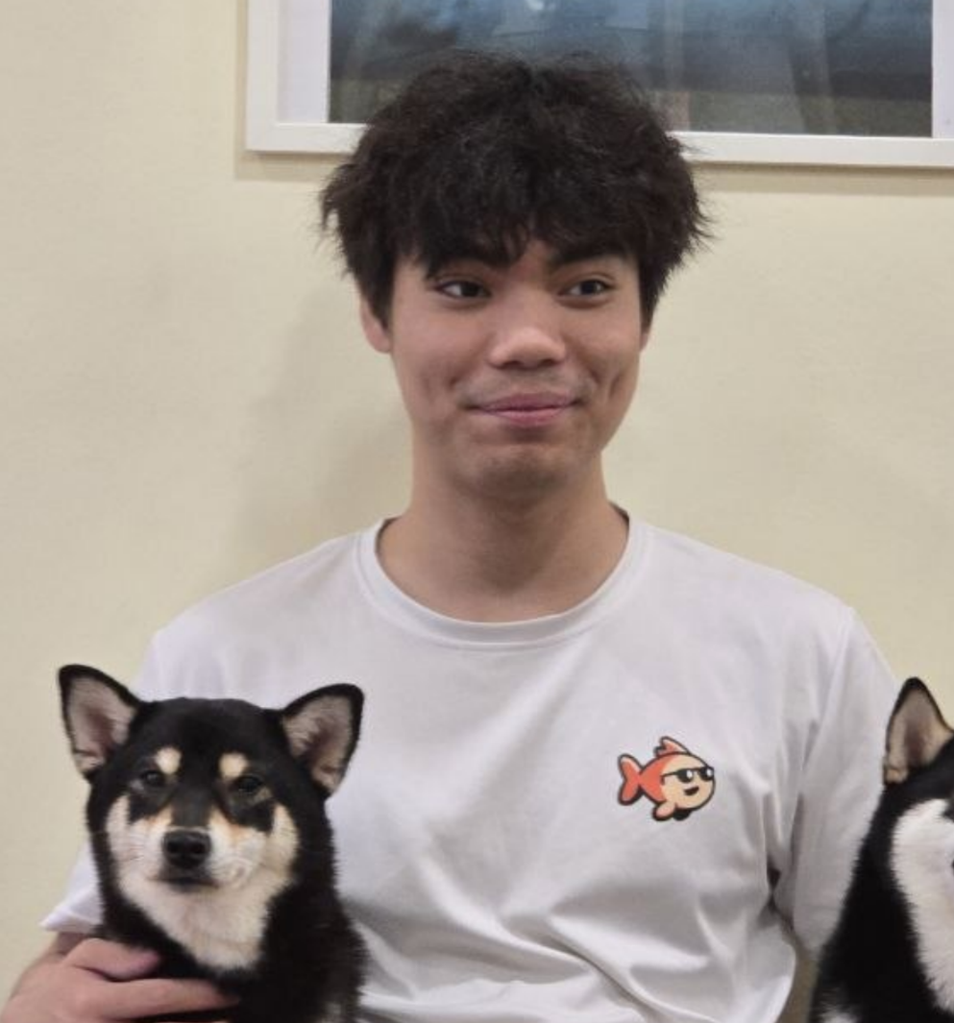

Our Team (G1 - Team 3)
Jocelyn
Luck
Yvonnie
Mun Yau
Wunna

Slide 3
Table of contents
Motivations
New TSP Variant
01
02
Redesign
AI Usage
03
04
Real-life scenario
What we changed
New data structure & algo
How we used AI

Slide 4
01
Motivations and Use cases
Why

Slide 5
Imagine…
A
Cmd
+
Z
C
Ctrl

Slide 6

You are a political party

Slide 7


General elections coming
A general election is coming. Every party wants to reach as many people as possible.

Slide 8

Different politicians, different starting points
One party, many members. Each politician sets off from their own base, with only 14 days to campaign.

Slide 9

They can’t visit everywhere!

Slide 10
Things to consider
Time is limited
90 towns, and every rally takes at least 1.7 hours
That’s 198 hours of rallies, before any driving
Kuala Lumpur has about 28 times as many people as our smallest town
Towns are not equal
Minimize overlaps

Slide 11
Hence!
Classic TSP is NOT enough

Slide 12
What’s wrong with classic TSP?
Not all stops are equal in priority
Clashes are minimised
Politicians have limited time
Bigger towns reach more people per rally
Two speakers at once split one crowd
14 days, 16 hours a day, then polling

Slide 13
How would you achieve that?
Max Reach
Population
Min. collision
Time-bound
Favour towns that reach the most people for the time spent
Teammates avoid rallying in the same town at once, because overlaps cost reach
14 days, 06:00–22:00, and everyone home by polling day

Slide 14
So the problem changes
Pick towns
Timing matters
Not every rally fits, so we pick which towns to visit
Every rally has a start and end time, not just an order
Repeats reach less
Plan as a team
A second rally soon after the first reaches fewer people
Each route depends on where the teammates are

Slide 15
02
Our TSP Variant
How

Slide 16





What’s different?
K politicians
Time bound
Clashes
Different points

Slide 17

What’s different?
Maximise reach

Slide 18



Multiple travellers
Limited time
Maximise rewards
Different bases
Clash handling
Time-dependent rewards
Team orienteering problem

Slide 19
Our TSP variant
Input
Output
90 towns
K politicians
Home bases
Travel time
Time limit
Reach parameters
Constraints
A timed route for each politician: the towns in order, each with arrive, start and finish times
The total population reached
Start/end at home
Rally 06:00–22:00
One rally per town each
Home by poll day

Slide 20
Inputs
How we used the data:
With different home base
How we calculate
Default inputs
90 towns
K politicians
Removing any data that doesn’t have ‘P’ or population is 0
Merging places to avoid double counting
Only places with at least 50k people
DEFAULT_HOMES = {
"Kuala Lumpur", "George Town", "Johor Bahru", "Kota Bharu", "Ipoh", "Kuantan", "Alor Setar" };
Travel time
Campaign time
straight-line distance × 1.3 ÷ 70 km/h
14 days
0600 - 2200

Slide 21

Inputs
Reach parameters
Discount for a repeat rally in the same town
Rate of how that discount fades
Rate of how voters forget early rallies
Clash penalty

Slide 22


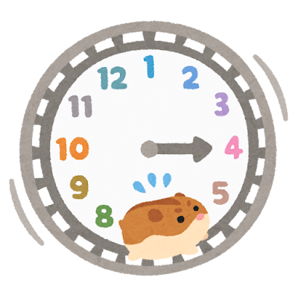


Constraints
Return home
Possible timings
Polling day ends
Only 1 visit
Daily window
Starts at their own home and is back there by the end of the campaign
Travel takes time. A rally can't start before the politician arrives.
There should be no rally after polling day
A politician rallies in each town at most once
Each rally fits inside one day's 6am – 10pm window

Slide 23
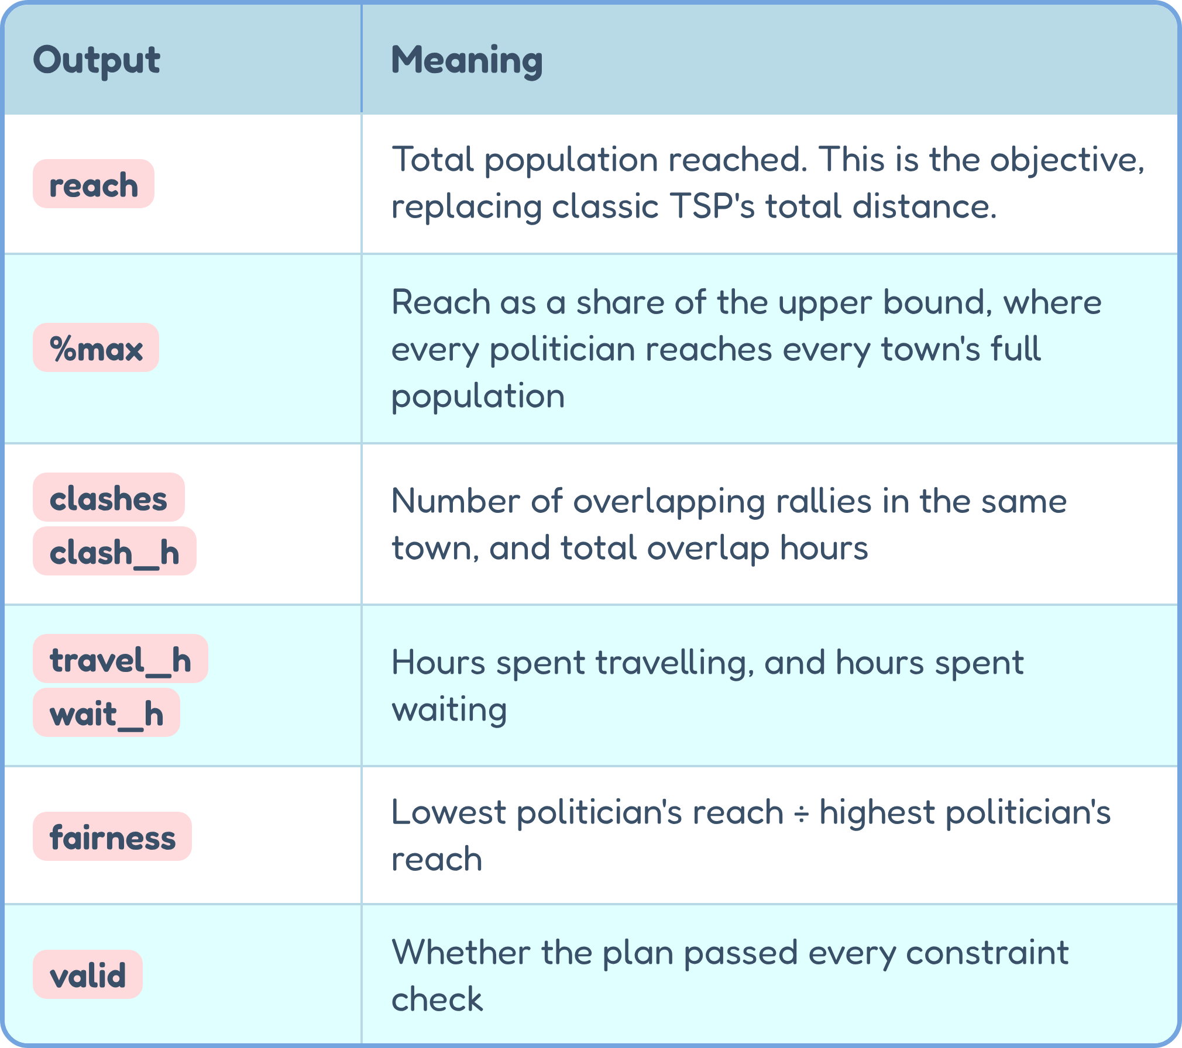
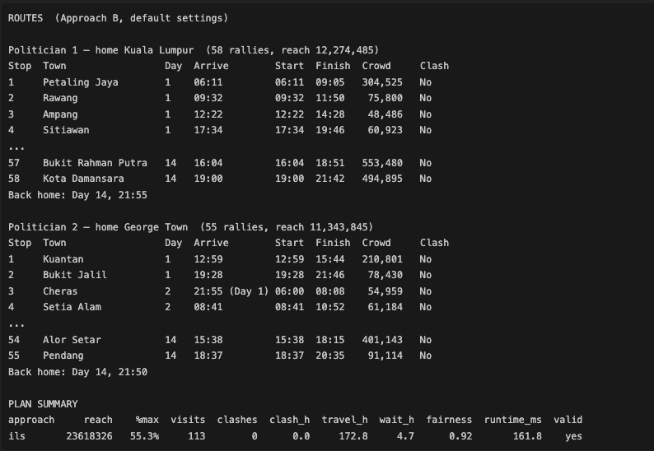
Output: A timed route + summary

Slide 24
03
Data structures & algorithms
How we redesigned classic TSP

Slide 25
Data structure: tracking routes
O(1) lookup, coordinates only
O((n + k)²) · lookup O(1) · 66 KB at defaults
A appends, amortised O(1) · B inserts, O(L)
check and set O(1)
Town Record
Travel-time matrix
vector<Town>
index = town id; homes are n, n+1, ...
vector<vector<double>>
(n + k)², homes included
Timed route
Visited flags per politician
routes[p]: vector<Visit>
{town, arrive, start, finish}
inRoute[p][town]: vector<vector<bool>>
k × n bits

Slide 26




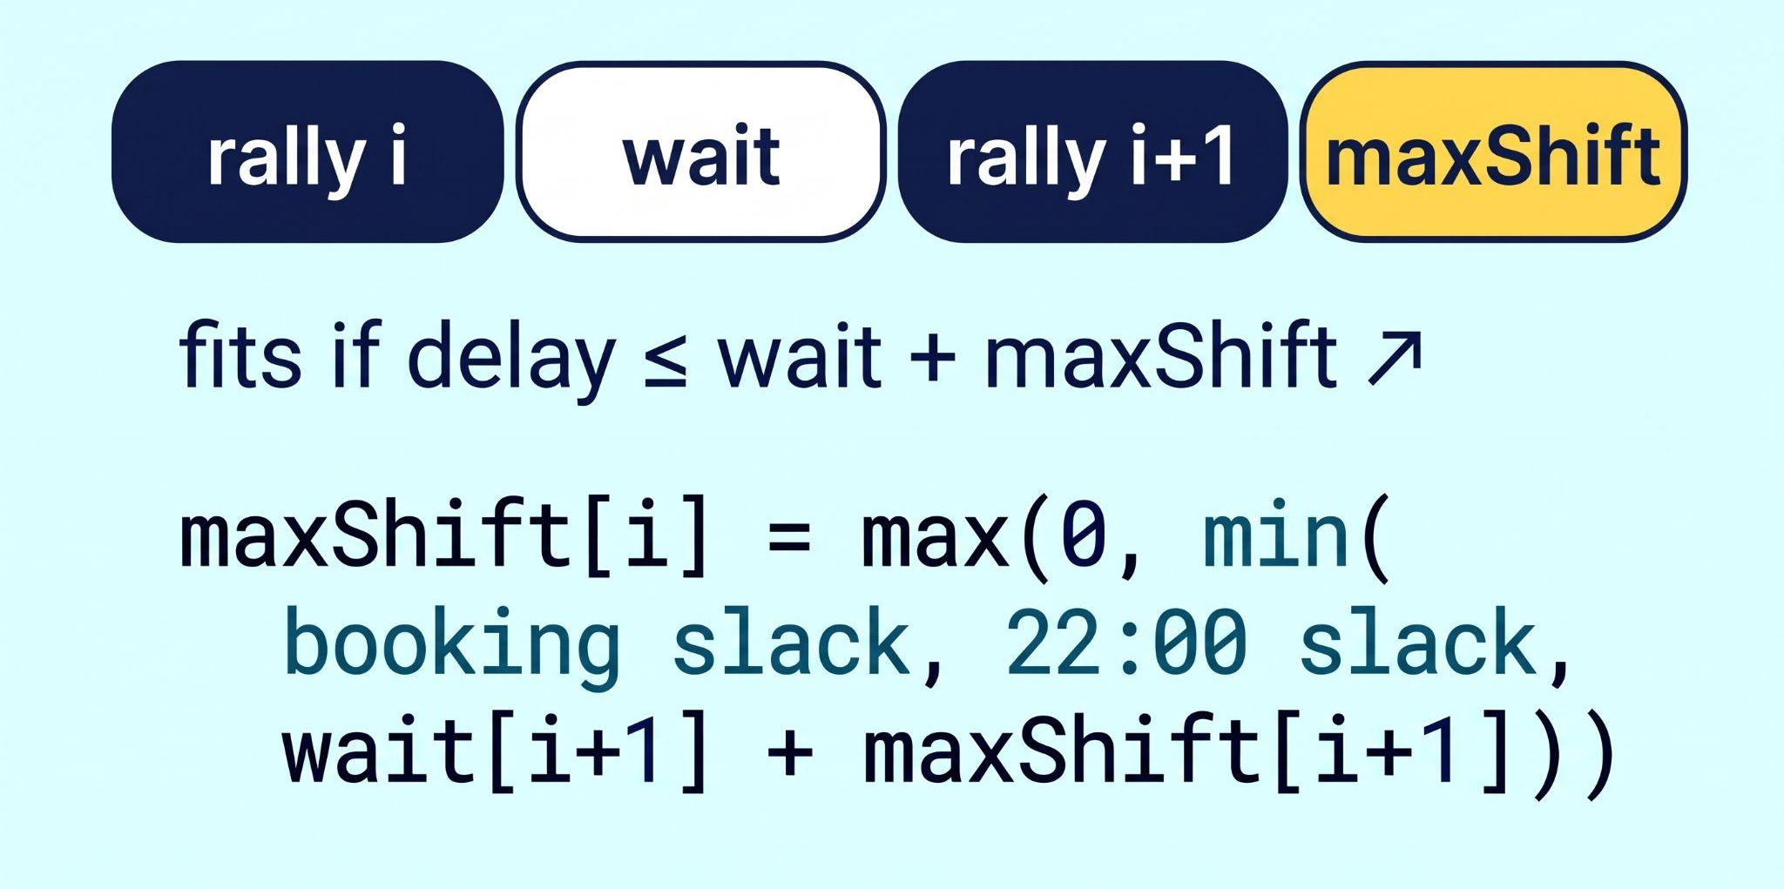
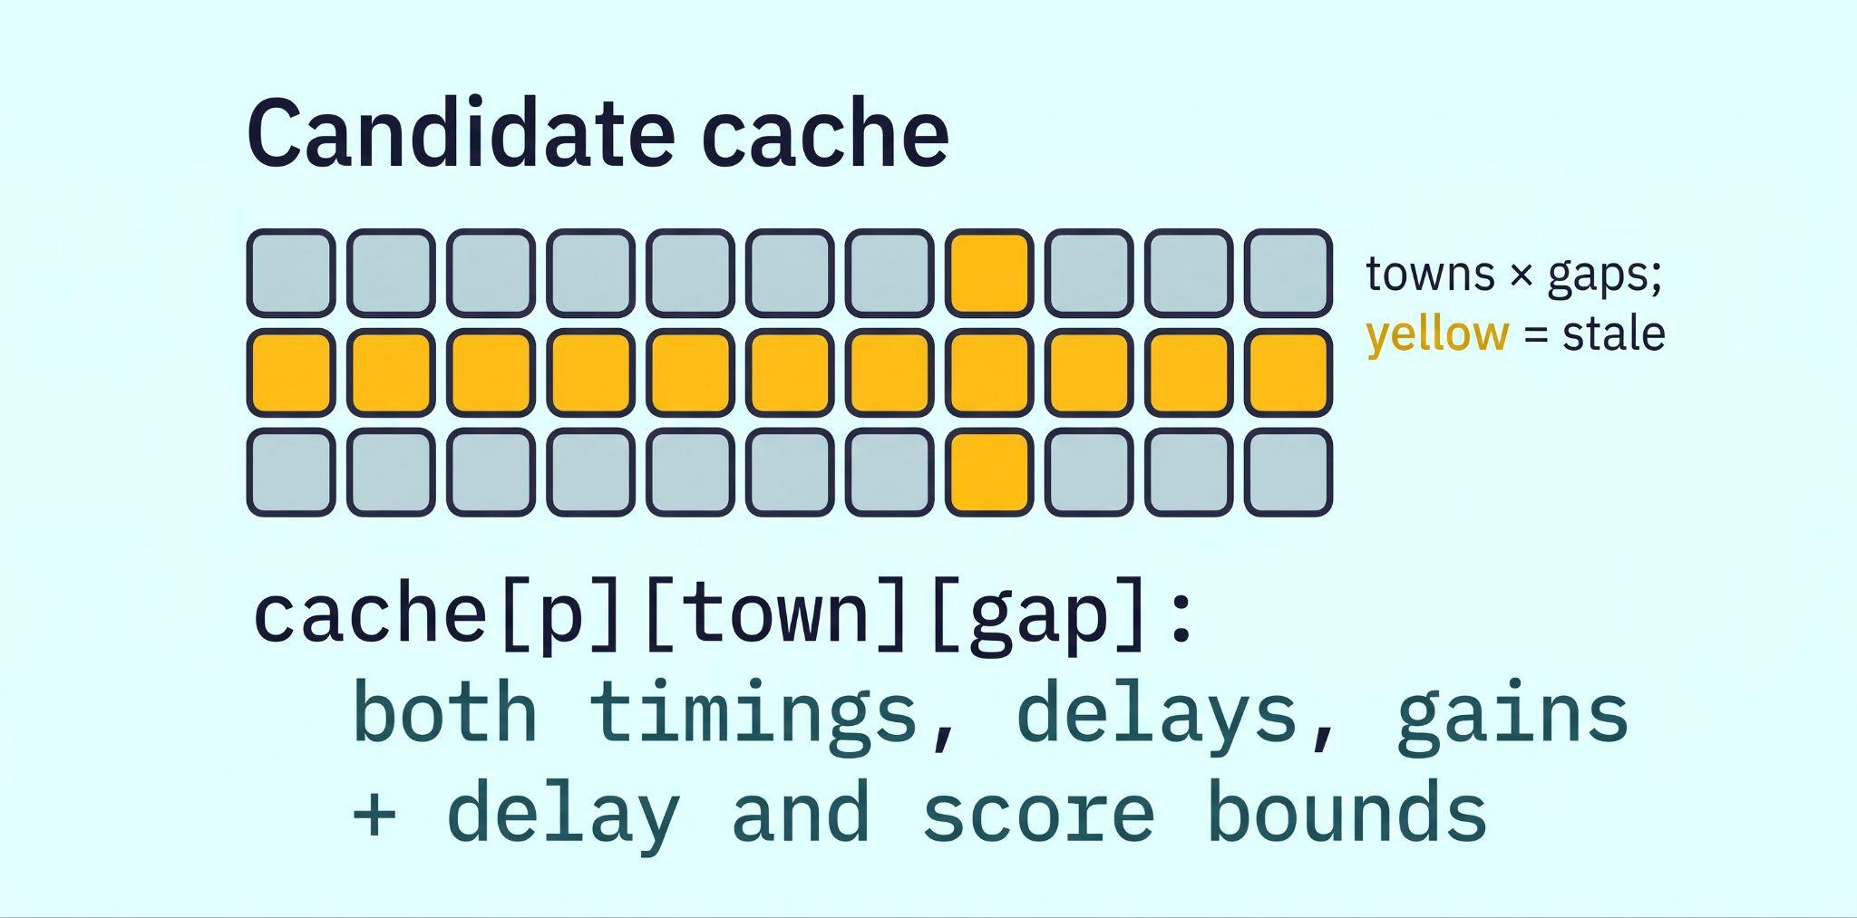
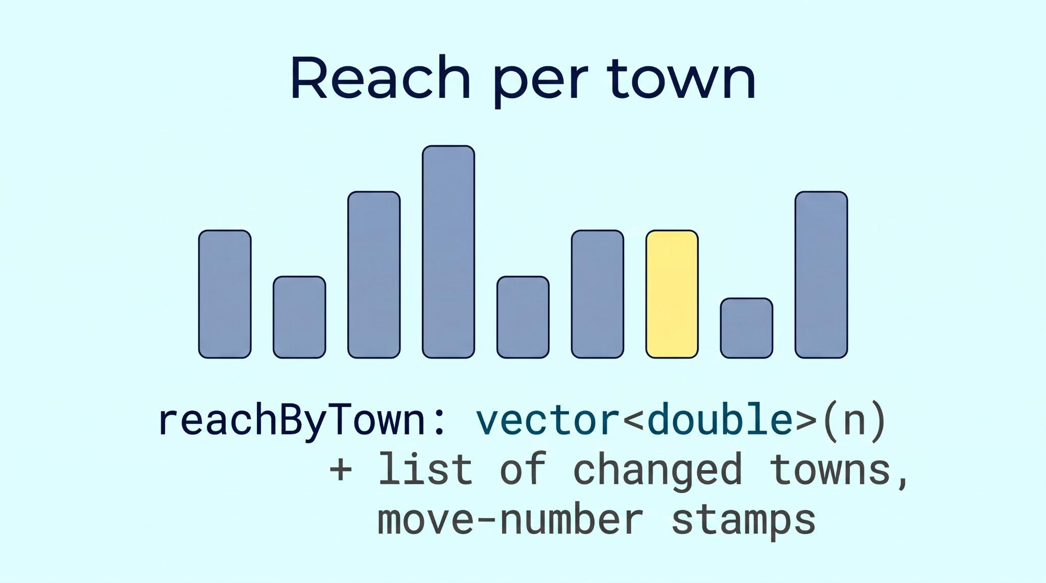
maxShift per visit
Candidate cache
Reach per town
O(1)
0.14%
1 - 2
To check that an insertion fits, instead of O(L)
Of candidates need the exact reach calculation (253 towns)
Towns rescored per move, not all n
A field in every visit, recomputed backwards in one O(L) pass after each insertion
Recomputed only if its gap changed or its town was rebooked. Same plans, about 3x faster
A move’s gain is the new reach of the towns it changed minus their stored values.

Slide 27
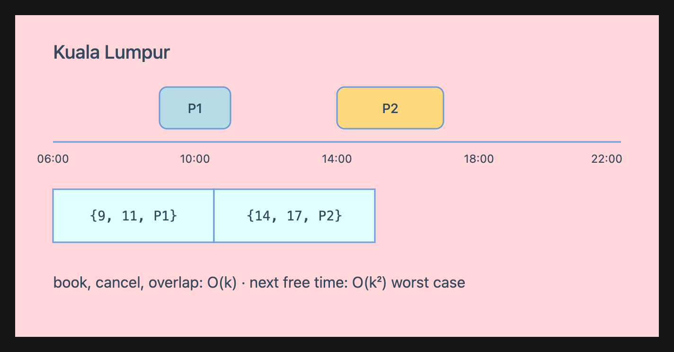
BookingTable
For each town, its bookings {start, end, politician}, sorted by start. At most k per town.
vector<vector<Booking>>
book, cancel, overlap: O(k) · next free time: O(k²) worst case
Not an interval tree: with k ≤ 10, a small sorted array is faster and far less code.

Slide 28
Two approaches
A: Randomised Sequential Greedy
B: Iterated Local search
Best reach per hour first, one politician at a time, best of 200 shuffled runs.
Insert anywhere it fits, then shake and refill, keeping the best plan found.
Vansteenwegen et al. (2009)

Slide 29


Slide 30
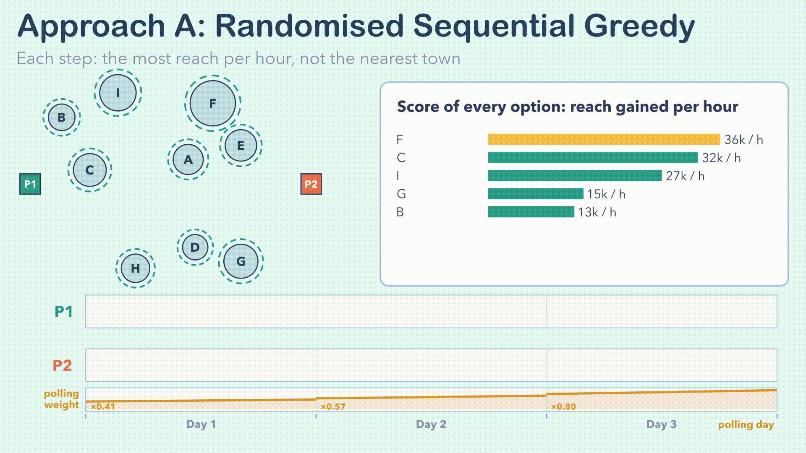

Slide 31
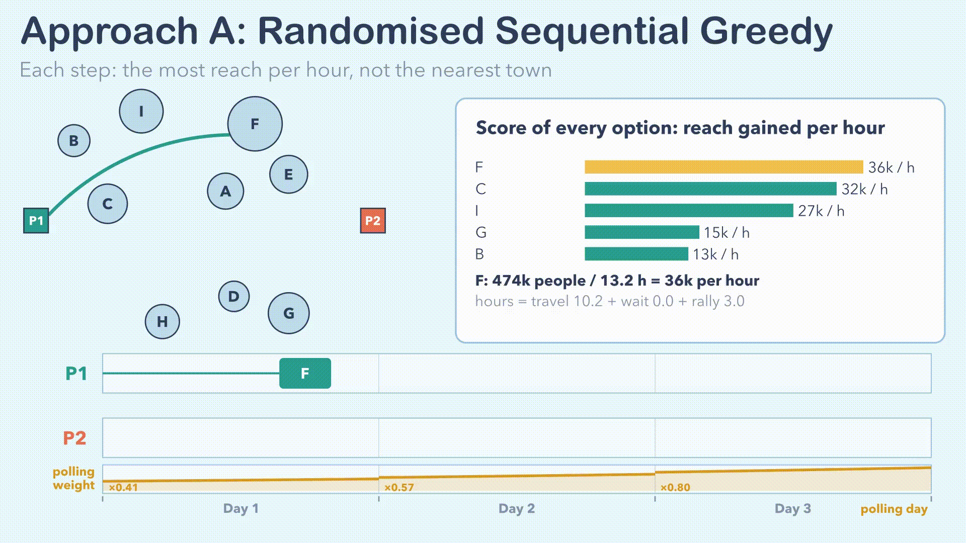

Slide 32
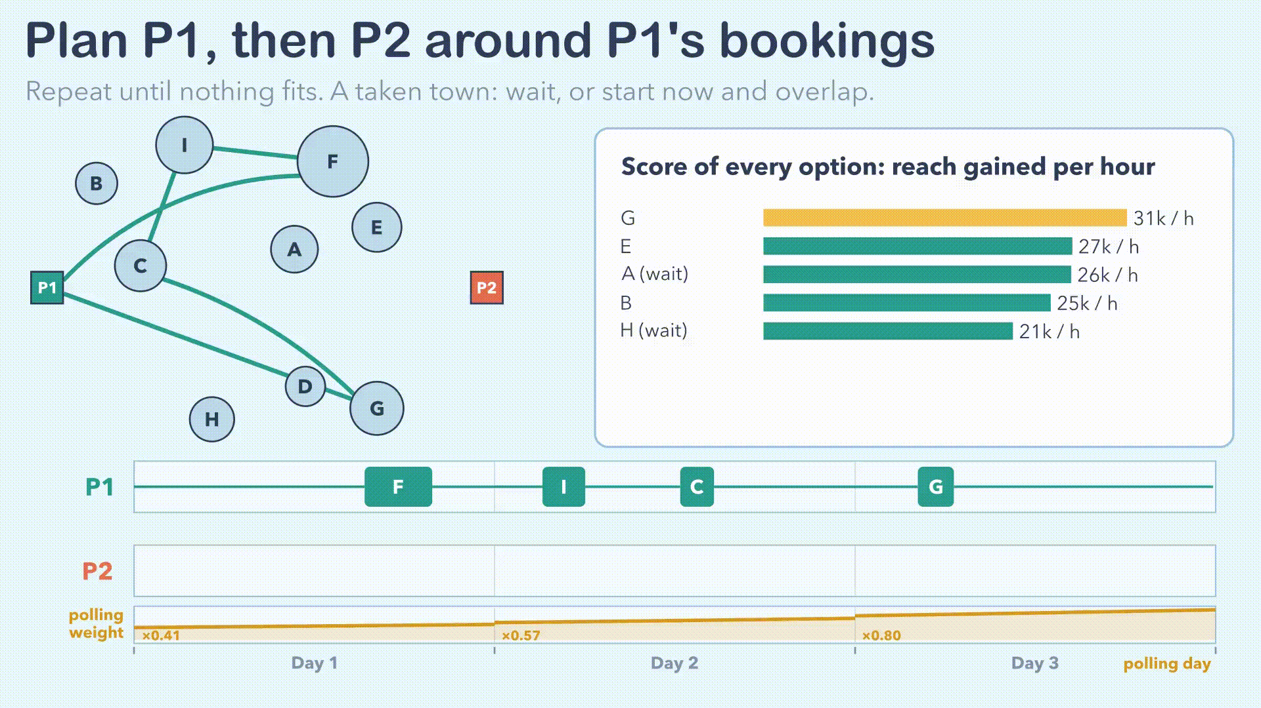

Slide 33
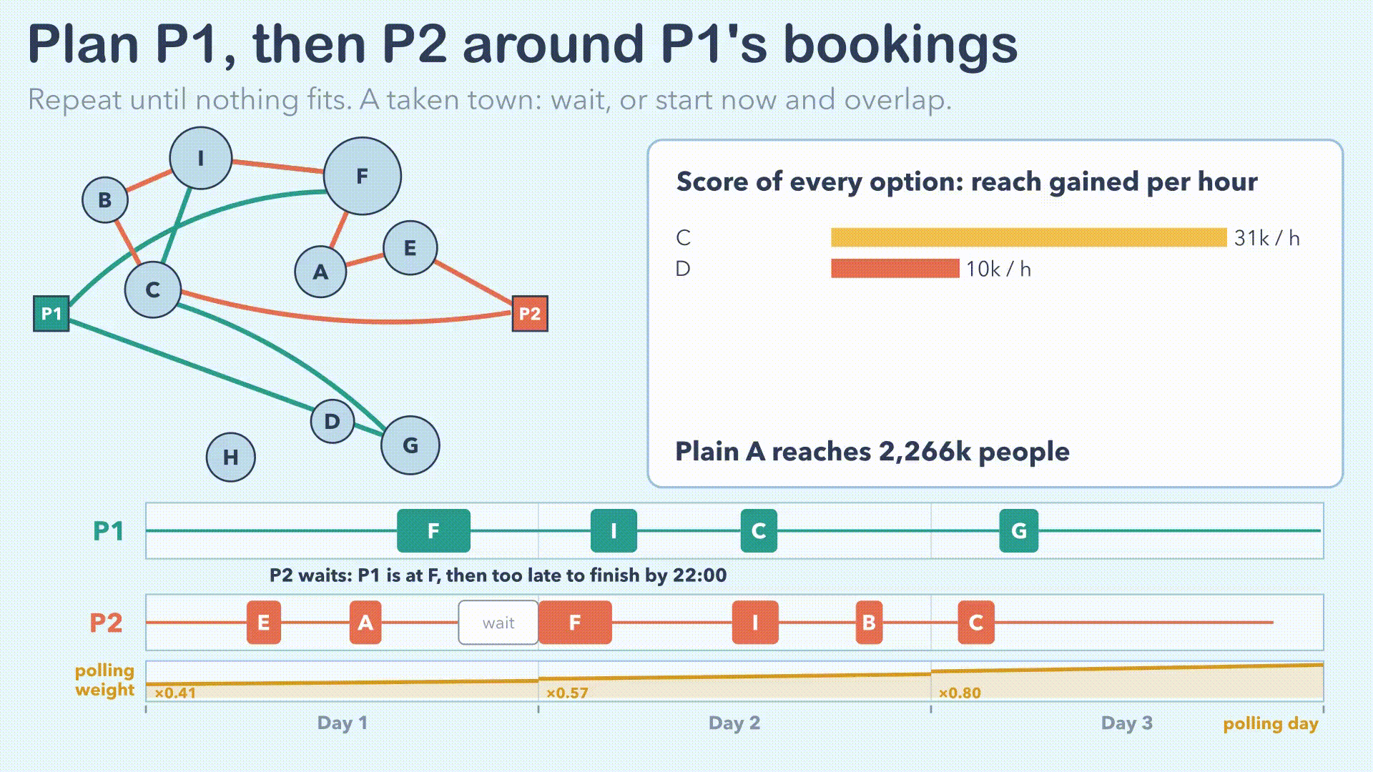

Slide 34
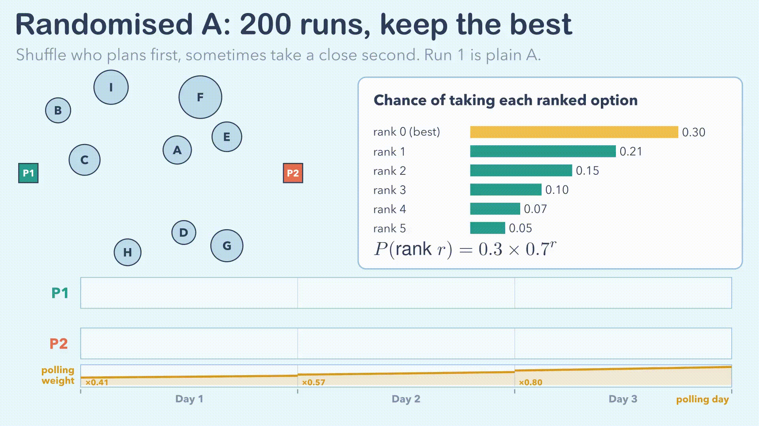

Slide 35
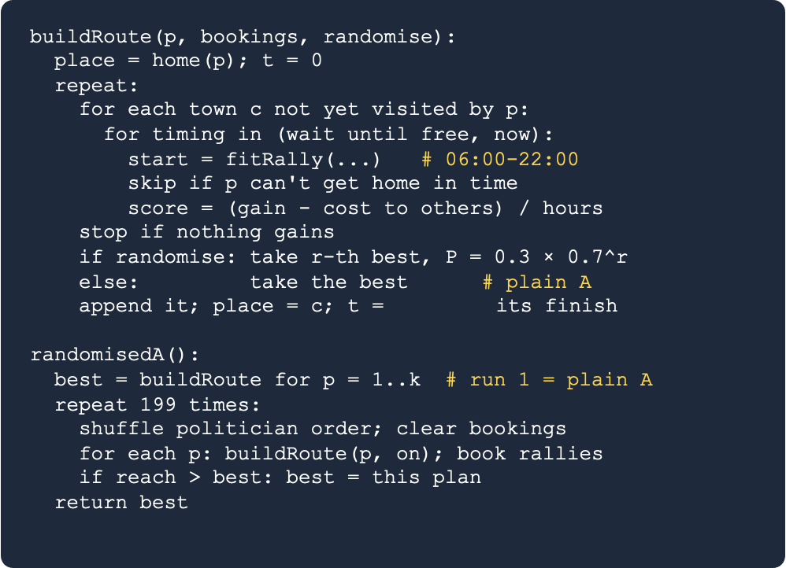
Approach A: Randomised Sequential Greedy

Slide 36
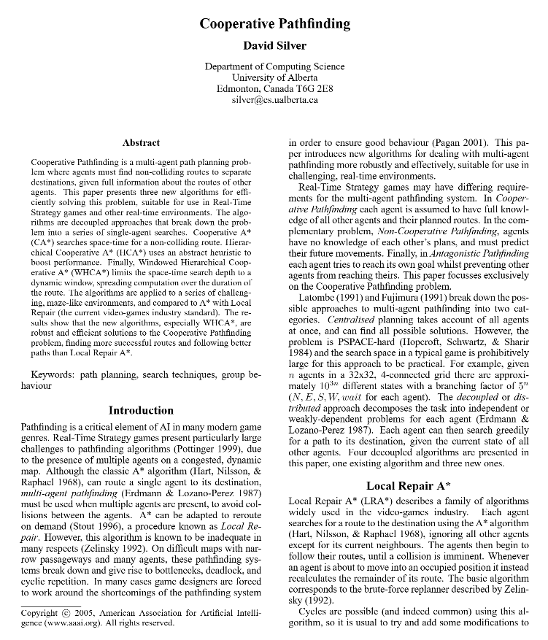
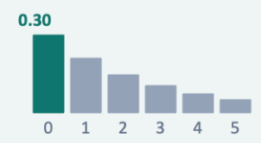
Approach A: Randomised Sequential Greedy
Biased Random Pick
Rank options best first and pick rank r.
P(r) = 0.3 × 0.7ʳ
Introduces controlled stochastic variance in choice.
Multiple Runs
Each run shuffles politician order to prevent systematic bias toward the first-planning politician.
Silver, D. (2005). Cooperative Pathfinding. AIIDE 2005

Slide 38
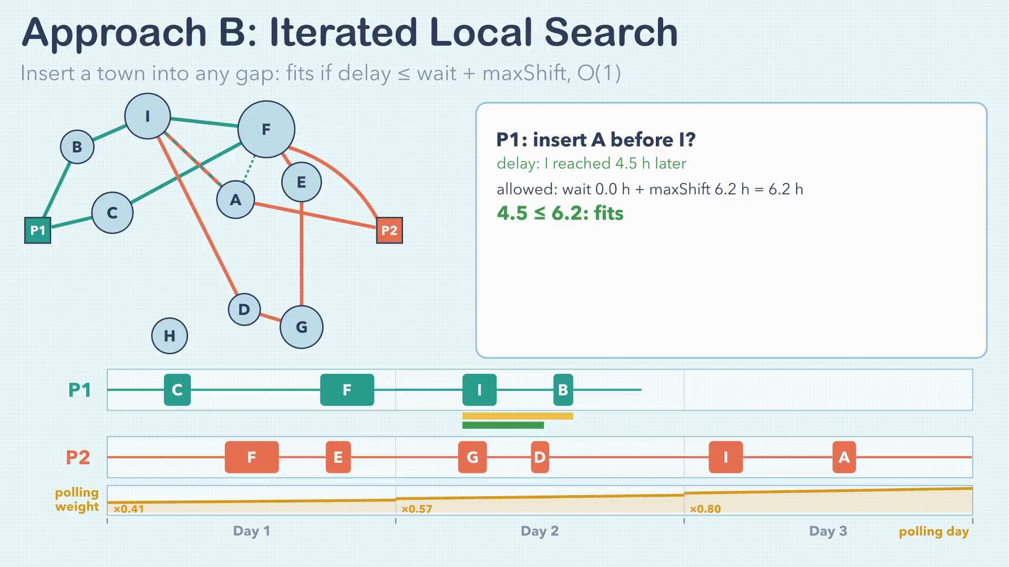

Slide 39
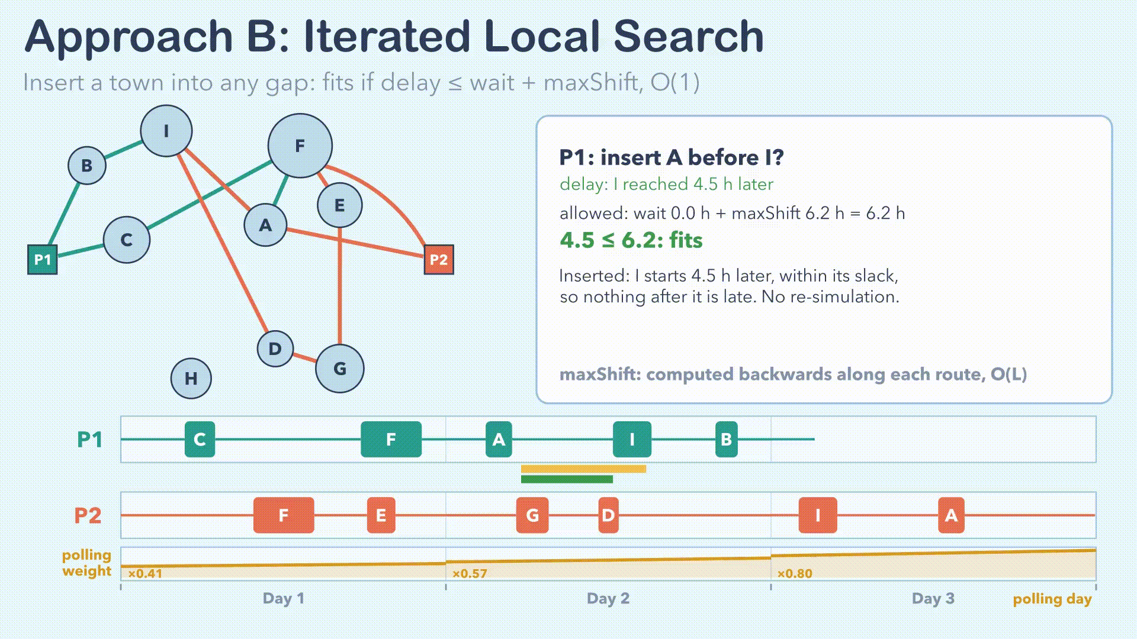

Slide 40
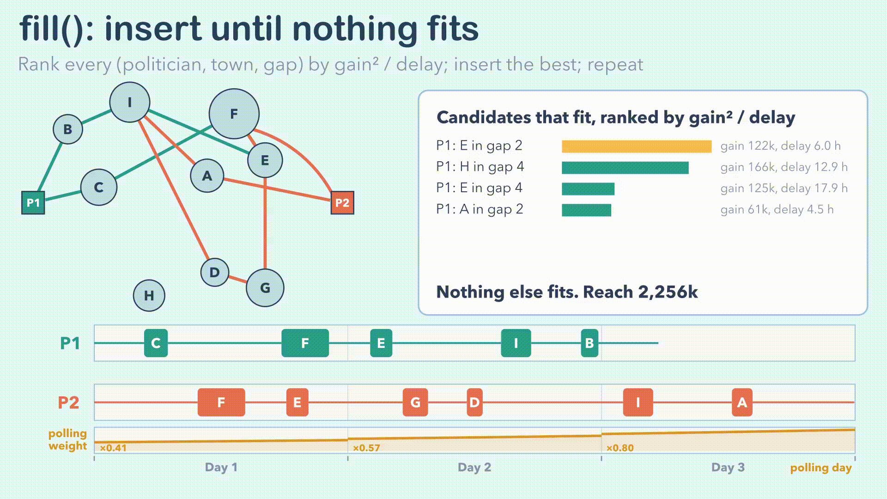

Slide 41
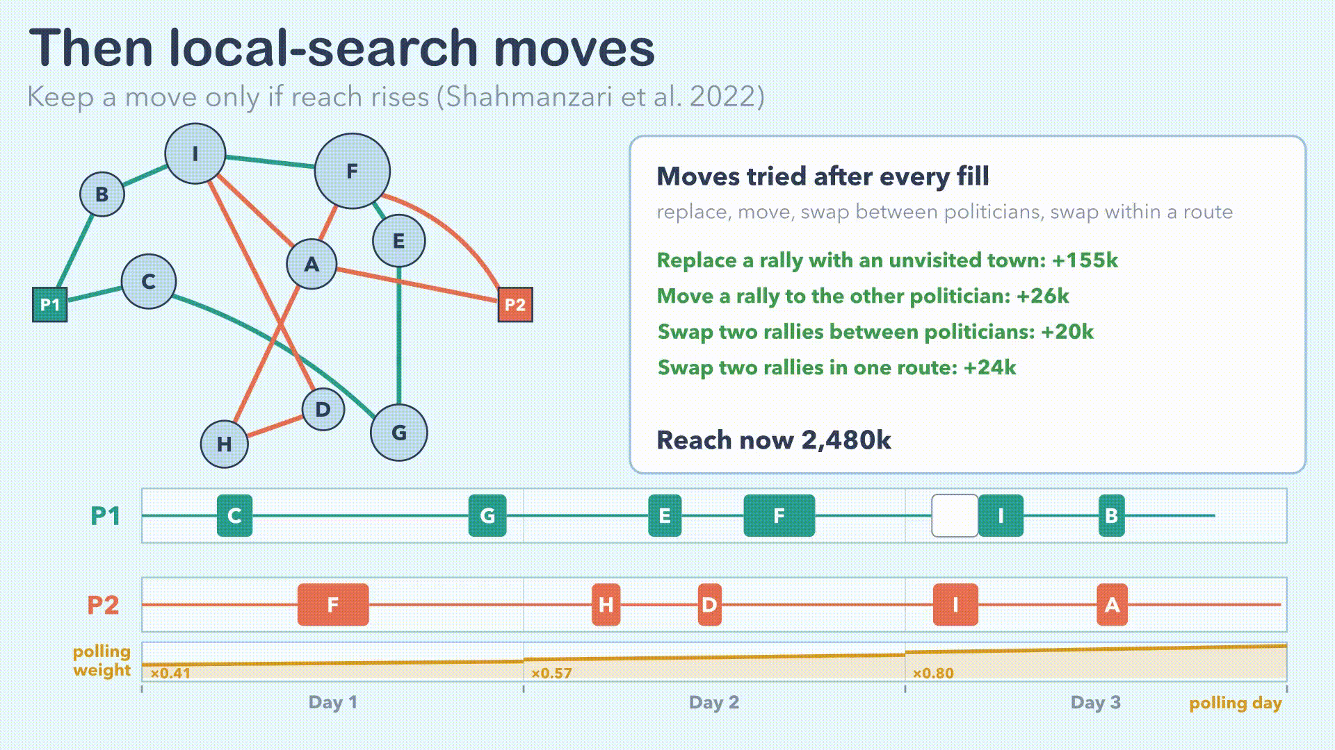

Slide 42
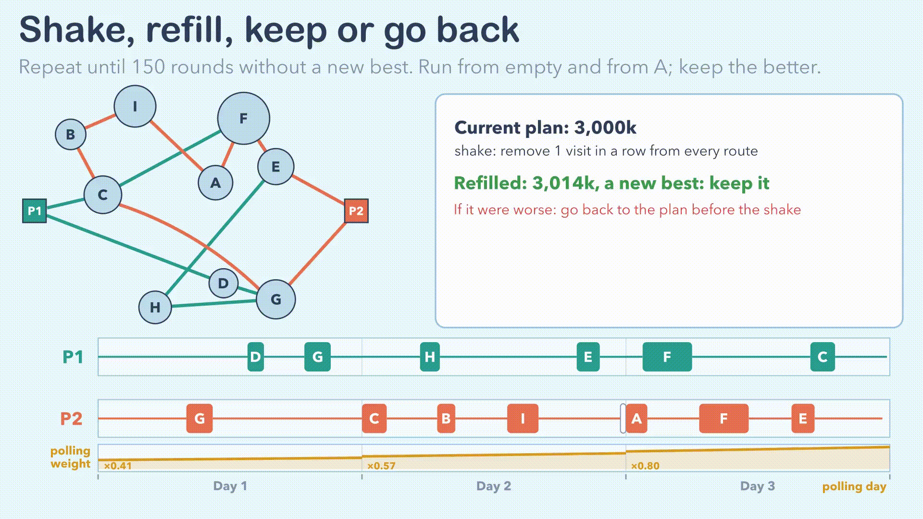

Slide 43
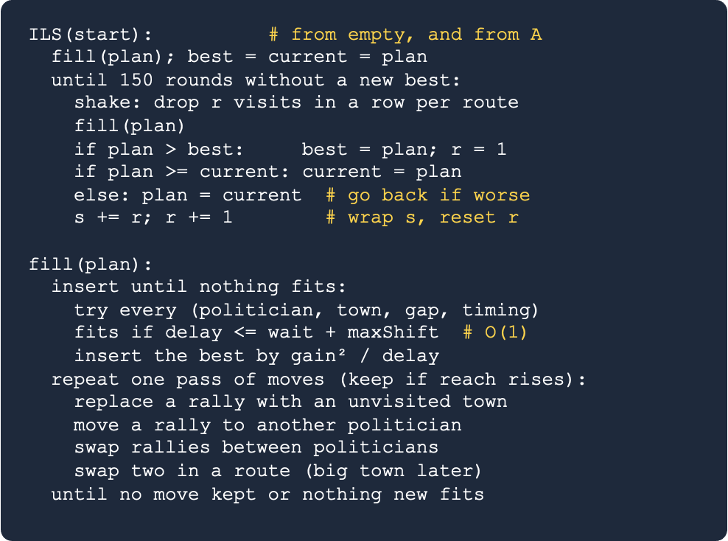
Approach B: Iterated local search

Slide 44
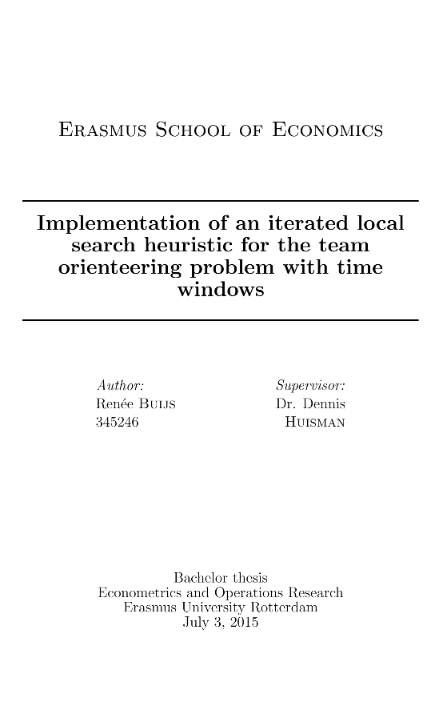
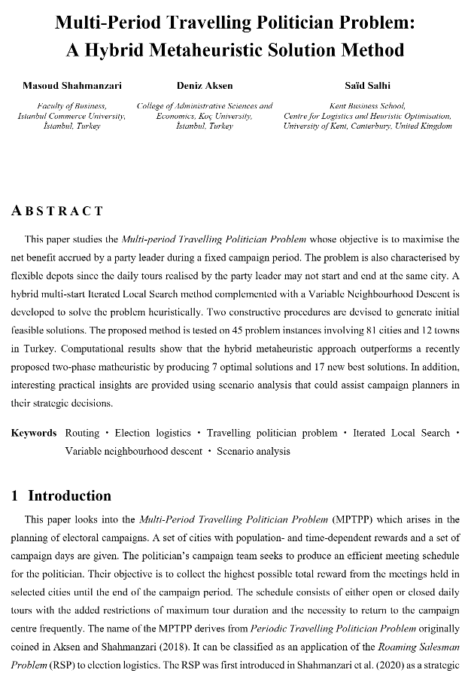
Approach B: Iterated local search
Candidate cache
Keep every candidate insertion between steps; recompute only those the last insertion changed. Same plans, faster.
01
Local-search moves
After each refill: replace a rally, move or swap rallies between politicians, swap two in a route.
02
Go back if worse
If a shake and refill lose reach, return to the plan from before the shake.
03
Vansteenwegen et al. (2009, as cited in Buijs, 2015)
Shahmanzari, Aksen & Salhi (2022)

Slide 45
Interesting findings
Classic TSP fails
Visiting all 90 towns needs 16.3 days in a 14-day campaign

Slide 46
Results (default run)
Nearest neighbour | Baseline | Approach A | Approach B
Closest town next Ignores population Stops when it must go home Classic benchmark | Each plans alone Same greedy as A Can't see teammates 13 clashes | Plans in turn Shared booking table Adds to route end Under 1 ms | Plans everyone at once Booking table + maxShift Inserts anywhere About 150 ms
21.14M reached | 15.08M reached | 19.25M reached | 23.62M reached
Notes:
Multisatrt A
ILS B

Slide 47
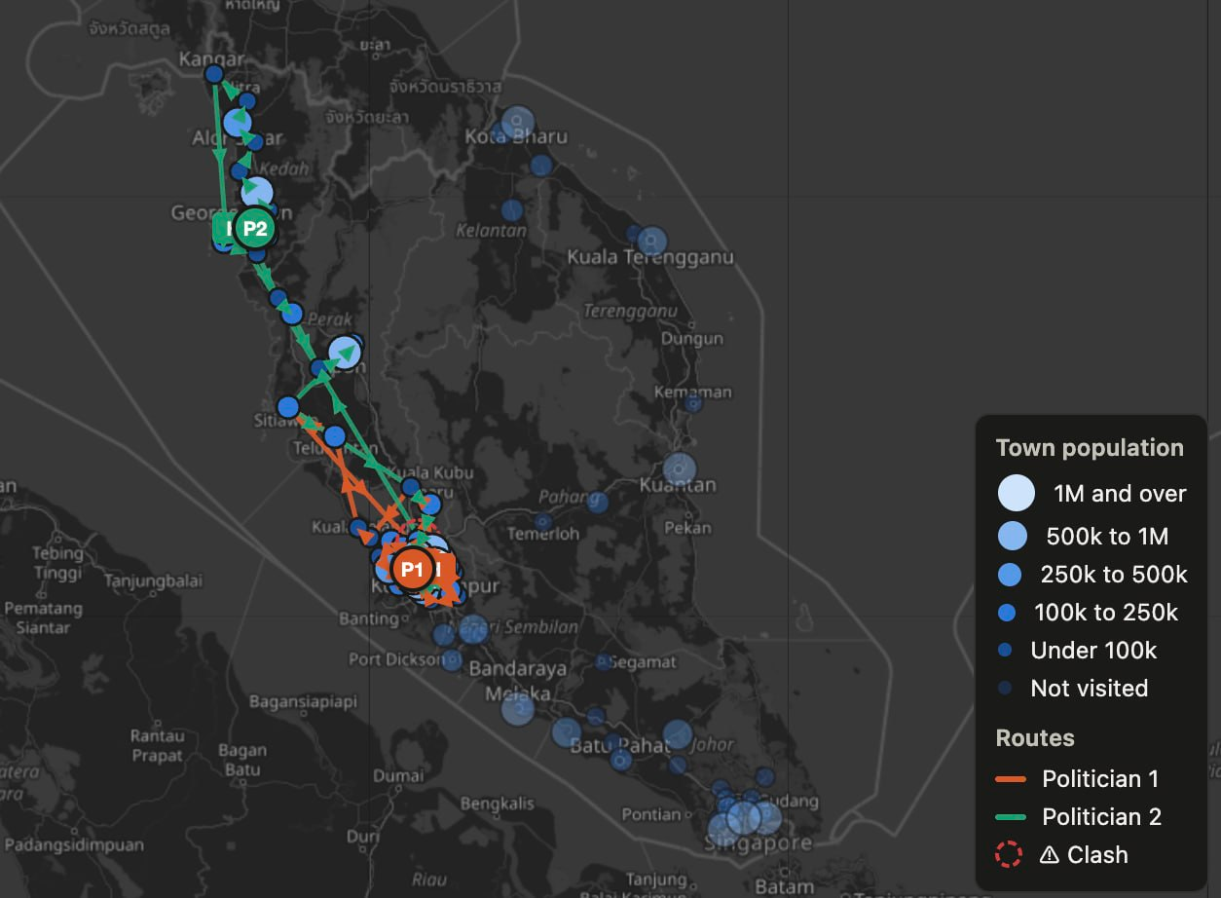
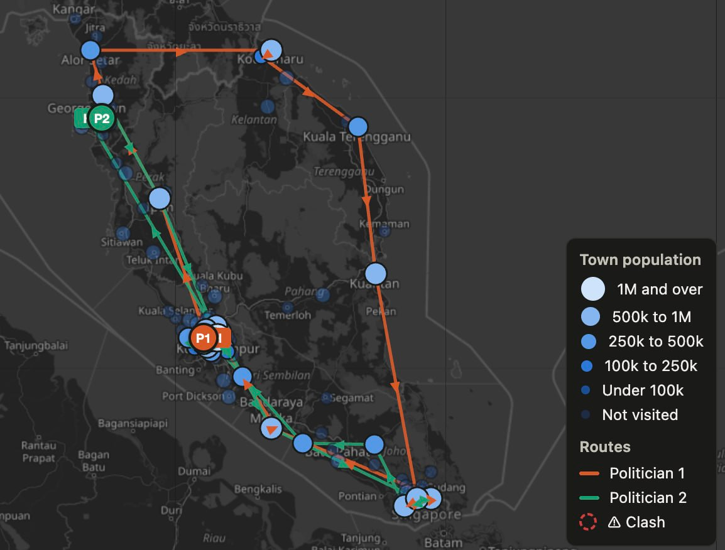
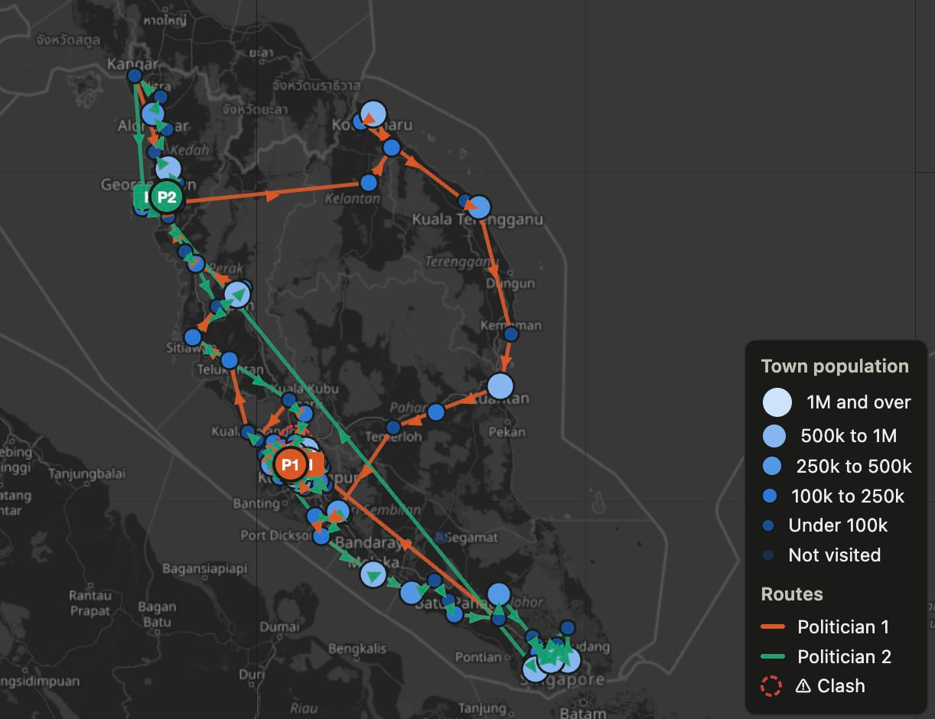
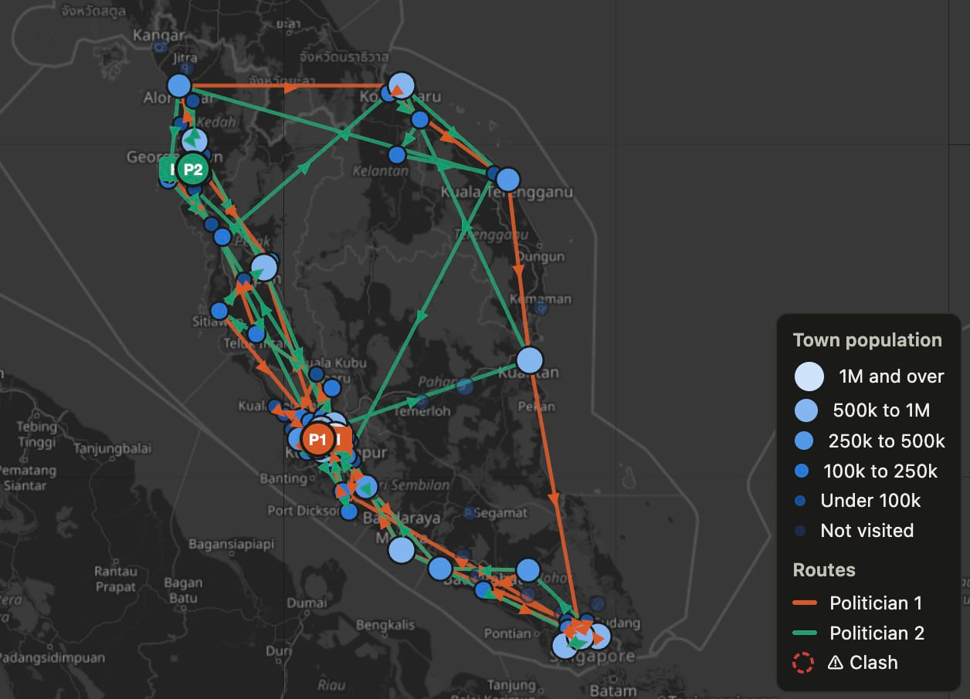
Interesting findings
2. Approach A vs Nearest Neighbor in different campaign durations
NN
A
13.64M
17.69M
6d
Approach A reaches more than Nearest Neighbor in short campaigns, and less in long campaigns
21.14M
18.36M
14d

Slide 48
Improving B step by step
Cache scores
Undo bad shakes
01
02
Local search
Both together
03
04
Same plans, about 3× faster
Go back if a shake lost reach: +4.8%
Replace, move and swap rallies: +10.4%
Our final B: +13.1%, better in all 117 runs

Slide 49
Results (with final B)
26.71M
Approach B
23.62M
29% more than A, 12% more than nearest neighbour
21.14M
18.36M
15.08M
Final B
With local-search moves and undo: 13% more again
Default run: 90 towns, 2 politicians, 14 days. Every plan is re-checked by our validator
Nearest
neighbour
Baseline
A
B
Final B

Slide 50
Time Complexity
Nearest Neighbor
Reach
calculation
Approach A
Approach B
O(k · n²)
O(k³) per town
O(k³ · n · L)
Insertion: O(k³ · n · (L + k)) worst case
Local-search: O(L · (n + L))

Slide 51
Trade-offs and limitations
Speed vs reach
No fairness goal
Guessed settings
Simple travel
A is about 200× faster; B reaches 29% more
Fairness can fall to 0.41 with 5 politicians
Decay settings change reach more than the algorithm does
Straight line × 1.3 at 70 km/h; no roads or traffic

Slide 52
X-factor: a new problem
Our variant
(k politicians)
Team routing
Fading repeats
Soft clashes
Many politicians, different bases, limited days and hours
A repeat rally reaches fewer people, then recovers over days
Teammates can share a town at once, but with added cost
We found no paper that combines all three.

Slide 53
X-factor: rigour
Own validator
Academically
Supported
Multiple Parameters
Individual experiment
Recomputes every plan: 3,960 test plans, all valid
Design choices are backed by research
Varied parameter values, clash penalty, homes and team size
Each improvement to B measured on its own
Notes:
Point 4: if we want to show examples, go into the results sheet and take a table from there

Slide 54
04
AI Usage
Report

Slide 55
How we used AI
AI helped with:
We decided:
Finding papers, writing the code, and drafting docs
The use case, the model rules, both approaches, which experiments to run, and what to present
Tools: Claude Opus 5.5, GPT-5

Slide 56
Three representative prompts
Design
“two people want to travel the same itinerary but never want to be in the same city at the same time”
Literature
“How would we design an algo that could solve this problem? (find papers online…)”
Implementation
“can we now start with the implementation of the solution? i want it C++”

Slide 57
Thank You Very Much!
G1 - Team 3

Slide 58
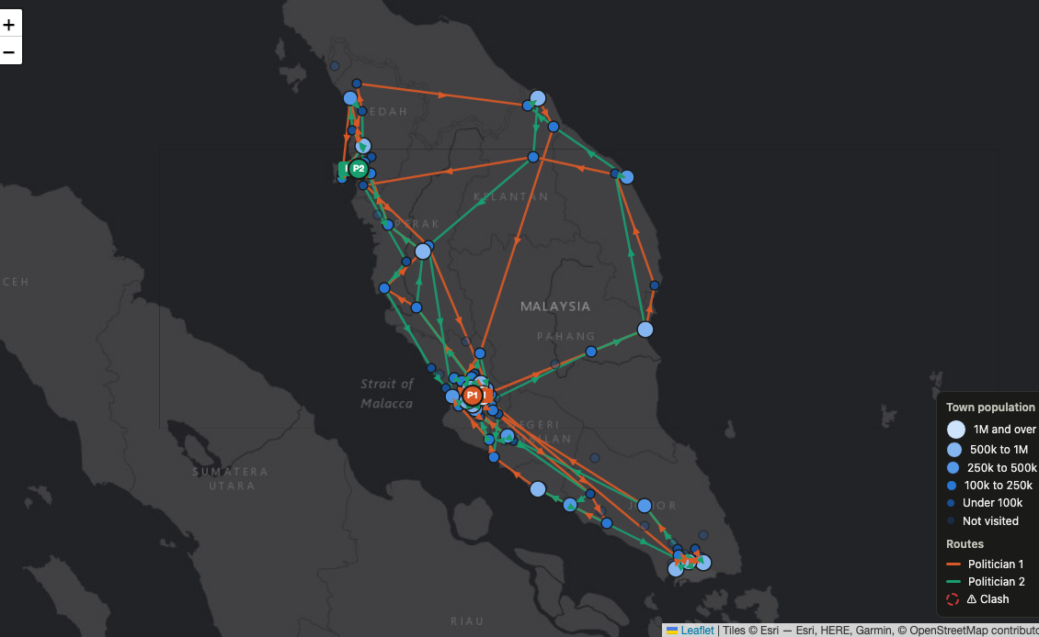
Our routes on the map
Final B, default run: 135 rallies, 0 clashes, fairness 0.95. Orange starts in KL, green in George Town

Slide 59


Slide 60
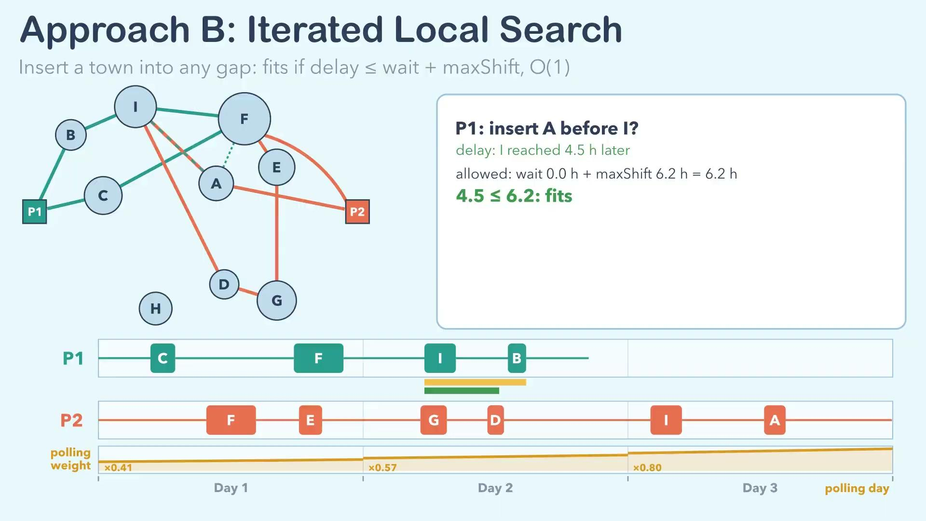

Slide 61
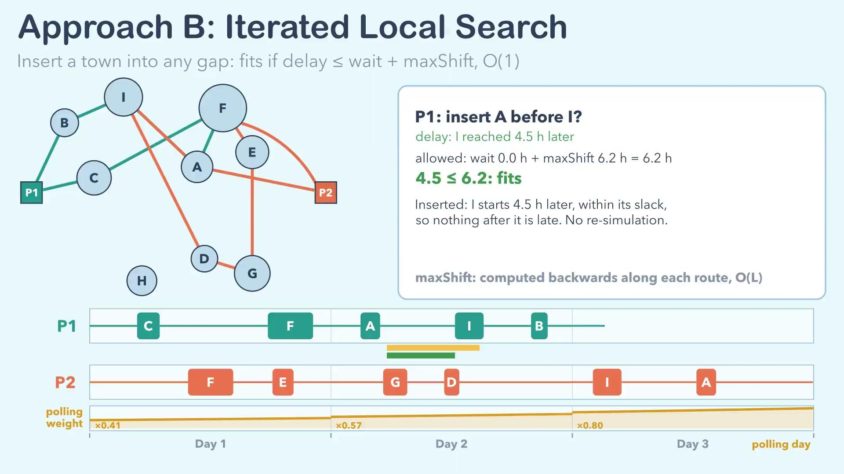

Slide 62
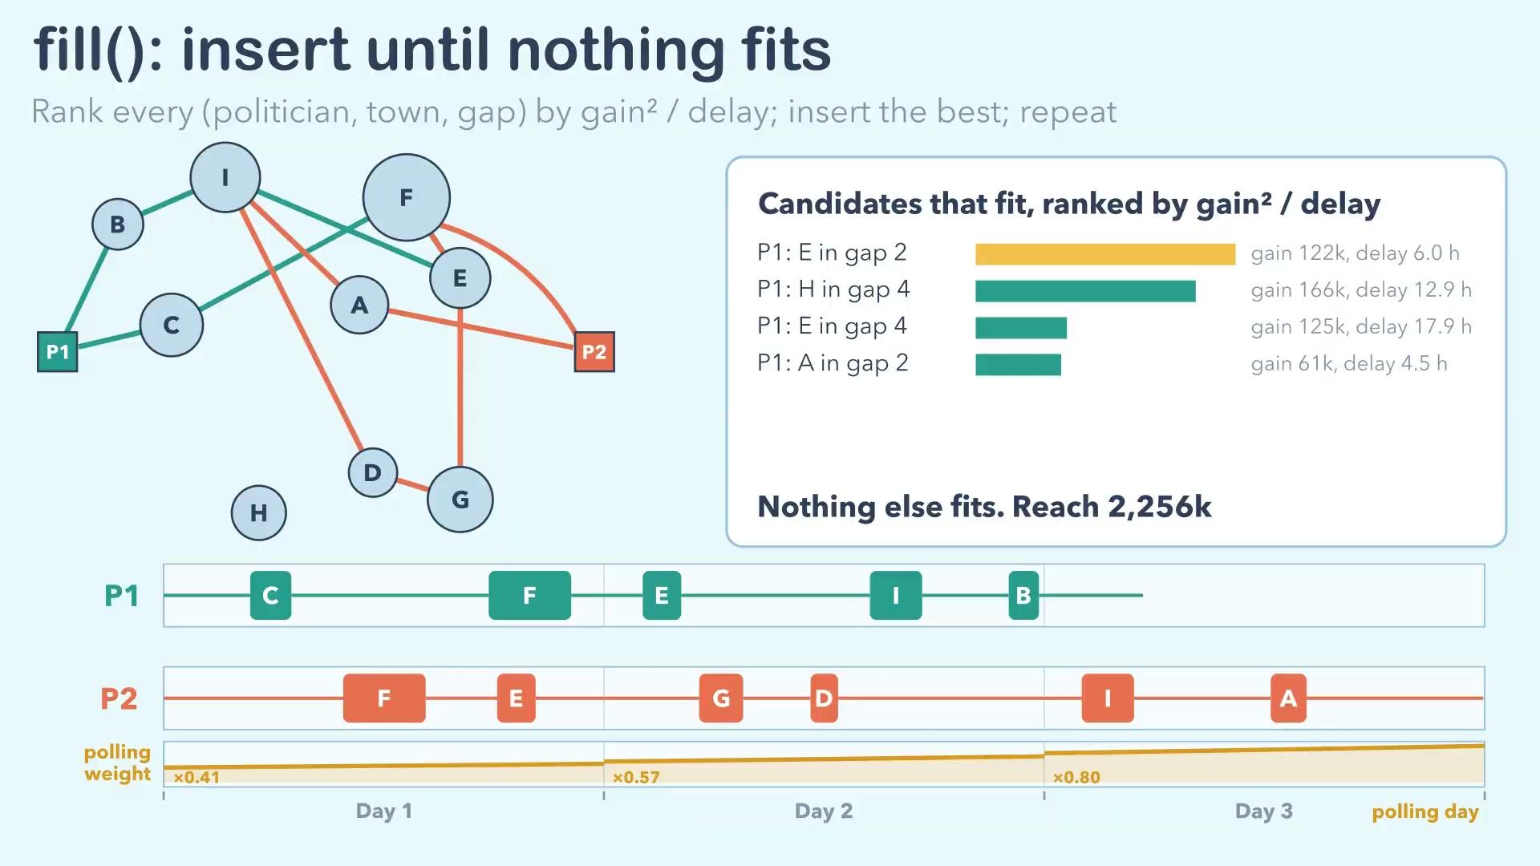

Slide 63
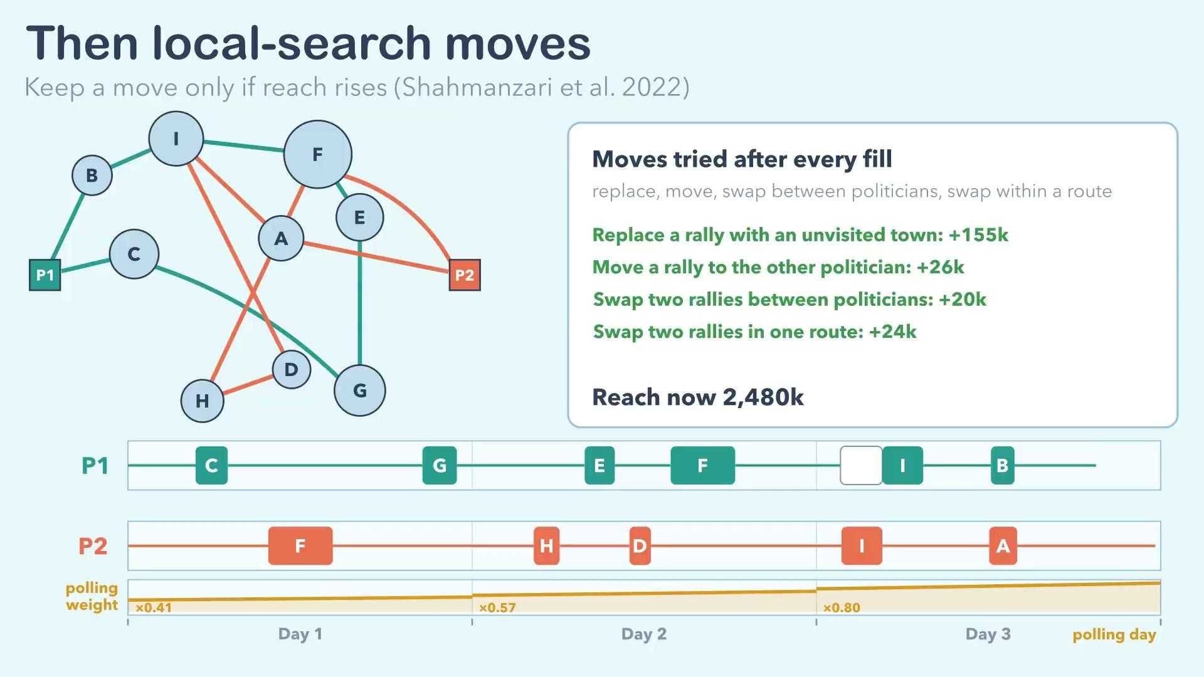

Slide 64
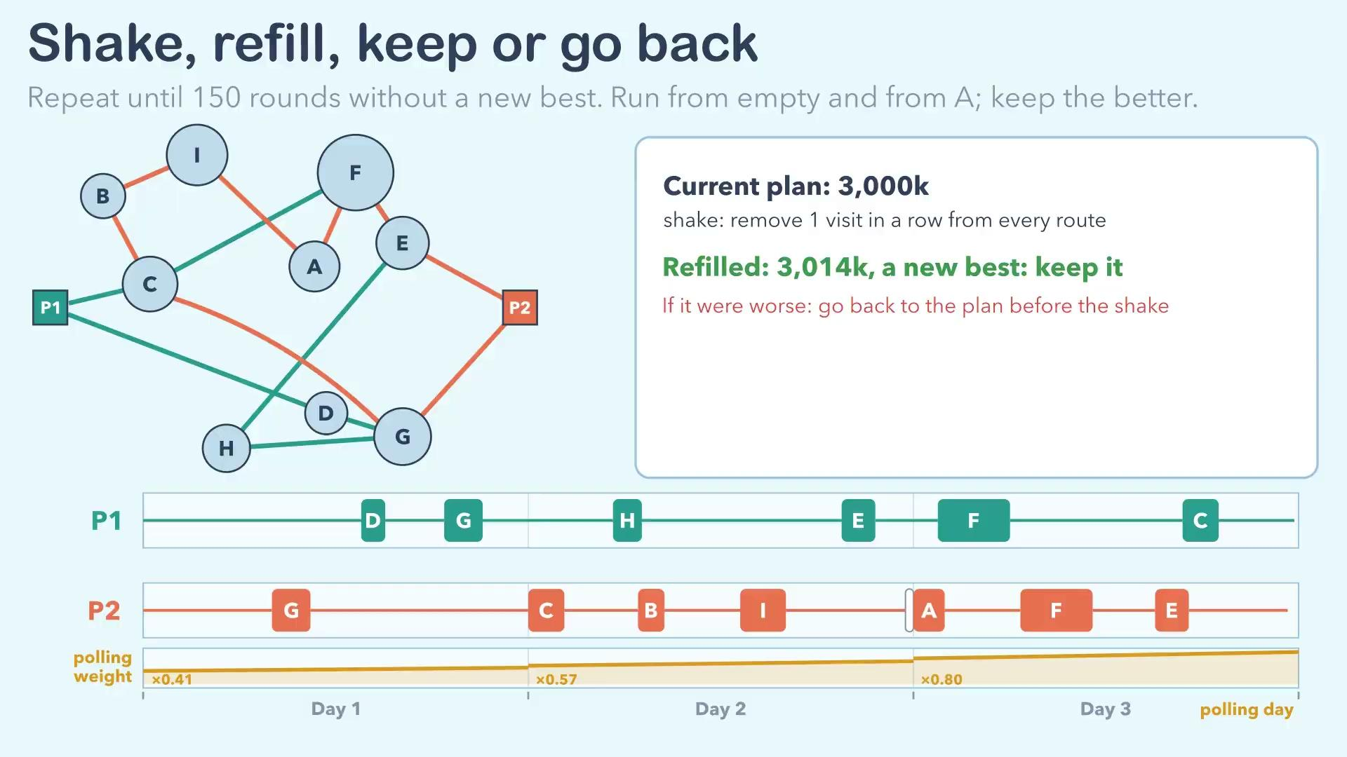

Slide 65
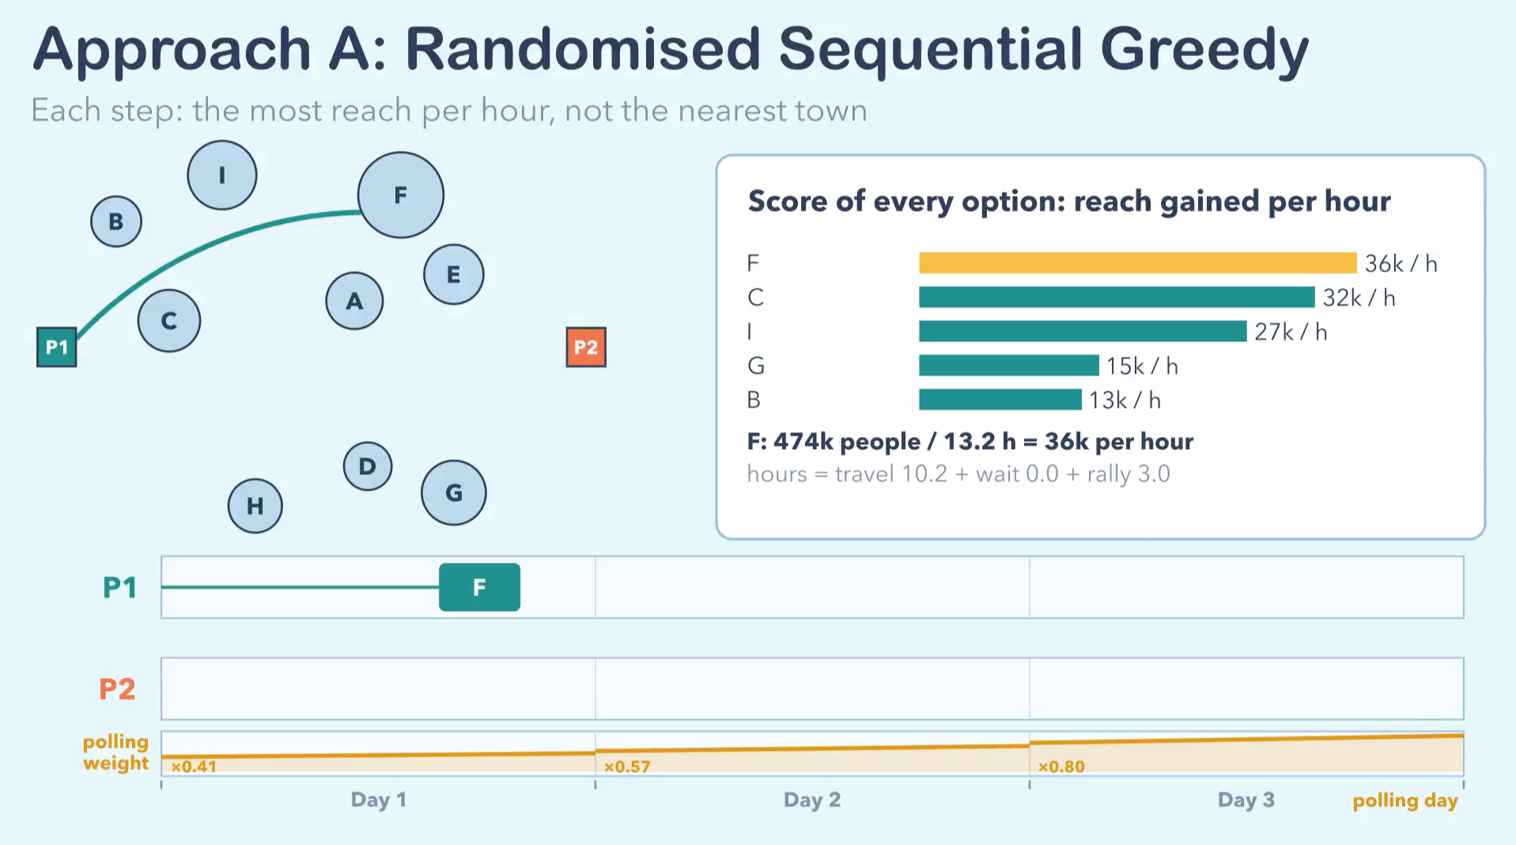

Slide 66
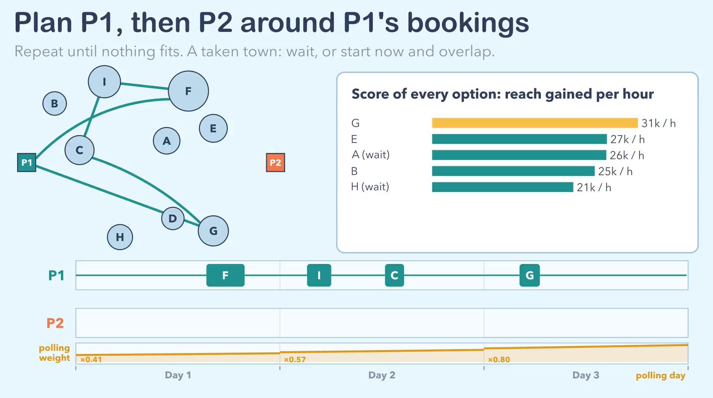

Slide 67


Slide 68


Slide 69
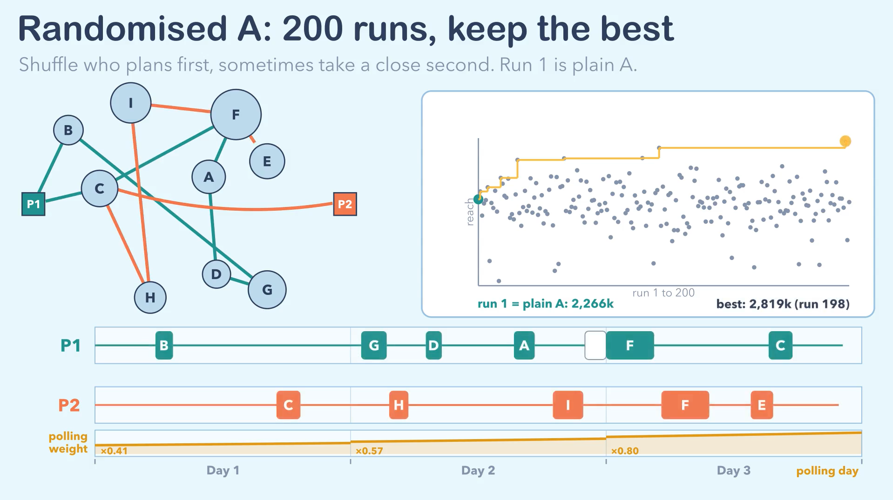

Slide 70
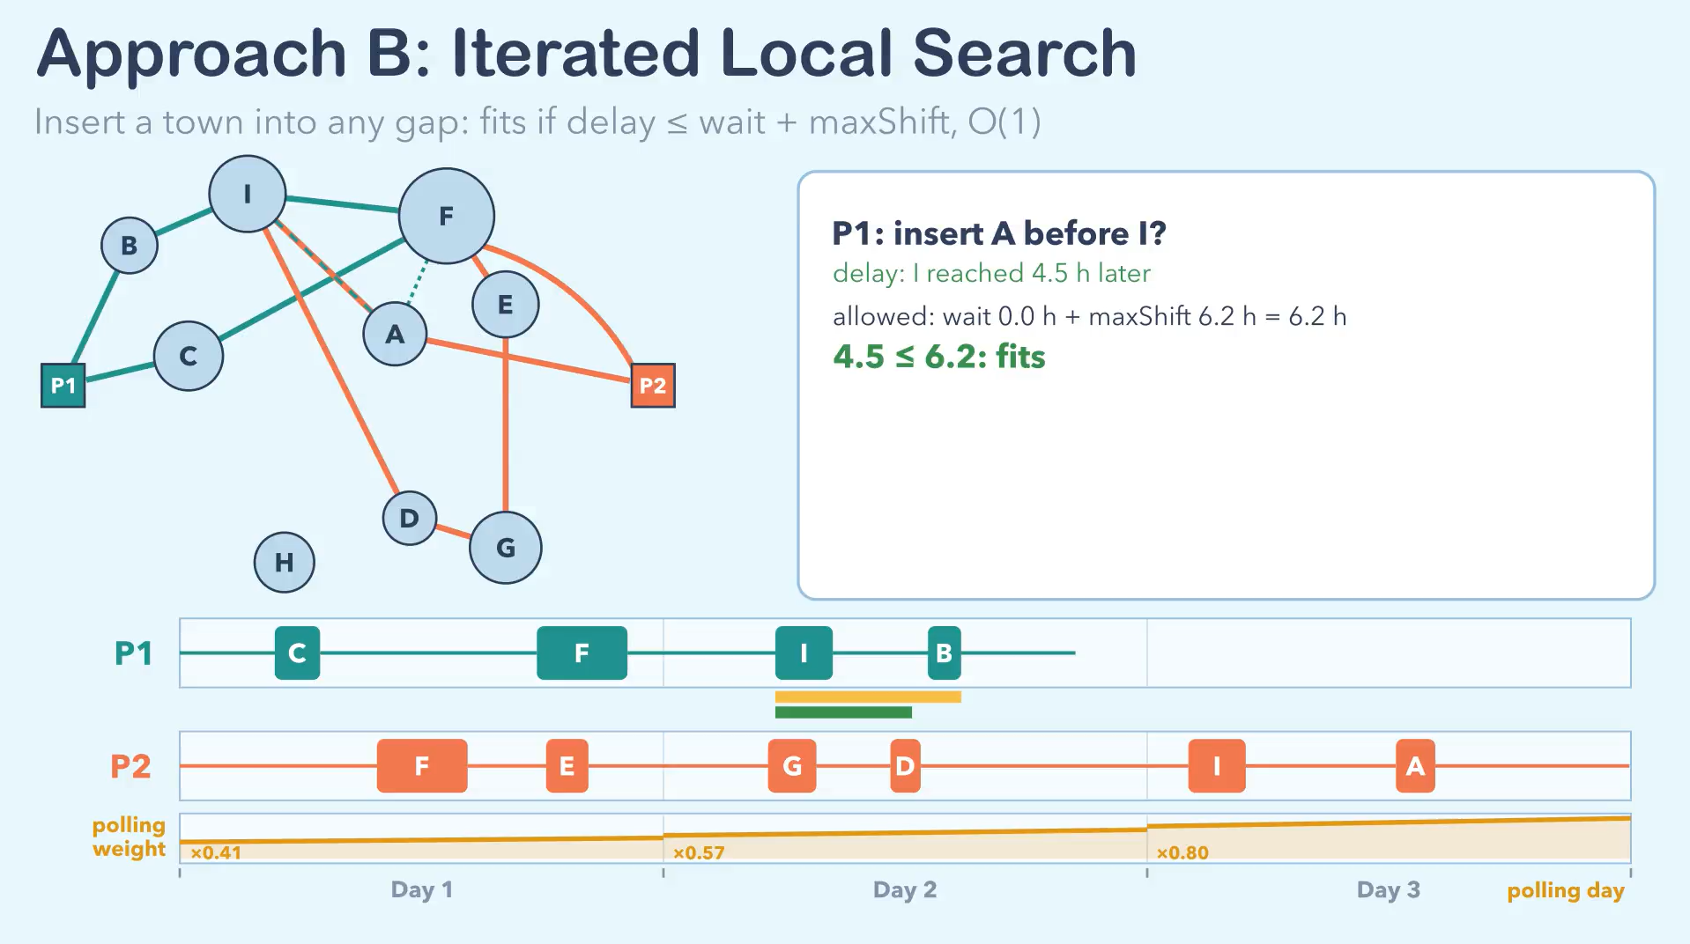

Slide 71
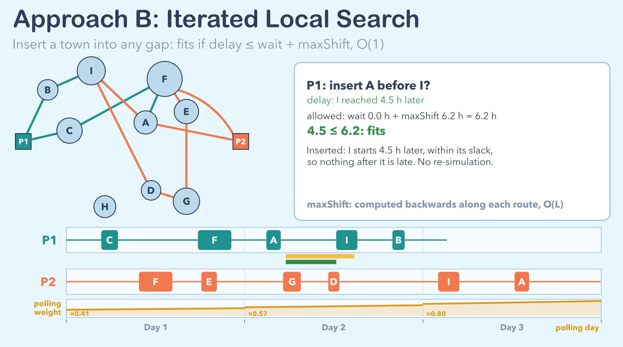

Slide 72
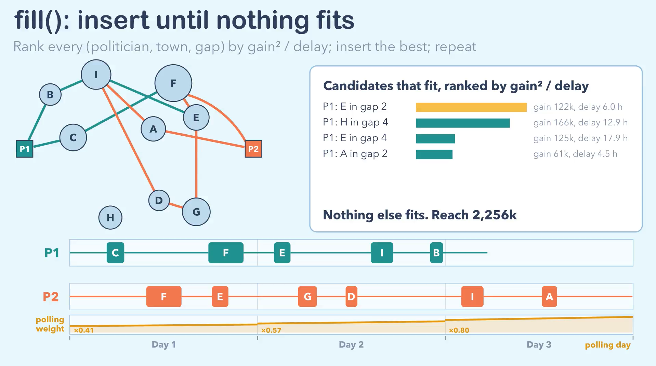

Slide 73
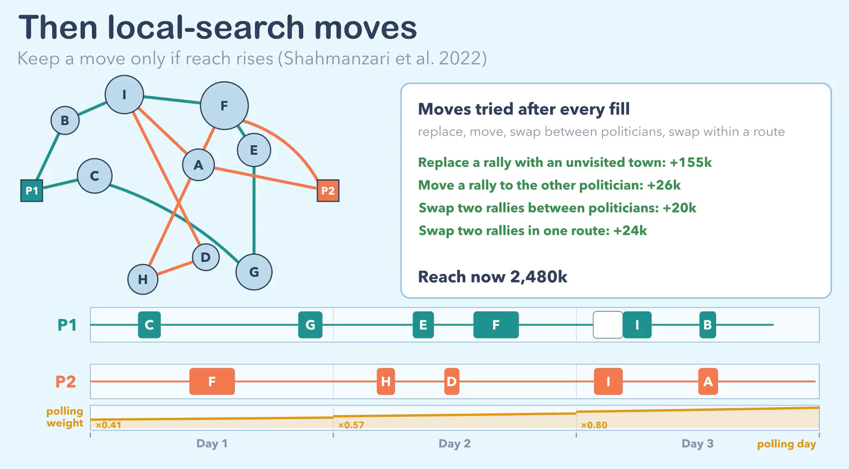

Slide 74
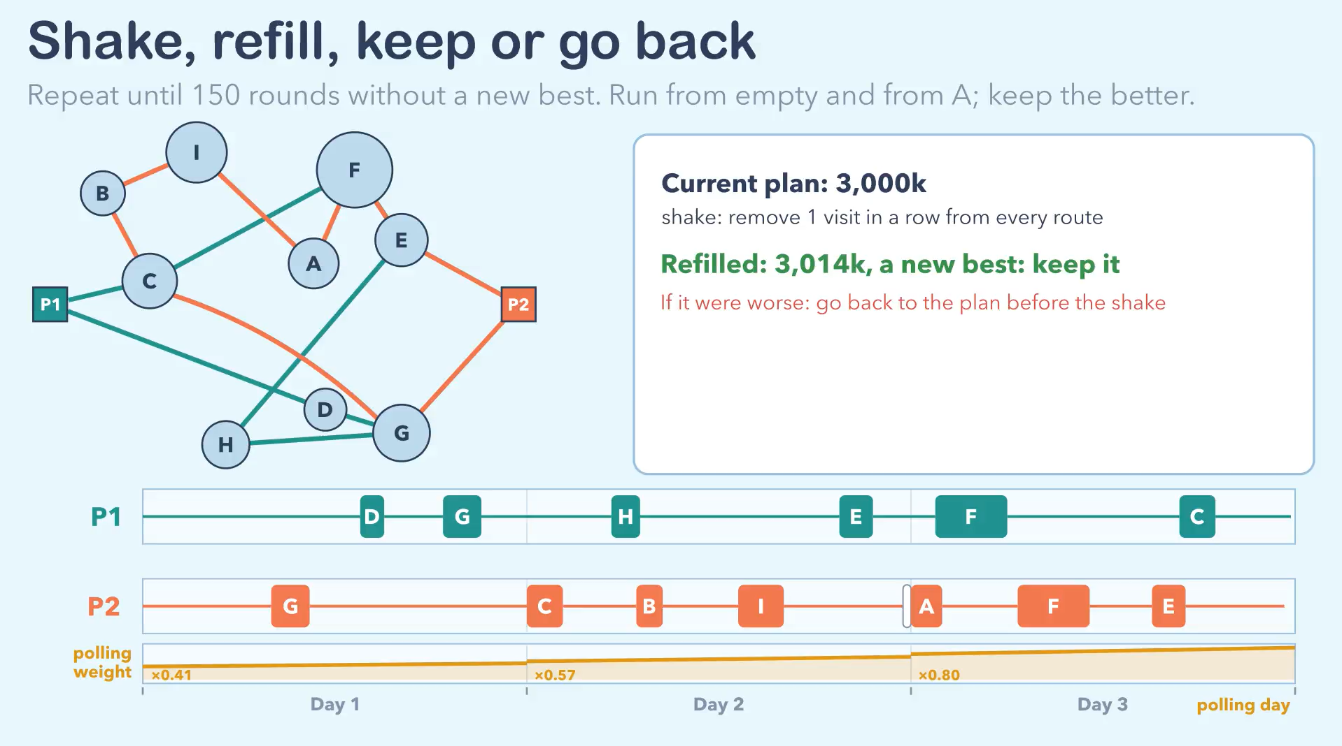

Slide 75
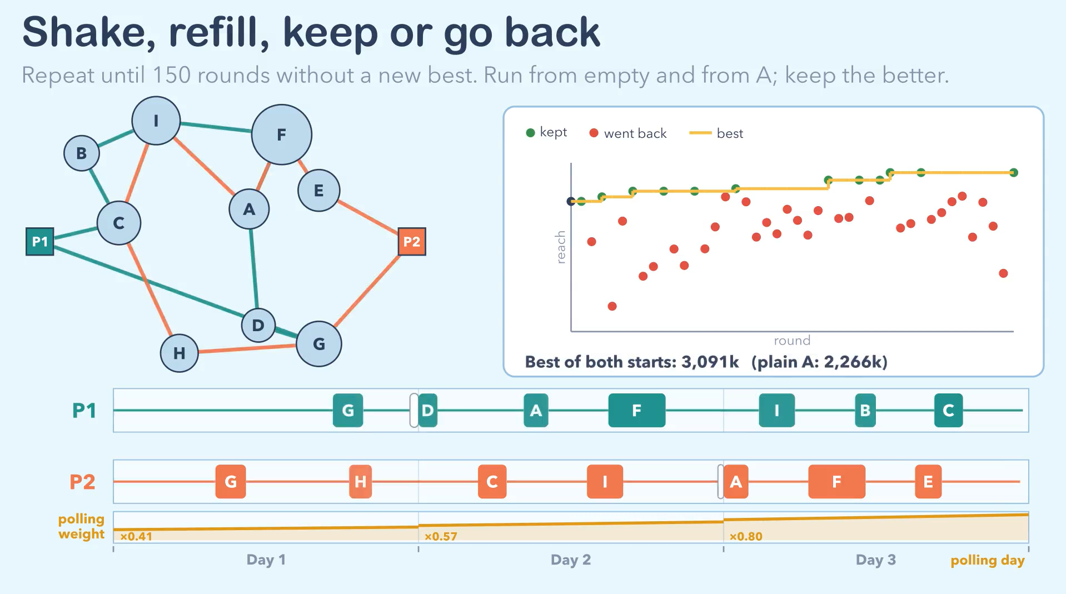

Slide 77
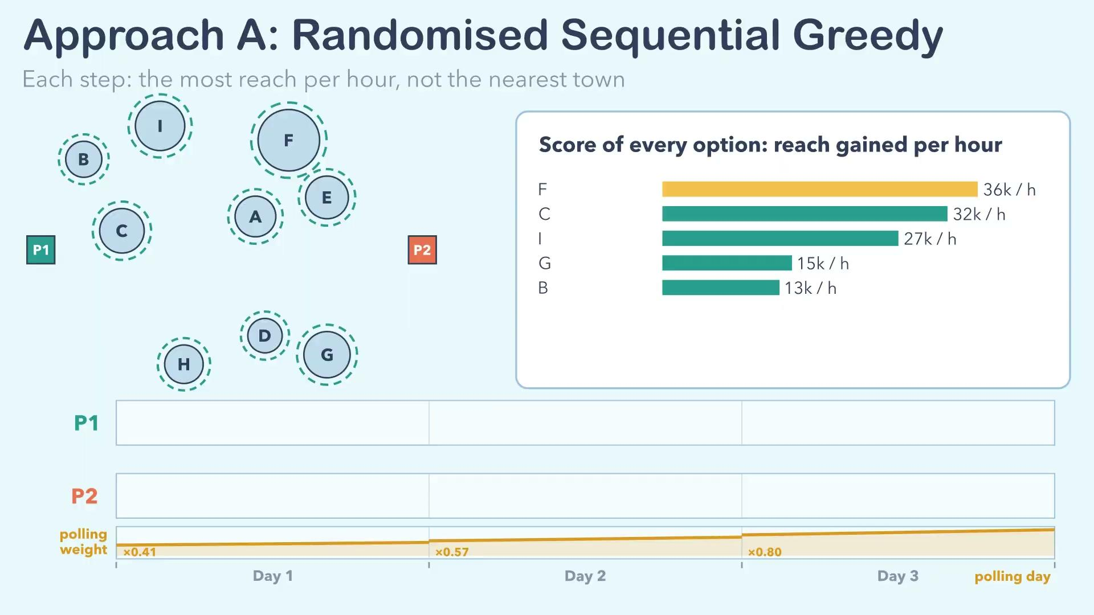

Slide 78
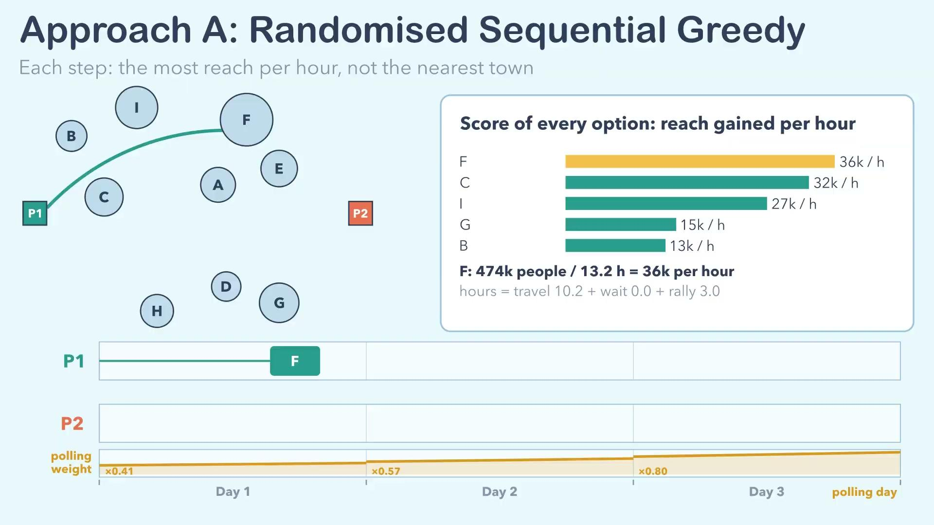

Slide 79


Slide 80


Slide 81


