Slide 1

OCEANSENSE
An IoT-Based System for Real-Time Detection and Tracking of Marine Debris
Group ID : 25-26J-002

Slide 2
Background / Problem Context
Marine debris is a major environmental issue
Plastic waste harms marine life
Difficult to monitor large ocean areas
Limited real-time monitoring systems
Research Problem
Manual observation is expensive
Satellite monitoring is limited
No continuous real-time tracking
Devices may lose communication in open sea

Slide 3
Proposed Solution: OceanSense
OceanSense is an autonomous marine monitoring system that:
Detects marine debris using image processing
Operates using energy-efficient technology
Works in harsh ocean environments
Uses multiple floating nodes for large-area monitoring
Supports self-healing communication

Slide 4
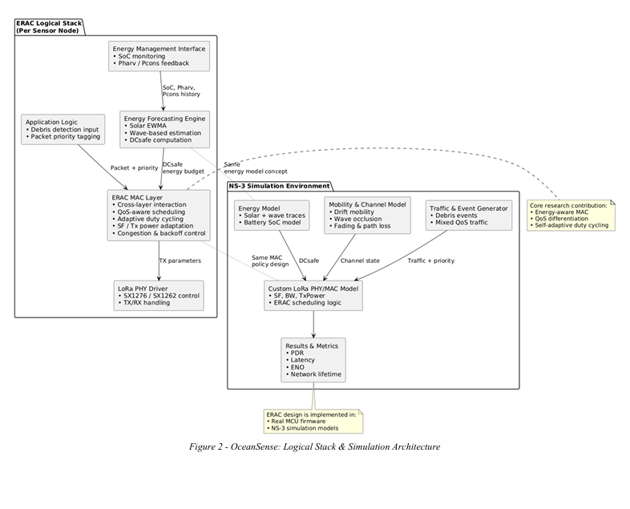
System Architecture

Slide 5
Target Users
Environmental monitoring organizations
Marine research institutes
Coastal protection agencies
Ocean cleanup organizations
Environmental NGOs

Slide 6






Our Research Team
Ms. Dinithi Pandithage
Supervisor
Ms. Narmada Gamage
Co-Supervisor
Jayasak D.L.C.
Leader
Rathnayake G.R.M.S.D.
Member
Abeysinghe P.T.G.S.R.
Member
Dissanayake D.M.T.N.
Member

