Slide 1

Cyclistic Bike Share
Presented by: Francis O’Shaughnessy
Last updated: 23rd August 2025

Slide 2
Table of contents
Cyclistic Bike Share
What are we talking about?
Let's look at the data
Recommendations
Appendix

Slide 3
What are we talking about?

Slide 4
What are we talking about?
Objective
Understanding how casual and member Cyclistic users differ, and how we can use digital marketing to influence casual users to become members

Slide 5
Let's look at the data

Slide 6
Let’s look at the data
From June 2024 to June 2025 …
4,405,990
Unique trips
23 mins
Avg. trip casual
12 mins
Avg. trip member
Saturday
Most popular day
July
Most popular month

Slide 7
Let’s look at the data
From June 2024 to June 2025 …
23 mins
Avg. trip casual
4,405,990
Unique trips
12 mins
Avg. trip member
Saturday
Most popular day
July
Most popular month

Slide 8
Let’s look at the data
From June 2024 to June 2025 …
12 mins
Avg. trip member
4,405,990
Unique trips
23 mins
Avg. trip casual
Saturday
Most popular day
July
Most popular month

Slide 9
Let’s look at the data
From June 2024 to June 2025 …
Saturday
Most popular day
4,405,990
Unique trips
23 mins
Avg. trip casual
12 mins
Avg. trip member
July
Most popular month

Slide 10
Let’s look at the data
From June 2024 to June 2025 …
July
Most popular month
4,405,990
Unique trips
23 mins
Avg. trip casual
12 mins
Avg. trip member
Saturday
Most popular day

Slide 11
Let’s look at the data
From June 2024 to June 2025 …
4,405,990
Unique trips
23 mins
Avg. trip casual
12 mins
Avg. trip member
Saturday
Most popular day
July
Most popular month

Slide 12
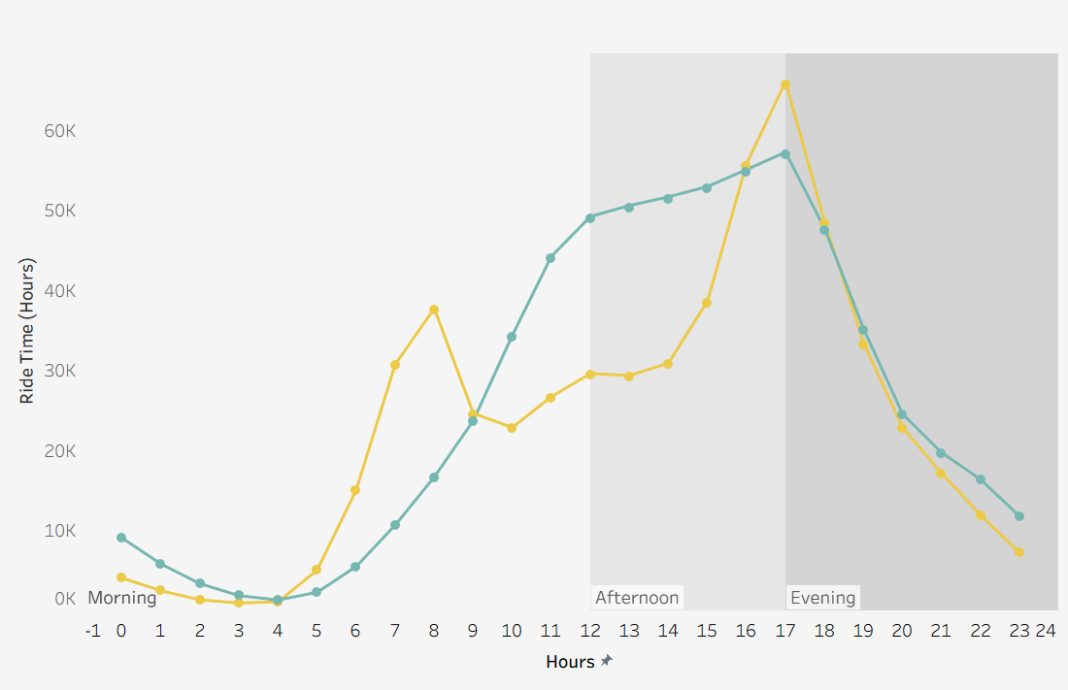
Let’s look at the data

Slide 13
Let’s look at the data
Members peak at 8am and 5pm

Slide 14
Let’s look at the data
Members peak at 8am and 5pm
Casual graduate towards peak at 5pm

Slide 15
Let’s look at the data
Members peak at 8am and 5pm
Casual graduate towards peak at 5pm
Members use for work, 9-5 pattern

Slide 16
Let’s look at the data
Members peak at 8am and 5pm
Casual graduate towards peak at 5pm
Members use for work, 9-5 pattern
Casual use for leisure/sightseeing

Slide 17
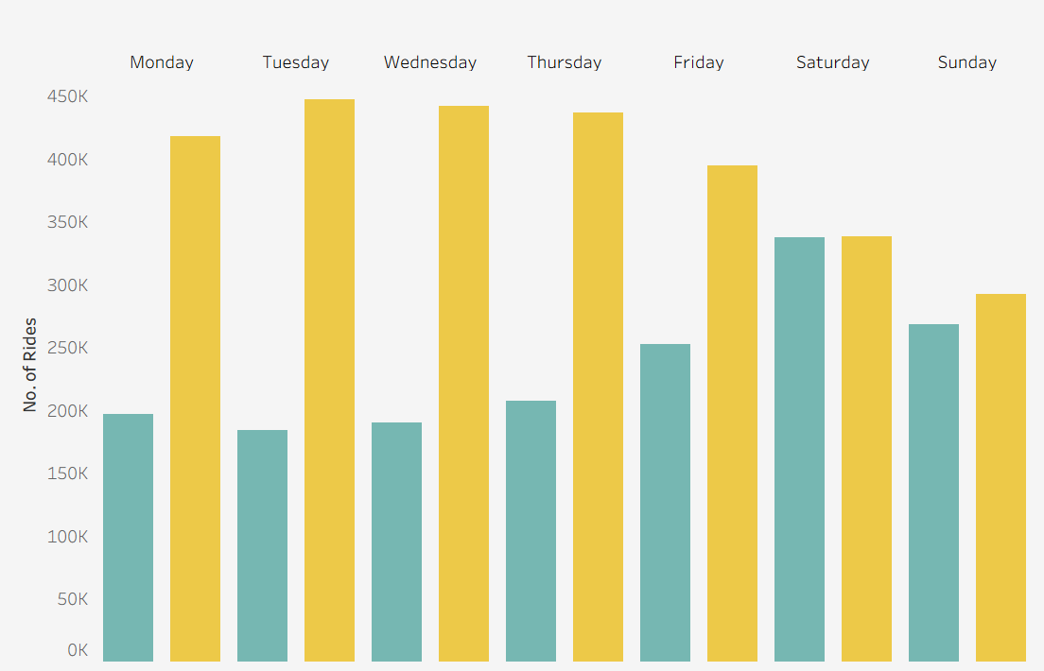
Let’s look at the data

Slide 18
Let’s look at the data
Members peak during week and drop at weekend

Slide 19
Let’s look at the data
Members peak during week and drop at weekend
Casual graduates towards peak at Saturday

Slide 20
Let’s look at the data
Members peak during week and drop at weekend
Casual graduates towards peak at weekend
Further strengthens Members usage for work

Slide 21
Let’s look at the data
Members peak during week and drop at weekend
Casual graduates towards peak at weekend
Further strengthens Members usage for work
And Casuals for leisure

Slide 22
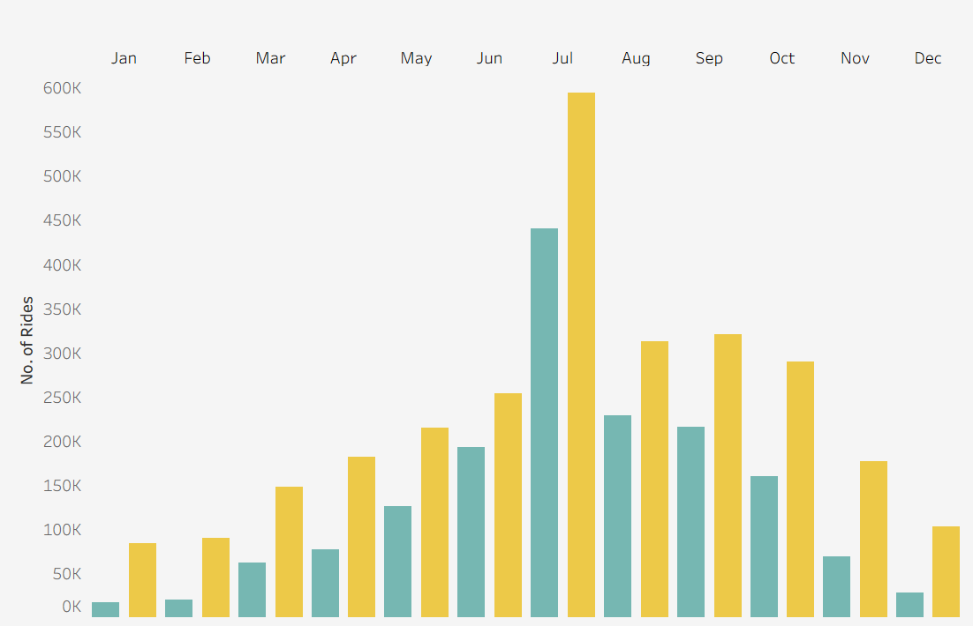
Let’s look at the data

Slide 23
Let’s look at the data
Member and Casual users both bell curve over a year

Slide 24
Let’s look at the data
Member and Casual users both bell curve over a year
Peak is in July, the summertime

Slide 25
Let’s look at the data
Member and Casual users both bell curve over a year
Peak is in July, the summertime
Flattens out the further away from summer

Slide 26
Let’s look at the data
Member and Casual users both bell curve over a year
Peak is in July, the summertime
Flattens out the further away from summer
With winter being the lowest point for both (Dec – Feb)

Slide 27
Let’s look at the data
Member and Casual users both bell curve over a year
Peak is in July, the summertime
Flattens out the further away from summer
With winter being the lowest point for both (Dec – Feb)

Slide 28
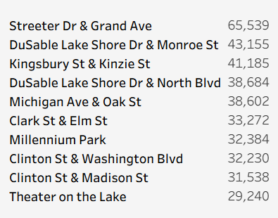
Let’s look at the data

Slide 29
Let’s look at the data
Locations are prominent tourist/sightseeing locations

Slide 30
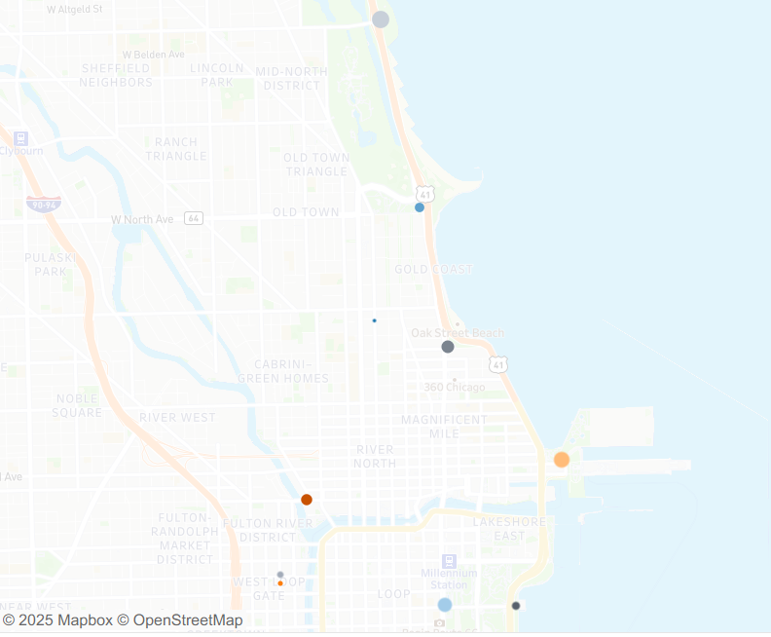
Let’s look at the data
Locations are prominent tourist/sightseeing locations
Focused along the coast & city centre

Slide 31
Let’s look at the data
Locations are prominent tourist/sightseeing locations
Focused along the coast & city centre
In areas of high amenity concentration

Slide 32
Recommendations

Slide 33
Recommendations

Slide 34
Recommendations
1.
Weekend pass
Create weekend passes to target Casual user peak times

Slide 35
Recommendations
1.
2.
Weekend pass
Create weekend passes to target Casual user peak times
Summer Focus
Start campaign before summer season to best capture highest amount of users

Slide 36
Recommendations
1.
2.
3.
Weekend pass
Create weekend passes to target Casual user peak times
Summer Focus
Start campaign before summer season to best capture highest amount of users
Tour de City
Focus on Chicago tourism; target hotels, parks and iconic locations for digital marketing

Slide 37
Thankyou

Slide 38
Appendix
Dashboard
Change Log
Case Study

