Slide 1
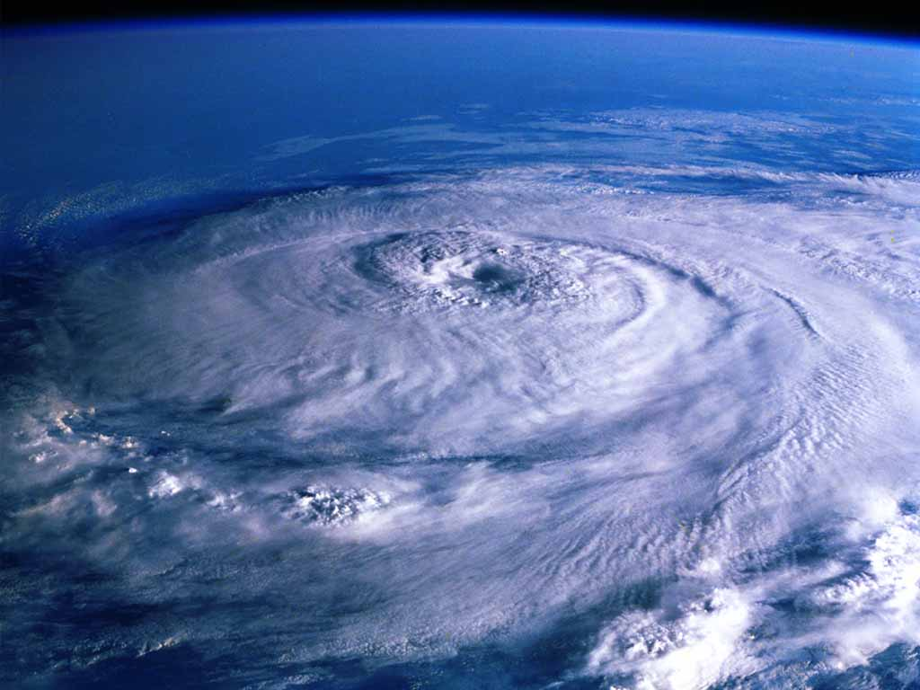

Practical Steps For “Smart Buoy” Project Realization
Motyzhev S.*, Brown J.**, Horton E.*, Lunev E.*, Tolstosheev A.*, Motyzhev V.*
* Marine Hydrophysical Institute NASU, Kapitanskaya,2, Sebastopol, Ukraine, 99011
** Naval Oceanographic Office, 1002 Balch Boulevard, Stennis Space Center, MS 39522-5001,USA

Slide 2

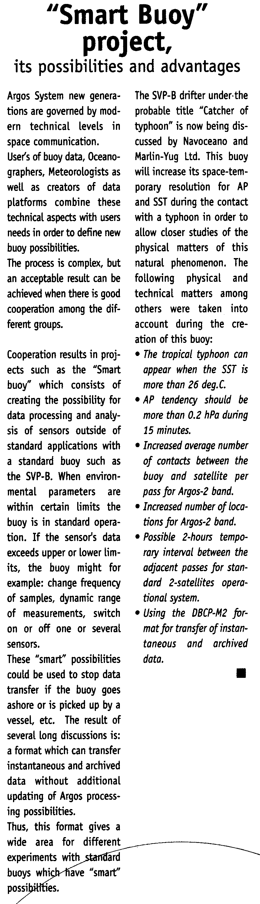
The first presentation of “Smart Buoy” idea

Slide 3
The issue of “Smart Buoy” idea
Transformation of buoy for not only data
collection and transfer to user, but also data
analysis by its own processing possibilities to
change the buoy status or goal of application

Slide 4
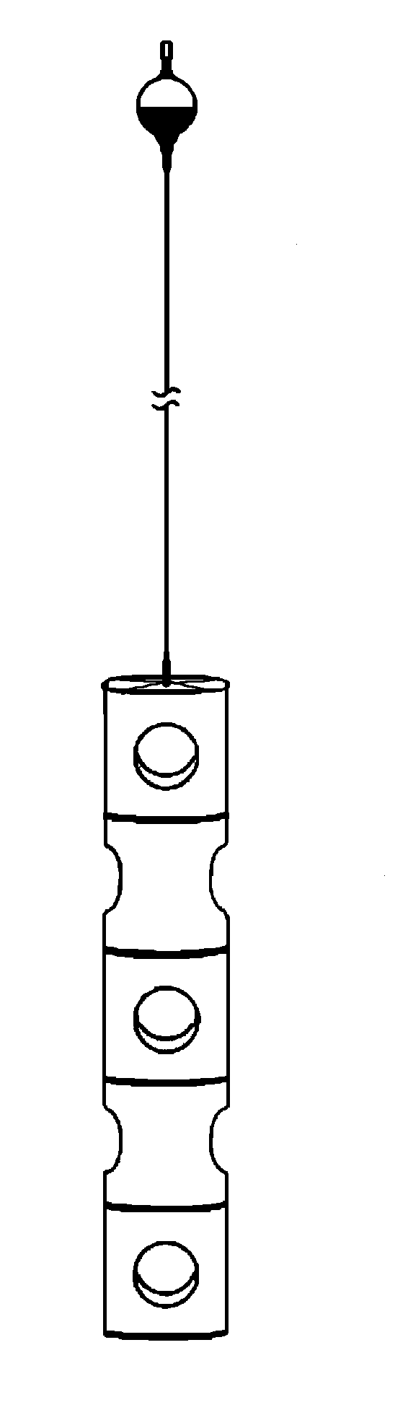
SVP-BL (Light) drifter
Current problems for 51 Marlin buoys used inside the
areas with limited surface (closed seas or semi-closed gulfs)
Mean lifetime was less than 150 days (ID16330-600 days in Black Sea)
29% of buoys came ashore
6% were picked up by ships
65% stopped data transfer (vandalism or technical reasons)
Reasons for this development:
Decrease of operator expenses (cost of buoy and payment for Argos)
Decrease of load for Argos carrying capacity
Fast re-using of Argos ID’s
“Smart” parameters of buoy
Self-switching off after two days being extracted of water
Self-switching on being returned in water within 1 year in operation
Preliminary programmable lifetime no longer than 1 year
Technical issue
34 cm surface float, 32 batteries and modified “Holey Sock”
D=34 cm

Slide 5
SVP-BT (Typhoon ) drifter
Stages of storm development:
Tropical wave
Tropical disturbance (trade wind)
Tropical depression (wind velocity between 20 and 34 knots)
Tropical storm (wind velocity between 35 and 64 knots)
Hurricane or Typhoon (wind velocity more than 64 knots)
Reason of storm buoy creation
Deployment and support of low-cost storm forecasting drifter
networks with AP high resolution and data processing ability to
predict the stages of storm development

Slide 6
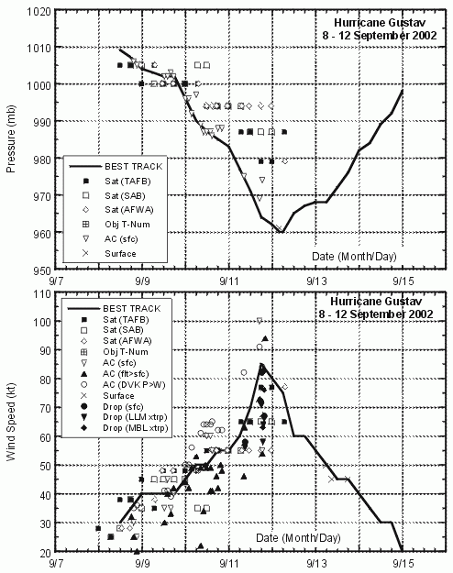
SVP-BT (Typhoon ) drifter
Idea to be investigated
There is an experimental point of view that small level of AP
variability can determine the direction of storm stages
development (from birth to dissipation)

Slide 7
SVP-BT (Typhoon ) drifter
Tasks of the first experiment
Investigation of ways to create the SVP-B drifter with higher tool-temporary resolution when AP measurement
Realization of drifter experiment in the tropical zone
Accumulation of data when different storm stages took place
Joint with storm experts data analysis
Determination of future ways
Some positive things, which took place before experiment
Creation of AP channel with high resolution and without rejection of AP data during a storm
Good covering by passes due to the uniform distribution for 3-satellite Argos Service
DBCP-M2 format for transfer of instantaneous as well as archived data
New electronic component with reduced power consumption for continuous data computation inside a buoy

Slide 8
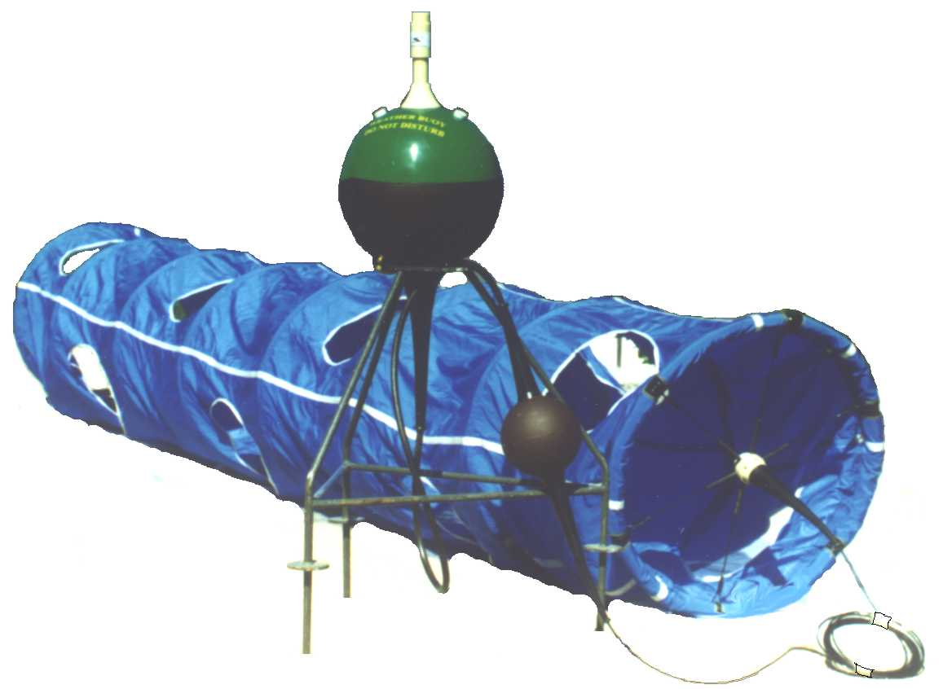
SVP-BT (Typhoon ) drifter
Comparison of SVP-B and SVP-BT parameters
Parameter | SVP-B Marlin | SVP-BT Marlin
AP resolution (hPa) | 0.1 | 0.05
AP dynamic range (hPa) | 850.0 to 1054.7 | 930.00 to 1032.35
APT dynamic range (hPa) | -25.5 to +25.6 | -12.75 to +12.80
Interval between samples (min) | 60 | 15
AP measurement | Standard algorithm 40 AP samples (40 s). Median of the lowest 3 points. Median within 1 hPa | 10 standard measurements within 15 minutes with 90 sec interval. Average of 10 medians
Rank for data transfer | 1 | 4 (0, 1, 2, 3)

Slide 9

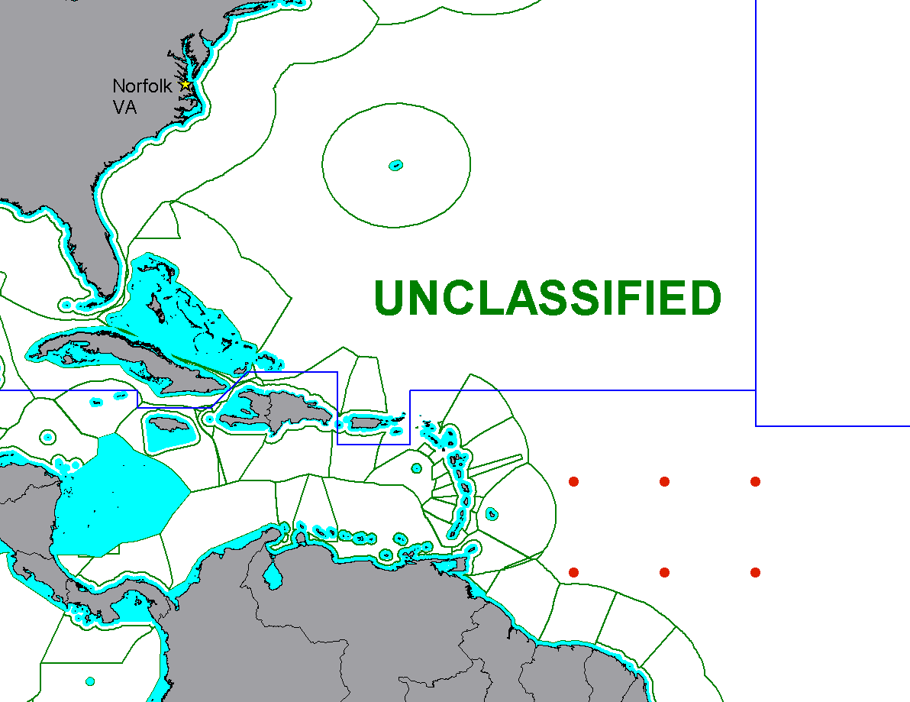
SVP-BT (Typhoon ) drifter
Schedule deployment of buoys
9-10 July 2003
40432
40432
40434
40429
40430
40433

Slide 10
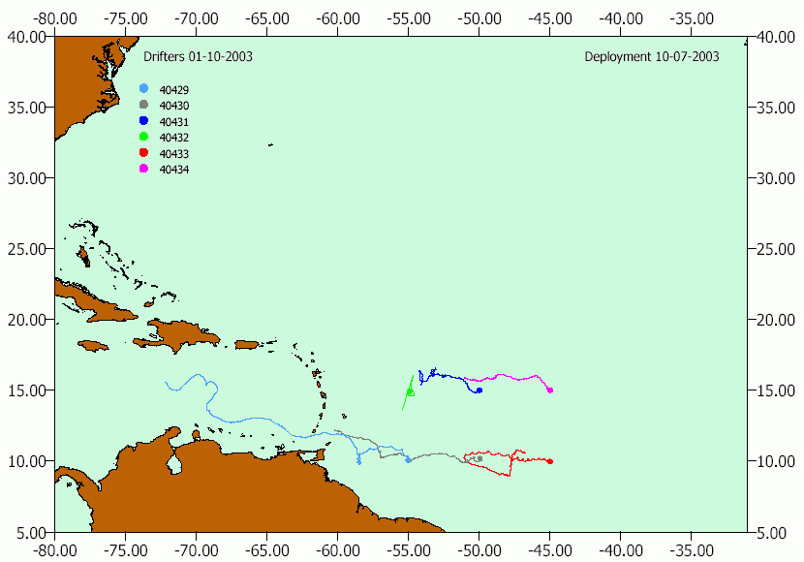
SVP-BT (Typhoon ) drifter
Trajectories of drifters from 09.07.03 (date of buoy deployments) to 1.10.03

Slide 11
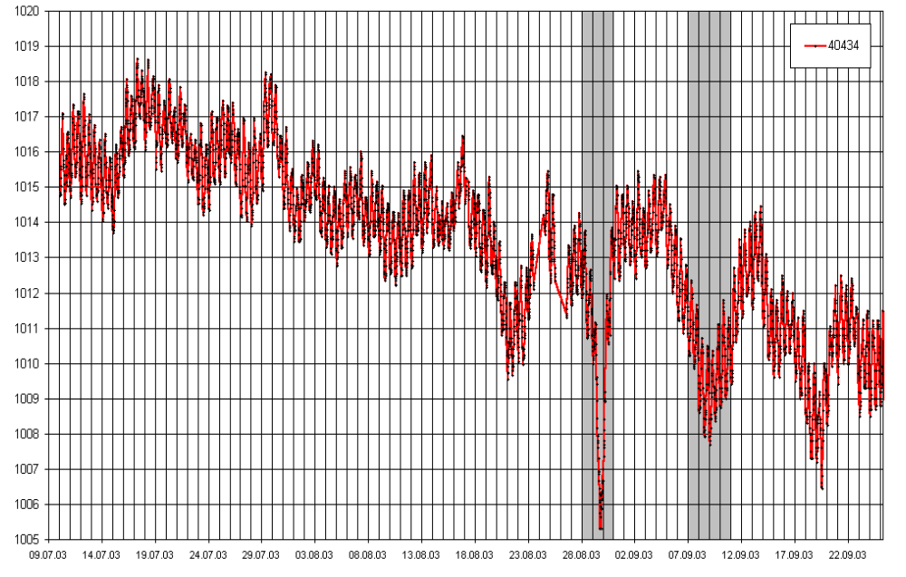
SVP-BT (Typhoon ) drifter
AP variability for ID40434/WMO41521
from 09.07.03 (date of buoy deployment) to 24.09.03
Registration of hurricane ISABEL 06.09.03 – 12.09.03
Registration of hurricane FABIAN 20.08.03 – 02.09.03

Slide 12
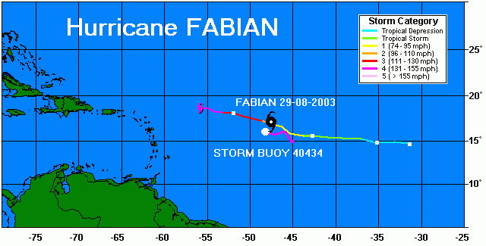
SVP-BT (Typhoon ) drifter
Positional relationship of drifter and hurricane FABIAN
when minimum AP took place

Slide 13
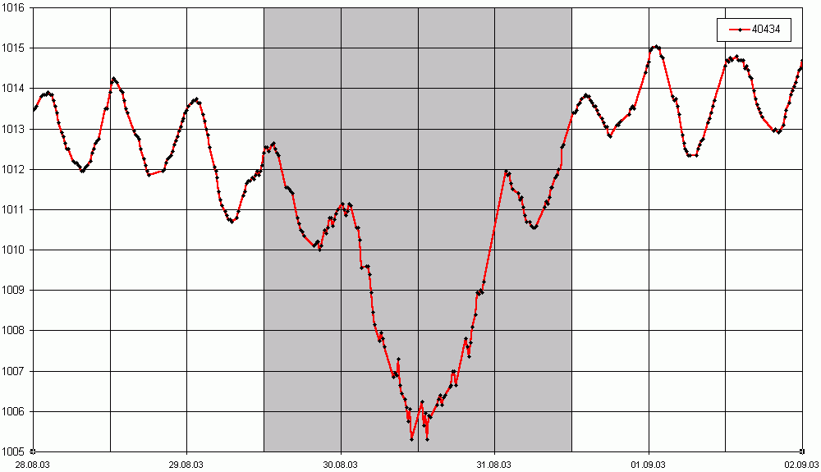
SVP-BT (Typhoon ) drifter
AP variability before, during and after “contact” of buoy
with hurricane FABIAN
The distance between drifter and hurricane eye - approximately 85 miles

Slide 14
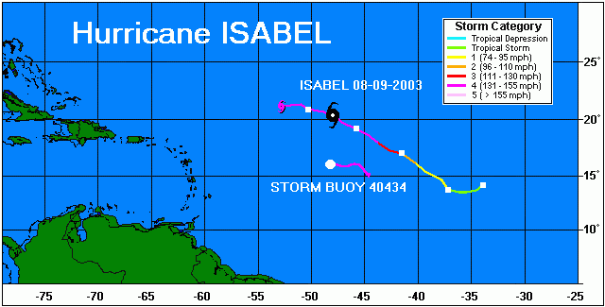
SVP-BT (Typhoon ) drifter
Positional relationship of drifter and hurricane ISABEL
when minimum AP took place

Slide 15
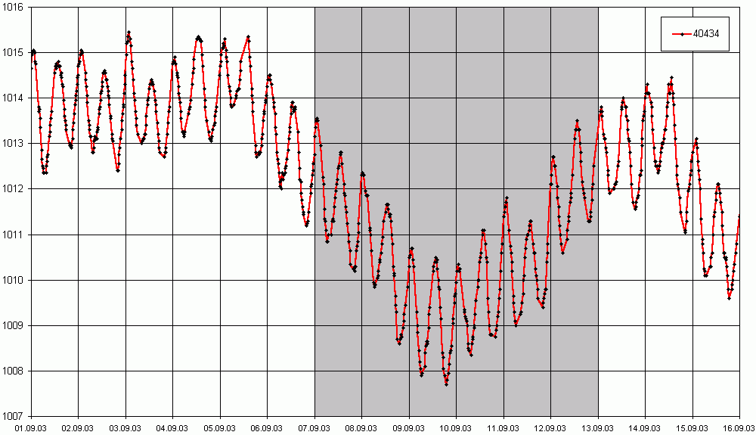
SVP-BT (Typhoon ) drifter
AP variability before, during and after “contact” of buoy
with hurricane ISABEL
The distance between drifter and hurricane eye – approximately 265 miles

Slide 16
SVP-BT (Typhoon ) drifter
Preliminary results of experiment
Positive results
Storm buoy has been developed
Buoy network has been deployed
It has been demonstrated the buoy ability for AP measurement with high resolution in rough seas without AP rejections
Long-time observation of AP and SST variability has been provided
Registration of hurricane different stages was done
Accumulation of data for the future analysis is being provided
Negative result
Chosen AP sensor provides high resolution, but it has bad stability when shock (systematic shift of AP data can be after the air deployment)

Slide 17
SVP-BT (Typhoon ) drifter
Next steps to develop the idea of Storm Buoy
Participation in DBCP Evaluation Group activity to study the reasons of AP rejections
Joint with hurricane experts data analysis to determine the future ways of Storm Buoy development
Creation of new low-cost AP channel with high stability when shock (has been done)
Investigation of ways to assess the surface waves parameters (amplitude and period) by SVP-BT drifters
Integration of Light buoy and Storm buoy ideas to develop and support the low-cost storm warning networks

