Slide 1
Mixing and mortality
Biofouling 3D transport
3 February 2021

Slide 2
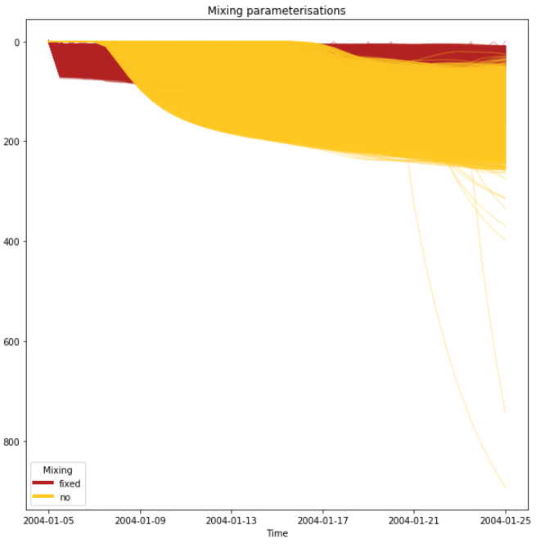
Mixing
Random value between -20 and 20 cm/s

Slide 3
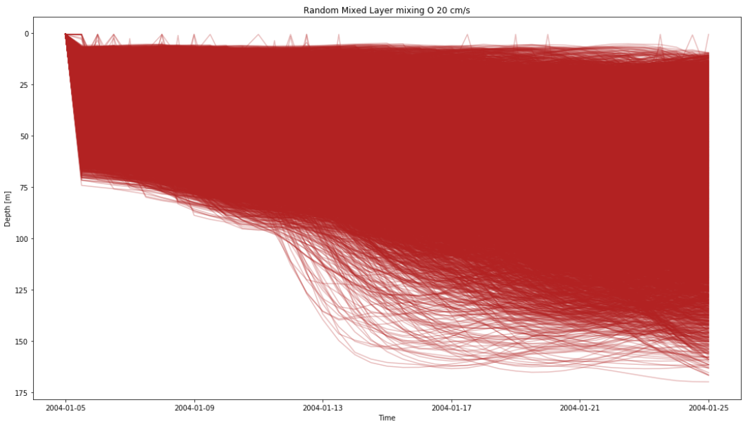

Slide 4
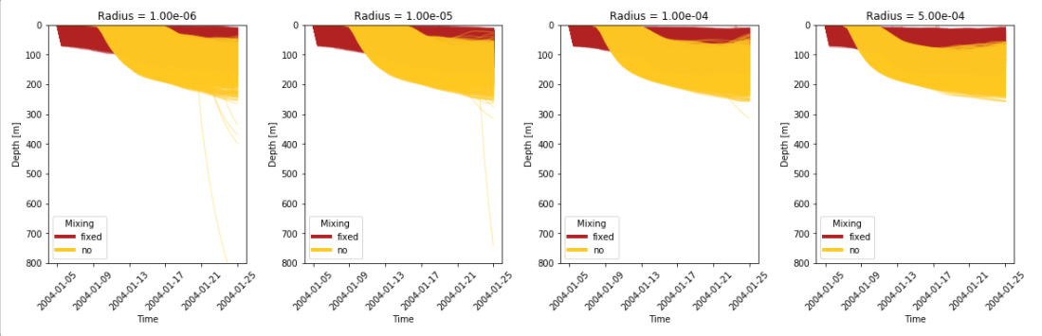
Dependency on particle radius

Slide 5
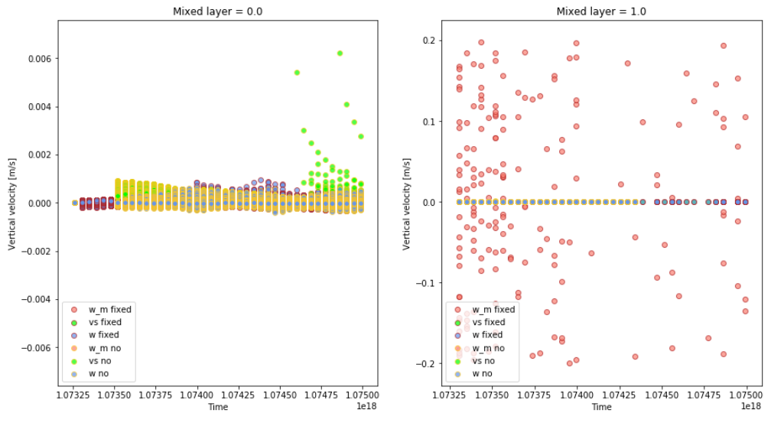
Comparing vertical velocities

Slide 6
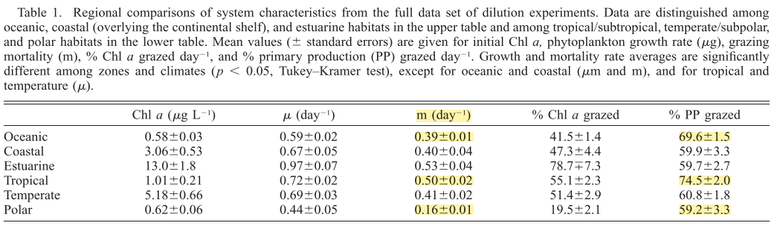
Algal Mortality
Three values from Calbet and Landry, 2004

Slide 7
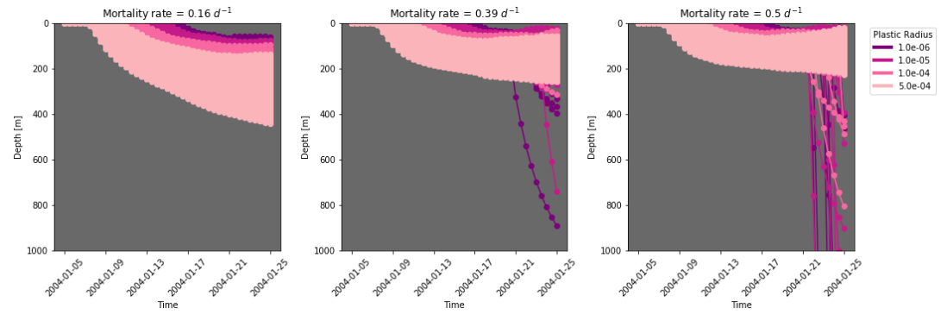
Algal Mortality

Slide 8
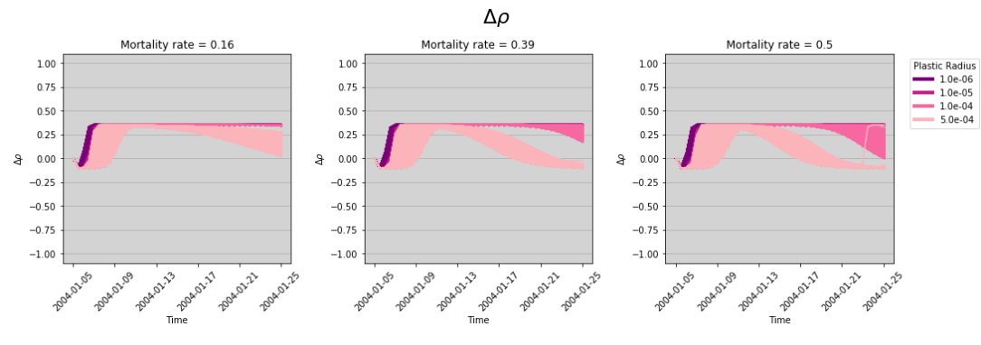
Relative density

Slide 9
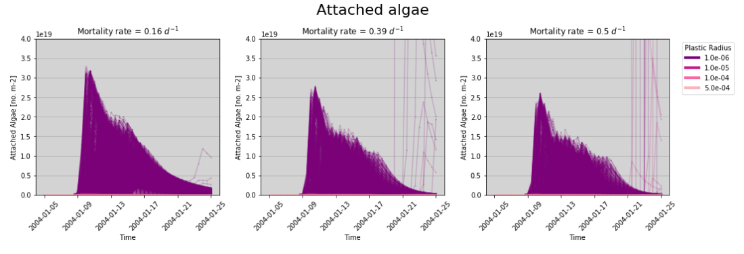
Number of attached algae

Slide 10
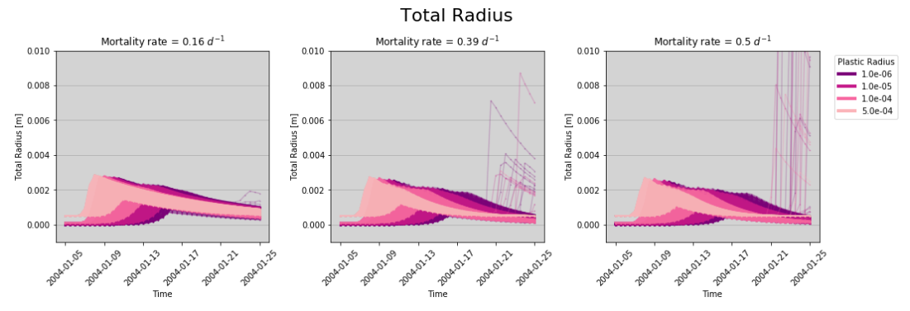
Total Radius

