Slide 1
CCTECH INTERNSHIP CAPSTONE PROJECT
Localizer App
AI-Powered Software Localization Engine for Enterprise CAD/BIM Applications
Developed by Sarthak Mahadik and Ganesh Chavan
Project Mentor: CCTech & Autodesk Stakeholders | Date: June 22, 2026

Slide 2
TRADITIONAL LSP SOURCING VS. COMMUNITY-LED AI VALIDATION
The Business Problem
$10,000,000
Annual Autodesk LSP Localization Spend
Software localization for global CAD/BIM products traditionally depends on Language Service Providers (LSPs), resulting in high costs, long turnaround times, and limited scalability. Autodesk aims to explore a fundamentally different approach by leveraging employees, customers, partners, and the user community as translation contributors while using AI for quality assurance.
🌍 Uneven Community Participation
Community contributions vary significantly across languages, making it difficult to ensure consistent coverage for all supported languages.
🤖 Scalability of Review Process
As the number of community contributions grows, efficiently reviewing, approving, and integrating translations becomes increasingly challenging without intelligent automation.
📚 Terminology & Brand Consistency
Community-generated translations may fail to adhere to Autodesk's domain-specific terminology, product voice, and brand guidelines.
⚖️ Legal & Intellectual Property
Accepting translations from external contributors raises ownership, licensing, and intellectual property ambiguities for proprietary product content.
🏢 Organizational Adoption Risks
Transitioning from an LSP-driven workflow to a community-sourced model may face resistance due to existing vendor relationships and established localization processes.
🔄 Maintaining Quality at Scale
Ensuring that community-sourced translations achieve quality levels comparable to professional LSPs while significantly reducing costs is a major challenge.

Slide 3
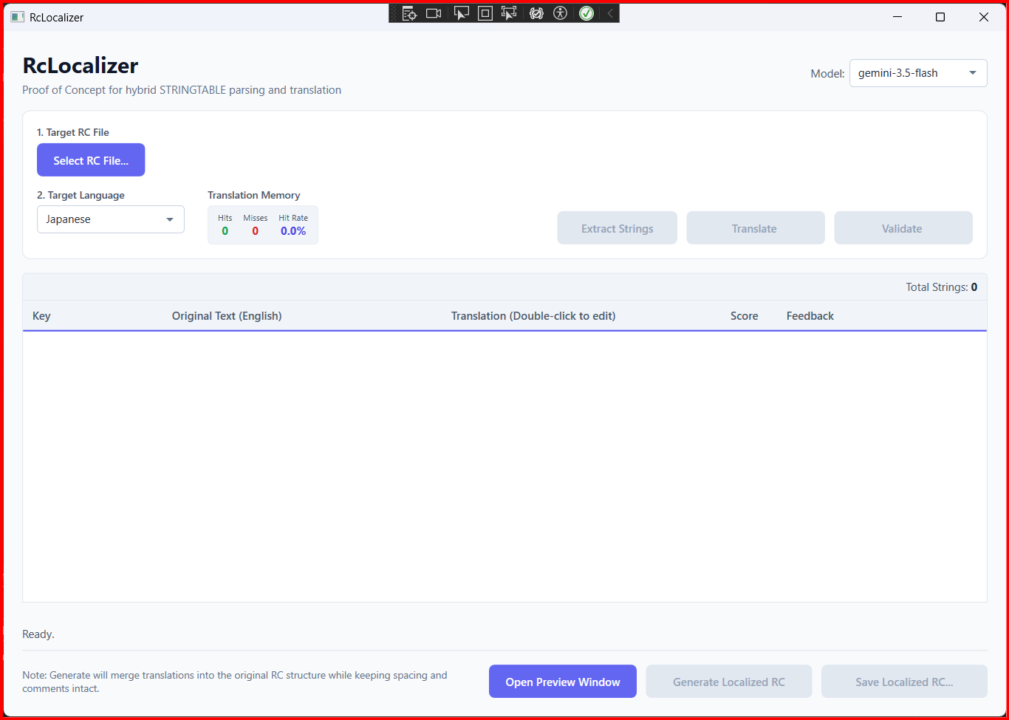
DIRECT BUSINESS TRANSFORMATION
The Solution: Localizer App
Automated, AI-Assisted CAD Localization Studio
Localizer App bridges resource lexer tokenizers with Google Gemini AI. The tool delivers a streamlined, desktop-integrated translation workspace:
📦 Automated Extraction: Reads C++ .rc files directly, targetting string tables while ignoring macros/comments.
⚡ Sub-ms Local Caching: Translation Memory holds previous translations and validations to prevent API costs.
🛡️ Double-Layer Guard: Validates syntax placeholders locally + executes Gemini AI QA evaluations.
🖥️ Simulative Workspace Dialogs: Overlays edits in real-time on a virtual UI mockup, verifying spacing before export.
Figure: Main Application Grid showing loaded workspace status

Slide 4
ENGINEERED FOR PRODUCT TEAMS
Key Features & Capabilities
🔍 RC File Parsing
Scans C++ Resource Scripts natively. Identifies translatable strings inside STRINGTABLE blocks while preserving coordinate offsets.
🧠 AI Translation Workflow
Translates string batches using Gemini model fallback logic, selecting optimal words using specialized CAD/BIM terminology lists.
⚡ Translation Memory Cache
Saves translations, QA scores, and feedbacks. Bypasses Gemini API calls for identical source keys, cutting costs to $0.
🛡️ Glossary Validation
Enforces formatting checks (escapes and parameters) to prevent crashes, combined with Gemini linguistic quality evaluations.
🖥️ Simulative Preview Window
Mockup workspace displaying menu ribbons and properties panels, dynamically populated to verify text overflows live.
📁 Safe Localized Export
Generates C++ resource script files in-place using back-to-front replacement, keeping layout coordinate files perfectly intact.

Slide 5
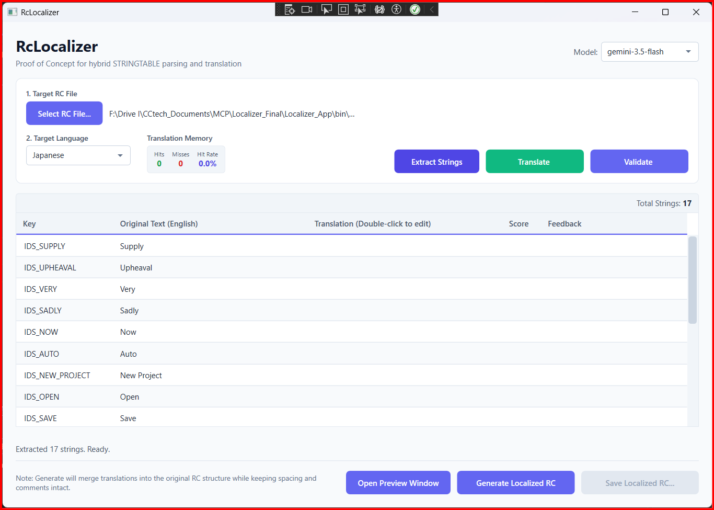
PARSING AND SEGMENTING WINDOWS RESOURCE SCRIPTS
Step 1: Ingestion & Resource Parsing
Automated Lexical Ingestion
The pipeline begins by ingesting the target C++ `.rc` file. The custom tokenizer immediately parses structure without modifying code:
🔍 Tokenizer Extraction: Identifies all key-value entries localized strictly inside STRINGTABLE boundaries.
🔒 Offset Coordinate Mapping: Captures precise start/end index offsets of string values, ensuring character positions are recorded.
🚫 Non-Destructive Filtering: Ignores compiler directive macros (#ifdef, #endif) and comments, preventing codebase corruption.
Workspace: Strings successfully extracted and populated into UI grid editor

Slide 6
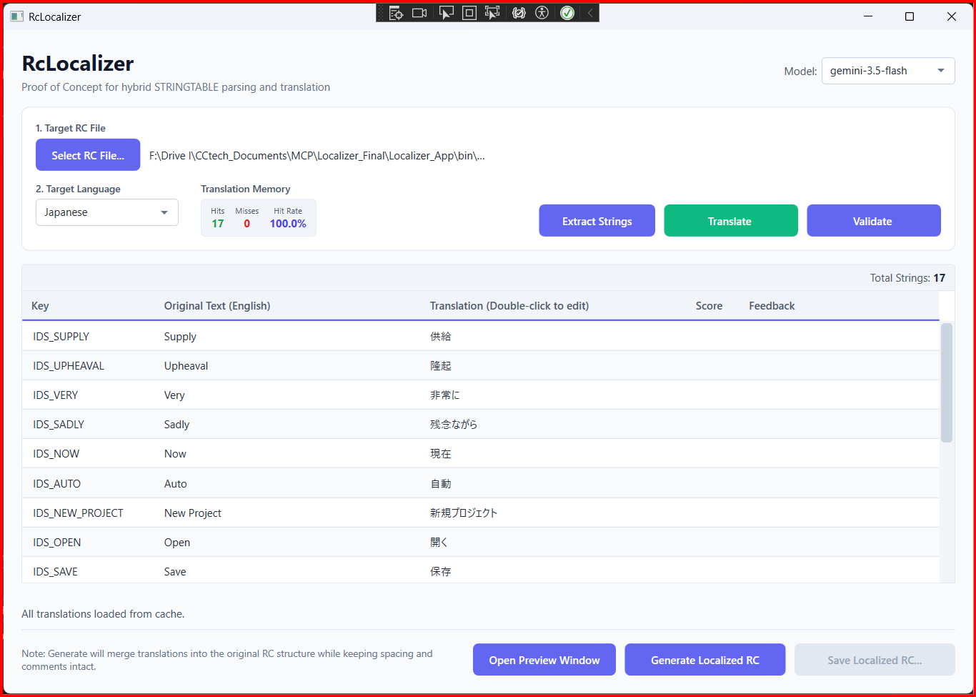
CONTEXT-AWARE COGNITIVE TRANSLATION SERVICES
Step 2: AI-Powered Batch Translation
Parallel Cognitive Batches
Missing string keys are processed in parallel batches. Cognitive prompts map translations using domain vocabulary definitions:
🧠 Specialized Glossary Prompts: Forces the AI model to match domain-specific terms (e.g. AutoCAD 'Draft' vs literal 'Wind draft').
⚡ Parallel Async Batches: Group keys to reduce API call overhead, achieving sub-second batch translation times.
🔄 Resilient Model Fallbacks: Automatically routes requests through flash alternatives (3.5 -> 2.5 -> 1.5) if rate limits hit.
WPF Workspace: Main translation editor grid after running AI batch translation

Slide 7
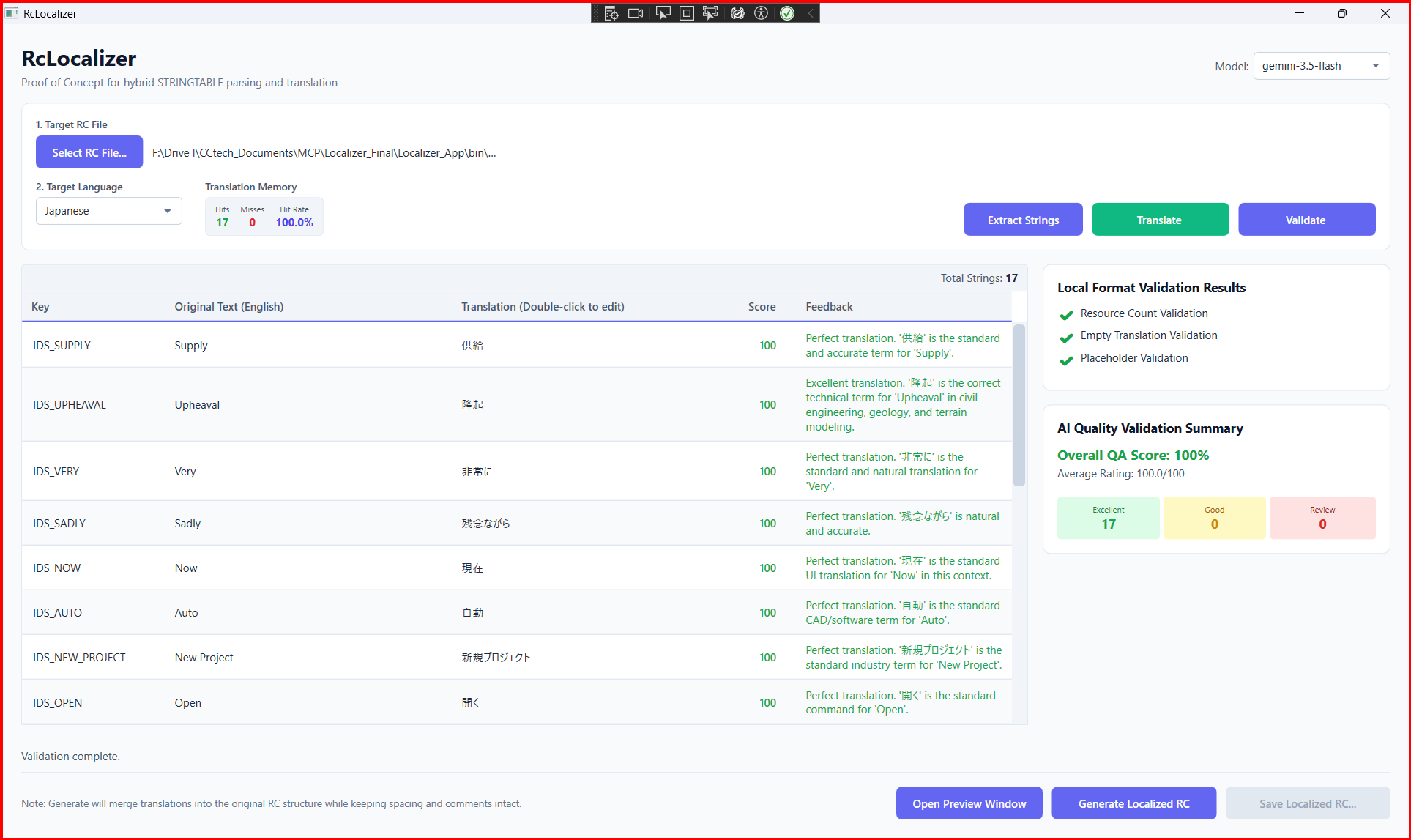
COMBINING LOCAL SYNTAX VERIFICATION WITH AI-POWERED QUALITY AUDITS
Step 3: Dual-Layer Validation & QA
Unified QA Panel & Diagnostics
Clicking 'Validate' runs double-layer diagnostic checks. The Validation Panel slides open on the right side of the main workspace:
✔️ Local Placeholder Verifiers: Scans parameter counts (%s, %d, {0}) to guarantee C++ compiler safety.
🧠 Gemini AI Quality Rating: Evaluates context, scoring translations from 0 to 100, and categorizes into Excellent, Good, or Review tags.
📝 Actionable QA Feedback: Logs clear error descriptions and improvement recommendations inside the grid feedback cells.
Linguistic Quality Audit: Side-by-side validation panels displaying local syntax checks and AI QA scorecards

Slide 8
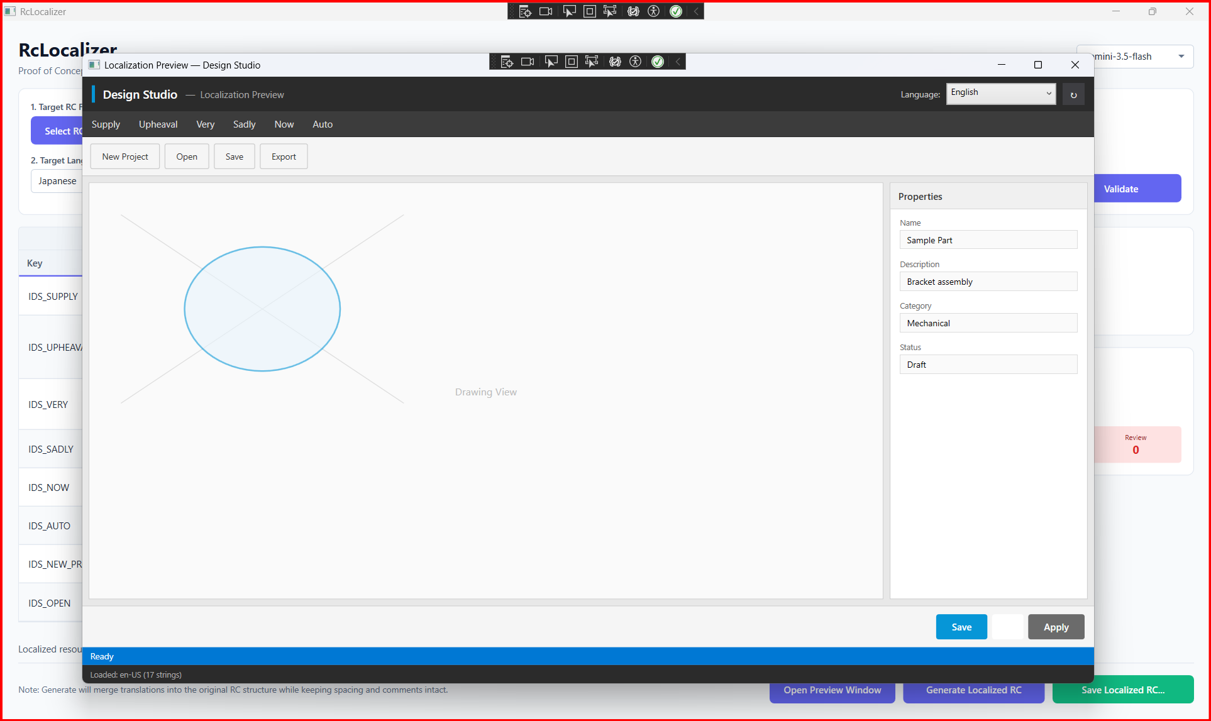
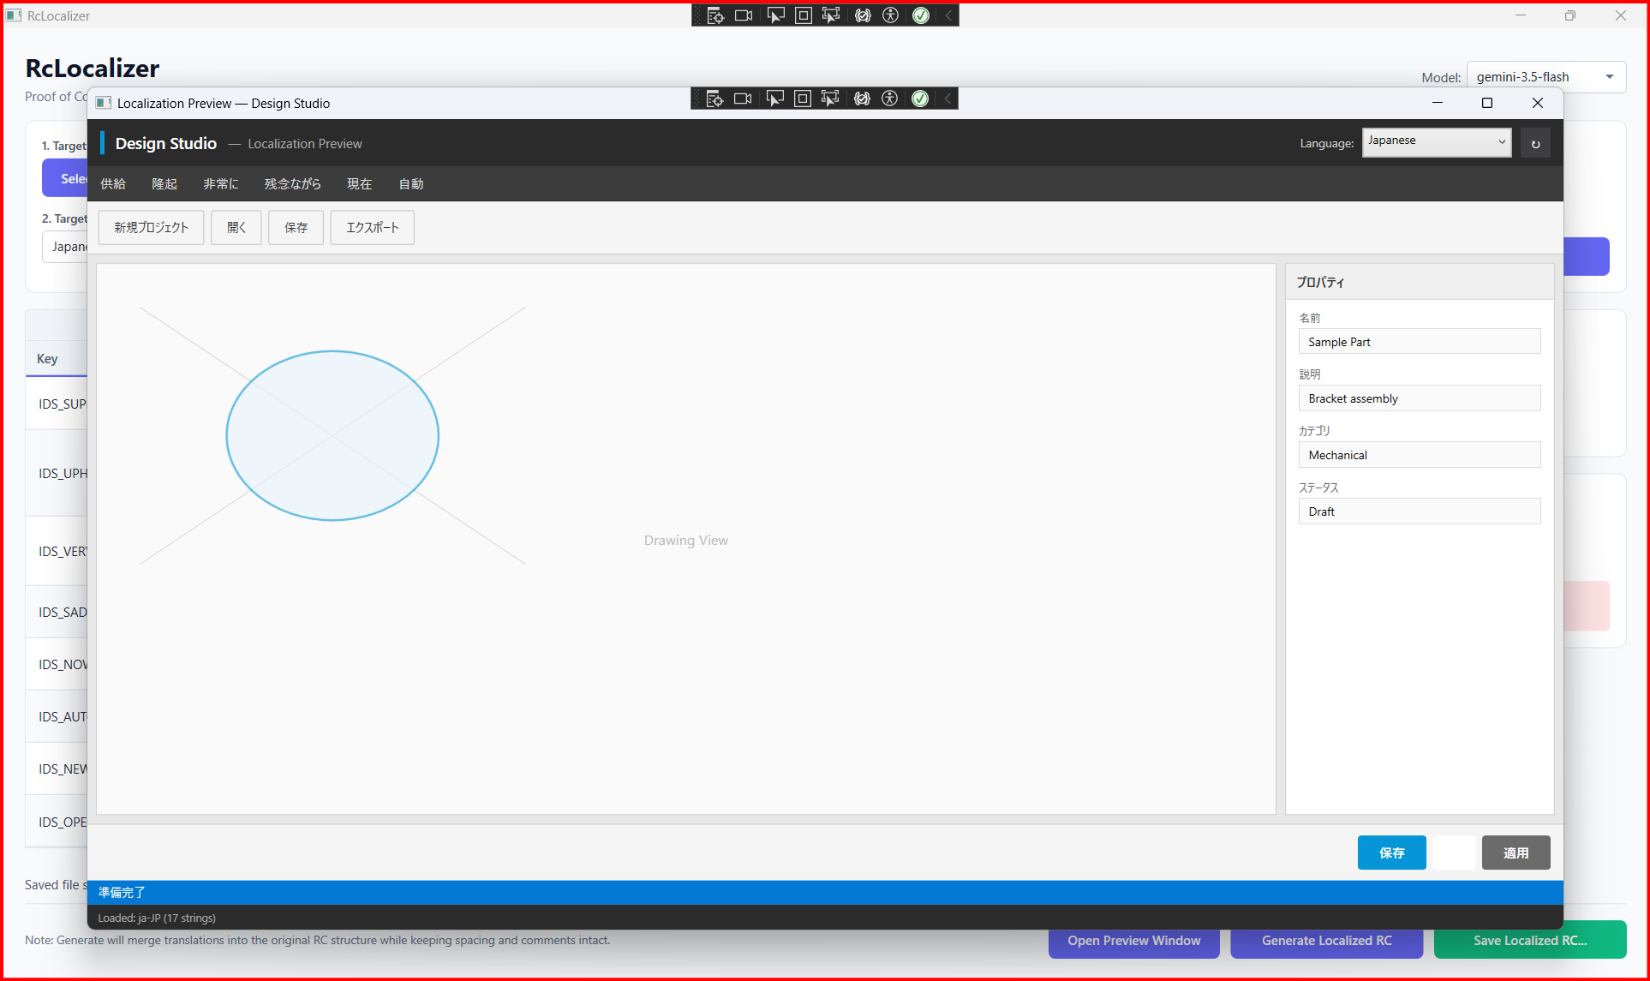
REAL-TIME VISUAL LAYOUT VERIFICATION
Step 4: Visual Dialogue Simulation
Standard English UI Dialog Mockup Layout
Japanese Localized UI Dialog Mockup Overlay
Linguistic validation is overlaid in-memory. Designers can instantly review if a translated string overflows menu borders or overlaps labels before generating compiled binary outputs.

Slide 9
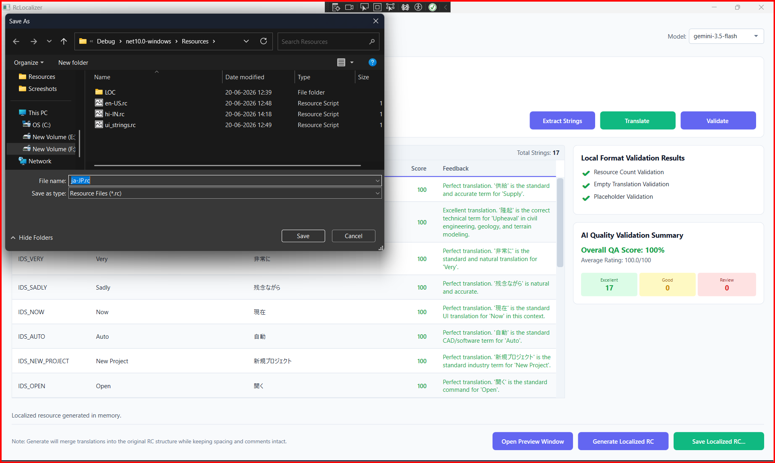
REVERSE INDEX-SAFE SEGMENT REPLACEMENTS
Step 5: Coordinate-Safe Resource Rebuilder
Bottom-Up String Injector
Modifying C++ resource scripts (.rc) can corrupt character coordinate layouts if segment lengths alter. The generator implements a bottom-up parsing replace loop:
🔄 Descending Replace Loop: Sorts translatable strings in descending order based on their character offsets before inserting translations.
🔒 Spacing & Comment Preservation: Only modifies targeted string literals, keeping preceding spacing, includes, and headers intact.
📝 Proper Escaping Rules: Automatically doubles nested quotes inside string segments to adhere strictly to C++ compiler standards.
File Generation: Saving the compiled localized resource script output

Slide 10
END-TO-END LOCALIZER PROCESSING PIPELINE
How It Works: The Automated Data Pipeline
01
INGEST & LEX
Reads base C++ .rc script. Extracts translatable label definitions inside STRINGTABLE blocks. Maps indices & skips macro directives.
02
TM CACHE CHECK
Performs sub-millisecond local hash lookups. Matches previously translated and validated strings. Achieves $0 API transaction overhead.
03
AI TRANSLATION
Batches cache misses asynchronously to Gemini models. Enforces Autodesk glossaries to resolve CAD terms. Automatically fallbacks on rate-limit timeouts.
04
DUAL QA AUDIT
Scans syntax variables locally for compiler safety. Evaluates and scores translation quality (0-100) via Gemini. Flags warning items for review.
05
SAFE COMPILE
Validates layout spacing in visual preview overlays. Generates localized script via bottom-up injection. Preserves offsets and coordinates.

Slide 11
LIVE SYSTEM WALKTHROUGH & DEMO.MP4
Product Demonstration Video
Video Demonstration Overview
A complete execution cycle is recorded and packaged in the demo media package. Watch the system parse C++ files, translate strings, and validate parameters:
🎥 Video File Name: Demo.mp4 (located in the project root directory).
⚡ Key Video Highlights: Extracting sample.rc, executing cache lookups, checking validation logs, and viewing the live Japanese preview.
🖥️ Playback: Playable in standard desktop media players during client-facing reviews.
DEMO VIDEO: DEMO.MP4
Launch Demo.mp4 from workspace for actual client playback

Slide 12
MODERN DESKTOP & COGNITIVE SERVICE FOUNDATIONS
Technology Stack & Code Architecture
Built on Robust Desktop Foundations
💻 Framework: C# .NET 10 & Windows Presentation Foundation (WPF) with modern MVVM design properties.
🧠 AI Platform: Google Gemini API Integration (gemini-3.5-flash, gemini-2.5-flash, gemini-1.5-flash fallbacks).
📁 Caching: Local JSON file database holding translation memories and syntax metrics per culture code.
📄 Resource Engine: Custom C++ Tokenizer Lexer scanning STRINGTABLE segments with index coordinate mapping.
SYSTEM LOGICAL DATA PIPELINE
1. RcParserService: Scans raw files using token matching loops to identify start/end coordinates of translatable text.
2. TranslationMemory: Resolves text hash matches, fetching cached C# validation values before invoking network handlers.
3. GeminiService REST Client: Submits payloads containing specialized system instructions and fallbacks to flash models on failure.
4. ValidationService QA: Matches format flags, counting escape codes. Updates local scores and caches validation logs.
5. RcGeneratorService: Sorts modified indices in descending order, replacing strings from bottom to top to preserve offsets.

Slide 13
WORKSPACE ORGANIZATION & CLEAN DIRECTORY DESIGN
Modular System Structure
Workspace Directory Tree
Localizer_App/ ├── Models/ │ └── Models.cs <-- Data transfer models & constants ├── Services/ │ ├── AiService.cs <-- Gemini API, translator & AI Validation │ ├── RcParserService.cs <-- C++ Resource tokenizer parser │ ├── RcGeneratorService.cs <-- Bottom-up coordinate safe rebuilder │ ├── TranslationMemoryService.cs <-- Local JSON caches per language │ └── ValidationService.cs <-- Syntax placeholder checks ├── Views/ │ ├── MainWindow.xaml/cs <-- Main editor controller │ └── PreviewWindow.xaml/cs <-- Live UI dialog simulation mockup └── Resources/ ├── en-US.rc / ui_strings.rc <-- Base UI layouts resource script └── TranslationMemory/ <-- Local cache database storage
High-Cohesion Architecture Overview
The application organizes logic into clear layers to ensure code review readiness: • Low Code Complexity: Methods are designed to be under 10 lines of code, prioritizing event-driven triggers inside views. • Data Model Integrity: Models.cs consolidates models (ResourceString, TargetLanguage, ValidationResult) under one namespace, avoiding scattered class files. • Dynamic Dropdown System: PreviewWindow parses files inside the Resources/ folder dynamically, eliminating hardcoded languages list and keeping preview logic purely file-driven. • Secure Storage Boundaries: Config details are isolated in AppData config.env files rather than standard App.config, safeguarding API credentials.

Slide 14
MEASURABLE OPERATIONAL VALUE
ROI & Business Outcomes
3.0x
Faster Turnaround
Localization reviews shrink from weeks to minutes. Eliminates pipeline friction between engineers and agencies.
90%
Cost Reduction
Sub-millisecond local caching limits Gemini API calls exclusively to changed text keys, saving translation budgets.
100%
CAD Accuracy
Tailored system instructions enforce strict technical glossary standards for design tools, preventing generic translations.
0%
Syntax Crashes
Local validators scan placeholder counts and escape parameters, preventing C++ runtime crashes before compiling.

Slide 15
PRODUCT EXPANSION ROADMAP
Future Roadmap & Action Plan
Scaling to Enterprise-Grade Pipelines
1. CLI & Build Script Integration: Inject automated translation validation checks directly into CI/CD compiler pipelines on code commit.
2. Dynamic Layout Adjustments: Utilize parser data to recommend panel layout dimension updates for verbose translations in CAD properties docks.
3. Centralized Cloud TM Syncing: Synchronize local JSON caches with central database repositories to share terminology overrides across global teams.
4. Expanded Localization Types: Extend parser scanning logic to support XML, JSON, and standard C# resx resources, centralizing global UI tasks.
Enterprise Readiness Conclusion
Localizer App resolves the structural, layout, and terminology failures of software localization workflows. By automating parsing, integrating local cache memories, and embedding simulative CAD mockups, we empower development teams to translate and validate resources locally, efficiently, and safely. The proof-of-concept is built, validated, and ready for integration. Let's schedule a hands-on session to review deployment into your active build pipelines.

Slide 16
SESSION CONCLUSION
Thank You
Questions & Answers | Product Feedback Session
For architectural walkthrough and code details, refer to:
• Developer Architecture Guide: RcLocalizer_Guide.md | • Concepts Index: RcLocalizer_Concepts.md

