Slide 1
CCTECH INTERNSHIP CAPSTONE PROJECT
Localizer App
AI-Powered Software Localization Engine for Enterprise CAD/BIM Applications
Developed by Sarthak Mahadik And Ganesh Chavan
Project Mentor: CCTech & Autodesk Stakeholders | Date: June 20, 2026

Slide 2
MARKET CONTEXT & INEFFICIENCIES
The Business Problem
Software localization in CAD/BIM engineering fields faces strict layout rules and domain vocabulary gaps:
⏱️ Slow Time-to-Market: Manual translation script reviews take days or weeks for minor UI revisions.
🔤 Technical Vocab Gaps: Generic translation tools lack context, translating specialized words literally (e.g. 'Draft', 'Viewport').
🔄 Redundant Translation Expenses: Re-translating unchanged files incurs constant operational costs and API queries.
💥 Unvalidated Code Failures: Altered string tokens disrupt C++ formatting guides, leading to immediate system crashes.
85%
Linguistic cycle delay in standard releases due to manual C++ resource checking.
$10k+
Average localized translation agency and pipeline setup cost per major release.

Slide 3
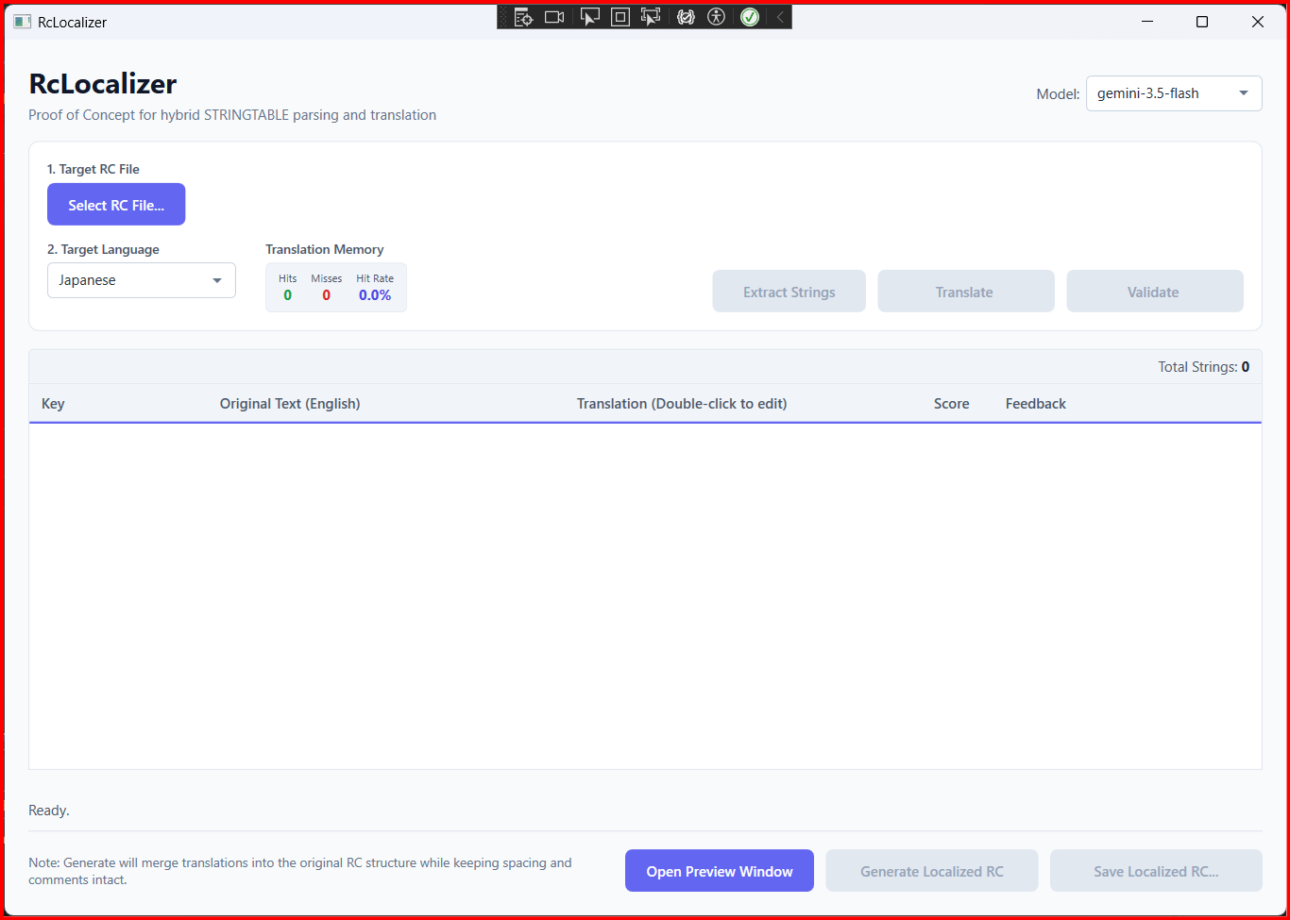
DIRECT BUSINESS TRANSFORMATION
The Solution: Localizer App
Automated, AI-Assisted CAD Localization Studio
Localizer App bridges resource lexer tokenizers with Google Gemini AI. The tool delivers a streamlined, desktop-integrated translation workspace:
📦 Automated Extraction: Reads C++ .rc files directly, targetting string tables while ignoring macros/comments.
⚡ Sub-ms Local Caching: Translation Memory holds previous translations and validations to prevent API costs.
🛡️ Double-Layer Guard: Validates syntax placeholders locally + executes Gemini AI QA evaluations.
🖥️ Simulative Workspace Dialogs: Overlays edits in real-time on a virtual UI mockup, verifying spacing before export.
Figure: Main Application Grid showing loaded workspace status

Slide 4
ENGINEERED FOR PRODUCT TEAMS
Key Features & Capabilities
🔍 RC File Parsing
Scans C++ Resource Scripts natively. Identifies translatable strings inside STRINGTABLE blocks while preserving coordinate offsets.
🧠 AI Translation Workflow
Translates string batches using Gemini model fallback logic, selecting optimal words using specialized CAD/BIM terminology lists.
⚡ Translation Memory Cache
Saves translations, QA scores, and feedbacks. Bypasses Gemini API calls for identical source keys, cutting costs to $0.
🛡️ Glossary Validation
Enforces formatting checks (escapes and parameters) to prevent crashes, combined with Gemini linguistic quality evaluations.
🖥️ Simulative Preview Window
Mockup workspace displaying menu ribbons and properties panels, dynamically populated to verify text overflows live.
📁 Safe Localized Export
Generates C++ resource script files in-place using back-to-front replacement, keeping layout coordinate files perfectly intact.

Slide 5
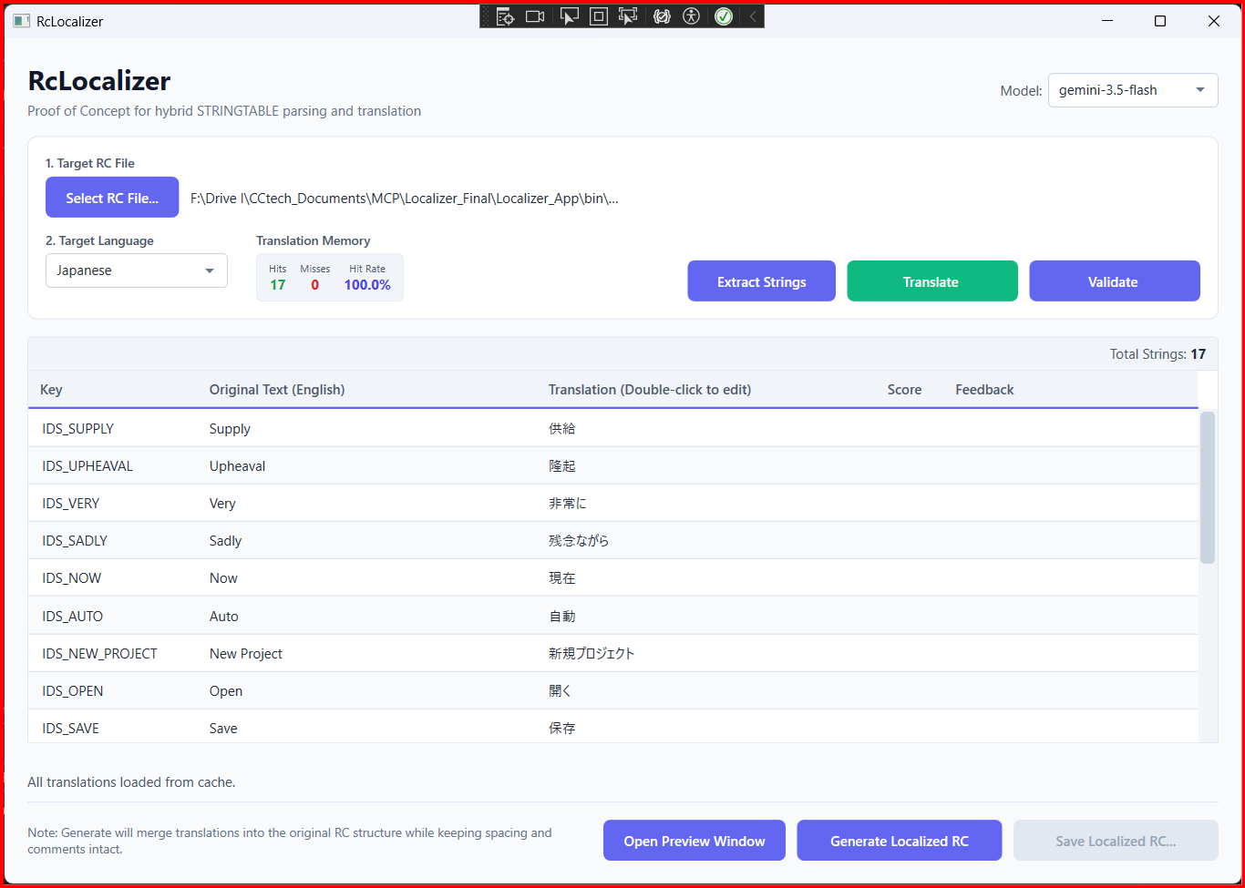
INTERACTIVE STRING GRID & TRANSLATION WORKFLOW
Active Translation Workspace
Visual Grid Editor with Manual Override
The system loads extracted strings directly into an in-memory editor grid. Translators can perform direct, key-by-key editing and trigger batch automation:
✍️ Inline Manual Editing: Double-click any translation cell to override values manually.
⚡ Batch Translation: Sends missing keys to Google Gemini in parallel threads to maximize throughput.
📊 Cache Hit Tracking: Monitors hits and misses in real-time, computing active cache percentage ratios in the header stats bar.
WPF Workspace: Main translation editor grid after running AI batch translation

Slide 6
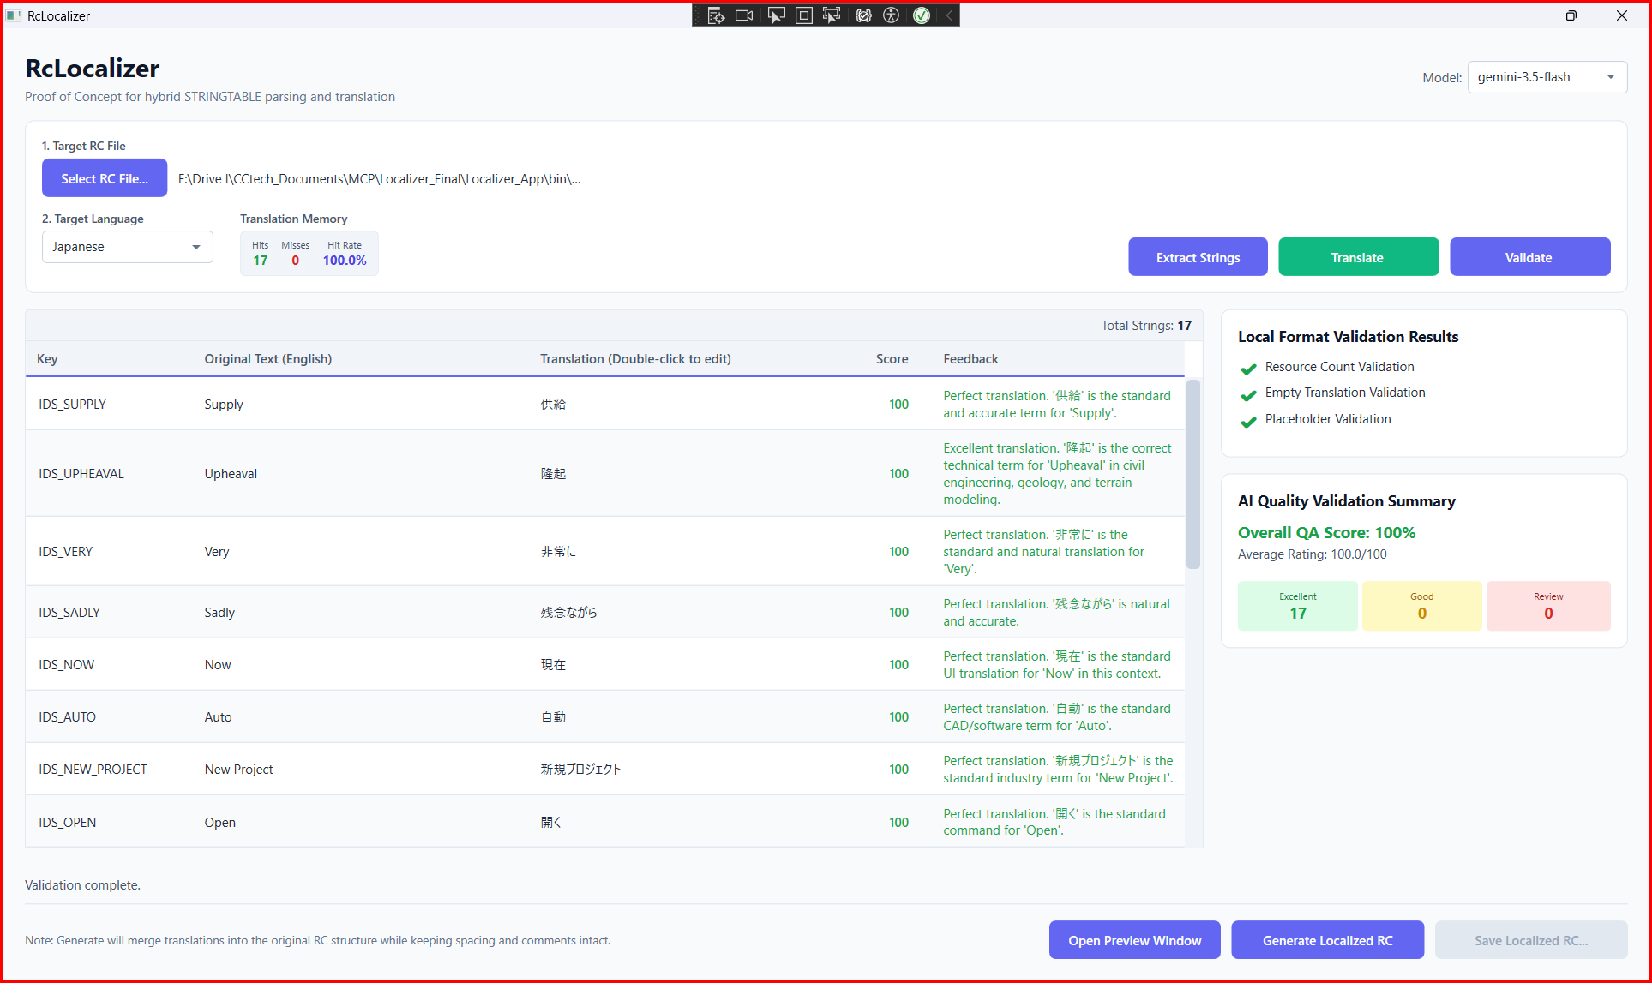
HYBRID LOCAL & AI-POWERED QA AUDITS
Quality Validation Workspace
Unified QA Panel & Diagnostics
Clicking 'Validate' runs double-layer diagnostic checks. The Validation Panel slides open on the right side of the main workspace:
✔️ Local Placeholder Verifiers: Scans parameter counts (%s, %d, {0}) to guarantee C++ compiler safety.
🧠 Gemini AI Quality Rating: Evaluates context, scoring translations from 0 to 100, and categorizes into Excellent, Good, or Review tags.
📝 Actionable QA Feedback: Logs clear error descriptions and improvement recommendations inside the grid feedback cells.
Linguistic Quality Audit: Side-by-side validation panels displaying local syntax checks and AI QA scorecards

Slide 7
LINGUISTIC LOCALIZATION PROCESS FLOW...
Application execution sequence showing tokenizing, cache-lookup, cognitive API, and local validation...
Select sample.rc (User UI Upload)
Extract English Strings (RcParserService tokenizer)
Translation Memory Cache Hit?
No
Yes
Query Gemini API (Specialized Glossary Prompts)
Load Cached Translation & QA Stats (Sub-millisecond)
Translate Batch (Sequential Fallback Logic)
Populate Grid
Populate Grid
Grid Editor / In-Memory Strings (WPF Active Workspace)
Validate
Preview
Generate
Local Validation Service (Counts escapes / brackets)
Dynamic Preview Studio (Visual ribons & mockups)
Generate Localized RC (RcGeneratorService rebuild)
Safe rebuild
Local Checks Pass?
Scan Resources (en-US.rc, ja-JP.rc, etc.)
Export Localized C++ Resource RC File
No
Yes
Score: 0 / Needs Review (Requires correction retry)
Save
Save
AI QA Validation & Scoring (Analyzes Context & Tone)
Translation Memory JSON (ja-JP.json database)

Slide 8
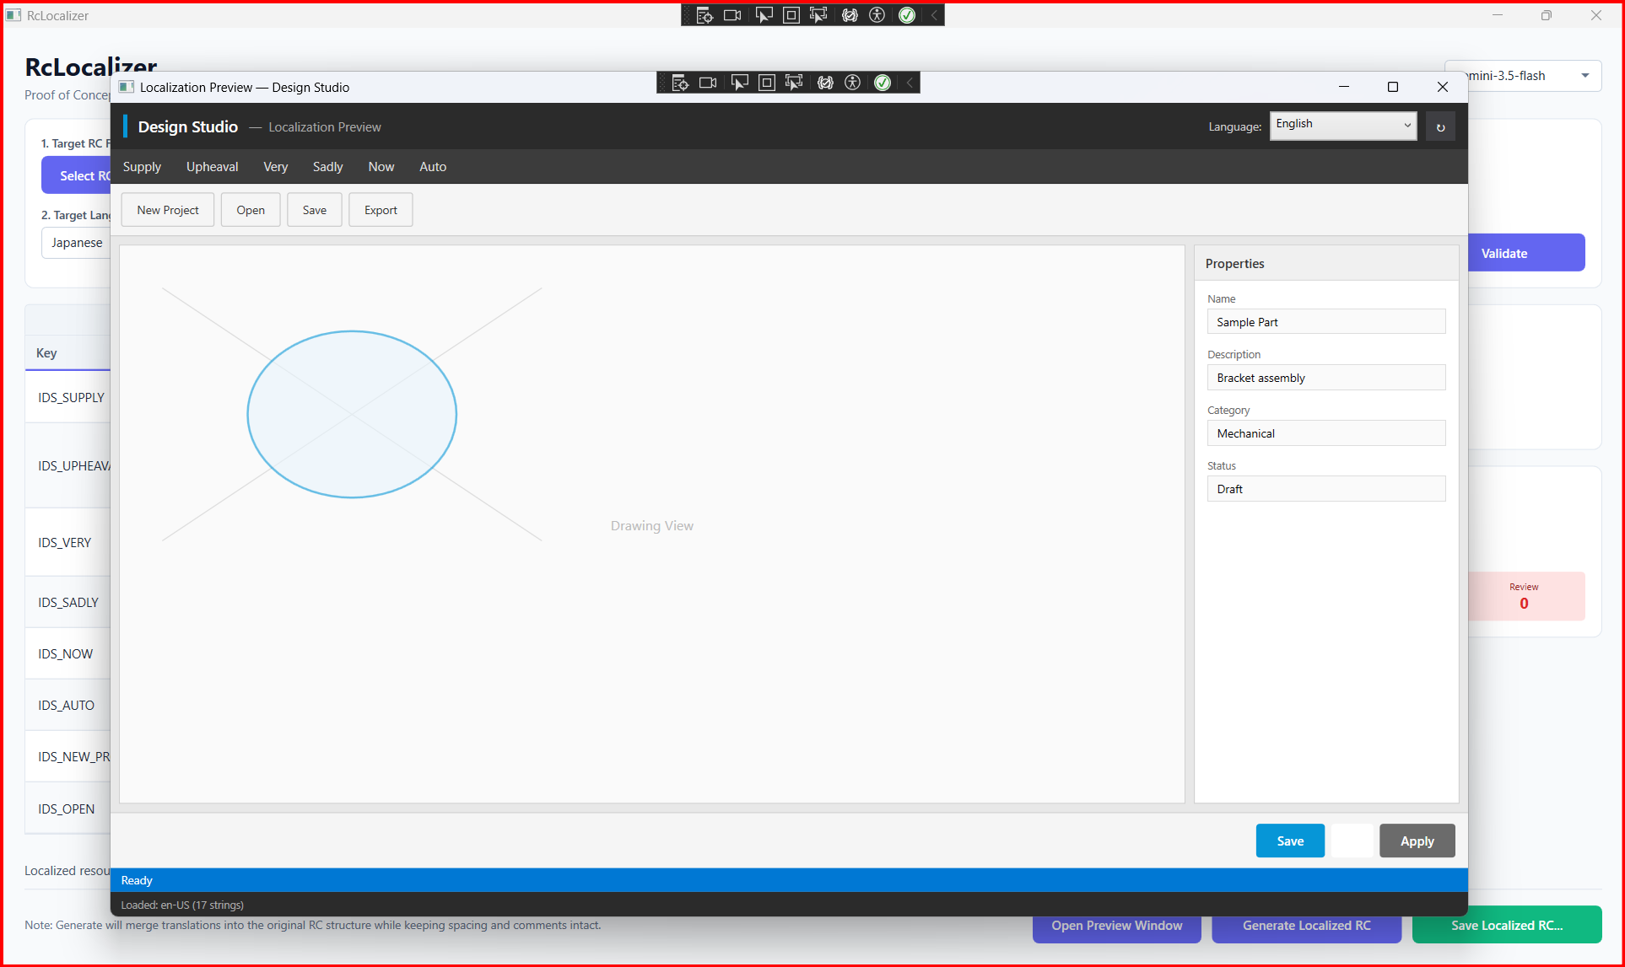
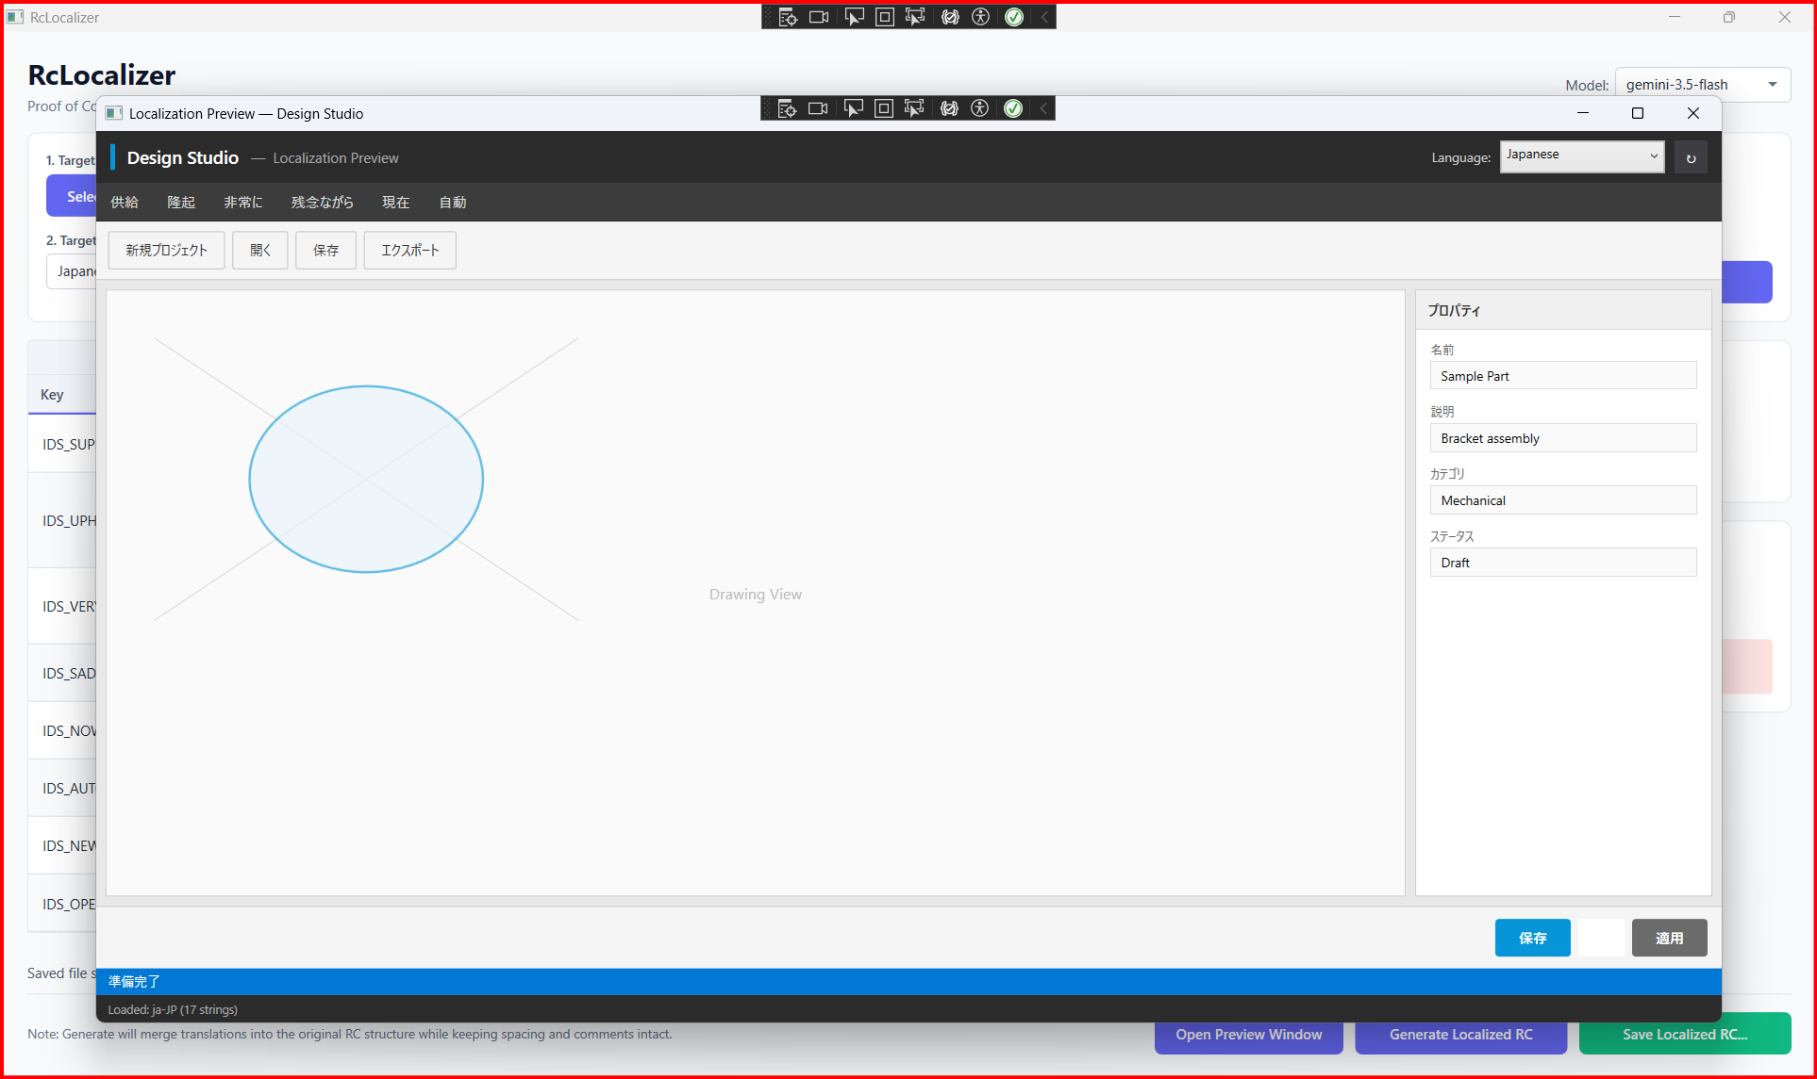
REAL-TIME VISUAL LAYOUT VERIFICATION
WPF Dialog Simulation Studio
Standard English UI Dialog Mockup Layout
Japanese Localized UI Dialog Mockup Overlay
Linguistic validation is overlaid in-memory. Designers can instantly review if a translated string overflows menu borders or overlaps labels before generating compiled binary outputs.

Slide 9
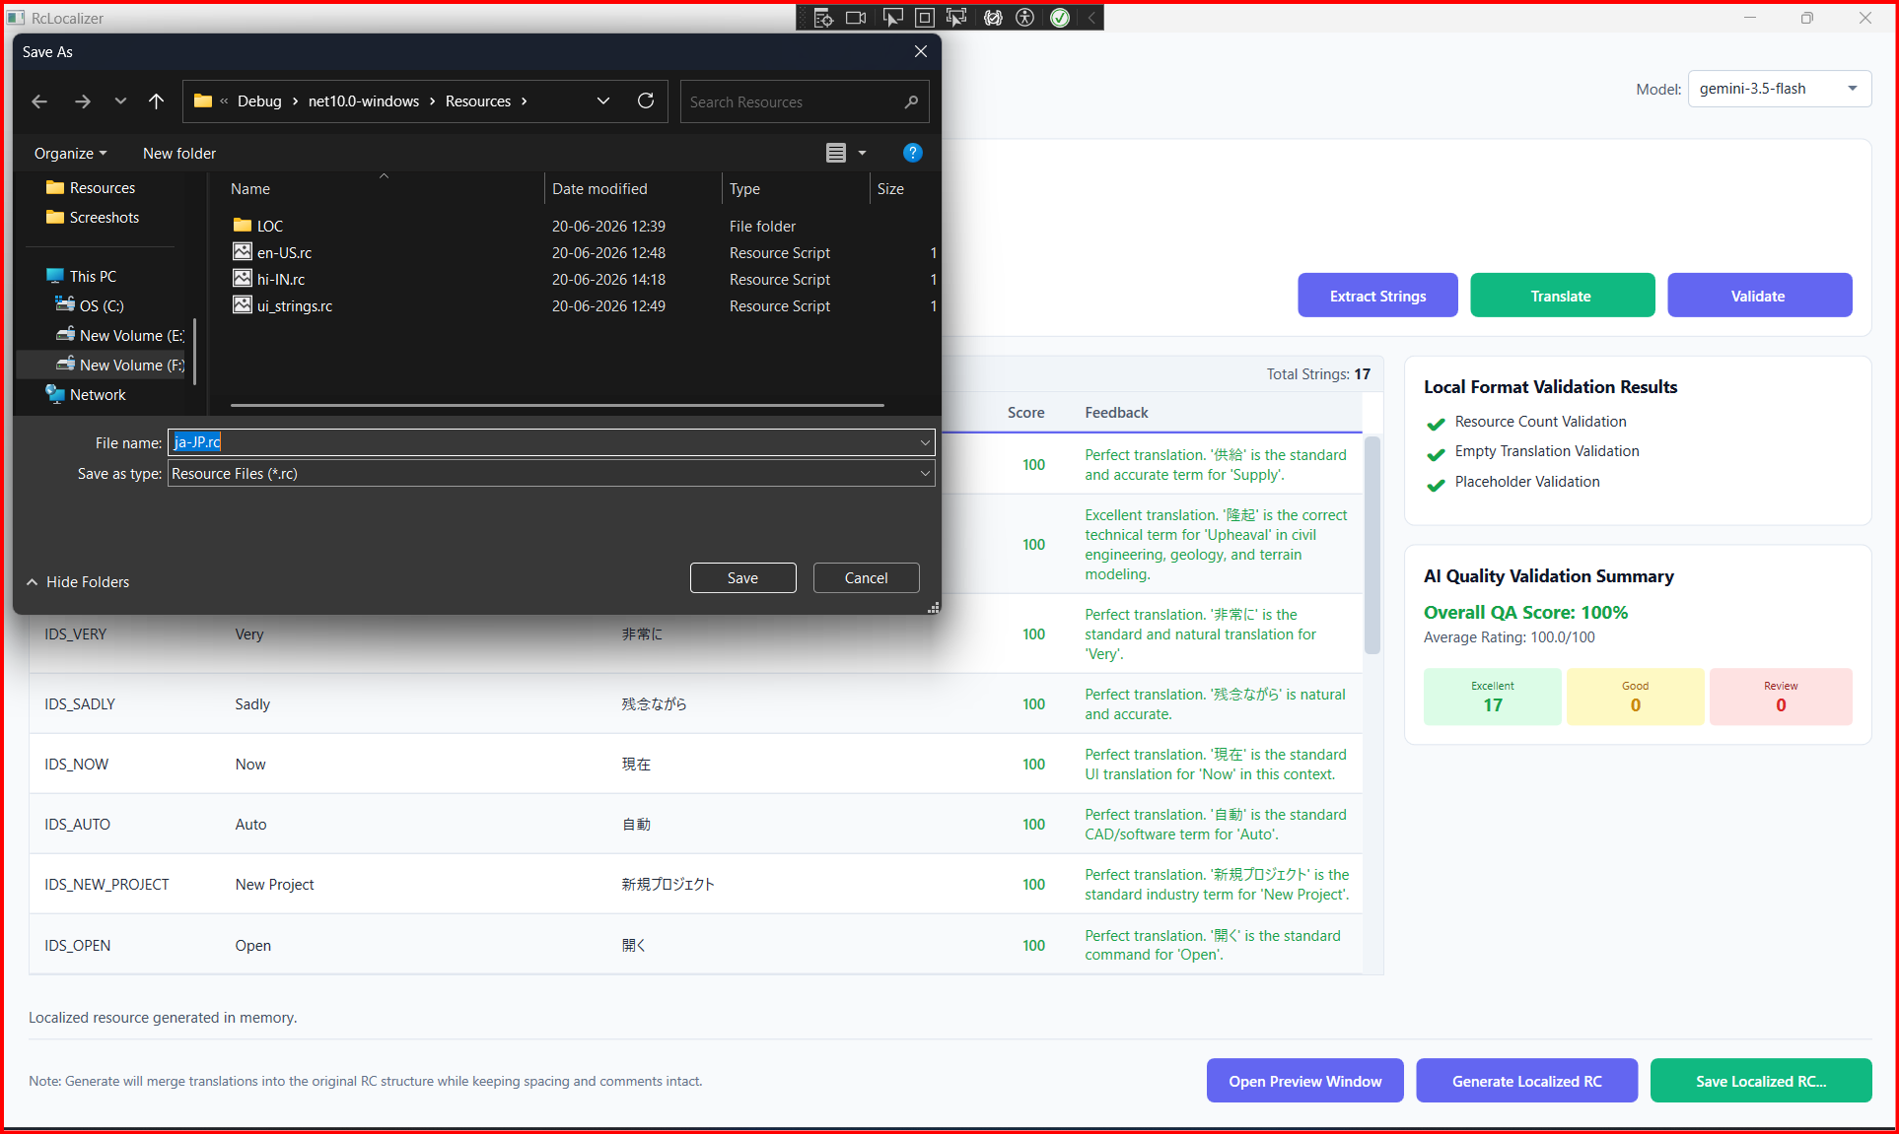
REVERSE INDEX-SAFE SEGMENT REPLACEMENTS
Coordinate-Safe Rebuilder
Bottom-Up String Injector
Modifying C++ resource scripts (.rc) can corrupt character coordinate layouts if segment lengths alter. The generator implements a bottom-up parsing replace loop:
🔄 Descending Replace Loop: Sorts translatable strings in descending order based on their character offsets before inserting translations.
🔒 Spacing & Comment Preservation: Only modifies targeted string literals, keeping preceding spacing, includes, and headers intact.
📝 Proper Escaping Rules: Automatically doubles nested quotes inside string segments to adhere strictly to C++ compiler standards.
File Generation: Saving the compiled localized resource script output

Slide 10
LIVE SYSTEM WALKTHROUGH & DEMO.MP4
Product Demonstration Video
Video Demonstration Overview
A complete execution cycle is recorded and packaged in the demo media package. Watch the system parse C++ files, translate strings, and validate parameters:
🎥 Video File Name: Demo.mp4 (located in the project root directory).
⚡ Key Video Highlights: Extracting sample.rc, executing cache lookups, checking validation logs, and viewing the live Japanese preview.
🖥️ Playback: Playable in standard desktop media players during client-facing reviews.
DEMO VIDEO: DEMO.MP4
Launch Demo.mp4 from workspace for actual client playback

Slide 11
MODERN DESKTOP & COGNITIVE SERVICE FOUNDATIONS
Technology Stack & Code Architecture
Built on Robust Desktop Foundations
💻 Framework: C# .NET 10 & Windows Presentation Foundation (WPF) with modern MVVM design properties.
🧠 AI Platform: Google Gemini API Integration (gemini-3.5-flash, gemini-2.5-flash, gemini-1.5-flash fallbacks).
📁 Caching: Local JSON file database holding translation memories and syntax metrics per culture code.
📄 Resource Engine: Custom C++ Tokenizer Lexer scanning STRINGTABLE segments with index coordinate mapping.
SYSTEM LOGICAL DATA PIPELINE
1. RcParserService: Scans raw files using token matching loops to identify start/end coordinates of translatable text.
2. TranslationMemory: Resolves text hash matches, fetching cached C# validation values before invoking network handlers.
3. GeminiService REST Client: Submits payloads containing specialized system instructions and fallbacks to flash models on failure.
4. ValidationService QA: Matches format flags, counting escape codes. Updates local scores and caches validation logs.
5. RcGeneratorService: Sorts modified indices in descending order, replacing strings from bottom to top to preserve offsets.

Slide 12
LINGUISTIC LOCALIZATION PROCESS FLOW...
Application execution sequence showing tokenizing, cache-lookup, cognitive API, and local validation...
Local Validation (Counts & Escapes)
Select sample.rc
Load Cached Translation & QA Stats (Sub-ms)
Yes
Local Checks Pass?
Yes
AI QA Validation (Evaluate Context)
Validate
RcParserService
Populate Grid
Translation Memory Hit?
No
Assign QA Score & Feedback
Extract English (RcParserService)
Check Cache
Grid Editor In-Memory Strings
Score: 0 Needs Review
No
Query Gemini API (Specialized Prompts)
Save to Cache
Preview
Translation Memory Cache JSON
Populate Grid
Model Fallback
Generate
Open Preview Window (Dynamic Studio)
Scan Resources (en-US, ja-JP, etc.)
Translate Batch (Fallback Logic)
Generate Localized RC (RcGeneratorService)
Safe Replacements
Localized C++ Resource RC File

Slide 13
SYSTEM ARCHITECTURE & COMPONENT MAPPING...
Three-tier architecture showing Views layer, business Services layer, and Data/API layer integrations...
VIEWS LAYER (WPF UI)
MainWindow.xaml / MainWindow.xaml.cs (Controls operations, displays grid editor, handles sequential button state validation)
PreviewWindow.xaml / PreviewWindow.xaml.cs (Simulates active dialog layouts in English, Japanese, French, etc.)
User Inputs
Simulates Layout
BUSINESS SERVICES LAYER
RcParserService (Lexical Tokenizer)
TranslationService (API Fallback Orchestrator)
AiValidationService (Gemini QA Auditor)
TranslationMemoryService (Local JSON Cache Coordinator)
RcGeneratorService (Reverse String Rebuilder)
Reads
Cache Synced
Writes Output
Misses Query
DATA & EXTERNAL SERVICE INTEGRATIONS
Input C++ Resource Script (.rc)
Translation Memory Local Storage (ja-JP.json, etc.)
Google Gemini AI Cognitive Service (API Endpoint)

Slide 14
SYSTEM ARCHITECTURE & COMPONENT MAPPING...
Three-tier architecture showing Views layer, business Services layer, and Data/API layer integrations...
VIEWS LAYER (WPF UI)
MainWindow.xaml / MainWindow.xaml.cs (Controls operations, displays grid editor, handles sequential button state validation)
PreviewWindow.xaml / PreviewWindow.xaml.cs (Simulates active dialog layouts in English, Japanese, French, etc.)
User Inputs
Simulates Layout
BUSINESS SERVICES LAYER
RcParserService (Lexical Tokenizer)
TranslationService (API Fallback Orchestrator)
AiValidationService (Gemini QA Auditor)
TranslationMemoryService (Local JSON Cache Coordinator)
RcGeneratorService (Reverse String Rebuilder)
Reads
Cache Synced
Writes Output
Misses Query
DATA & EXTERNAL SERVICE INTEGRATIONS
Input C++ Resource Script (.rc)
Translation Memory Local Storage (ja-JP.json, etc.)
Google Gemini AI Cognitive Service (API Endpoint)

