Slide 1
Agenda
What is Statistics?
Introduction
Branches of Statistics
Data & Data Types
Measures of Central Tendency
Measures of Variance

Slide 2
What is Statistics?
Statistics
science of collecting, organizing, analyzing, and interpreting Data
C | Collecting …
O | Organizing …
D | Displaying …
I | Interpreting …
A | Analyzing …
Data
The objective of this module is to provide a brief introduction to
Statistics and its application in business scenarios.

Slide 3
Application of Statistics
Financial analysts use a variety of statistical information, including price-earnings ratios and dividend yields, to guide their investment recommendations.
A variety of statistical quality control charts are used to monitor the output of a production process.
Economists use statistical information in making forecasts about the future of the economy or some aspect of it.
Banks use lot of statistics to understand the customers they have and take right decisions.
Public accounting firms use statistical sampling procedures when conducting audits for their clients.

Slide 4
Two Branches of Statistics:
Inferential Statistics
Given the data you have about these people, does this say anything about other people?
Statistics
Descriptive Statistics
Describes a given set of data you have

Slide 5
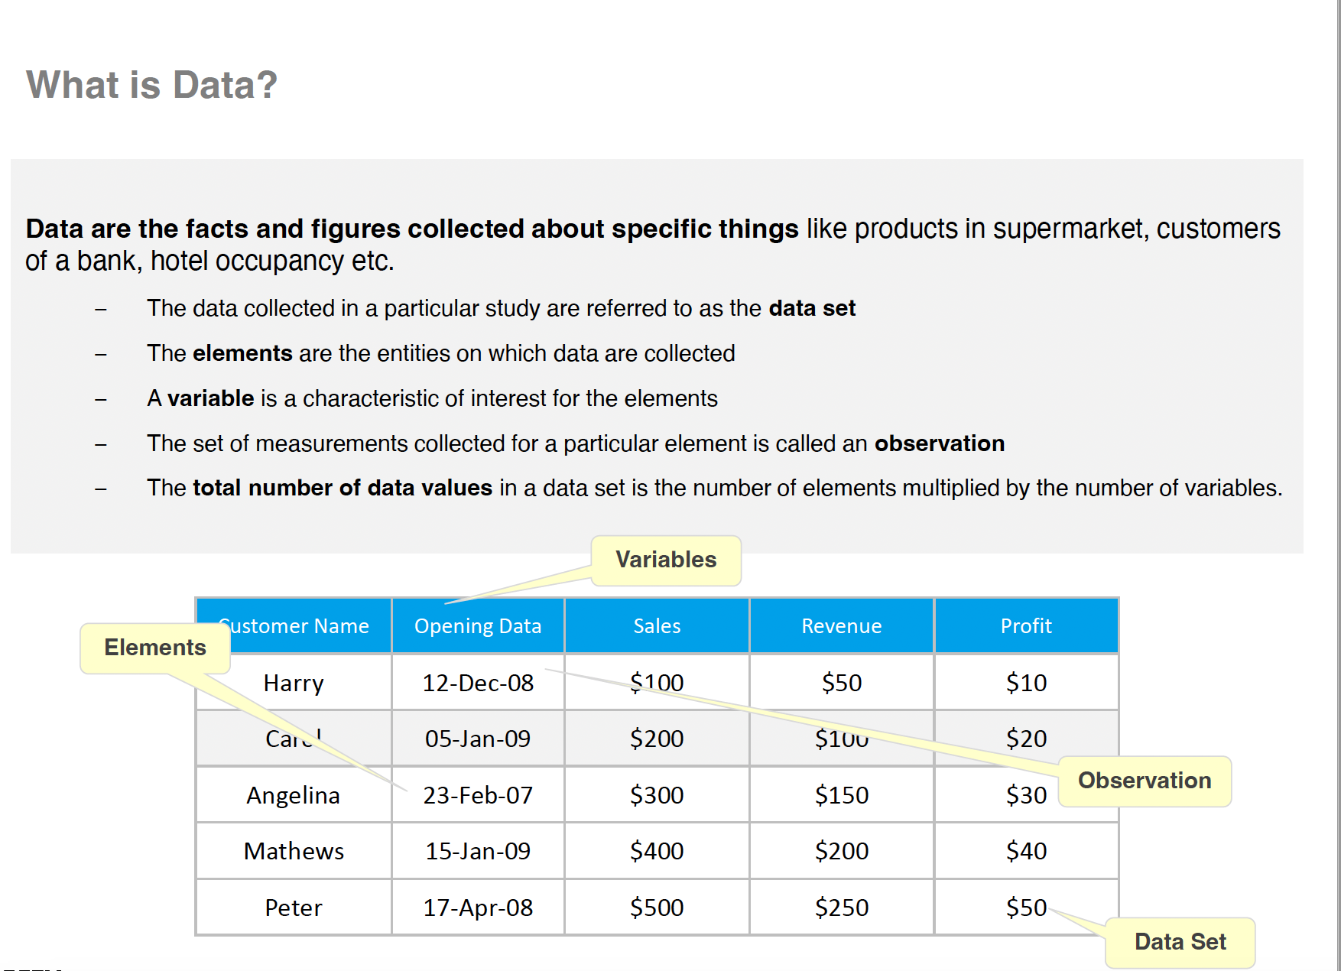

Slide 6

Scales of Measurement
The scale determines the amount of information
contained in the data.
The scale indicates the data summarization and statistical analyses that are most appropriate.

Slide 7
Scales of Measurement
Type | Description | Example
Nominal | Data are labels or names used to identify an attribute of the element A nonnumeric label or numeric code may be used | Department you work in PE, MIG, Graphics, Finance Also be numeric codes like Zip Code you live in 1201, 1004 etc.
Ordinal | Same as properties of nominal data but the order or rank of the data is meaningful A nonnumeric label or numeric code may be used | Grades of students in a college exam – A, B, C, F Floor number you live on 1, 2 3
Interval | The data with the properties of ordinal data, and the interval between observations is expressed in terms of a fixed unit of measure Interval data is always numeric | Scores group of people got in SAT Exam like 1205, 1090, 950 Savings account balance $100, $3500, $250
Ratio | The data with all the properties of interval data and the ratio of two values is meaningful Variables such as distance, height, weight, and time use the ratio scale | Melissa’s scored 1200 in her SAT Exam while Kevin’s scored only 600. Melissa has 2-times the score of Kevin

Slide 8
Types of Data
Data
Qualitative /
Categorical
Quantitative/
Numerical
Nominal / Ordinal
Numerical
(Interval/Ratio)
Discrete
Continuous
Measuring
how many
Measuring
how much

Slide 9
Summary Measures
Describing Data Numerically
Central Tendency
Position
Variation
Shape
 | Percentiles
 | Quartiles
 | Range
 | Interquartile Range
 | Variance
 | Standard Deviation
 | Coefficient of Variation
 | Skewness
 | Kurtosis
Arithmetic Mean
Median
Mode
Geometric Mean

Slide 10
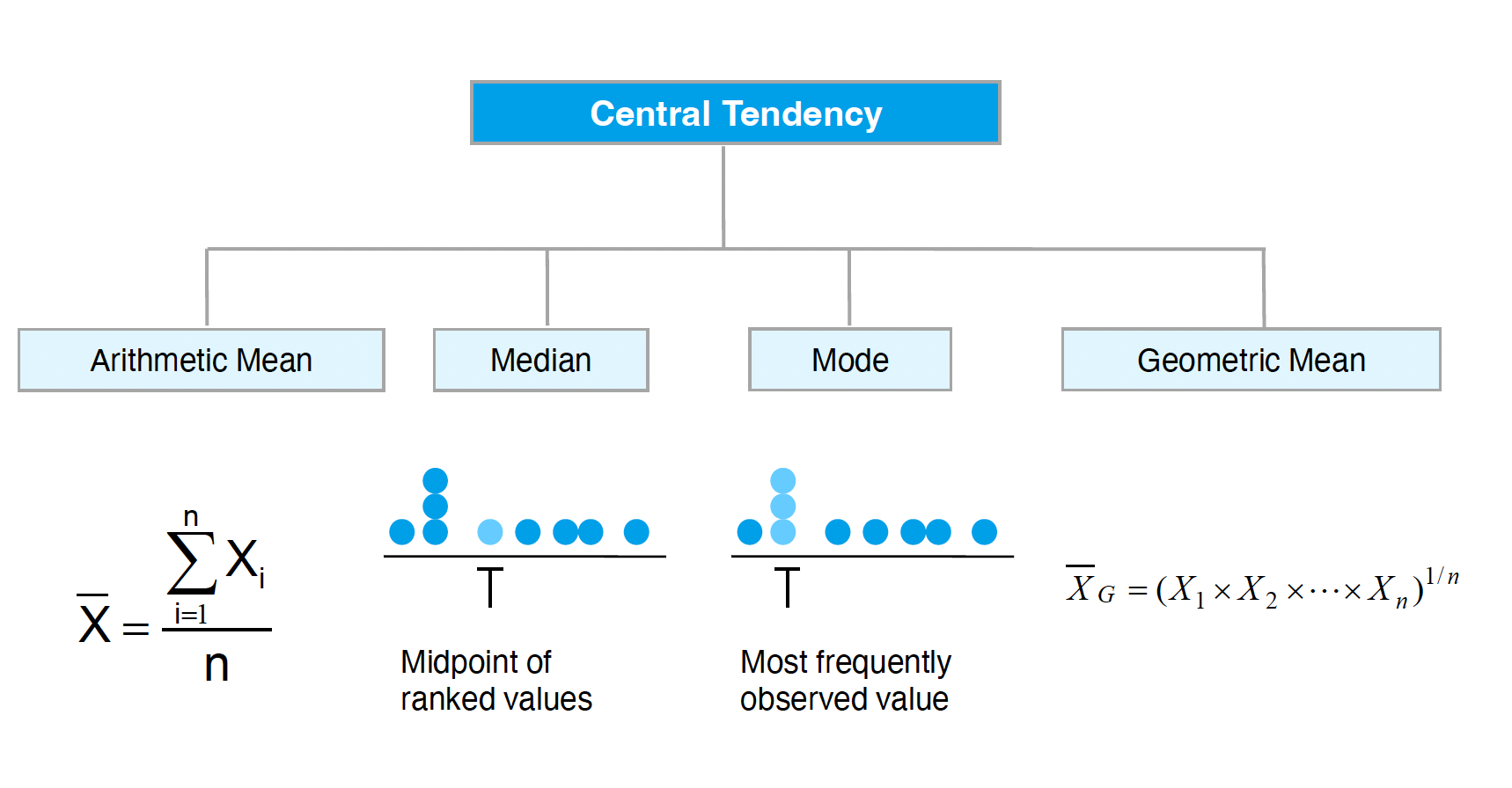
Measures of Central Tendency

Slide 11
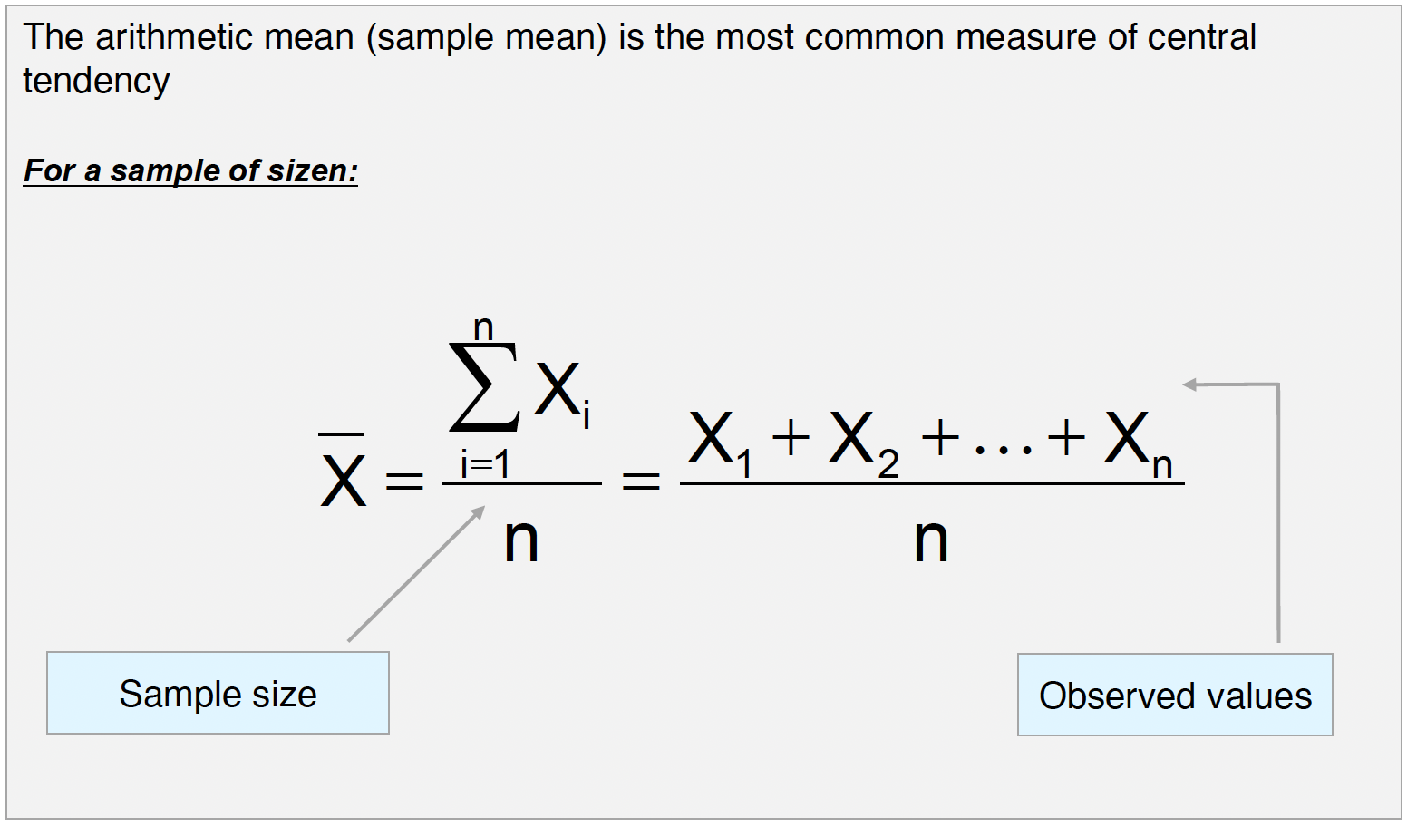
Arithmetic Mean

Slide 12
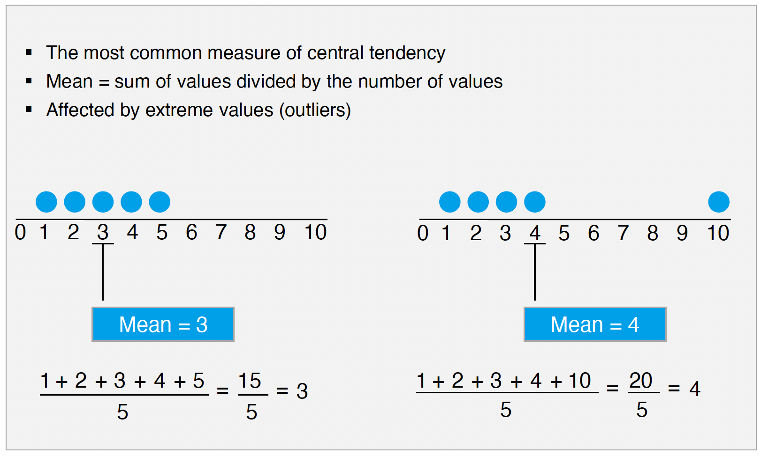
Arithmetic Mean
(continued)

Slide 13
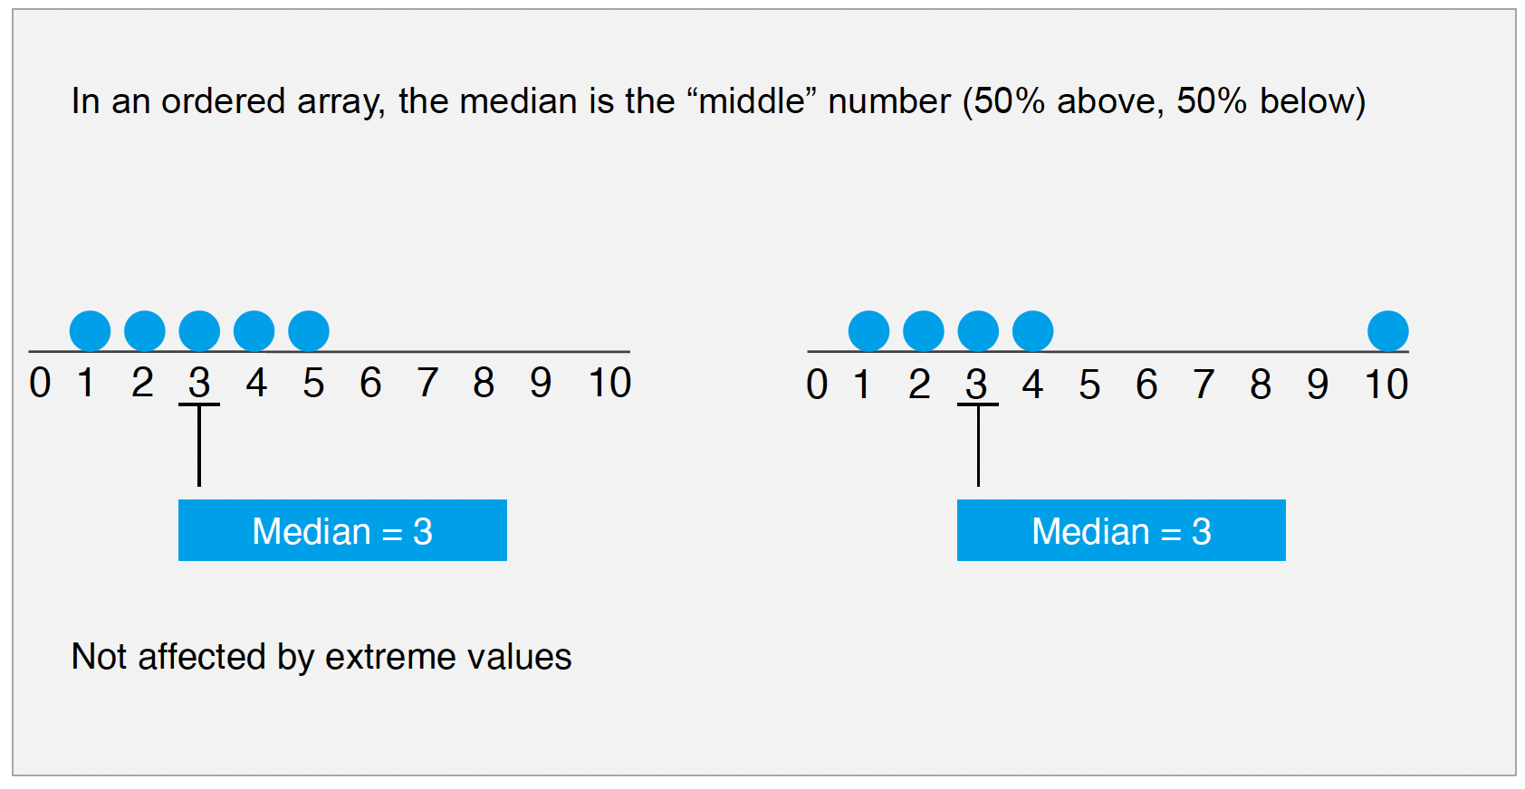
Median

Slide 14
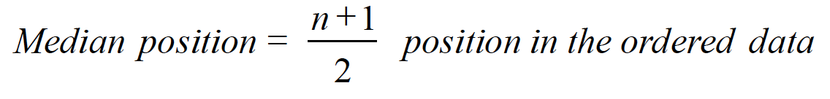
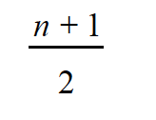
Finding the Median
The location of the median:
If the number of values is odd, the median is the middle number
If the number of values is even, the median is the average of the two middle numbers
Note that is not the value of the median, only the position of the median in the ranked data

Slide 15
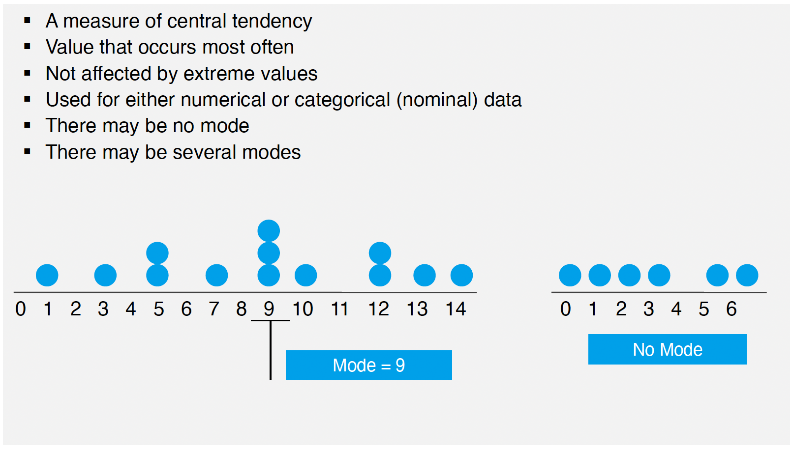
Mode

Slide 16
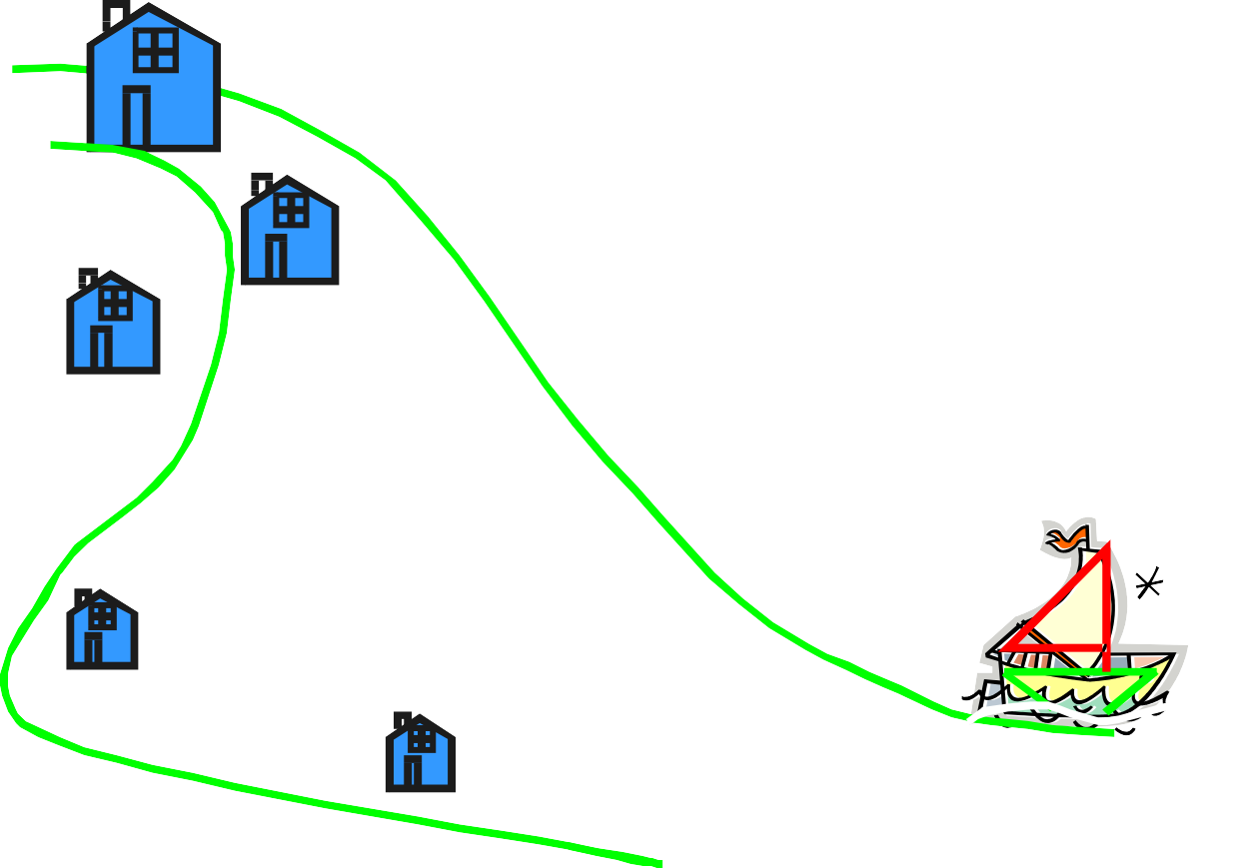
Review Example
Five houses on a hill by the beach
$2,000 K
$500 K
$300 K
$100 K
$100 K
House Prices:
$2,000,000 500,000
300,000
100,000
100,000

Slide 17
Review Example: Summary Statistics
House Prices:
$2,000,000
500,000
300,000
100,000
100,000
Sum $3,000,000
Mean: ($3,000,000/5) = $600,000
Median: middle value of ranked data = $300,000
Mode: most frequent value = $100,000

Slide 18
Which measure of location is the “best”?
Mean is generally used, unless extreme values (outliers) exist
Then median is often used, since the median is not sensitive to extreme
values.
Example: Median home prices may be reported for a region – less sensitive to outliers

Slide 19
Quartiles
Quartiles split the ranked data into 4 segments with an equal number of values per segment
25% | 25% | 25% | 25%
Q1
Q2
Q3
The first quartile, Q1, is the value for which 25% of the observations are smaller and 75% are larger
Q2 is the same as the median (50% are smaller, 50% are larger)
Only 25% of the observations are greater than the third quartile

Slide 20
Quartile Formulas
Find a quartile by determining the value in the appropriate position in the ranked data, where
First quartile position: Q1 = (n+1)/4
Second quartile position: Q2 = (n+1)/2 (the median position)
Third quartile position: Q3 = 3(n+1)/4
where n is the number of observed values

Slide 21
Quartiles
Example:
Find the first quartile
Sample Data in Ordered Array: 11 12 13 16 16 17 18 21 22
(n = 9)
Q1 is in the
(9+1)/4 = 2.5 position
of the ranked data
so use the value half way between the 2nd and 3rd values,
so
Q1 = 12.5
Q1 and Q3 are measures of noncentral location Q2 = median, a measure of central tendency

Slide 22
Quartiles
(continued)
Q1 is in the (9+1)/4 = 2.5 position of the ranked data,
so Q1 = 12.5
Q2 is in the (9+1)/2 = 5th position of the ranked data,
so Q2 = median = 16
Q3 is in the 3(9+1)/4 = 7.5 position of the ranked data,
so Q3 = 19.5

Slide 23
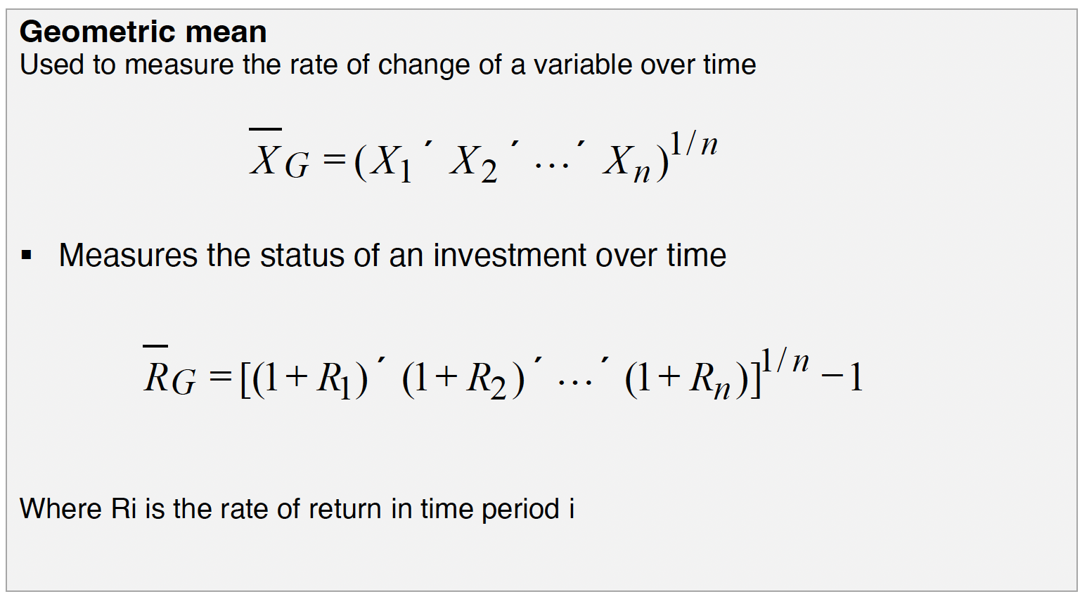
Geometric Mean

Slide 24
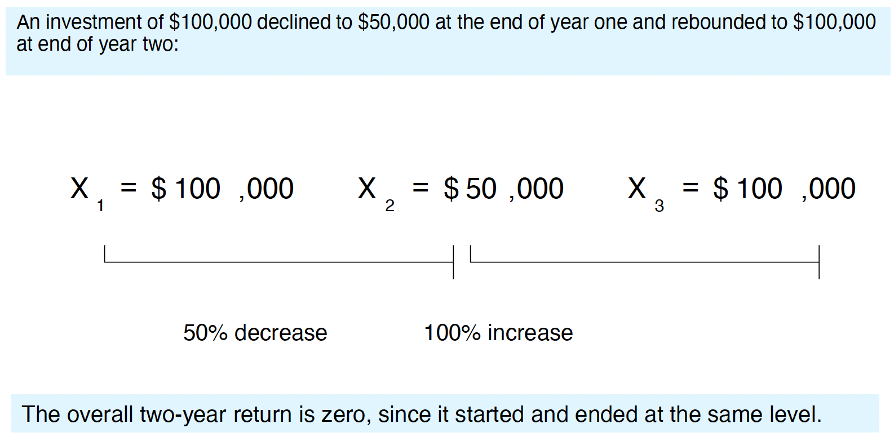
Example

Slide 25
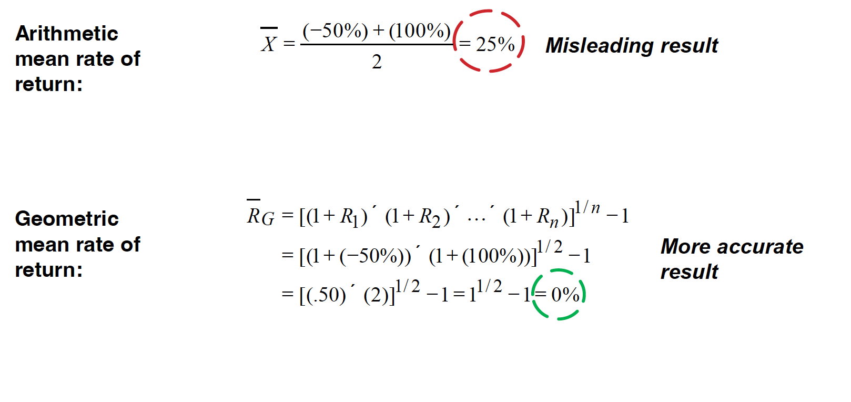
Example
(continued)
Use the 1-year returns to compute the arithmetic mean and the geometric mean:

Slide 26
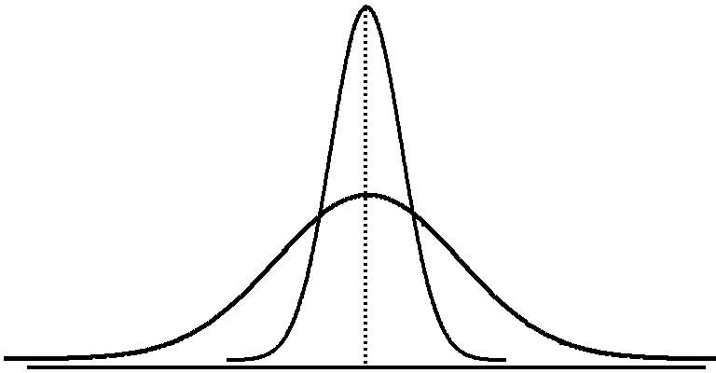
Measures of Variation
Variation
Range
Interquartile
Range
Variance
Standard
Deviation
Coefficient of
Variation
Measures of variation give information on the spread or variability of the data values.
Same center, different variation

Slide 27
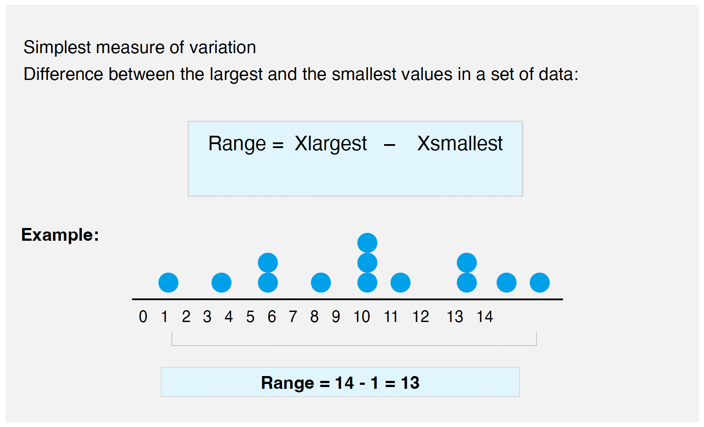
Range

Slide 28
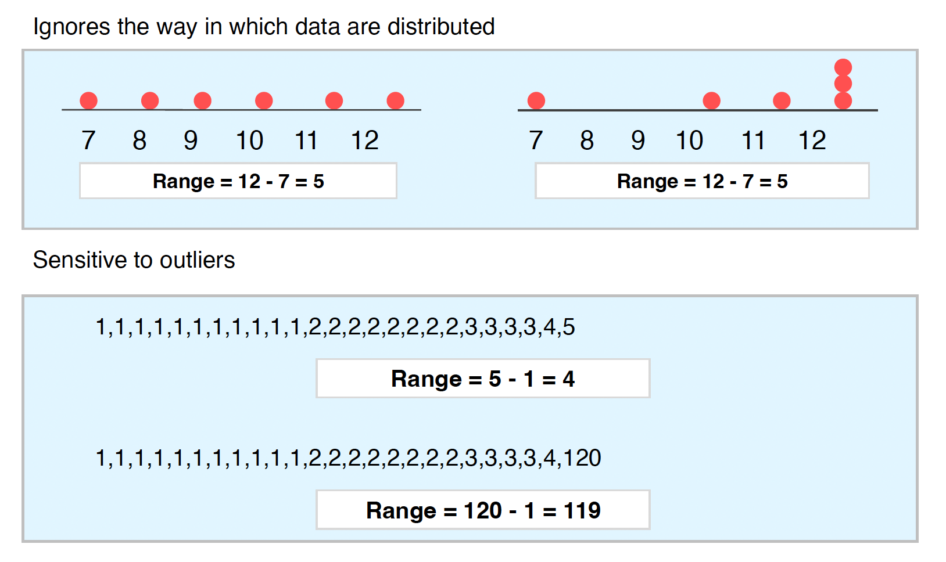
Disadvantages of the Range

Slide 29
Interquartile Range
Can eliminate some outlier problems by using the interquartile range
Eliminate some high- and low-valued observations and calculate the range from the remaining values
Interquartile range = 3rd quartile – 1st quartile = Q3 – Q1

Slide 30
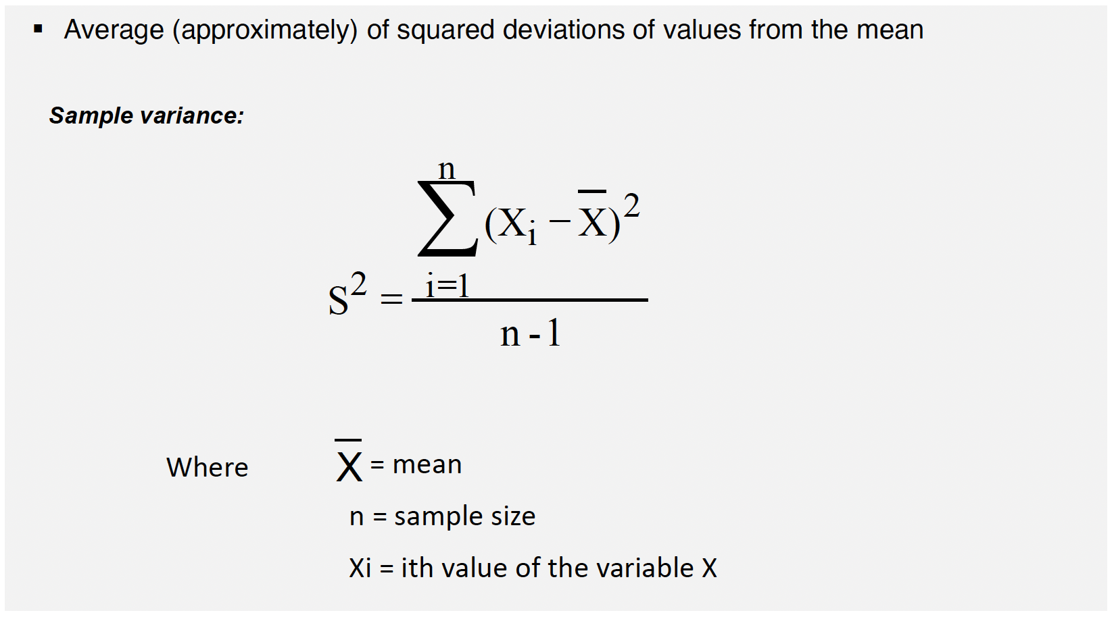
Variance

Slide 31
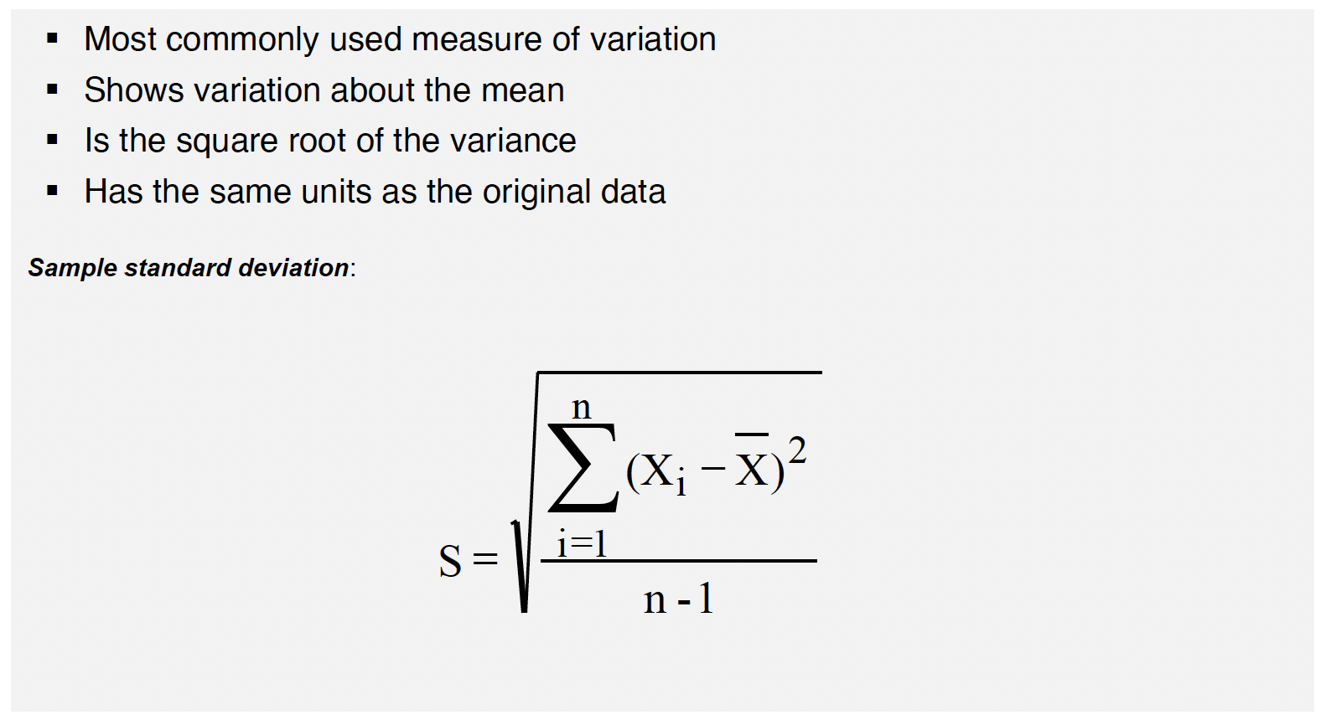
Standard Deviation

Slide 32
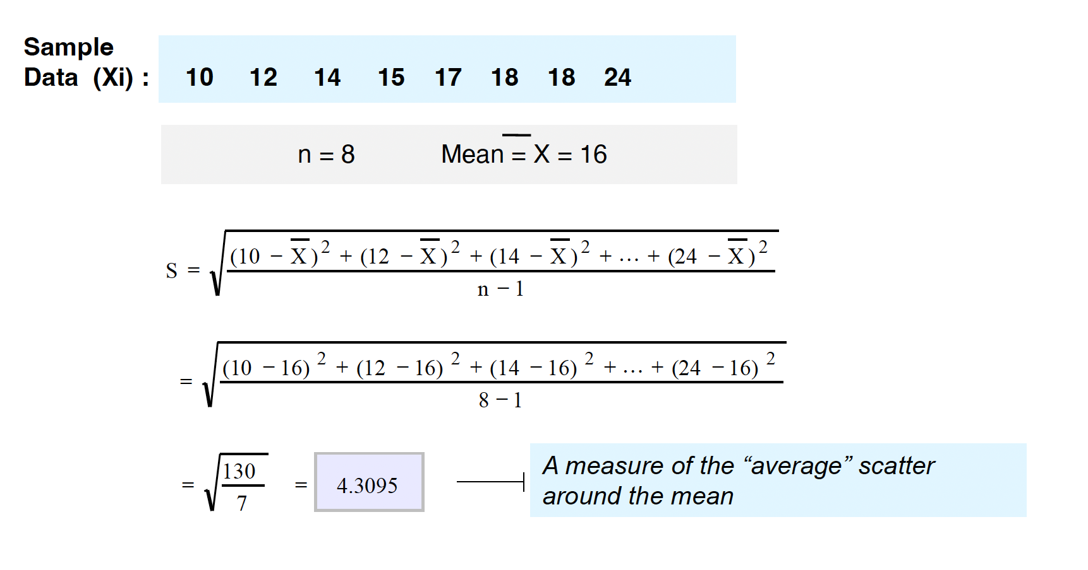
Calculation Example: Sample Standard Deviation

Slide 33
Measuring variation
Small standard deviation
Large standard deviation

Slide 34



Comparing Standard Deviations
Data A
Mean = 15.5
11 12 13 14 15 16 17 18 19 20 21
S = 3.338
Mean = 15.5
S = 0.926
Data B
11 | 12 | 13 | 14 | 15 | 16 | 17 | 18 | 19 | 20 | 21
 |  | Data C
11 | 12 | 13 | 14 | 15 | 16 | 17 | 18 | 19 | 20 | 21
Mean = 15.5
S = 4.567
Advantages of Variance and Standard Deviation
Each value in the data set is used in the calculation
Values far from the mean are given extra weight because deviations from the mean are squared)

Slide 35
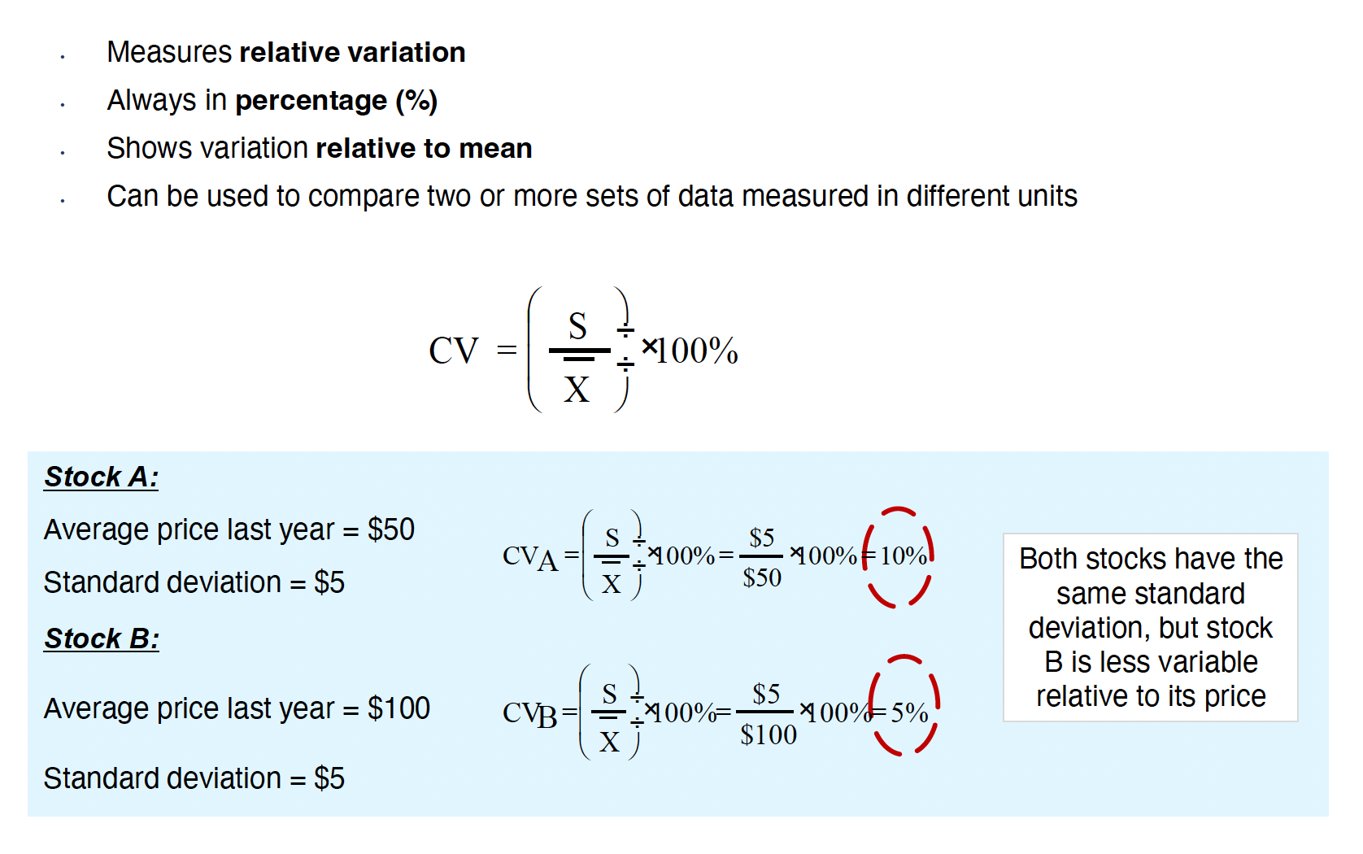
Coefficient of Variation

Slide 36
Shape of a Distribution
Describes how data are distributed
Measures of shape
Symmetric or skewed
Left-Skewed
Symmetric
Right-Skewed
Mean < Median
Mean = Median
Median < Mean

