Slide 1
Designing for Volatility
A look at volatility based decomposition and design

Slide 2
The One True Slide
What?
Why?
When?
How?

Slide 3
What…is volatility
According to Vocabulary.com:
Volatility is the trait of being excitable and unpredictable. Your volatility might ultimately be the thing that makes you unsuitable as [an anger management counselor]. The noun volatility is the characteristic of changing often and unpredictably.
TL;DR – Volatility means things change

Slide 4
What… is volatility based decomposition
Two Primary Types
Functional Decomposition
…is the process of taking a complex process and breaking it down into its smaller, simpler parts…based on the varying functions the process or system performs.
Volatility based decomposition
…is the process of decomposing a process based not on what the system does, but rather on the volatility inherent in the process.

Slide 5
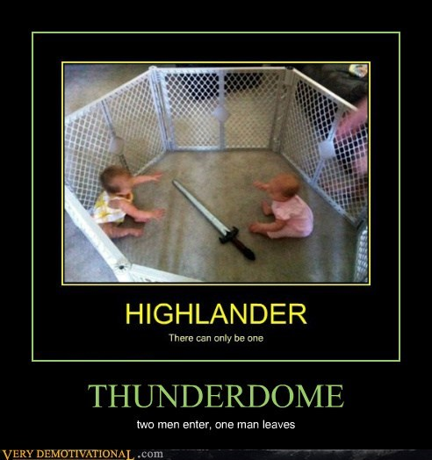
It’s not this serious…
In truth, projects should almost always use BOTH – just not for the same purpose

Slide 6
Why…
Characteristics of Good Software Design
Maintainability
Legibility
Extensibility
Reusability

Slide 7
Why…
Characteristics of Good Software Design
Maintainability
Legibility
Extensibility
Reusability
In Short: Adaptability
“Intelligence is the ability to adapt to change” – Stephen Hawking

Slide 8
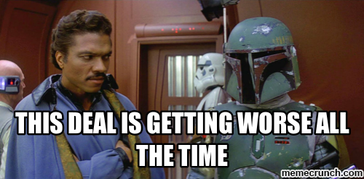
Why…
Focus on what hurts most…
True business logic / functional concerns tend to be surprisingly self-constraining
Volatile interactions hurt more than volatile business rules
Functional decomposition ignores interaction…
Change tends to be a much more difficult beast to manage…
(Lando didn’t account for volatility)

Slide 9
When
Initial focus is in the architecture/design phase
This is the easiest time to identify and organize volatile components
Continued attention throughout the development lifecycle
Sometimes as an individual component becomes more complex, additional volatility can surface

Slide 10

How…
Patterns already exist to help!

Slide 11
SOLID Principles
Single Responsibility – Responsibility = Reason to Change
Open/Closed – Deals with how to support change within a concept
Extension versus modification
Liskov Substitution – Makes it possible for external contract implementations to change
Interface-segregation – Provides for minimal change impact
Dependency Inversion – Allows all levels of the application to be insulated from change

Slide 12
Take Away
If nothing else, remember the “One True Slide”
What…is likely to change
Why…is it likely to change
When…is it likely to change
How…is it likely to change

