Slide 1
Angular 2
Poster Child for Continuous Improvement

Slide 2
Agenda
What and Why
Fundamentals via Sample Application Overview
Common Concerns
Q&A
Wrap Up

Slide 3
“One Framework”
Cross Platform
Web
Mobile
Desktop
“Universal” rendering
Not just a tool

Slide 4

Why Bother With Angular (or any framework)?

Slide 5
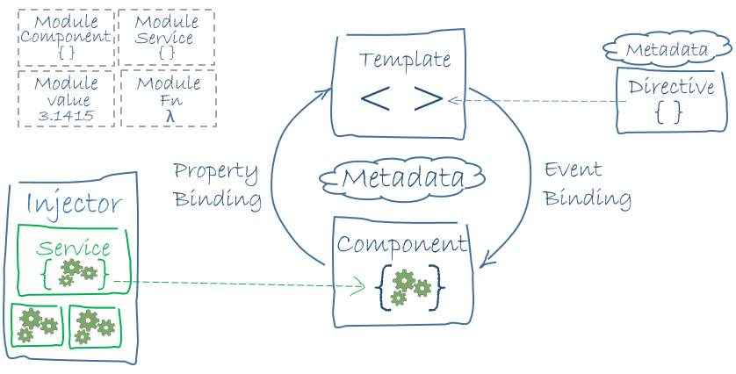
Architecture

Slide 6
Common Concerns
What are they and how have they been addressed?

Slide 7
I use Angular 1, won’t it hurt to switch?

Slide 8
I don’t want to learn and/or teach my team TypeScript.

Slide 9
It seems like there’s a lot of boilerplate code, I want to hit the ground running
npm install -g angular-cli
ng --help
Win!

Slide 10
Questions?

Slide 11
Resources
https://angular.io/features.html
https://angular.io/docs/ts/latest/tutorial/
https://angular.io/docs/ts/latest/guide/style-guide.html
https://angular.io/docs/ts/latest/cookbook/a1-a2-quick-reference.html
https://angular.io/docs/ts/latest/guide/upgrade.html
https://github.com/angular/angular-cli

