Slide 1
Dapper.NET
A Micro-ORM for the Discerning Developer

Slide 2
Agenda
Overview of Micro ORMs
Installation / Setup
Usage
Q&A / Wrap-up

Slide 3
Micro-ORM
NOT a colloquialism for a Microsoft ORM

Slide 4
Micro-ORM
NOT a colloquialism for Microsoft’s ORM
Intentionally feature sparse

Slide 5


Traditional ORM
(EF/NHibernate)
Micro-ORM
Caching
Lazy Loading
Object
Mapping
Validation
DB Migration
& Generation
Object Mapping

Slide 6
Micro-ORM
NOT a colloquialism for Microsoft’s ORM
Intentionally feature sparse
Typically geared toward high performance

Slide 7
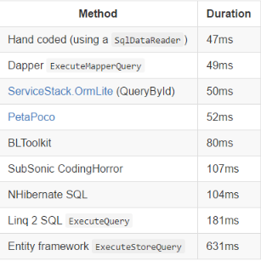
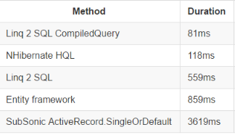
Full Disclosure: These are the benchmarks the dapper project produces/publishes. However, they are roughly in line with others (see resources)

Slide 8
Installation and Usage
(Code Demo)

Slide 9
Questions?

Slide 10
Resources
https://github.com/StackExchange/dapper-dot-net
https://github.com/FransBouma/RawDataAccessBencher
http://www.toptensoftware.com/petapoco/

