Slide 1
OAuth
Authorization Made Simple….Sort of

Slide 2
Overview
A brief history of OAuth
Why does it exist?
Authorization versus Authentication
How Does it Work?
Major Versions
Revision A
Signatures versus SSL

Slide 3
A Brief History
Nov. 2006: Blaine Cooke, Chris Messina, and David Recordon meet with other OpenID users to discuss existing solutions
A new authorization standard was needed
April 2007: The OpenAuth Google group is born
Later changed to Oauth to prevent conflict with AOL’s OpenAuth protocol
July 2007: The group goes public
December 2007: The 1.0 spec is finalized
June 2009 – Revision A is released (following a security advisory release in April)

Slide 4
Why does it Exist
No more username and password sharing
Separate authentication from authorization
Standardization of authorization solutions
Flikr Auth
Google AuthSub
Yahoo! BBAuth

Slide 5
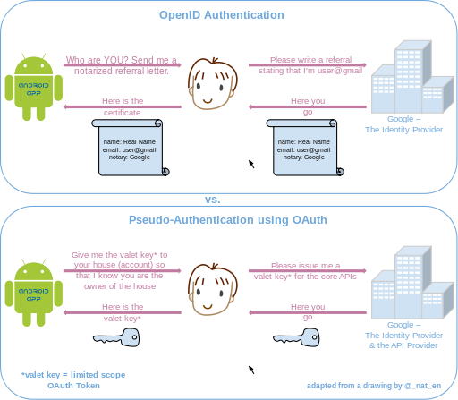
Didn’t OpenID Do This?
Common question on Stack Overflow and similar sites
Answer: Partially
*Imaged borrowed from wikipedia

Slide 6
Authorization v. Authentication
Authentication
Who is this person?
Verification of user credentials
Association of credentials with user data
Authorization
What can the person with these credentials do?
By providing my password, exchange is able to verify I am tstokes.
By using the user information associated with tstokes, it is able to authorize me to view my mailbox, but not someone else’s.

Slide 7
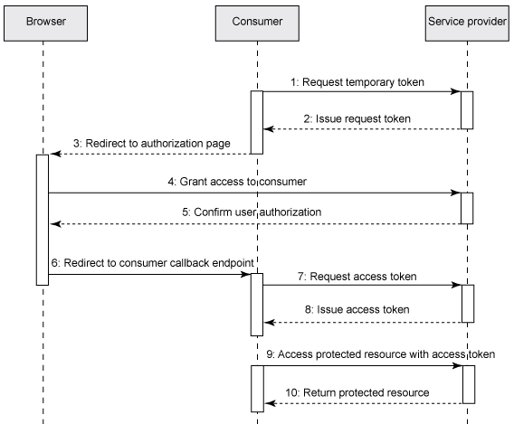
How Does it Work?

Slide 8
Request Security
Signatures – OAuth 1.0
OAuth allows dynamic determination of algorithm
Nonce
Unique request identifier
Timestamp
Allows expiration and re-use of Nonce values

Slide 9
References
Eric Hammer-Lahav
http://hueniverse.com/oauth/guide/history/
Primary reference for history of Oauth
Wikipedia: OpenID vs. Oauth Psuedo-Authentication Graphic
http://en.wikipedia.org/wiki/File:OpenIDvs.Pseudo-AuthenticationusingOAuth.svg
OAuth Community Site
http://oauth.net/
IBM – Three Legged OAuth
http://www.ibm.com/developerworks/web/library/wa-oauthsupport/ThreeLeggedOAuthDance.gif

