Slide 1
MERGERMAYHEM
Intro to Cloud Penetration Testing with Entra ID
Ocelot Security + Revolver Industries
Zachary Keenan

Slide 2
What even is cloud pentesting?
Same objectives as traditional pentesting find weaknesses before attackers do.
But the attack surface is different.
No network perimeter to breach
Authentication endpoints are internet-facing by design
Identity IS the perimeter
Compromise one account, enumerate the entire tenant
Configuration > exploitation
Misconfigs cause more breaches than zero-days
APIs everywhere
Microsoft Graph, Azure Resource Manager, Power Platform
MergerMayhem
Ocelot Security

Slide 3
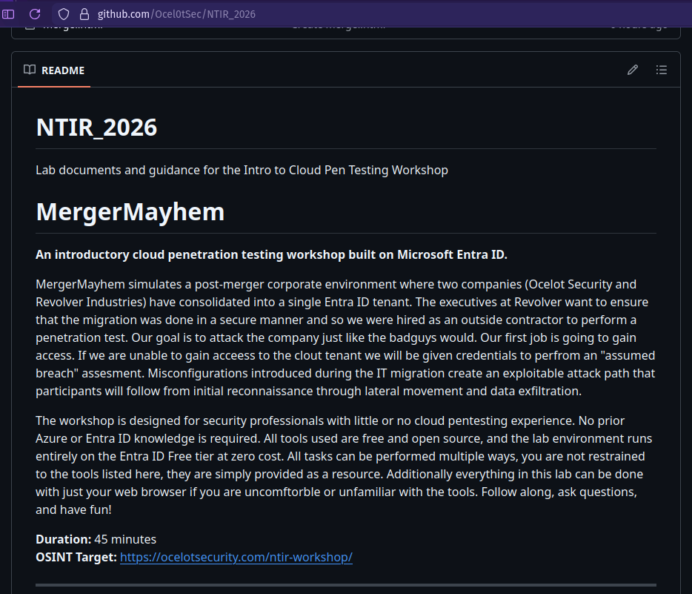
The Scenario
Ocelot Security acquired Revolver Industries.
Both companies now share a single Microsoft Entra ID tenant.
The IT migration was rushed.
A helpdesk analyst still has a temp password.
Migration credentials live in a SharePoint doc.
Your job: show leadership how bad it is before a real adversary does.
Follow along at https://github.com/Ocel0tSec/NTIR_2026
MergerMayhem
Ocelot Security

Slide 4
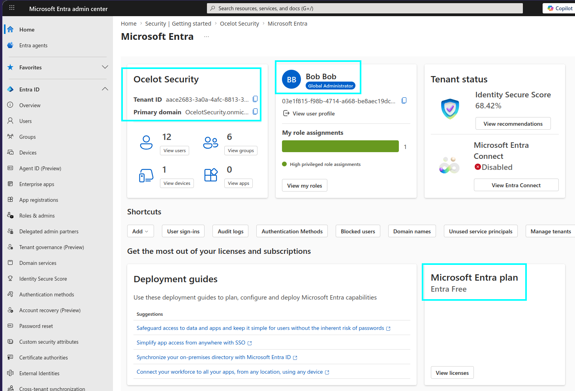
Microsoft Entra ID in 60 seconds
Entra ID is Microsoft's cloud identity platform.
Formerly called Azure Active Directory (Azure AD).
If your company uses 365, Outlook, Teams, or Azure
Entra ID is managing every login behind the scenes.
→
Users, groups, roles → who can do what
→
OAuth2 / OpenID Connect → how authentication works
→
SharePoint, Power Platform → where data lives
→
Graph API → how everything talks to everything
MergerMayhem
Ocelot Security

Slide 5
Attack Path
Five phases. One kill chain.
1
2
3
4
5
OSINT & Recon
→
Password Spray
→
Graph API Enum
→
Lateral Movement
→
Report
Company website → usernames
One password, many accounts
Explore the tenant, find SharePoint
Pivot to Revolver user
Document findings, discuss defense
Tools you'll use today:
o365spray — user enumeration + password spraying
MSOLSpray — password spray (PowerShell)
GraphRunner — post-exploitation via MS Graph API
Browser — no need to use tools, everything can be done with a web browser
Brain — don’t restrict yourself to the tools and guidance, make your own path
MergerMayhem
Ocelot Security

Slide 6
1
OSINT & Enumeration
Reconnaissance

Slide 7
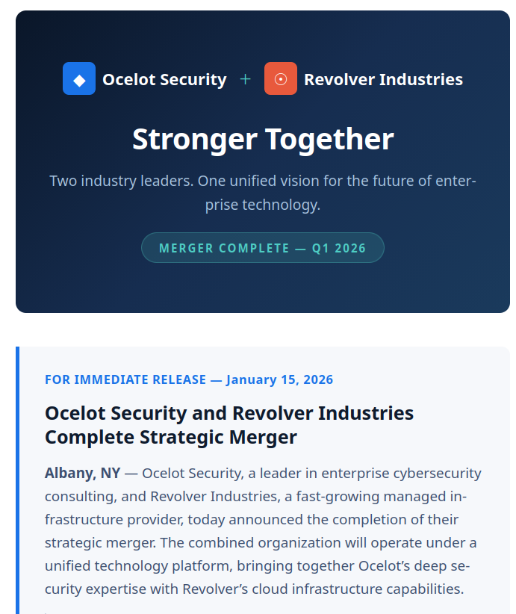
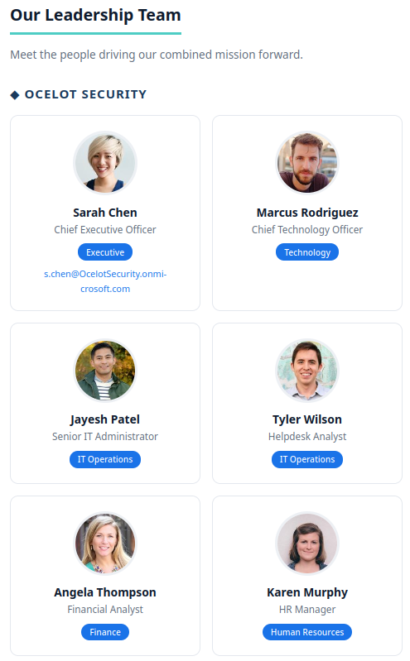
1
Start with OSINT
Every engagement starts with open-source intelligence.
The company has a public website announcing the merger.
Employee names and titles are listed.
One person's email is visible — that gives you the format.
# The OSINT target
https://ocelotsecurity.com/ntir-workshop
MergerMayhem
Ocelot Security

Slide 8
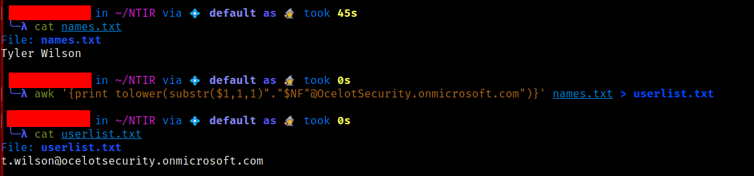
1
Build your username wordlist
From the website you know:
Email format: f.last@domain
Create a names.txt with full names,
then convert to the right format:
Bonus:
Add fake names too.
In a real engagement,
not every guess will
be valid .
# Bash
awk '{print tolower(substr($1,1,1)"."$NF"@OcelotSecurity.onmicrosoft.com")}' \names.txt > userlist.txt
# PowerShell
Get-Content names.txt | ForEach-Object {$s=$_.Split(' ')"$($s[0][0]).$($s[-1])@OcelotSecurity.onmicrosoft.com".ToLower()} | Out-File userlist.txt
MergerMayhem
Ocelot Security

Slide 9
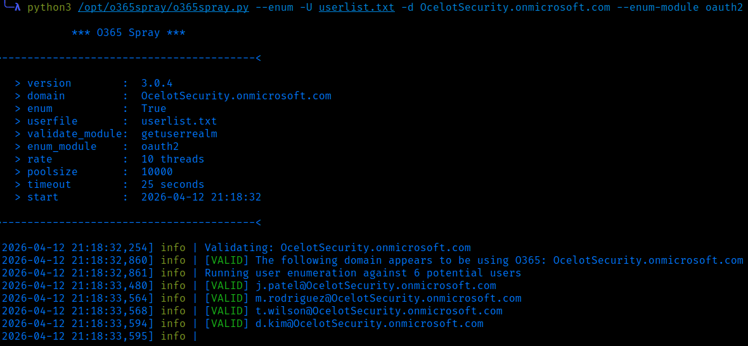
1
User enumeration
python3 o365spray.py --enum -U userlist.txt -d OcelotSecurity.onmicrosoft.com --enum-module oauth2
Azure's OAuth2 endpoint responds differently
to valid vs invalid usernames.
This is a known behavior — not a vulnerability,
but it lets you confirm which accounts exist.
You should see ~10 valid users out of your wordlist.
MergerMayhem
Ocelot Security

Slide 10
2
Password Spraying
Initial Access · ~10 minutes

Slide 11
2
Spraying vs brute force
Brute force
1000 passwords → 1 account
Triggers lockout immediately
Loud, obvious, blocked
Password spray
1 password → 1000 accounts
Stays under lockout threshold
Quiet, effective, realistic
Why does it work during mergers?
→ New hires get temp passwords that nobody rotates
→ IT teams are stretched thin, skip password policies
→ Seasonal patterns: Welcome2026!, Summer2026!, Company2026!
MergerMayhem
Ocelot Security

Slide 12
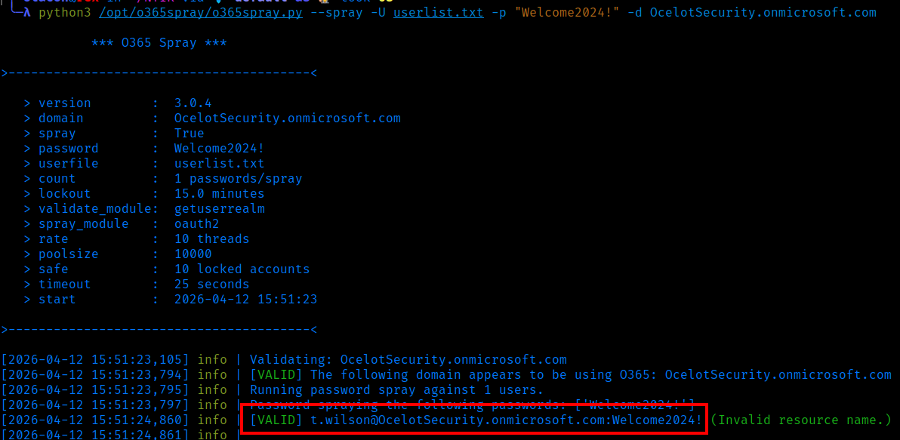
2
Execute the spray
# Python
python3 o365spray.py --spray -U valid_users.txt -p "Welcome2026!" -d OcelotSecurity.onmicrosoft.com
# PowerShell
Import-Module .\MSOLSpray.ps1
Invoke-MSOLSpray -UserList .\valid_users.txt -Password "Welcome2026!"
What other passwords would you try?
Summer2026! Winter2026! Ocelot2026!
Welcome123! Password1! Revolver2026!
MergerMayhem
Ocelot Security

Slide 13
3
Post-Compromise Enumeration
Microsoft Graph API · ~12 minutes

Slide 14
3
Every user can read the entire directory
By default, every Entra ID member can:
→ List all users, groups, and their memberships
→ See application registrations and service principals
→ Search SharePoint sites they have access to
→ Read their own profile and group memberships
One compromised account = full directory enumeration.
All of this is done through the Microsoft Graph API.
GraphRunner wraps these API calls into PowerShell commands.
MergerMayhem
Ocelot Security

Slide 15
3
Enumerate with GraphRunner
Import-Module .\GraphRunner.ps1
Get-GraphTokens t.wilson@OcelotSecurity.onmicrosoft.com
Invoke-GraphRecon -Tokens $tokens -PermissionEnum
Get-AzureADUsers -Tokens $tokens -OutFile users.txt
Get-SecurityGroups -AccessToken $tokens.access_token
Get-SharePointSiteURLs -Tokens $tokens
# Search for interesting files
Invoke-SearchSharePointAndOneDrive -Tokens $tokens -SearchTerm "credentials"
Or just log into portal.office.com and browse!
MergerMayhem
Ocelot Security

Slide 16
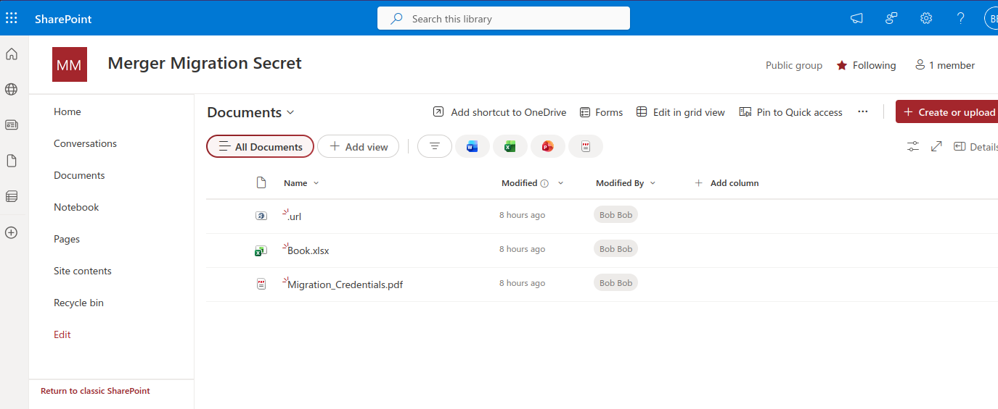
3
The SharePoint goldmine
People store everything there — migration docs, onboarding checklists, credentials spreadsheets, architecture diagrams, API keys, you name it.
MergerMayhem
Ocelot Security

Slide 17
4
Lateral Movement
Credential Reuse · ~10 minutes

Slide 18
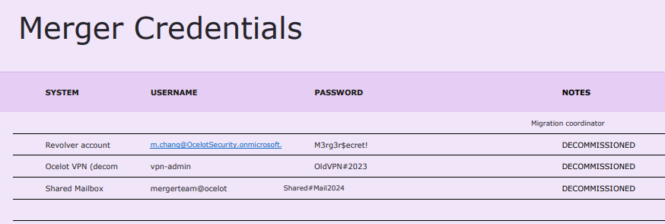
4
Pivot to Revolver Industries
You found m.chang's password in the spreadsheet.
Incognito window → portal.office.com
Sign in as m.chang@OcelotSecurity.onmicrosoft.com
This user is in Revolver Industries - All Staff.
She can see resources t.wilson never could.
MergerMayhem
Ocelot Security

Slide 19
5
Findings & Defense
Report · ~5 minutes

Slide 20
5
What would you report?
01
Initial Access
Weak temporary password on helpdesk account survived merger
02
Data Exposure
Cross-BU credentials stored in a shared SharePoint doc
03
Lateral Movement
Single compromised cred chain led to Revolver-only data
04
PII at Risk
Power Automate flow contained customer SSNs and DB creds
This is a critical-severity finding chain. Any one of these alone is a problem. Together, they represent a full business unit compromise.
MergerMayhem
Ocelot Security

Slide 21
How do you stop this?
Enable MFA / Conditional Access
Blocks password spray entirely. This is the single most impactful control.
Never store credentials in documents
Use Azure Key Vault, a PAM solution, or a secrets manager.
Monitor sign-in logs
Entra ID Identity Protection flags spray patterns automatically.
Audit Power Platform
DLP policies catch embedded secrets in flows and apps.
Least-privilege during mergers
Separate service accounts per BU. Scoped group memberships.
Rotate all temporary passwords
Enforce password change on first login. Audit compliance.
MergerMayhem
Ocelot Security

Slide 22
Keep going
Free resources and next steps
GraphRunner
Post-exploitation via Graph API
github.com/dafthack/GraphRunner
HackTricks Cloud
Azure pentesting encyclopedia
cloud.hacktricks.xyz
BadZure
Build your own vulnerable Entra lab
github.com/mvelazc0/BadZure
Graph Explorer
Test Graph API in your browser
developer.microsoft.com/graph/graph-explorer
MergerMayhem
Ocelot Security

Slide 23
Questions?

