Slide 1
The effect of population kinship estimation bias in heritability estimation
Zhuoran Hou
Advisor: Alejandro Ochoa, PhD.
Department of Biostatistics & Bioinformatics

Slide 2
Content
Background
Methods
Results

Slide 3
Background

Slide 4
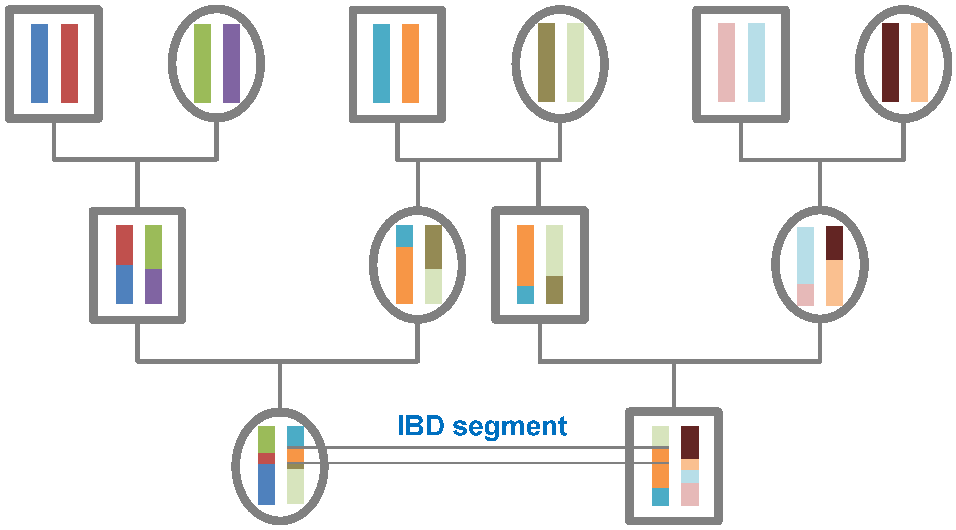
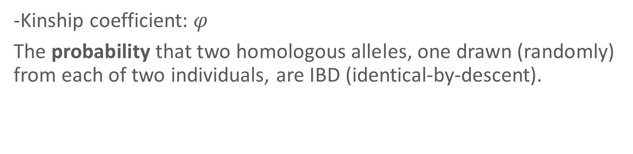
Kinship coefficient: measure of relatedness
-Kinship coefficient: $φ$
The probability that two homologous alleles, one drawn (randomly) from each of two individuals, are IBD (identical-by-descent).
-IBD:
Two alleles are called IBD if they are copies of the identical allele carried by a recent common ancestor.
https://isogg.org/wiki/Identical_by_descent

Slide 5
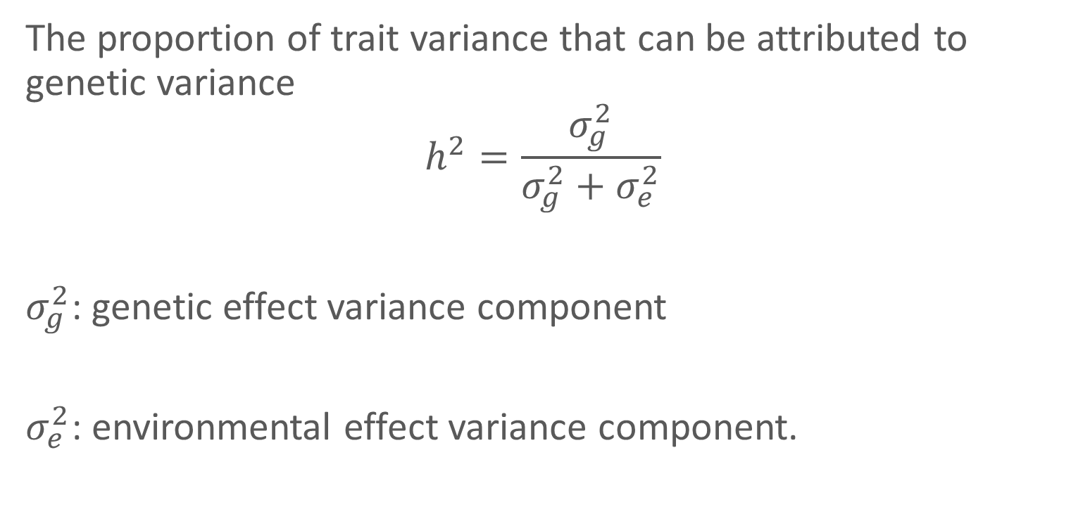
Heritability
The proportion of trait variance that can be attributed to genetic variance
$$h^{2}=\frac{σ_{g}^{2}}{σ_{g}^{2}+σ_{e}^{2}}$$
$σ_{g}^{2}$: genetic effect variance component
$σ_{e}^{2}$: environmental effect variance component.

Slide 6
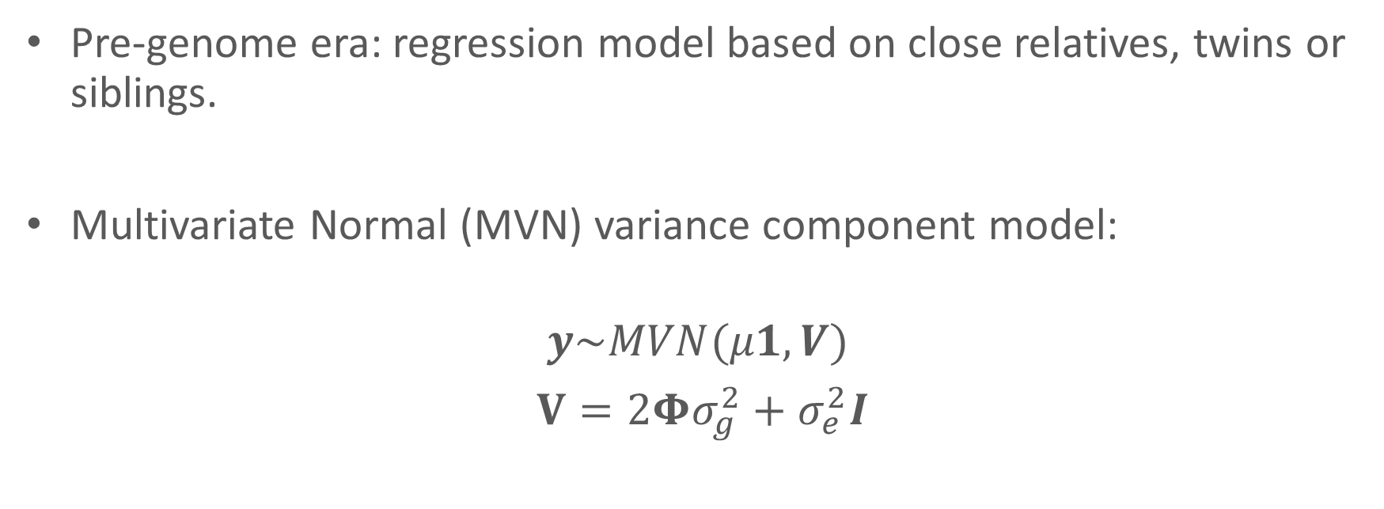
Methods for heritability estimation
Pre-genome era: regression model based on close relatives, twins or siblings.
Multivariate Normal (MVN) variance component model:
$$y\sim MVN(μ1, V)$$
$V=2Φσ_{g}^{2}+σ_{e}^{2}I$
Notes:
GCTA approach
$y$: phenotype vector

Slide 7


GCTA software
Genome-wide Complex Trait Analysis (GCTA) (Yang et al. 2011)
It was initially designed to estimate heritability.
It was then extended for all kinds of analysis in GWAS.
It is based on MVN model.

Slide 8

Problem
The most common family of kinship estimators for populations can be severely biased
(Ochoa and Storey, 2016; Weir and Goudet, 2017).
Standard kinship estimator

Slide 9
Methods

Slide 10
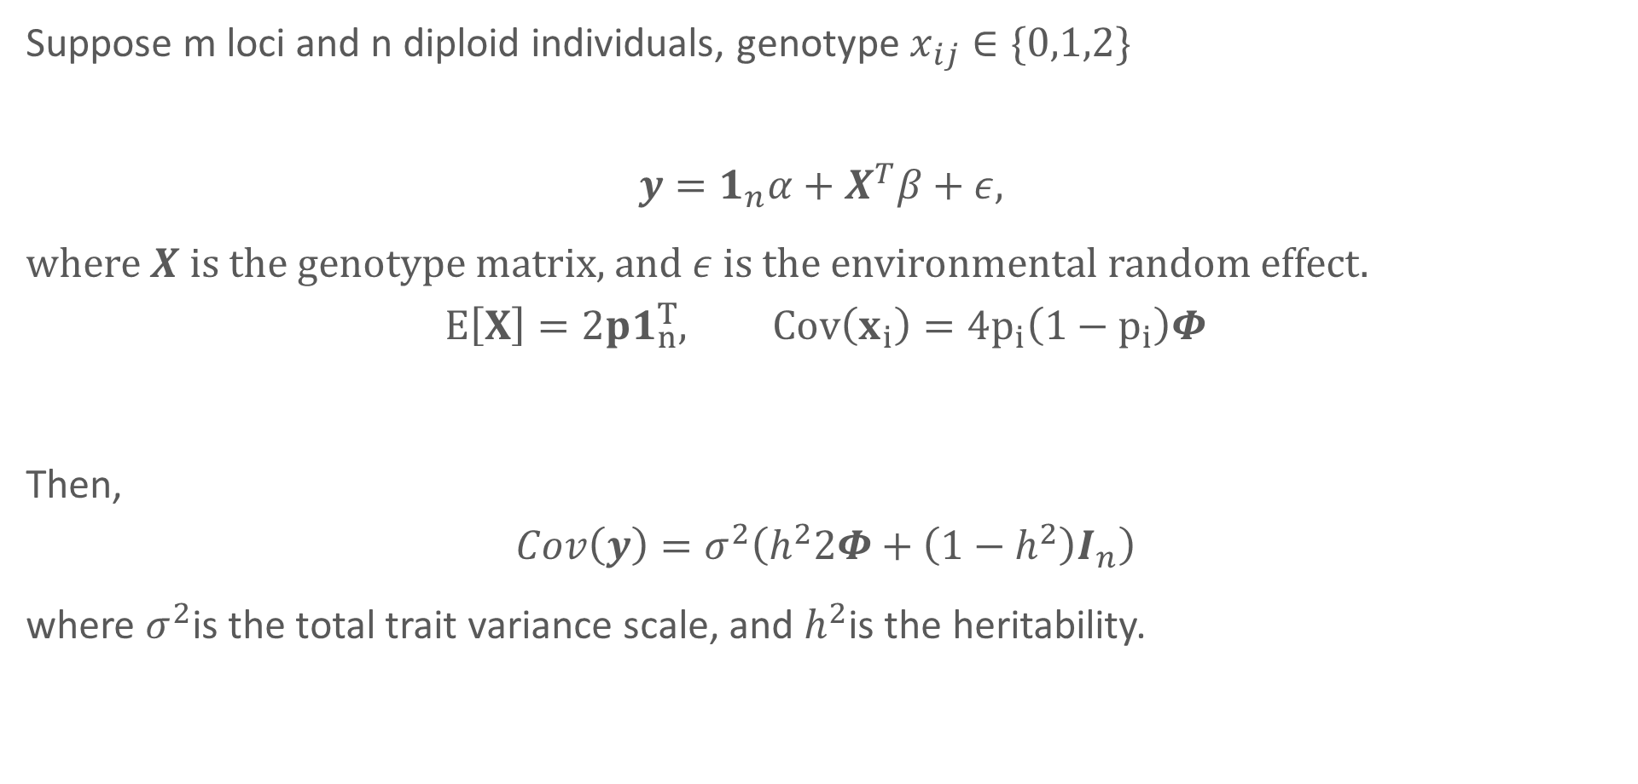
Genetic model
Suppose m loci and n diploid individuals, genotype $x_{ij}∈\{0,1,2\}$
$$y=1_{n}α+X^{T}β+ε,$$
where $X$ is the genotype matrix, and $ε$ is the environmental random effect.
$$E\left[X\right]=2p1_{n}^{T}, Cov\left(x_{i}\right)=4p_{i}\left(1−p_{i}\right)Φ$$
Then,
$$Cov\left(y\right)=σ^{2}\left(h^{2}2Φ+\left(1−h^{2}\right)I_{n}\right)$$
where $σ^{2}$is the total trait variance scale, and $h^{2}$is the heritability.
Notes:
$α$ intercept; $β$ Effect size coefficients m*1

Slide 11
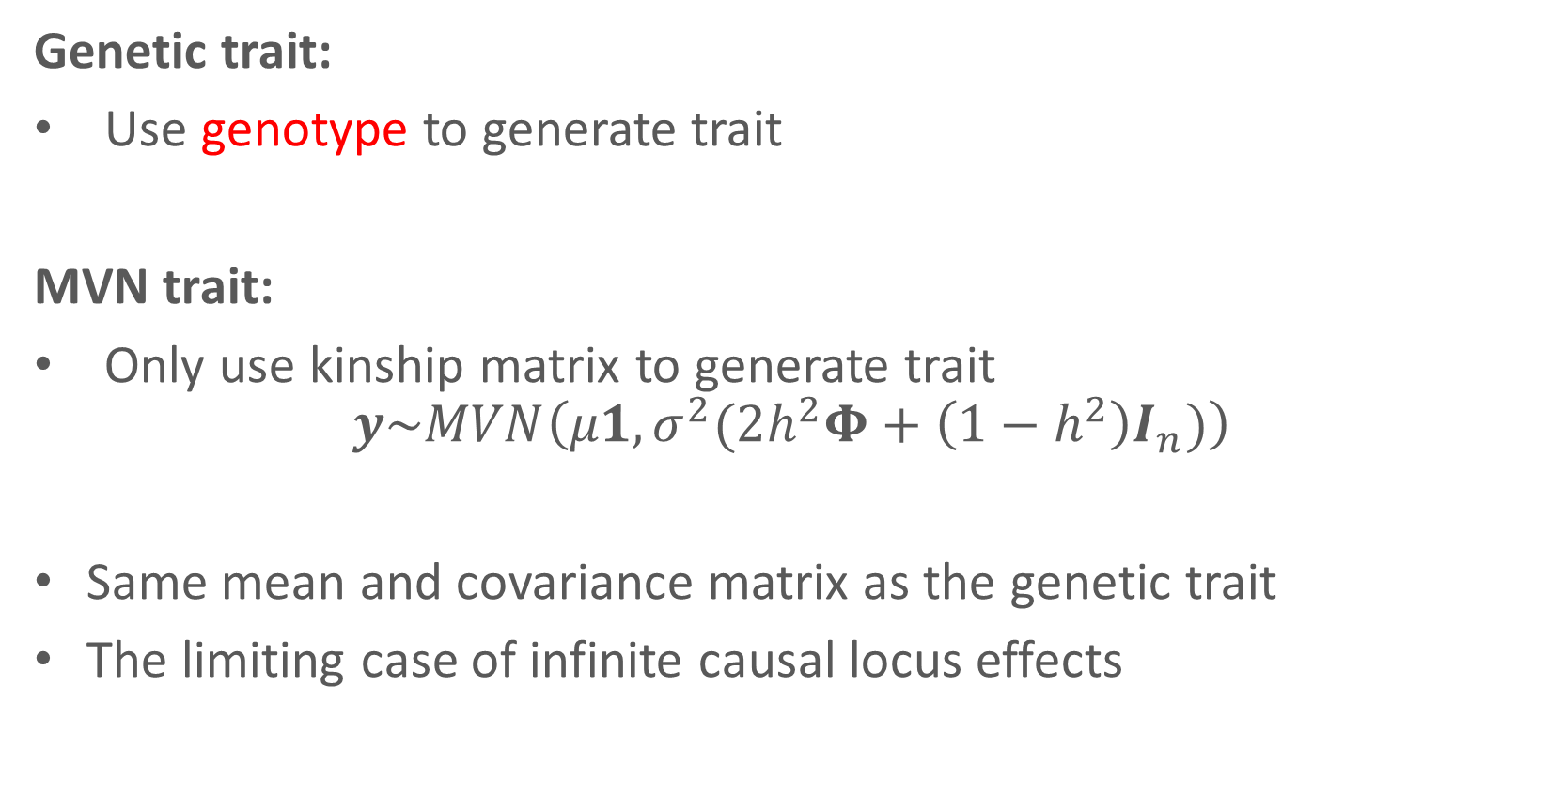
Genetic trait vs. MVN trait
Genetic trait:
Use genotype to generate trait
MVN trait:
Only use kinship matrix to generate trait
$$y\sim MVN\left(μ1, σ^{2}(2h^{2}Φ+\left(1−h^{2}\right)I_{n})\right)$$
Same mean and covariance matrix as the genetic trait
The limiting case of infinite causal locus effects
Notes:
use true kinship matrix and model parameters (the desired heritability, total variance scale, and mean) to generate trait

Slide 12


Kinship estimation
1.Standard kinship estimator
2.GCTA kinship estimator
3.Popkin kinship estimator (Ochoa and Storey, 2016).
$${\hat{φ}}_{jk}\underset{m→∞}{\underset{→}{a.s}}φ_{jk}$$

Slide 13
Simulations
genotype simulation:
1) admixture structure only:
2) admixture structure + family structure
phenotype simulation:
genetic trait
MVN trait
Heritability estimation software:
GCTA

Slide 14
Results

Slide 15
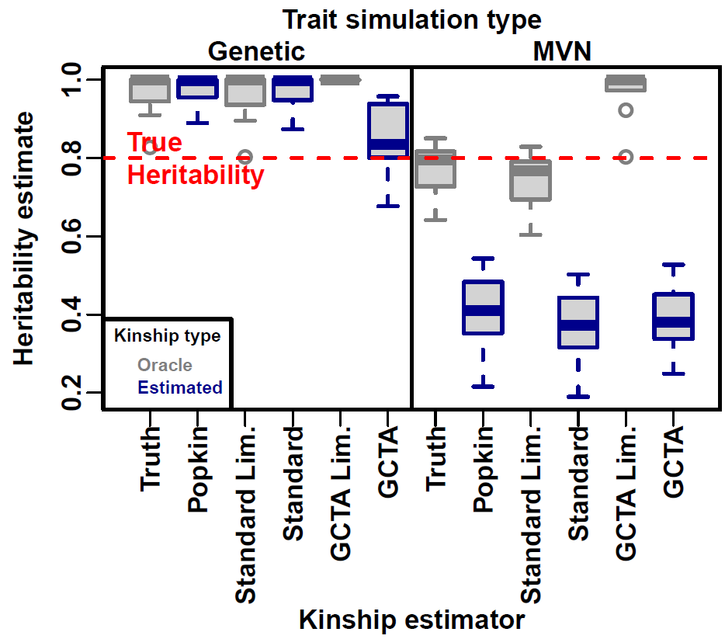
Admixture simulation
Upward bias
Downward bias
Limit
Notes:
Genotypes and traits were simulated for n = 5000 individuals, m = 100000 loci, for 10 replicates, from an admixture simulation (K = 3 ancestral subpopulations, FST = 0:3 for admixed individuals, bias coefficient of s = 0:5), no family structure, and the traits had a true heritability of h2 = 0.8 and m1 = 100 causal loci).

Slide 16
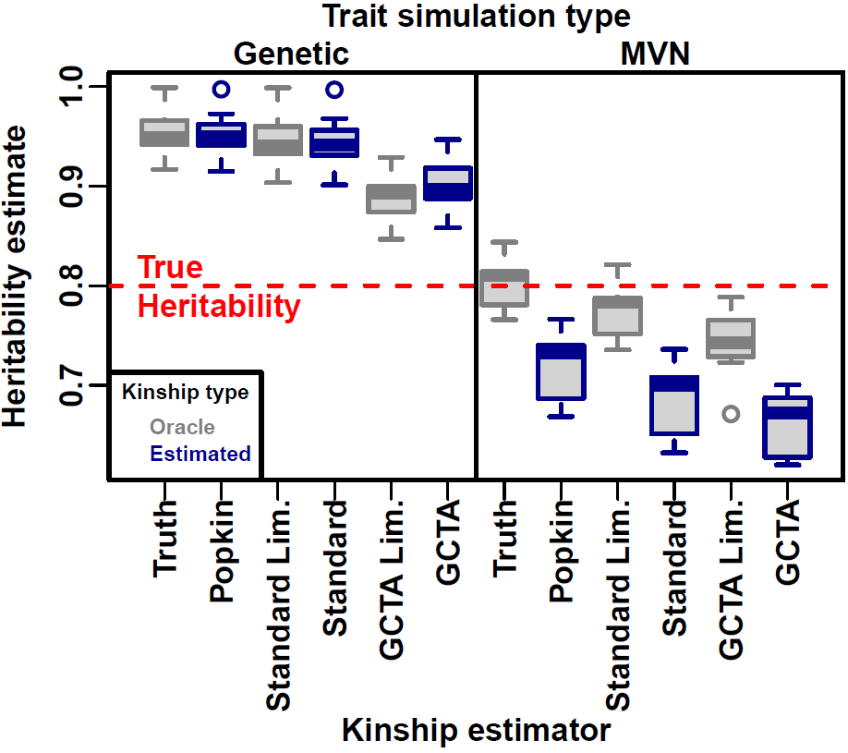
Admixture plus family structure
Upward bias
Downward bias
Limit
Notes:
Since traditional heritability estimation is based on family structure, we decided to consider a simulation including both population and family structure.

Slide 17
Conclusion
Upward bias due to performing inference with the mis-specified MVN model
Downward bias due to the noise in kinship estimation
Future work
how bias and the # of causal loci are related
Notes:
So today, I’ve introduced some basic concepts and models in heritability estimation, and how we compare the effect of different kinship estimators by simulations. In the end, we found out these two sources of bias.
Increase the # of causal loci to test the convergence of genetic traits

Slide 18
Acknowledgments
Ochoa Lab
Alejandro Ochoa, PhD.
Amika Sood, Ph.D.
Tiffany Tu
Yiqi Yao (Alumni)

Slide 19
References
Demontis, Ditte, et al. "Discovery of the first genome-wide significant risk loci for attention deficit/hyperactivity disorder." Nature genetics 51.1 (2019): 63-75.
Astle, William and David J. Balding (2009). “Population Structure and Cryptic Relatedness in Genetic Association Studies”. Statist. Sci. 24(4). Mathematical Reviews number (MathSciNet): MR2779337, pp. 451–471.
Speed, D., & Balding, D. J. (2015). Relatedness in the post-genomic era: is it still useful?. Nature Reviews Genetics, 16(1), 33-44.
Yang, Jian et al. (7, 2011). “GCTA: a tool for genome-wide complex trait analysis”. Am. J. Hum. Genet. 88(1), pp. 76–82.
Falconer, Douglas S. and Trudy F. C. Mackay (16, 1996). Introduction to Quantitative Genetics. 4 edition. Harlow: Pearson
Ochoa, Alejandro and John D. Storey (2016b). “FST and kinship for arbitrary population structures II: Method of moments estimators”. Submitted, preprint at http://biorxiv.org/content/early/2016/10/27/083923.

Slide 20
Q&A session

Slide 22
Notes:
m
1
Number of loci
n
1
Number of individuals
$$y$$
$$n×1$$
Trait vector
$$α$$
1
Intercept coefficient
$$1_{n}$$
$$n×1$$
Vector of ones
$$β$$
$$m×1$$
Effect size coefficients
$$X$$
$$m×n$$
Genotype matrix
$$ε$$
$$n×1$$
Non-genetic random effect

Slide 23
Notes:
m 1 Number of loci; n, 1 Number of individuals

