Slide 1

Day 2: Variant effect prediction
09/19/2023
Apoorva Iyengar

Slide 2
Clinical motivation: variant effect prediction
Any given person has ~4 million genetic variants
Rare/monogenic disease – which 1-2 variants are causal?
Common/polygenic disease – which variants are causal, and what genes do they affect?
Knowing causal variants, genes, and mechanisms can inform drug development and treatment
Ex. BRCA, triple-negative breast cancer,

Slide 3
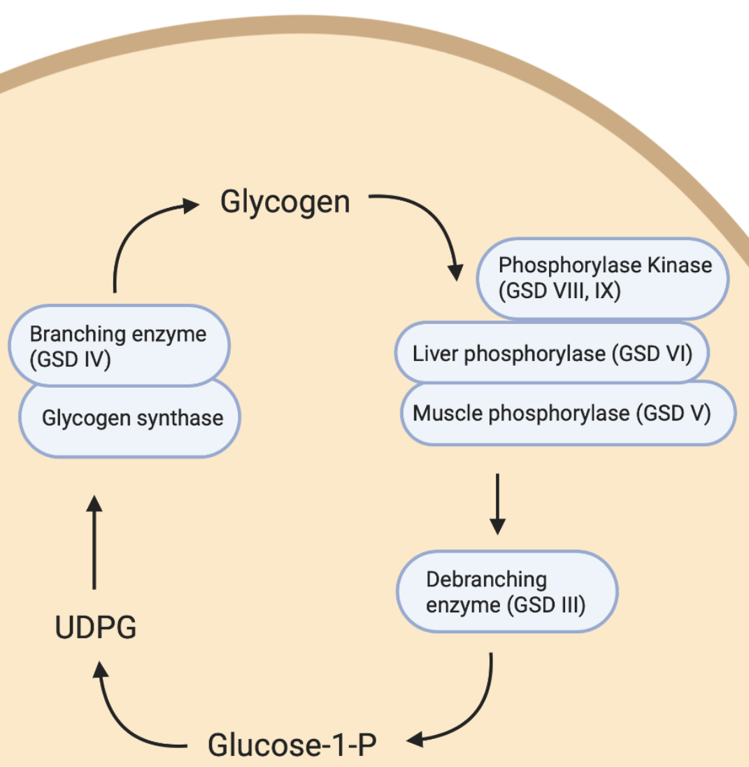
Example exercise 1: Glycogen Storage Disease IX γ2
PHKG2 regulates glycogen debranching
Pathogenic variants cause issues regulating blood glucose and severely damage the liver
Disorder | Gene | Liver PhK | Pathogenic variants
GSD IX γ2 | PHKG2 | 20% | ?
GSD IX γ2 | PHKG2 | 10% | ?
Whole genome sequencing showed no known pathogenic variants, but found one that may be relevant:
chr16:30754550 T>G

Slide 4
Ensembl Variant Effect Predictor (VEP)
Open source, first-line tool for variant interpretation
Predicts the impact on RNA transcripts and proteins by aggregating data from other, more specific pieces of variant prediction software
Can do variant lookups in >100 species, including human and all major model organisms
Can easily toggle settings to look for specific effects (alternative splicing, transcriptional regulation, conservation, associated phenotypes/diseases, etc)
https://useast.ensembl.org/Tools/VEP
Notes:
VEP can be used for variant interpretation and annotation without any further info than genomic position
Works for coding and non-coding variants, rare and common variants

Slide 5
File setup
Will need to make a VCF (Variant Calling Format) file
Use TextEdit or <Windows Equivalent>
Example format
#HEADER
#CHROM POS ID REF ALT
20 10001019 . T G

Slide 6
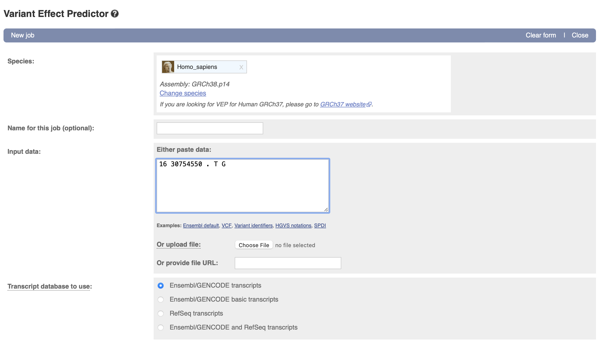
Using VEP
Input variant information in one of the accepted formats, scroll to bottom and hit “Run”

Slide 7
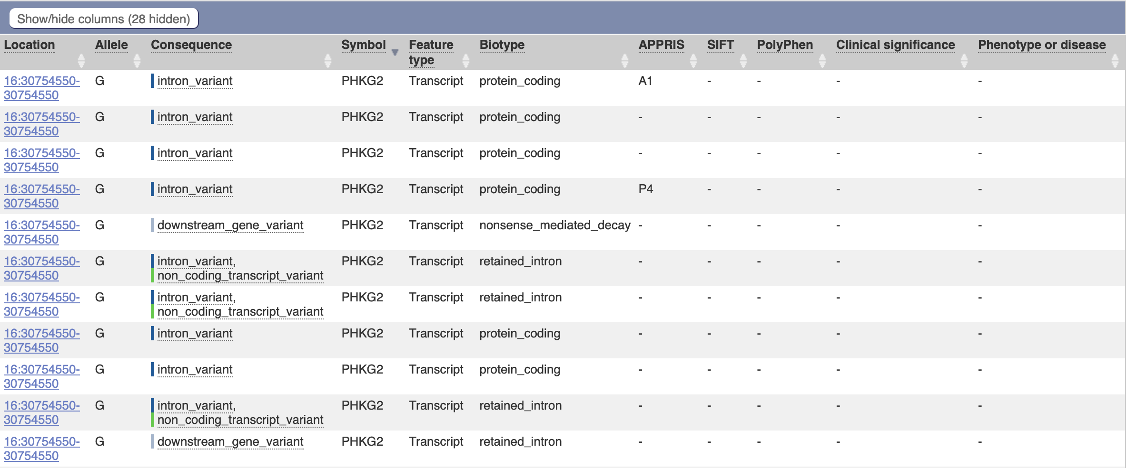
VEP output
Evidence that it may cause splicing changes → next step was to do RNA-seq

Slide 8
Visualize RNA-seq data
We’ve performed RNA-seq and have aligned the reads to the human genome – download the aligned reads from the GitHub day 2 folder
Upload them into IGV under the hg38 genome build
File -> Load from File -> select .bam file
.bai (bam index) file should be in the same folder as the .bam that you are uploading
Can we identify any splicing abnormalities in that region, that occur in the patient with GSD IX but not in the 2 healthy people?
Visualize in Sashimi plot
VEP often cannot tell you whether a variant is pathogenic, but can often give you a starting point to look for other relevant evidence

Slide 9
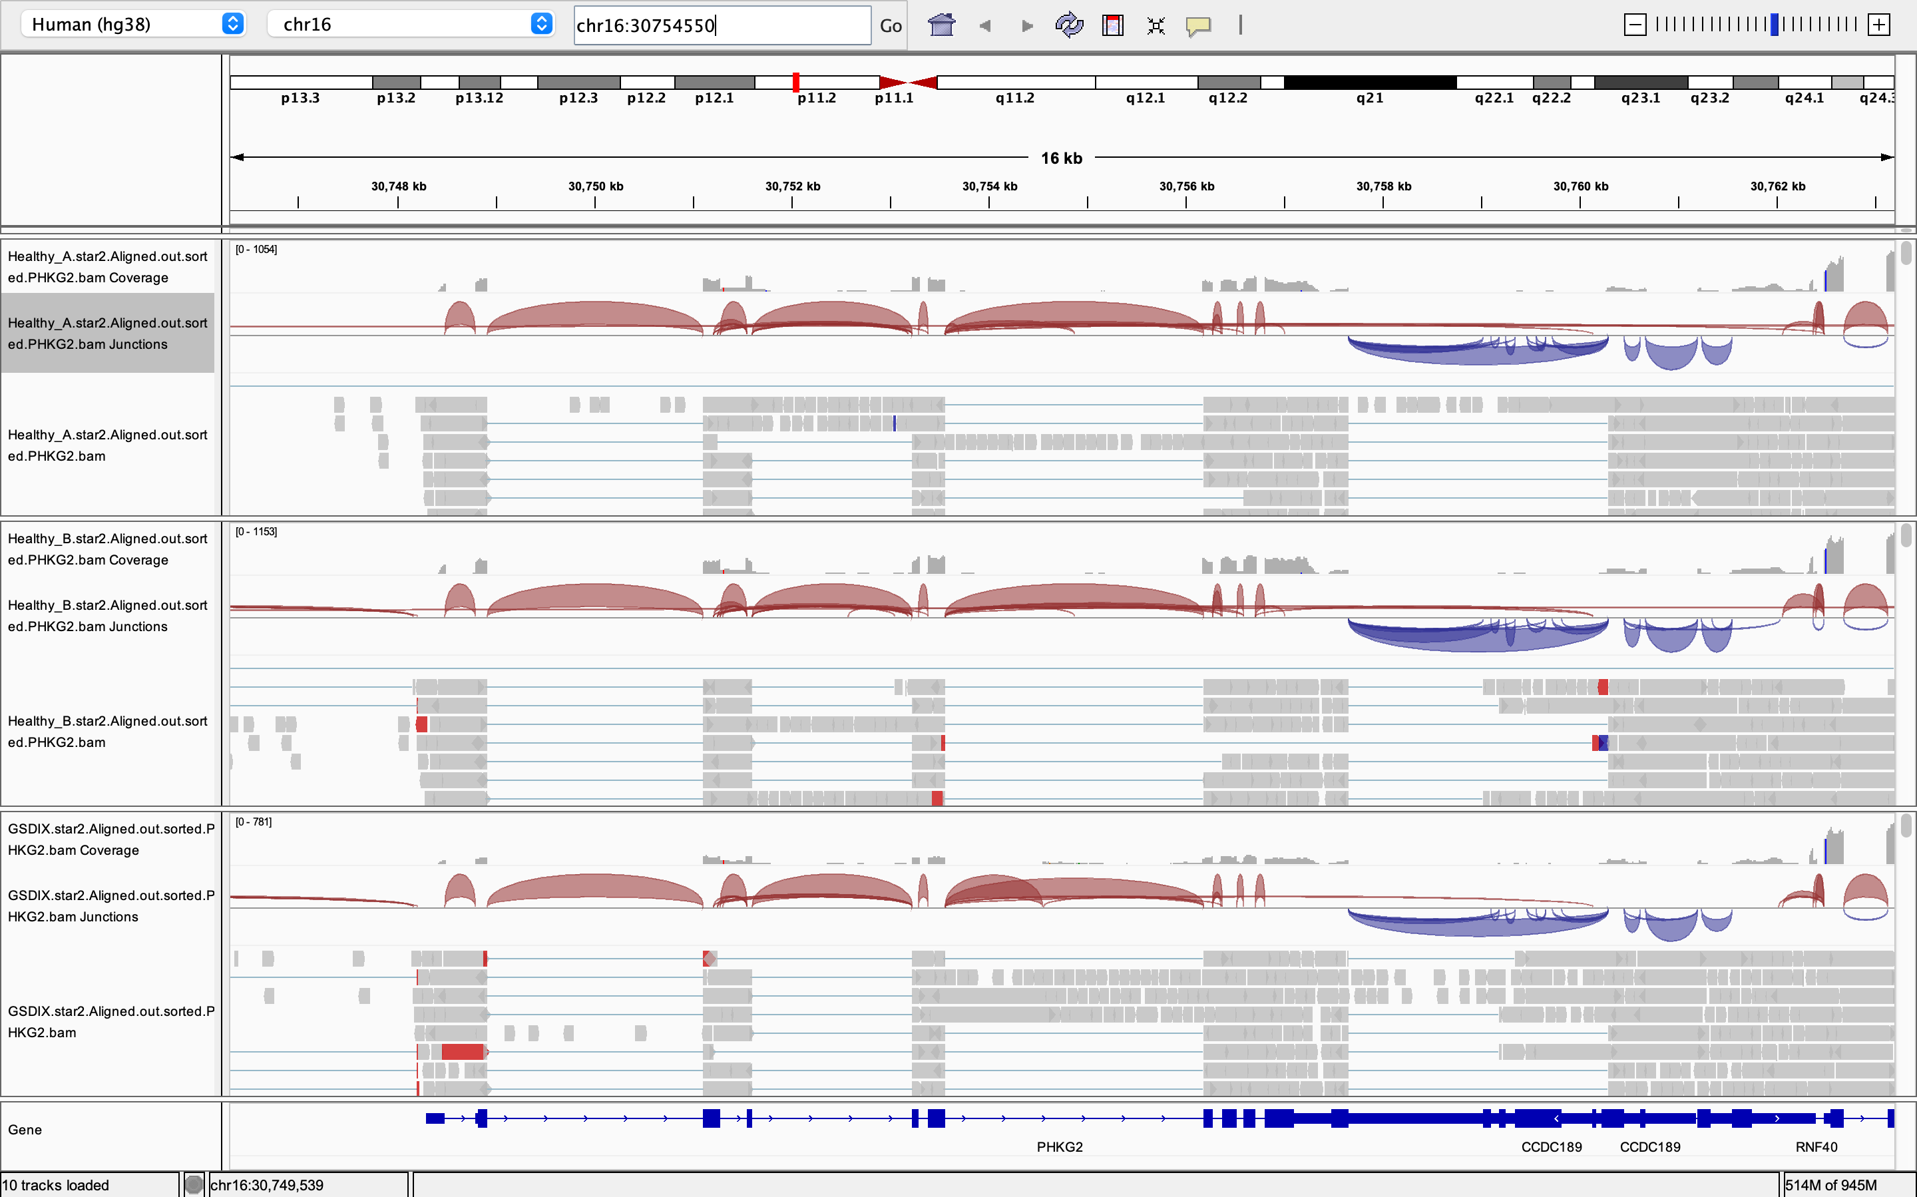
Go to potential pathogenic variant site in IGV

Slide 10
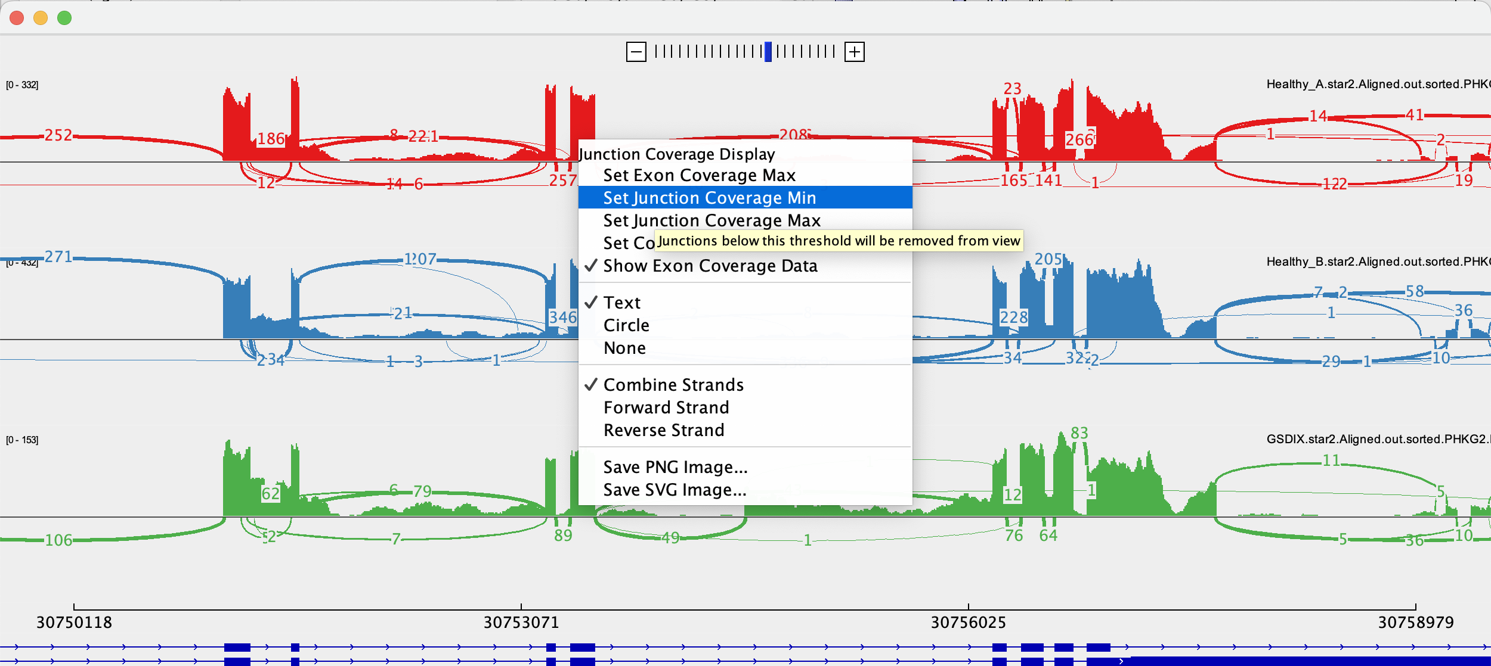
Zoom out and make a Sashimi plot to further examine splicing
Right click -> “Sashimi Plot”
Right click on each track and set Junction Coverage Min to 5 – this will remove junctions without plenty of supporting evidence from the data viz

Slide 11
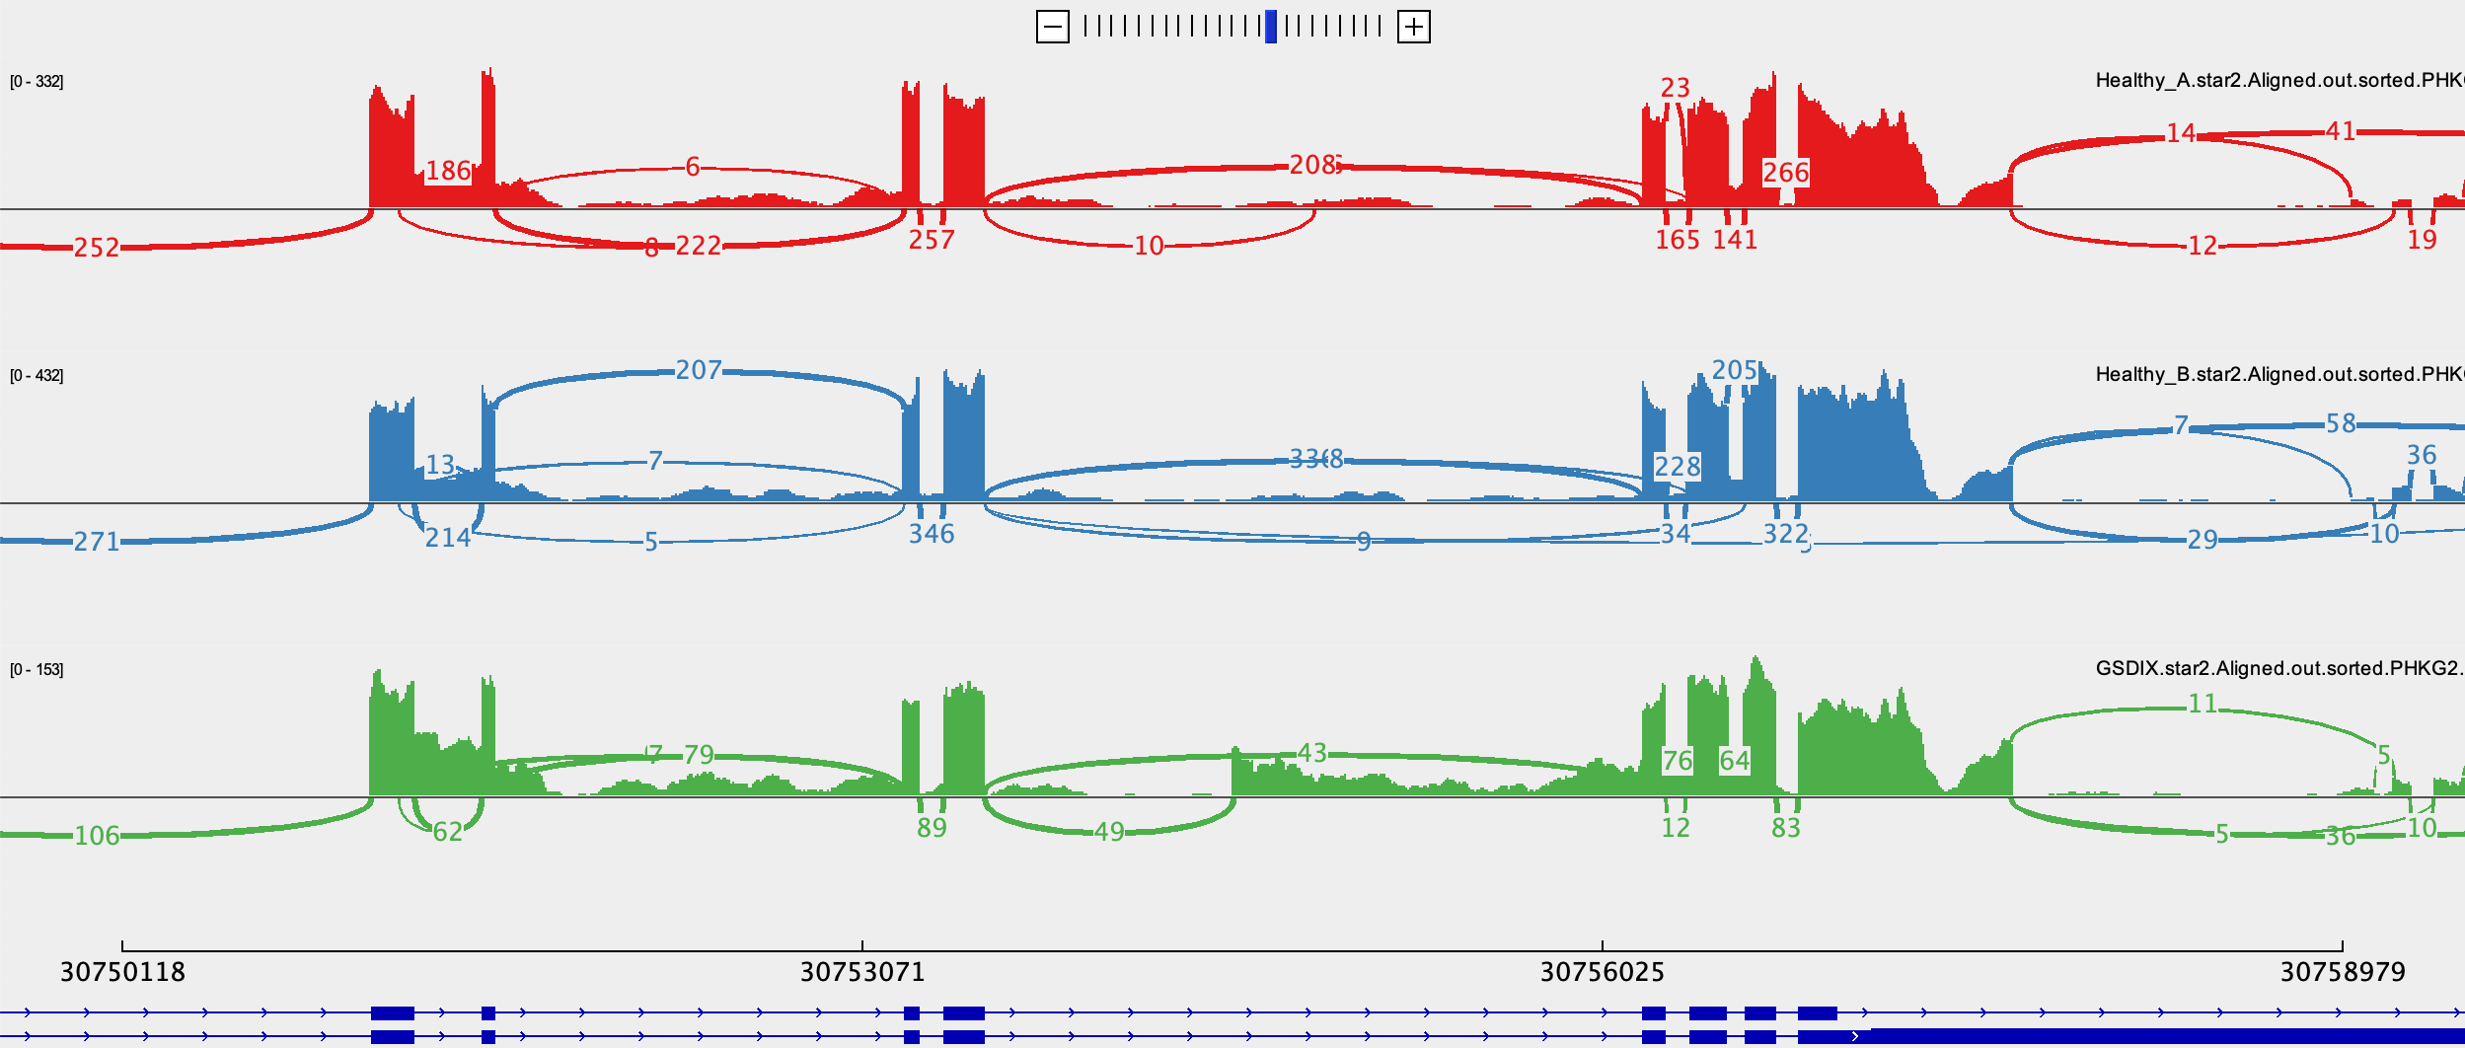
Visualize pseudoexon splice acceptor

Slide 12
Additional variants to look up & discuss in groups:
You can put rsIDs (if they exist for that variant) straight into VEP
List of variants in BCL11A on this slide – submit this list as a job in VEP
For each variant, use links on next slide to:
Note “biotype(s)” (gene/transcript classification) and what they mean
Note “consequence(s)”
Scroll over to other columns – SIFT, PolyPhen, Clinical Significance, APPRIS, NMD
In aggregate, what does this tell you about the impact of this variant on BCL11A function? What are the potential mechanisms?
rs1333618217
rs1670455296
rs1670521527
rs781461905
rs748538213
rs1168443709
rs902477442
rs1249313093
rs1573096202
rs529993149
Notes:
Tell them how to interpret each row

Slide 13
VEP instructions
https://useast.ensembl.org/info/docs/tools/vep/online/index.html
Hit “Launch VEP”
Choose species: Homo sapiens, GRCh38
List rsIDs in the “Input data” box
Other input formats are possible, including VCF files and HGVS notations, which are often used in clinical reports
Scroll to the bottom and hit “run”
For help interpreting variant consequences and biotypes that come out of VEP, here are some resources:
http://useast.ensembl.org/info/genome/genebuild/biotypes.html
https://useast.ensembl.org/info/genome/variation/prediction/predicted_data.html
Notes:
Say, this is all important in different contexts, today we will focus on splicing/pathogenicity, but tell them we are ignoring other info that is not directly relevant to this variant

