Slide 1

Day 1 Exercise: Consequences of genetic variation
1/23/2025
Apoorva Iyengar

Slide 2
Clinical motivation: variant effect prediction
Any given person has ~4 million genetic variants
Rare/monogenic disease – which 1-2 variants are causal?
Common/polygenic disease – which variants are causal, and what genes do they affect?
Knowing causal variants, genes, and mechanisms can inform drug development and treatment
Ex. BRCA, cystic fibrosis
Notes:
Any given person has ~4 million genetic variants
Rare/monogenic disease – of those 4 million variants, patients have maybe 1 or 2 variants that have very large, very detrimental effects on the person’s health
Common/polygenic disease – more of those 4 million variants will have an effect, hundreds or even thousands, but most of them are outside of genes – so predicting the effect they will have on genes, and even which genes they may affect, is very complicated
Now, it’s important to know which variants and genes are causing disease is important because it can affect how patients are treated. So an example would be knowing whether a variant in the BRCA genes causes disease or whether it doesn’t really have an effect on that gene at all. If someone has a pathogenic BRCA1 mutation, for example, they’re potentially at very high risk for breast or ovarian cancer, so that would affect how often they get cancer screenings or even whether they might have mastectomy to prevent cancer from developing.
Another example is cystic fibrosis, where there is a drug on the market, but it’s only responsive to patients who have very specific mutations, so in this case it’s very important for a patient’s treatment plan to know which mutation is causing their disease

Slide 3
Predicting the function of genetic variants
Important to know the mechanisms underlying a genetic variant – how does it cause disease?
Variant Effect Predictor gives a broad sense of how a variant functions
Other resources exist for each specific molecular mechanism
Coding variants/single amino acid changes (ex. SIFT, PolyPhen)
RNA stability (ex. UTRannotator)
Transcriptional regulation (ex. overlaps with ENCODE regulatory peaks)
Splicing (ex. SpliceAI)
Notes:
So it’s important to know whether a variant causes disease, but it’s also important to know *how* a variant causes disease. What are the mechanisms of how a variant affects RNA or a protein that’s implicated in human disease?
There are some resources like Variant Effect Predictor that give a broad, general view of what are potentially the ways that a variant might function. But, let’s say VEP tells you, hey, we think this variant impacts splicing – what exactly does that mean? *Where* in the gene is this variant impacting splicing? How sure can we be that that’s true?
And that’s where these other, more specific resources come in. I’ve put a few different examples here with hyperlinks so that you can explore them on your own if you’d like, so for missense variants, SIFT or PolyPhen will tell you, how does this variant impact the protein sequence, and how does that potentially affect protein function? Or you might remember Bill talking about untranslated regions or UTRs – this UTRannotator tool tells you whether that variant might affect stability of that RNA molecule, which would affect the amount of protein that is made.
Today we’ll focus on a tool called SpliceAI

Slide 4
Exercise for today:
Part 1 (as a group): learn to use SpliceAI and Integrative Genomics Viewer
Together, use SpliceAI to predict variant effect on splicing
Validate SpliceAI prediction using RNA sequencing data in IGV
Part 2 (individually/in teams):
Individually, use SpliceAI to predict the effects of 3 variants on splicing
Determine splicing effect on mRNA frame
Assess potential disease relevance

Slide 5
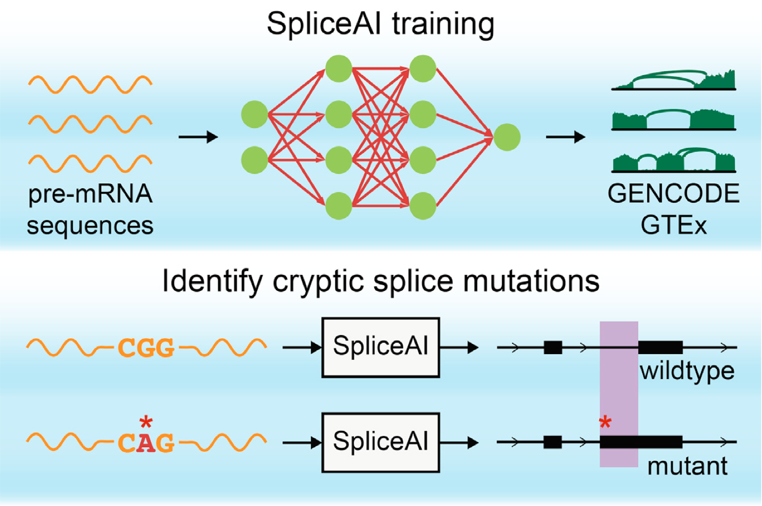
Intro to SpliceAI
Splicing prediction tool with a web interface
Predicts where a pre-mRNA nucleotide sequence may:
Contain a new splice donor or acceptor
Disrupt a canonical splice donor or acceptor
Jaganathan (2019) Cell
Notes:
SpliceAI is an open-source splicing prediction tool with a web interface, it’s one of the most commonly used splicing prediction tools used in the clinic, and we’re going to try it out today.
So how does SpliceAI work? Basically, it has all the information we already know about the sequence of the human genome and what sequences are associated with splicing
So when we give it a new variant of that genome sequence, it takes all that information and predicts whether that new variant might change the sequence in a way that would create or destroy a splice site.

Slide 6
Using SpliceAI
Navigate to https://spliceailookup.broadinstitute.org
Enter 1 variant at a time in the following format: chr#-pos-ref-alt
Ex. chr16-30754626-T-G (hg38)
Make sure position and genome build (hg38) match and “REF & ALT Scores” box is checked
Hit “Submit”
Notes:
So, we’re going to try this out…
COPY AND PASTE genome position

Slide 7
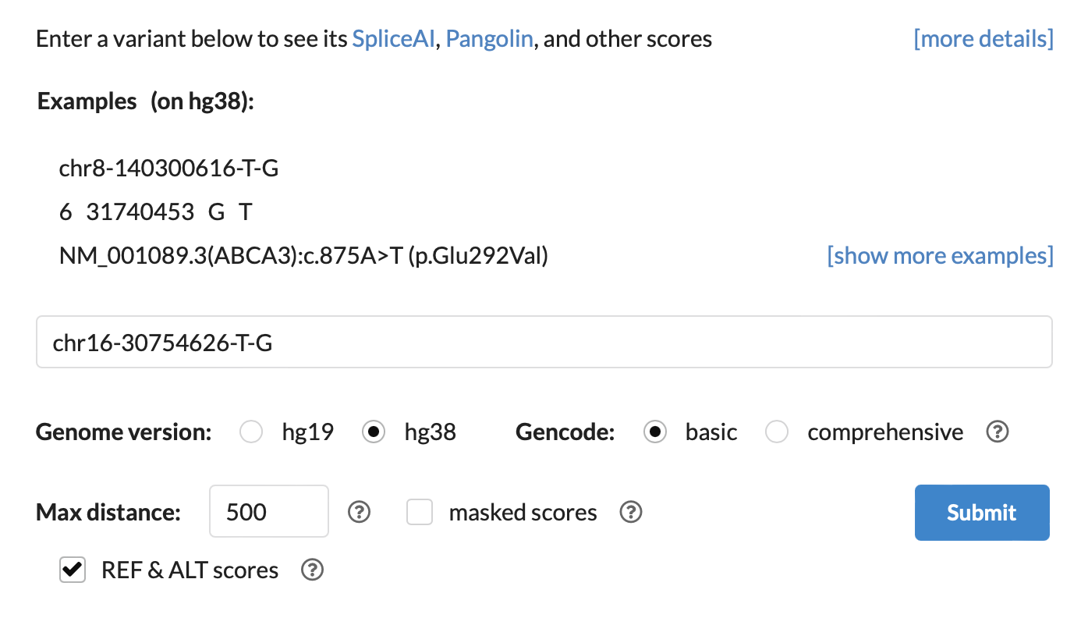
SpliceAI example
Enter variant in following format: chr#-pos-ref-alt
Ex. chr16-30754626-T-G
Make sure position and genome build (hg38) match and “REF & ALT Scores” box is checked

Slide 8
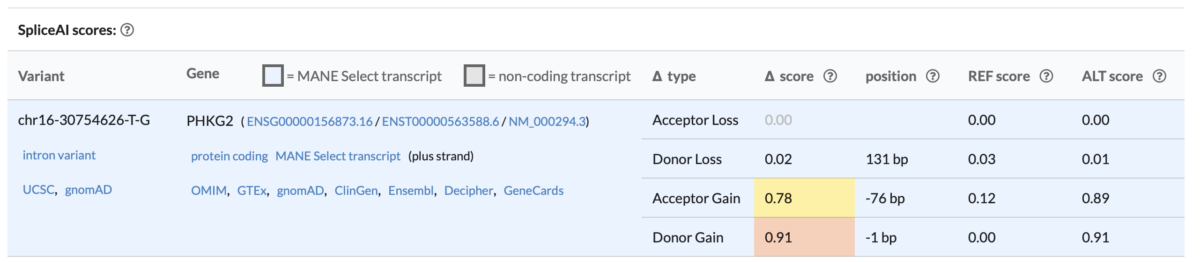
SpliceAI example results
For variant chr16-30754626-T-G, the top SpliceAI result should be
This predicts that the variant causes a new 76bp exon to be included in the
mRNA transcript, starting 76bp upstream of the variant.

Slide 9
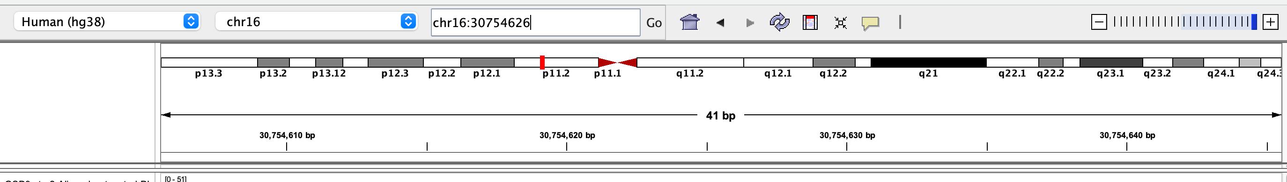
Visualize RNA-seq data in IGV
We’ve performed RNA-seq on cells that have the healthy variant and the PHKG2 variant and have aligned the reads to the human genome
You should have these downloaded in the day1/Exercise directory
Open IGV and upload the 2 files ending in “.bam”
File -> Load from File -> select .bam file
.bai (bam index) file with the matching name should be located in the same directory as the .bam that you are uploading
Enter the variant position (chr16:30754626) into the box at the top and click “Go” to navigate to site of the potentially pathogenic variant

Slide 10
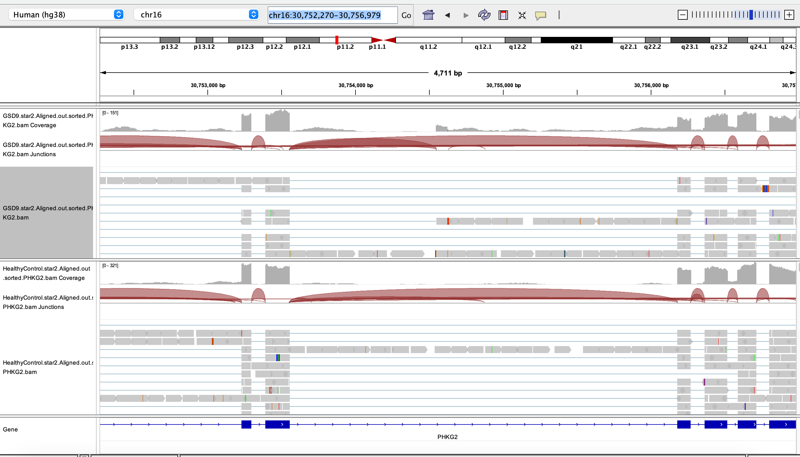
Visualize RNA-seq data in IGV
Zoom out several (~7) times by clicking the “-” in the top right corner

Slide 11
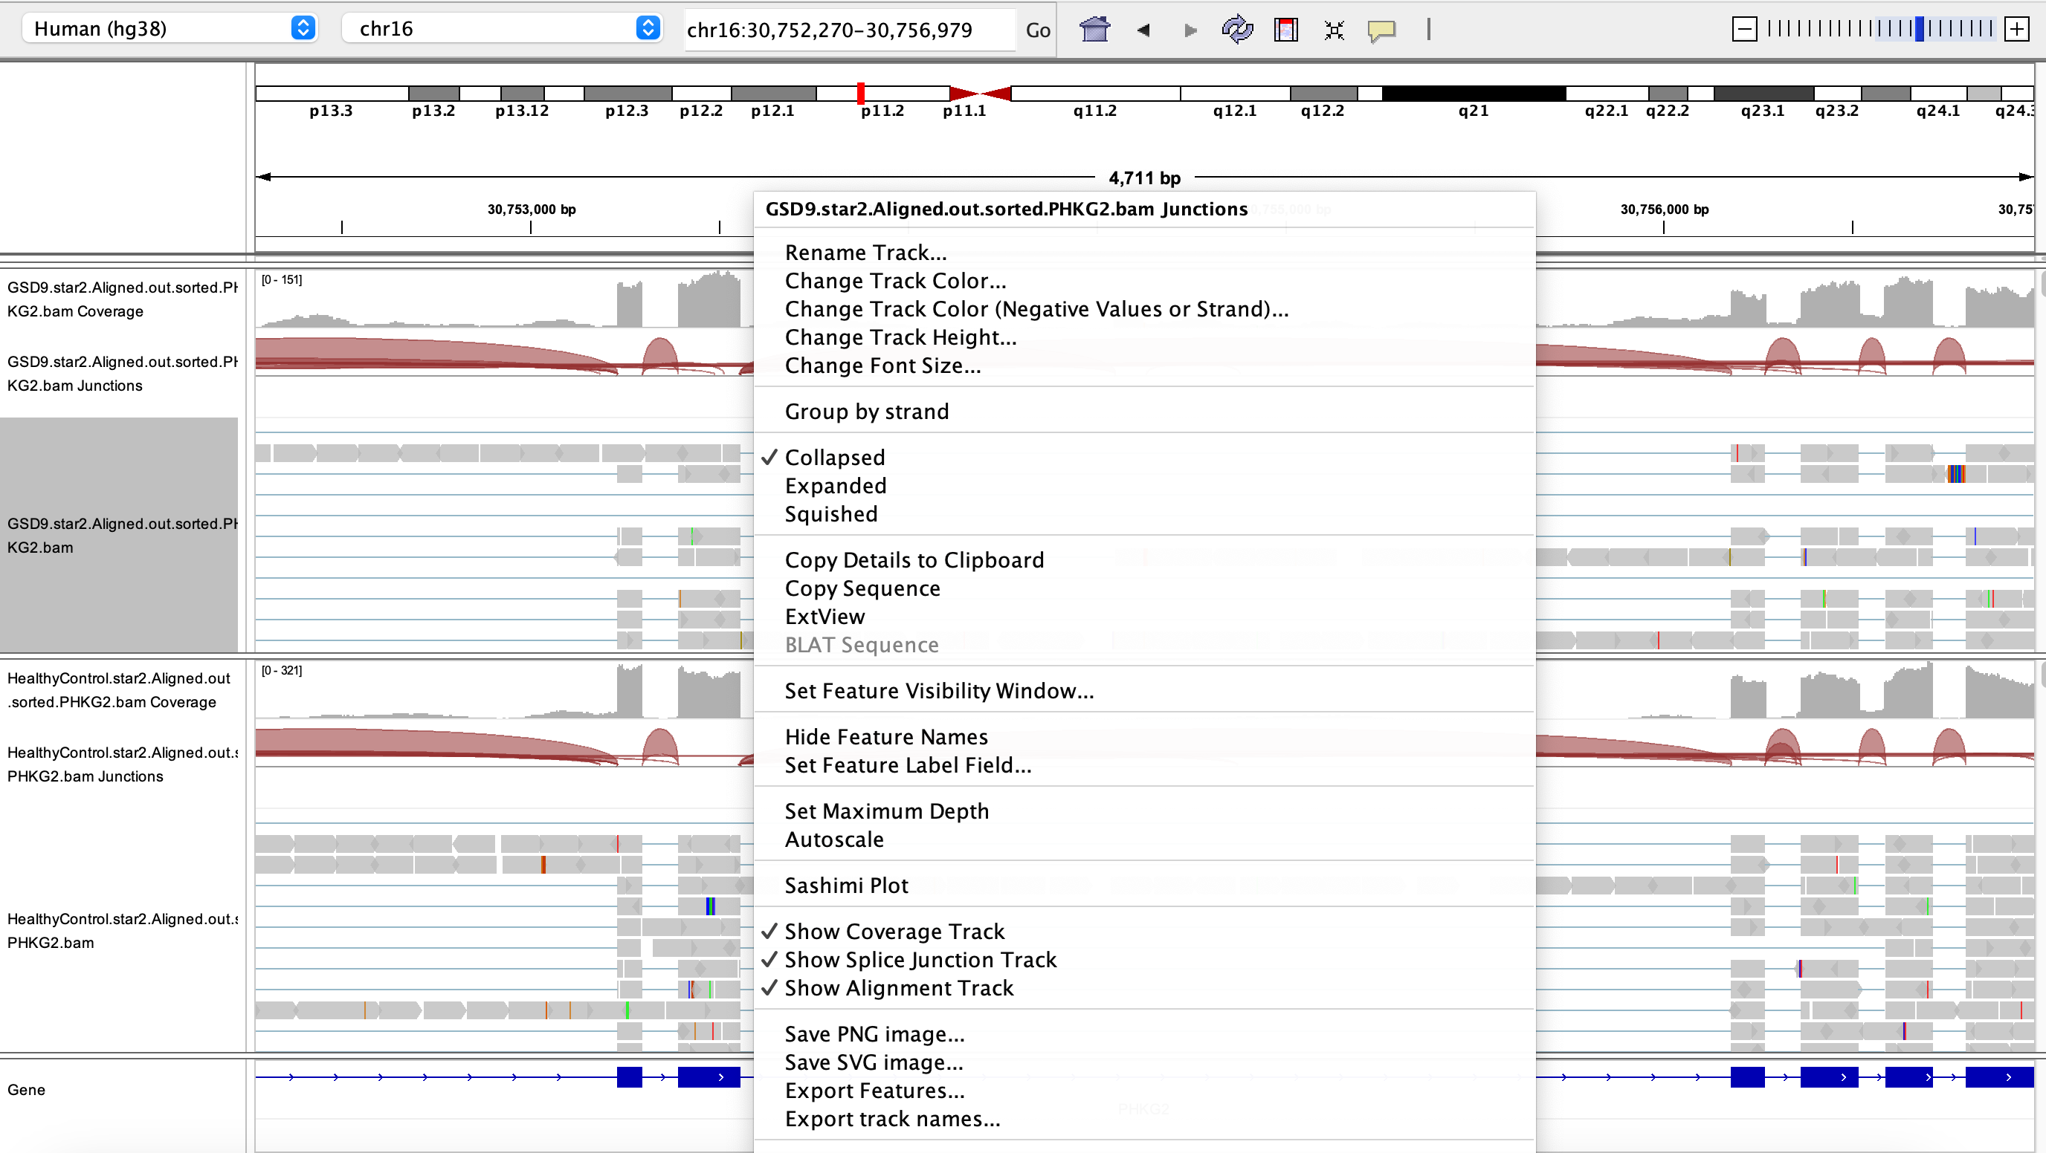
Make a sashimi plot to further examine splicing
Right click -> Sashimi plot -> OK

Slide 12
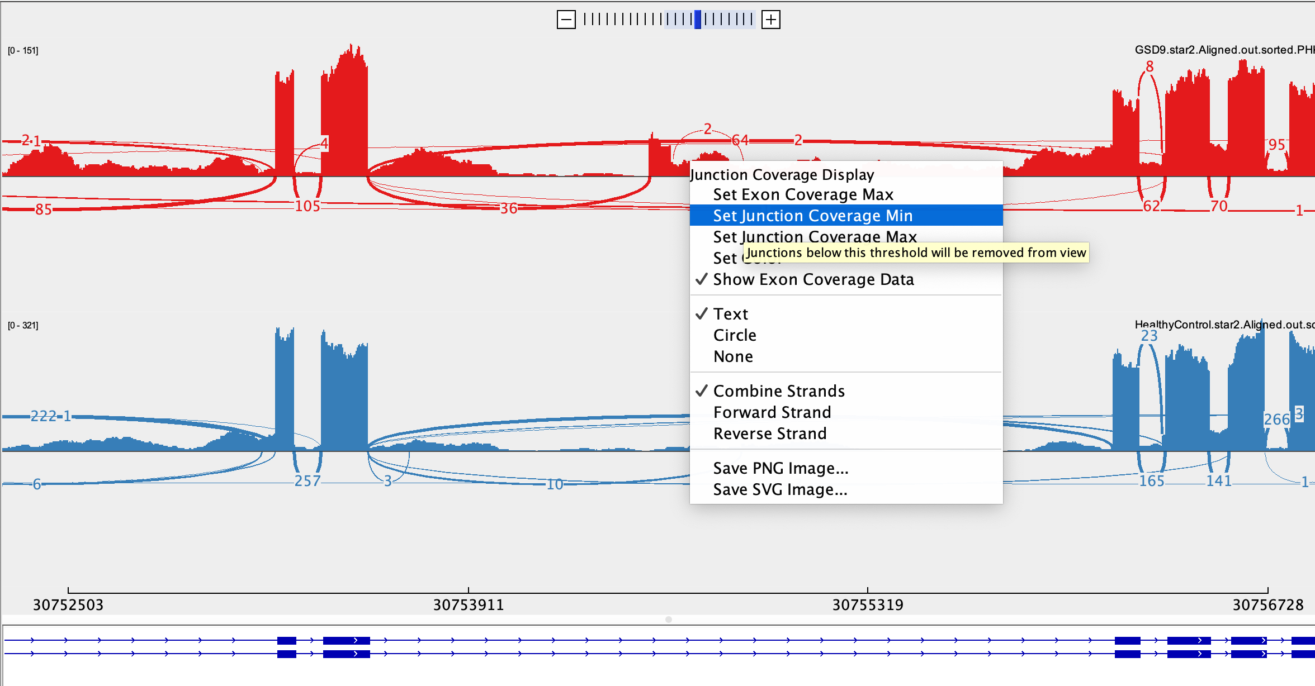
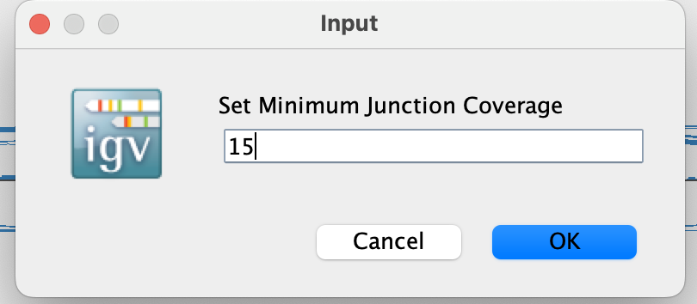
Make a sashimi plot to further examine splicing
Right click on both tracks and set Junction Coverage Min to 15 – this will remove splice junctions that may have only been called due to sequencing or alignment error

Slide 13
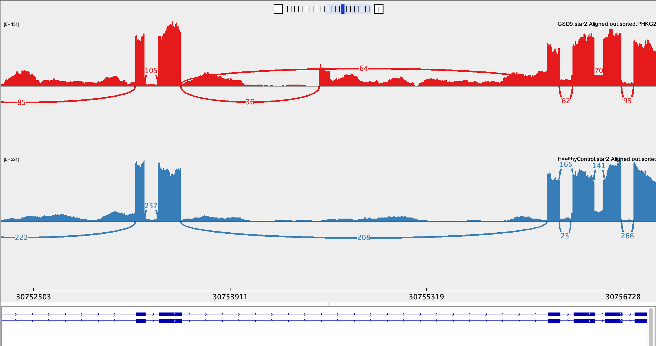
Visualize abnormal splicing
Affected patient
Healthy control

Slide 14
Exercise: Step 1
Look up the following variants in SpliceAI (all hg38):
chr2-60546042-A-AA
chr11-47343158-C-T
chr5-42700794-A-G
For each variant:
Does spliceAI predict function at any level? If so, note
Type (donor gain/donor loss/acceptor gain/acceptor loss)
REF score, ALT score, and delta score for any predicted changes, and what these scores mean
Position of change relative to variant
What gene is this variant in?

Slide 15
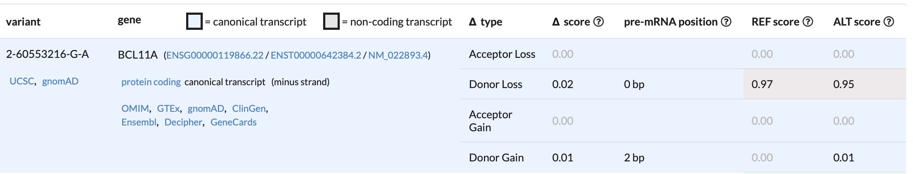
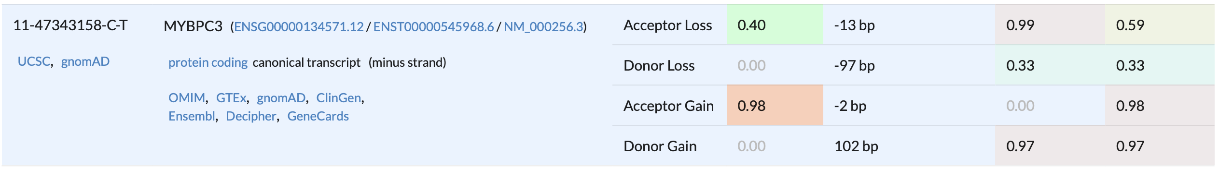
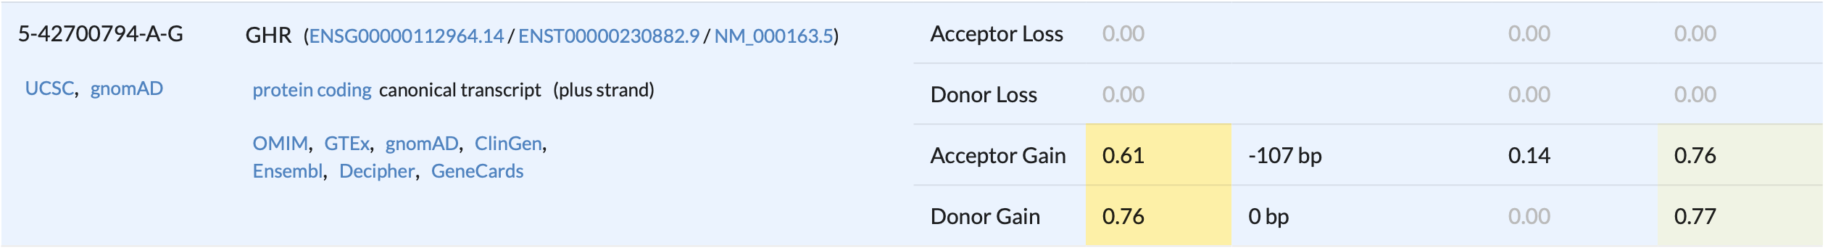
Step 1 - results

Slide 16
Step 2: assess potential effect on mRNA frame
Which variants, if any, have high or moderate delta scores?
For those variants, use donor and acceptor loss/gain positions to calculate how many bases have been lost or gained.
Are these variants predicted to cause frameshift?
If # bases added/subtracted is not divisible by 3, the frame will change
If # bases added is divisible by 3, there will not be frame change
Notes:
Bill talked a lot about cascading effects of splicing, especially frame change

Slide 17
Step 2: assess potential effect on mRNA frame
Which variants, if any, have high or moderate delta scores?
Variants 2 and 3
For those variants, use donor and acceptor loss/gain positions to calculate how many bases have been lost or gained.
Variant 2 - 11bp exon extension (insertion)
Variant 3 - 107bp pseudoexon (insertion)
Are these variants predicted to cause frameshift?
If # bases added/subtracted is not divisible by 3, the frame will change
If # bases added is divisible by 3, there will not be frame change
Both variants 2 and 3 will cause frameshift
Notes:
Bill talked a lot about cascading effects of splicing, especially frame change

Slide 18
Step 3: Assess disease relevance
Search the genes in OMIM (Online Mendelian Inheritance in Man – catalog of genes and their associated diseases/phenotypes).
https://www.omim.org
For each variant: what is the function of the gene? Is it associated with one or more phenotypes/diseases?
For each variant: what is the potential effect of this variant on human health?

Slide 19
Step 3: Assess disease relevance
Search the genes in OMIM (Online Mendelian Inheritance in Man – catalog of genes and their associated diseases/phenotypes).
https://www.omim.org
For each variant: what is the function of the gene? Is it associated with one or more phenotypes/diseases? Variant 2 – MYBPC3 – Cardiac myosin binding protein C – involved in heart development – associated with cardiomyopathy Variant 3 – GHR – Growth hormone receptor – dwarfism, growth hormone oversensitivity/insensitivity, affects cholesterol levels
For each variant: what is the potential effect of this variant on human health? Frameshift of MYBPC3 and GHR would significantly alter protein function and could lead to (or increase risk of) cardiomyopathy and growth defects, respectively

