Slide 1

Day 3: Consequences of genetic variation
09/26/2023
Apoorva Iyengar

Slide 2
Predicting the function of genetic variants
Important to know the mechanisms underlying a genetic variant – how does it cause disease?
Last week’s exercise using VEP showed how to get a broad sense of how a variant functions
Other resources exist for each specific molecular mechanism
Coding variants/single amino acid changes (ex. SIFT, PolyPhen)
RNA stability (ex. UTRannotator)
Transcriptional regulation (ex. overlaps with ENCODE regulatory peaks)
Splicing (ex. SpliceAI)

Slide 3
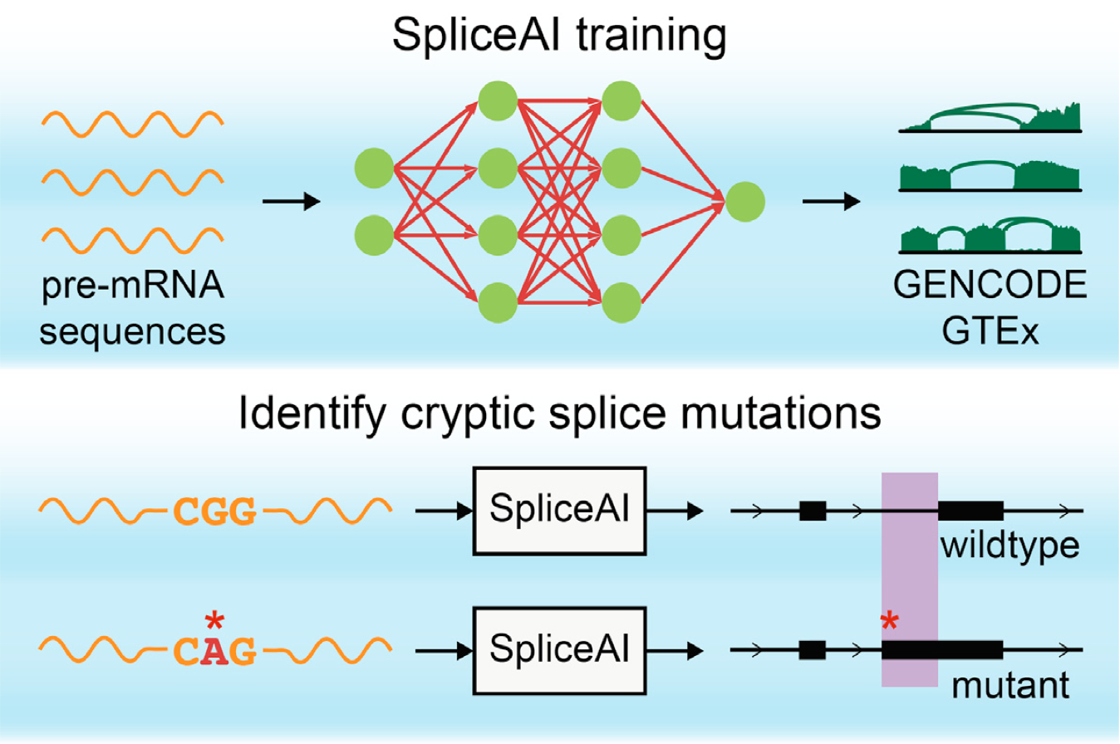
Intro to SpliceAI
Splicing prediction tool with a web interface
Predicts where a pre-mRNA nucleotide sequence may:
Contain a new splice donor or acceptor
Disrupt a canonical splice donor or acceptor
Jaganathan (2019) Cell

Slide 4
Using SpliceAI
Navigate to https://spliceailookup.broadinstitute.org
Enter 1 variant at a time in the following format: chr#-pos-ref-alt
Ex. chr16-30751095-G-A (hg38)
Make sure position and genome build match
Hit “Submit”

Slide 5
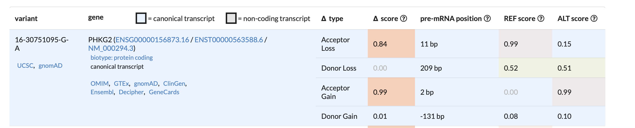
SpliceAI example: PHKG2
Gives a score and a position (relative to the variant) for loss or gain of a splice donor/acceptor
Example prediction in PHKG2:
REF/ALT scores: probability that this position is a splice acceptor or donor using the reference or alternate variant
Delta score = |REF – ALT|
< 0.2 = low confidence (green)
0.2 – 0.8 = moderate confidence (yellow)
> 0.8 = high confidence (red)

Slide 6
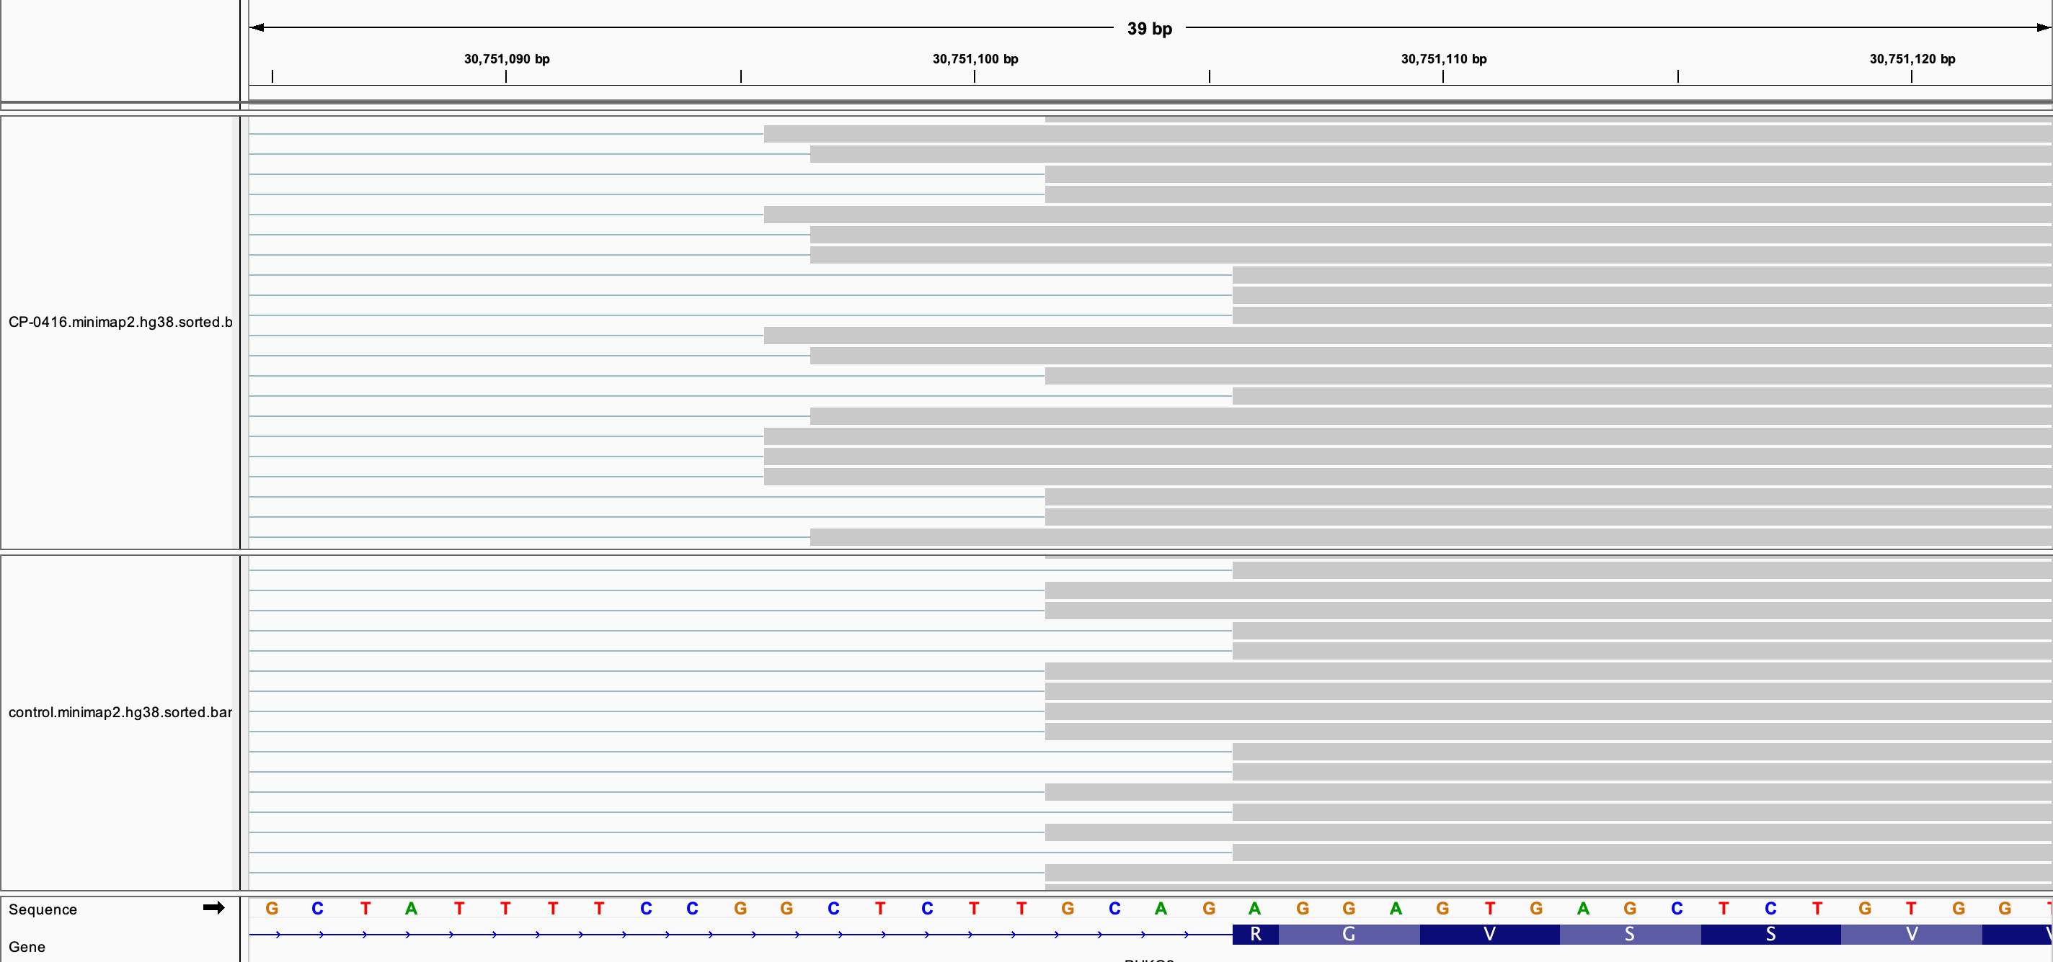
IGV browser view of PHKG2 SpliceAI prediction
Splice acceptor gain
(+2bp)
Splice acceptor loss
(+11bp)
Affected patient (heterozygous)
Healthy control
G>A variant

Slide 7
Exercise: Step 1
Look up the following variants in SpliceAI (all hg38):
chr2-60546042-A-AA
chr11-47343158-C-T
chr5-42700794-A-G
For each variant:
Does spliceAI predict function at any level? If so, note
Type (donor gain/donor loss/acceptor gain/acceptor loss)
REF score, ALT score, and delta score for any predicted changes, and what these scores mean
Position of change
What gene is this variant in?

Slide 8
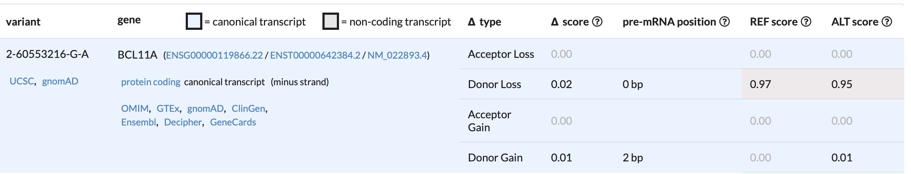
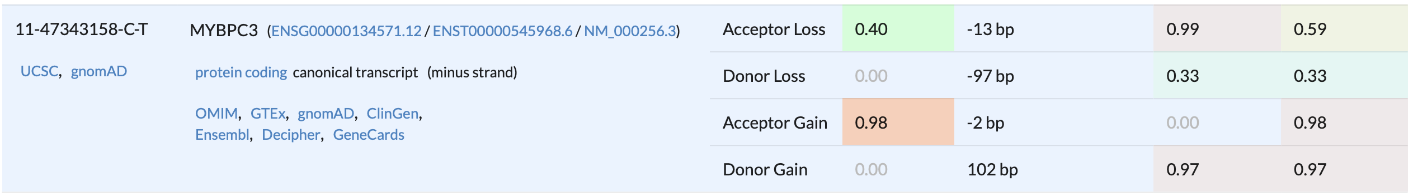
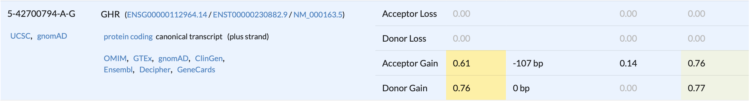
Step 1 - results

Slide 9
Step 2: assess potential effect on mRNA frame
Which variants, if any, have high or moderate delta scores?
For those variants, use donor and acceptor loss/gain positions to calculate how many bases have been lost or gained.
Are these variants predicted to cause frameshift?
If # bases added/subtracted is not divisible by 3, the frame will change
If # bases added is divisible by 3, there will not be frame change
For any variant

Slide 10
Step 3: Assess disease relevance
Search the genes in OMIM (Online Mendelian Inheritance in Man – catalog of genes and their associated diseases/phenotypes).
https://www.omim.org
For each variant: what is the function of the gene? Is it associated with one or more phenotypes/diseases?
For each variant: what is the potential effect of this variant on human health?

