Slide 1

Day 4: Gene regulation
10/3/2023
Makenzie Beaman

Slide 2
Different sequencing data types give us complementary information
DNA sequencing – patient mutations, structural variants, differences between species / individuals
RNA sequencing – gene expression, gene regulation, transcription consequences, identity of isoforms
By combining these datasets, we can understand the impact of patient variants and genomic features on gene expression

Slide 3
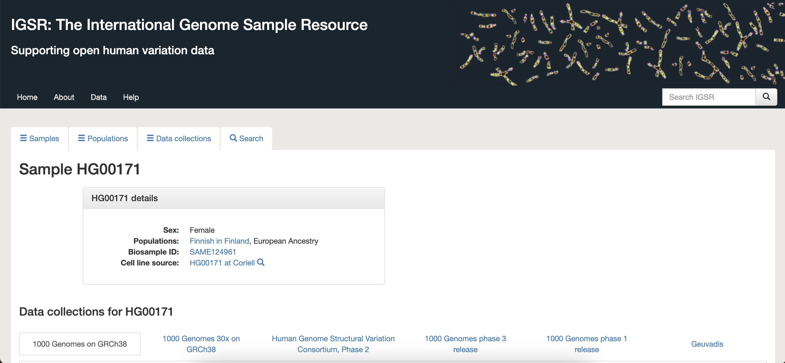

Slide 4


Distinguishing RNA from DNA in the genome browser
Load exercise4_file1.bam and exercise4_file2.bam into IGV
Navigate to the gene AMPD3 using the search bar.
Explore the region. What are some features of each of the tracks that you notice?

Slide 5
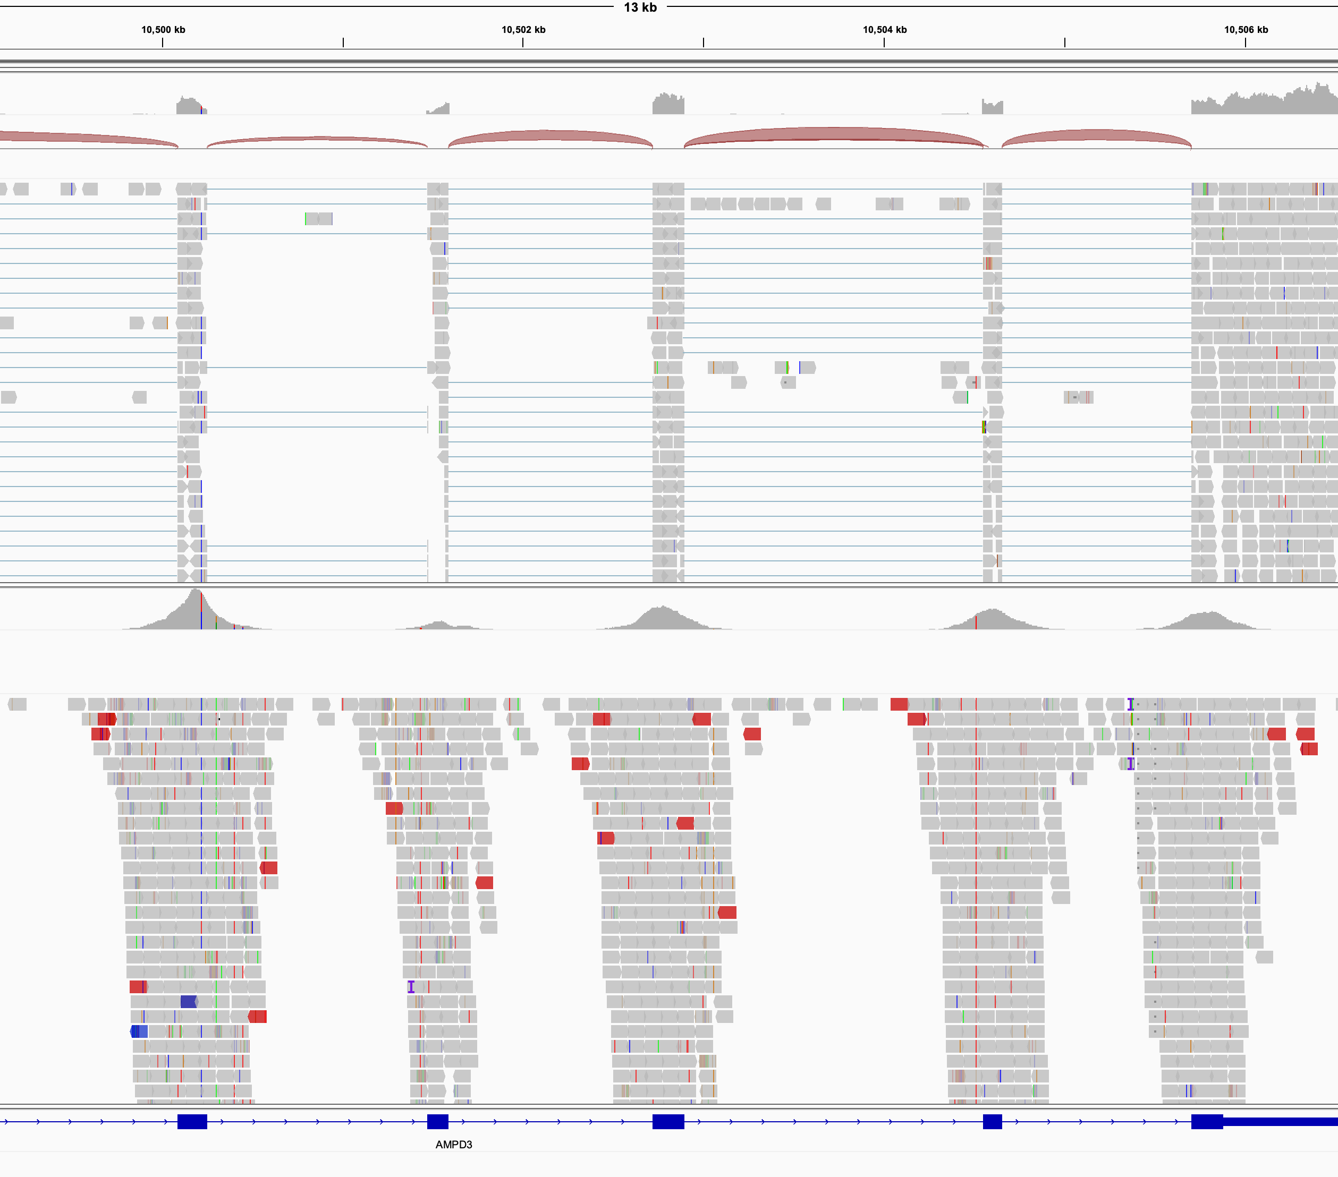

Slide 6
strict cutoff at exon boundaries
splice junctions
reads spanning multiple exons
normal distribution of read depth
reads in intronic regions

Slide 7
strict cutoff at exon boundaries
splice junctions
RNA
reads spanning multiple exons
normal distribution of read depth
reads in intronic regions
DNA

Slide 8
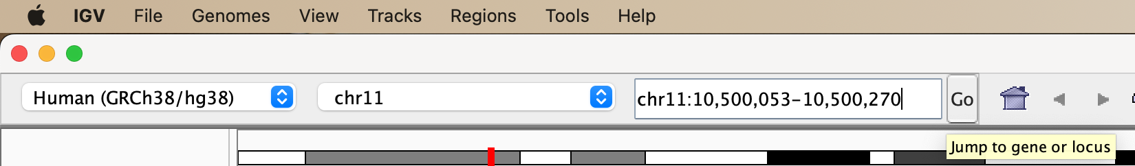
Measuring relative expression of alleles
Navigate to exon 11 of AMPD3
Can you find any single nucleotide polymorphisms which might help us identify alleles?

Slide 9
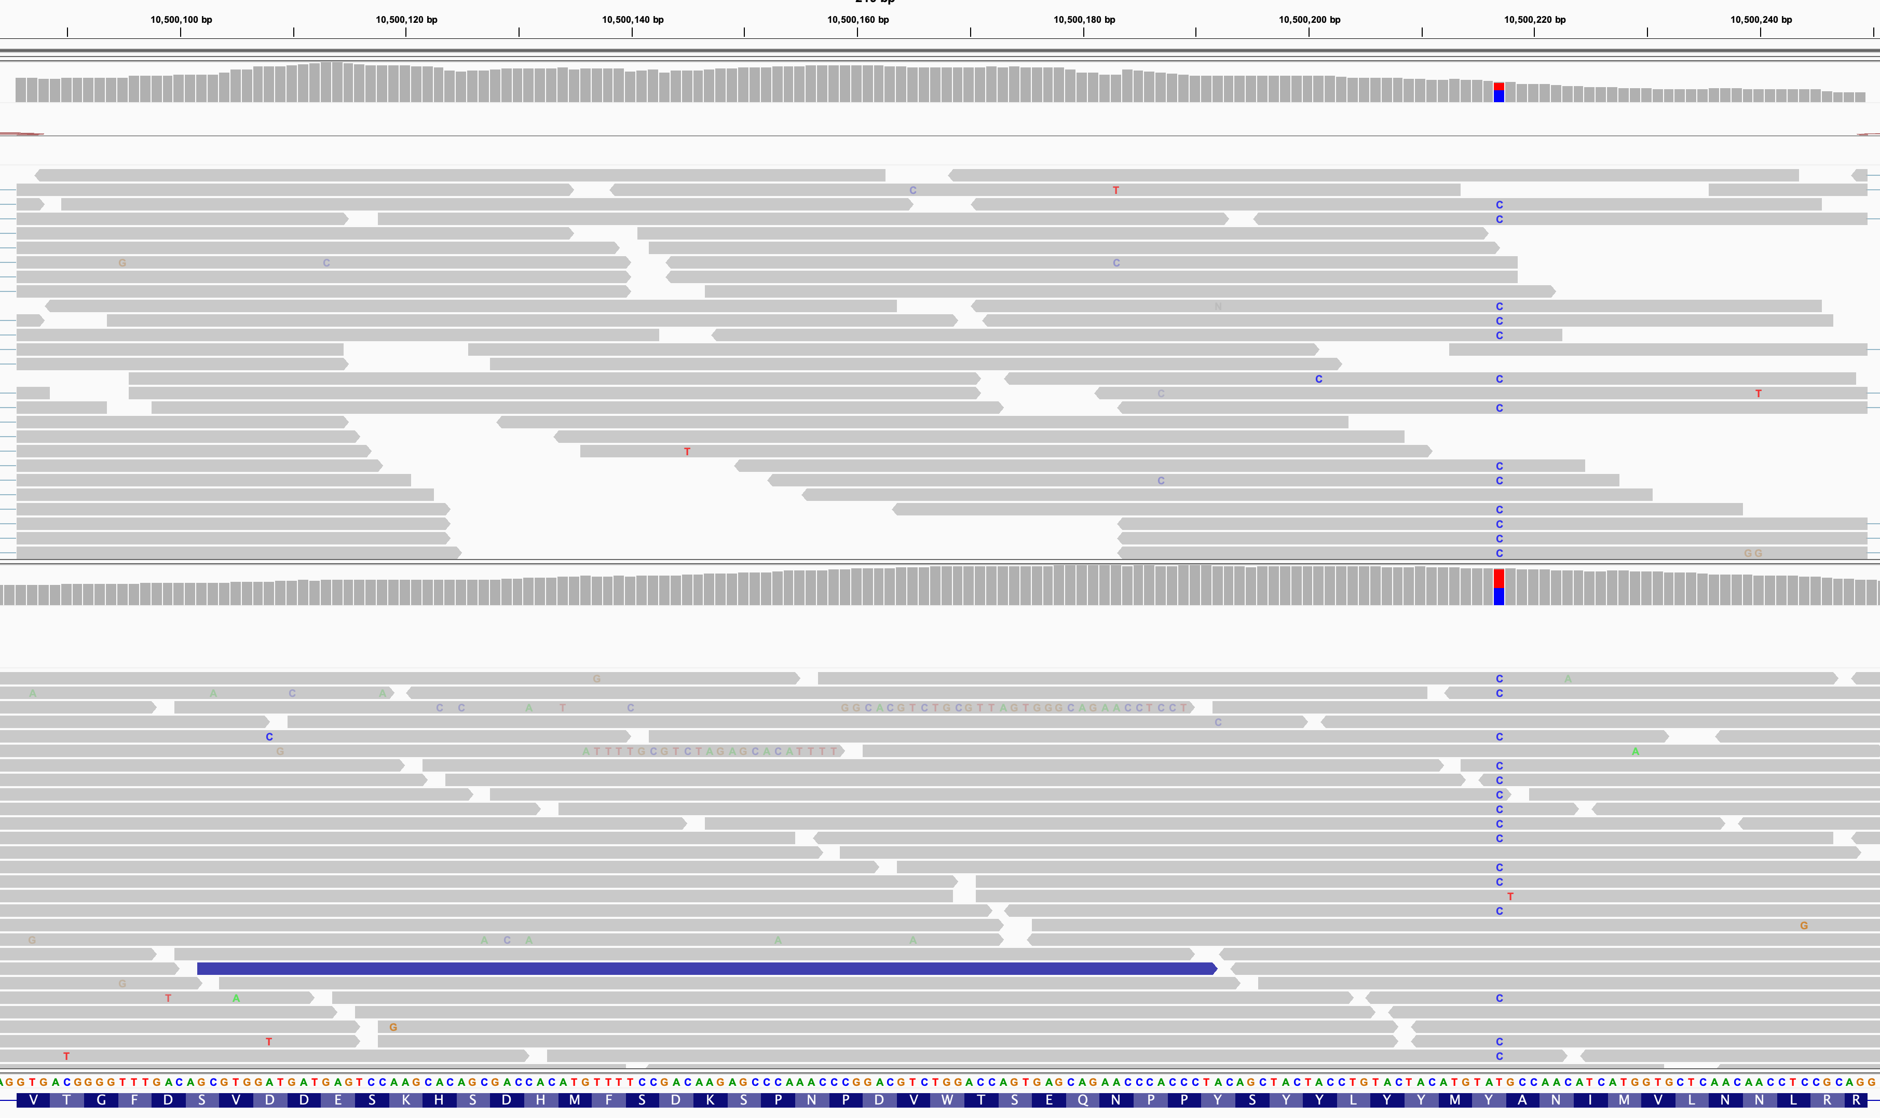
Measuring relative expression of alleles
RNA
DNA

Slide 10
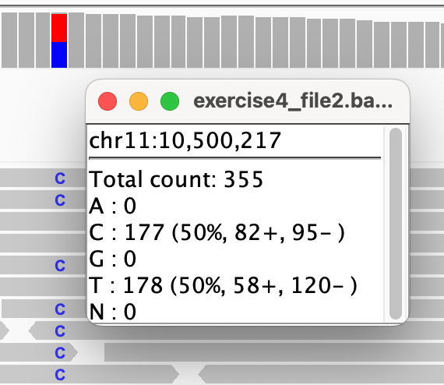
Measuring relative expression of alleles
Click on the coverage track for the SNP in the DNA track (exercise4_file2.bam)
What is the relative expression in DNA for each allele?
Is this a heterozygous or homozygous variant?

Slide 11
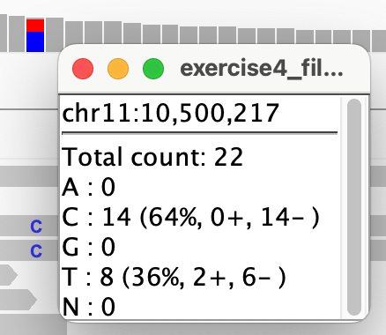
Measuring relative expression of alleles
Click on the coverage track for the SNP in the RNA track (exercise4_file1.bam)
What is the relative expression in RNA for each allele?
Are both alleles expressed at this locus?

Slide 12
Cases where both alleles are not expressed
What can lead to monoalellic or imbalanced expression?

Slide 13
Cases where both alleles are not expressed
What can lead to monoalellic or imbalanced expression?
Deletion
Structural variant
Transcript degradation (nonsense mediated decay)
Improper gene regulation
Imprinting

Slide 14
Molecular imprinting
Exclusive expression of only the maternal or paternal allele
Methylation of regulatory elements
Many imprinted genes regulated cell growth
Cause of numerous human diseases

Slide 15
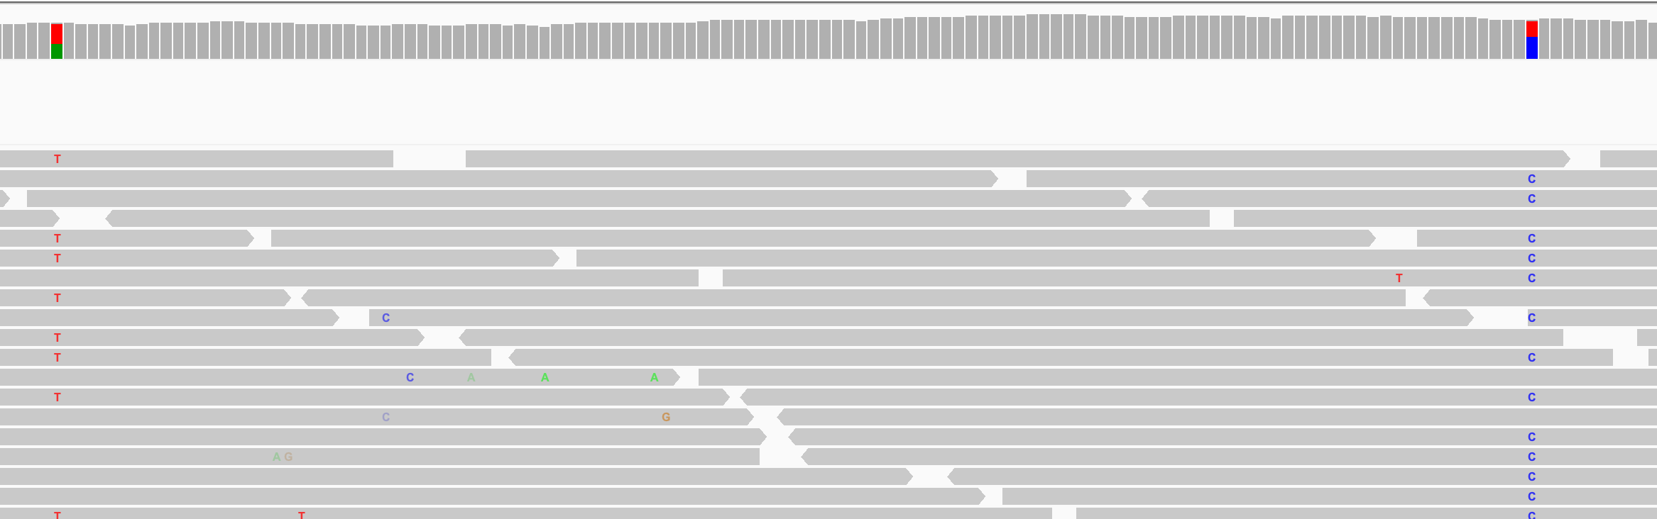
Find imprinted loci in IC2 (11p15.5)
ZNF215
chr11:6,955,755-6,956,010

Slide 16

Find imprinted loci in IC2 (11p15.5)
ZNF215
chr11:6,955,755-6,956,010
DNA
RNA

Slide 17
Other ways we utilize DNA and RNA data to understand disease
altered gene expression levels
altered gene splicing
understanding effects of new variants

Slide 18


Contact me if you’d like to chat more!
GSP Slack: Makenzie Beaman
E-mail: mmb95@duke.edu

