Slide 1

GENOMICS SEMINAR
Rasheed Gbadegesin, MD
October, 2023

Slide 2



Background
Significant racial disparity in the incidence/severity of CKD
People of African ancestry make up ~13% of the US population but:
They constitute ~35% of the ESKD population
~70% of patients with FSGS
GENERAL US POPULATION
US ESKD POPULATION
US FSGS POPULATION
AA
OTHERS

Slide 3
Background
Drivers of disparity
Structural racism
Mistrust of the health system
Disparity in care/Implicit bias
Environmental/social determinants of health
Biologic and genetic factors
Freedman et al. The familial risk of end-stage renal disease in African Americans. Am J Kidney Dis. 1993 Apr;21(4):387-93. PMID: 8465818.

Slide 4
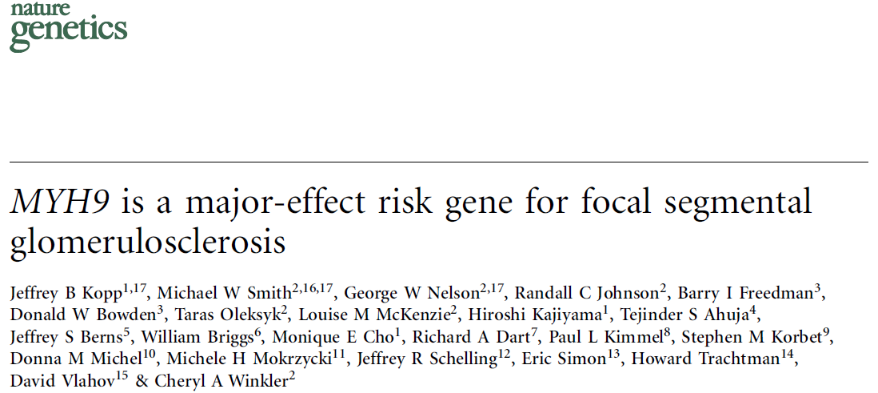
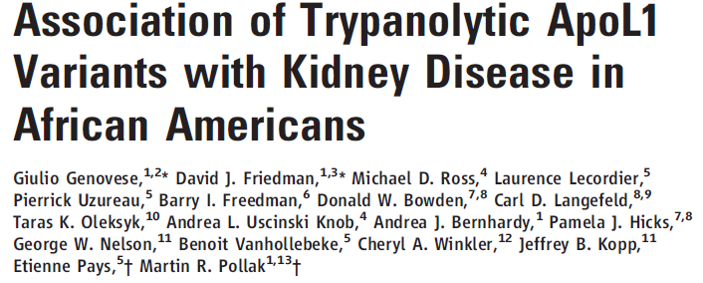
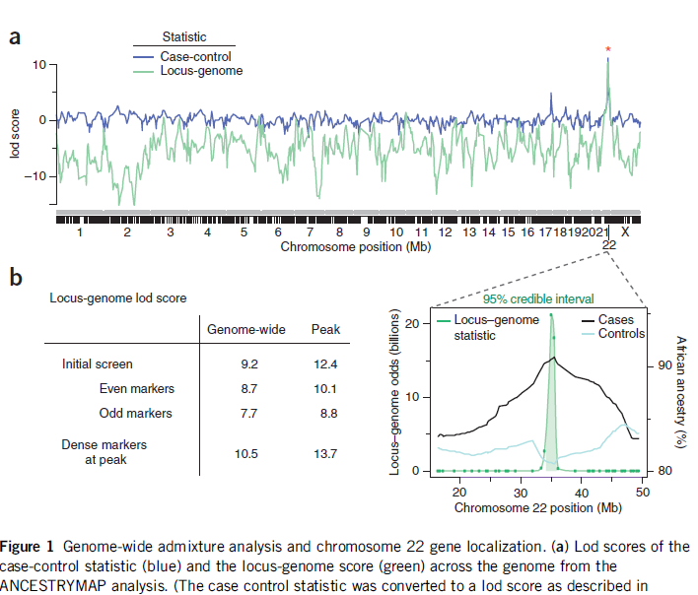
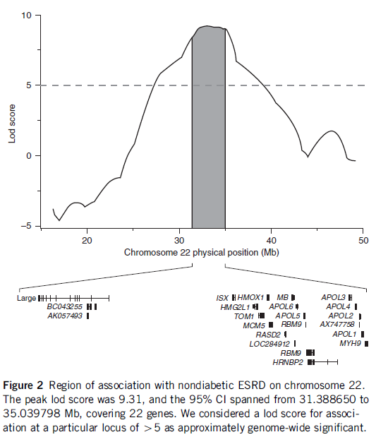
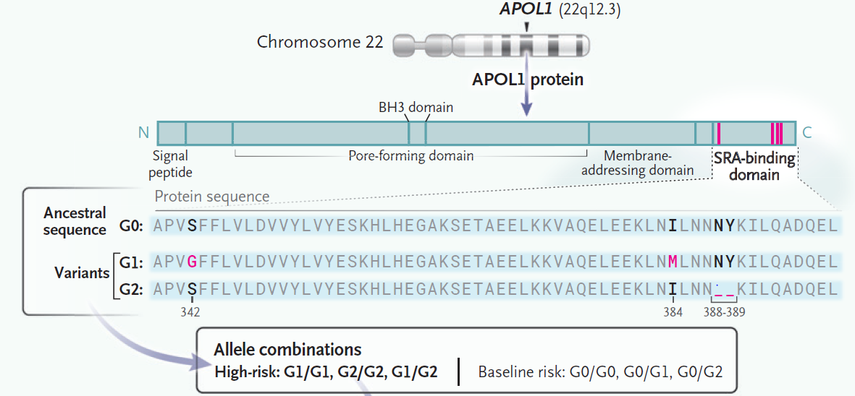
Background
Importance of genetic contribution: ID of risk variants in APOL1 as major contributing factor to excess risk of non-diabetic CKD in Africans and Africans in diaspora.
Hypothesis: Dx risk alleles in larger interval because of longer LD in SNP undergoing selection
Further analysis expanded region: ID of SNP in APOL1
N Engl J Med. 2023 Mar 16;388(11):1045-1049
GWAS: Mapping by Admixture Linkage Disequilibrium (MALD)
Variants in MYH9 associated with FSGS p=4 x10⁻²³

Slide 5
Background
Homozygous/Compound heterozygous variants in APOL1 (G1/G1, G1/G2, G2/G2) major driver of excess of CKD in AA
G1 and G2 likely rose to high population prevalence because of protection against deadly trypanosome in Africa thousands of years ago
New disease nomenclature:
?APOL1 mediated kidney disease (AMKD)

Slide 6
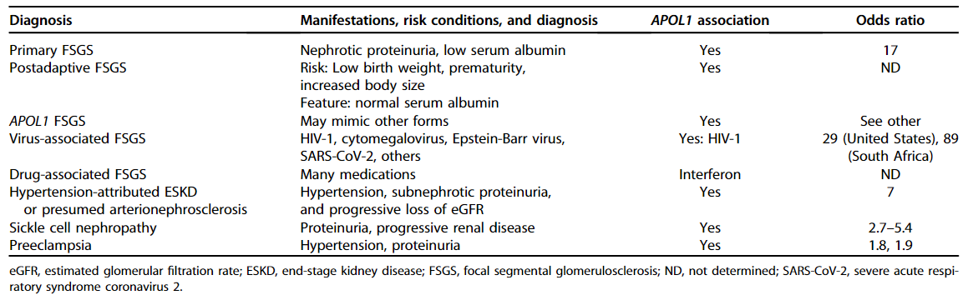
Background
PUBMED: APOL1 and kidney 731 pubs (9/21/2023)
APOL1 associated kidney diseases
Kidney Int. 2021 Jun;99(6):1296-1302
Large effect size for a common variants: APOL1 Mediated Kidney Disease (AMKD)

Slide 7
Background
13% of AA carry the high risk genotype
Could be up to 25% in some West African population
The lifetime risk for developing CKD in people with high risk genotype is 15%
Identification of specific therapeutic target for APOL1
Major impact on CKD burden (Rx and prevention)
Reduce disparity in prevalence and severity of CKD

Slide 8
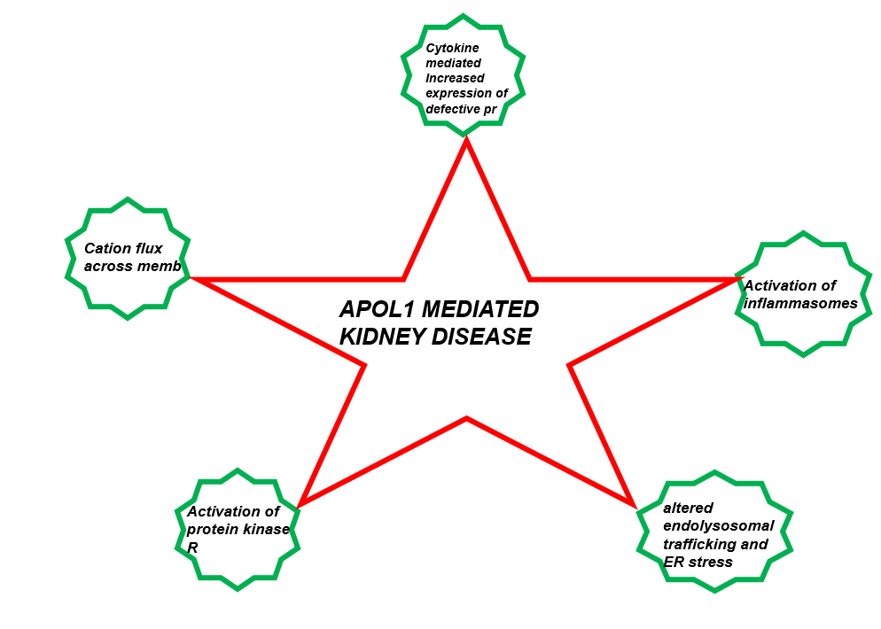
Therapeutic targets
Disease mechanisms
Immune effector protection against trypanosome in human and non-human primates
APOL1 G1/G2 variants cause trypanolysis and protection against deadly African sleeping sickness
G1/G2 form pores in mammalian cells: cation flux, cytotoxicity

Slide 9
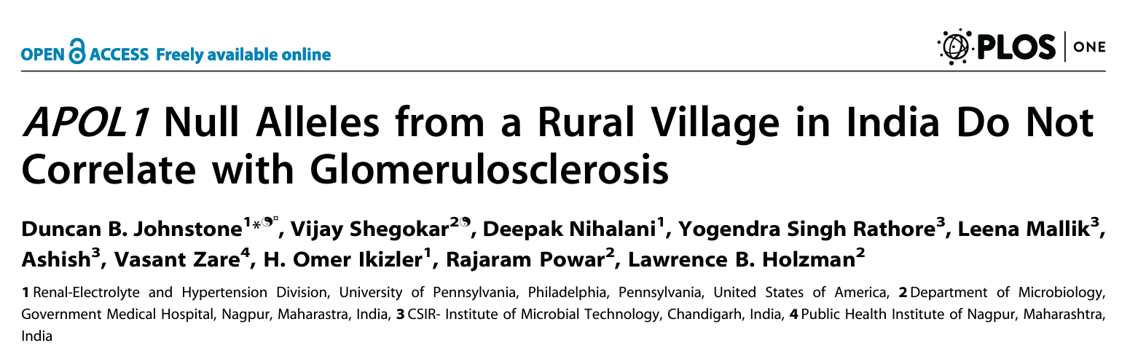
Therapeutic targets
APOL1 null is not lethal and compatible with normal life span
Targeting the effects of APOL1 may have only limited off target effects

Slide 10

Therapeutic targets
JAK/STAT inhibitor
APOL1 antisense oligo (ASO)
Inaxaplin (VX-147)

Slide 11
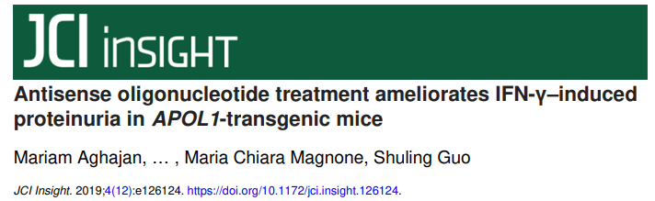
Therapeutic targets: ASO
Generated APOL1 transgenic mice (G0/G1): Rodents do not have APOL1 gene!!
Induced kidney disease with IFN-γ
Treated mice with antisense oligonucleotide (ASO) targeting APOL1 mRNA

Slide 12
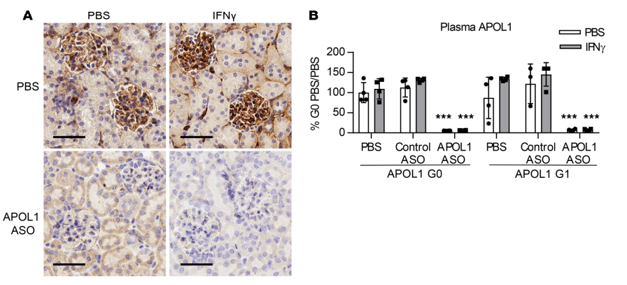
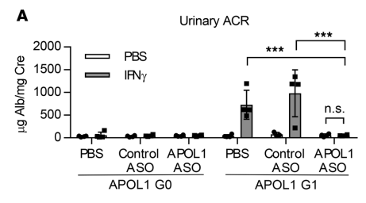
Therapeutic targets: ASO
APOL1 ASO reduces kidney and plasma APOL1 protein levels
APOL1 ASO prevents IFN-γ–induced proteinuria IN APOL1 G1 Mice
Human Phase 1 trial completed: Awaiting results

Slide 13
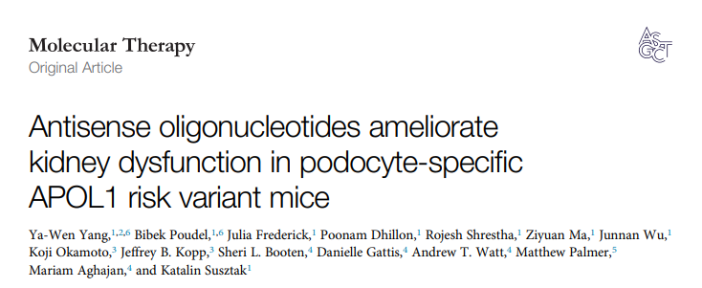
Therapeutic targets: ASO
Molecular Therapy Vol. 30 No 7 July 2022

Slide 14
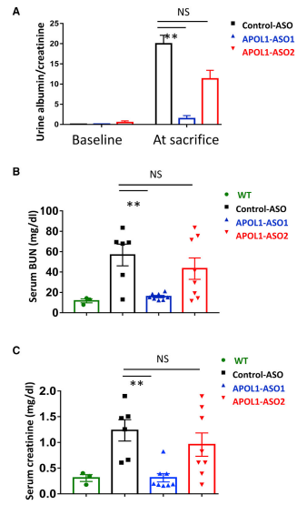
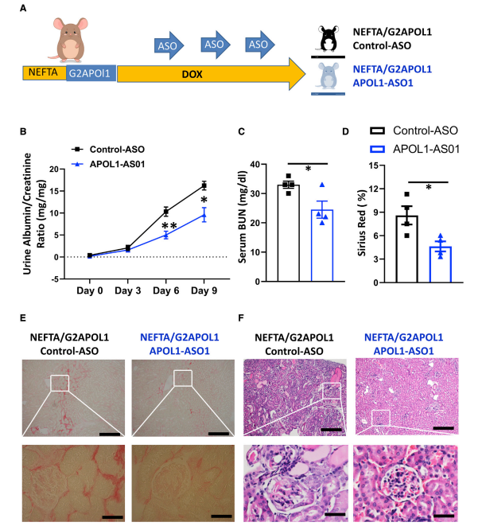
Therapeutic targets: ASO
APOL1 ASO1 improves kidney function in G2 APOL1 transgenic mice
APOL1 ASO1 improves kidney function and fibrosis in G2 APOL1 transgenic mice with established kidney disease

Slide 15
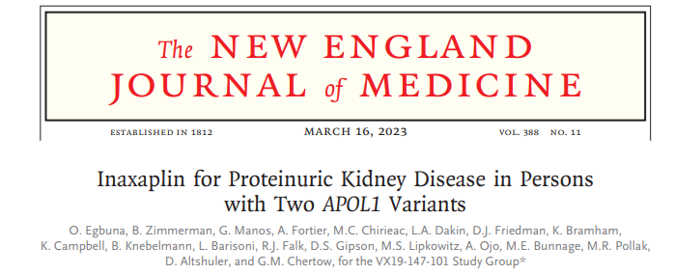
Therapeutic targets: Inhibitor of cation flux
N Engl J Med. 2023 Mar 16;388(11):969-979

Slide 16
Therapeutic targets: Inhibitor of cation flux
Phase 2a clinical trial
Inaxaplin a small molecule that inhibits APOL1 mediated pore formation and aberrant channel-mediated ion flux in cells
Studies
In vitro: Test the effect of inaxaplin on channel function in tetracycline-inducible APOL1 HEK293 cell line
Animal study: APOL1 G2–homologous transgenic mouse model of proteinuric kidney disease was used to assess inaxaplin treatment for proteinuria.
Human study: Single-group, open-label, phase 2a clinical study of inaxaplin in 13 patients with two APOL1 variants, FSGS, and proteinuria

Slide 17
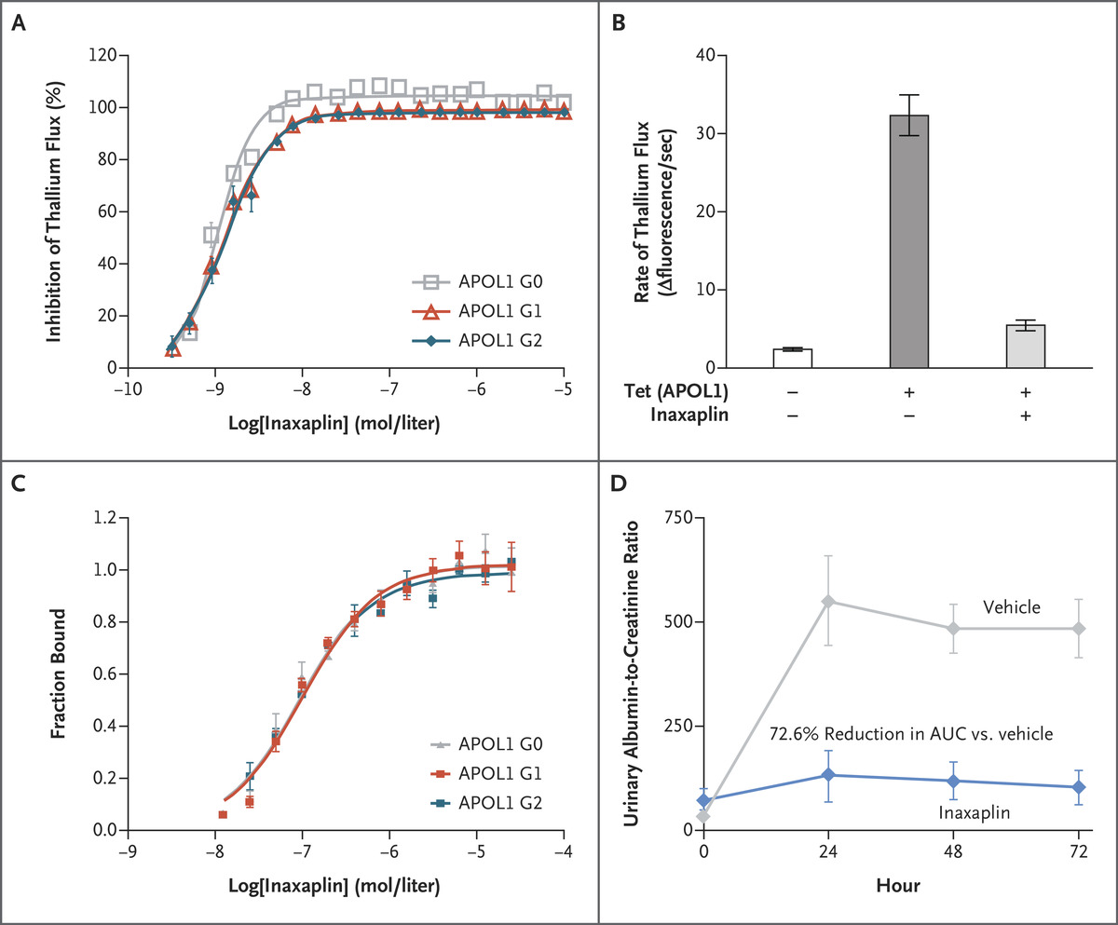
Therapeutic targets: Inhibitor of cation flux
B: Inaxaplin reduces cation influx in transgenic APOL1 G2 HEK293 cell line
D: Inaxaplin reduces interferon gamma–induced proteinuria in
APOL1 G2 transgenic mice.

Slide 18
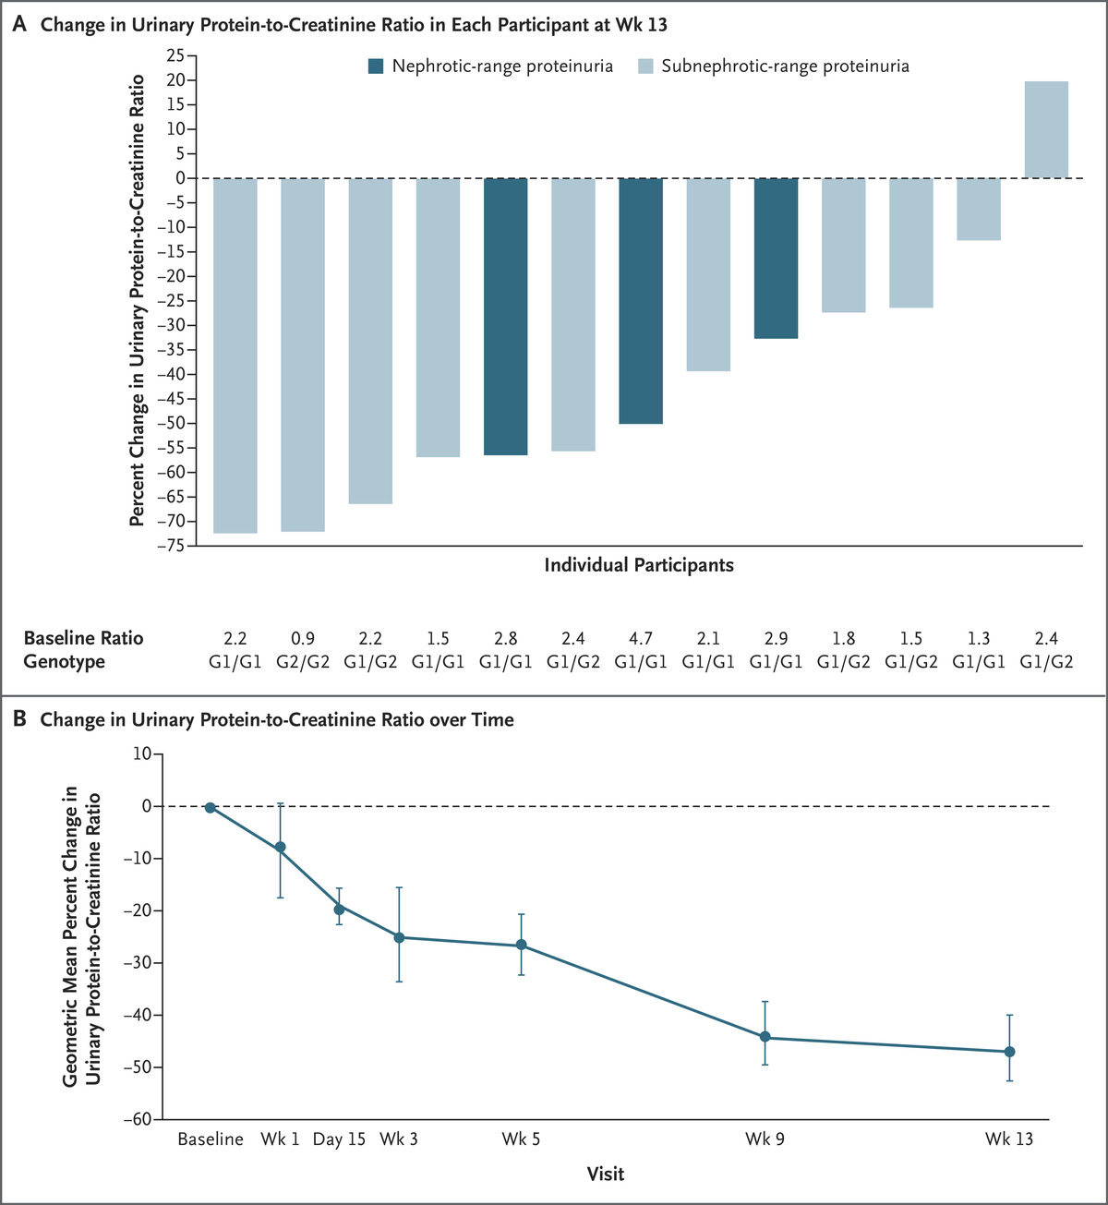
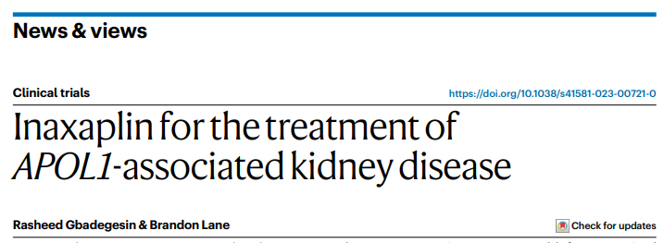
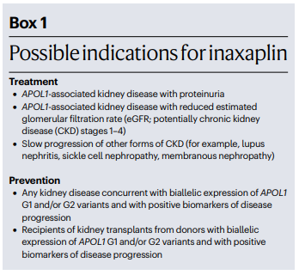
Therapeutic targets: Inhibitor of cation flux
Inaxaplin reduces proteinuria in 12/13 patients with FSGS and proteinuria
Reduction in proteinuria sustained over 13 weeks of follow up
Ongoing Phase 2/3 clinical trials

Slide 19
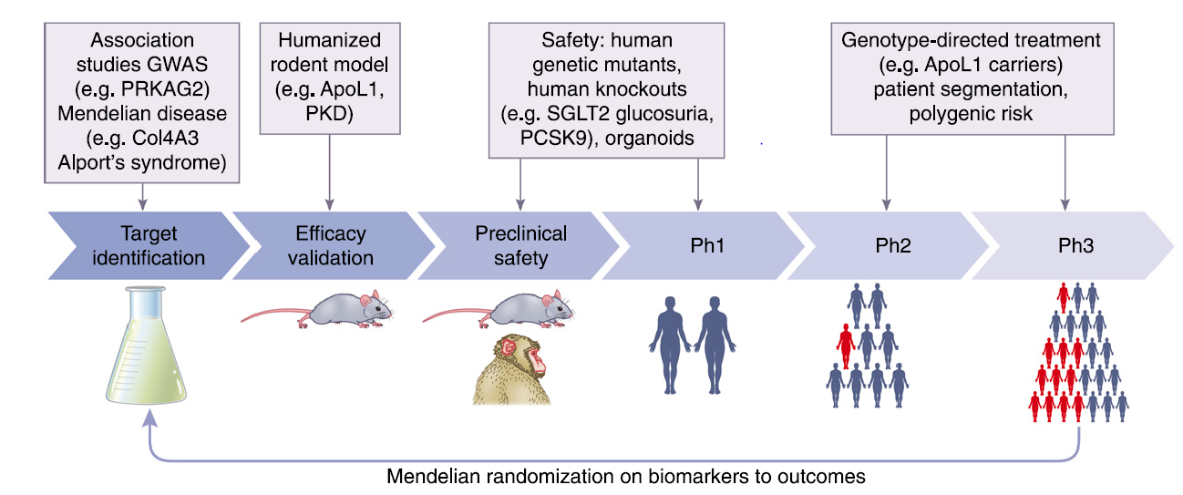
Therapeutic targets
Genomic target (APOL1) <10 years
Traditional target ID: ~20-30 years
In <10 years after discovery of APOL1 CKD variants (G1/G2), we now have at least three agents in clinical trial.
This demonstrates clearly the power of genomics in drug discoveries

Slide 20


