Slide 1
The role of APOL1 in Sickle Cell Nephropathy
Allison Ashley-Koch, Ph.D.
Professor
Duke Molecular Physiology Institute
Department of Medicine
Duke University Medical Center

Slide 2
SCD is common, chronic and causes significant morbidity
SCD affects 1/375 African Americans in the US.
A single amino acid substitution of valine for glutamic acid in position 6 of the β globin gene causes HbS.
Over 90% of children born with HbSS in the US now survive to adulthood.
Nonetheless, shortened RBC survival and hemolysis, as well as vaso-occlusion lead to significant morbidity.

Slide 3
Kidney Dysfunction in SCD
Renal failure occurs in 5-18% of adult SCD patients.
Mortality due to chronic renal failure in adult SCD patients is about 10.5% (Platt, et al 1994).
Proteinuria is the earliest sign of sickle cell nephropathy and occurs in about 30% of adult patients.
Existing therapies for SCD and CKD have limited to no effect on sickle cell nephropathy.
Transfusion, HU, ACEi, Stem cell transplant
Notes:
Kidney dysfunction is a relatively common complication of SCD. Overt kidney failure occurs in as much as 20% of patients and there is a high degree of mortality associated with renal failure. Proteinuria, or protein in the urine, is usually the earliest sign that there is a problem.

Slide 4
APOL1 and MYH9 in Sickle Nephropathy
Data set included:
521 unrelated SCD patients
18-83 years, mean = 33.9 years
230 subjects were male
452 patients had HbSS diagnosis (86.76%)
26 SNPs in MYH9 and 2 SNPs (G1 and G2) in APOL1 were genotyped.
Multiple regression analysis evaluated relationship between SNPs and the occurrence of proteinuria and GFR.
Controlled for effect of APOL1 G1 and G2 alleles
Proteinuria = SNP_{APOL1} + SNP_{MYH9}
Ashley-Koch et al. (2011)
Notes:
.

Slide 5
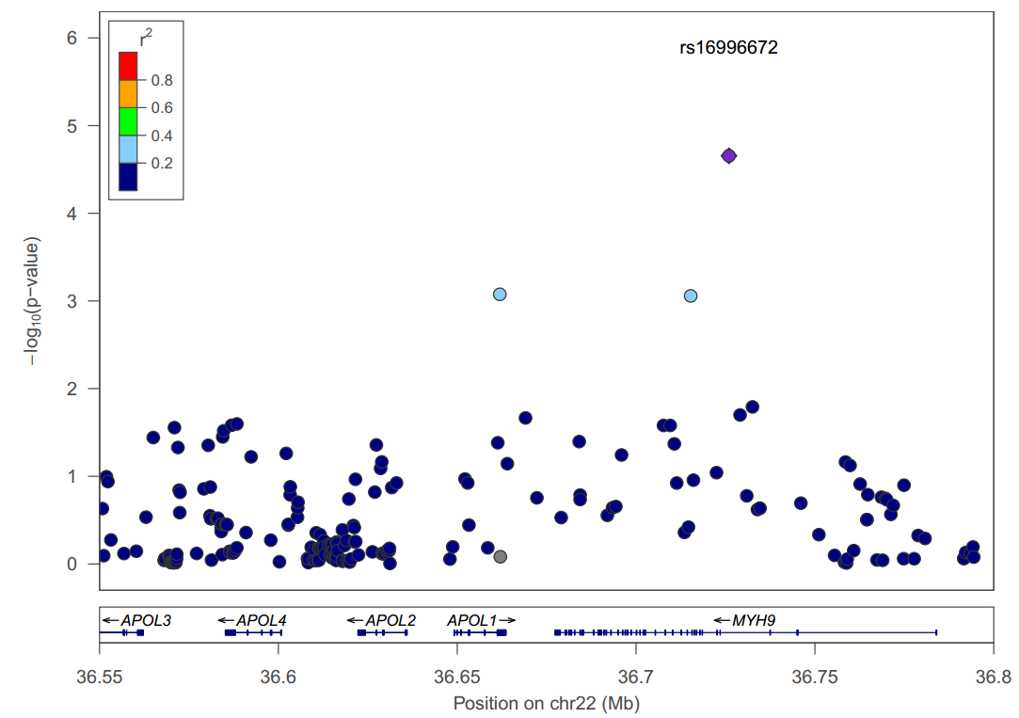
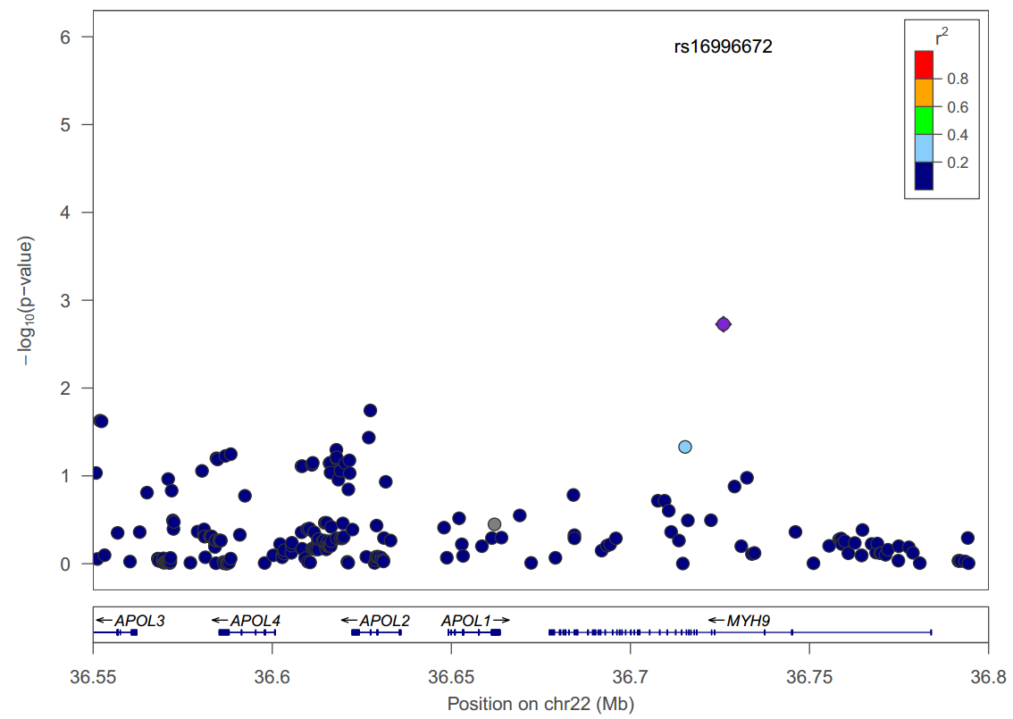
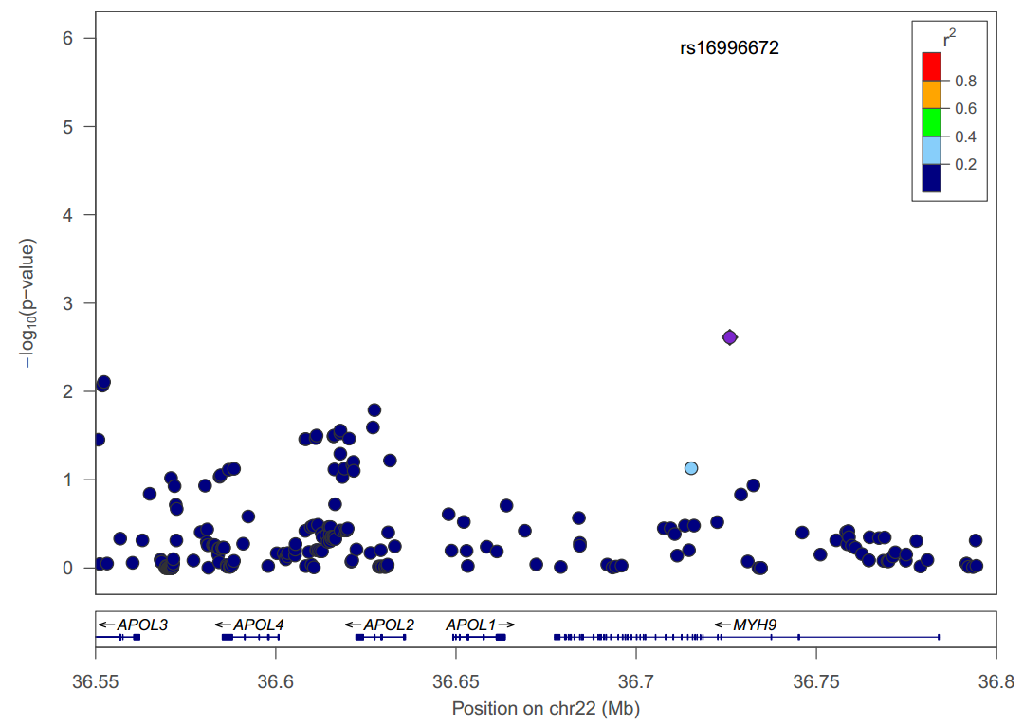
APOL1 and MYH9 Association with Proteinuria
Proteinuria - single marker
Proteinuria – conditional on G1
MYH9 strongest
signal and remained
even when controlling
for APOL1
Proteinuria – conditional on G1 and G2

Slide 6
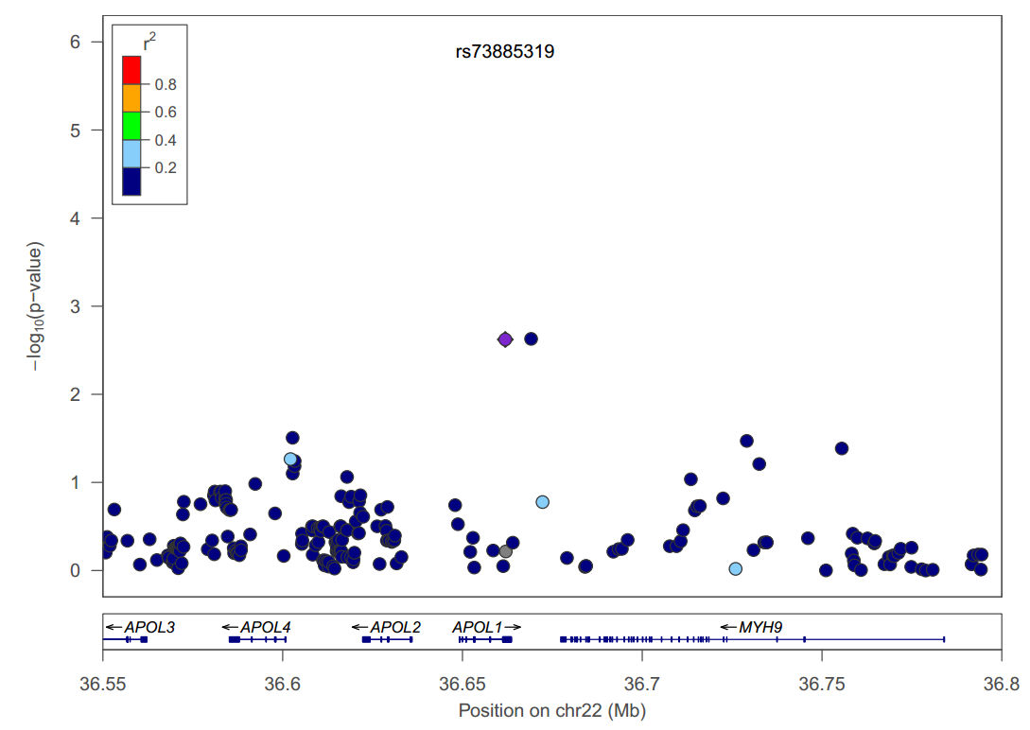
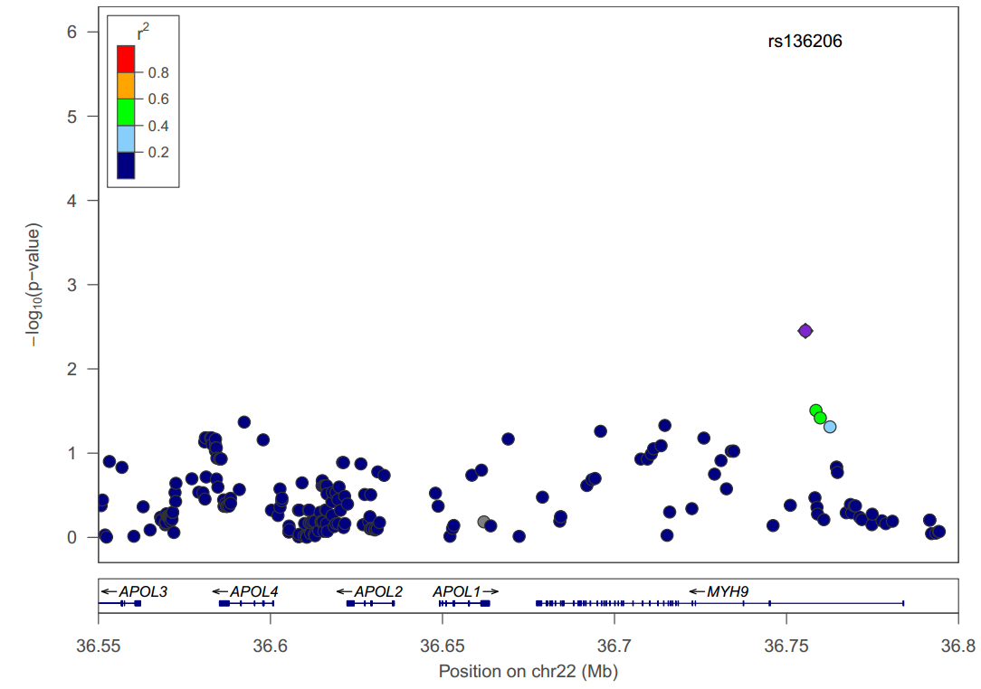
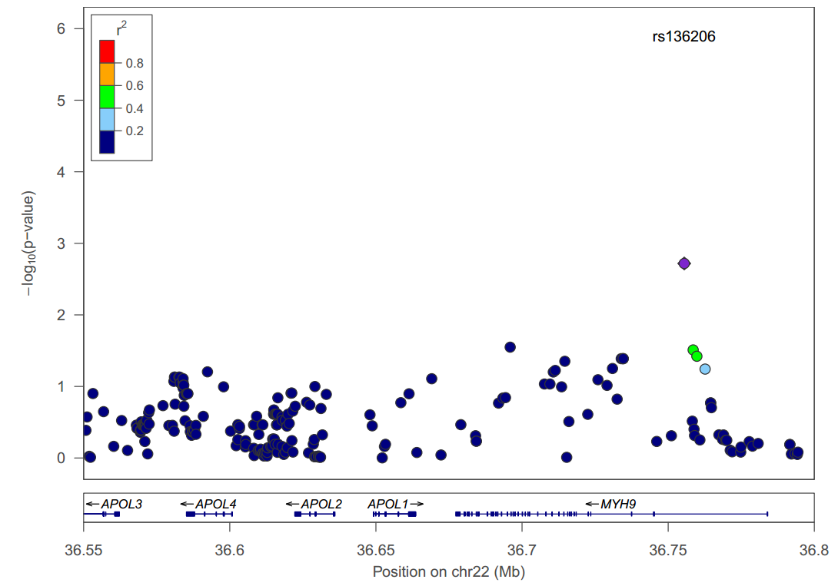
APOL1 and MYH9 Association with Glomerular Filtration Rate
GFR - single markers
GFR– conditional on G1
APOL1 is strongest
signal and MYH9 became stronger when controlling
for APOL1
GFR – conditional on G1 and G2

Slide 7
APOL1 and MYH9 in Sickle Nephropathy
Variation in both APOL1 and MYH9 contribute to risk for proteinuria and also predict GFR in sickle cell patients.
This is different from most other kidney diseases whereby the signal has been attributed to APOL1 only.
Odds Ratio’s were in the range of 2 to 3 for the homozygous risk genotypes in SCD.
These are much smaller than reported for other nephropathies.
OR = 7 for hypertensive kidney disease
OR = 29 for HIV-associated kidney disease
OR = 17 for FSGS
So, while APOL1 plays a role in Sickle Nephropathy, the association is a bit more muted and more complex.

Slide 8
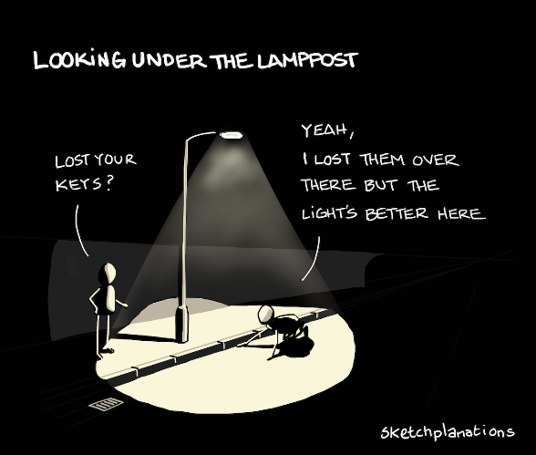
Novel Genetic Risk Factors for Sickle Nephropathy?
Given that the APOL1 and MYH9 associations, although significant, were not as strong, are there other genetic risk factors that we can identify?
Two approaches:
Candidate gene (like APOL1 and MYH9 were)
Genome-wide Association Study (GWAS)
No hypothesis about the biology needed
Look all over the genome—every chromosome
Can find new genes we might not think of
BUT, testing millions of genetic markers means we run the risk of false positives.

Slide 9
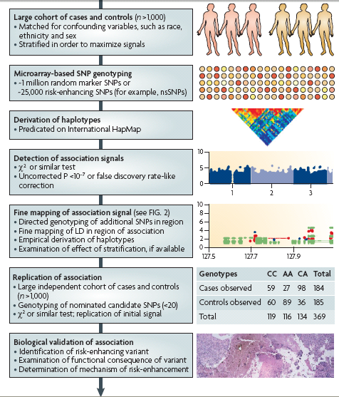
Overview of optimal GWAS design
We are here
Nat Rev Drug Discov. 2008 Mar;7(3):221-30

Slide 10
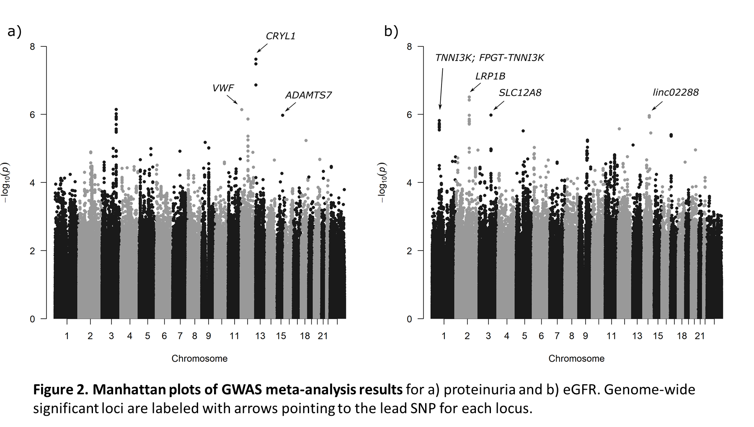
GWAS Identified New Loci for Sickle Nephropathy
Garrett et al. (2023)

Slide 11
Genetic Risk for Sickle Nephropathy is Complex
All of the genome-wide significant associations for proteinuria, and several for eGFR, are genes that are highly expressed in the kidney.
The implicated genes have not been associated with other nephropathies, suggesting that Sickle Nephropathy is different.
Neither APOL1 nor MYH9 were within the top GWAS signals.
APOL1 rs2239785 p=0.0003 proteinuria
APOL1 rs136148 p=0.7691 eGFR
MYH9 rs16996672 p=0.0008 proteinuria
MYH9 rs136206 p=0.0024 eGFR

Slide 12
Summary
Sickle Nephropathy has both overlapping and distinct genetics from other nephropathies.
While APOL1 is highly predictive of many other forms of nephropathy, it has a much smaller role in risk in SCD.
Like other forms of nephropathies, however, there does not appear to be a single gene that is associated with risk, but many genes that may collectively contribute.
Identifying the risk genes may help us develop new therapies.

Slide 13
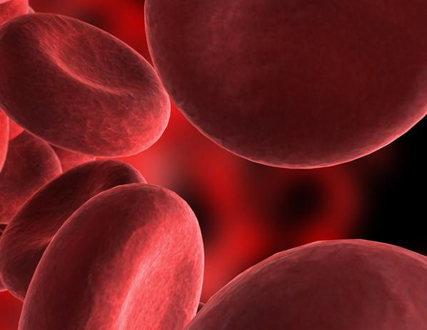


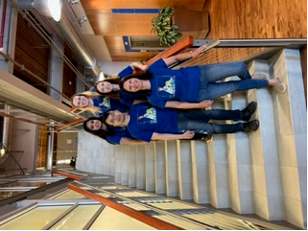



Acknowledgements
Duke Sickle Cell Team
Marilyn Telen
Matt Foster
Melanie Garrett
Brandon Le
Anvita Kulshrestha
A special Thank You to all the patients for their participation in our studies!

