Slide 1
Lecture 2: Gene structure/central dogma/splicing
Bill Majoros

Slide 2
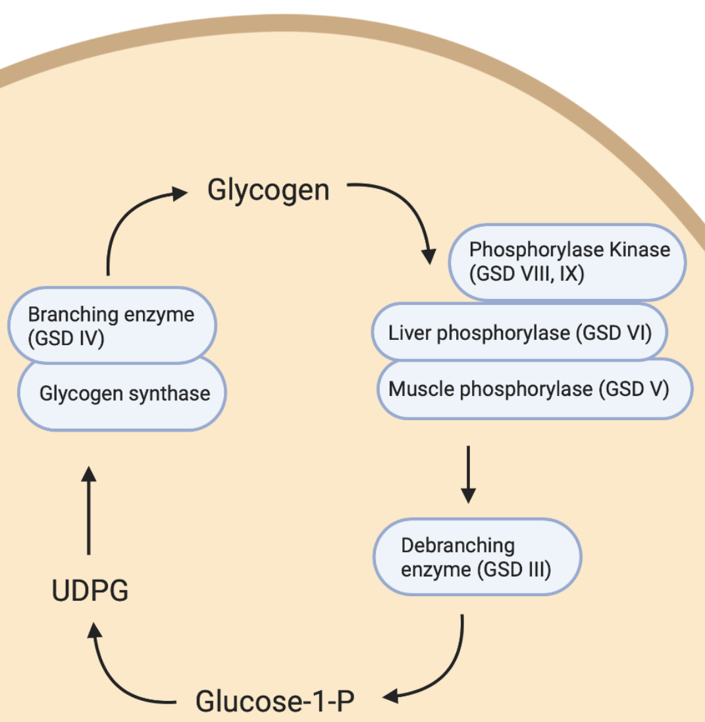
Clinical motivation: Glycogen Storage Disease IX γ2
PHKG2 regulates glycogen debranching
Pathogenic variants cause issues regulating blood glucose and severely damage the liver
Disorder | Gene | Liver PhK | Pathogenic variants
GSD IX γ2 | PHKG2 | 20% | ?
GSD IX γ2 | PHKG2 | 10% | ?
Whole genome sequencing showed no known pathogenic variants, but found one that may be relevant:
chr16:30754550 T>G

Slide 3
Ensembl Variant Effect Predictor (VEP)
A good first-line tool for variant interpretation
For any input variant, predicts the impact on RNA transcripts and proteins
Can do variant lookups in >100 species, including human and all major model organisms
Can easily toggle settings to look for specific effects (alternative splicing, transcriptional regulation, conservation, associated phenotypes/diseases, etc)

Slide 4
File setup
Will need to make a VCF (Variant Calling Format) file
Use TextEdit or <Windows Equivalent>
Example format
#HEADER
#CHROM POS ID REF ALT
20 10001019 . T G

Slide 5
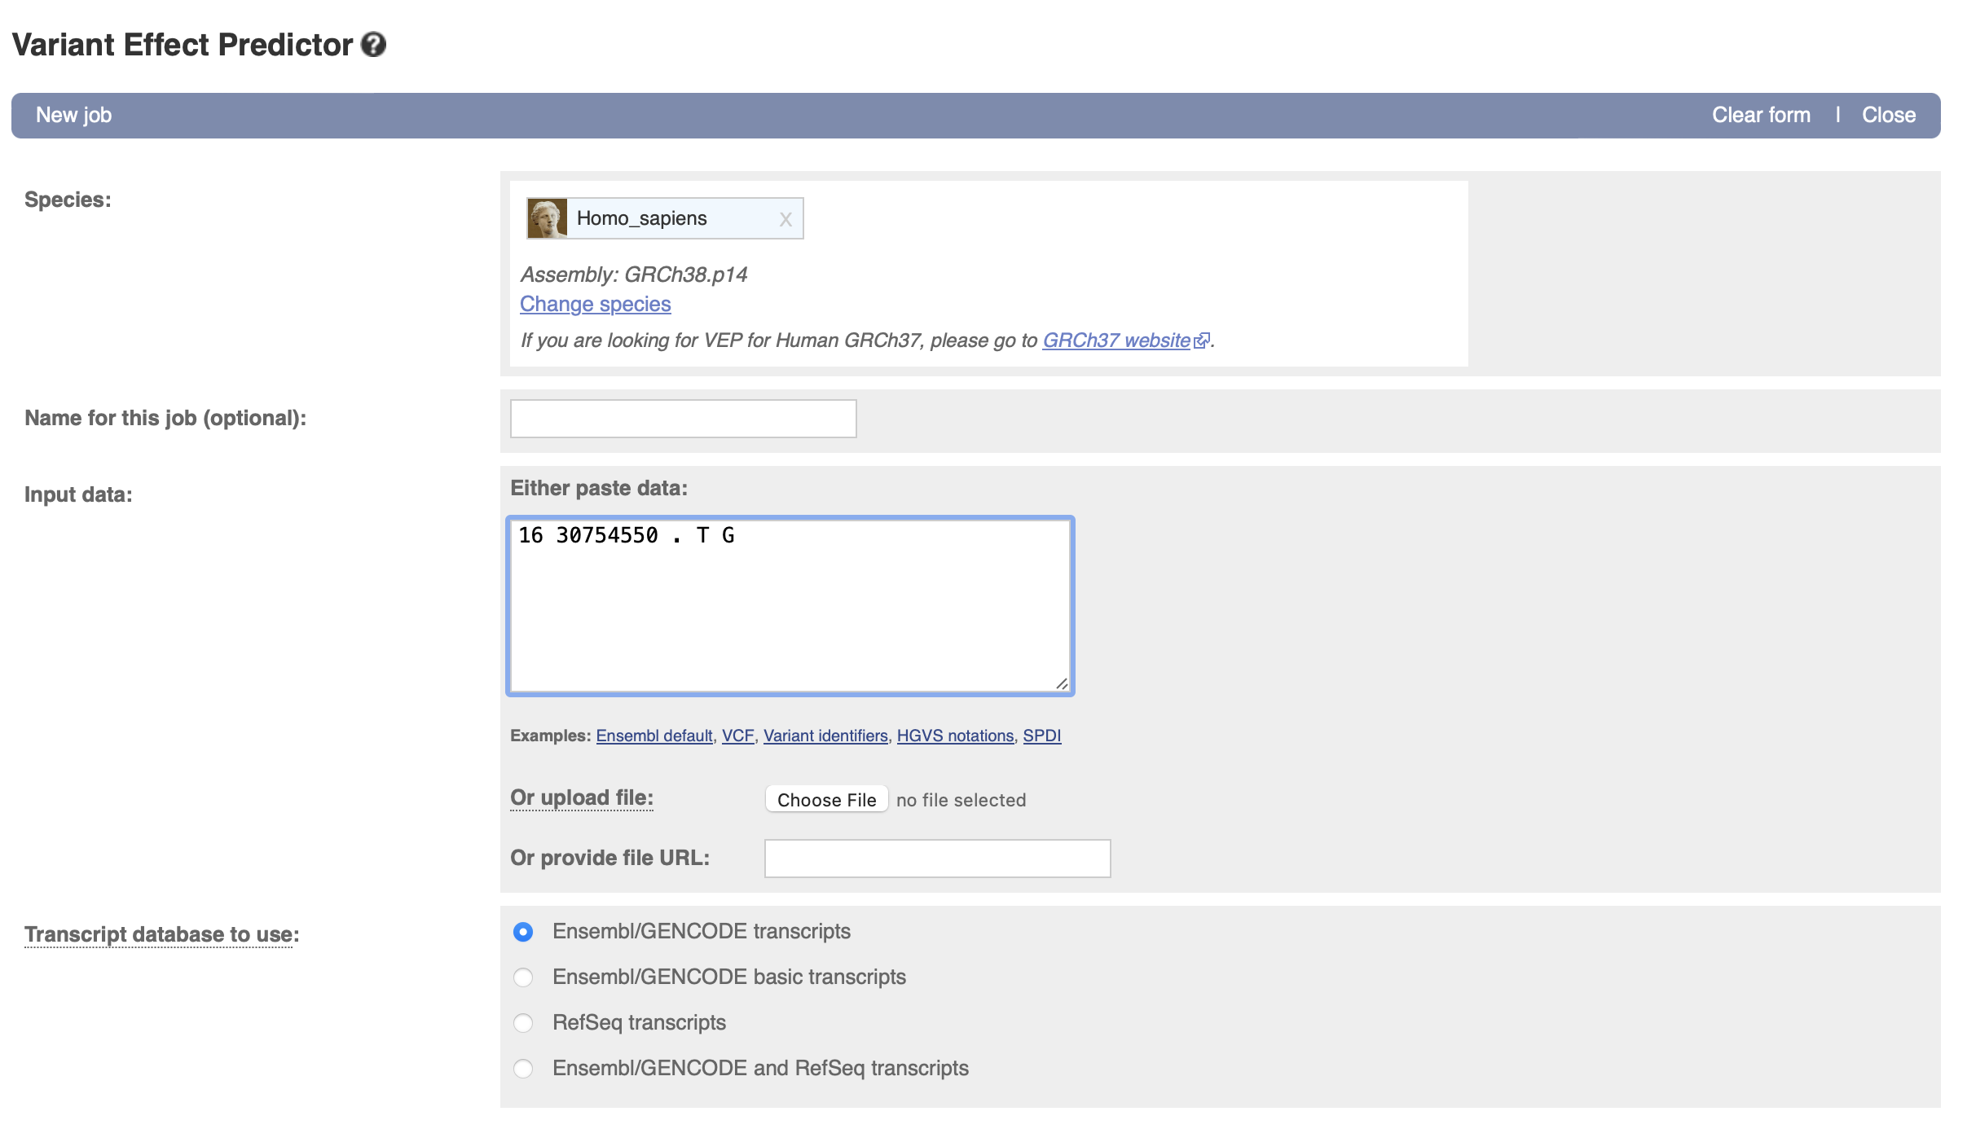
Using VEP
Input variant information in one of the accepted formats, scroll to bottom and hit “Run”

Slide 6
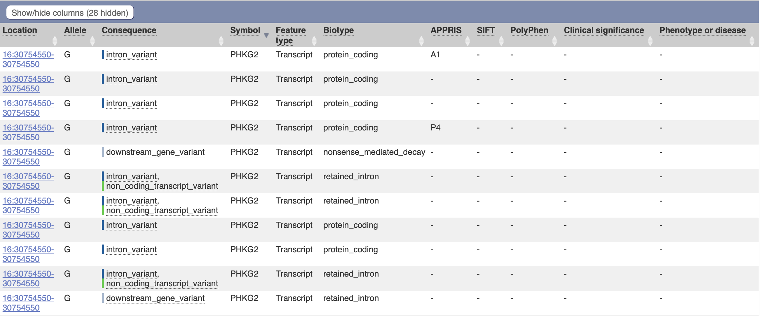
VEP output
Evidence that it may cause splicing changes → next step was to do RNA-seq

Slide 7
Visualize RNA-seq data
We’ve performed RNA-seq and have aligned the reads to the human genome – download the aligned reads from the GitHub day 2 folder
Upload them into IGV under the hg38 genome build
Find chr16:30754550 T>G
Can we identify any splicing abnormalities in that region, that occur in the patient with GSD IX but not in the 2 healthy people?
Visualize in Sashimi plot
VEP often cannot tell you whether a variant is pathogenic, but can often give you a starting point to look for other eviedence

Slide 8
PHKG2 cryptic exon example
Maybe do this one together?
I have .bam files from WT and homozygous mutant HEK cells
Filtered out non-PHKG2 reads so that the files are small/downloadable. Can I deposit these (.bam and .bai files) in the github?
They should have IGV (and hg38, presumably?) already from the 1st session
Upload .bam files into IGV
Find variant/splice site change
Make Sashimi plot

Slide 9
Variants to look up:
You can put rsIDs (if they exist for that variant) straight into VEP
List of variants in BCL11A – submit this list as a job in VEP
Which variants have evidence of impact on gene function? What are the potential mechanisms?
rs1333618217
rs1670455296
rs1670521527
rs781461905
rs748538213
rs1168443709
rs902477442
rs1249313093
rs1573096202
rs529993149

Slide 10
VEP instructions
https://useast.ensembl.org/info/docs/tools/vep/online/index.html
Hit “Launch VEP”
Choose species: Homo sapiens, GRCh38
List rsIDs in the “Input data” box
Other input formats are possible, including VCF files and HGVS notations, which are often used in clinical reports
Scroll to the bottom and hit “run”
For help interpreting variant consequences and biotypes that come out of VEP, here are some resources:
http://useast.ensembl.org/info/genome/genebuild/biotypes.html
https://useast.ensembl.org/info/genome/variation/prediction/predicted_data.html

Slide 11
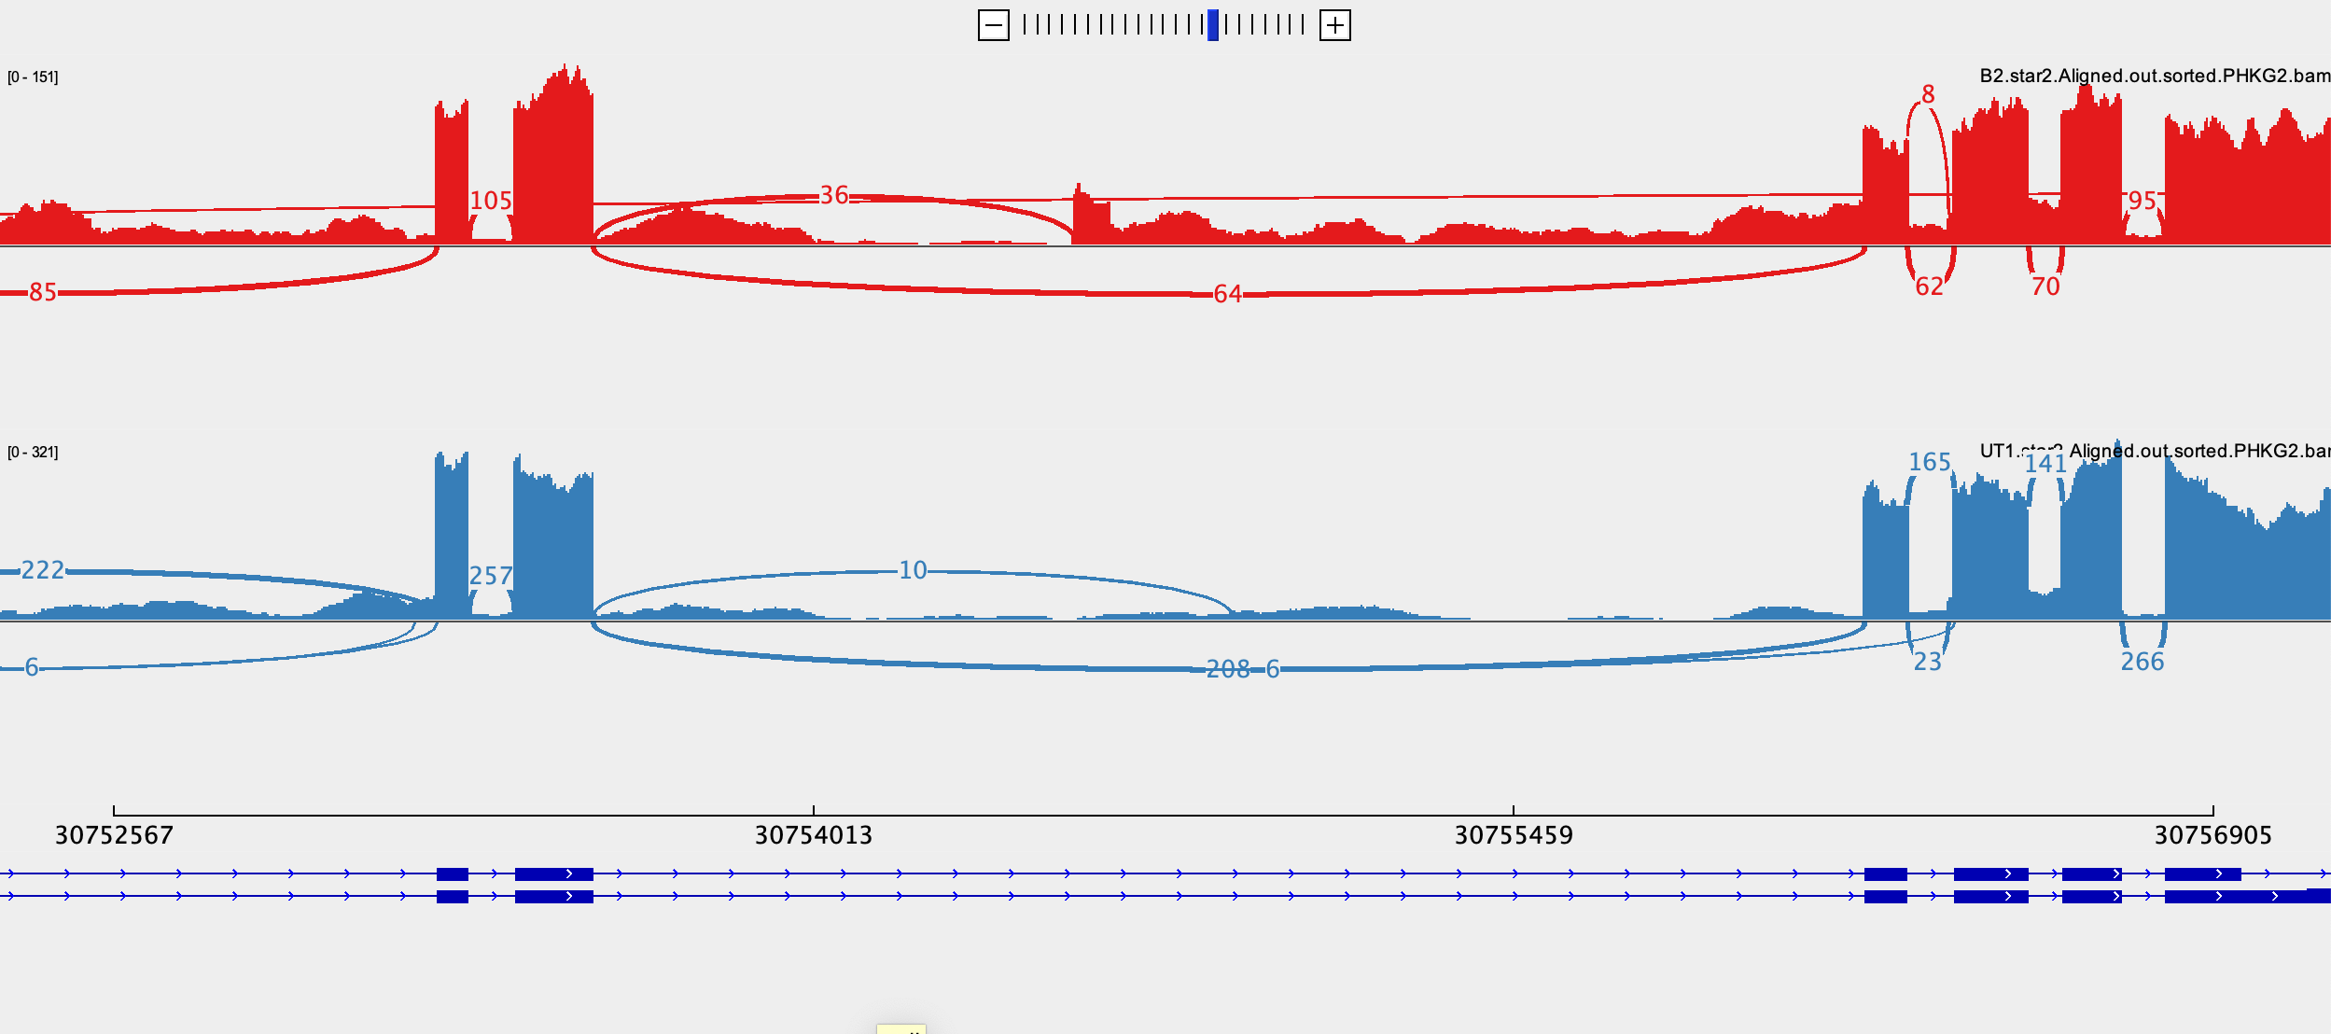
Potential problem w/ alignment/other splice site in WT
I think this is an issue with my settings in STAR. If I cannot fix, will find something similar in GEUVADIS

Slide 12
Lecture: Consequences of genetic variation
Bill Majoros

Slide 13
Brief intro to SpliceAI (& SPANR?)
Cannot find web interface for SPANR
Have them do variant lookups and compare interpretations of SpliceAI and CADD instead?
Does Bill have a different suggestion than CADD?

Slide 14
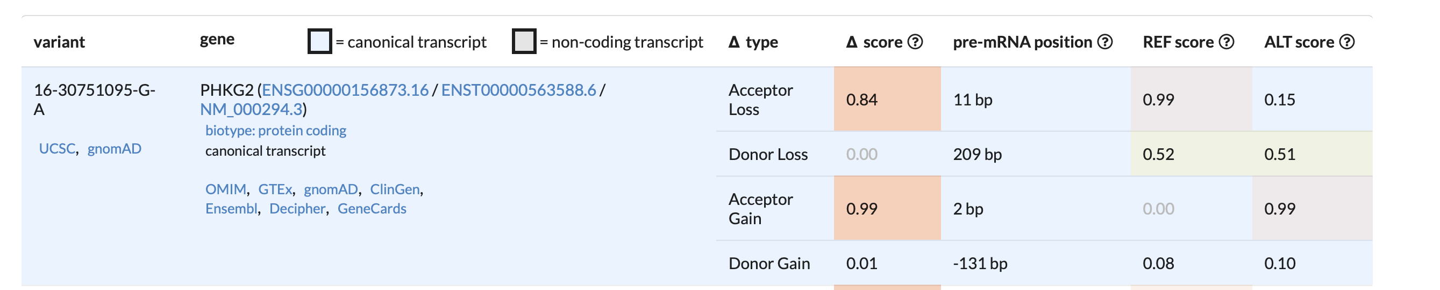
SpliceAI
SpliceAI is a tool that predicts whether a particular pre-mRNA nucleotide sequence contains a splice donor, splice acceptor, or neither
Gives a score and a position (relative to the variant) for loss or gain of a splice donor/acceptor
Example prediction in PHKG2:

Slide 15
Using SpliceAI
Navigate to https://spliceailookup.broadinstitute.org
Enter 1 variant at a time in the following format: chr#-pos-ref-alt
Ex. chr8-140300616-T-G
Make sure position and genome build match
Hit “Submit”

Slide 16
How to use and interpret SpliceAI
https://spliceailookup.broadinstitute.org
Variant format for entry
Chr pos ref alt
This time, give them rsID and have them come up with the chr/pos/ref/alt themselves
Check with Revathy to see if they will know how to do this from the intro to genome browsers – otherwise have a quick guide in the slides

Slide 17
Variants of interest
rs1573096202 – low confidence donor loss
rs1249313093 – high confidence donor loss
rs1011727375 – moderate confidence donor gain (w/ -107 acceptor gain) = pseudoexon

Slide 18
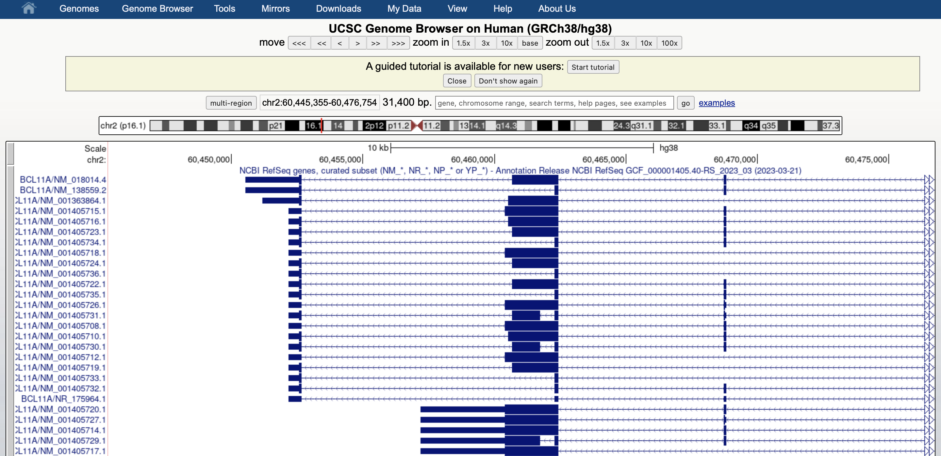
Step 1: format variants
Use the UCSC genome browser to identify the chromosome, position, reference allele, and alternate allele(s) for each variant
Paste rsID into the box and hit “go”, then click on the rsID when it comes up in the search results

Slide 19
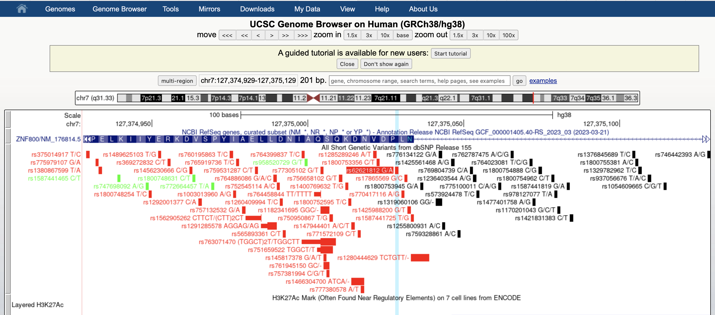
Click on the variant that is highlighted

Slide 20
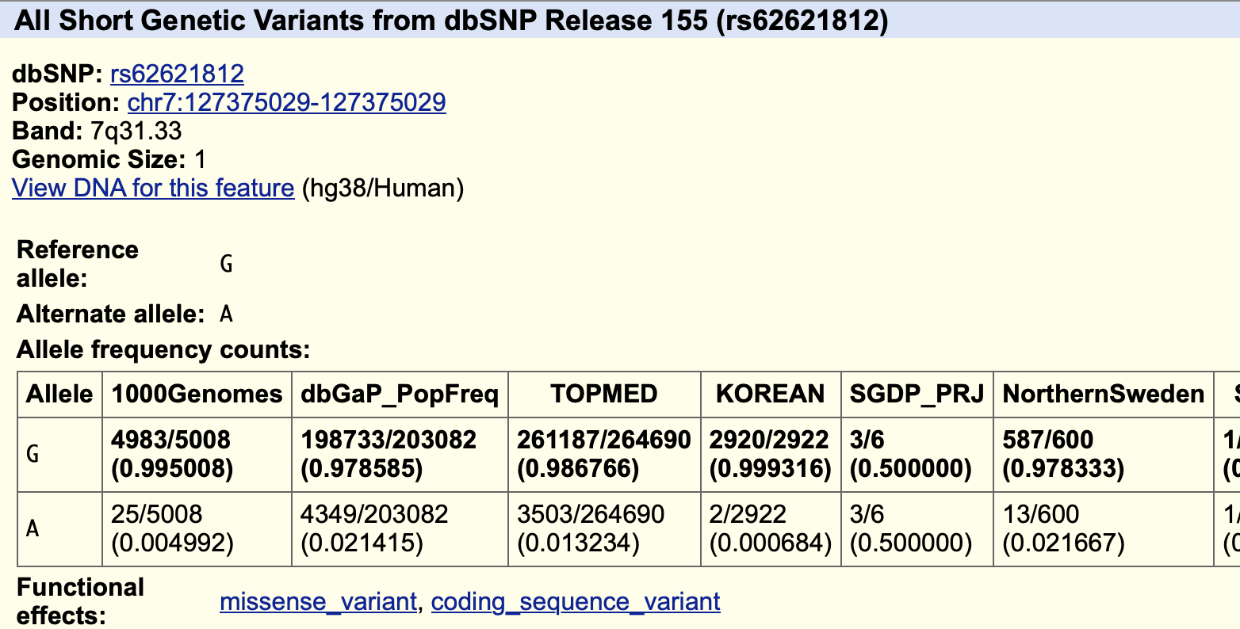
Format for spliceAI: chr-pos-ref-alt
This variant would be chr7-127375029-G-A

Slide 21
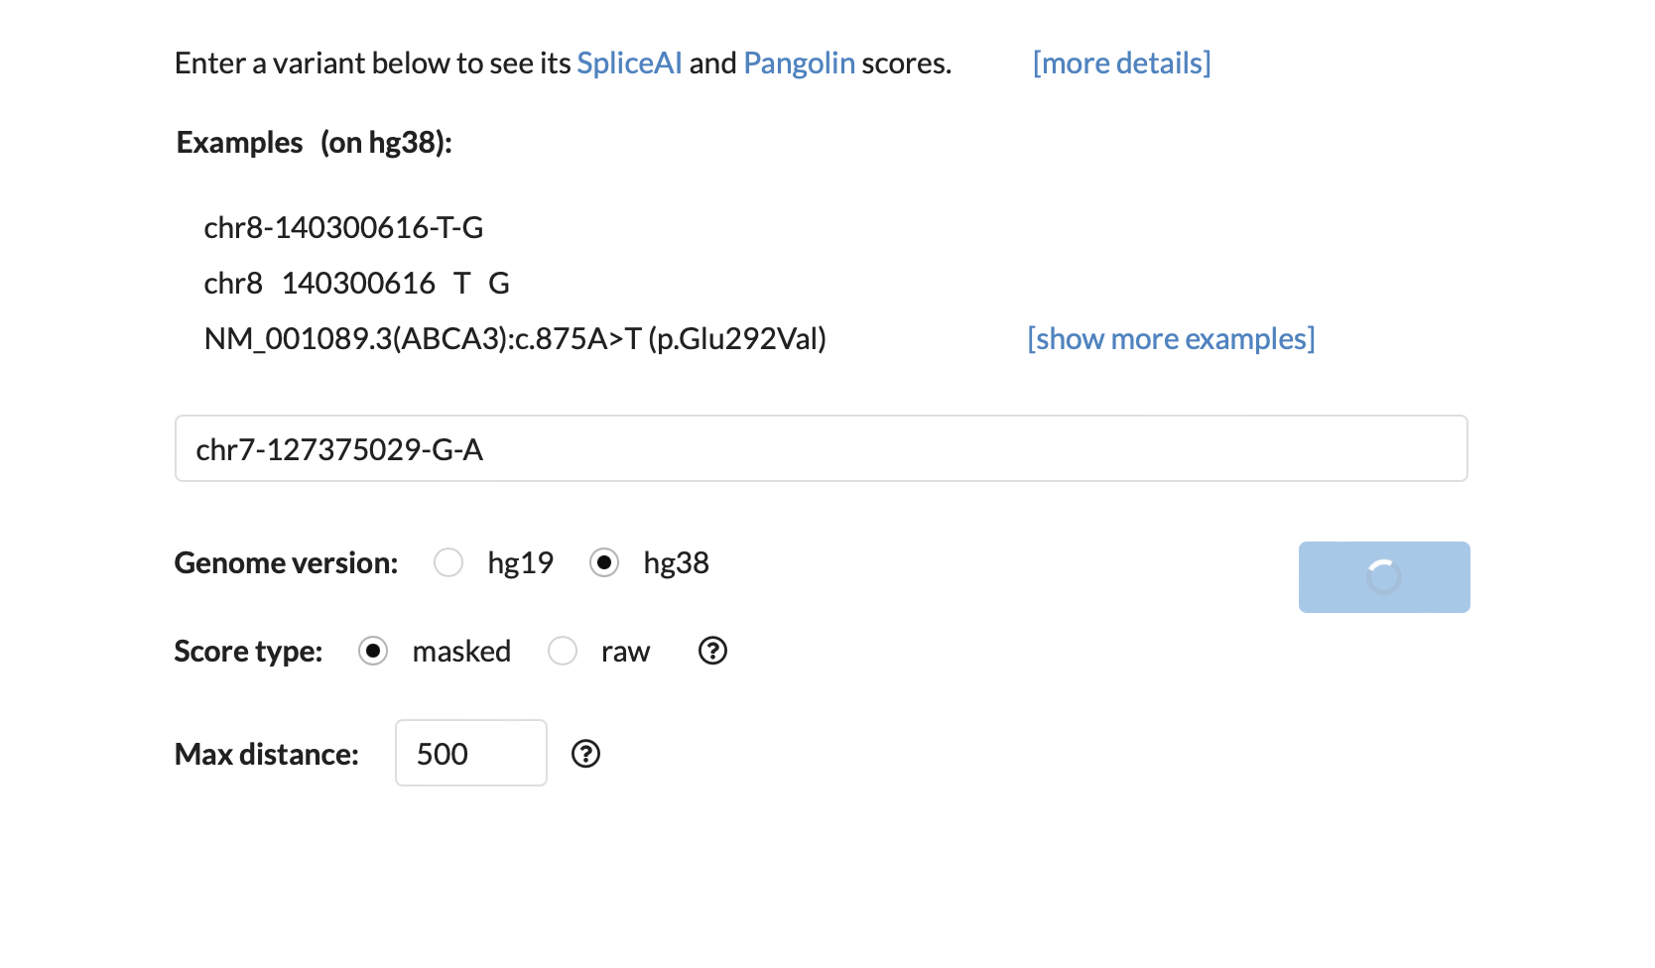
Step 2: Enter into SpliceAI
Enter formatted variant in this box and hit “submit”

Slide 22
Step 3: assess potential effect on mRNA & disease/phenotype
For variants with high/moderate predicted splicing change, identify amino acids inserted/deleted, or whether there is a frame change
Is this too complicated for a short exercise?
Look up the genes in OMIM to identify potential impact of these variants on disease

