Slide 1

Open Chromatin Analyses
GCB genomics modules

Slide 2
Overview for today
Introduction to open chromatin as a biological concept
Basic analyses steps to identify open chromatin regions in different tissue data

Slide 3
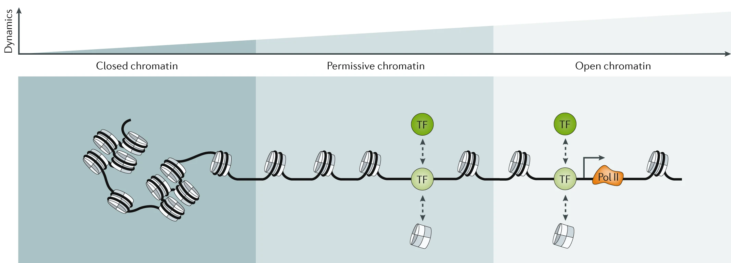
Chromatin states are dynamic

Slide 4
How do we identify open chromatin regions?

Slide 5
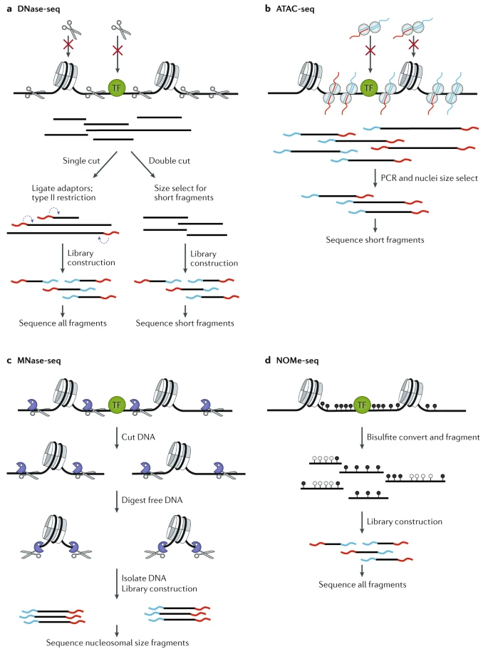
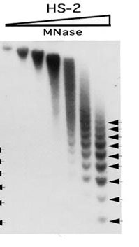
MNase Seq
Sarah Elgin
Notes:
Micrococcal nuclease (EC 3.1.31.1, S7 Nuclease, MNase, spleen endonuclease, thermonuclease, nuclease T, micrococcal endonuclease, nuclease T', staphylococcal nuclease, spleen phosphodiesterase, Staphylococcus aureus nuclease, Staphylococcus aureus nuclease B, ribonucleate (deoxynucleate) 3'-nucleotidohydrolase) is an endo-exonuclease that preferentially digests single-stranded nucleic acids. The rate of cleavage is 30 times greater at the 5' side of A or T than at G or C and results in the production of mononucleotides and oligonucleotides with terminal 3'-phosphates. The enzyme is also active against double-stranded DNA and RNA and all sequences will be ultimately cleaved.

Slide 6
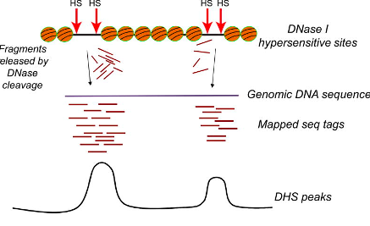
DNase Seq
Notes:
Deoxyribonuclease I (usually called DNase I), is an endonuclease of the DNase family coded by the human gene DNASE1.^{[5]} DNase I is a nuclease that cleaves DNA preferentially at phosphodiester linkages adjacent to a pyrimidine nucleotide, yielding 5'-phosphate-terminated polynucleotides with a free hydroxyl group on position 3', on average producing tetranucleotides. It acts on single-stranded DNA, double-stranded DNA, and chromatin.

Slide 7
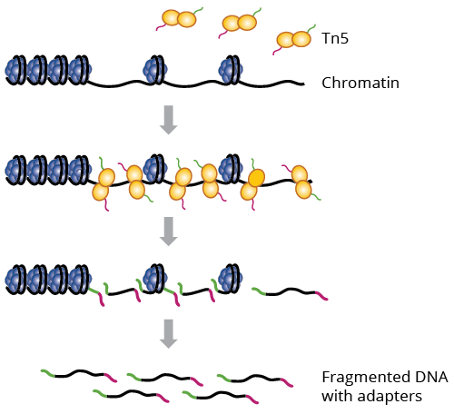
ATAC Seq (Assay for Transposase-Accessible Chromatin)
Notes:
The transposition system has fast “cut and paste” and “copy and paste” functions, and has been innovatively applied to the NGS field. For example, the Assay for Transposase-Accessible Chromatin with high throughput sequencing (ATAC-Seq) uses high-throughput sequencing to detect chromatin regions accessible by Tn5 transposase.
Tn5 transposases can randomly insert adaptors/barcodes into DNA, and the resulting DNA molecules are ready for PCR amplification and sequencing

Slide 8
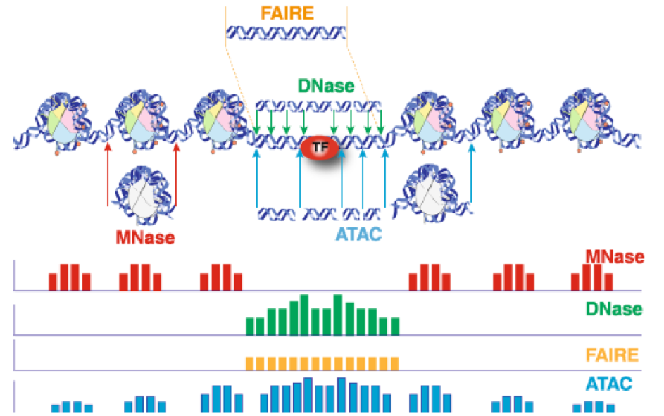
Open chromatin assay profiles

Slide 9
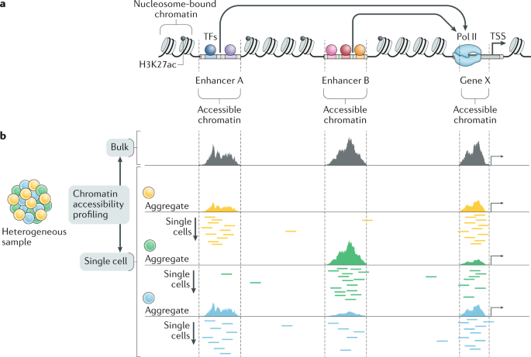
Single vs. bulk ATAC seq profile

Slide 10
Single vs. bulk ATAC seq profile

Slide 11
Single vs. bulk ATAC seq profile

Slide 12
Contact
laavanya11@gmail.com

Slide 13
Exercise
Use IGV web browser to look at ATAC-seq sequencing data
Use GALAXY on the web browser to analyse the ATAC-seq datat to identify open chromatin regions.
Go to usegalaxy.org and log in to your account.
Open the working document for the class : https://docs.google.com/document/d/1t4FOlTSPERT27pQSIRX4sX6up7aABFtXtLsb9IY0cb8/edit?usp=sharing

