Slide 1
Data Makeup
Group | Number | Case | Control (% of total number of controls) | % Cases (% per group)
Black | 343 | 219 | 124 (26.4) | 63.8
White | 362 | 240 | 122 (26.0) | 66.3
Hispanic | 59 | 57 | 2 (0.4) | 96.6
South Asian | 562 | 357 | 205 (43.7) | 63.5
East Asian | 22 | 6 | 16 (3.4) | 27.3

Slide 2
Data Filtering
 | Removed | Remaining
Initial SNPs |  | 1748250
Autosome | 74442 | 1673808
Non standard allele (D, I) | 23249 | 1650559
Biallelic (missing allele) | 56907 | 1593652
Missingness (sample, 0.1) Check duplicates | 13 sample (3 ctrls) | 1378 sample
Missingness (variant, 0.1) | 2227 | 1591425
Hardy-Weinberg P<10-4 | 129434 | 1461991
Maf (0.01) | 620339 | 841652

Slide 3
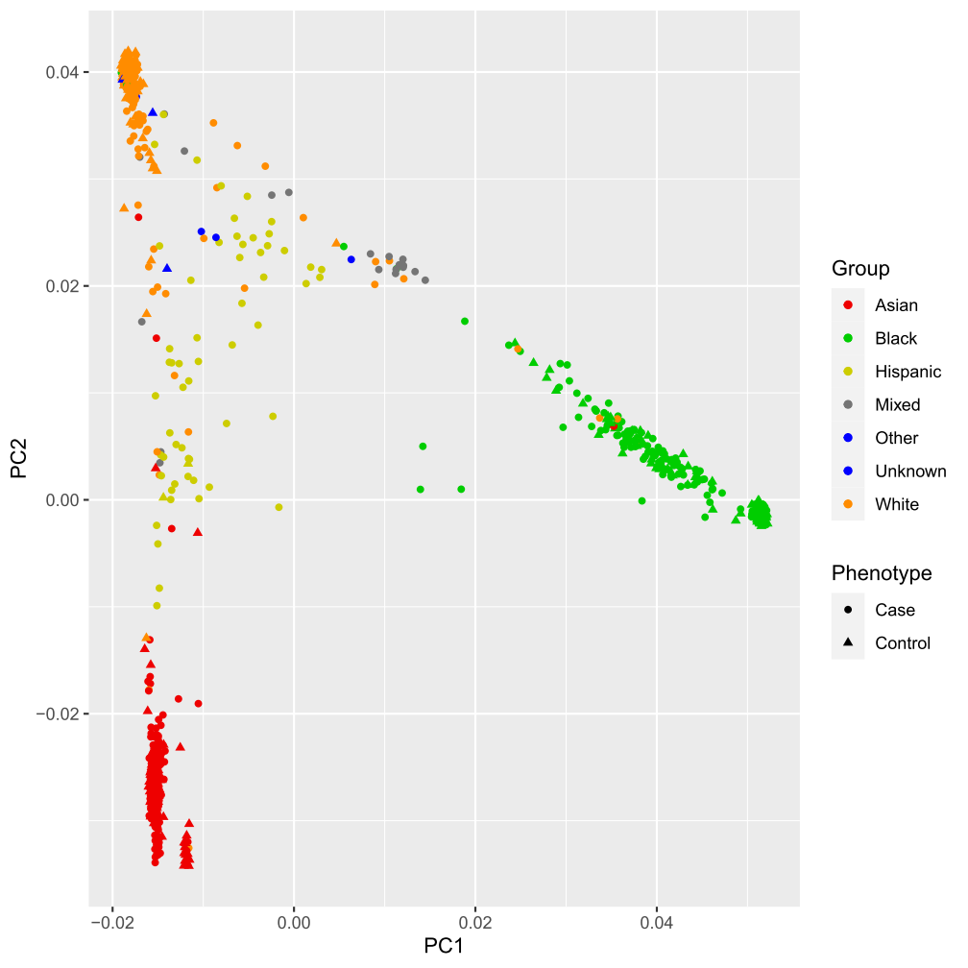
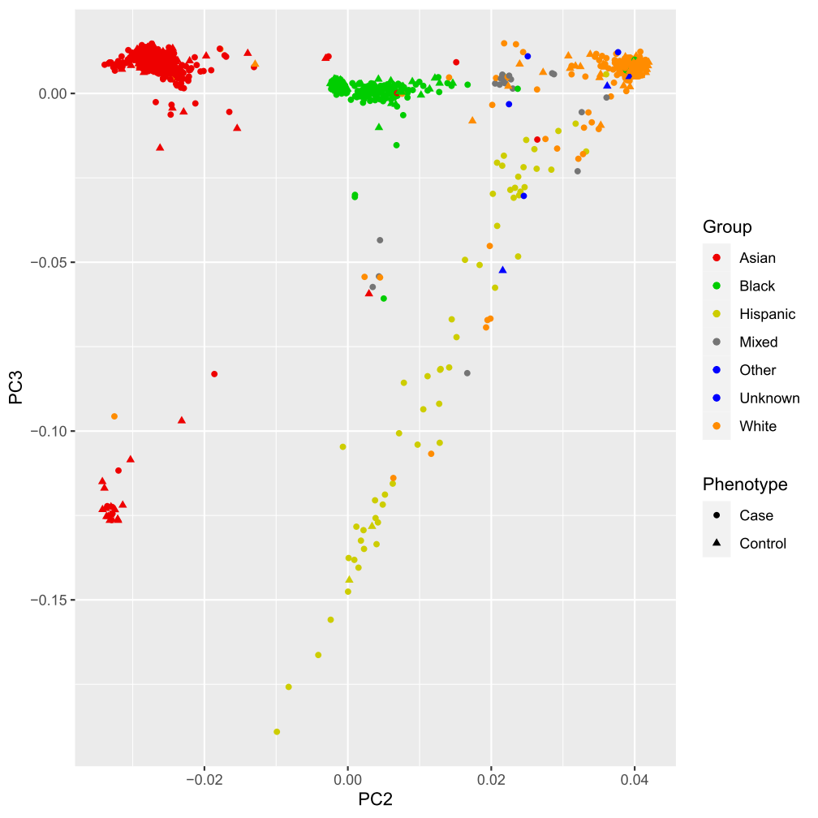
PCA plot

Slide 4
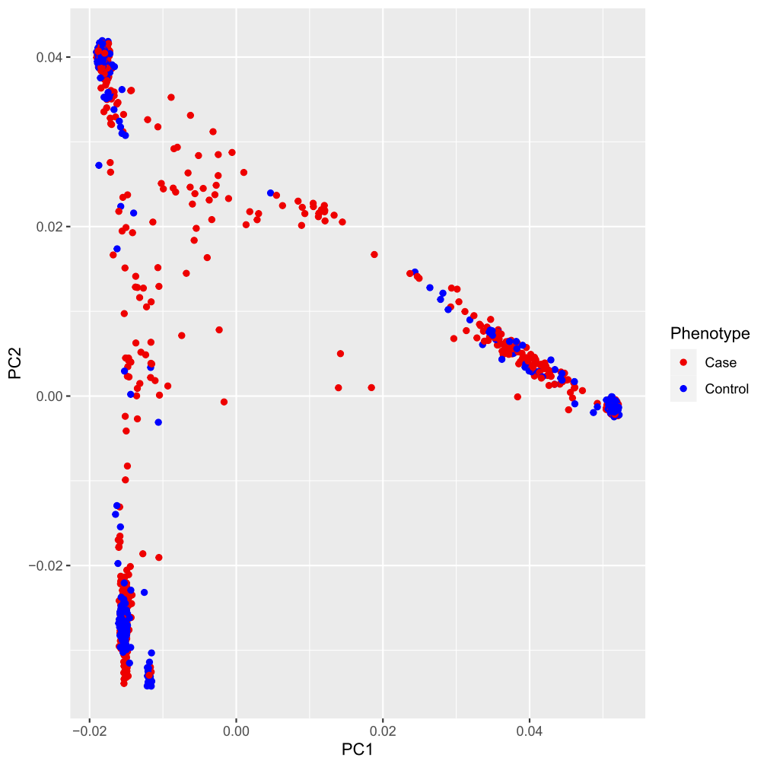
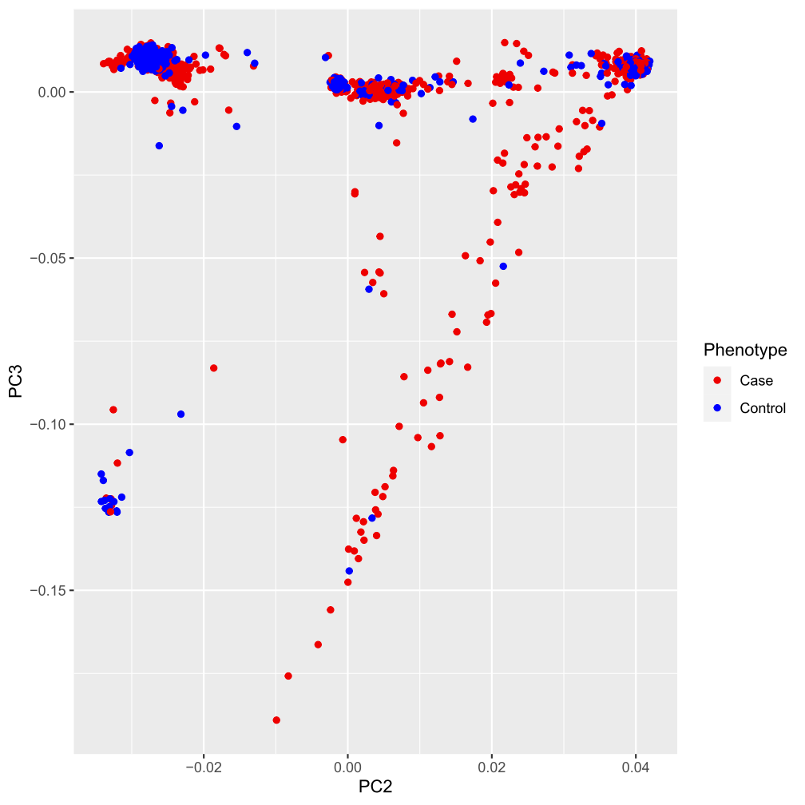
PCA plot

Slide 5
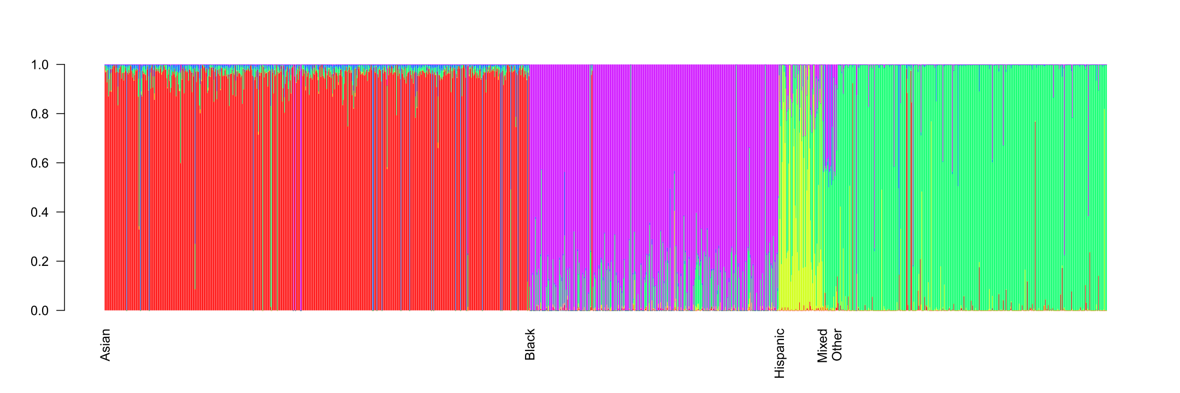
Admixture analysis
5 populations: African, European, South Asian, East Asian and, Native American
Ancestry
Individuals

Slide 6
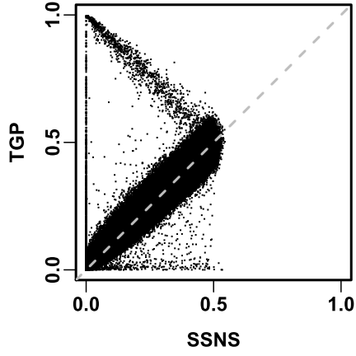
Allele frequency (Alt allele): GWAS controls vs TGP
1034655 common SNPs

Slide 7
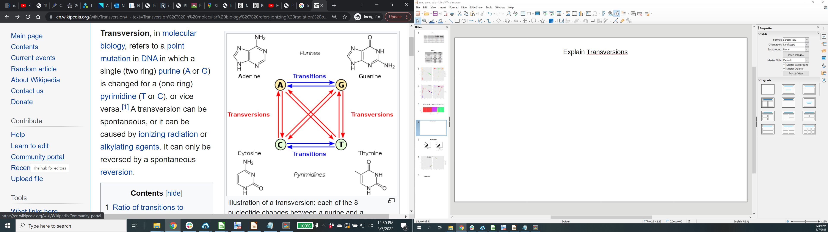
Transversions

Slide 8
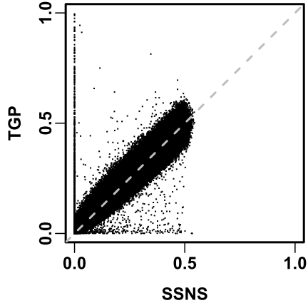
Allele frequency (Alt allele): GWAS controls vs TGP
Removed Transversions: 165270 SNPs
Remaining: 909585 SNPs

Slide 9
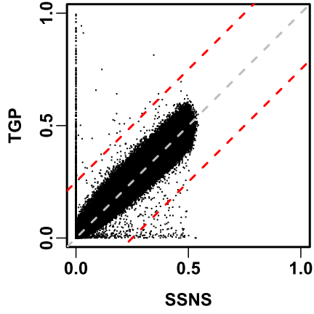
322 SNPs
104 SNPs

Slide 10
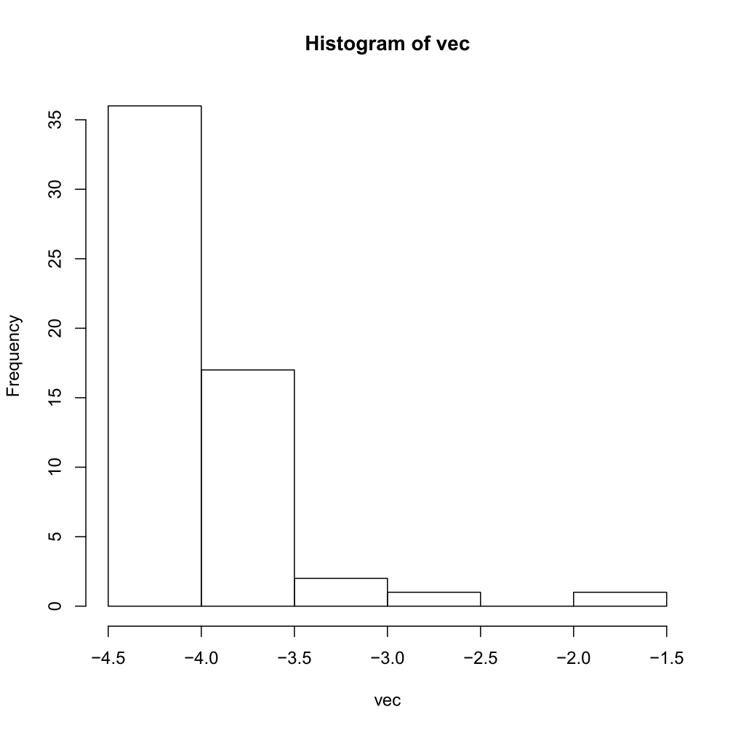
Discordance

Slide 11
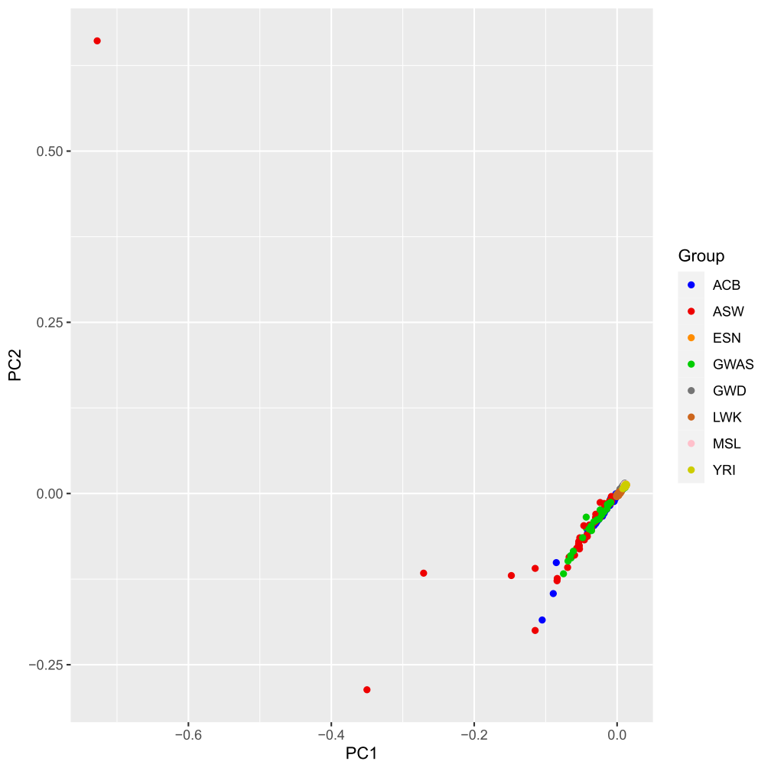
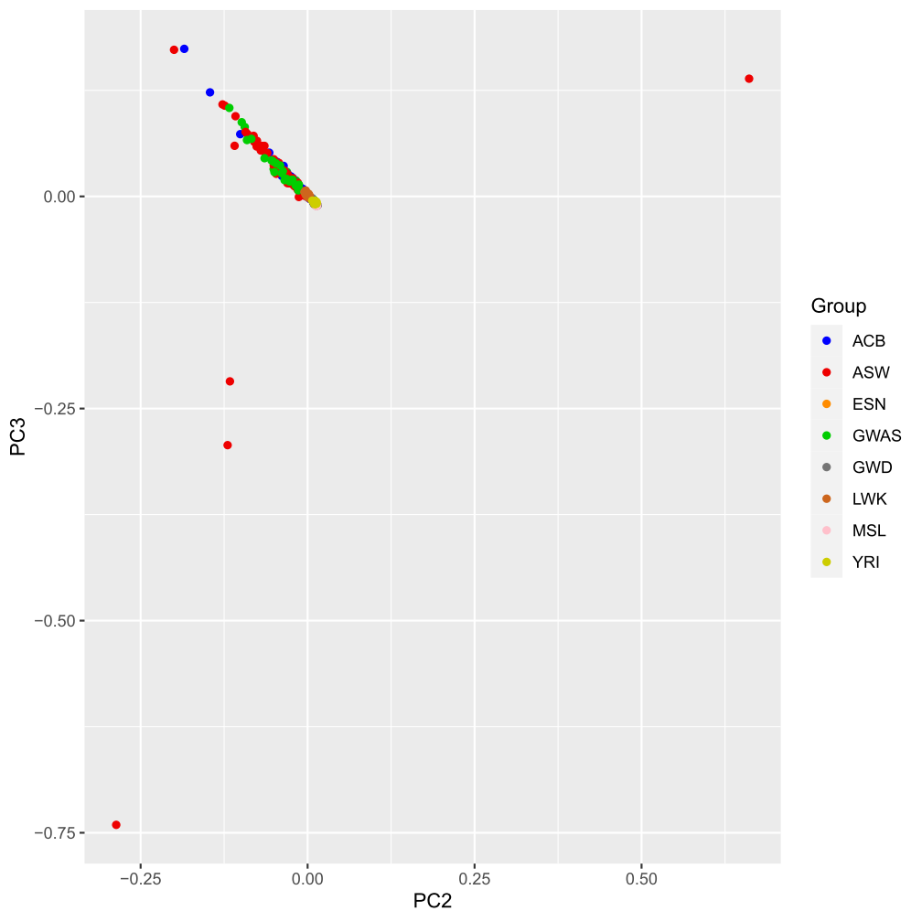
PCA plot: Controls+TGP
African Ancestry
Removed 5 non-founders in TGP

Slide 12
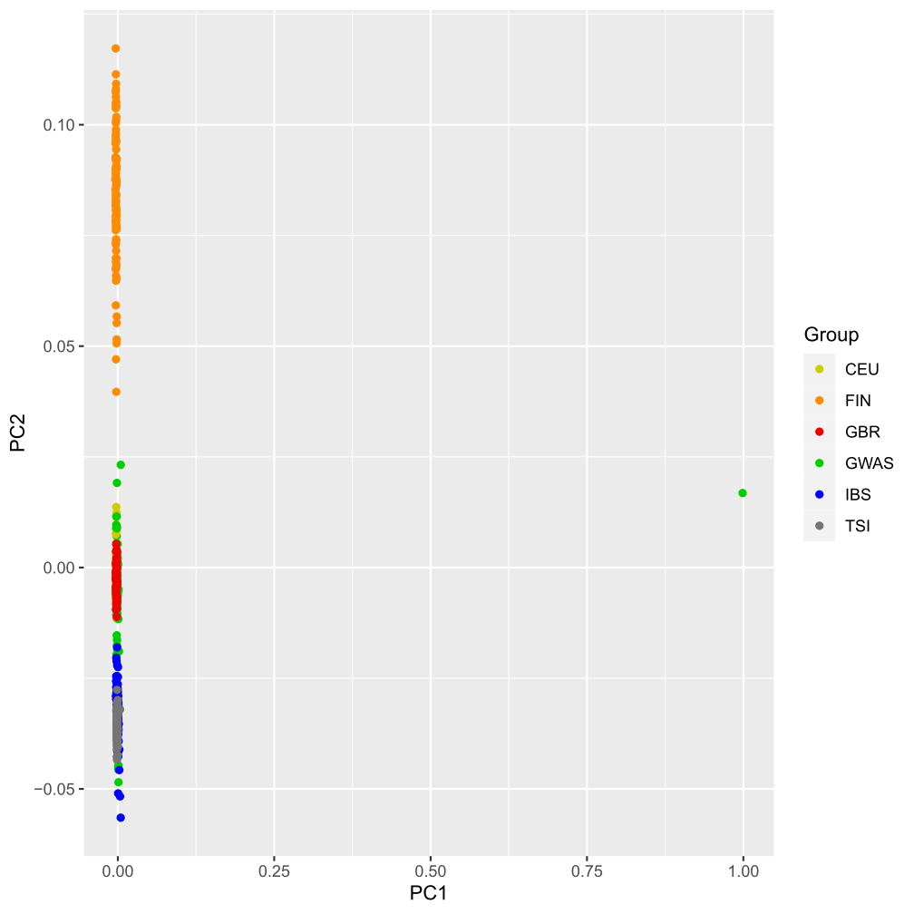
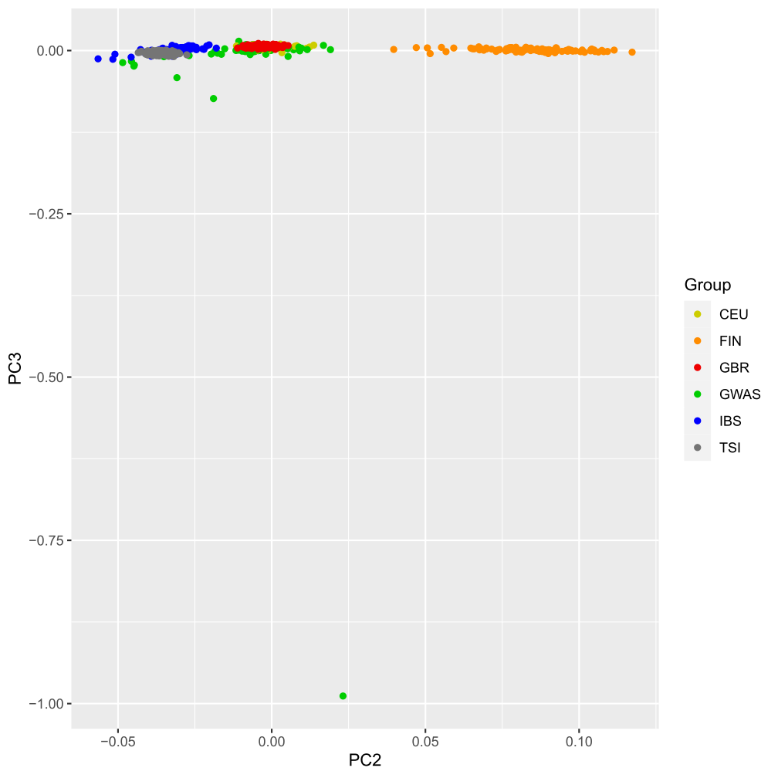
PCA plot: Controls+TGP
White Ancestry
Removed 4 non-founders in TGP

Slide 13
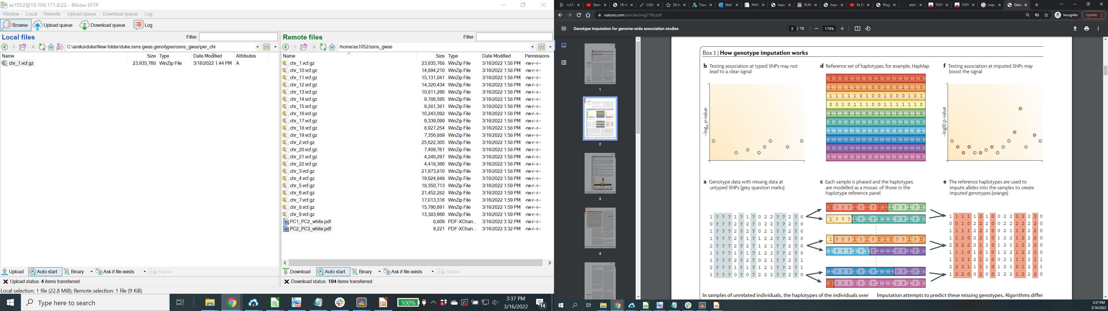
Future Steps: Imputation
Merge with 1000 Genome Project
Analysis
Marchini, J., Howie, B. Genotype imputation for genome-wide association studies. Nat Rev Genet 11, 499–511 (2010).

