Slide 1
SSNS GWAS
Troubleshooting association QC issues

Slide 2
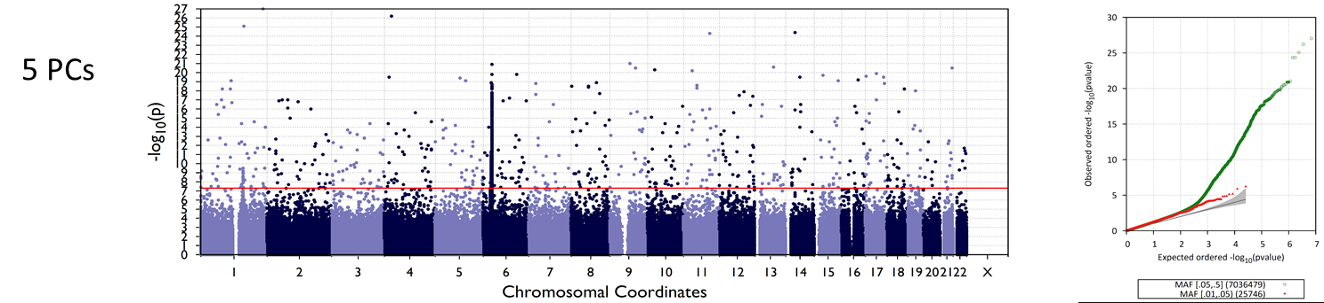
Issue
The SSNS Asian sample and overall joint analysis show inadequately controlled test statistics and Manhattan plots with multiple isolated GWS SNPs on every chromosome [i.e. in addition to known chr6. locus and normal looking novel loci]
This effect was seen even after adjusting for 5 PCs
Asian SSNS GWAS

Slide 3
Re-examination of PCs show a cluster of individuals that separate out on PC4
1000 Genomes samples in magenta, SSNS samples in green.
The arrow points to the cluster of interest

Slide 4
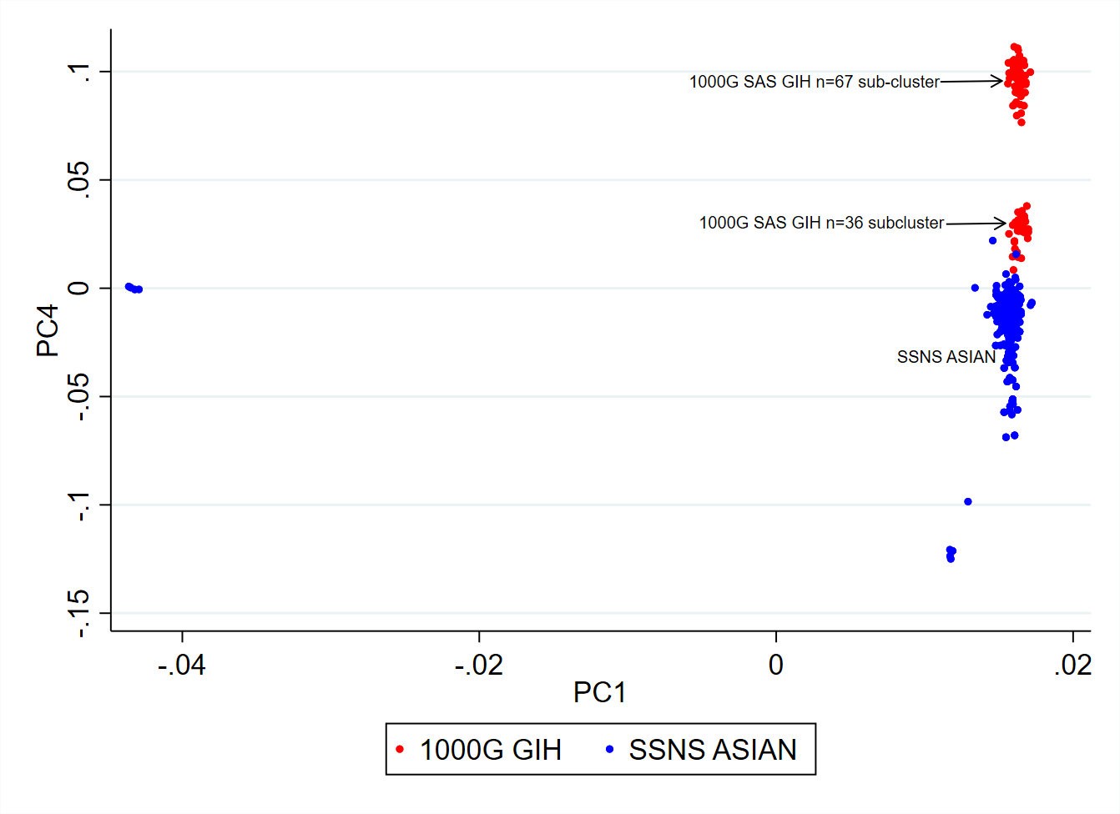
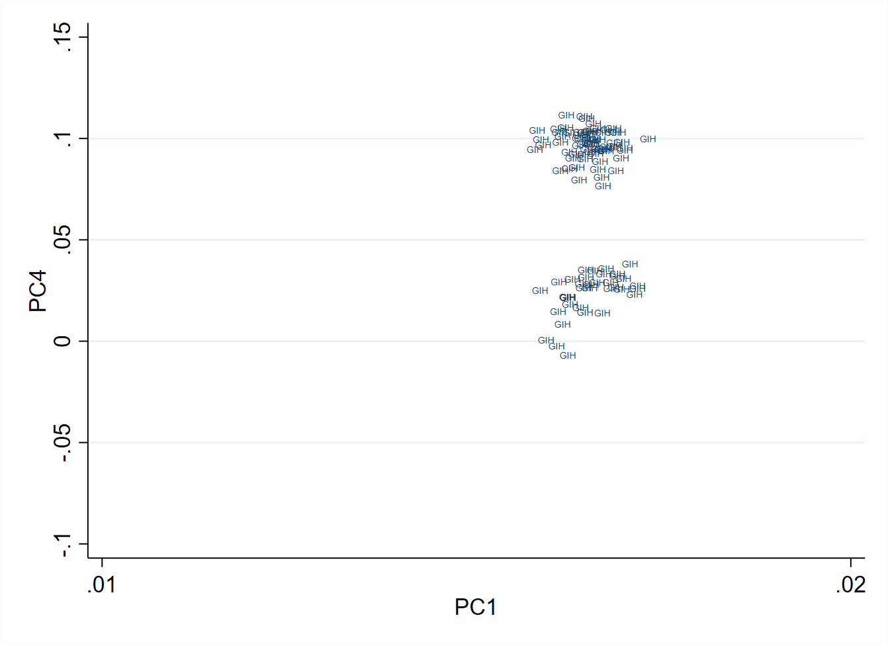
The cluster consists entirely of 1000 Genomes SAS/GIH
The GIH separates out into two clusters on PC4, the bigger cluster [n=67] is separate from all other samples while the smaller cluster [n=36] clusters with SSNS Asian samples

Slide 5
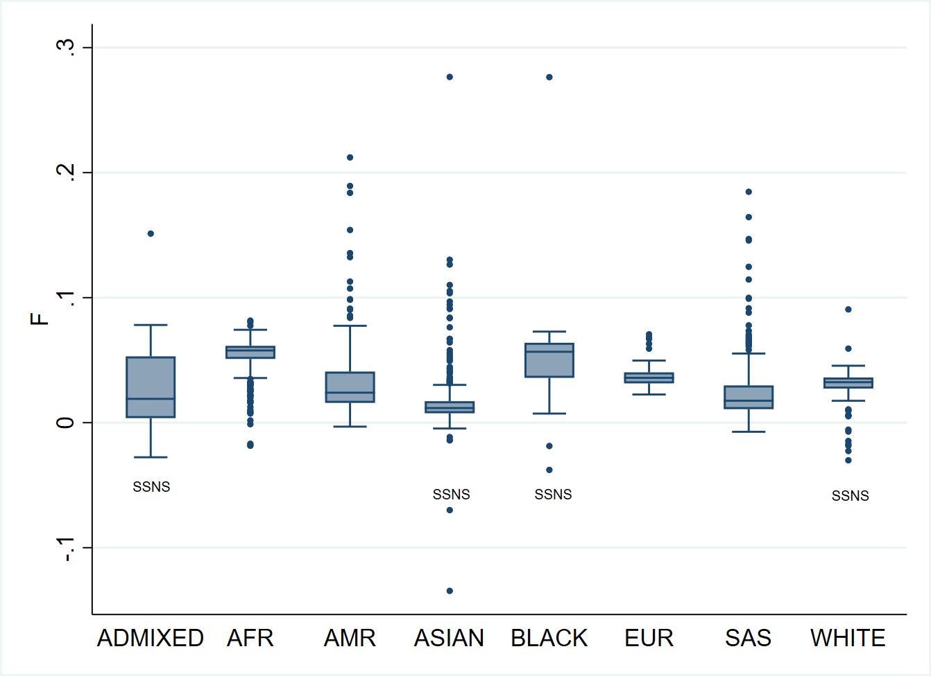
Inbreeding coefficient differs between groups but there is no notable excess of high F individuals among the Asians

Slide 6
Check of relatedness
Relatedness checks also show that the Asians do not have an unusual number of the very few first or second degree relationships observed in the dataset

Slide 7
Conclusion and next steps
The findings can be explained by the 1000G SAS GIH clustering pattern
Next steps
Drop the individuals in the outlying cluster and rerun Asian and joint analysis
To improve the case-control imbalance in the Asians, look for more South Asian controls that match the SSNS samples

