Slide 1
SSNS WGS family genome analysis

Slide 2
 | Remaining
Initial | 19210933
Bi-allelic, Filetr=PASS, Qual>20, autosome | 14554557
Hardy-Weinberg P<10-4 | 14349337
Missingness (0.1) | 14330472

Slide 3
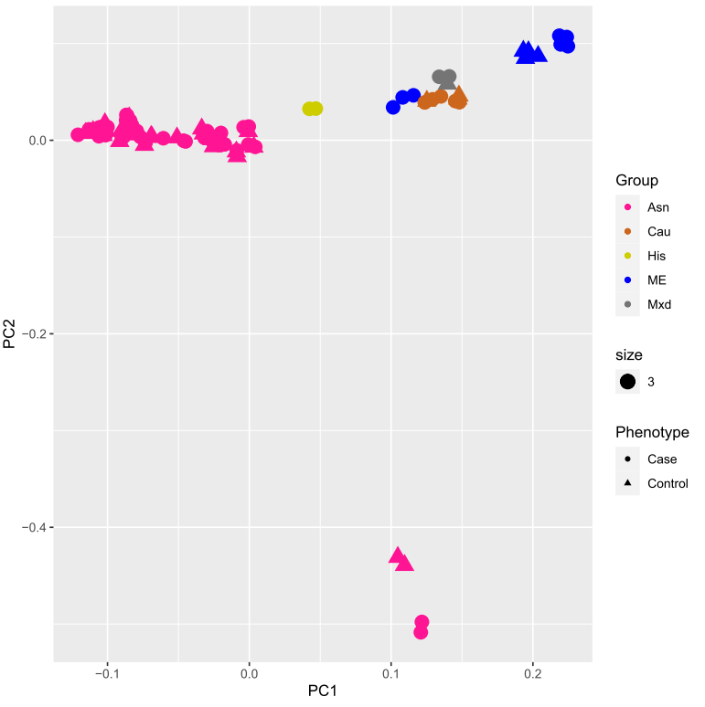
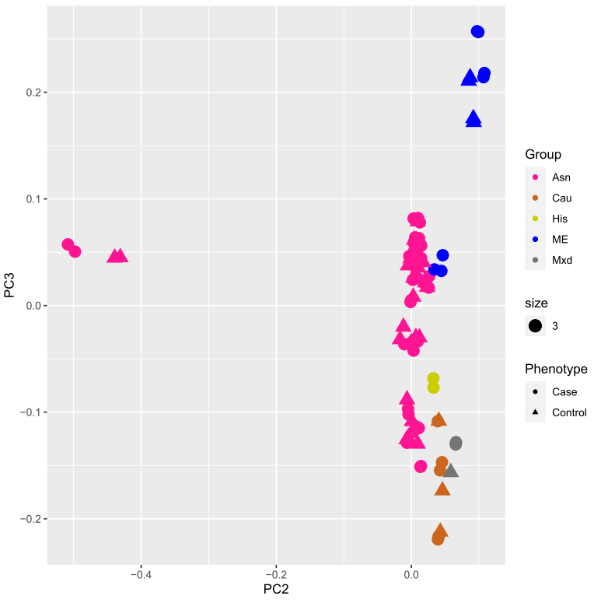

Slide 4
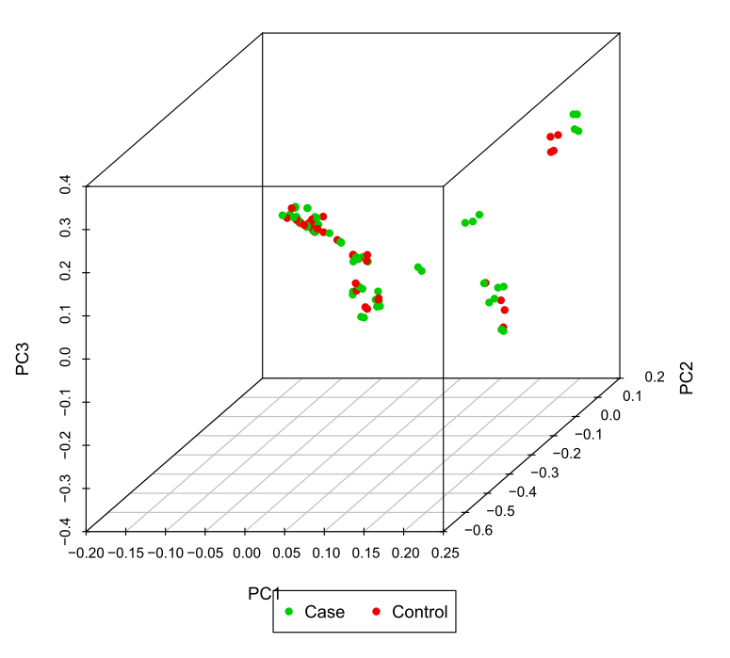

Slide 5
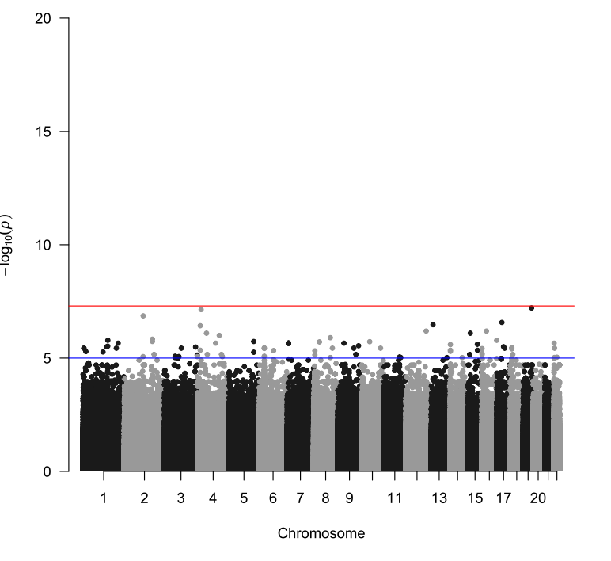
GWAS analysis (Manhattan Plot)

Slide 6
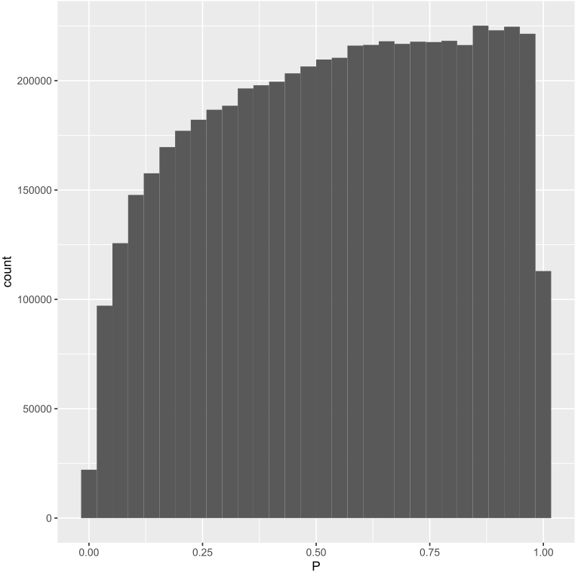
GCTA: Genome-wide Complex Trait Analysis

Slide 7
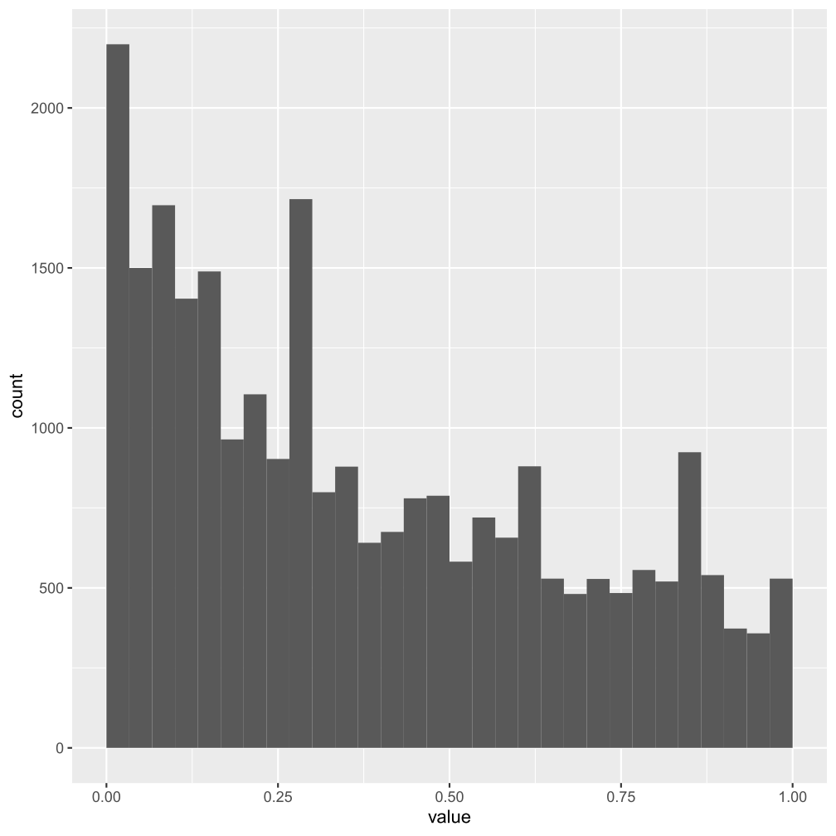
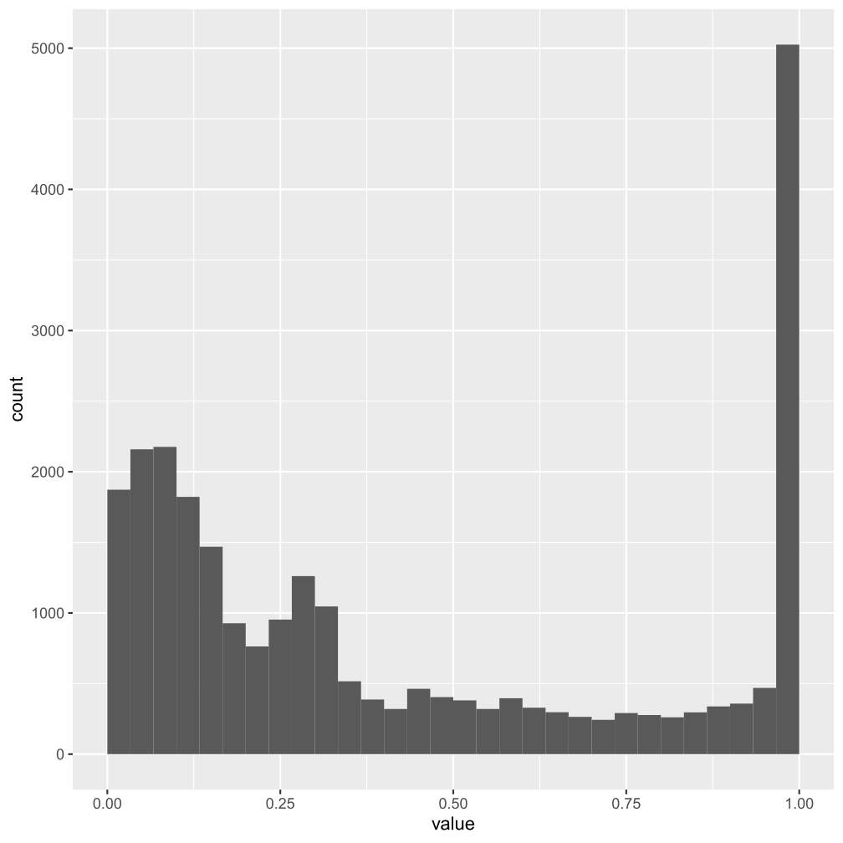
Family-Based Rare Variant Association Analysis
Sample size not large enough (94 individuals).
No parents in the
dataset.
multivariate and collapsing (CMC) method
extended FARVAT

Slide 8
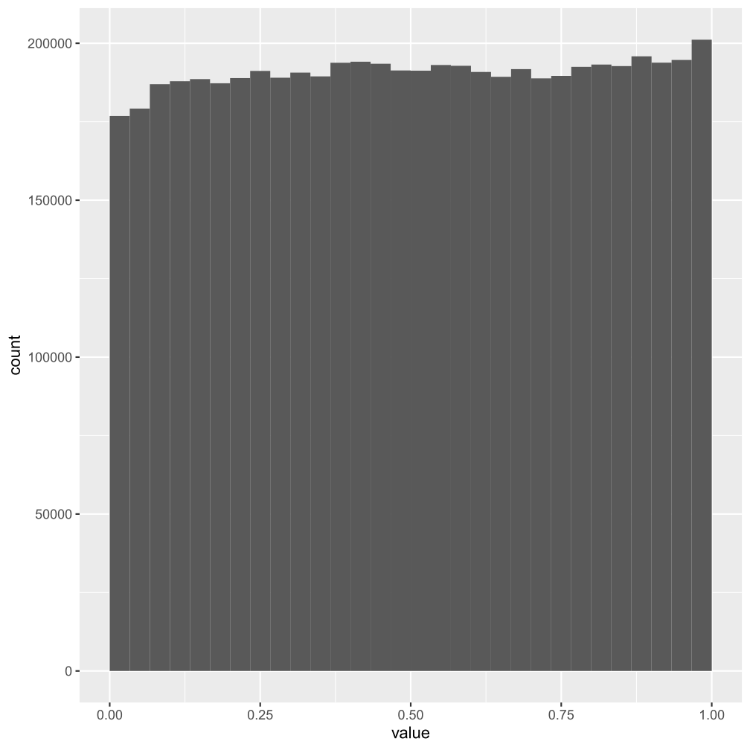
Ligera (LIght GEnetic Robust Association)
Too many SNPs

Slide 9
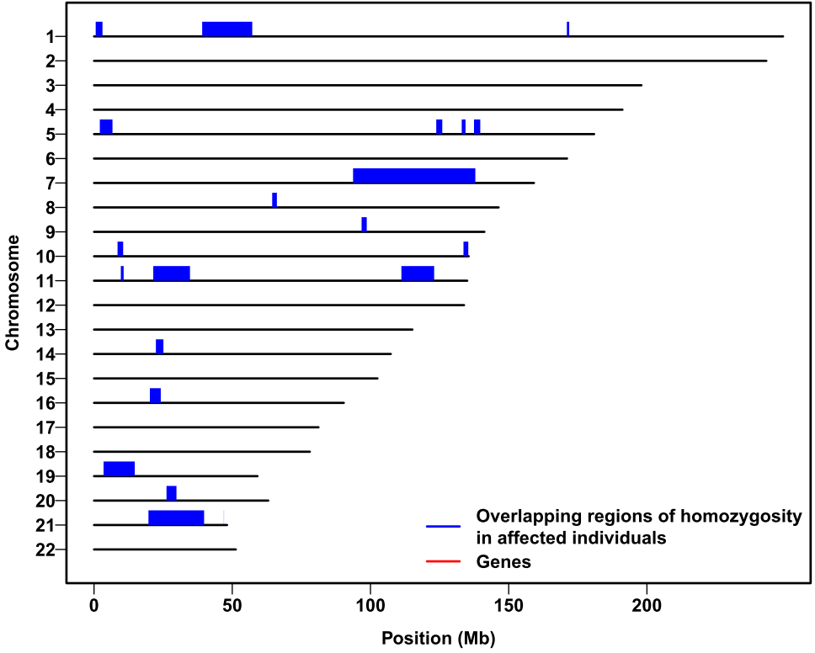
Per family analysis (40419)
Runs of homozygosity
768199 SNPs

Slide 10
Chr | Pos | ID | Gene | AF | AN
1 | 909665 | rs201962954 | PLEKHN1 | 2.8E-04 | 249976
1 | 957741 | rs533320704 | AGRN | 1.1E-04 | 250954
1 | 986389 | rs566928020 | AGRN | 3.8E-04 | 150716
1 | 1500093 | rs575403187 | SSU72 | 5.6E-05 | 249102
1 | 2537823 | rs765911833 | MMEL1 | 7.0E-05 | 241668
1 | 47152525 | rs768186418 | EFCAB14 | 2.4E-05 | 250984
1 | 47767375 | rs143587840 | STIL | 4.8E-05 | 251368
1 | 53574218 | rs531323798 | SLC1A7 | 4.0E-05 | 150982
5 | 138715049 | rs768353821 | NPTX2 | 4.0E-06 | 250522
7 | 98246724 | rs75820577 | NPTX2 | 4.8E-02 | 294
7 | 99312171 | rs369588507 | ZSCAN25 | 4.0E-06 | 250904
7 | 101267233 | rs530334669 | MYL10 | 2.5E-05 | 39482
7 | 102111980 | rs12534337 | LRWD1 | 5.8E-02 | 414
7 | 128850945 | rs762491039 | SMO | 2.5E-05 | 243122
10 | 135123741 | rs149909072 | ZNF511 | 2.7E-04 | 251412
11 | 113559038 | rs750607562 | TMPRSS5 | 1.8E-05 | 166326
19 | 6732058 | rs1438658117 | GPR108 | 4.0E-06 | 248930
19 | 6754047 | rs368991633 | SH2D3A | 2.4E-04 | 228014
19 | 8552879 | rs57390264 | HNRNPM | 8.1E-03 | 124
19 | 10224496 | rs753346854 | PPAN-P2RY11 | 6.0E-05 | 248364
21 | 30250655 | rs765434905 | N6AMT1 | 8.0E-06 | 249736
21 | 33690177 | rs369162830 | URB1 | 1.6E-03 | 156972
21 | 33716962 | rs564985567 | URB1 | 1.5E-04 | 158916
2 Cases, 35 Controls
Homozygosity only in cases not in controls, including gnomAD
Resulting in 23 SNPs of interest

Slide 11
8 SNPs with CADD greater than 10
Gene | CADD | PolyPhen | Mut Taster | SIFT | SnpEff | Mutation | Ptn Exp(Glomeruli/Tubules) | RNA (nTPM)
STIL | 29.8 | D,.,D,D,D | D,D,D,D,D | D,D,D,D,D | Moderate | Arg-Gln | - | 0.7
N6AMT1 | 28.9 | B,P | D,D | D,T | Moderate | Val-Leu | Not | 4.2
AGRN | 25.5 | . | N | D | Moderate | Pro-His | NA/High | 44
SMO | 25.4 | D | D | T | Moderate | Gly-Arg | NA/Med | 15.4
GPR108 | 21 | D,.,.,. | D,D,D | D,.,.,D | Moderate | Ala-Ser | NA/Med | 42.2
AGRN | 14.97 | . | . | . | Modifier | Intron | NA/High | 44
NPTX2 | 13.33 | . | . | . | Modifier | UTR | Not | 0.8
EFCAB14 | 12.61 | . | . | . | Modifier | Synonym/Intron | NA/Med | 44.6

