Slide 1
Merging SSNS GWAS data with 1000 Genomes
Amika Sood
Alejandro Ochoa
Department of Biostatistics and Bioinformatics
Duke University

Slide 2
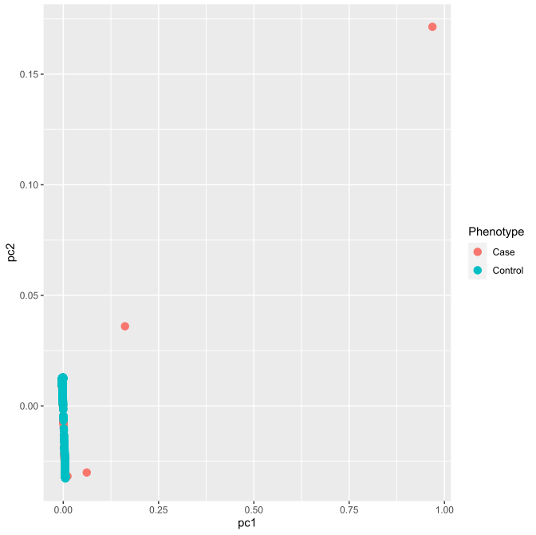
PCA Analysis of merged data

Slide 3
Missing genotypes of individuals
FID | IID | PHENO1 | MISSING_CT | OBS_CT | F_MISS
426 | A1024110 | N | 311 | 1401696 | 0.000222
427 | A2008981 | N | 505422 | 1401696 | 0.360579
428 | A2008893 | N | 252 | 1401696 | 0.00018
740 | A1024044 | N | 252 | 1401696 | 0.00018
741 | A1024299 | N | 355326 | 1401696 | 0.253497
742 | A2006615 | N | 248844 | 1401696 | 0.177531
743 | A1024066 | N | 337 | 1401696 | 0.00024

Slide 4
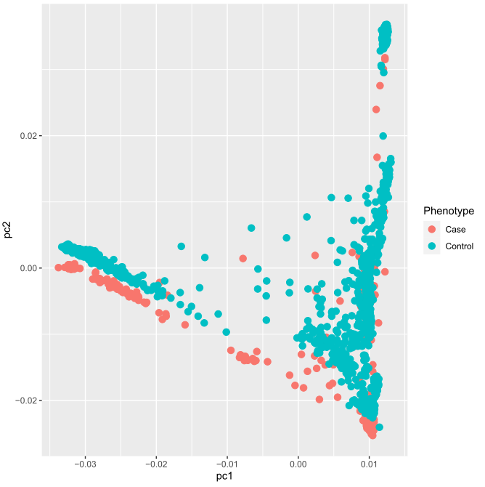
PCA analysis with updated data

Slide 5
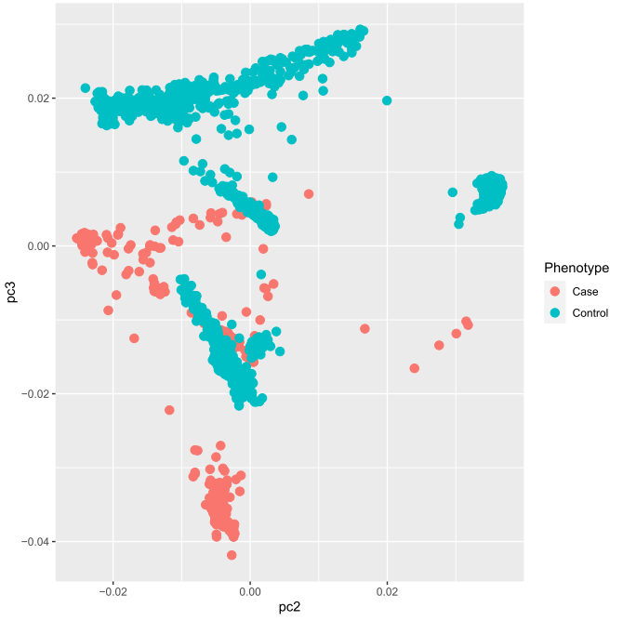
PCA analysis with updated data

Slide 6
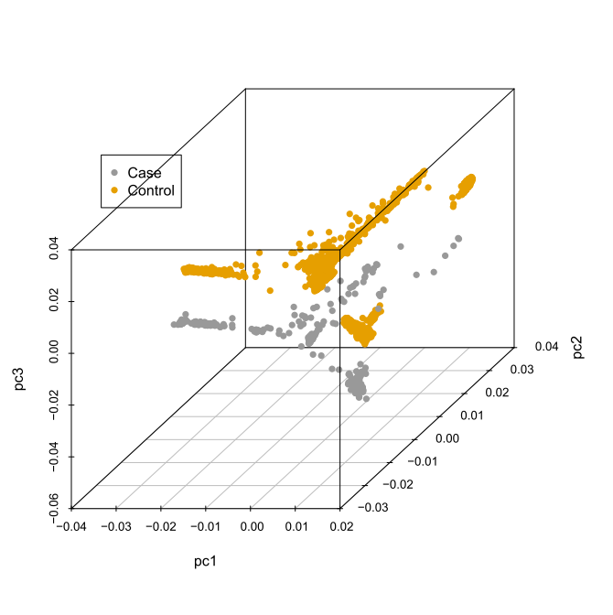
PCA analysis with updated data

Slide 7
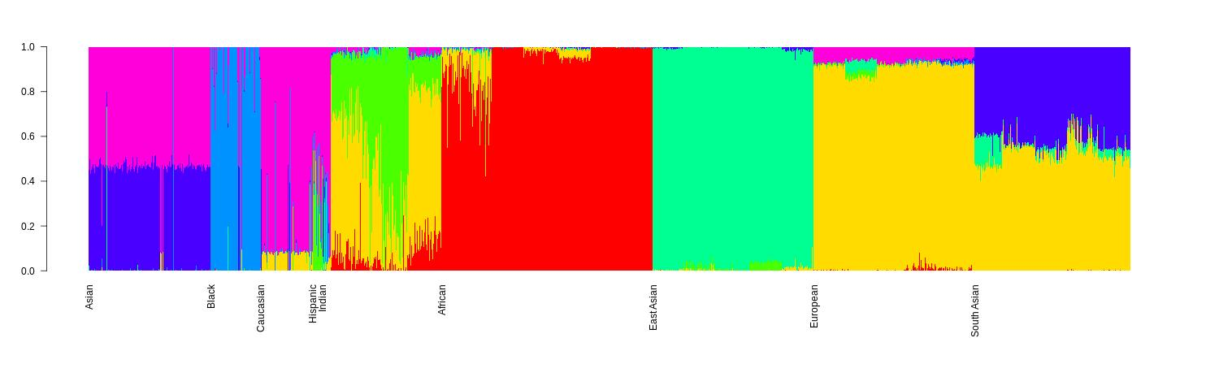
Admixture analysis with updated data

Slide 8
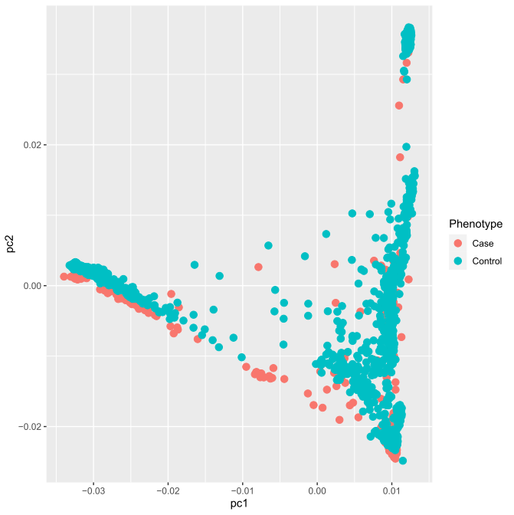
PCA analysis after removing 12% of variants with transversion mutation

